Slide 1

Notes:
Background gold bars are licensed from http://www.bigstockphoto.com/image-2766296/stock-photo-gold-bars to reuse go and license your own copy.
Copyright © 2006−2020. All rights reserved. Bible Point is a registered trademark of Dennis Henderson. All other trademarks acknowledged.
Bible Point contains graphics from Bible Point artists. These illustrations belong to Bible Point and the respective artists. You may use the designs and illustrations for graphical illustration of lessons free and without special permission, provided they are not used in any way that maligns the Christian faith. Furthermore, republication or production of any illustration by any other graphic service whether it be in book, in a machine-readable form, or in any other design resource is strictly prohibited. Furthermore, they cannot be duplicated or resold as any other form of publishing, clip art, or graphic resource.
So What does it mean? (A simple translations of the legal jargon)
So, if you don’t own the presentation(s), graphic(s), and text(s) how can you legally use them? The purchase of the license allows you to use all the images in the product. However, the actual ownership and copyright of the presentation(s), graphic(s), and text(s) remain the property of Bible Point and its licensors. If you had plans on using this product in your “for sale” work—think again!
License Agreement
Article 1: License Grant
All the graphics and text in Bible Point presentations (excluding quotes from the Bible and stated sources) are the intellectual and real property of Bible Point and its licensors, and is protected by law, including United States copyright laws and international treaties. Bible Point grants to you a license:
1. To use the presentation in a single church, single school, or single office of a Christian organization.
2. To make a single archival back-up copy of the program.
3. To modify the presentation(s) and merge with other presentations in a single church, school, or Christian organization.
4. To transfer to another party if that party agrees to accept the terms and conditions of this agreement, and you do not retain any copies of the presentation, whether printed, machine readable, modified, or merged form.
Article 2: Terms
This license is effective until terminated. You may terminate the license at any time by destroying the presentation(s), graphic(s), or text(s) together with all copies, modifications and merged portions in any form. Bible Point may terminate your license if you fail to comply with this Agreement. You agree, upon such termination, for any reason, to destroy the presentation(s), graphics, and text(s) with all copies, modifications, and merged portions in any form.
Article 3: Disclaimers
1. Bible Point presentations, graphics, and texts are licensed to you As Is. You, the consumer, bear the entire risk relating to the quality and performance of the presentation(s), graphic(s), or text(s). In no event will Bible Point be liable for damages resulting from any defect.
2. Thirty-day limited warrantee on disks. Bible Point warrants the disks to be free of defects in material and workmanship under normal use for 30 days after purchase. During the 30-day period you may return a defective presentation, graphic, or text with proof of purchase and it will be replaced without charge, unless the presentation is damaged by misuse.
Article 4: General
1. You may not sub-license, assign, or transfer the license of the presentation(s), graphic(s), or text(s) except as provided by this Agreement.
2. This Agreement will be governed by the laws of the State of Michigan.
So What does it mean? (A simple translations of the legal jargon)
May I let someone borrow or copy my licensed Bible Point presentation (even after I modified it)? As long as it is within your local church, or single school, or the immediate office of a Christian organization you may. Otherwise, please refer the person interested in borrowing to: http://www.biblepoint.com or E-mail: dennis@drdh.net with any related questions.

Slide 2
Two parts to this study:
Discovering Our Riches
(Chapters 1-3)
Spending Our Riches
(Chapters 4-6)

Slide 3
Today we will begin to discover our riches from the fact that:
God Thinks
We Are
VALUABLE!

Slide 4
The entire Godhead thinks so:
The Father thinks we
are VALUABLE 1:3-6
The Son thinks we
are VALUABLE 1:4-12
The Spirit thinks we
are VALUABLE 1:13-14

Slide 5
After the introduction …
Ephesians 1:1
Paul, an apostle of Christ Jesus by the will of God,
To the saints in Ephesus,
the faithful in Christ Jesus:
² Grace and peace to you from God our Father and the Lord Jesus Christ.

Slide 6

The Father thinks so--so much:
He BLESSED Us 1:3
³ Praise be to the God and Father of our Lord Jesus Christ, who has blessed us in the heavenly realms with every spiritual blessing in Christ.
Notes:
Clouds = FREE = from dreamstimefree_2738941

Slide 7


The Father thinks so--so much:
He CHOSE Us 1:4
⁴ For he chose us in him before the creation of the world to be holy and blameless in his sight. In love …
²⁷ But God chose the foolish things of the world to shame the wise; God chose the weak things of the world to shame the strong. ²⁸ He chose the lowly things of this world and the despised things--and the things that are not--to nullify the things that are, ²⁹ so that no one may boast before him. (1Corinthians 1:27-29)
Notes:
Check Mark = FREE = BiblePoint art.

Slide 8

The Father thinks so--so much:
He LOVED Us 1:4
in love ⁵ he predestined
us to be adopted as his
sons through Jesus Christ, in accordance with his pleasure and will--
Notes:
Heart = FREE =BiblePoint art.

Slide 9
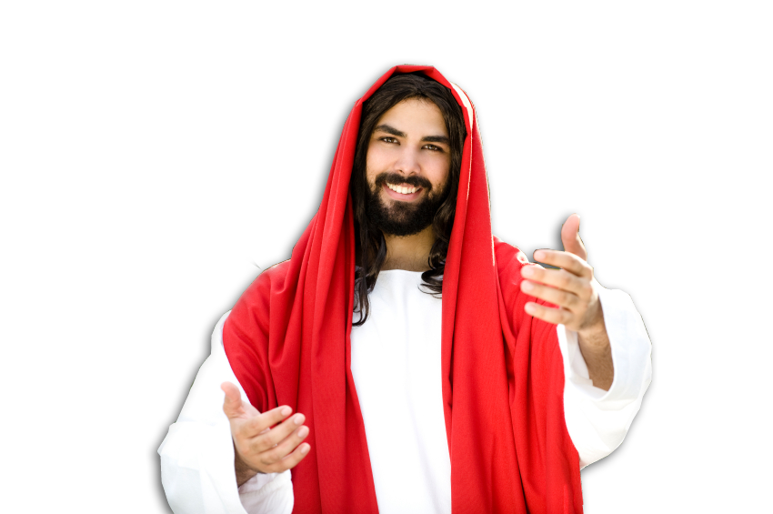
The Father thinks so--so much:
He PREDESTINED Us 1:5
in love ⁵ he predestined
us to be adopted as his
sons through Jesus
Christ, in accordance
with his pleasure
and will--
²⁹ For those God foreknew he also predestined to be conformed to the likeness of his Son, (Rom 8:29 NIV)
Notes:
Jesus = LICENSED and NOT for reuse elsewhere. To reuse get your own license from = istock_000007254772

Slide 10
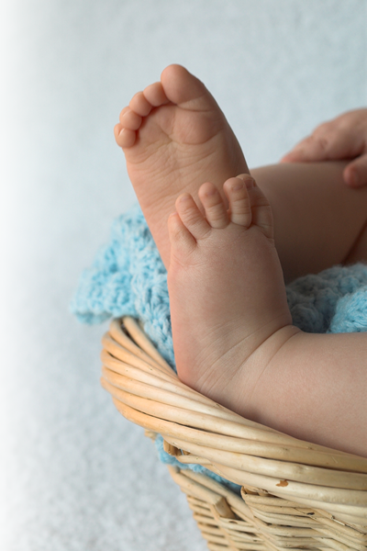
The Father thinks so--so much:
He ADOPTED Us 1:5
in love ⁵ he predestined
us to be adopted as his
sons through Jesus Christ,
in accordance with his
pleasure and will--
Notes:
Baby’s feet = FREE = from http://www.dreamstime.com/baby-feet-free-stock-photography-imagefree1924737

Slide 11

The Father thinks so--so much:
He GRACED Us 1:6
⁶ to the praise of his glorious grace, which
he has freely given us
in the One he loves.
Notes:
Gift box = Licensed = NOT FOR REUSE. To reuse get your license from http://www.dreamstime.com/gift-image9378333

Slide 12
The Father thinks so--so much:
He GRACED Us 1:6
Believe me the Father thinks we are valuable—
that makes us richer than we think!
Notes:
Gift box = Licensed = NOT FOR REUSE. To reuse get your license from http://www.dreamstime.com/gift-image9378333

Slide 13
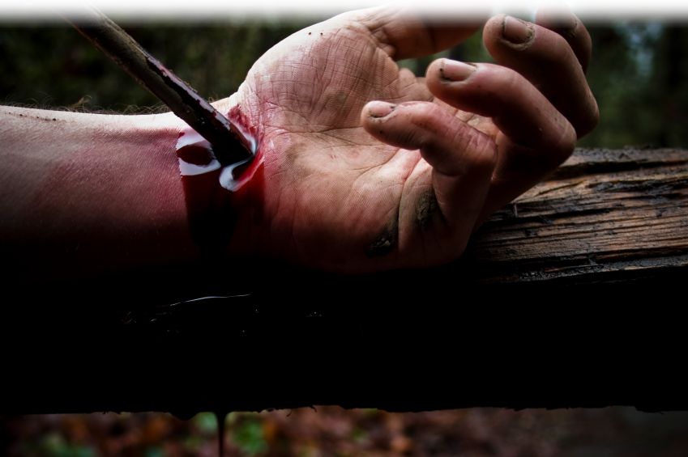
The SON thinks so--so much:
In Him… we have REDEMPTION 1:7
⁷ In him we have redemption through his blood,
Notes:
Nailed hand = LICENSED and NOT FOR REUSE. To reuse get a license from http://www.istockphoto.com/stock-photo-5625751-crucified.php

Slide 14
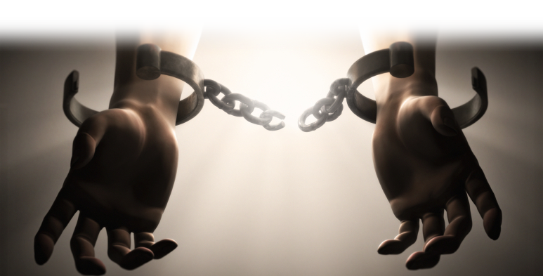
The SON thinks so--so much:
In Him… we have FORGIVENESS 1:7
⁷…the forgiveness
of sins,
Notes:
Chains broken = LICENSED and NOT FOR REUSE. To reuse get a license from http://www.istockphoto.com/stock-photo-7292096-broken-manacles.php

Slide 15

The SON thinks so--so much:
In Him… we have GRACE 1:7,8
⁷… in accordance
with the riches of
God's grace ⁸ that
he lavished on us with all wisdom and understanding.
Notes:
Gift box = Licensed = NOT FOR REUSE. To reuse get your license from http://www.dreamstime.com/gift-image9378333

Slide 16
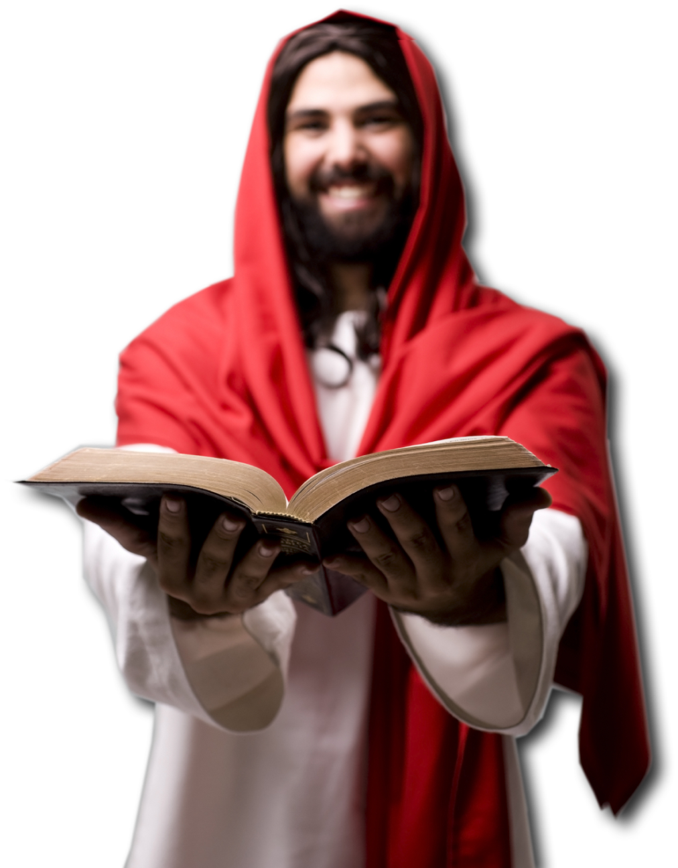
The SON thinks so--so much:
In Him… we have GOD’S WILL 1:9,10
⁹ And he made known to us the
mystery of his will according
to his good pleasure, which
he purposed in Christ,
¹⁰ to be put into effect when the
times will have reached their fulfillment—
to bring all things in heaven and on earth together under one head, even Christ.
Notes:
Jesus with Bible = LICENSED and NOT FOR REUSE. To reuse get a license from http://www.istockphoto.com/stock-photo-7676004-jesus-is-teaching-you.php

Slide 17
The SON thinks so--so much:
In Him… we were CHOSEN 1:11
¹¹ In him we were also chosen,
Notes:
Check Mark = FREE = from BiblePoint art.

Slide 18
The SON thinks so--so much:
In Him… we were PREDESTINED 1:11
¹¹ In him we were also chosen,
having been predestined
according to the plan of
him who works out
everything in conformity
with the purpose of his will,

Slide 19
The SON thinks so--so much:
In Him… we have HOPE 1:12
¹² in order that we, who were the first to hope in Christ,
might be for the praise of
his glory.
Believe me the Son thinks we are valuable—that makes us richer than we think!

Slide 20
The SPIRIT thinks so-so much:

Slide 21

The SPIRIT thinks so-so much:
He SAVED us 1:13
¹³ And you also were included in Christ when you heard the word of truth, the gospel of your salvation. …
Notes:
Life ring = LICENSED and NOT FOR REUSE. To reuse get a license from http://www.bigstockphoto.com/image-7198188/stock-photo-help!-ring-buoy-underwater
Stretched hand = FREE = from http://www.sxc.hu/browse.phtml?f=download&id=377625

Slide 22
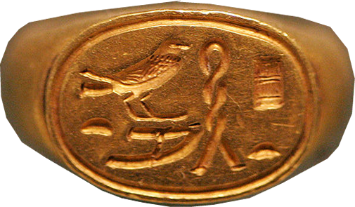

The SPIRIT thinks so-so much:
He MARKS us as His Possession 1:13
Having believed, you were marked in him with a seal, the promised Holy Spirit,
Notes:
Scroll = LICENSED and NOT FOR REUSE. To reuse get a license at http://www.istockphoto.com/stock-photo-9551866-sealed-scroll-document.php
Signet Ring = FREE = from http://commons.wikimedia.org/wiki/File:Seal_ring_Ptah_Great_with_love_E3603_mp3h8732.jpg

Slide 23
The SPIRIT thinks so-so much:
He SEALED us 1:13
Having believed, you were marked in him with a seal, the promised Holy Spirit,
Notes:
Scroll = LICENSED and NOT FOR REUSE. To reuse get a license at http://www.istockphoto.com/stock-photo-9551866-sealed-scroll-document.php

Slide 24
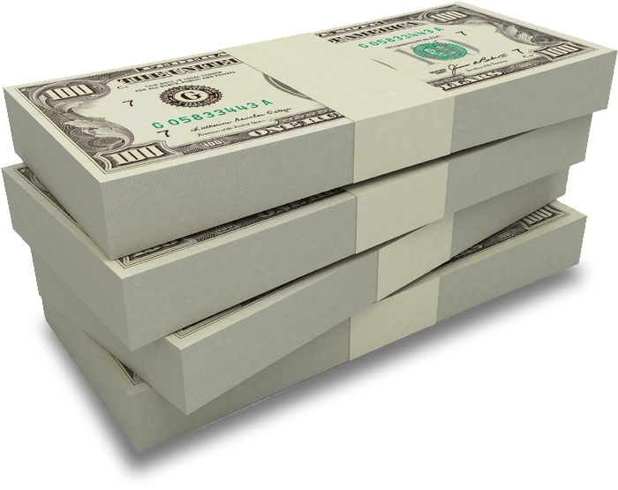
The SPIRIT thinks so-so much:
He is the DOWN PAYMENT 1:14
¹⁴ who is a deposit guaranteeing
our inheritance until the
redemption of those who
are God's possession--to
the praise of his glory.
Notes:
Money = LICENSED and NOT FOR REUSE elsewhere. To reuse get a license from http://www.dreamstime.com/item.php?imageid=3006819

Slide 25
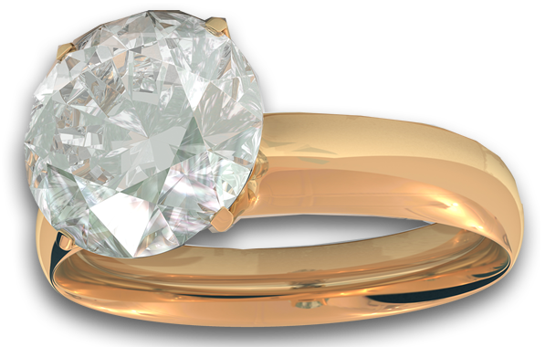
The SPIRIT thinks so-so much:
He is the DOWN PAYMENT 1:14
¹⁴ who is a deposit guaranteeing
our inheritance until the
redemption of those who
are God's possession--to
the praise of his glory.
Notes:
Money = LICENSED and NOT FOR REUSE elsewhere. To reuse get a license from http://www.dreamstime.com/item.php?imageid=3006819

Slide 26
The SPIRIT thinks so-so much:
He is the DOWN PAYMENT 1:14
¹⁴ who is a deposit guaranteeing
our inheritance until the
redemption of those who
are God's possession--to
the praise of his glory.
Believe me we are valuable—
that makes us richer than we think!
Notes:
Money = LICENSED and NOT FOR REUSE elsewhere. To reuse get a license from http://www.dreamstime.com/item.php?imageid=3006819

Slide 27

But WHY? Why?
He told us why 4 times…
“Praise be to the God” 1:3
“To the praise of his glorious grace” 1:6
“For the praise of his glory. 1:12
“To the praise of His glory” 1:14
Notes:
Cross = LICENSED and NOT FOR REUSE. To reuse get your own license from istock_000000431801

Slide 28

Here's the point …
We are valuable to God
–not because of our
own intrinsic value
Notes:
Look in mirror is LICENSED and NOT FOR REUSE. To reuse get a license from http://www.dreamstime.com/reflection-in-a-mirror-image2095515

Slide 29
Here's the point …
We are valuable to God
–not because of our
own intrinsic value
INSTEAD …
We are valuable to God
–because He sovereignly
graced us.
Notes:
Gift box = Licensed = NOT FOR REUSE. To reuse get your license from http://www.dreamstime.com/gift-image9378333

Slide 30
Repeat with me …
I am a valuable worthwhile human being …
Because God graced me!
Because God chose me!
Because God loved me!
Because God predestined me!
Because God adopted me!

Slide 31
Repeat with me …
Because God forgave me
Because God revealed His will to me
Because God saved me
Because God sealed me
Because God guarantees me
Because God marked me

Slide 32
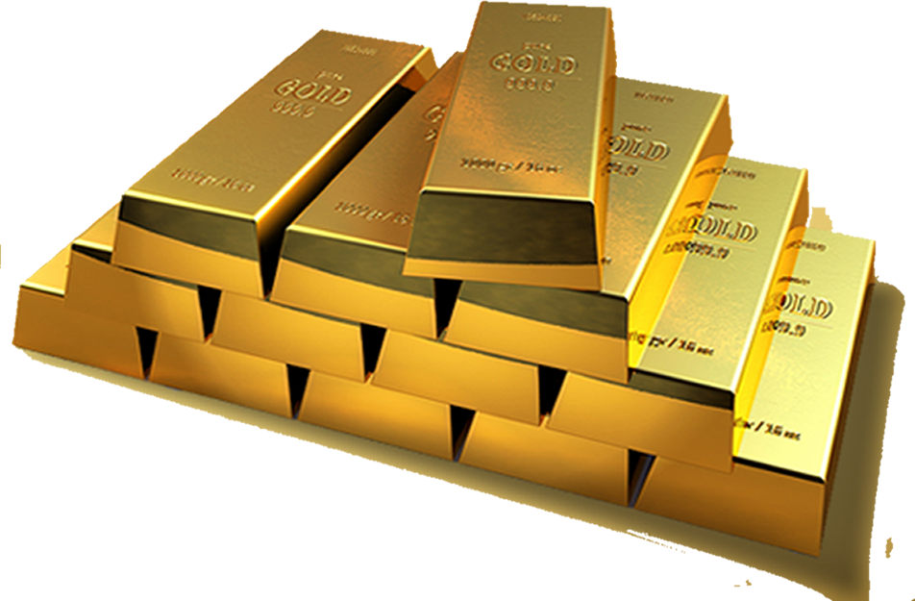
I guess you might say that
we Christians, …
in Christ, have
everything
money
can't buy!
Notes:
Gold bars are LICENSED and NOT FOR REUSE. To reuse get a license from http://www.bigstockphoto.com/image-2766296/stock-photo-gold-bars

Slide 33
Let’s Pray!

