Slide 1



Be happy in an …
Notes:
Camera Phone = https://p1.pxfuel.com/preview/310/297/182/hand-smartphone-mockup-bokeh-colorful-color.jpg
World = edited from https://pixabay.com/photos/planet-earth-earth-planet-global-4427436/
Copyright © 2006−2021. All rights reserved. Bible Point is a registered trademark of Dennis Henderson. All other trademarks acknowledged.
Bible Point contains graphics from Bible Point artists. These illustrations belong to Bible Point and the respective artists. You may use the designs and illustrations for graphical illustration of lessons free and without special permission, provided they are not used in any way that maligns the Christian faith. Furthermore, republication or production of any illustration by any other graphic service whether it be in book, in a machine-readable form, or in any other design resource is strictly prohibited. Furthermore, they cannot be duplicated or resold as any other form of publishing, clip art, or graphic resource.
So What does it mean? (A simple translations of the legal jargon)
So, if you don’t own the presentation(s), graphic(s), and text(s) how can you legally use them? The purchase of the license allows you to use all the images in the product. However, the actual ownership and copyright of the presentation(s), graphic(s), and text(s) remain the property of Bible Point and its licensors. If you had plans on using this product in your “for sale” work—think again!
License Agreement
Article 1: License Grant
All the graphics and text in Bible Point presentations (excluding quotes from the Bible and stated sources) are the intellectual and real property of Bible Point and its licensors, and is protected by law, including United States copyright laws and international treaties. Bible Point grants to you a license:
1. To use the presentation in a single church, single school, or single office of a Christian organization.
2. To make a single archival back-up copy of the program.
3. To modify the presentation(s) and merge with other presentations in a single church, school, or Christian organization.
4. To transfer to another party if that party agrees to accept the terms and conditions of this agreement, and you do not retain any copies of the presentation, whether printed, machine readable, modified, or merged form.
Article 2: Terms
This license is effective until terminated. You may terminate the license at any time by destroying the presentation(s), graphic(s), or text(s) together with all copies, modifications and merged portions in any form. Bible Point may terminate your license if you fail to comply with this Agreement. You agree, upon such termination, for any reason, to destroy the presentation(s), graphics, and text(s) with all copies, modifications, and merged portions in any form.
Article 3: Disclaimers
1. Bible Point presentations, graphics, and texts are licensed to you As Is. You, the consumer, bear the entire risk relating to the quality and performance of the presentation(s), graphic(s), or text(s). In no event will Bible Point be liable for damages resulting from any defect.
2. Thirty-day limited warrantee on disks. Bible Point warrants the disks to be free of defects in material and workmanship under normal use for 30 days after purchase. During the 30-day period you may return a defective presentation, graphic, or text with proof of purchase and it will be replaced without charge, unless the presentation is damaged by misuse.
Article 4: General
1. You may not sub-license, assign, or transfer the license of the presentation(s), graphic(s), or text(s) except as provided by this Agreement.
2. This Agreement will be governed by the laws of the State of Michigan.
So What does it mean? (A simple translations of the legal jargon)
May I let someone borrow or copy my licensed Bible Point presentation (even after I modified it)? As long as it is within your local church, or single school, or the immediate office of a Christian organization you may. Otherwise, please refer the person interested in borrowing to: http://www.biblepoint.com or E-mail: dennis@DrDH.net with any related questions.

Slide 2


Be happy in an…
Notes:
Balloon background = https://pixabay.com/illustrations/background-balloon-colorful-color-1500060/
World = edited from https://pixabay.com/photos/planet-earth-earth-planet-global-4427436/

Slide 3


Notes:
Risk = FREE = from http://upload.wikimedia.org/wikipedia/commons/b/b7/Risk-icon.jpg

Slide 4

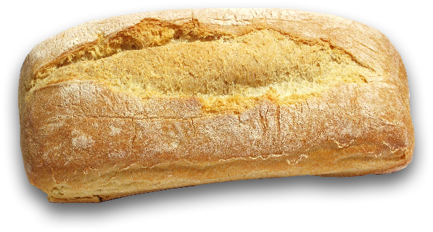
Take good risks like …
¹ Cast your bread upon the waters, for after many days you will find it again.
Notes:
Bread = FREE = From http://www.sxc.hu/browse.phtml?f=download&id=210375= From
Water = FREE = from http://www.sxc.hu/browse.phtml?f=download&id=1378348

Slide 5
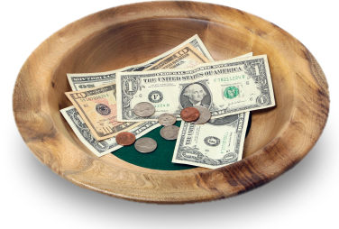
With Charity 11:1
¹ Cast your bread upon the waters, for after many days you will find it again.
Notes:
Offering plate = LICENSED and NOT FOR REUSE. To reuse get a license from http://www.istockphoto.com/stock-photo-3781555-wooden-offering-plate.php

Slide 6
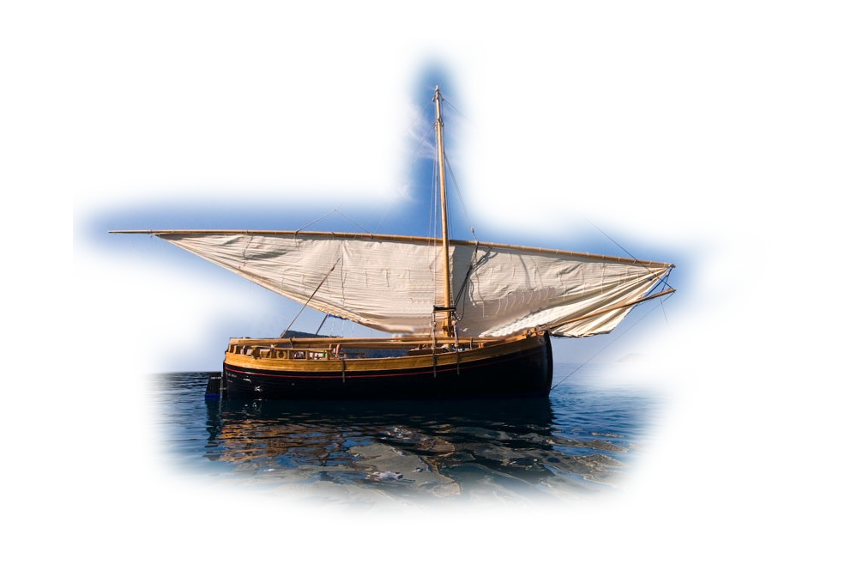
With Investments 11:1
¹ Send your grain across the seas, and in time, profits will flow back to you. (NLT)
Notes:
https://upload.wikimedia.org/wikipedia/commons/b/b1/Traditional_sailboat_lateen_sail.jpg

Slide 7

The Point: TAKE …
¹ Send your grain across the seas, and in time, profits will flow back to you. (NLT)
Notes:
Check = FREE = from http://www.sxc.hu/browse.phtml?f=download&id=531970

Slide 8
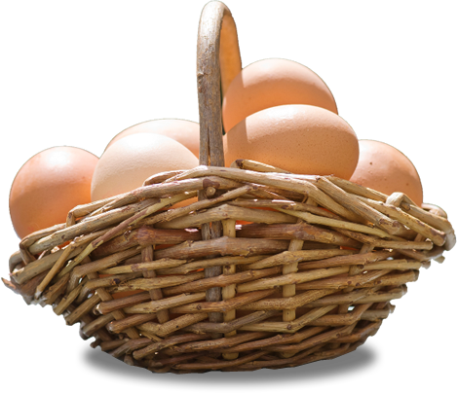
With Diversity 11:2
² Give portions to seven, yes to eight, for you do not know what disaster may come upon the
land.
Notes:
Eggs in basket = FREE = from http://www.rgbstock.com/download/Zela/mxlHN0k.jpg
Hebrew Idiomatic expression: a number +1 = many
You don’t know your future holdings—disaster may strike and the diversified investment will protect you.

Slide 9
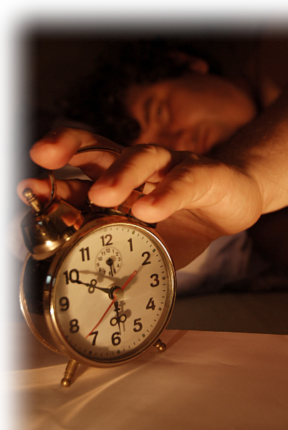
With Decisiveness 11:3-4
³ If clouds are full of water, they pour rain upon the earth. Whether a tree falls to the south or to the north, in the place where it falls, there will it lie. ⁴ Whoever watches the wind will not plant; whoever looks at the clouds will not reap.
Notes:
Alarm clock = FREE = from http://www.rgbstock.com/download/hisks/mhYf47M.jpg

Slide 10
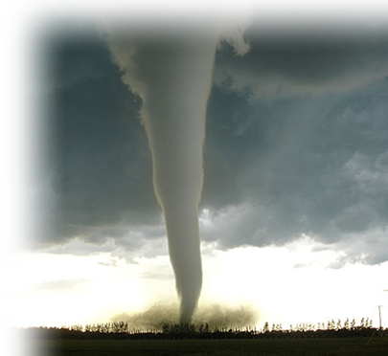
With Confidence 11:5-6
⁵ As you do not know the path of the wind, or how the body is formed in a mother's womb, so you cannot understand the work of God, the Maker
of all things.
Notes:
Tornado = FREE = from http://commons.wikimedia.org/wiki/File:F5_tornado_Elie_Manitoba_2007.jpg
Ultrasound baby = FREE = from http://upload.wikimedia.org/wikipedia/commons/1/16/Baby_in_ultrasound.jpg
As you don’t know the tornado’s path – you know with confidence that destruction is in it
As you don’t know how the fetus is formed -- you know with confidence a pregnant woman has a baby inside

Slide 11
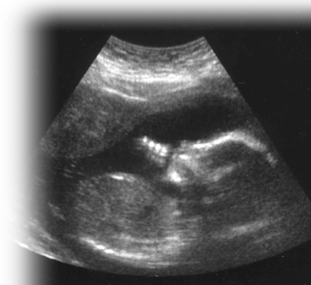
With Confidence 11:5-6
⁵ As you do not know the path of the wind, or how the body is formed in a mother's womb, so you cannot understand the work of God, the Maker
of all things.
Notes:
Tornado = FREE = from http://commons.wikimedia.org/wiki/File:F5_tornado_Elie_Manitoba_2007.jpg
Ultrasound baby = FREE = from http://upload.wikimedia.org/wikipedia/commons/1/16/Baby_in_ultrasound.jpg
As you don’t know the tornado’s path – you know with confidence that destruction is in it
As you don’t know how the fetus is formed -- you know with confidence a pregnant woman has a baby inside

Slide 12
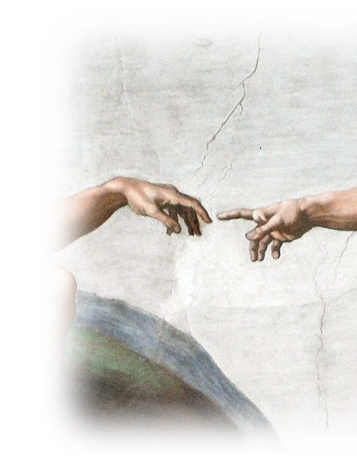
With Confidence 11:5-6
⁵ As you do not know the path of the wind, or how the body is formed in a mother's womb, so you cannot understand the work of God, the Maker
of all things.
Notes:
Tornado = FREE = from http://commons.wikimedia.org/wiki/File:F5_tornado_Elie_Manitoba_2007.jpg
Ultrasound baby = FREE = from http://upload.wikimedia.org/wikipedia/commons/1/16/Baby_in_ultrasound.jpg
As you don’t know the tornado’s path – where it will carry the seed and where it will land to produce or not.
As you don’t know how the fetus is formed -- you know with confidence a pregnant woman has a baby inside.
You do not know understand what God is doing (working) (How His providence will turn out) - You only see the results later. Therefore, …

Slide 13
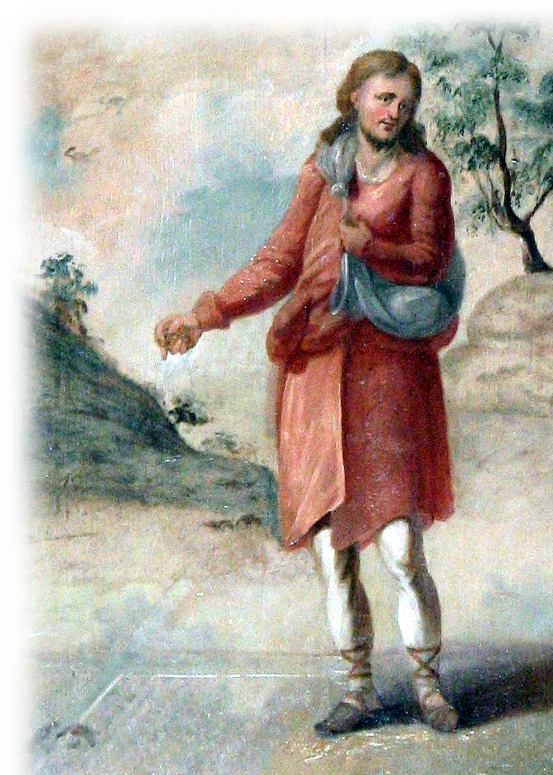
With Confidence 11:5-6
⁶ Sow your seed in the morning, and at evening let not your hands be idle, for you do not know which will succeed, whether this or that, or whether both will do equally well.
Notes:
Sow seed -- work hard – something will succeed!
Keep putting our resumes, keep making application, keep seeking treatment, Keep getting tests, etc.
Do it with confidence that in God’s providence something good will come to some of your labors.

Slide 14
So, in an …

Slide 15




Slide 16


Learn from the GOOD!
⁷ Light is sweet, and it pleases the eyes to see the sun. ⁸ How-ever many years a man may live, let him enjoy them all.
Notes:
Today, we would say, “Be Positive!”

Slide 17

Learn from the BAD!
⁸ ... But let him remember the days of darkness, for they will be many. Everything to come is meaningless.
Notes:
Learn from your mistakes.

Slide 18
Furthermore, in an …

Slide 19



Slide 20

Enthused NOW! 11:9
⁹ Be happy, young man, while you are young, and let your heart give you joy in the days of your youth. ...
Notes:
I’m definitely younger today than I will be tomorrow … tomorrow is my birthday!
Truth is, I don’t have time to not be happy. My time is running out.
I love my wife, I love my kids, grandkids, I love my church, I love my job. How could I not be happy.
The key is contentment … Phil 4:

Slide 21
Enthused NOW! 11:9
⁹ Be happy, young man, while you are young, and let your heart give you joy in the days of your youth. ...
TODAY
Sunday
November 15, 2020
Notes:
I’m definitely younger today than I will be tomorrow … tomorrow is my birthday!
Truth is, I don’t have time to not be happy. My time is running out.
I love my wife, I love my kids, grandkids, I love my church, I love my job. How could I not be happy.
The key is contentment … Phil 4:

Slide 22



Enthused IN YOUR HEART! 11:9
... Follow the ways of your heart ...

Slide 23

Enthused WITH ETERNITY IN VIEW! 11:9
... Follow the ways of your heart and whatever your eyes see, but know that for all these things God will bring you to judgment.
Notes:
Gavel = FREE = wiki photo.
To really enjoy your contented life you must posture it against eternal life.
My life here and now is just a foretaste of eternity to come. Since I love him whom I have not seen—how much more Him I will see.
Listen, we will all give an account of our lives at the Judgment Seat of Christ.

Slide 24

A Final Thoughts 11:10
¹⁰ So then, banish anxiety from your heart and cast off the troubles of your body, for youth and vigor are meaningless.
DON’T WORRY
Notes:
Worried = LICENSED and NOT FOR REUSE ELSEWHERE. To reuse get a license from istock.

Slide 25
HOW?

Slide 26

10 ACTIONS TO TAKE
Psalm 37 Of David.
¹ Do not fret because of evil men …

Slide 27
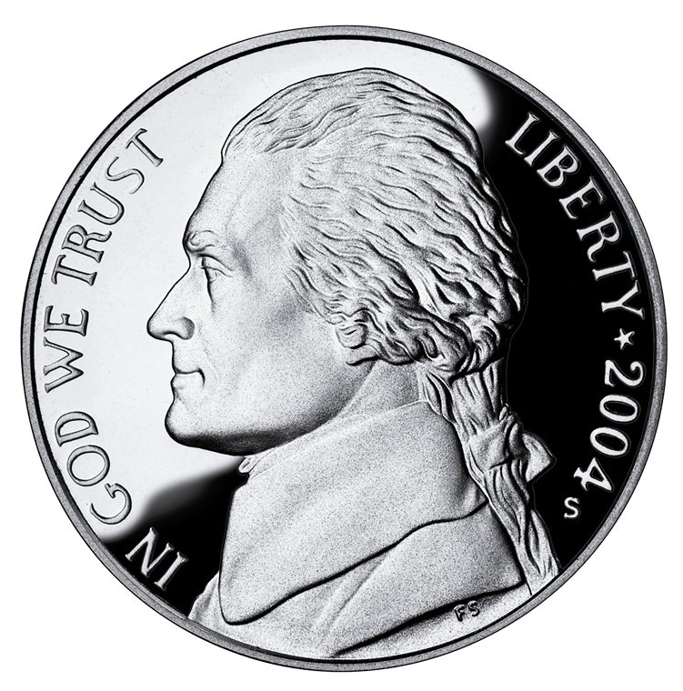
1
³ Trust in the LORD
Commit
it to
God!

Slide 28
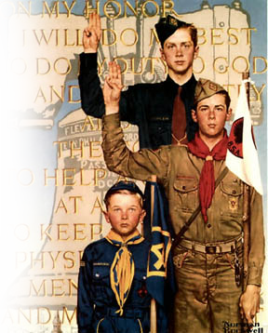
1
³ Trust in the LORD and
do good;
2
Do the Right Thing
Notes:
The Scout slogan is Do a Good Turn Daily.

Slide 29
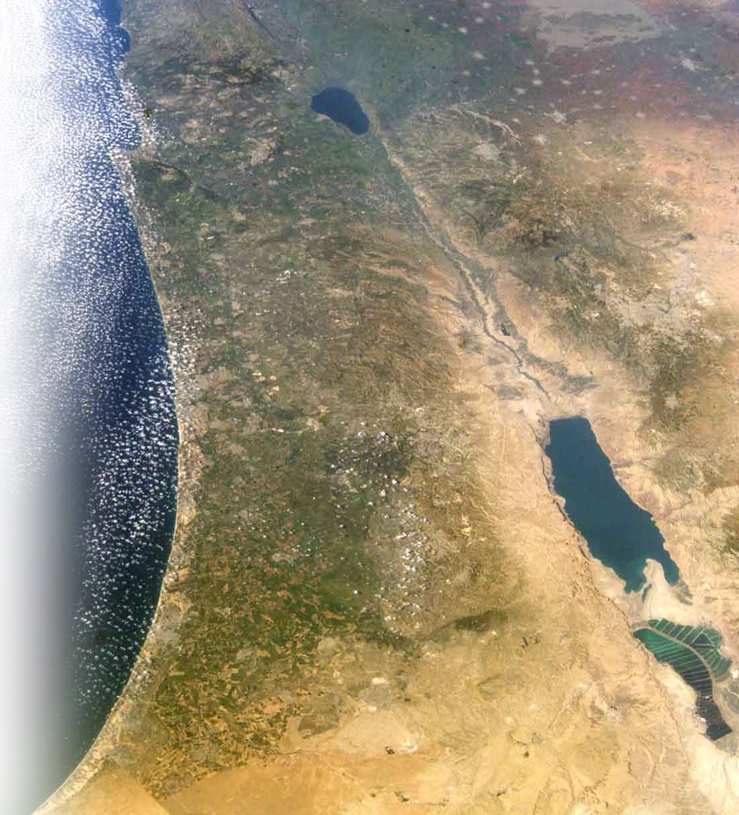
1
³ Trust in the LORD and
do good;
dwell in the land
2
3
Live in
God’s
Revealed
Will!

Slide 30

1
³ Trust in the LORD and
do good;
dwell in the land and
enjoy safe pasture.
2
3
4
Find a
Safe
Place!

Slide 31
1
³ Trust in the LORD and
do good;
dwell in the land and
enjoy safe pasture.
⁴ Delight yourself in the
LORD …
2
3
4
5
Make Yourself
Happy!
Notes:
Most people do not consider the following a hymn or a praise song...but it is theologically accurate:
Don't Worry Be Happy
Bobby McFerrin
Here's a little song I wrote
You might want to sing it note for note
Don't worry, be happy
In every life we have some trouble
But when you worry you make it double
Don't worry, be happy
Don't worry, be happy now
don't worry
(Ooh, ooh ooh ooh oo-ooh ooh oo-ooh) be happy
(Ooh, ooh ooh ooh oo-ooh ooh oo-ooh) don't worry, be happy
(Ooh, ooh ooh ooh oo-ooh ooh oo-ooh) don't worry
(Ooh, ooh ooh ooh oo-ooh ooh oo-ooh) be happy
(Ooh, ooh ooh ooh oo-ooh ooh oo-ooh) don't worry, be happy
Ain't got no place to lay your head
Somebody came and took your bed
Don't worry, be happy
The landlord say your rent is late
He may have to litigate
Don't worry, be happy
Oh, ooh ooh ooh oo-ooh ooh oo-ooh don't worry, be happy

Slide 32
1
³ Trust in the LORD and
do good;
dwell in the land and
enjoy safe pasture.
⁴ Delight yourself in the
LORD …
2
3
4
5
Don’t Worry ... Be Happy!
Notes:
Most people do not consider the following a hymn or a praise song...but it is theologically accurate:
Don't Worry Be Happy
Bobby McFerrin
Here's a little song I wrote
You might want to sing it note for note
Don't worry, be happy
In every life we have some trouble
But when you worry you make it double
Don't worry, be happy
Don't worry, be happy now
don't worry
(Ooh, ooh ooh ooh oo-ooh ooh oo-ooh) be happy
(Ooh, ooh ooh ooh oo-ooh ooh oo-ooh) don't worry, be happy
(Ooh, ooh ooh ooh oo-ooh ooh oo-ooh) don't worry
(Ooh, ooh ooh ooh oo-ooh ooh oo-ooh) be happy
(Ooh, ooh ooh ooh oo-ooh ooh oo-ooh) don't worry, be happy
Ain't got no place to lay your head
Somebody came and took your bed
Don't worry, be happy
The landlord say your rent is late
He may have to litigate
Don't worry, be happy
Oh, ooh ooh ooh oo-ooh ooh oo-ooh don't worry, be happy

Slide 33
Here's a little song I wrote
You might want to sing it note for note ... Don't worry, be happy
In every life we have some trouble
But when you worry you make it double ... Don't worry, be happy
Don't worry, be happy
nowdon't worry
Notes:
Most people do not consider the following a hymn or a praise song...but it is theologically accurate:
Don't Worry Be Happy
Bobby McFerrin
Here's a little song I wrote
You might want to sing it note for note
Don't worry, be happy
In every life we have some trouble
But when you worry you make it double
Don't worry, be happy
Don't worry, be happy now
don't worry
(Ooh, ooh ooh ooh oo-ooh ooh oo-ooh) be happy
(Ooh, ooh ooh ooh oo-ooh ooh oo-ooh) don't worry, be happy
(Ooh, ooh ooh ooh oo-ooh ooh oo-ooh) don't worry
(Ooh, ooh ooh ooh oo-ooh ooh oo-ooh) be happy
(Ooh, ooh ooh ooh oo-ooh ooh oo-ooh) don't worry, be happy
Ain't got no place to lay your head
Somebody came and took your bed
Don't worry, be happy
The landlord say your rent is late
He may have to litigate
Don't worry, be happy
Oh, ooh ooh ooh oo-ooh ooh oo-ooh don't worry, be happy

Slide 34
(Ooh, ooh ooh ooh oo-ooh ooh oo-ooh) be happy
(Ooh, ooh ooh ooh oo-ooh ooh oo-ooh) don't worry, be happy
(Ooh, ooh ooh ooh oo-ooh ooh oo-ooh) don't worry
(Ooh, ooh ooh ooh oo-ooh ooh oo-ooh) be happy
(Ooh, ooh ooh ooh oo-ooh ooh oo-ooh) don't worry, be happy
Notes:
Most people do not consider the following a hymn or a praise song...but it is theologically accurate:
Don't Worry Be Happy
Bobby McFerrin
Here's a little song I wrote
You might want to sing it note for note
Don't worry, be happy
In every life we have some trouble
But when you worry you make it double
Don't worry, be happy
Don't worry, be happy now
don't worry
(Ooh, ooh ooh ooh oo-ooh ooh oo-ooh) be happy
(Ooh, ooh ooh ooh oo-ooh ooh oo-ooh) don't worry, be happy
(Ooh, ooh ooh ooh oo-ooh ooh oo-ooh) don't worry
(Ooh, ooh ooh ooh oo-ooh ooh oo-ooh) be happy
(Ooh, ooh ooh ooh oo-ooh ooh oo-ooh) don't worry, be happy
Ain't got no place to lay your head
Somebody came and took your bed
Don't worry, be happy
The landlord say your rent is late
He may have to litigate
Don't worry, be happy
Oh, ooh ooh ooh oo-ooh ooh oo-ooh don't worry, be happy

Slide 35
Ain't got no place to lay your head
Somebody came and took your bed
Don't worry, be happy
The landlord say your rent is late
He may have to litigate
Don't worry, be happy
Oh, ooh ooh ooh oo-ooh ooh oo-ooh
Don't worry, be happy
Notes:
Most people do not consider the following a hymn or a praise song...but it is theologically accurate:
Don't Worry Be Happy
Bobby McFerrin
Here's a little song I wrote
You might want to sing it note for note
Don't worry, be happy
In every life we have some trouble
But when you worry you make it double
Don't worry, be happy
Don't worry, be happy now
don't worry
(Ooh, ooh ooh ooh oo-ooh ooh oo-ooh) be happy
(Ooh, ooh ooh ooh oo-ooh ooh oo-ooh) don't worry, be happy
(Ooh, ooh ooh ooh oo-ooh ooh oo-ooh) don't worry
(Ooh, ooh ooh ooh oo-ooh ooh oo-ooh) be happy
(Ooh, ooh ooh ooh oo-ooh ooh oo-ooh) don't worry, be happy
Ain't got no place to lay your head
Somebody came and took your bed
Don't worry, be happy
The landlord say your rent is late
He may have to litigate
Don't worry, be happy
Oh, ooh ooh ooh oo-ooh ooh oo-ooh don't worry, be happy

Slide 36
³ Trust in the LORD and
do good;
dwell in the land and
enjoy safe pasture.
⁴ Delight yourself in the LORD
and he will give you the
desires of your heart.
1
2
3
4
5
1

Slide 37

³ Trust in the LORD and
do good;
dwell in the land and
enjoy safe pasture.
⁴ Delight yourself in the LORD
and he will give you the
desires of your heart.
⁵ Commit your way to the LORD;
1
2
3
4
5
1
6
Roll your burden
on Him

Slide 38
³ Trust in the LORD and
do good;
dwell in the land and
enjoy safe pasture.
⁴ Delight yourself in the LORD
and he will give you the
desires of your heart.
⁵ Commit your way to the LORD;
trust in him
1
2
3
4
5
1
6
1

Slide 39
³ Trust in the LORD and
do good;
dwell in the land and
enjoy safe pasture.
⁴ Delight yourself in the LORD
and he will give you the
desires of your heart.
⁵ Commit your way to the LORD;
trust in him and he will do this: ⁶ He will make your righteousness shine like the dawn, the justice of your cause like the noonday sun.
1
2
3
4
5
1
6
2
1

Slide 40

7
⁷ Be still before the LORD
Take a
“time-out”
for God!

Slide 41
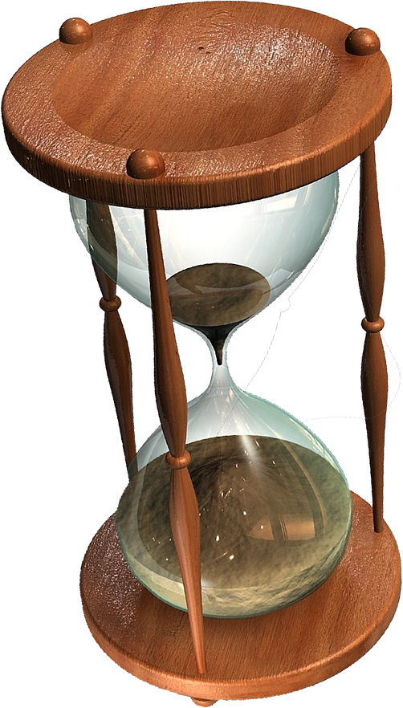
7
⁷ Be still before the LORD and
wait patiently for him;
8
Endure under
extended
pressure!
Wait longingly!

Slide 42
7
⁷ Be still before the LORD and
wait patiently for him;
do not fret when men succeed in their ways,
when they carry out
their wicked schemes.
8

Slide 43

7
⁷ Be still before the LORD and
wait patiently for him;
do not fret when men succeed in their ways,
when they carry out
their wicked schemes.
⁸ Refrain from anger
8
9
Let go of anger

Slide 44
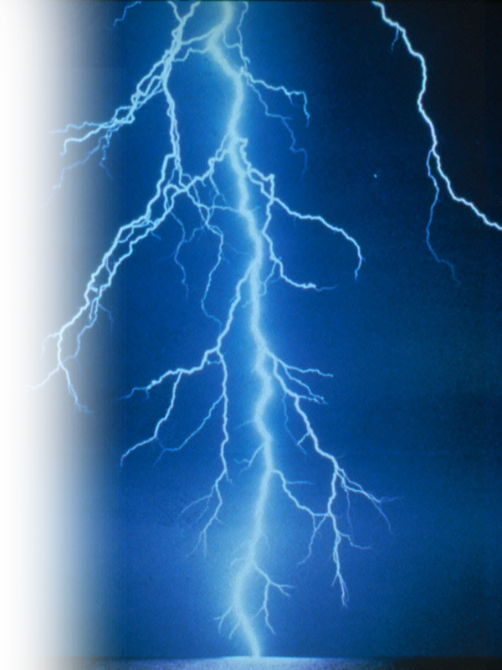
7
⁷ Be still before the LORD and
wait patiently for him;
do not fret when men succeed in their ways,
when they carry out
their wicked schemes.
⁸ Refrain from anger
turn from wrath; it leads only to evil.
8
9
10
Don’t get even

Slide 45
7
⁷ Be still before the LORD and
wait patiently for him;
do not fret when men succeed in their ways,
when they carry out
their wicked schemes.
⁸ Refrain from anger
turn from wrath; it leads only to evil. ⁹ For evil men will be cut off, but those who hope in the LORD will inherit the land.
8
9
10

Slide 46
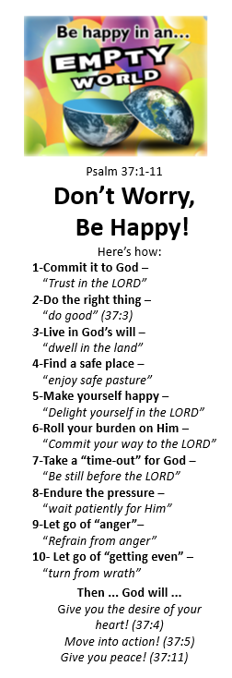
¹⁰ A little while, and the wicked will be no more; though you look for them, they will not be found. ¹¹ But the meek will inherit the land and enjoy great peace.

Slide 47



Let’s Sum Up:
To be happy in an unpredictable world:
Be AGGESSIVE
Be TEACHABLE
Be WORRY FREE

Slide 48
Let’s Pray

