Slide 1


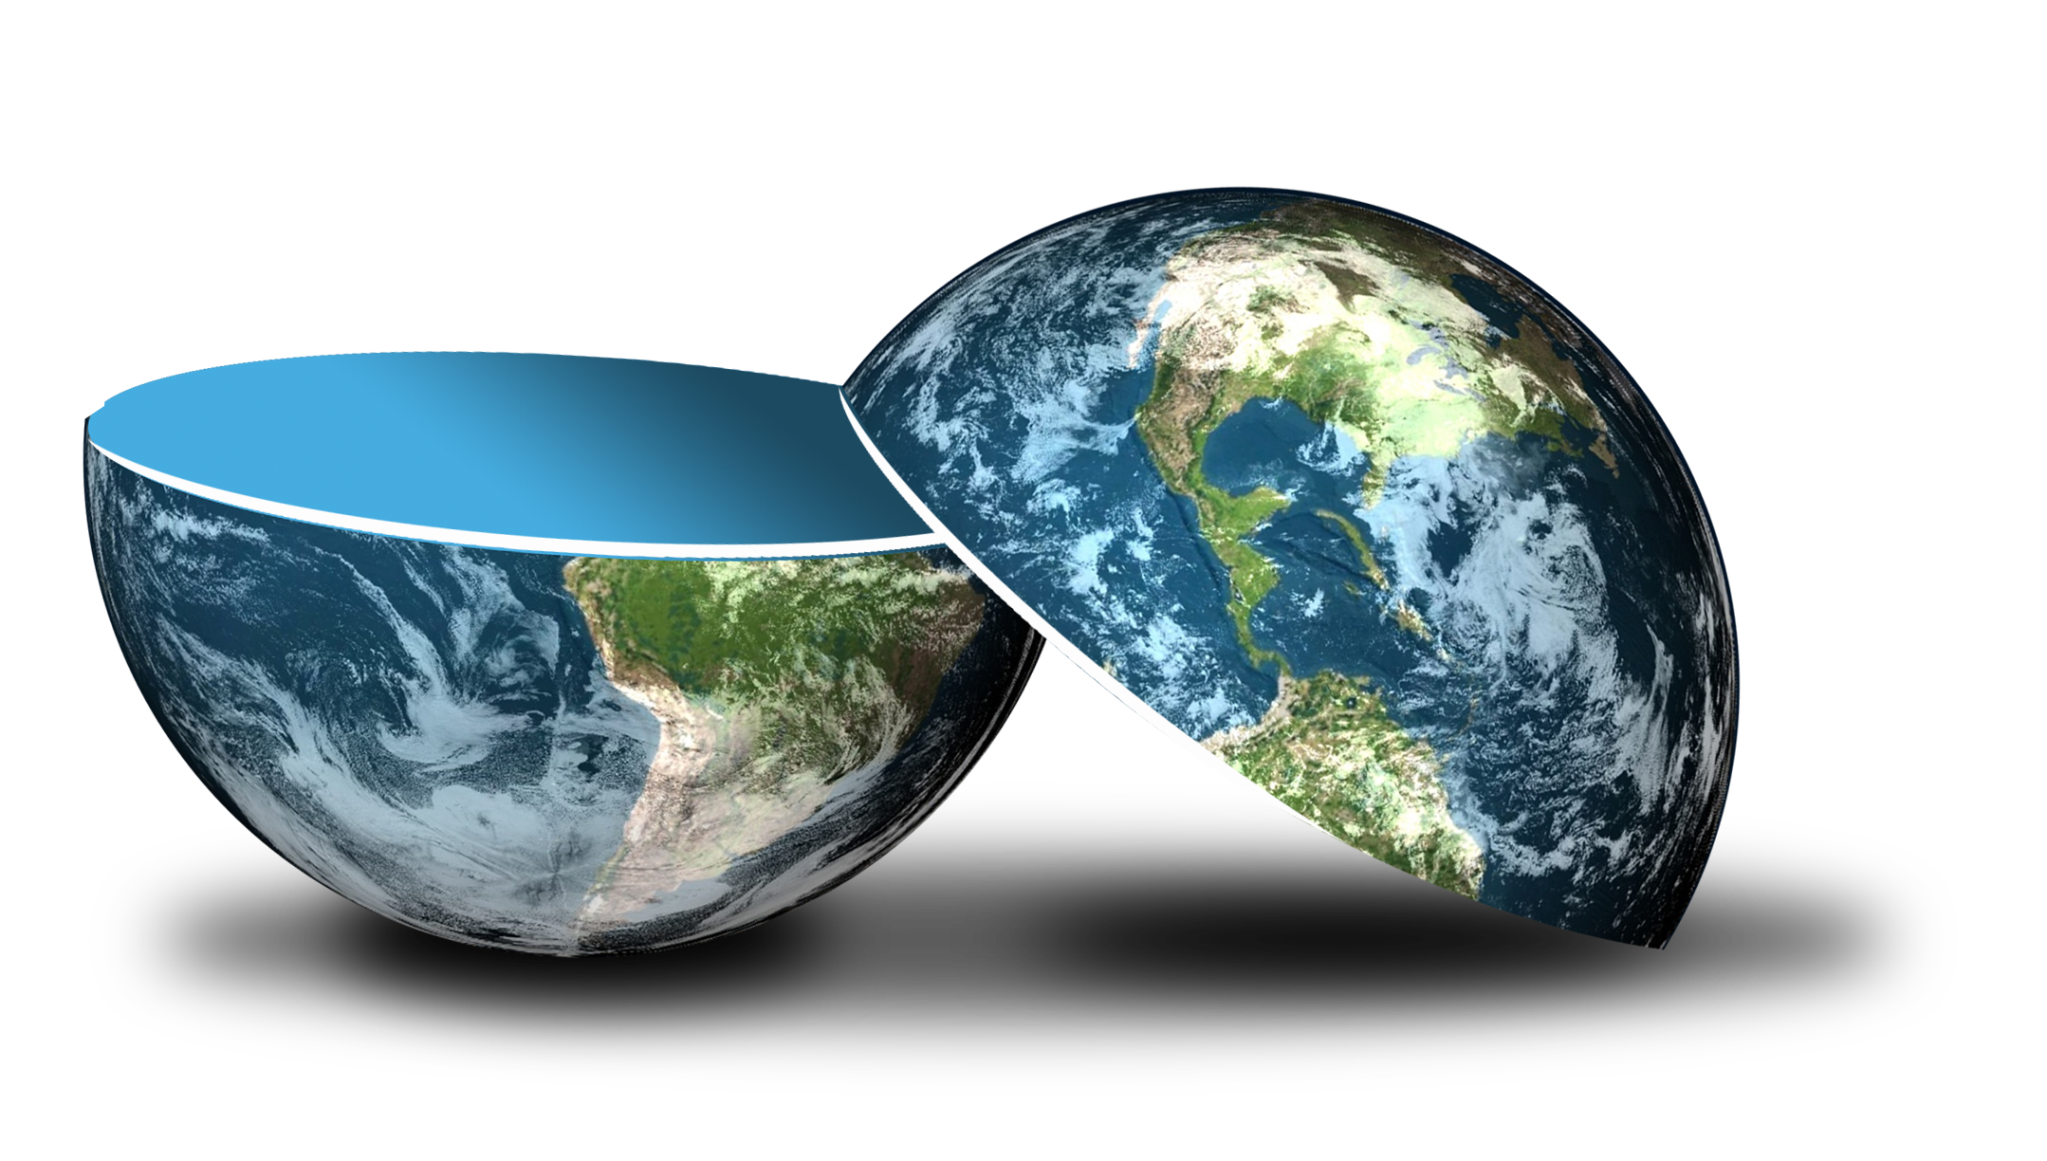
Be happy in an …
Notes:
Camera Phone = https://p1.pxfuel.com/preview/310/297/182/hand-smartphone-mockup-bokeh-colorful-color.jpg
World = edited from https://pixabay.com/photos/planet-earth-earth-planet-global-4427436/
Copyright © 2006−2021. All rights reserved. Bible Point is a registered trademark of Dennis Henderson. All other trademarks acknowledged.
Bible Point contains graphics from Bible Point artists. These illustrations belong to Bible Point and the respective artists. You may use the designs and illustrations for graphical illustration of lessons free and without special permission, provided they are not used in any way that maligns the Christian faith. Furthermore, republication or production of any illustration by any other graphic service whether it be in book, in a machine-readable form, or in any other design resource is strictly prohibited. Furthermore, they cannot be duplicated or resold as any other form of publishing, clip art, or graphic resource.
So What does it mean? (A simple translations of the legal jargon)
So, if you don’t own the presentation(s), graphic(s), and text(s) how can you legally use them? The purchase of the license allows you to use all the images in the product. However, the actual ownership and copyright of the presentation(s), graphic(s), and text(s) remain the property of Bible Point and its licensors. If you had plans on using this product in your “for sale” work—think again!
License Agreement
Article 1: License Grant
All the graphics and text in Bible Point presentations (excluding quotes from the Bible and stated sources) are the intellectual and real property of Bible Point and its licensors, and is protected by law, including United States copyright laws and international treaties. Bible Point grants to you a license:
1. To use the presentation in a single church, single school, or single office of a Christian organization.
2. To make a single archival back-up copy of the program.
3. To modify the presentation(s) and merge with other presentations in a single church, school, or Christian organization.
4. To transfer to another party if that party agrees to accept the terms and conditions of this agreement, and you do not retain any copies of the presentation, whether printed, machine readable, modified, or merged form.
Article 2: Terms
This license is effective until terminated. You may terminate the license at any time by destroying the presentation(s), graphic(s), or text(s) together with all copies, modifications and merged portions in any form. Bible Point may terminate your license if you fail to comply with this Agreement. You agree, upon such termination, for any reason, to destroy the presentation(s), graphics, and text(s) with all copies, modifications, and merged portions in any form.
Article 3: Disclaimers
1. Bible Point presentations, graphics, and texts are licensed to you As Is. You, the consumer, bear the entire risk relating to the quality and performance of the presentation(s), graphic(s), or text(s). In no event will Bible Point be liable for damages resulting from any defect.
2. Thirty-day limited warrantee on disks. Bible Point warrants the disks to be free of defects in material and workmanship under normal use for 30 days after purchase. During the 30-day period you may return a defective presentation, graphic, or text with proof of purchase and it will be replaced without charge, unless the presentation is damaged by misuse.
Article 4: General
1. You may not sub-license, assign, or transfer the license of the presentation(s), graphic(s), or text(s) except as provided by this Agreement.
2. This Agreement will be governed by the laws of the State of Michigan.
So What does it mean? (A simple translations of the legal jargon)
May I let someone borrow or copy my licensed Bible Point presentation (even after I modified it)? As long as it is within your local church, or single school, or the immediate office of a Christian organization you may. Otherwise, please refer the person interested in borrowing to: http://www.biblepoint.com or E-mail: dennis@DrDH.net with any related questions.

Slide 2



Be happy in a …

Slide 3
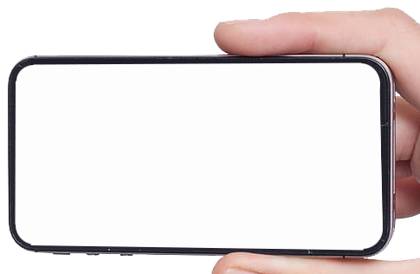

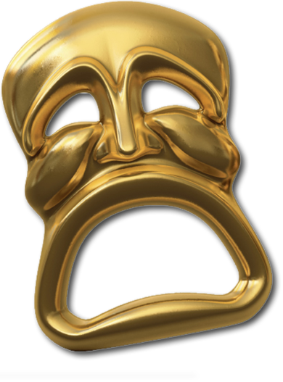
Two Selfies:
Fool
Wise
Notes:
Phone in hand = https://p1.pxfuel.com/preview/848/570/494/apple-iphone-display-damage.jpg

Slide 4
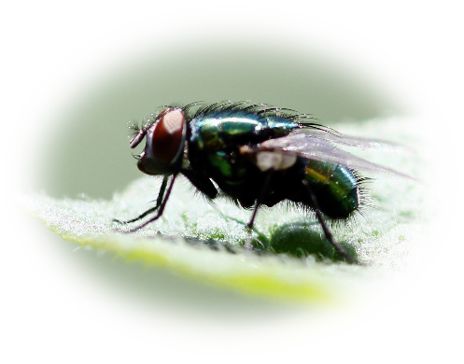
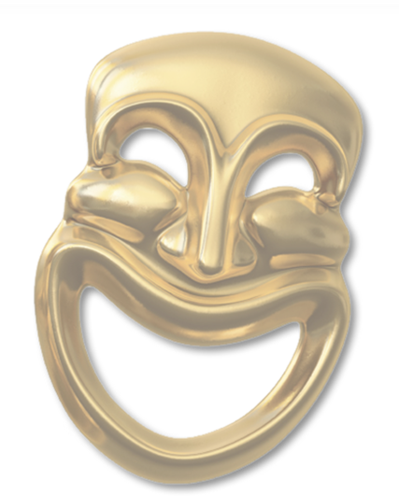

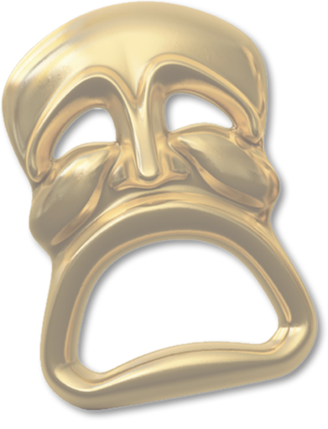
1-The Reputation Selfie 10:1
Stinks
Perfumed
As dead flies give perfume a bad smell, so a little folly outweighs wisdom and honor.
Notes:
Our expression “a fly in the ointment” comes from here. The dead fly causes stench –vs- the perfume with pleasant aroma.
Fly = free = from http://www.sxc.hu/browse.phtml?f=download&id=1381505
Perfume = free =from

Slide 5
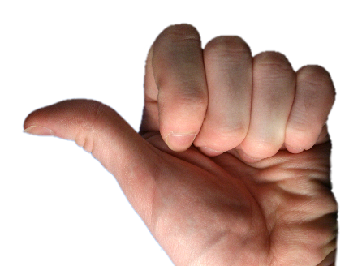
2-The Position Selfie 10:2
Left
Right
The heart of the wise inclines to the right, but the heart of the fool to the left.
Notes:
Thumbs = FREE = from http://www.sxc.hu/browse.phtml?f=download&id=785930
The idea is the “right” is right, strong, good, powerful, protective
The left is, as the Latin word for “left” is “sinister”, evil, weak, anarchist
In Jesus’s day the left were the Sadducees and the right were the Pharisees.
The left did not believe in the resurrection and the right did.
The concept of left and right prevails to this day.
The wise are inclined to the right. And the fool to the left.
You get the picture—it’s much like that today.

Slide 6


3-The Sensibility Selfie 10:3-5
Senseless
[Smart]
Even as he walks along the road, the fool lacks sense and shows everyone how stupid he is.
Notes:
Dunce = Licensed = Bigstock photo
Cap = FREE = from http://www.sxc.hu/browse.phtml?f=download&id=993663
Even if he takes a middle of the road position—as he journeys down that road, he is exposed for the folly of his position. He is stupid = the fool that he is.

Slide 7


4-The Emotions Selfie 10:3-5
Angry
Calm
If a ruler's anger rises against you, do not leave your post; calmness can lay great errors to rest.
Notes:
Angry man = free = from http://www.sxc.hu/photo/731511
Calm lady = LICENSED and NOT FOR REUSE. To reuse get a license from Dreamstime image 9300513

Slide 8
5-The Attitude Selfie 10:6,7
High-Minded
Humble
⁵ There is an evil I have seen under the sun, the sort of error that arises from a ruler ⁶ Fools are put in many high positions, while the rich occupy the low ones. ⁷ ... slaves on horse-back, while princes go on foot like slaves.

Slide 9
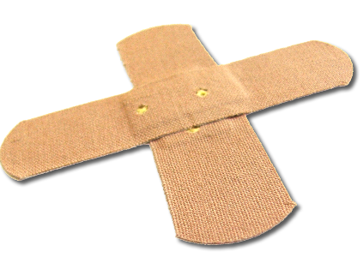
6-The Action Selfie 10:8-11
Own Hurt
⁸ Whoever digs a pit may fall into it; whoever breaks through a wall may be bitten by a snake.
Notes:
Bandages = FREE = from http://www.sxc.hu/browse.phtml?f=download&id=782778

Slide 10
6-The Action Selfie 10:8-11
Own Hurt
Whoever quarries stones may be injured by them; whoever splits logs may be endangered by them.
Notes:
Bandages = FREE = from http://www.sxc.hu/browse.phtml?f=download&id=782778
Give him enough rope and he’ll hang himself ...

Slide 11

6-The Action Selfie 10:8-11
Own Hurt
Success
¹⁰ If the ax is dull and its edge unsharpened, more strength is needed but skill will bring success.
Notes:
Bandages = FREE = from http://www.sxc.hu/browse.phtml?f=download&id=782778
Success arrow = FREE = from http://www.sxc.hu/browse.phtml?f=download&id=952332
Like the men of issacar “knew the times and what to do!”
What you sow is what you reap.

Slide 12
6-The Action Selfie 10:8-11
Own Hurt
Success
¹¹ If a snake bites before it is charmed, there is no profit for the charmer.
Notes:
Bandages = FREE = from http://www.sxc.hu/browse.phtml?f=download&id=782778
Success arrow = FREE = from http://www.sxc.hu/browse.phtml?f=download&id=952332

Slide 13
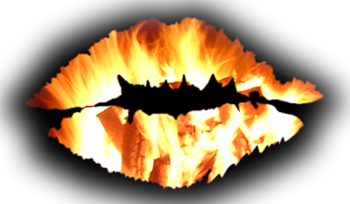
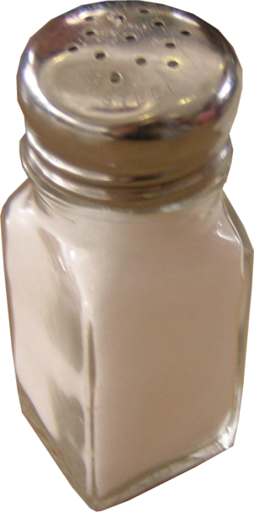
7-The Speech Selfie 10:12-14
Own Hurt
Grace
¹² Words from a wise man's mouth are gracious, but a fool is consumed by his
own lips.
Notes:
Lips = FREE = BiblePoint image
Salt = free =from http://www.sxc.hu/photo/106538

Slide 14
7-The Speech Selfie 10:12-14
Own Hurt
Grace
¹³ At the beginning his words are folly; at the end they are wicked madness-- ¹⁴ and the fool multiplies words. No one knows what is coming-- who can tell him what will happen after him?
Notes:
Lips = FREE = BiblePoint image
Facebook fools – put whole life out there—that’s stupid.

Slide 15

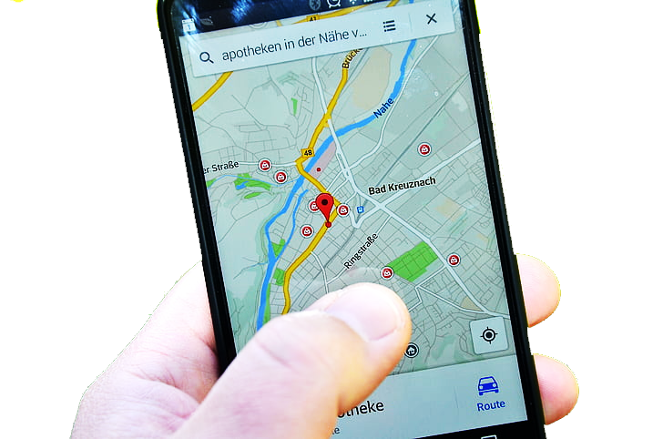
8-The Progress Selfie 10:12-14
Lost
[Knows the Way]
¹⁵ A fool's work wearies him; he does not know the way to town.
Notes:
Woman with map = FREE = from http://www.rgbstock.com/download/lusi/mhGv7yG.jpg
GPS https://www.pickpik.com/smartphone-location-lg-navigation-maps-media-photo-138415

Slide 16
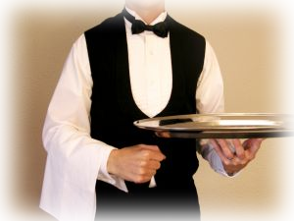
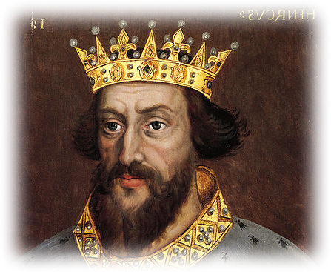
9-The Experience Selfie 10:16
Inexperienced
Experienced
¹⁶ Woe to you, O land whose king was a servant and whose princes feast in the morning.
Notes:
Servant = FREE = from http://www.sxc.hu/browse.phtml?f=search&w=1&txt=waiter&p=2
King Henry 1 = FREE = from http://commons.wikimedia.org/wiki/File:King_Henry_I.jpg
The term “servant” can also mean “slave” or even a “child.” The point is he is inexperienced to be the king.

Slide 17
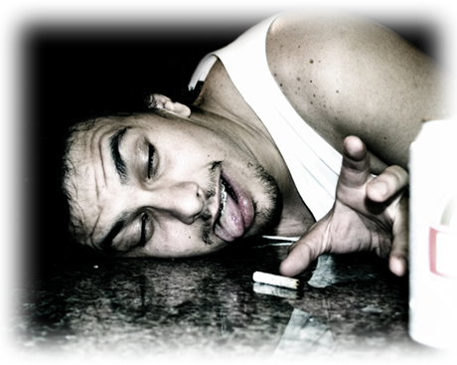
10-The Life-Style Selfie 10:17
Undisciplined
Disciplined
¹⁷ Blessed are you, O land whose king is of noble birth and whose princes eat at a proper time-- for strength and not for drunkenness.
Notes:
Drunk = FREE = from http://www.sxc.hu/browse.phtml?f=download&id=557070
King Henry 1 = FREE = from http://commons.wikimedia.org/wiki/File:King_Henry_I.jpg
The contrast is between the one born and reared in royal ways. He is disciplined in the schooling of leadership.
Vs. those who are undisciplined and it leads to life dominance.

Slide 18
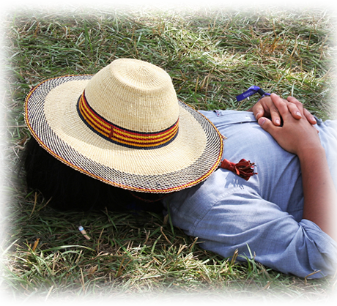
11-The Work Ethic Selfie 10:18-19
Lazy Reveler
¹⁸ If a man is lazy, the rafters sag; if his hands are idle, the house leaks. ¹⁹A feast is made for laughter, and wine makes life merry, ...
Notes:
Lazy = FREE = from http://www.sxc.hu/browse.phtml?f=download&id=1037355

Slide 19
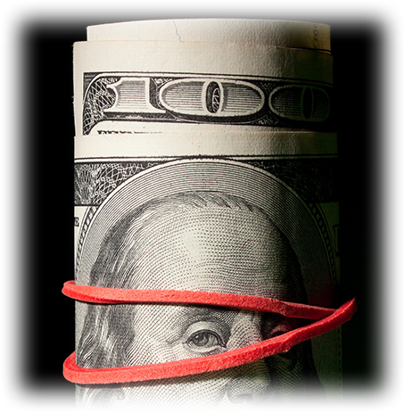
11-The Work Ethic Selfie 10:18-19
Lazy Reveler
Fiscally Responsible
but money is the answer for everything.
Notes:
Lazy = FREE = from http://www.sxc.hu/browse.phtml?f=download&id=1037355
Money = FREE =from http://www.sxc.hu/browse.phtml?f=download&id=1377964
The fool believes that money is the answer to everything. So he wants it—to waste it trying to solve all his problems.
A wise man knows that money alone cannot solve everything

Slide 20
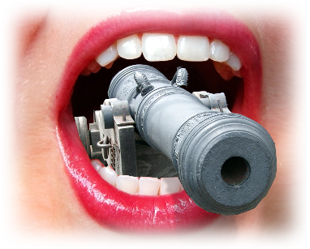
12-The Political Selfie 10:20
Loose Cannon
²⁰ Do not revile the king even in your thoughts, or curse the rich in your bedroom,
Notes:
Cannon = FREE = from http://www.sxc.hu/browse.phtml?f=download&id=359095
Open mouth = FREE = from http://www.sxc.hu/photo/837375
I cannot believe the nasty things some people post on Facebook about our President.

Slide 21
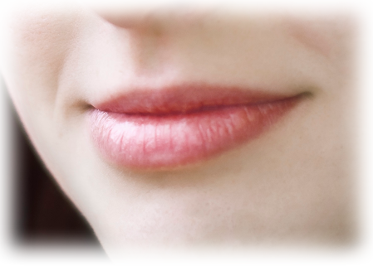
12-The Political Selfie 10:20
Tight Lipped
Loose Cannon
because a bird of the air may carry your words, and a bird on the wing may report what you say.
Notes:
Cannon = FREE = from http://www.sxc.hu/browse.phtml?f=download&id=359095
Open mouth = FREE = from http://www.sxc.hu/photo/837375
Closed mouth = FREE = from http://www.sxc.hu/photo/1359709
Another way of putting this is “Loose lips sinks ships” WWII slogan

Slide 22
Two Selfies—which are you?
Fool
Wise

Slide 23
Two Selfies—which are you?
Fool
Stinking Reputation
Leaning to the Left
Senseless
Angry
High-Minded
Self Inflicted Pain

Slide 24
Two Selfies—which are you?
Fool
Loose Lips
Lost
Inexperienced
Undisciplined
Procrastinator
Loose Canon

Slide 25
Two Selfies—which are you?
Perfumed with Grace
Lean to the Right
Known to be Smart
Known to be Calm
Known to be Humble
Known to be Successful
Wise

Slide 26
Two Selfies—which are you?
Known to be Graceful
Known to be Helpful
Known to be Found
Experienced
Money Maker
Tight Lipped
Wise

Slide 27
Two Selfies—which are you?
Fool
Probably some of both!
That gives you something to work on!
Wise

Slide 28

How do you become wise?
³⁰ It is because of him that you are in Christ Jesus, who has become for us wisdom from God--that
is, our righteousness, holiness and redemption. (1Corinthians 1:30)
Wise
Notes:
Staircase = https://www.pxfuel.com/en/free-photo-qqear

Slide 29
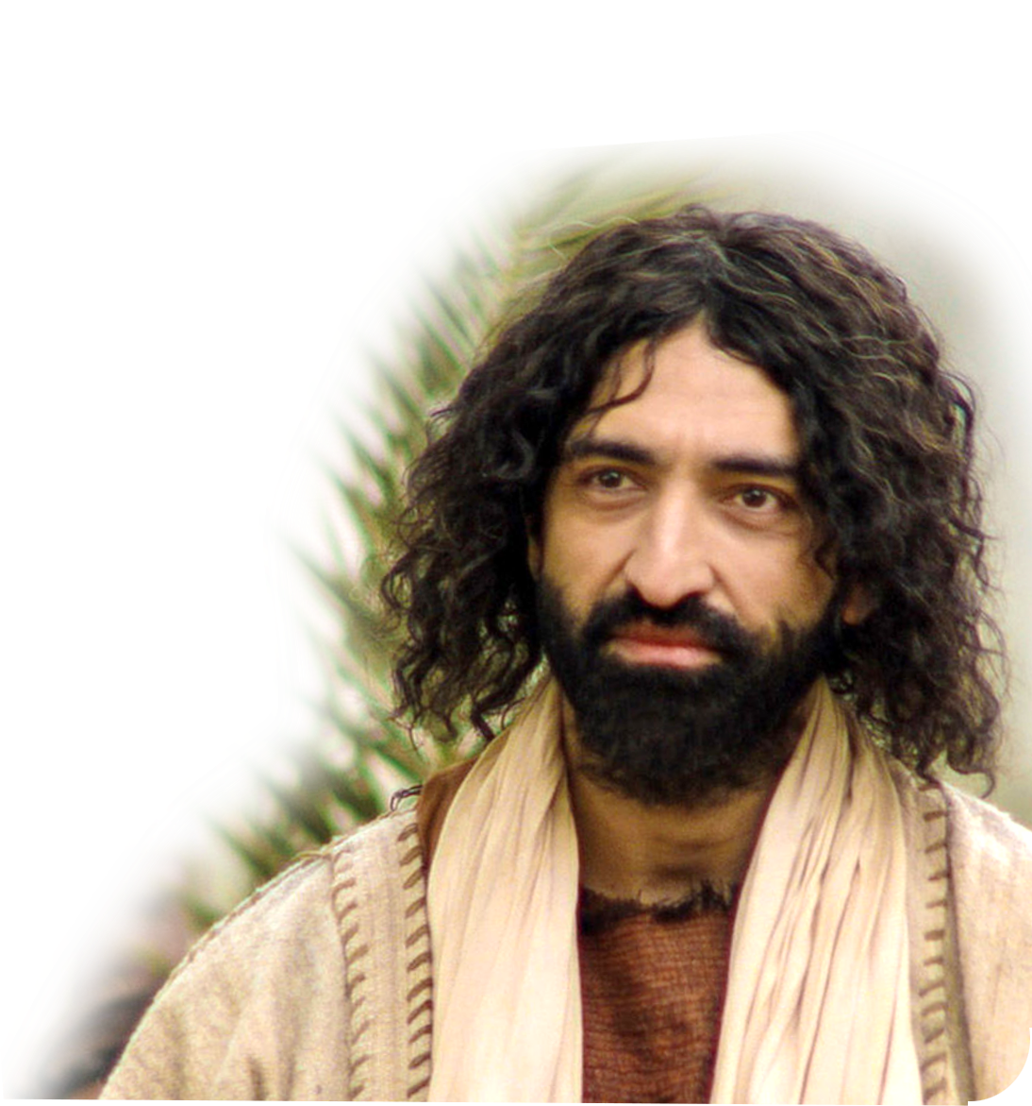
How do you become wise?
³⁰ It is because of him that you are in Christ Jesus, who has become for us wisdom from God--that
is, our righteousness, holiness and redemption. (1Corinthians 1:30)
Wise

Slide 30
How do you become wise?
³⁰ It is because of him that you are in Christ Jesus, who has become for us wisdom from God--that
is, our righteousness, holiness and redemption. (1Corinthians 1:30)
Wise

Slide 31
How do you become wise?
³⁰ It is because of him that you are in Christ Jesus, who has become for us wisdom from God--that
is, our righteousness, holiness and redemption. (1Corinthians 1:30)
Wise

Slide 32
How do you become wise?
³⁰ It is because of him that you are in Christ Jesus, who has become for us wisdom from God--that
is, our righteousness, holiness and redemption. (1Corinthians 1:30)
Wise

Slide 33
How do you become wise?
³⁰ It is because of him that you are in Christ Jesus, who has become for us wisdom from God--that
is, our righteousness, holiness and redemption. (1Corinthians 1:30)
Wise
Wise

Slide 34

So, are you in Christ?
³⁰ It is because of him that you are in Christ Jesus, who has become for us wisdom from God--that
is, our righteousness, holiness and redemption. (1Corinthians 1:30)

Slide 35
Fool
Wise
LET’S PRAY

