Slide 1


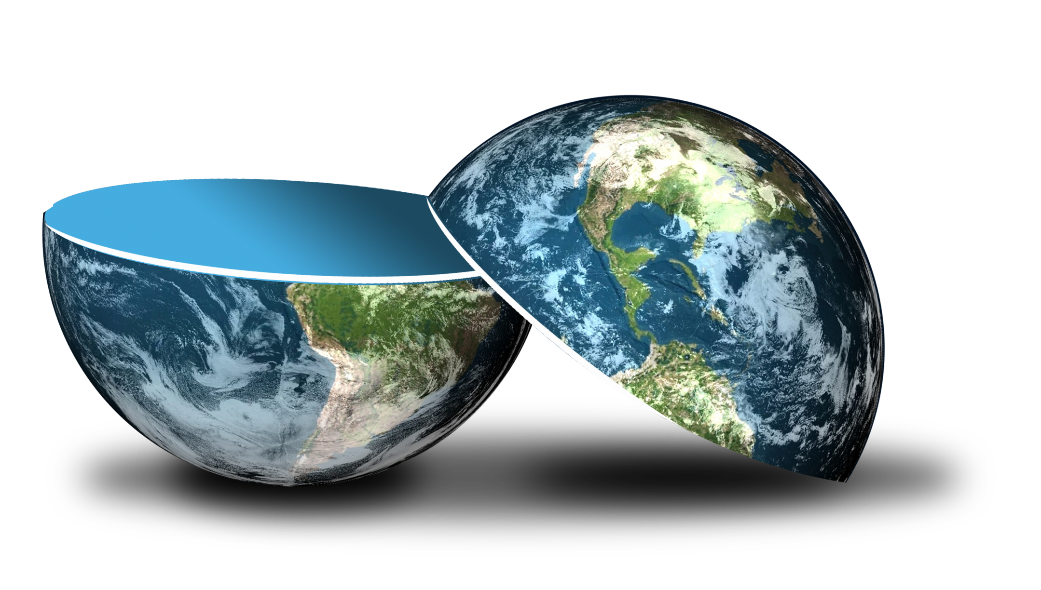
Be happy in an …
Notes:
Camera Phone = https://p1.pxfuel.com/preview/310/297/182/hand-smartphone-mockup-bokeh-colorful-color.jpg
World = edited from https://pixabay.com/photos/planet-earth-earth-planet-global-4427436/
Copyright © 2006−2021. All rights reserved. Bible Point is a registered trademark of Dennis Henderson. All other trademarks acknowledged.
Bible Point contains graphics from Bible Point artists. These illustrations belong to Bible Point and the respective artists. You may use the designs and illustrations for graphical illustration of lessons free and without special permission, provided they are not used in any way that maligns the Christian faith. Furthermore, republication or production of any illustration by any other graphic service whether it be in book, in a machine-readable form, or in any other design resource is strictly prohibited. Furthermore, they cannot be duplicated or resold as any other form of publishing, clip art, or graphic resource.
So What does it mean? (A simple translations of the legal jargon)
So, if you don’t own the presentation(s), graphic(s), and text(s) how can you legally use them? The purchase of the license allows you to use all the images in the product. However, the actual ownership and copyright of the presentation(s), graphic(s), and text(s) remain the property of Bible Point and its licensors. If you had plans on using this product in your “for sale” work—think again!
License Agreement
Article 1: License Grant
All the graphics and text in Bible Point presentations (excluding quotes from the Bible and stated sources) are the intellectual and real property of Bible Point and its licensors, and is protected by law, including United States copyright laws and international treaties. Bible Point grants to you a license:
1. To use the presentation in a single church, single school, or single office of a Christian organization.
2. To make a single archival back-up copy of the program.
3. To modify the presentation(s) and merge with other presentations in a single church, school, or Christian organization.
4. To transfer to another party if that party agrees to accept the terms and conditions of this agreement, and you do not retain any copies of the presentation, whether printed, machine readable, modified, or merged form.
Article 2: Terms
This license is effective until terminated. You may terminate the license at any time by destroying the presentation(s), graphic(s), or text(s) together with all copies, modifications and merged portions in any form. Bible Point may terminate your license if you fail to comply with this Agreement. You agree, upon such termination, for any reason, to destroy the presentation(s), graphics, and text(s) with all copies, modifications, and merged portions in any form.
Article 3: Disclaimers
1. Bible Point presentations, graphics, and texts are licensed to you As Is. You, the consumer, bear the entire risk relating to the quality and performance of the presentation(s), graphic(s), or text(s). In no event will Bible Point be liable for damages resulting from any defect.
2. Thirty-day limited warrantee on disks. Bible Point warrants the disks to be free of defects in material and workmanship under normal use for 30 days after purchase. During the 30-day period you may return a defective presentation, graphic, or text with proof of purchase and it will be replaced without charge, unless the presentation is damaged by misuse.
Article 4: General
1. You may not sub-license, assign, or transfer the license of the presentation(s), graphic(s), or text(s) except as provided by this Agreement.
2. This Agreement will be governed by the laws of the State of Michigan.
So What does it mean? (A simple translations of the legal jargon)
May I let someone borrow or copy my licensed Bible Point presentation (even after I modified it)? As long as it is within your local church, or single school, or the immediate office of a Christian organization you may. Otherwise, please refer the person interested in borrowing to: http://www.biblepoint.com or E-mail: dennis@DrDH.net with any related questions.

Slide 2



Be happy in an …

Slide 3
What is a PARADOX?
It is “a statement that is seemingly contradictory or opposed to common sense and yet is perhaps true.”

Slide 4

The Paradox:
¹ So I reflected on all this and concluded that the righteous and the wise and what they do are in God's hands,

Slide 5
The Paradox:
¹ So I reflected on all this and concluded that the righteous and the wise and what they do are in God's hands, whether it is love or hate, man does not know; both are before him.

Slide 6
The Paradox:
Everything is in God’s hands … yet
I don’t know what is in his hands!
To God everything is
CERTAIN …
Still, I live in a world of
UNCERTAINTY!
Notes:
https://pixabay.com/photos/hands-earth-next-generation-4087018/

Slide 7
I. Here’s what we do know …

Slide 8
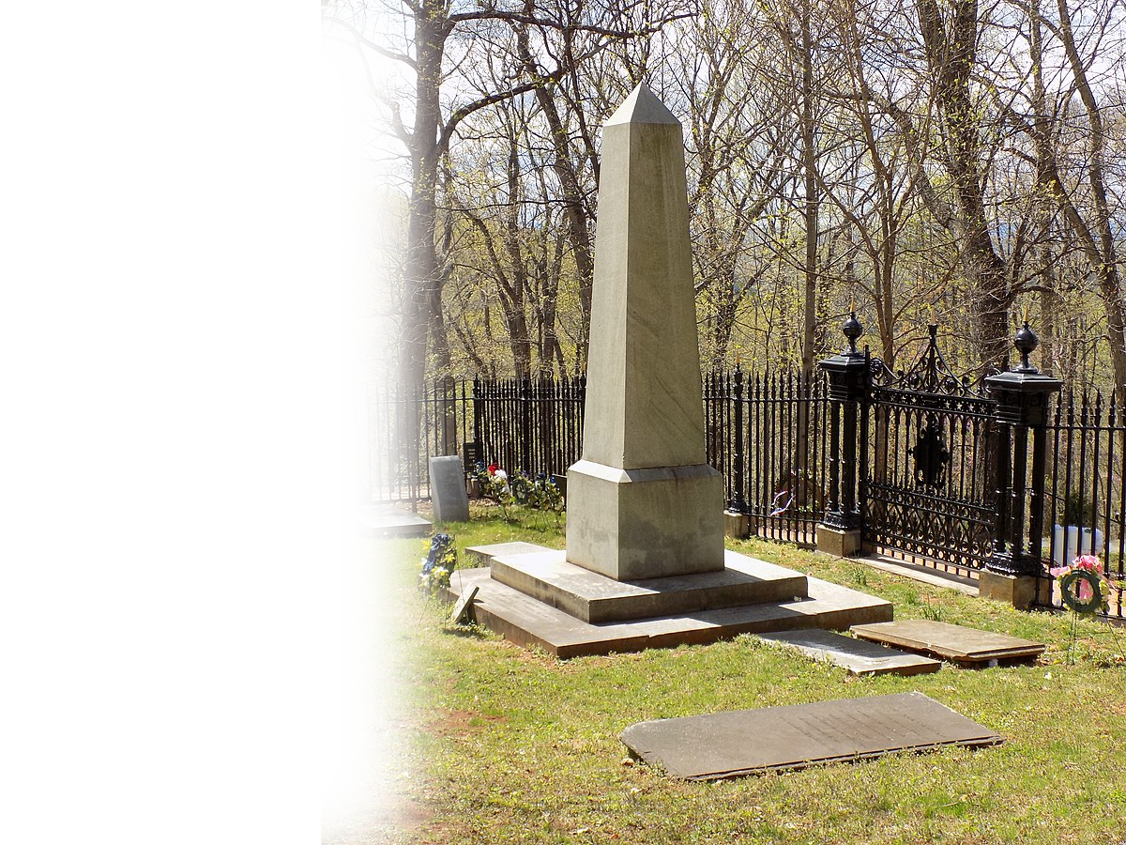
1. Death is inevitable 9:2-3
² All share a common destiny--the righteous and the wicked, the good and the bad, the clean and the unclean, those who offer sacrifices and those who do not. As it is with the good man, so with the sinner; as it is with those who take oaths, so with those who are afraid to take them.
Notes:
https://commons.wikimedia.org/wiki/File:Thomas_Jefferson%27s_grave_site.jpg

Slide 9
1. Death is inevitable 9:2-3
³ This is the evil in everything that happens under the sun: The same destiny overtakes all. The hearts of men, moreover, are full of evil and there is madness in their hearts while they live, and afterward they join the dead.
Notes:
All started with the tree of the knowledge of “good and evil”
This is the evil the same destiny = “death” –”the grave overtakes all,”
So evil people live as it this is all there is and do all sorts of evil and then join the dead.
No so for the Christian! 1 cor 15:51-58

Slide 10
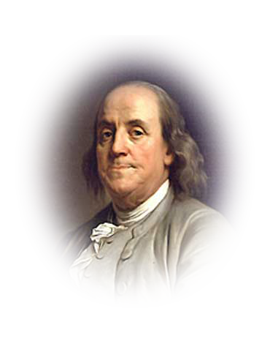
2. Life Gives Hope 9:4-6
Nothing sure but death and taxes.
–Ben Franklin
Notes:
https://www.flickr.com/photos/elycefeliz/6039314863/
Nothing sure but death and taxes. –Ben Franklin
Nothing sure but death and living hope. -- Solomon

Slide 11
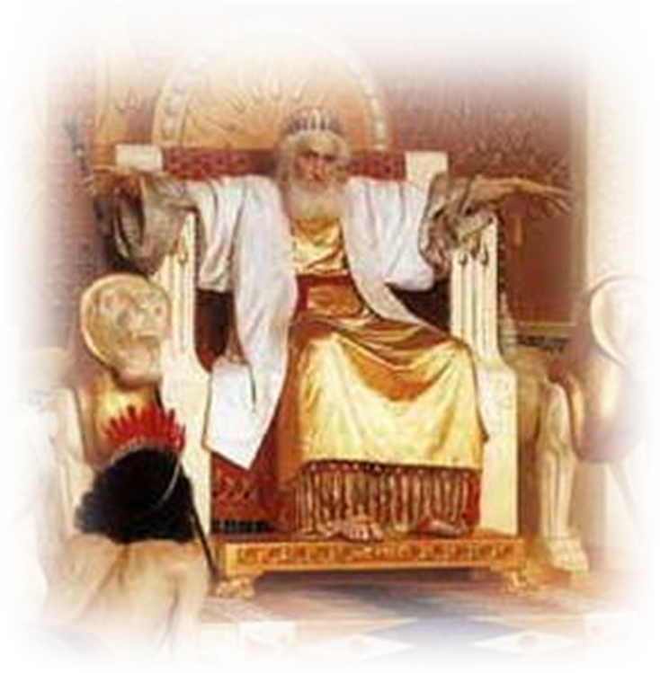
2. Life Gives Hope 9:4-6
Nothing sure but death and taxes.
–Ben Franklin
Nothing sure but death and living hope.
–Solomon
Notes:
Nothing sure but death and taxes. –Ben Franklin
Nothing sure but death and living hope. -- Solomon

Slide 12
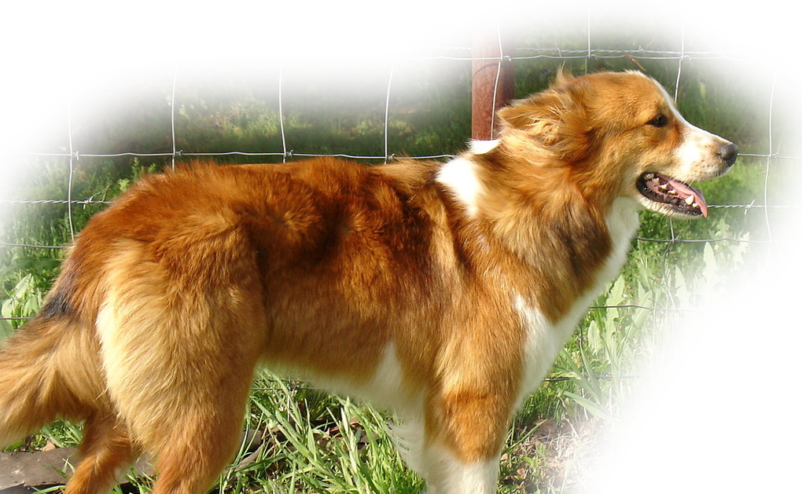
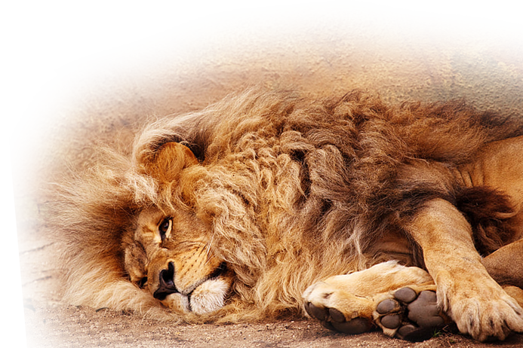
2. Life Gives Hope 9:4-6
⁴ Anyone who is among the living has hope--even a live dog is better off than a dead lion!
Notes:
Dog = https://commons.wikimedia.org/wiki/File:Sable_and_White_Female_OTFS_Dog.JPG
Lion = https://www.pickpik.com/mannequin-lying-down-street-dead-ignoring-uncaring-41740
Nothing sure but death and taxes. –Ben Franklin
Nothing sure but death and living hope. -- Solomon

Slide 13
2. Life Gives Hope 9:4-6
⁵ For the living know that they will die, but the dead know nothing; they have no further reward, and even the memory of them is forgotten. ⁶ Their love, their hate and their jealousy have long since vanished; …
Notes:
Nothing sure but death and taxes. –Ben Franklin
Nothing sure but death and living hope. -- Solomon

Slide 14
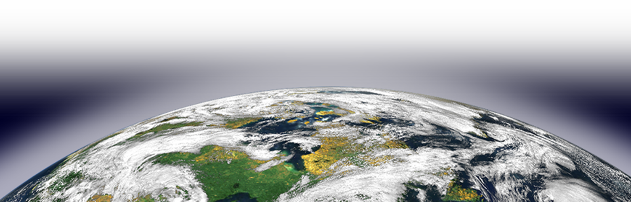
2. Life Gives Hope 9:4-6
The DOT is so important!
never again will they have a part in anything that happens under the sun.
What you Believe in the dot …
determines where you spend the line.
determines how you spend the line.
What you Do in the dot …
Notes:
That’s what makes the Dot and Line analogy so important.
There are no redos on the dot.
But the dot determines the line.

Slide 15
II. Here’s How We Should Live 9:7-9
UNDER THE SUN …

Slide 16
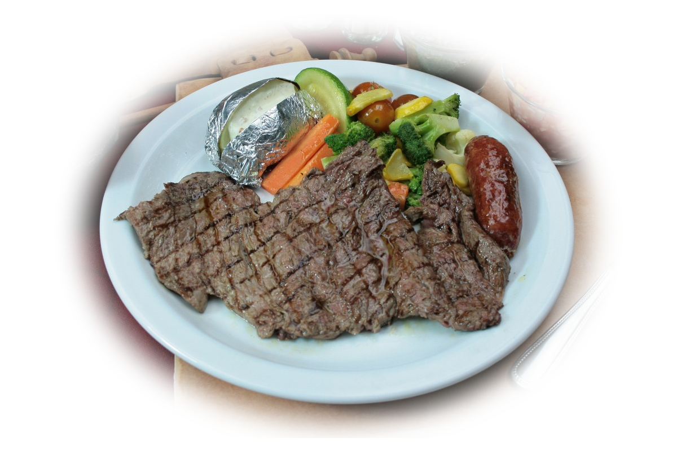

Live with Gladness
⁷ Go, eat your food with gladness,
Notes:
https://pxhere.com/en/photo/830129

Slide 17




Live with Joy
and drink your wine with a joyful heart,
Notes:
Wine glasses = https://www.pxfuel.com/en/free-photo-qsfml
Joyful heart = https://www.needpix.com/photo/download/746780/heart-cute-beautiful-love-together-care-lifestyle-happiness-family

Slide 18

Live with God’s Favor
for it is now that God favors what you do.
Notes:
https://pixabay.com/illustrations/praise-feedback-well-done-emotion-5257999/

Slide 19
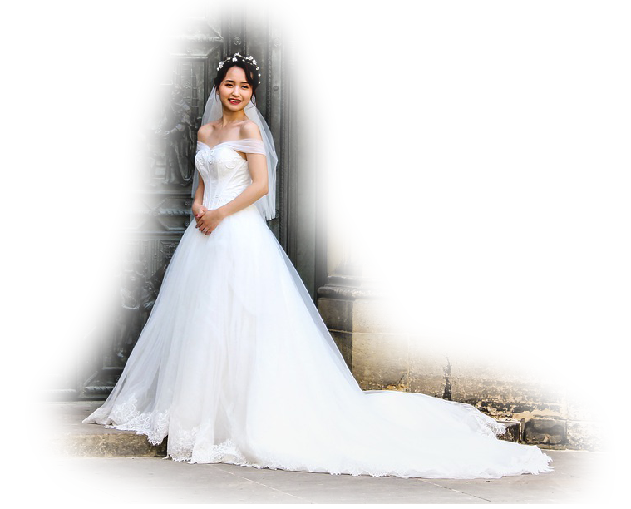

Live with Style
⁸ Always be clothed in white, and always anoint your head
with oil.
Notes:
https://www.needpix.com/photo/download/1880588/bride-wedding-prague-st-vitus-cathedral-romantic-female-romance-dress-white
https://pxhere.com/en/photo/871569
Clothed and refreshed
“White garments” metaphorically symbolized sinlessness (Like white wedding dress represented virginity (in generations before us).
“Anointed head” ceremonially meant consecrated you to God – mundane, common use – refreshed and perfumed.

Slide 20
Live with Spouse
⁹ Enjoy life with your wife, whom you love, …

Slide 21
Live with Spouse
⁹ Enjoy life with your wife, whom you love, all the days of this meaningless life that God has given you under the sun--all your meaningless days. For this is your lot in life and in your toilsome labor under the sun.
Notes:
Point: Life is fleeting so you must enjoy in for the duration of the DOT. You will not be married in heaven!

Slide 22

Live with Purpose
¹⁰ Whatever your hand finds to do, do it with all your might,
Whatever you do, work at it with all your heart, as working for the Lord, not for men (Col 3:23)
Notes:
https://www.pikist.com/free-photo-ssdcw

Slide 23
WHY?
for in the grave, where you are going, there is neither working nor planning nor knowledge nor wisdom. (Ecc 9:10 NIV)
Notes:
You only have this one life—make it count!
You need to make the dot count.

Slide 24
III. Here’s the PARADOX 9:11-16

Slide 25
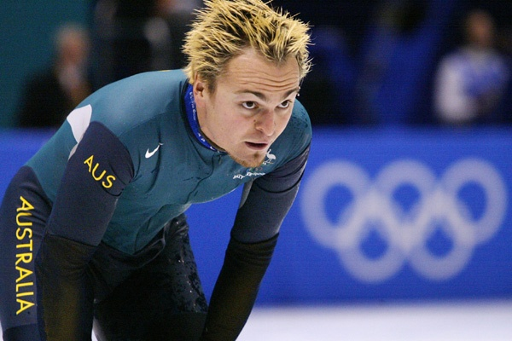
1. The Race Paradox
¹¹ I have seen something else under the sun:
The race is not to the swift
Ask 2002 Gold Medal Olympian
speed skater, Steven Bradbury
Notes:
Ask 2002 Gold Medal Olympian
speed skater, Steven Bradbury

Slide 26
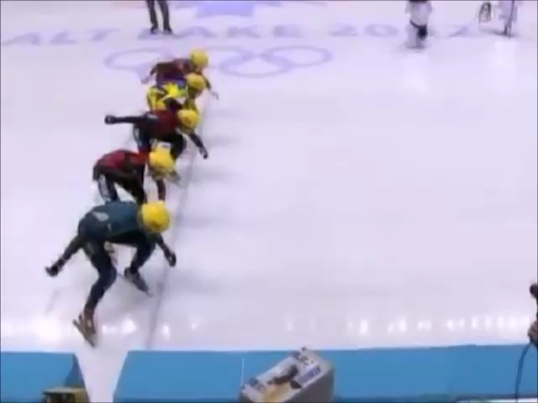
1. The Race Paradox
¹¹ I have seen something else under the sun:
The race is not to the swift
Ask 2002 Gold Medal Olympian
speed skater, Steven Bradbury

Slide 27
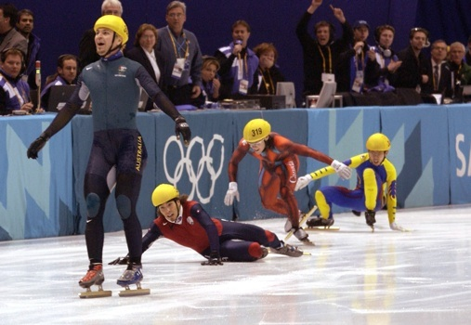
1. The Race Paradox
¹¹ I have seen something else under the sun:
The race is not to the swift
Ask 2002 Gold Medal Olympian
speed skater, Steven Bradbury

Slide 28
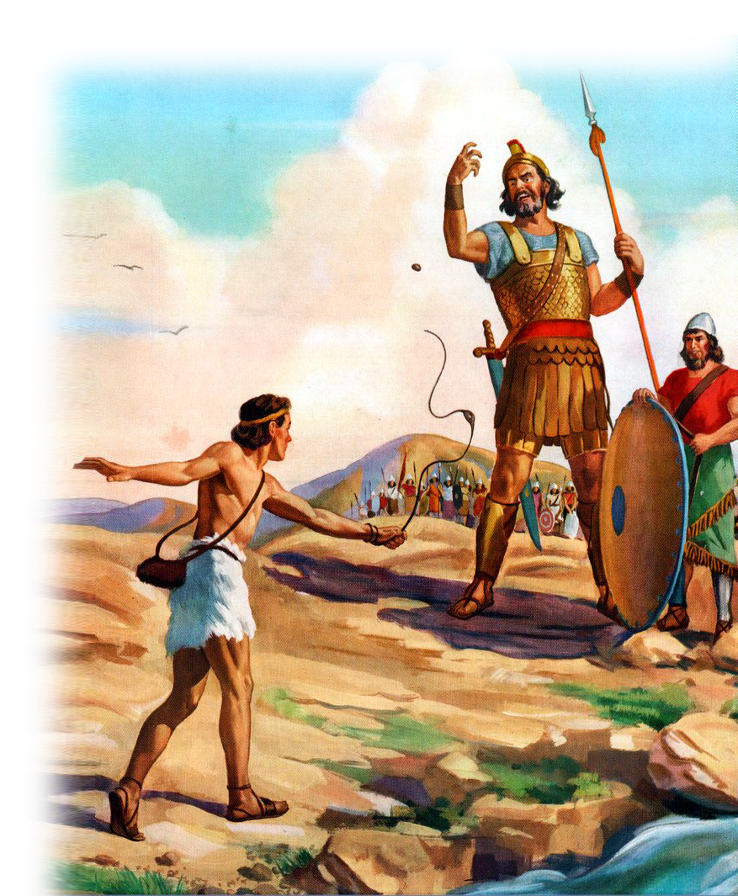
2. The Battle Paradox
or the battle to the strong,
Notes:
https://www.flickr.com/photos/42787780@N04/4975296555

Slide 29
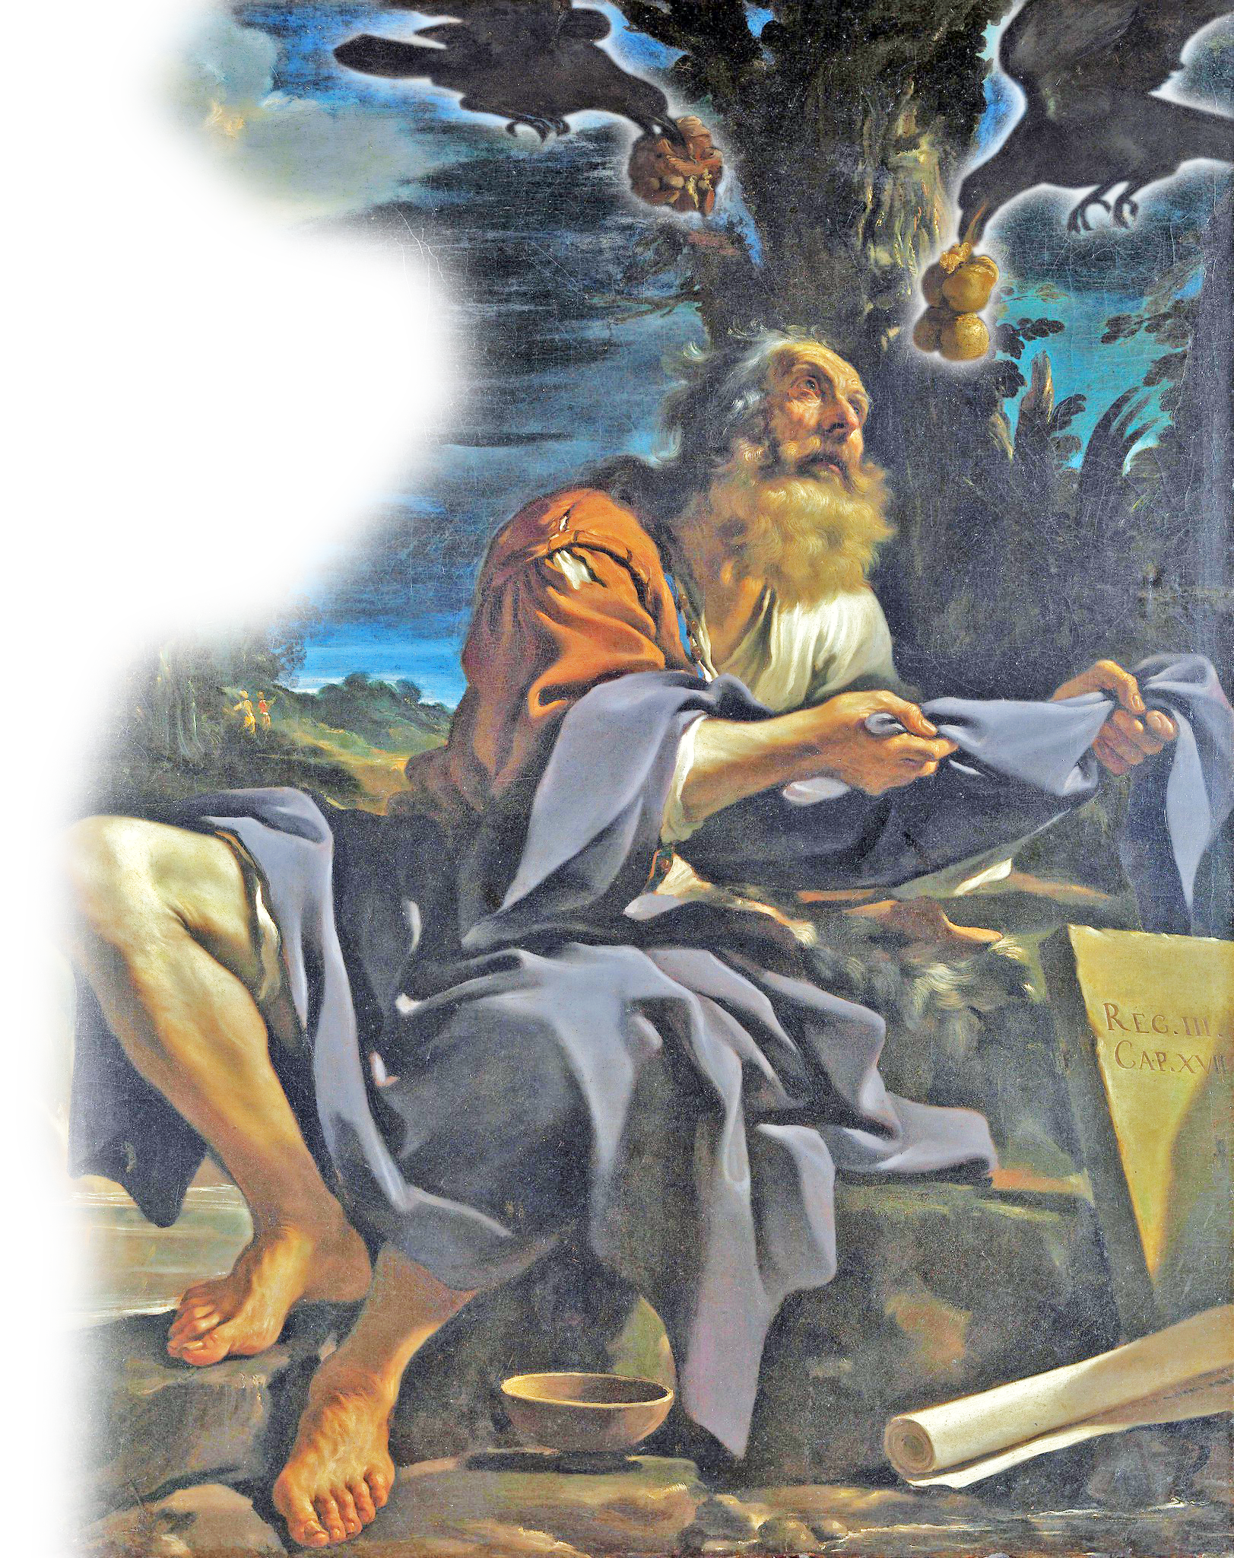
3. The Meal Paradox
nor does food come to the wise
Notes:
Elijah https://www.flickr.com/photos/gandalfsgallery/6013588711/
⁶ The ravens brought him bread and meat in the morning and bread and meat in the evening, and he drank from the brook. (1Ki 17:6 NIV)

Slide 30
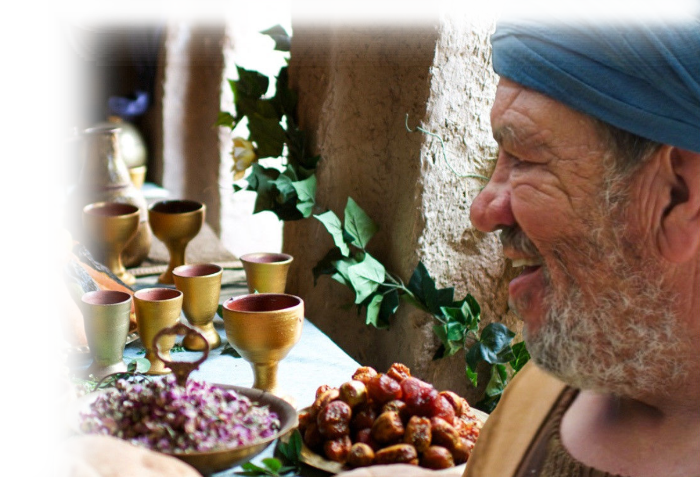
4. The Wealth Paradox
or wealth to the brilliant
Notes:
¹⁶ And he told them this parable: "The ground of a certain rich man produced a good crop.
¹⁷ He thought to himself, 'What shall I do? I have no place to store my crops.'
¹⁸ "Then he said, 'This is what I'll do. I will tear down my barns and build bigger ones, and there I will store all my grain and my goods.
¹⁹ And I'll say to myself, "You have plenty of good things laid up for many years. Take life easy; eat, drink and be merry."'
²⁰ "But God said to him, 'You fool! This very night your life will be demanded from you. Then who will get what you have prepared for yourself?'
(Luk 12:16-20 NIV)

Slide 31
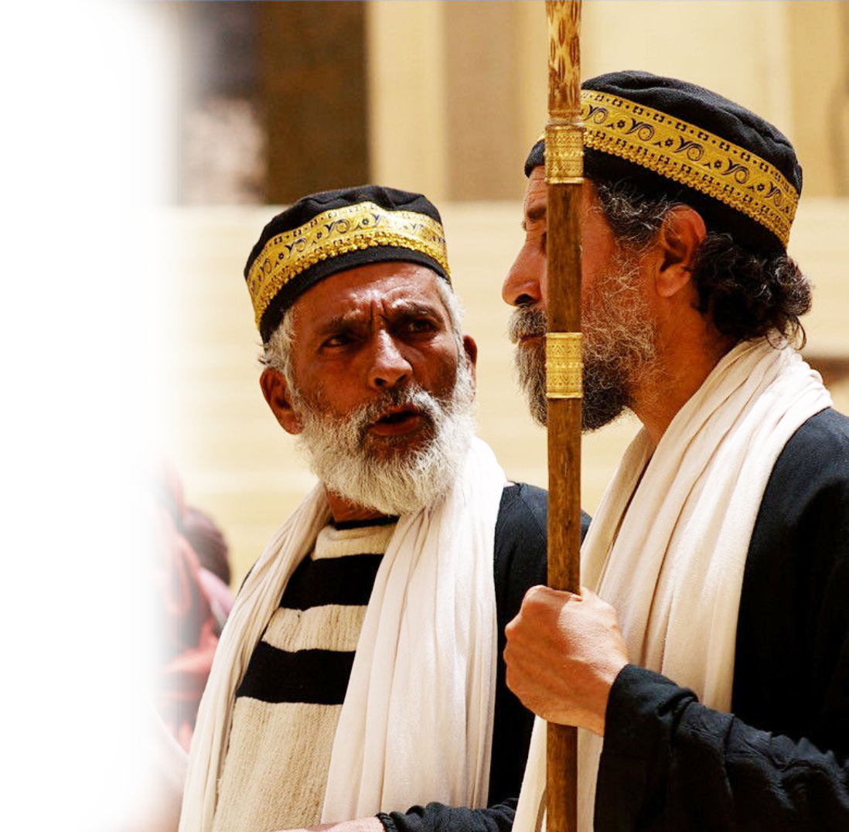
5. The Favor Paradox
or favor to the learned;
Notes:
⁵² "Woe to you experts in the law, because you have taken away the key to knowledge. You yourselves have not entered, and you have hindered those who were entering." (Luk 11:52 NIV)

Slide 32
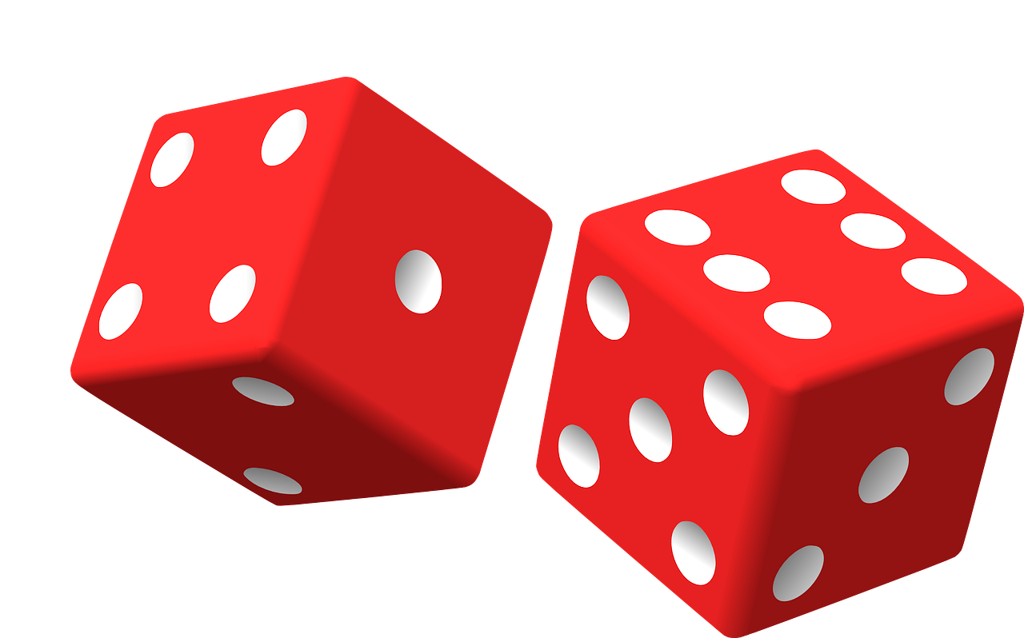
6. The Random Paradox
but time and chance happen to them all.
Notes:
https://pixabay.com/vectors/dice-red-two-game-rolling-chance-25637/
The appointed time (by God)
And happenstance (what God has secretly determined to happen) happens to all.

Slide 33

7. The Time Paradox
¹² Moreover, no man knows when his hour will come: As fish are caught in a cruel net, or birds are taken in a snare, so men are trapped by evil times that fall unexpectedly upon them.
Notes:
Here’s the point: you do not know when your time is coming.
Even when you expect it—it comes unexpectantly.

Slide 34
8. The Story Paradox
¹³ I also saw under the sun this example of wisdom that greatly impressed me:

Slide 35
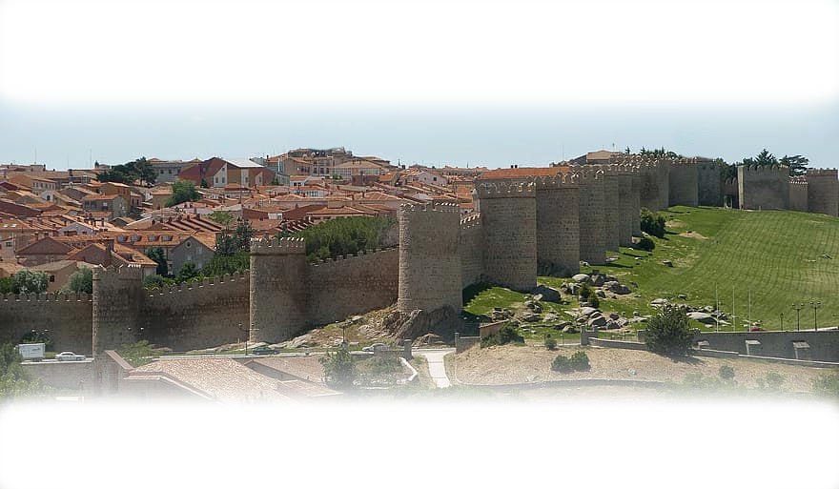
8. The Story Paradox
¹⁴ There was once a small city with only a few people in it.
And a powerful king came against it, surrounded it and built huge siegeworks against it.
Notes:
https://www.pikist.com/free-photo-vwbgi

Slide 36
8. The Story Paradox
¹⁵ Now there lived in that city a man poor but wise,
and he saved the city by his wisdom. But nobody remembered that poor man.

Slide 37
8. The Story Paradox
¹⁶ So I said, "Wisdom is better than strength.“
But the poor man's wisdom is despised, and his words are no longer heeded.

Slide 38
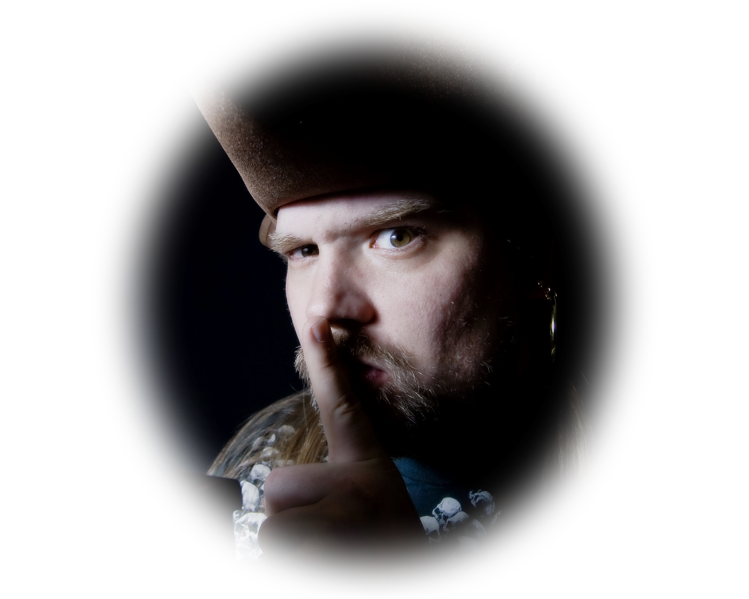
The Conclusion: 9:17-18
¹⁷ The quiet words of the wise are more to be heeded than the shouts of a ruler of fools.
¹⁸ Wisdom is better than weapons of war, but one sinner destroys much good.
Notes:
https://www.flickr.com/photos/cayusa/2344645894
Whoever speaks the softest wins!

Slide 39
So what should we learn?
Two things are certain:
1) Death with Judgement that follows
2) Hope as long as we live
Therefore, in your uncertainty …
make each day of the dot count for the line!

Slide 40
  LET’S PRAY!

