Slide 1


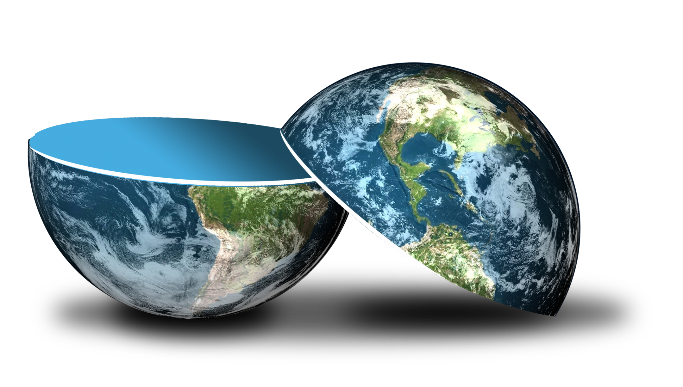
Be happy in an …
Notes:
Camera Phone = https://p1.pxfuel.com/preview/310/297/182/hand-smartphone-mockup-bokeh-colorful-color.jpg
World = edited from https://pixabay.com/photos/planet-earth-earth-planet-global-4427436/
Copyright © 2006−2021. All rights reserved. Bible Point is a registered trademark of Dennis Henderson. All other trademarks acknowledged.
Bible Point contains graphics from Bible Point artists. These illustrations belong to Bible Point and the respective artists. You may use the designs and illustrations for graphical illustration of lessons free and without special permission, provided they are not used in any way that maligns the Christian faith. Furthermore, republication or production of any illustration by any other graphic service whether it be in book, in a machine-readable form, or in any other design resource is strictly prohibited. Furthermore, they cannot be duplicated or resold as any other form of publishing, clip art, or graphic resource.
So What does it mean? (A simple translations of the legal jargon)
So, if you don’t own the presentation(s), graphic(s), and text(s) how can you legally use them? The purchase of the license allows you to use all the images in the product. However, the actual ownership and copyright of the presentation(s), graphic(s), and text(s) remain the property of Bible Point and its licensors. If you had plans on using this product in your “for sale” work—think again!
License Agreement
Article 1: License Grant
All the graphics and text in Bible Point presentations (excluding quotes from the Bible and stated sources) are the intellectual and real property of Bible Point and its licensors, and is protected by law, including United States copyright laws and international treaties. Bible Point grants to you a license:
1. To use the presentation in a single church, single school, or single office of a Christian organization.
2. To make a single archival back-up copy of the program.
3. To modify the presentation(s) and merge with other presentations in a single church, school, or Christian organization.
4. To transfer to another party if that party agrees to accept the terms and conditions of this agreement, and you do not retain any copies of the presentation, whether printed, machine readable, modified, or merged form.
Article 2: Terms
This license is effective until terminated. You may terminate the license at any time by destroying the presentation(s), graphic(s), or text(s) together with all copies, modifications and merged portions in any form. Bible Point may terminate your license if you fail to comply with this Agreement. You agree, upon such termination, for any reason, to destroy the presentation(s), graphics, and text(s) with all copies, modifications, and merged portions in any form.
Article 3: Disclaimers
1. Bible Point presentations, graphics, and texts are licensed to you As Is. You, the consumer, bear the entire risk relating to the quality and performance of the presentation(s), graphic(s), or text(s). In no event will Bible Point be liable for damages resulting from any defect.
2. Thirty-day limited warrantee on disks. Bible Point warrants the disks to be free of defects in material and workmanship under normal use for 30 days after purchase. During the 30-day period you may return a defective presentation, graphic, or text with proof of purchase and it will be replaced without charge, unless the presentation is damaged by misuse.
Article 4: General
1. You may not sub-license, assign, or transfer the license of the presentation(s), graphic(s), or text(s) except as provided by this Agreement.
2. This Agreement will be governed by the laws of the State of Michigan.
So What does it mean? (A simple translations of the legal jargon)
May I let someone borrow or copy my licensed Bible Point presentation (even after I modified it)? As long as it is within your local church, or single school, or the immediate office of a Christian organization you may. Otherwise, please refer the person interested in borrowing to: http://www.biblepoint.com or E-mail: dennis@DrDH.net with any related questions.

Slide 2


Be happy in an…
Notes:
Money = https://p0.pikist.com/photos/309/975/us-dollars-american-background-bank-banking-banknote-bill-business-cash.jpg
World = edited from https://pixabay.com/photos/planet-earth-earth-planet-global-4427436/

Slide 3

What do you see?

Slide 4
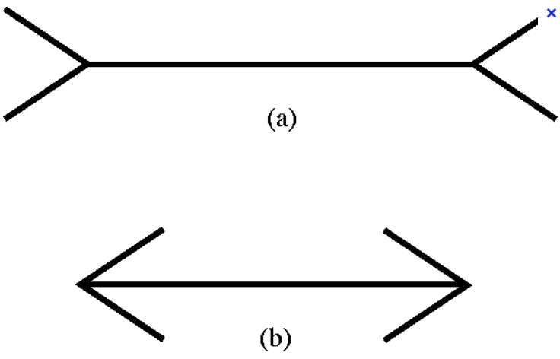
Which is longer?

Slide 5

How many boards?
1
1
2
2
3
4
3

Slide 6

How many legs?
1
2
3
4
5

Slide 7

Count the black dots …

Slide 8
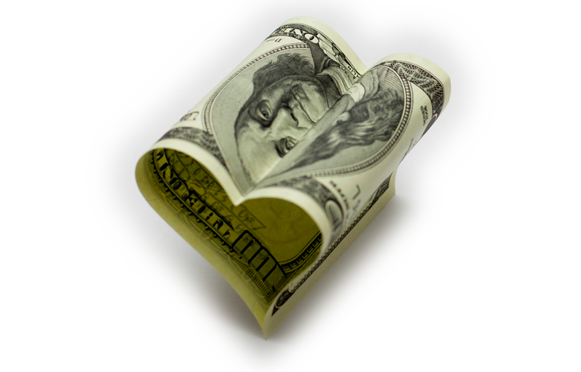
Some things are NOT as they appear!
Last week – the FINANCIAL delusion
“Without MONEY I can’t be happy!”

Slide 9

TODAY …
The ADVERSITY delusion
“Life is so bad I can’t be happy!”
Eccl 7:1-14
Notes:
This guy has really fallen into it.
That’s how some people feel. Life is to bad that I can’t be happy!
Nothing is going right in my life!

Slide 10
Be happy in an…
Notes:
Money = https://p0.pikist.com/photos/309/975/us-dollars-american-background-bank-banking-banknote-bill-business-cash.jpg
World = edited from https://pixabay.com/photos/planet-earth-earth-planet-global-4427436/

Slide 11
Notice Ecclesiates 6:12
¹² For who knows what is good for a man in life...?
“GOOD” or “BETTER”
occurs 12 times in 7:1-14
in a list of proverbs...

Slide 12
A Few Modern-Day PROVERBS:
Febreze is better than smelly cheese
A birthday is better than a funeral.
A party is better than a wake.
A wise man will be happy; a fool will be sad.
Laughter is better than crying.
Ones beginning is better than ones end.
An aggressive spirit is better than a passive one.
WRONG

Slide 13
WHY?
Prosperity is not always GOOD ... and
ADVERSITY is not always BAD!
Let’s see what Ecclesiastes says about
ADVERSITY!

Slide 14
1. It brings out a person’s CHARACTER!
^{7:1} A good name is better than fine perfume,

Slide 15
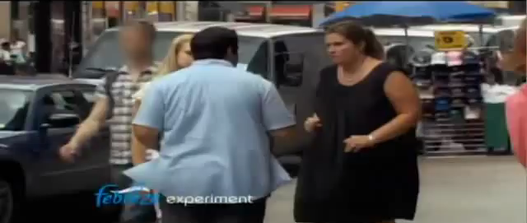
1. It brings out a person’s CHARACTER!
^{7:1} A good name is better than fine perfume,

Slide 16
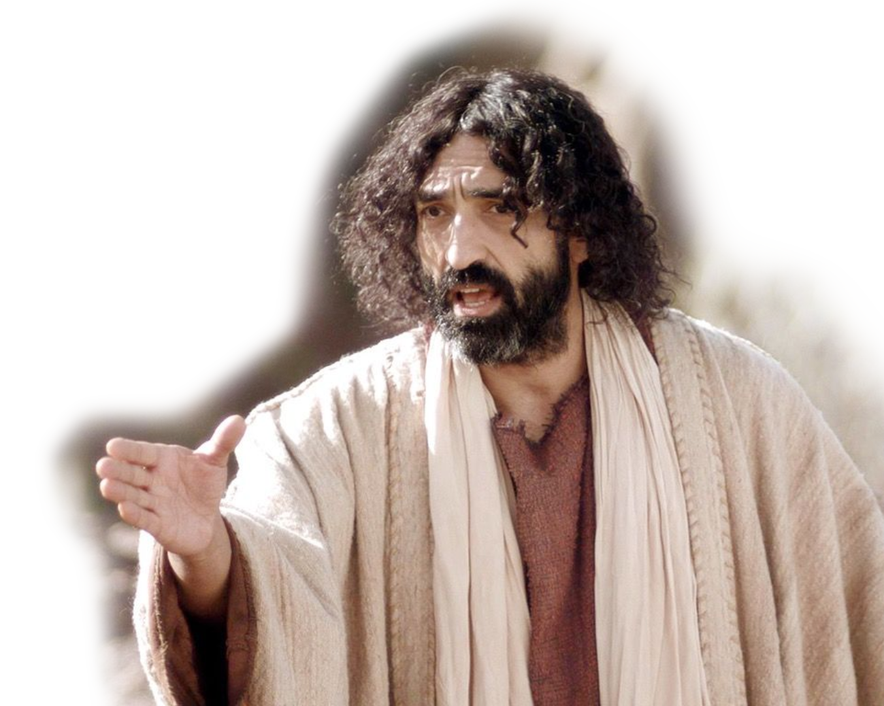

1. It brings out a person’s CHARACTER!
^{7:1} A good name is better than fine perfume,
You hypocrites! You are like whitewashed tombs, which look beautiful on the outside but on the inside are full of dead men’s bones and everything unclean. (Matthew 23:27)
Notes:
https://www.flickr.com/photos/7954439@N06/13000280074
It matters more how you are on the inside than what you look like on the outside.
Single ministry I would say, All dating starts on a lie—you don’t act like your real self. No, you pretend to be some great and wonderful person. You whitewash the outside, and slowly let the whitewash wash off.

Slide 17
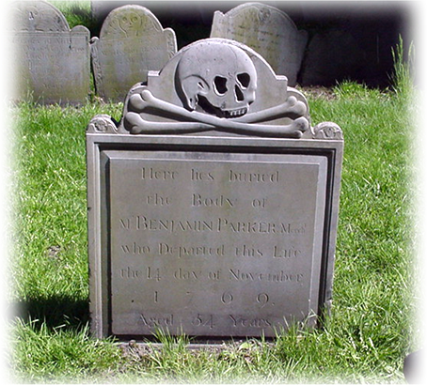
2. It brings out a person’s MORTALITY! !
¹ A good name is better than fine perfume, and the day of death better than the day of birth.
POINT: Death with character and integrity is better than birth and life without it!
Notes:
Grave stone = FREE = From BiblePoint photos.

Slide 18
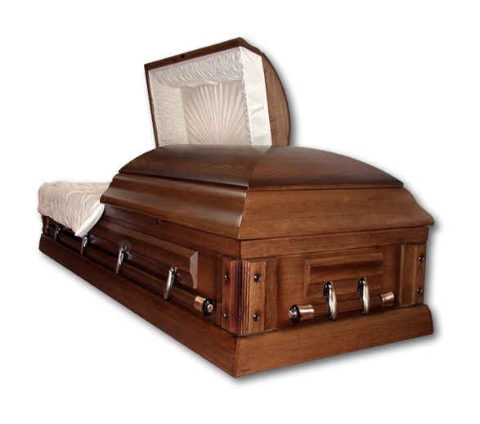
3. It brings out a person’s SOBRIETY!
² It is better to go to a house of mourning than to go to a house of feasting, for death is the destiny of every man;
the living should take this
to heart. ³ Sorrow is better
than laughter, because
a sad face is good
for the heart.
POINT: Nothing gets our attention like a severe adversity (death).
Notes:
Casket = LICENSED and NOT FOR REUSE. To reuse elsewhere, get a license from istock
Death or even the death of a relationship (separation or divorce).

Slide 19

4. It brings out a person’s SENSIBILTY!
⁴ The heart of the wise is in the house of mourning, but the heart of fools is in the
house of pleasure.
⁵ It is better to heed a wise
man's rebuke than to listen
to the song of fools.
⁶ Like the crackling of thorns
under the pot, so is the
laughter of fools. This too is
meaningless.
POINT: Adversity gets our attention and moves us from fun and games to listening to wise counsel!

Slide 20

5 - It brings out a person’s INTEGRITY!
⁷ Extortion turns a wise man into a fool, and a bribe corrupts the heart.
Notes:
White heart = FREE = from http://commons.wikimedia.org/wiki/File:White_heart.svg

Slide 21
6. It brings out a person’s PATIENCE!
⁸ The end of a matter is better than its beginning, and patience is better than pride.
⁹ Do not be quickly provoked in your spirit, for anger resides in the lap of fools.
¹⁰ Do not say, "Why were the old days better than these?" For it is not wise to ask such questions.
1-Wait for the end...
2-Be SLOW
to anger...
3-Be content...

Slide 22
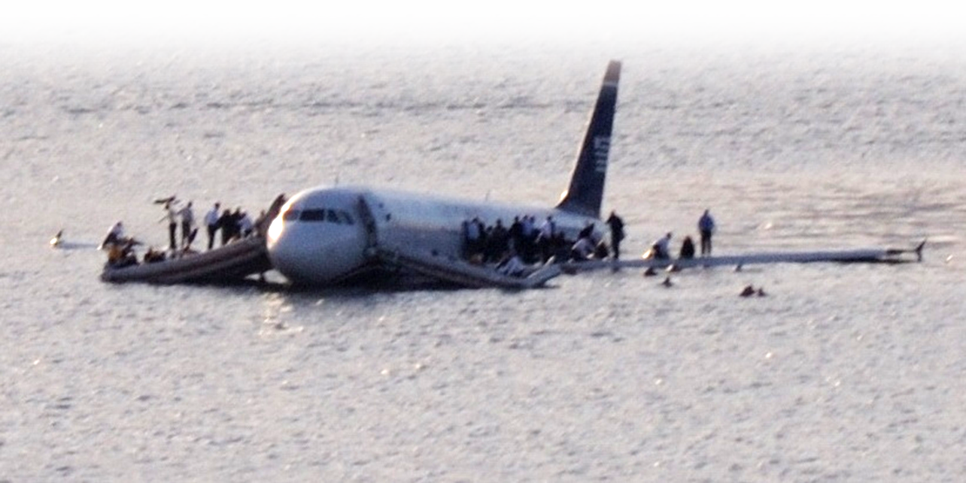
7. It brings out a person’s WISDOM!
¹¹ Wisdom, like an inheritance, is a good thing and benefits those who see the sun.
¹² Wisdom is a shelter as money is a shelter, but the advantage of knowledge is this: that wisdom preserves the life of its possessor.
Notes:
Captain who has sailed through the storm.
US Airways Flight 1549 = FREE = from http://en.wikipedia.org/wiki/US_Airways_Flight_1549
The pilot in command was 57-year-old Capt. Chesley B. "Sully" Sullenberger, of US Airways Flight 1549.

Slide 23
8. It brings out a person’s DEPENDENCY!
¹³ Consider what God has done: Who can straighten what he has made crooked?
¹⁴ When times are good, be happy; but when times are bad, consider: God has made the one as well as the other. Therefore, a man cannot discover anything about his future.

Slide 24
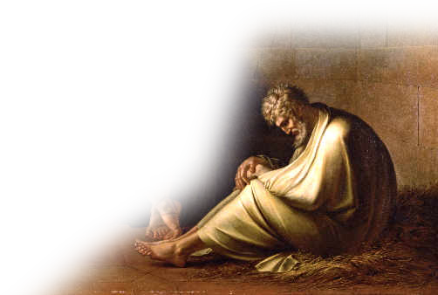
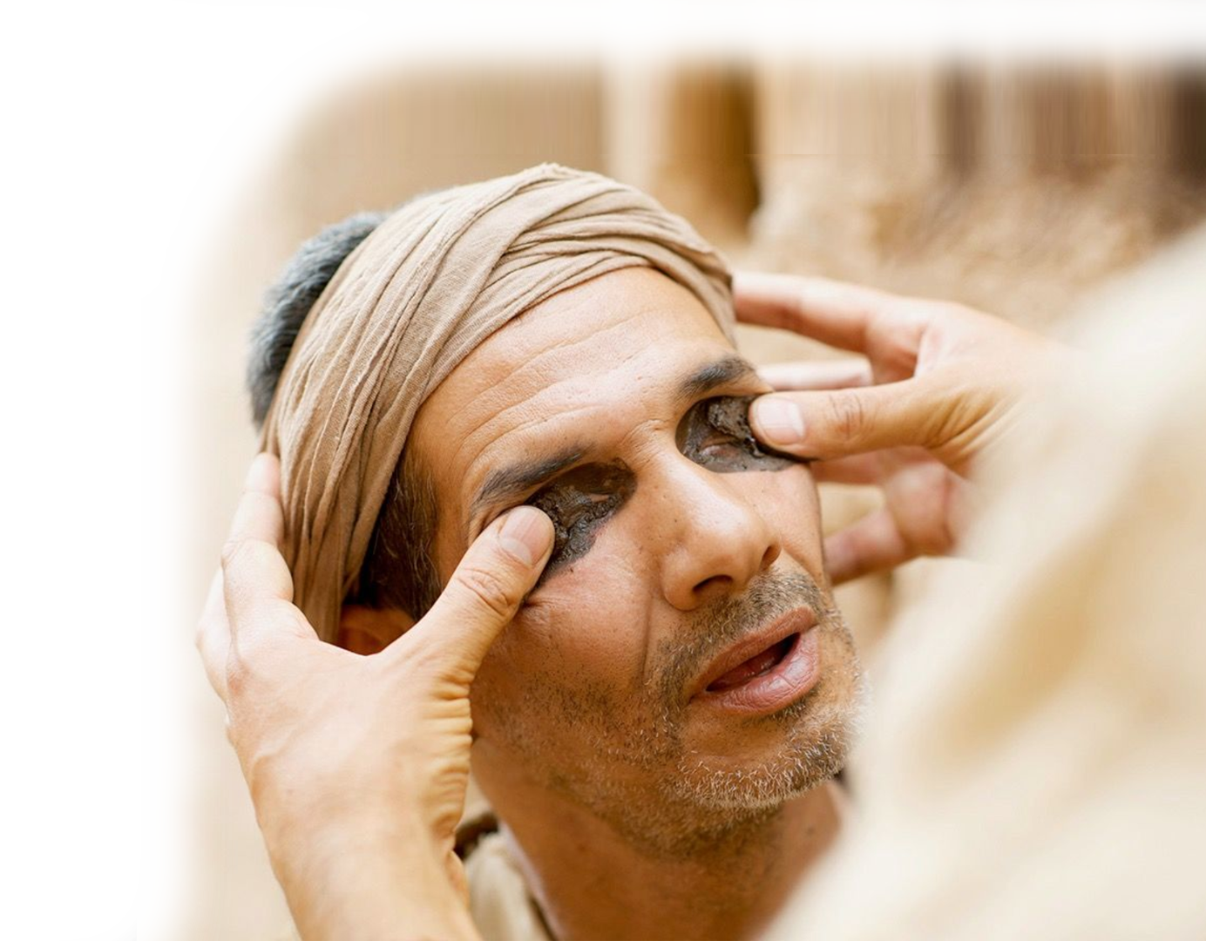
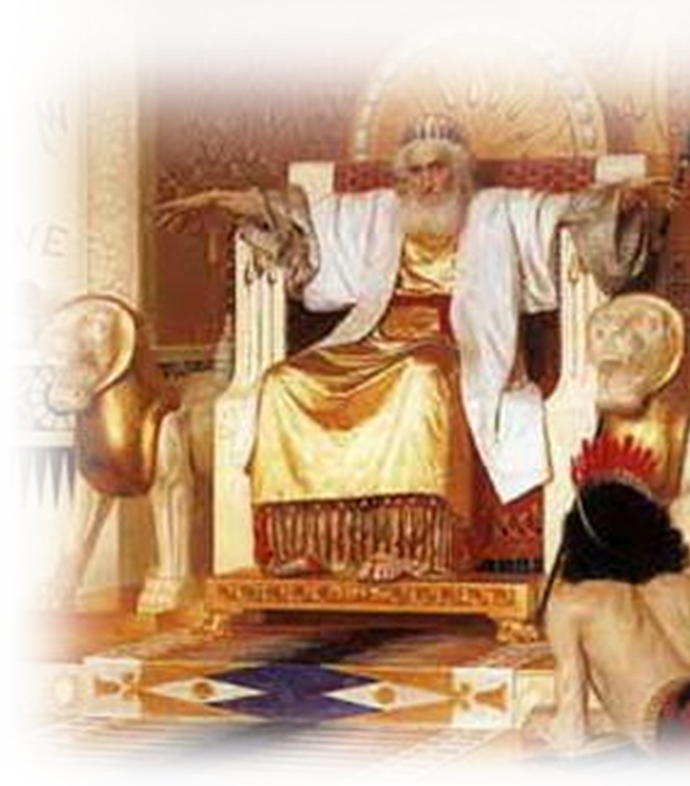
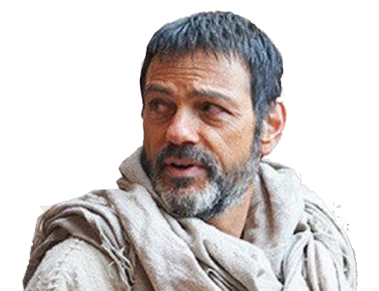
“ADVERSITY is always bad is a dilusion.”
If that statement is not true then ...
Solomon was wrong! (Eccl 7)
Job was wrong! (Job)
Jesus was wrong! (John 9)
Paul was wrong! (Romans 8:28)
Notes:
Solomon = FREE = from http://upload.wikimedia.org/wikipedia/commons/4/4d/Isaak_Asknaziy_02.jpeg
Job = FREE = from http://commons.wikimedia.org/wiki/File:Eberhard_von_W%C3%A4chter_Hiob_und_seine_Freunde.jpg
Jesus and Blind man = FREE = from http://upload.wikimedia.org/wikipedia/commons/b/b7/Ottheinrich_Folio126v_Jn9.jpg
Apostle Paul = FREE = from http://upload.wikimedia.org/wikipedia/commons/f/ff/El_Greco_-_Apostles_Peter_and_Paul_-_WGA10496.jpg

Slide 25
The POINT: Prosperity
Doesn’t develop CHARACTER ––––Adversity does.
Gives false sense of IMMORTALITY––vs Mortality
Shows up in frivolous FROLIC –––––– vs Sobriety
Leads to SENSELESS activities –––––– vs Sensible
Inclines to give in to EXTORTION ––––– vs Integrity
Fosters IMPATIENCE ––––––––––––––– vs Patience
Can be FOOLISH –––––––––––––––– vs Perspective
Promotes INDEPENDENCE –––– vs God Dependent

Slide 27
We need adversity to
Keep us Trusting in God

Slide 28
2 Corinthians 12: 9-10
⁹ But he said to me, "My grace is sufficient for you, for my power is made perfect in weak-ness." Therefore I will boast all the more gladly about my weaknesses, so that Christ’s
power may rest on me. ¹⁰ That is why,
for Christ's sake, I delight in weak-
nesses, in insults, in hardships, in
persecutions, in difficulties. For
when I am weak, then I am strong.
Notes:
Apostle Paul = FREE = from http://upload.wikimedia.org/wikipedia/commons/f/ff/El_Greco_-_Apostles_Peter_and_Paul_-_WGA10496.jpg

Slide 29
So Let’s Pray that we will take all that God intended us to take from our ADVERSITY.

Slide 30
  LET’S PRAY!

