Slide 1


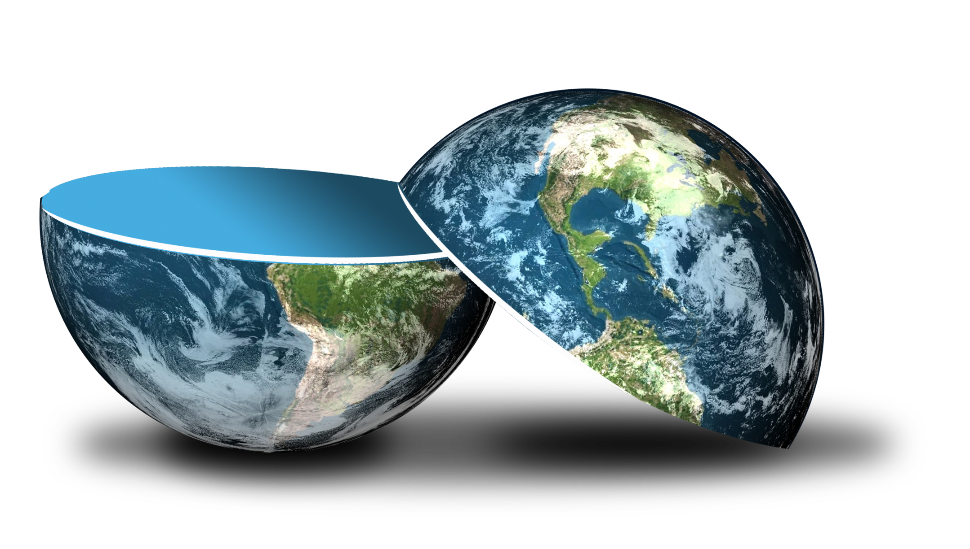
Be happy in an …
Notes:
Camera Phone = https://p1.pxfuel.com/preview/310/297/182/hand-smartphone-mockup-bokeh-colorful-color.jpg
World = edited from https://pixabay.com/photos/planet-earth-earth-planet-global-4427436/
World = edited from https://pixabay.com/photos/planet-earth-earth-planet-global-4427436/
Copyright © 2006−2021. All rights reserved. Bible Point is a registered trademark of Dennis Henderson. All other trademarks acknowledged.
Bible Point contains graphics from Bible Point artists. These illustrations belong to Bible Point and the respective artists. You may use the designs and illustrations for graphical illustration of lessons free and without special permission, provided they are not used in any way that maligns the Christian faith. Furthermore, republication or production of any illustration by any other graphic service whether it be in book, in a machine-readable form, or in any other design resource is strictly prohibited. Furthermore, they cannot be duplicated or resold as any other form of publishing, clip art, or graphic resource.
So What does it mean? (A simple translations of the legal jargon)
So, if you don’t own the presentation(s), graphic(s), and text(s) how can you legally use them? The purchase of the license allows you to use all the images in the product. However, the actual ownership and copyright of the presentation(s), graphic(s), and text(s) remain the property of Bible Point and its licensors. If you had plans on using this product in your “for sale” work—think again!
License Agreement
Article 1: License Grant
All the graphics and text in Bible Point presentations (excluding quotes from the Bible and stated sources) are the intellectual and real property of Bible Point and its licensors, and is protected by law, including United States copyright laws and international treaties. Bible Point grants to you a license:
1. To use the presentation in a single church, single school, or single office of a Christian organization.
2. To make a single archival back-up copy of the program.
3. To modify the presentation(s) and merge with other presentations in a single church, school, or Christian organization.
4. To transfer to another party if that party agrees to accept the terms and conditions of this agreement, and you do not retain any copies of the presentation, whether printed, machine readable, modified, or merged form.
Article 2: Terms
This license is effective until terminated. You may terminate the license at any time by destroying the presentation(s), graphic(s), or text(s) together with all copies, modifications and merged portions in any form. Bible Point may terminate your license if you fail to comply with this Agreement. You agree, upon such termination, for any reason, to destroy the presentation(s), graphics, and text(s) with all copies, modifications, and merged portions in any form.
Article 3: Disclaimers
1. Bible Point presentations, graphics, and texts are licensed to you As Is. You, the consumer, bear the entire risk relating to the quality and performance of the presentation(s), graphic(s), or text(s). In no event will Bible Point be liable for damages resulting from any defect.
2. Thirty-day limited warrantee on disks. Bible Point warrants the disks to be free of defects in material and workmanship under normal use for 30 days after purchase. During the 30-day period you may return a defective presentation, graphic, or text with proof of purchase and it will be replaced without charge, unless the presentation is damaged by misuse.
Article 4: General
1. You may not sub-license, assign, or transfer the license of the presentation(s), graphic(s), or text(s) except as provided by this Agreement.
2. This Agreement will be governed by the laws of the State of Michigan.
So What does it mean? (A simple translations of the legal jargon)
May I let someone borrow or copy my licensed Bible Point presentation (even after I modified it)? As long as it is within your local church, or single school, or the immediate office of a Christian organization you may. Otherwise, please refer the person interested in borrowing to: http://www.biblepoint.com or E-mail: dennis@DrDH.net with any related questions.

Slide 2
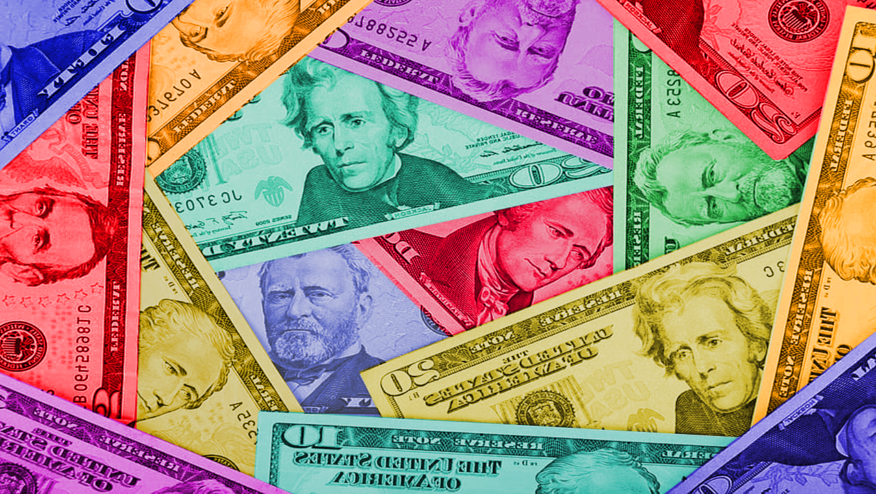
Be happy in an…
Notes:
Money = https://p0.pikist.com/photos/309/975/us-dollars-american-background-bank-banking-banknote-bill-business-cash.jpg
World = edited from https://pixabay.com/photos/planet-earth-earth-planet-global-4427436/

Slide 3

Be happy in a …
Notes:
Money = https://p0.pikist.com/photos/309/975/us-dollars-american-background-bank-banking-banknote-bill-business-cash.jpg
World = edited from https://pixabay.com/photos/planet-earth-earth-planet-global-4427436/

Slide 4
Don’t let Kleptocracy surprise you!
Kleptocracy ” is a government whose corrupt leaders (kleptocrats) use political to appropriate the wealth of their nation, typically by embezzling or misappropriating government funds at the expense of the wider population.
Notes:
Why do the politicians get so rich while their constituents get so poor?
Kleptocracy!

Slide 5
Don’t be surprised that …
^{5:8} If you see the poor oppressed in a district, and justice and rights denied, do not be surprised at such things ….
Notes:
Kleptocracy (from Greek κλέπτης kléptēs, "thief", κλέπτω kléptō, "I steal", and -κρατία -kratía from κράτος krátos, "power, rule") is a government whose corrupt leaders (kleptocrats) use political power to appropriate the wealth of their nation, typically by embezzling or misappropriating government funds at the expense of the wider population.^{[1][2]}

Slide 6
the poor are oppressed …
^{5:8} If you see the poor oppressed in a district, and justice and rights denied, do not be surprised at such things ….
Notes:
Kleptocracy (from Greek κλέπτης kléptēs, "thief", κλέπτω kléptō, "I steal", and -κρατία -kratía from κράτος krátos, "power, rule") is a government whose corrupt leaders (kleptocrats) use political power to appropriate the wealth of their nation, typically by embezzling or misappropriating government funds at the expense of the wider population.^{[1][2]}

Slide 7
by politicians ...
… for one official is eyed by a higher one, and over them both are others higher still. ⁹ The increase from the land is taken by all; the king himself profits from the fields.
Notes:
Kleptocracy (from Greek κλέπτης kléptēs, "thief", κλέπτω kléptō, "I steal", and -κρατία -kratía from κράτος krátos, "power, rule") is a government whose corrupt leaders (kleptocrats) use political power to appropriate the wealth of their nation, typically by embezzleng or misappropriating government funds at the expense of the wider population.^{[1][2]}
Isn’t great that we have a president that takes no salary! It’s not about corruption to make you kids rich by threatening to withhold money like Joe Biden.

Slide 8
Money corrupts!
So we need …
Notes:
Kleptocracy (from Greek κλέπτης kléptēs, "thief", κλέπτω kléptō, "I steal", and -κρατία -kratía from κράτος krátos, "power, rule") is a government whose corrupt leaders (kleptocrats) use political power to appropriate the wealth of their nation, typically by embezzleng or misappropriating government funds at the expense of the wider population.^{[1][2]}
Isn’t great that we have a president that takes no salary! It’s not about corruption to make you kids rich by threatening to withhold money like Joe Biden.

Slide 9
Financial Principles to live by …

Slide 10
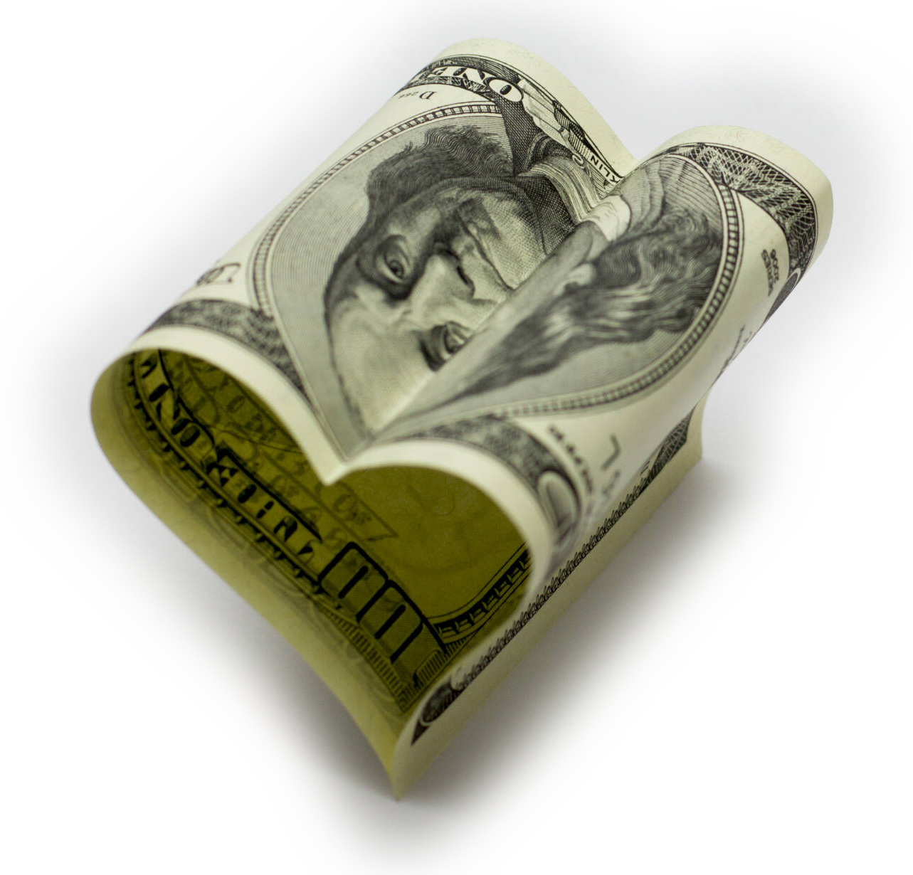
1- Love God—Not Money
¹⁰ Whoever loves money never
has money enough; whoever
loves wealth is never
satisfied with his
income. This too is
meaningless.
Notes:
Love of Money = https://torange.biz/love-money-16741
Financial principles to live by …
Love God--not Money 5:10
Be Content or Never Enough 5:11
Can’t Buy Sleep 5:12
Hoarder Beware 5:13
Can’t take it with you 5:14-15
Money never satisfies 5:16-7
Money matters to God 5:18-20
Really, you can’t keep it 6:1-6
Summary 6:7-12

Slide 11
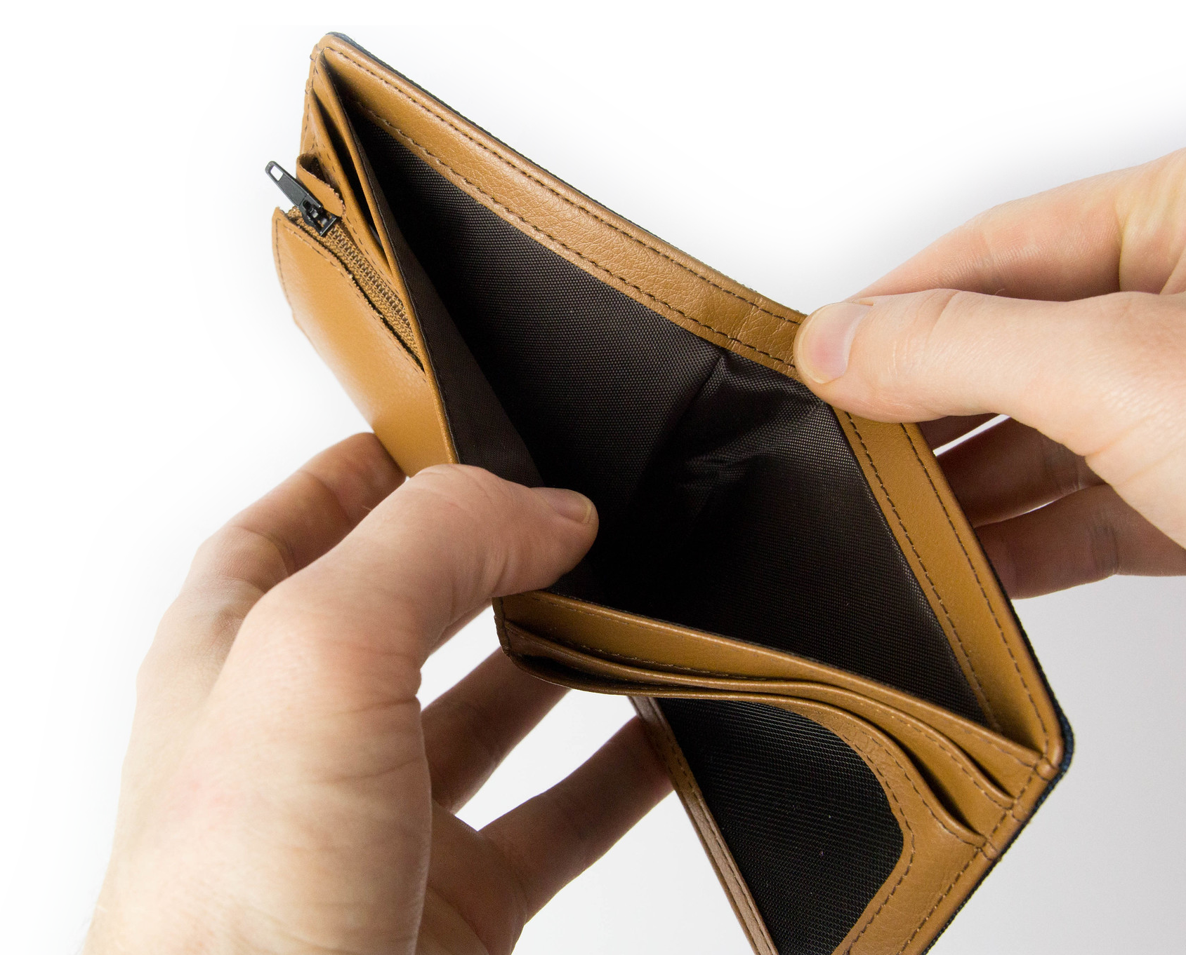
2- Be a Saver—Not a Spender
¹¹ As goods increase, so
do those who consume
them. And what benefit
are they to the owner
except to feast his
eyes on them?
Notes:
Wallet = https://www.flickr.com/photos/30478819@N08/40144693214Financial principles to live by …
Love God--not Money 5:10
Be Content or Never Enough 5:11
Can’t Buy Sleep 5:12
Hoarder Beware 5:13
Can’t take it with you 5:14-15
Money never satisfies 5:16-7
Money matters to God 5:18-20
Really, you can’t keep it 6:1-6
Summary 6:7-12

Slide 12
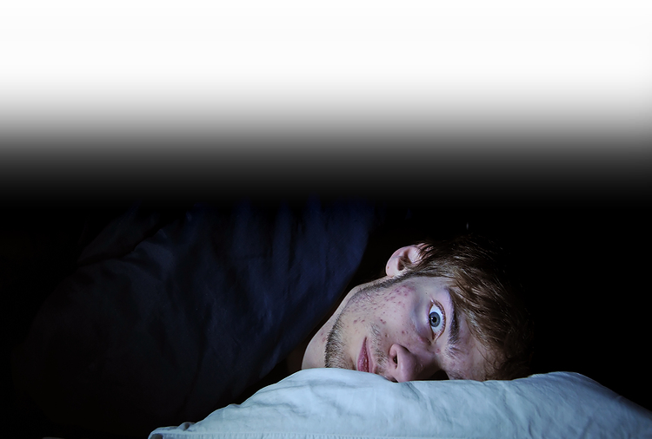
3- Sleep Well—Not an Insomniac
12 The sleep of a laborer is sweet, whether he eats little or much, but the abundance of a rich man permits him no sleep.
Notes:
Sleepless man = LICENSED and NOT FOR REUSE ELSEWHERE. To reuse elsewhere, get a license from http://www.bigstockphoto.com/image-6628461/stock-photo-insomnia
Financial principles to live by …
Love God--not Money 5:10
Be Content or Never Enough 5:11
Can’t Buy Sleep 5:12
Hoarder Beware 5:13
Can’t take it with you 5:14-15
Money never satisfies 5:16-7
Money matters to God 5:18-20
Really, you can’t keep it 6:1-6
Summary 6:7-12

Slide 13
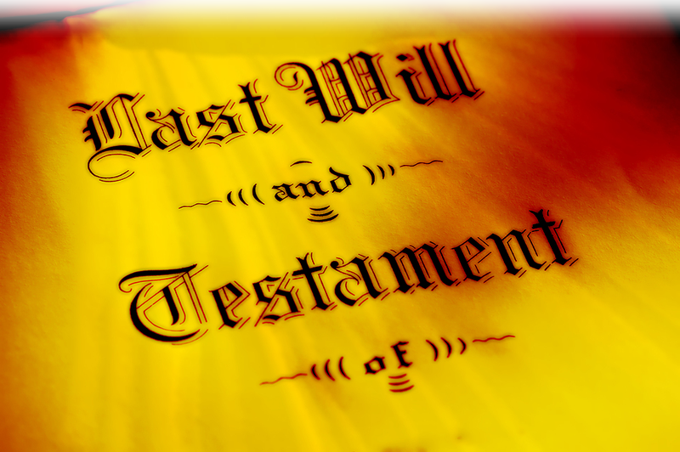
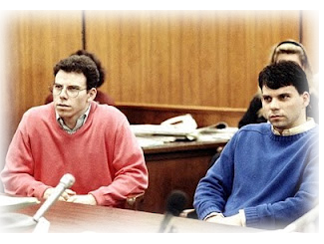
4- Share—Don’t Hoard
13 I have seen a grievous evil under the sun: wealth hoarded to the harm of its owner,
Notes:
Financial principles to live by …
Love God--not Money 5:10
Be Content or Never Enough 5:11
Can’t Buy Sleep 5:12
Hoarder Beware 5:13
Can’t take it with you 5:14-15
Money never satisfies 5:16-7
Money matters to God 5:18-20
Really, you can’t keep it 6:1-6
Summary 6:7-12

Slide 14
4- Share—Don’t Hoard
13 I have seen a grievous evil under the sun: wealth hoarded to the harm of its owner, 14 or wealth lost through some misfortune, so that when he has a son there is nothing left for him.
Notes:
Financial principles to live by …
Love God--not Money 5:10
Be Content or Never Enough 5:11
Can’t Buy Sleep 5:12
Hoarder Beware 5:13
Can’t take it with you 5:14-15
Money never satisfies 5:16-7
Money matters to God 5:18-20
Really, you can’t keep it 6:1-6
Summary 6:7-12

Slide 15
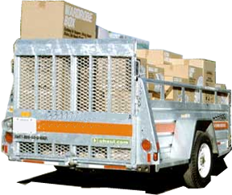
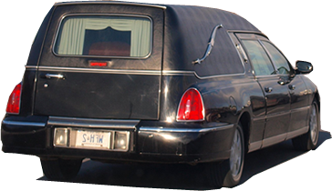
5- Invest Now--Can’t Taken It
15 Naked a man comes from his mother's womb, and as he comes, so he departs. He takes nothing from his labor that he can carry in his hand. 16 This too is a
grievous evil: As a
man comes, so he
departs, and what
does he gain, since
he toils for the wind?
Notes:
Financial principles to live by …
Love God--not Money 5:10
Be Content or Never Enough 5:11
Can’t Buy Sleep 5:12
Hoarder Beware 5:13
Can’t take it with you 5:14-15
Money never satisfies 5:16-7
Money matters to God 5:18-20
Really, you can’t keep it 6:1-6
Summary 6:7-12

Slide 16
5- Invest Now--Can’t Taken It
17 All his days he eats in darkness, with great frustration, affliction and anger.
Notes:
Financial principles to live by …
Love God--not Money 5:10
Be Content or Never Enough 5:11
Can’t Buy Sleep 5:12
Hoarder Beware 5:13
Can’t take it with you 5:14-15
Money never satisfies 5:16-7
Money matters to God 5:18-20
Really, you can’t keep it 6:1-6
Summary 6:7-12

Slide 17

6- Value Health—Not Money
6¹ I have seen another evil under the
sun, and it weighs heavily on men:
² God gives a man wealth, possess-
ions and honor, so that he lacks
nothing his heart desires, but
God does not enable him to
enjoy them, and a stranger
enjoys them instead. This is
meaningless, a grievous evil.
Notes:
Good Health = https://www.pxfuel.com/en/free-photo-ezvyz
Financial principles to live by …
Love God--not Money 5:10
Be Content or Never Enough 5:11
Can’t Buy Sleep 5:12
Hoarder Beware 5:13
Can’t take it with you 5:14-15
Money never satisfies 5:16-7
Money matters to God 5:18-20
Really, you can’t keep it 6:1-6
Summary 6:7-12

Slide 18
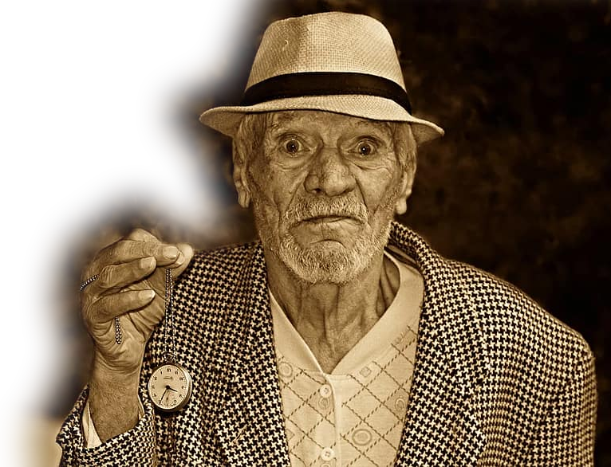
7-Spend Time Wisely--Can’t Buy It
³ A man may have a hundred children
and live many years; yet no matter
how long he lives, if he cannot enjoy
his prosperity and does not
receive proper burial, I say
that a stillborn child is
better off than he. ⁴ It comes
without meaning, …
Notes:
Old Man = https://www.pikist.com/free-photo-vvopl
Financial principles to live by …
Love God--not Money 5:10
Be Content or Never Enough 5:11
Can’t Buy Sleep 5:12
Hoarder Beware 5:13
Can’t take it with you 5:14-15
Money never satisfies 5:16-7
Money matters to God 5:18-20
Money Can’t Buy Health 6:1-6
Money Can’t Extend Life
Summary 6:7-12

Slide 19
7-Spend Time Wisely--Can’t Buy It
it departs in darkness, and in dark-
ness its name is shrouded. ⁵ Though
it never saw the sun or knew any-
thing, it has more rest than
does that man-- ⁶ even if he
lives a thousand years twice
over but fails to enjoy his
prosperity. Do not all go to
the same place?
Notes:
Old Man = https://www.pikist.com/free-photo-vvopl
Financial principles to live by …
Love God--not Money 5:10
Be Content or Never Enough 5:11
Can’t Buy Sleep 5:12
Hoarder Beware 5:13
Can’t take it with you 5:14-15
Money never satisfies 5:16-7
Money matters to God 5:18-20
Money Can’t Buy Health 6:1-6
Money Can’t Extend Life
Summary 6:7-12

Slide 20
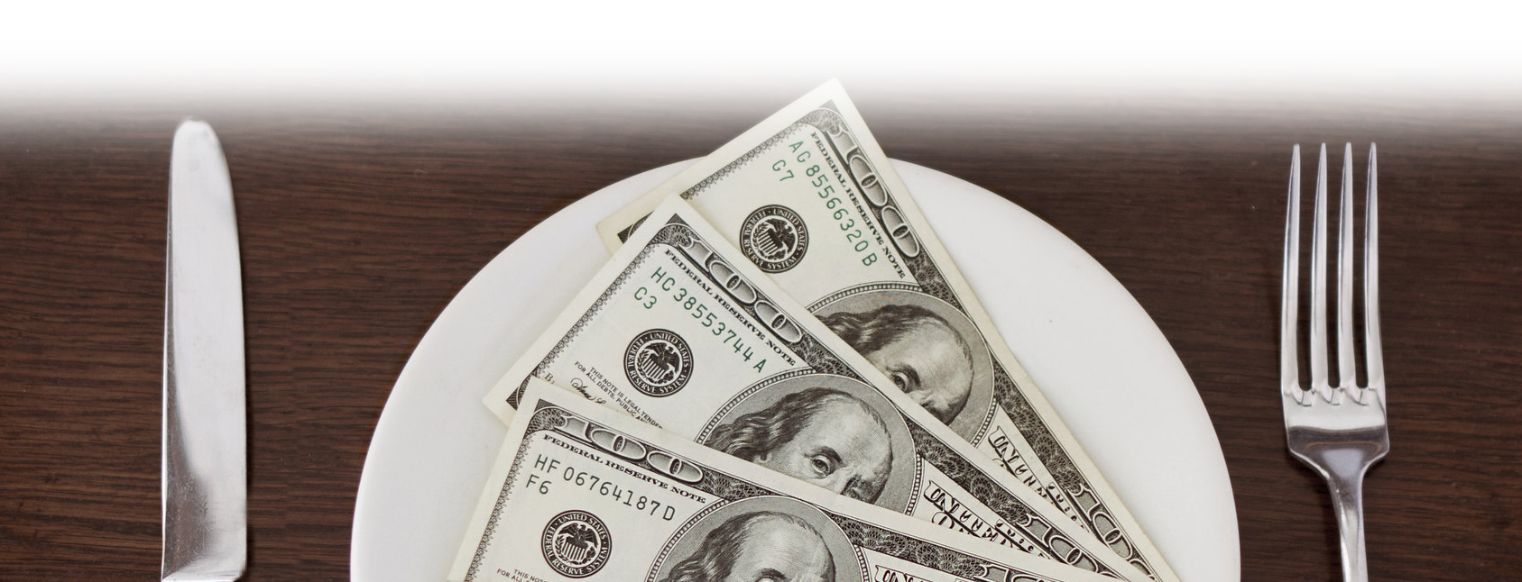
8- Be satisfied– not money hungry
⁷ All man's efforts are for his mouth, yet his appetite is never satisfied.
Notes:
Money on Plate = https://www.flickr.com/photos/pictures-of-money/17301073405

Slide 21
8- Be satisfied– not money hungry
⁸ What advantage has a wise man over a fool? What does a poor man gain by knowing how to conduct himself before others?
Notes:
Money on Plate = https://www.flickr.com/photos/pictures-of-money/17301073405

Slide 22
8- Be satisfied– not money hungry
⁹ Better what the eye sees than the roving of the appetite. This too is meaningless, a chasing after the wind.
Notes:
Money on Plate = https://www.flickr.com/photos/pictures-of-money/17301073405

Slide 23

9- Make Money Count– Don’t Waste
¹⁰ Whatever exists has already been named, and what man is has been known; no man can contend with one who is stronger than he.
Notes:
Make your money Count – https://www.pexels.com/photo/crop-woman-counting-money-at-modern-office-table-4475524/

Slide 24
9- Make Money Count– Don’t Waste
¹¹ The more the words, the less the meaning, and how does that profit anyone?
Notes:
Make your money Count – https://www.pexels.com/photo/crop-woman-counting-money-at-modern-office-table-4475524/

Slide 25
9- Make Money Count– Don’t Waste
¹² For who knows what is good for a man in life, during the few and meaningless days he passes through like a shadow? Who can tell him what will happen under the sun after he is gone?
Notes:
Make your money Count – https://www.pexels.com/photo/crop-woman-counting-money-at-modern-office-table-4475524/

Slide 26
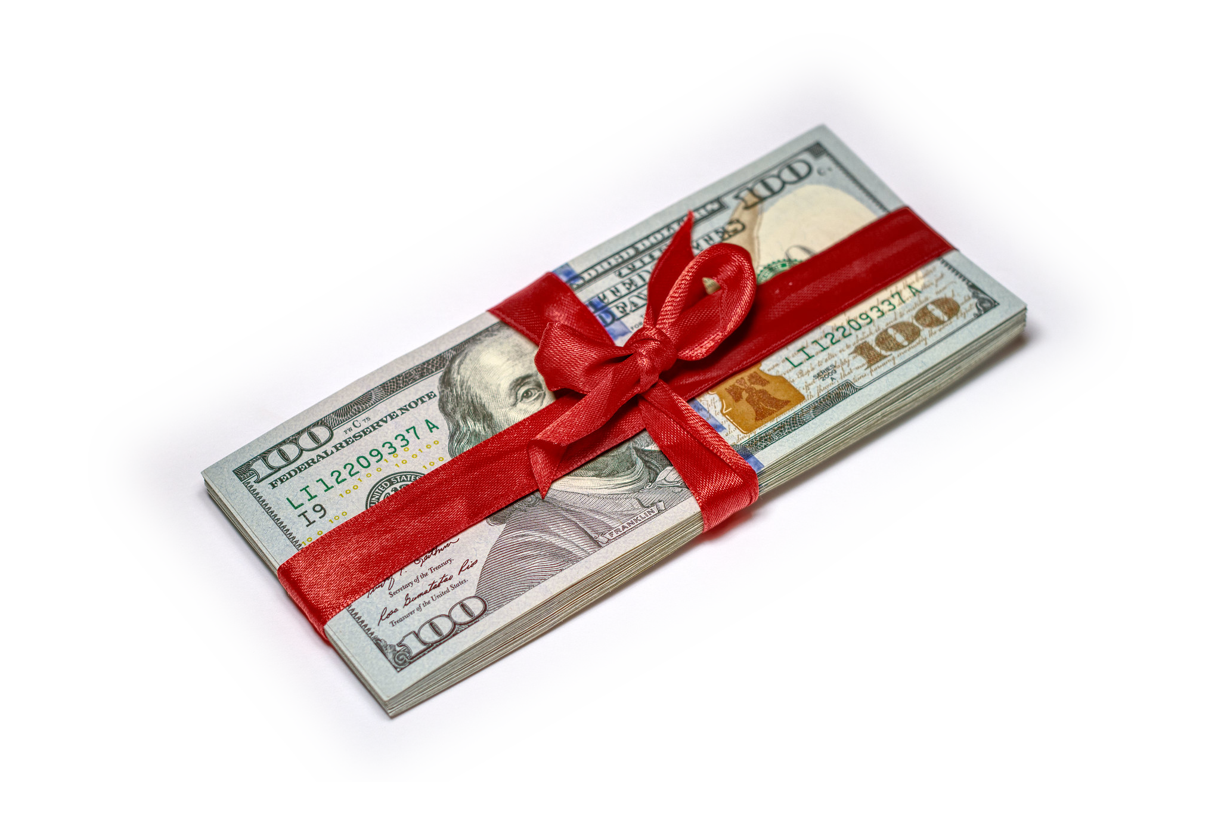
10- View as God’s Gift – Not Yours
5:18 Then I realized that it is good and proper for a man to eat and drink, and to find satisfaction in his toilsome labor
under the sun during the few
days of life God has given
him--for this is his lot.
Notes:
Money Gift =https://www.flickr.com/photos/ervins_strauhmanis/31095385103
Financial principles to live by …
Love God--not Money 5:10
Be Content or Never Enough 5:11
Can’t Buy Sleep 5:12
Hoarder Beware 5:13
Can’t take it with you 5:14-15
Money never satisfies 5:16-7
Money matters to God 5:18-20
Really, you can’t keep it 6:1-6
Summary 6:7-12

Slide 27
10- View as God’s Gift – Not Yours
¹⁹ Moreover, when God gives any man wealth and possessions, and enables him to enjoy them, to accept his lot and be happy
in his work--this is a gift of God.
²⁰ He seldom reflects on
the days of his life,
because God keeps
him occupied with
gladness of heart.
Notes:
Money Gift =https://www.flickr.com/photos/ervins_strauhmanis/31095385103
Financial principles to live by …
Love God--not Money 5:10
Be Content or Never Enough 5:11
Can’t Buy Sleep 5:12
Hoarder Beware 5:13
Can’t take it with you 5:14-15
Money never satisfies 5:16-7
Money matters to God 5:18-20
Really, you can’t keep it 6:1-6
Summary 6:7-12

Slide 28

Kleptocracy is real …
But you don’t have to be a Kleptocrat!
Instead, you can …

Slide 29
Love God– not money
Be a Saver– not a spender
Sleep well– not an insomniac
Share– not hoard
Invest now– can’t take it
Value health– not money
Spend time wisely– can’t buy it
Be satisfied– not money hungry
Make money count– don’t waste
View as God’s gift– not yours
Notes:
Love God--not Money 5:10
Be Content or Never Enough 5:11
Can’t Buy Sleep 5:12
Hoarder Beware 5:13
Can’t take it with you 5:14-15
Money never satisfies 5:16-7
Money matters to God 5:18-20
Really, you can’t keep it 6:1-6
Summary 6:7-12

Slide 30
  LET’S PRAY!

Slide 31
Song: He has made me glad

