Slide 1



Be happy in an …
Notes:
Camera Phone = https://p1.pxfuel.com/preview/310/297/182/hand-smartphone-mockup-bokeh-colorful-color.jpg
World = edited from https://pixabay.com/photos/planet-earth-earth-planet-global-4427436/
World = edited from https://pixabay.com/photos/planet-earth-earth-planet-global-4427436/
Copyright © 2006−2021. All rights reserved. Bible Point is a registered trademark of Dennis Henderson. All other trademarks acknowledged.
Bible Point contains graphics from Bible Point artists. These illustrations belong to Bible Point and the respective artists. You may use the designs and illustrations for graphical illustration of lessons free and without special permission, provided they are not used in any way that maligns the Christian faith. Furthermore, republication or production of any illustration by any other graphic service whether it be in book, in a machine-readable form, or in any other design resource is strictly prohibited. Furthermore, they cannot be duplicated or resold as any other form of publishing, clip art, or graphic resource.
So What does it mean? (A simple translations of the legal jargon)
So, if you don’t own the presentation(s), graphic(s), and text(s) how can you legally use them? The purchase of the license allows you to use all the images in the product. However, the actual ownership and copyright of the presentation(s), graphic(s), and text(s) remain the property of Bible Point and its licensors. If you had plans on using this product in your “for sale” work—think again!
License Agreement
Article 1: License Grant
All the graphics and text in Bible Point presentations (excluding quotes from the Bible and stated sources) are the intellectual and real property of Bible Point and its licensors, and is protected by law, including United States copyright laws and international treaties. Bible Point grants to you a license:
1. To use the presentation in a single church, single school, or single office of a Christian organization.
2. To make a single archival back-up copy of the program.
3. To modify the presentation(s) and merge with other presentations in a single church, school, or Christian organization.
4. To transfer to another party if that party agrees to accept the terms and conditions of this agreement, and you do not retain any copies of the presentation, whether printed, machine readable, modified, or merged form.
Article 2: Terms
This license is effective until terminated. You may terminate the license at any time by destroying the presentation(s), graphic(s), or text(s) together with all copies, modifications and merged portions in any form. Bible Point may terminate your license if you fail to comply with this Agreement. You agree, upon such termination, for any reason, to destroy the presentation(s), graphics, and text(s) with all copies, modifications, and merged portions in any form.
Article 3: Disclaimers
1. Bible Point presentations, graphics, and texts are licensed to you As Is. You, the consumer, bear the entire risk relating to the quality and performance of the presentation(s), graphic(s), or text(s). In no event will Bible Point be liable for damages resulting from any defect.
2. Thirty-day limited warrantee on disks. Bible Point warrants the disks to be free of defects in material and workmanship under normal use for 30 days after purchase. During the 30-day period you may return a defective presentation, graphic, or text with proof of purchase and it will be replaced without charge, unless the presentation is damaged by misuse.
Article 4: General
1. You may not sub-license, assign, or transfer the license of the presentation(s), graphic(s), or text(s) except as provided by this Agreement.
2. This Agreement will be governed by the laws of the State of Michigan.
So What does it mean? (A simple translations of the legal jargon)
May I let someone borrow or copy my licensed Bible Point presentation (even after I modified it)? As long as it is within your local church, or single school, or the immediate office of a Christian organization you may. Otherwise, please refer the person interested in borrowing to: http://www.biblepoint.com or E-mail: dennis@DrDH.net with any related questions.

Slide 2



Be happy in an…
Notes:
Stained Glass = https://www.publicdomainpictures.net/pictures/90000/velka/stained-glass-1403020555IjB.jpg
World = edited from https://pixabay.com/photos/planet-earth-earth-planet-global-4427436/

Slide 3

Be happy in an…
Notes:
Stained Glass = https://www.publicdomainpictures.net/pictures/90000/velka/stained-glass-1403020555IjB.jpg
World = edited from https://pixabay.com/photos/planet-earth-earth-planet-global-4427436/

Slide 4
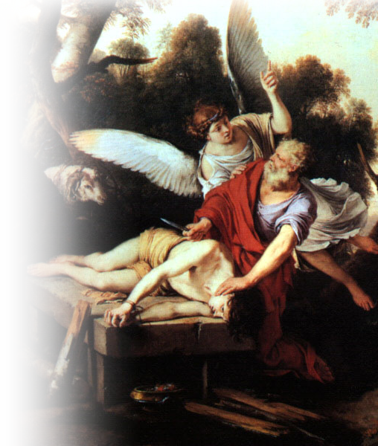
What is “worship?”
First occurrence– Gen 22:5
“....We will worship and then
we will come back to you.”
Powerful occurrence—Rom 12:1
... offer your bodies as living sacrifices, holy and pleasing to God--this is your spiritual act of worship.
Notes:
Abraham & Isaac = FREE = from http://commons.wikimedia.org/wiki/File:Abraham.jpg

Slide 5
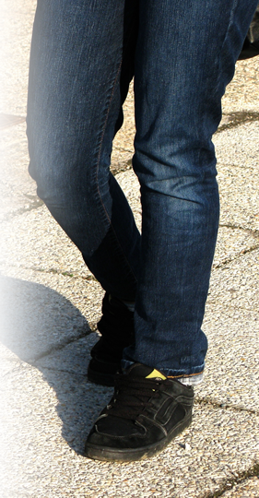
GO UP 5:1
¹ Guard your steps when you go to the house of God. Go near to listen rather than to offer the sacrifice of fools, who do not know that they do wrong.
Notes:
Step = FREE = from http://www.sxc.hu/photo/1181506

Slide 6
GO UP 5:1
¹ Guard your steps when you go to the house of God. Go near to listen rather than to offer the sacrifice of fools, who do not know that they do wrong.
Notes:
Step = FREE = from http://www.sxc.hu/photo/1181506

Slide 7
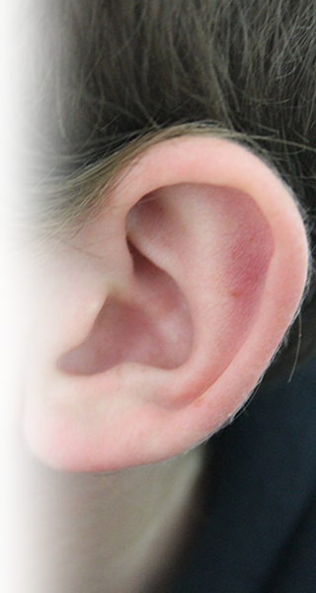
LISTEN UP 5:1
¹ Guard your steps when you go to the house of God. Go near to listen rather than to offer the sacrifice of fools, who do not know that they do wrong.
Abraham was listening...
Notes:
Ear = FREE = from http://commons.wikimedia.org/wiki/File:Earrr.JPG

Slide 8

HUSH UP 5:2
² Do not be quick with your mouth, do not be hasty in your heart to utter anything before God. God is in heaven and you are on earth, so let your words be few.
Notes:
Hush up = LICENSED and NOT FOR REUSE ELSEWHERE. To reuse elsewhere, get a license from http://www.istockphoto.com/stock-photo-860026-young-man-with-tape-over-mouth.php

Slide 9

WAKE UP 5:3
³ As a dream comes when there are many cares, so the speech of a fool when there are many words.
Notes:
Alarm Clock = FREE = from http://commons.wikimedia.org/wiki/File:Alarm_Clocks_20101105.jpg

Slide 10
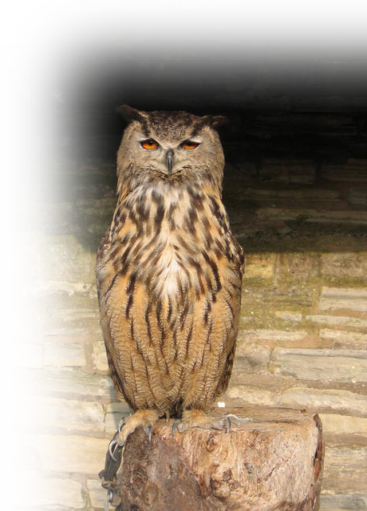
WISE UP 5:4
⁴ When you make a vow to
God, do not delay in
fulfilling it. He has
no pleasure in fools;
fulfill your vow.
Jacob vowed with an oath (Gen 28)
Hannah vowed in a prayer (1 Sam 1)
Notes:
Owl = FREE =from http://commons.wikimedia.org/wiki/File:European_Eagle_Owl_-_geograph.org.uk_-_260203.jpg

Slide 11
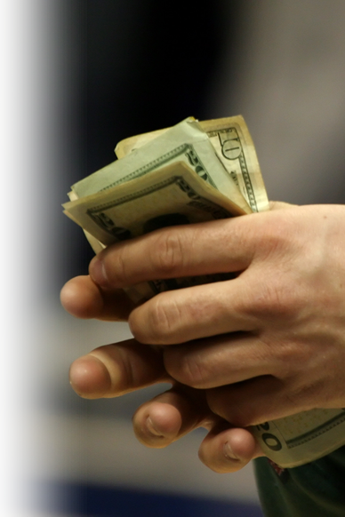
PAY UP 5:5
⁵ It is better not to vow than to make a vow and not fulfill it.
Hannah paid up (1 Sam 2)
Wilbur Breault paid up
Notes:
Hand full of money = FREE = from http://www.sxc.hu/photo/452697

Slide 12

OWN UP 5:6
Joshua owned up
Hannah likewise
⁶ Do not let your mouth lead you into sin. And do not protest to the temple messenger, "My vow was a mistake." Why should God be angry at what you say and destroy the work of your hands?
Notes:
Wall = FREE = from http://www.sxc.hu/photo/1359223

Slide 13

STAND UP 5:7
⁷ Much dreaming and many words are meaningless. Therefore stand in awe of God.

Slide 14
WRAP UP
The Happy Worshipper...
GOES UP
LISTENS UP
HUSHES UP
WAKES UP
WISES UP
PAYS UP
OWNS UP
STANDS UP

Slide 15
SUM UP
¹ Therefore, I urge you, brothers, in view of God's mercy, to offer your bodies as living sacrifices, holy and pleasing to God--this is your spiritual act of worship

Slide 16
SUM UP
² Do not conform any longer to the pattern of this world, but be transformed by the renewing of your mind. Then you will be able to test and approve what God's will is--his good, pleasing and perfect will. (Rom 12:1-2)

Slide 17
Let’s Pray Up #

