Slide 1


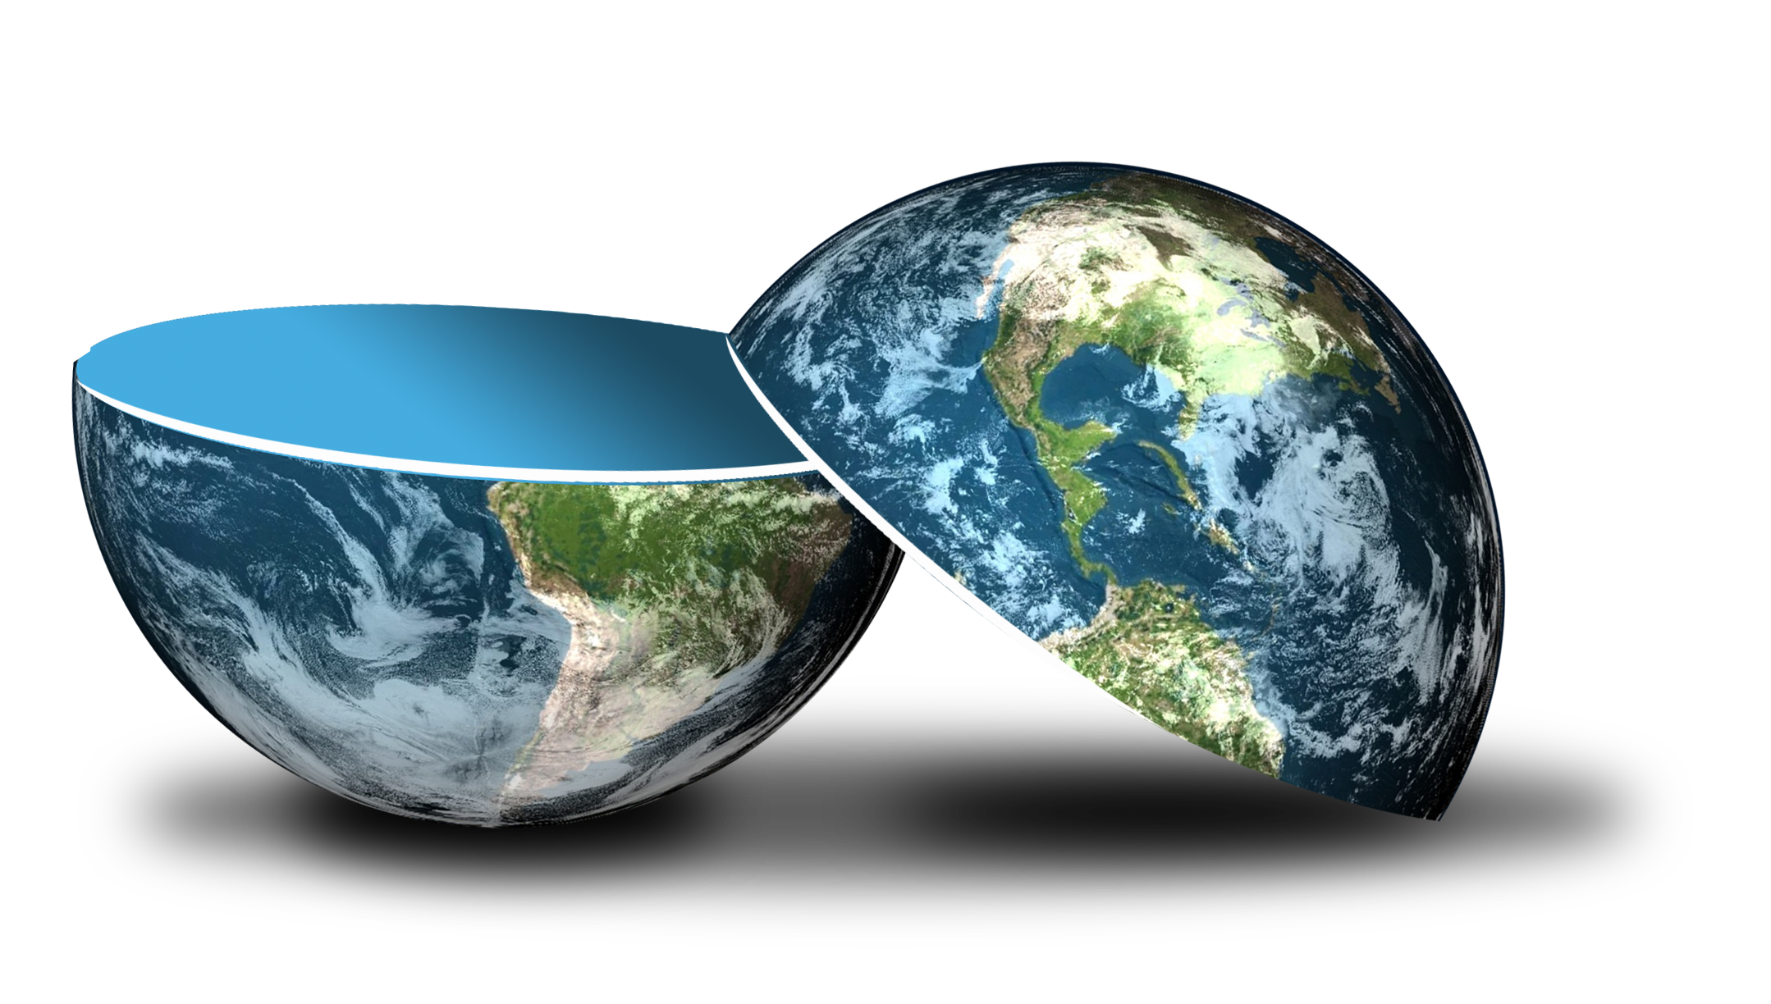
Be happy in an …
Notes:
Camera Phone = https://p1.pxfuel.com/preview/310/297/182/hand-smartphone-mockup-bokeh-colorful-color.jpg
World = edited from https://pixabay.com/photos/planet-earth-earth-planet-global-4427436/
World = edited from https://pixabay.com/photos/planet-earth-earth-planet-global-4427436/
Copyright © 2006−2021. All rights reserved. Bible Point is a registered trademark of Dennis Henderson. All other trademarks acknowledged.
Bible Point contains graphics from Bible Point artists. These illustrations belong to Bible Point and the respective artists. You may use the designs and illustrations for graphical illustration of lessons free and without special permission, provided they are not used in any way that maligns the Christian faith. Furthermore, republication or production of any illustration by any other graphic service whether it be in book, in a machine-readable form, or in any other design resource is strictly prohibited. Furthermore, they cannot be duplicated or resold as any other form of publishing, clip art, or graphic resource.
So What does it mean? (A simple translations of the legal jargon)
So, if you don’t own the presentation(s), graphic(s), and text(s) how can you legally use them? The purchase of the license allows you to use all the images in the product. However, the actual ownership and copyright of the presentation(s), graphic(s), and text(s) remain the property of Bible Point and its licensors. If you had plans on using this product in your “for sale” work—think again!
License Agreement
Article 1: License Grant
All the graphics and text in Bible Point presentations (excluding quotes from the Bible and stated sources) are the intellectual and real property of Bible Point and its licensors, and is protected by law, including United States copyright laws and international treaties. Bible Point grants to you a license:
1. To use the presentation in a single church, single school, or single office of a Christian organization.
2. To make a single archival back-up copy of the program.
3. To modify the presentation(s) and merge with other presentations in a single church, school, or Christian organization.
4. To transfer to another party if that party agrees to accept the terms and conditions of this agreement, and you do not retain any copies of the presentation, whether printed, machine readable, modified, or merged form.
Article 2: Terms
This license is effective until terminated. You may terminate the license at any time by destroying the presentation(s), graphic(s), or text(s) together with all copies, modifications and merged portions in any form. Bible Point may terminate your license if you fail to comply with this Agreement. You agree, upon such termination, for any reason, to destroy the presentation(s), graphics, and text(s) with all copies, modifications, and merged portions in any form.
Article 3: Disclaimers
1. Bible Point presentations, graphics, and texts are licensed to you As Is. You, the consumer, bear the entire risk relating to the quality and performance of the presentation(s), graphic(s), or text(s). In no event will Bible Point be liable for damages resulting from any defect.
2. Thirty-day limited warrantee on disks. Bible Point warrants the disks to be free of defects in material and workmanship under normal use for 30 days after purchase. During the 30-day period you may return a defective presentation, graphic, or text with proof of purchase and it will be replaced without charge, unless the presentation is damaged by misuse.
Article 4: General
1. You may not sub-license, assign, or transfer the license of the presentation(s), graphic(s), or text(s) except as provided by this Agreement.
2. This Agreement will be governed by the laws of the State of Michigan.
So What does it mean? (A simple translations of the legal jargon)
May I let someone borrow or copy my licensed Bible Point presentation (even after I modified it)? As long as it is within your local church, or single school, or the immediate office of a Christian organization you may. Otherwise, please refer the person interested in borrowing to: http://www.biblepoint.com or E-mail: dennis@DrDH.net with any related questions.

Slide 2

Be happy in an…
Notes:
Arrows = https://www.flickr.com/photos/61423903@N06/7382239368
World = edited from https://pixabay.com/photos/planet-earth-earth-planet-global-4427436/

Slide 3

Be happy in an…

Slide 4
If God rules, why are there so many seemingly contrary issues? Like…
Notes:
If God rules, why is there so many seemingly contrary issues? Like…
Why so people so unjust? 3:16-17
Why do people die like a dog? 3:18-22
Why are people so cruel? 4:1-3
Why are people so envious? 4:4-6
Why are people lonely? 4:7-12
Why are people so fickle? 4:13-16

Slide 5
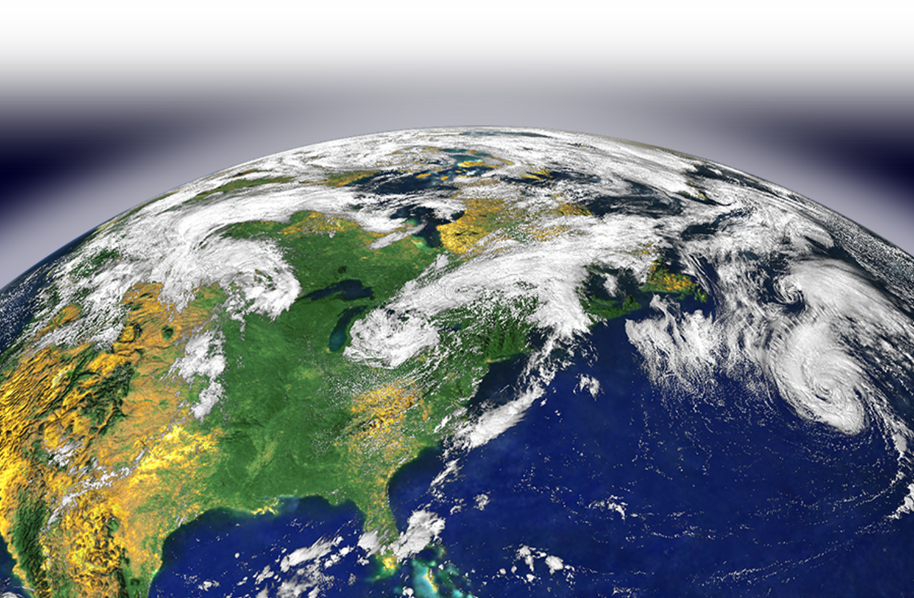
The Perspective …
^{3:16} And I saw something else under the sun
Notes:
Several Things that Solomon SAW “under the earth_
Why so people so unjust? 3:16-17

Slide 6
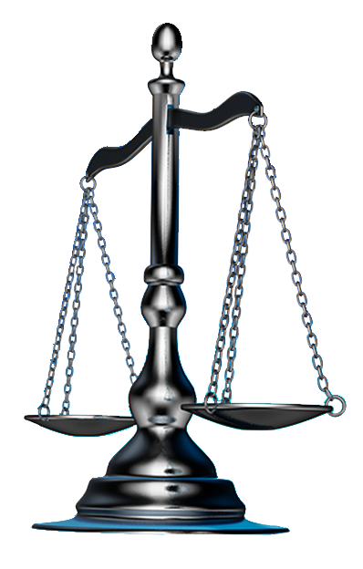
1. Why are people so UNJUST?
^{3:16} And I saw something else under the sun: In the place of judgment--wickedness was there, in the place of justice--wickedness was there.
Notes:
Why so people so unjust? 3:16-17

Slide 7
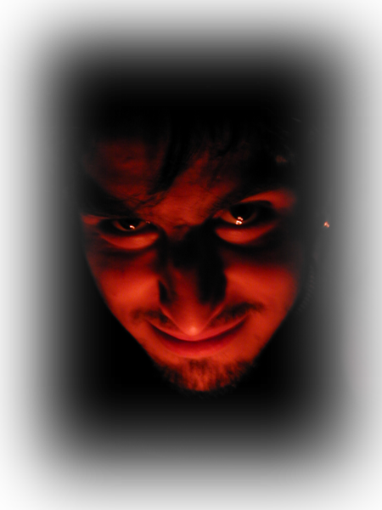
1. Why are people so UNJUST?
^{3:16} And I saw something else under the sun: In the place of judgment--wickedness was there, in the place of justice--wickedness was there.
COURTS
OJ Simpson
Casey Anthony
Gay Marriage
JUSTICE DEPT
Voter Intimidation
Illegal Aliens
Fast and Furious
EXECUTIVE
Abortion
Conscience
Notes:
Why so people so unjust? 3:16-17

Slide 8
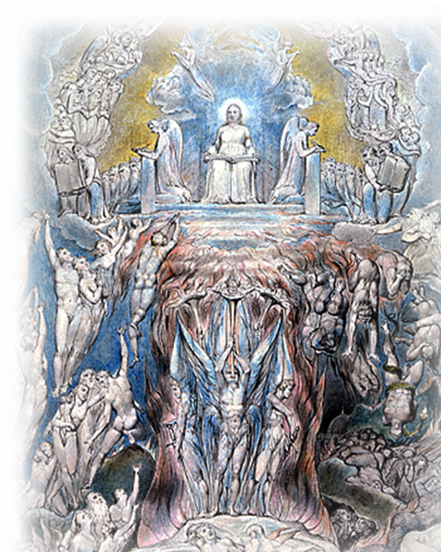
1. Why are people so UNJUST?
¹⁷ I thought in my heart, "God will bring to judgment both the righteous and the wicked, for there will be a time for every activity, a time for every deed."
Notes:
Why so people so unjust? 3:16-17

Slide 9
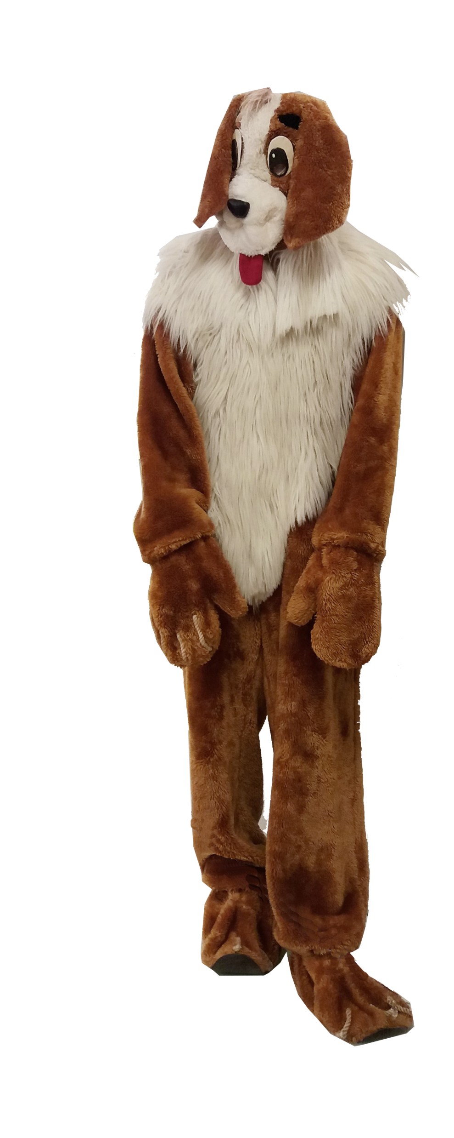
2. Why do people DIE like a dog?
¹⁸ I also thought, "As for men, God tests them so that they may see that they are like the animals.
Notes:
https://upload.wikimedia.org/wikipedia/commons/a/a7/Dog_costume_2.jpg
Why do people die like a dog? 3:18-22

Slide 10
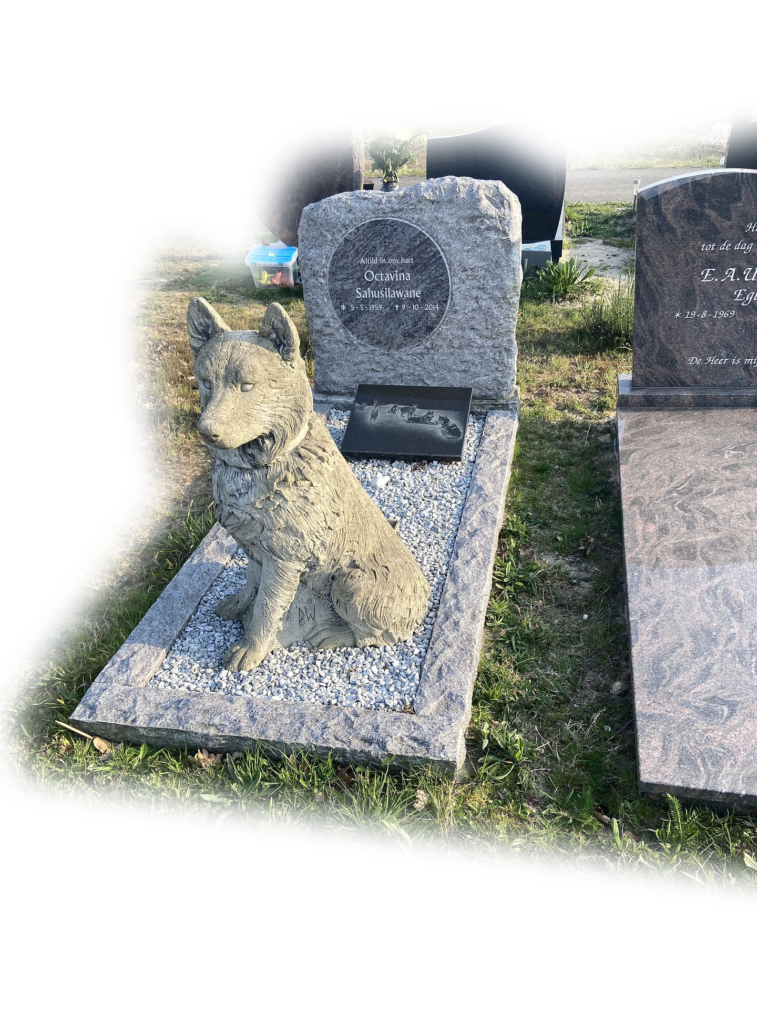
2. Why do people DIE like a dog?
¹⁹ Man's fate is like that of the
animals; the same fate awaits
them both: As one dies, so dies
the other. All have the same
breath; man has no advantage
over the animal. Everything
is meaningless.
Notes:
https://pixabay.com/photos/grave-graves-grave-with-a-dog-statue-5078182/
Why do people die like a dog? 3:18-22

Slide 11
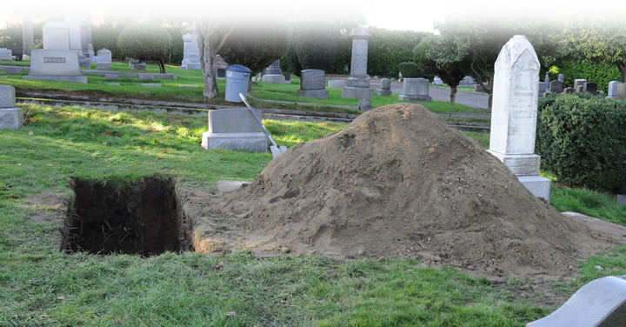
2. Why do people DIE like a dog?
²⁰ All go to the same place; all come from dust, and to dust all return.
Notes:
https://upload.wikimedia.org/wikipedia/commons/a/a7/Dog_costume_2.jpg
Why do people die like a dog? 3:18-22

Slide 12
2. Why do people DIE like a dog?
²¹ Who knows if the spirit of man rises upward and if the spirit of the animal goes down into the earth?“
IS THERE ANYTHING FOR MAN BEYOND THE GRAVE?
IF SO, WHERE WILL I SPEND ETERNITY?
?
Notes:
https://upload.wikimedia.org/wikipedia/commons/a/a7/Dog_costume_2.jpg
Why do people die like a dog? 3:18-22

Slide 13
2. Why do people DIE like a dog?
²² So I saw that there is nothing better for a man than to enjoy his work, because that is his lot. For who can bring him to see what will happen after him?
Notes:
https://upload.wikimedia.org/wikipedia/commons/a/a7/Dog_costume_2.jpg
Why do people die like a dog? 3:18-22

Slide 14
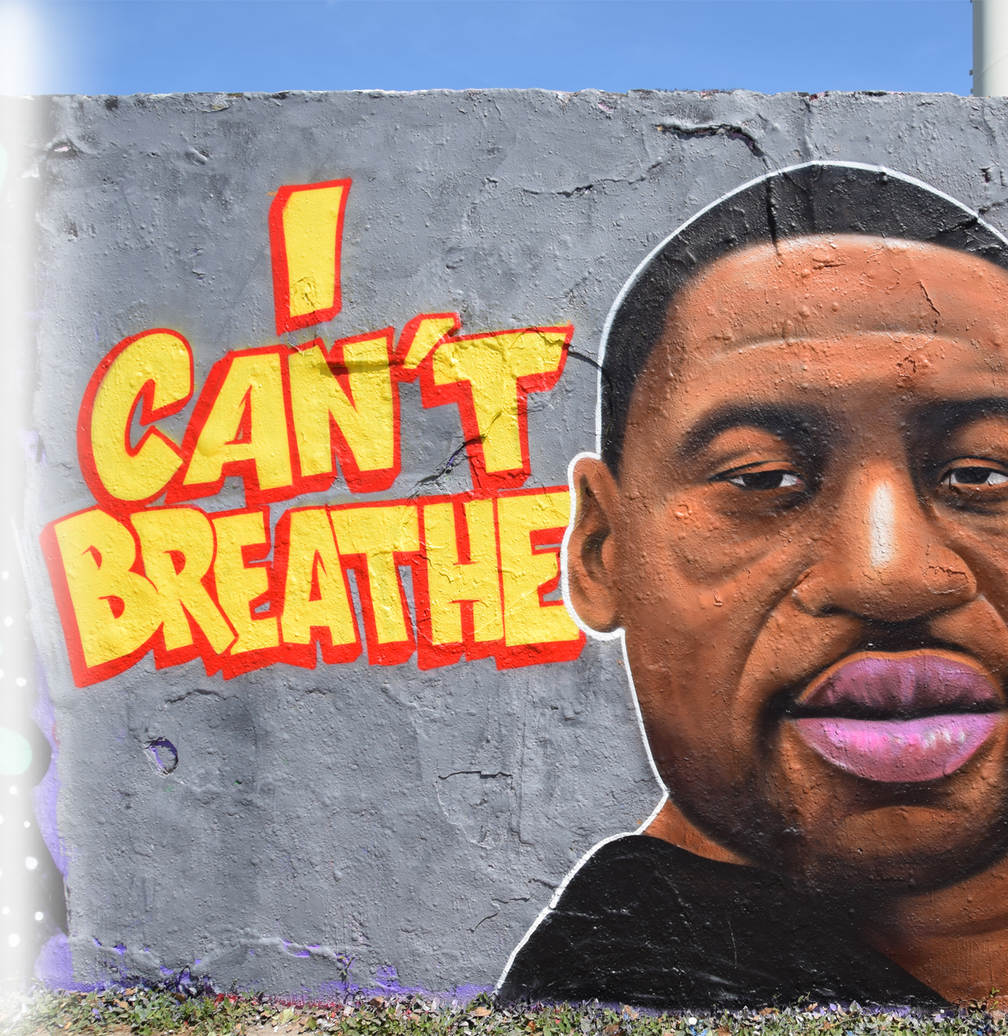
3. Why are people so CRUEL?
^{4:1} Again I looked and saw all the oppression that was taking place under the sun: I saw the tears of the oppressed-- and they have no comforter; power was on the side of their oppressors-- and they have no comforter.
Notes:
https://upload.wikimedia.org/wikipedia/commons/5/5f/Wandbild_Portrait_George_Floyd_von_Eme_Street_Art_im_Mauerpark_%28Berlin%29.jpg
Why are people so cruel? 4:1-3

Slide 15
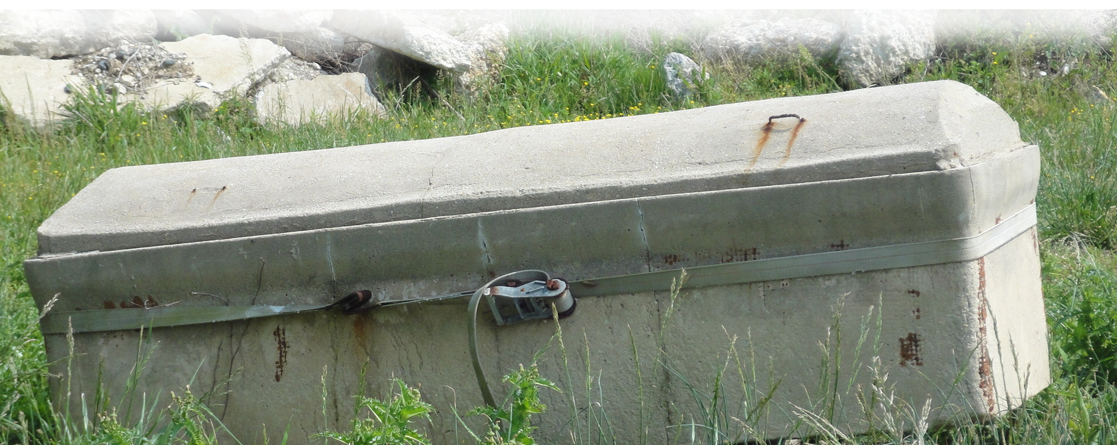
3. Why are people so CRUEL?
² And I declared that the dead, who had already died, are happier than the living, who are still alive.
Notes:
Why are people so cruel? 4:1-3

Slide 16
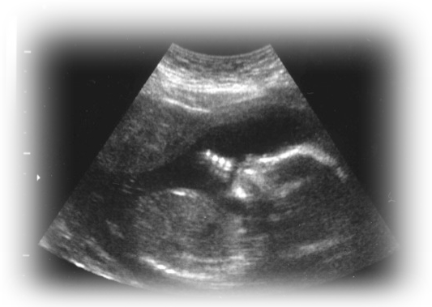
3. Why are people so CRUEL?
³ But better than both is he who has not yet been, who has not seen the evil that is done under the sun.
Notes:
Why are people so cruel? 4:1-3

Slide 17
3. Why are people so CRUEL?
³ But better than both is he who has not yet been, who has not seen the evil that is done under the sun.
Notes:
Why are people so cruel? 4:1-3

Slide 18
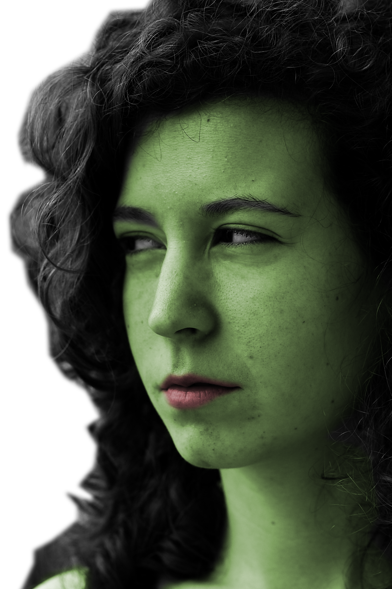
4. Why are people so ENVIOUS?
⁴ And I saw that all labor and all achievement spring from man's envy of his neighbor. This too is meaningless, a chasing after the wind. ⁵ The fool folds his hands and ruins himself. ⁶ Better one handful with tranquillity than two handfuls with toil and chasing after the wind.
Notes:
https://upload.wikimedia.org/wikipedia/commons/c/c8/Subtle_envy.jpg
Why are people so envious? 4:4-6

Slide 19

5. Why are people LONELY?
⁷ Again I saw something meaningless under the sun:
⁸ There was a man all alone; he had neither son nor brother. There was no end to his toil, yet his eyes were not content with his wealth.
Notes:
Why are people lonely? 4:7-12

Slide 20
5. Why are people LONELY?
"For whom am I toiling,“
he asked, "and why am I depriving myself of enjoyment?"
This too is meaningless–
a miserable business!
Notes:
Why are people lonely? 4:7-12

Slide 21
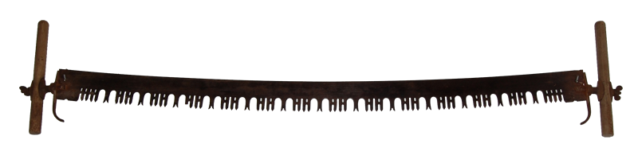
5. Why are people LONELY?
⁹ Two are better than one, because they have a good return for their work:
Notes:
Why are people lonely? 4:7-12

Slide 22
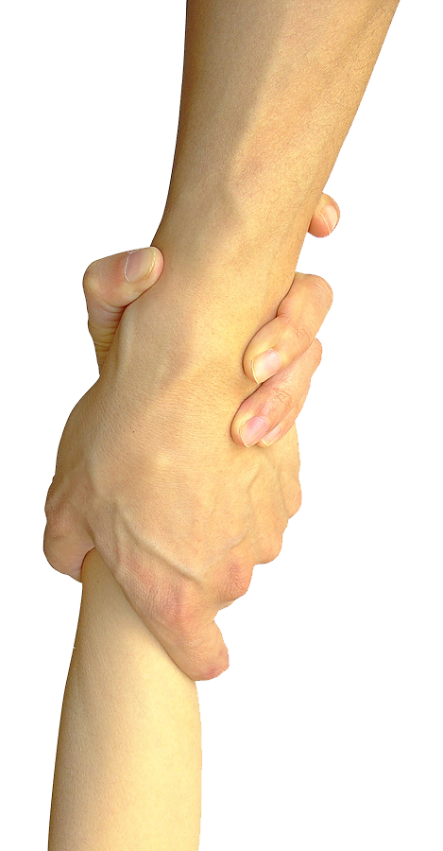
5. Why are people LONELY?
¹⁰ If one falls down, his friend can help him up. But pity the man who falls and has no one to help him up!
Notes:
Why are people lonely? 4:7-12

Slide 23
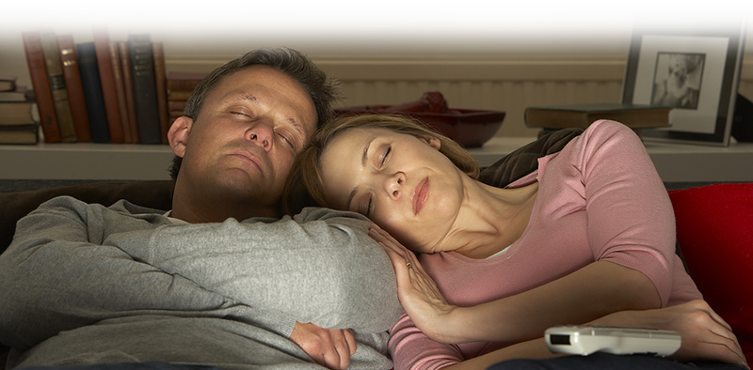
5. Why are people LONELY?
¹¹ Also, if two lie down together, they will keep warm. But how can one keep warm alone?
Notes:
Why are people lonely? 4:7-12

Slide 24
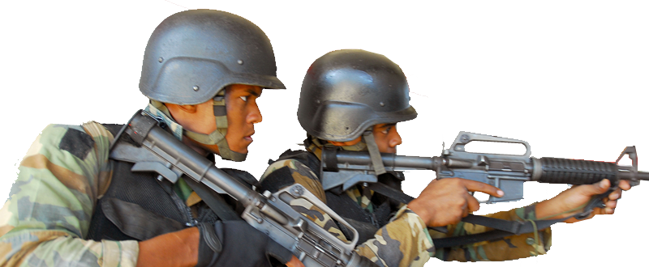
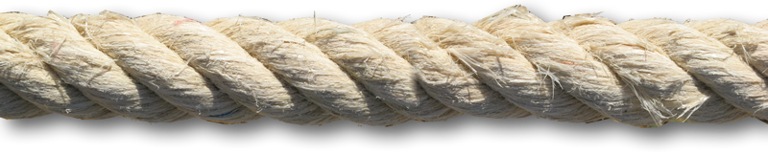
5. Why are people LONELY?
¹² Though one may be overpowered, two can defend themselves. A cord of three strands is not quickly broken.
Notes:
Why are people lonely? 4:7-12

Slide 25
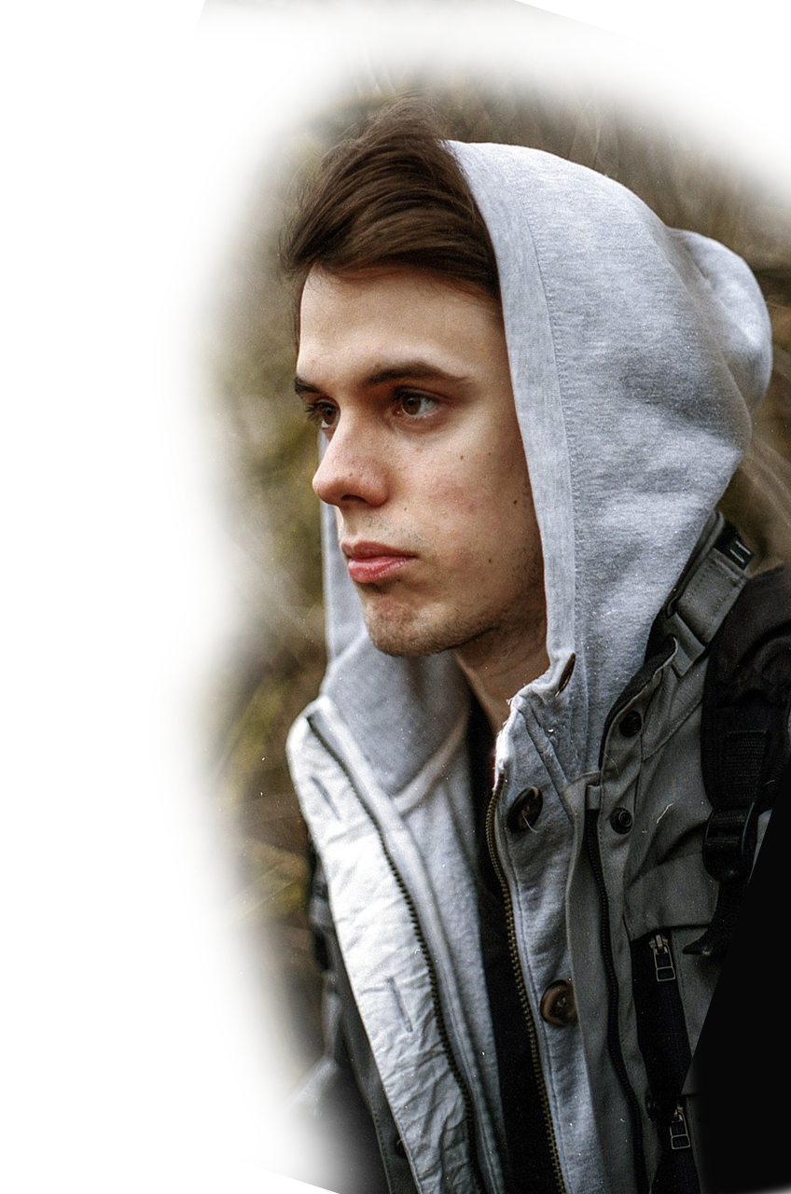
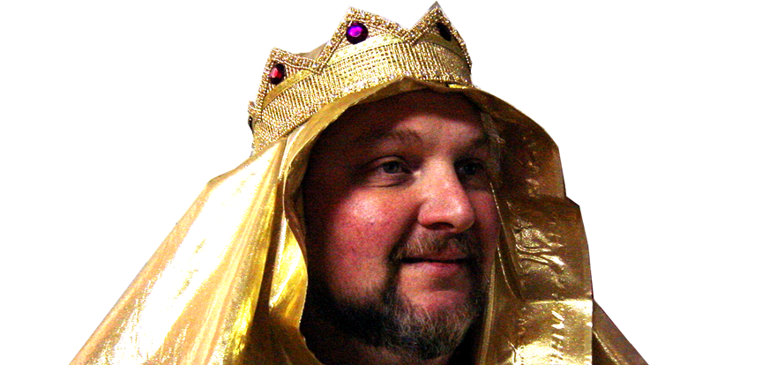
6. Why are people so FICKLE?
¹³ Better a poor but wise youth than an old but foolish king who no longer knows how to take warning.
Notes:
Why are people so fickle? 4:13-16

Slide 26
6. Why are people so FICKLE?
¹⁴ The youth may have come from prison to the kingship, or he may have been born in poverty within his kingdom.
Notes:
Why are people so fickle? 4:13-16

Slide 27
6. Why are people so FICKLE?
¹⁵ I saw that all who lived and walked under the sun followed the youth, the king's successor.
Notes:
Why are people so fickle? 4:13-16

Slide 28
6. Why are people so FICKLE?
¹⁶ There was no end to all the people who were before them. But those who came later were not pleased with the successor.
Notes:
Why are people so fickle? 4:13-16

Slide 29
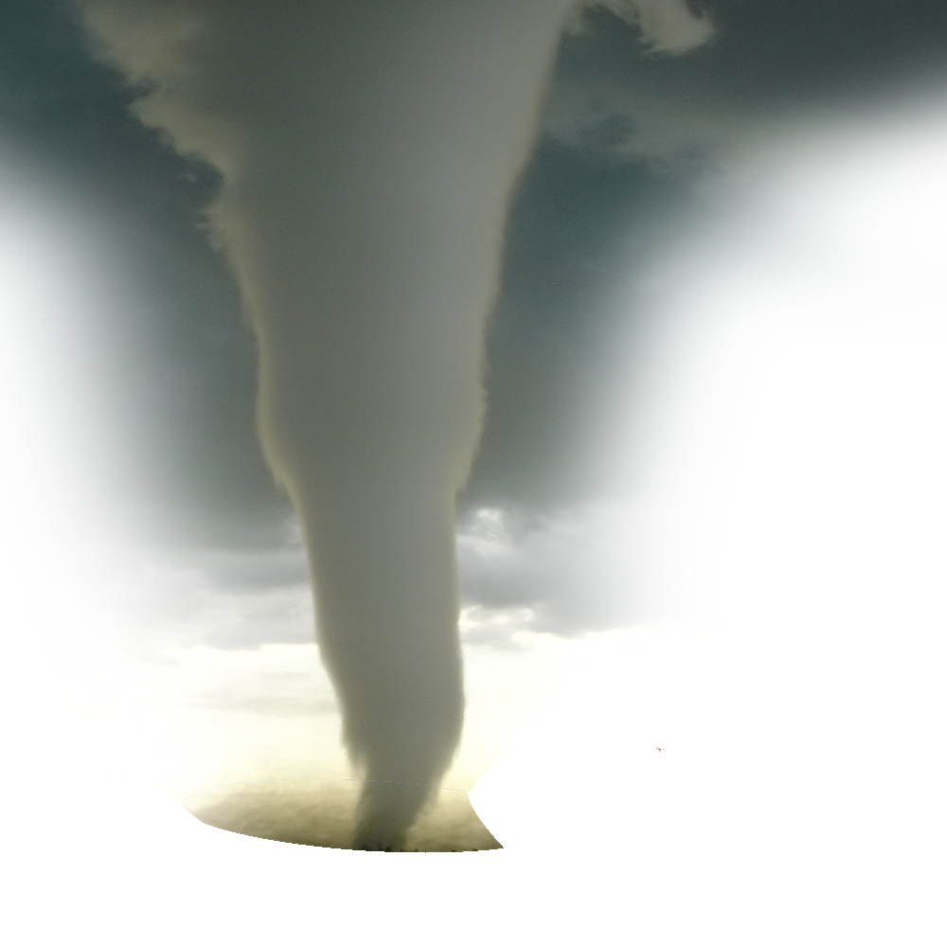
6. Why are people so FICKLE?
This too is meaningless,
a chasing after the wind.
Notes:
Why are people so fickle? 4:13-16

Slide 30
Take this with you today …

Slide 31
LET’S PRAY!

