Slide 1


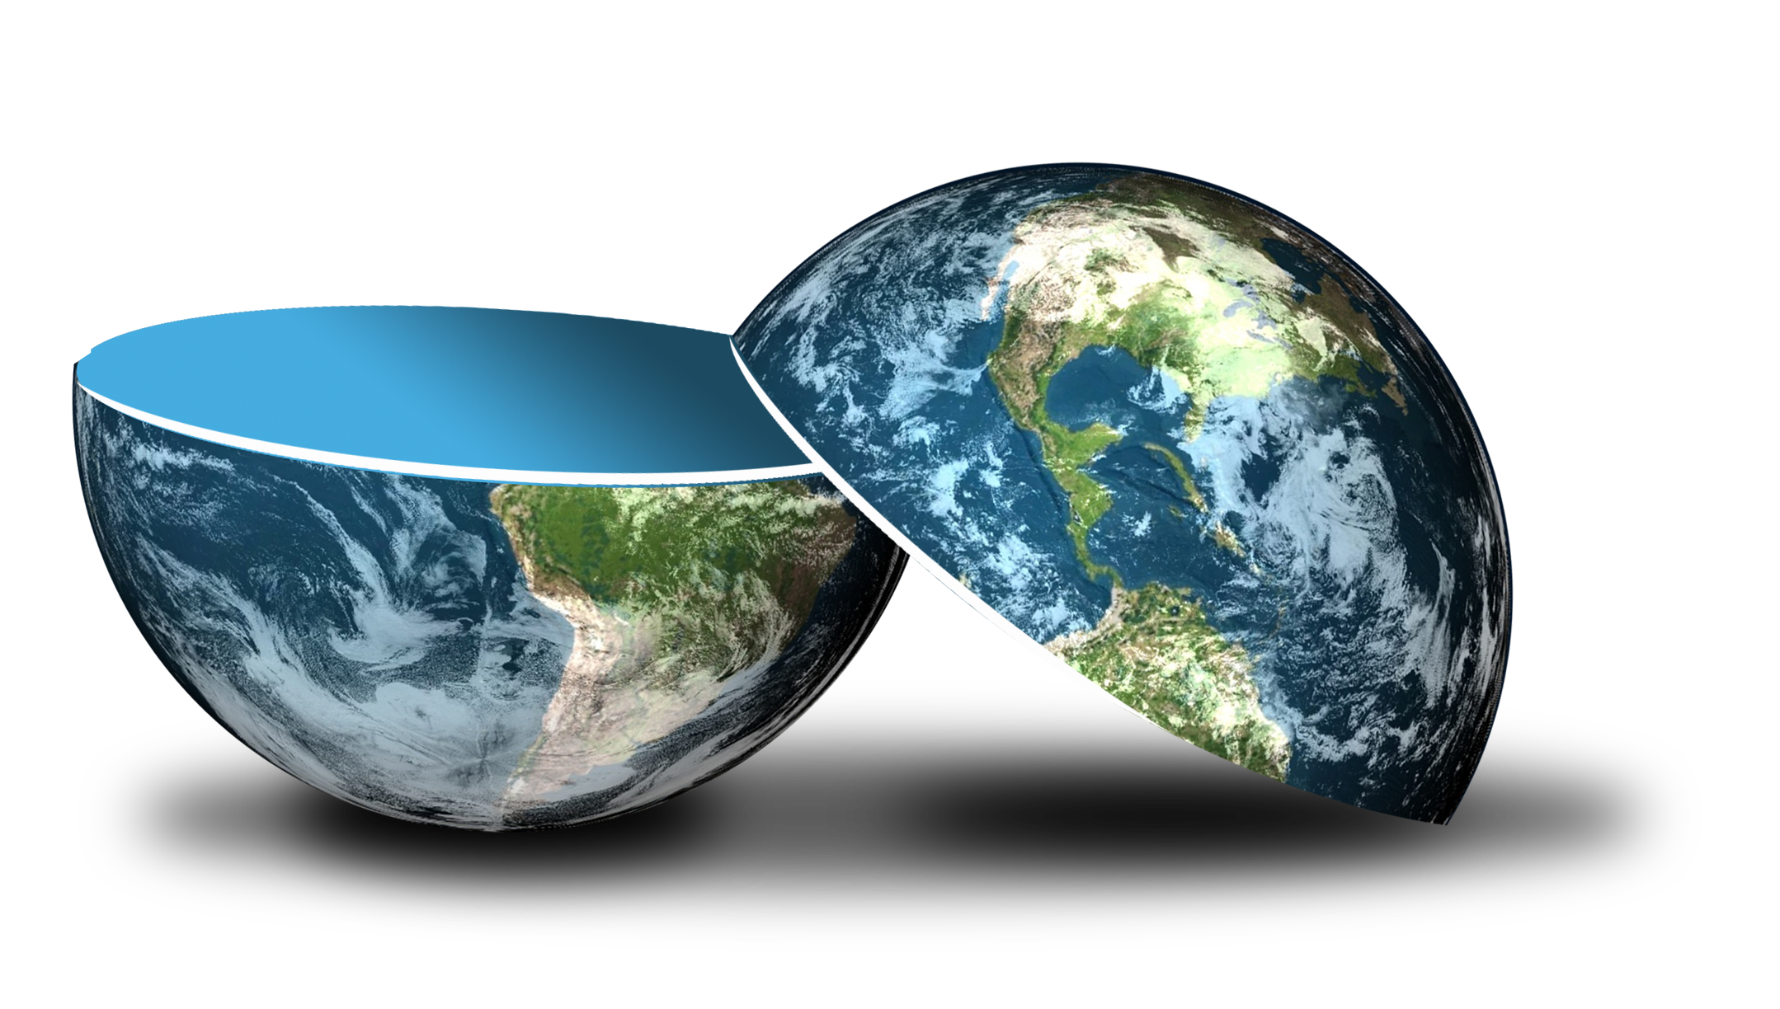
Be happy in an …
Notes:
Camera Phone = https://p1.pxfuel.com/preview/310/297/182/hand-smartphone-mockup-bokeh-colorful-color.jpg
World = edited from https://pixabay.com/photos/planet-earth-earth-planet-global-4427436/
World = edited from https://pixabay.com/photos/planet-earth-earth-planet-global-4427436/
Copyright © 2006−2021. All rights reserved. Bible Point is a registered trademark of Dennis Henderson. All other trademarks acknowledged.
Bible Point contains graphics from Bible Point artists. These illustrations belong to Bible Point and the respective artists. You may use the designs and illustrations for graphical illustration of lessons free and without special permission, provided they are not used in any way that maligns the Christian faith. Furthermore, republication or production of any illustration by any other graphic service whether it be in book, in a machine-readable form, or in any other design resource is strictly prohibited. Furthermore, they cannot be duplicated or resold as any other form of publishing, clip art, or graphic resource.
So What does it mean? (A simple translations of the legal jargon)
So, if you don’t own the presentation(s), graphic(s), and text(s) how can you legally use them? The purchase of the license allows you to use all the images in the product. However, the actual ownership and copyright of the presentation(s), graphic(s), and text(s) remain the property of Bible Point and its licensors. If you had plans on using this product in your “for sale” work—think again!
License Agreement
Article 1: License Grant
All the graphics and text in Bible Point presentations (excluding quotes from the Bible and stated sources) are the intellectual and real property of Bible Point and its licensors, and is protected by law, including United States copyright laws and international treaties. Bible Point grants to you a license:
1. To use the presentation in a single church, single school, or single office of a Christian organization.
2. To make a single archival back-up copy of the program.
3. To modify the presentation(s) and merge with other presentations in a single church, school, or Christian organization.
4. To transfer to another party if that party agrees to accept the terms and conditions of this agreement, and you do not retain any copies of the presentation, whether printed, machine readable, modified, or merged form.
Article 2: Terms
This license is effective until terminated. You may terminate the license at any time by destroying the presentation(s), graphic(s), or text(s) together with all copies, modifications and merged portions in any form. Bible Point may terminate your license if you fail to comply with this Agreement. You agree, upon such termination, for any reason, to destroy the presentation(s), graphics, and text(s) with all copies, modifications, and merged portions in any form.
Article 3: Disclaimers
1. Bible Point presentations, graphics, and texts are licensed to you As Is. You, the consumer, bear the entire risk relating to the quality and performance of the presentation(s), graphic(s), or text(s). In no event will Bible Point be liable for damages resulting from any defect.
2. Thirty-day limited warrantee on disks. Bible Point warrants the disks to be free of defects in material and workmanship under normal use for 30 days after purchase. During the 30-day period you may return a defective presentation, graphic, or text with proof of purchase and it will be replaced without charge, unless the presentation is damaged by misuse.
Article 4: General
1. You may not sub-license, assign, or transfer the license of the presentation(s), graphic(s), or text(s) except as provided by this Agreement.
2. This Agreement will be governed by the laws of the State of Michigan.
So What does it mean? (A simple translations of the legal jargon)
May I let someone borrow or copy my licensed Bible Point presentation (even after I modified it)? As long as it is within your local church, or single school, or the immediate office of a Christian organization you may. Otherwise, please refer the person interested in borrowing to: http://www.biblepoint.com or E-mail: dennis@DrDH.net with any related questions.

Slide 2

Be happy in an…
Notes:
Balloon background = https://pixabay.com/illustrations/banner-header-background-clock-1050602/
World = edited from https://pixabay.com/photos/planet-earth-earth-planet-global-4427436/

Slide 3

Be happy in an…
Notes:
Clock background = https://pixabay.com/illustrations/banner-header-background-clock-1050602/
World = edited from https://pixabay.com/photos/planet-earth-earth-planet-global-4427436/

Slide 4

What is this thing called:
Notes:
Balloon background = https://pixabay.com/illustrations/background-balloon-colorful-color-1500060/
World = edited from https://pixabay.com/photos/planet-earth-earth-planet-global-4427436/

Slide 5
TIME ...
When SPENT ............... Called HISTORY
When IMMINENT ....... Called FUTURE
When HERE NOW ....... Called PRESENT

Slide 6
TIME ...
WEBSTER says ... Time is ... “The period between two events or during which something exists, happens or acts.”
It is “measured or measurable duration.”

Slide 7

I SAY ...
Time is ... “The dimension of God’s creation that relates to finite duration (infinite duration is eternity) between eternity past and eternity future, in which creation exists, happens and acts.”
ETERNITY
PAST
(TIME)
ETERNITY
FUTURE

Slide 8
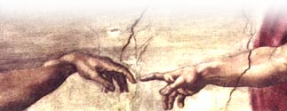
God CREATED Time
Genesis 1:1 In the beginning God created
Hebrews 1:2 “God ... has spoken to us by his Son, whom he appointed heir of all things, and through whom he made the universe [lit. “the ages].”

Slide 9
God CONTROLS Time
Eph 1:11... being predestined according to the purpose of Him who works all things according to the counsel of His will, (NKJ)
Point: God Rules!

Slide 10
This brings us to ...
Ecclesiastes 3:1

Slide 11
God Rules: AFFIRMED
3:1 There is a time for everything, and a season for every activity under heaven:
3:1 There is an appointed time for everything. And there is a time for every event under heaven– (NASB)

Slide 12
God Rules: ILLUSTRATED

Slide 13
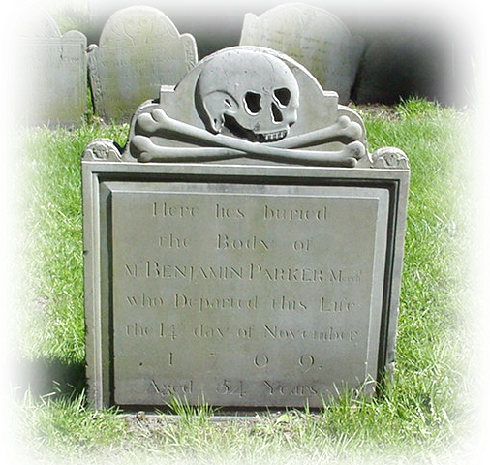
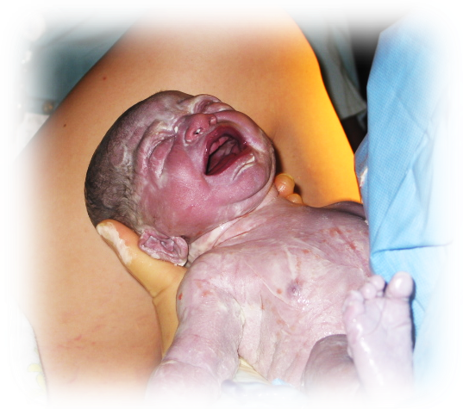
An APPOINTED TIME:
² a time to be born,
and a time to die
Notes:
Birth = FREE = from http://www.sxc.hu/browse.phtml?f=download&id=962622
Grave Stone = FREE = BiblePoint photo

Slide 14
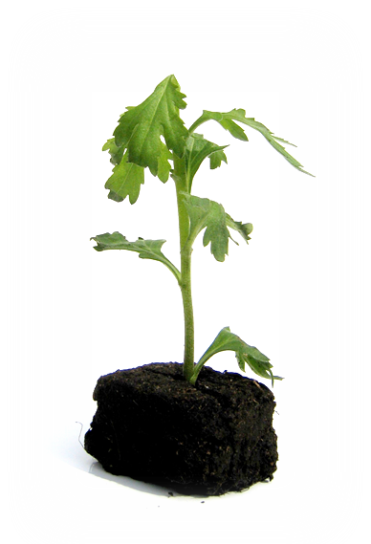
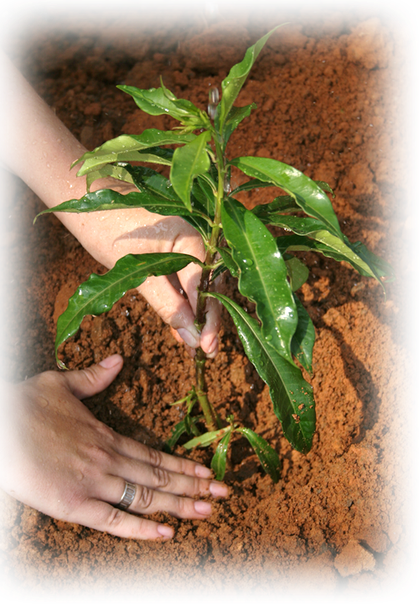
An APPOINTED TIME:
and a time to uproot,
a time to plant
Notes:
Planting = FREE = http://www.sxc.hu/browse.phtml?f=download&id=428778
Uprooted = FREE = http://www.sxc.hu/photo/1060728

Slide 15
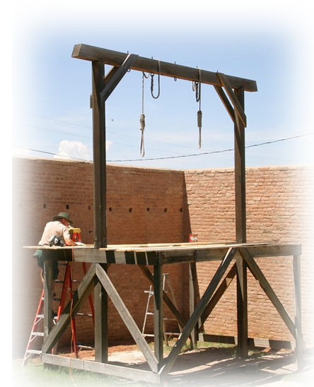

An APPOINTED TIME:
³ a time to kill
and a time to heal,
Notes:
Gallows = FREE = from http://commons.wikimedia.org/wiki/File:Tombstone_courthouse_gallows.jpg
Surgery = FREE = from http://upload.wikimedia.org/wikipedia/commons/3/33/US_Navy_040203-N-4182M-001_National_Naval_Medical_Center_physician%2C_Capt._David_Thompson_performs_an_ear_tube_surgery_on_a_young_hospital_patient.jpg

Slide 16
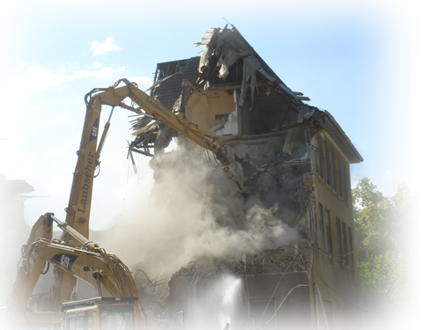
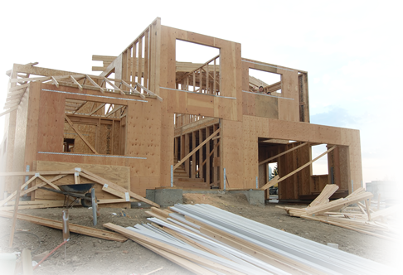
An APPOINTED TIME:
a time to tear down
and a time to build,
Notes:
Tear down = FREE = from http://commons.wikimedia.org/wiki/File:Abriss_bagger_demolition_7.JPG
Building House = FREE = from http://www.dreamstime.com/new-construction-site-stock-photography-imagefree1184252

Slide 17


An APPOINTED TIME:
⁴ a time to weep
and a time to laugh,
Notes:
Cry = FREE = from http://www.sxc.hu/photo/920324
Laugh = FREE = http://www.sxc.hu/photo/1052838

Slide 18

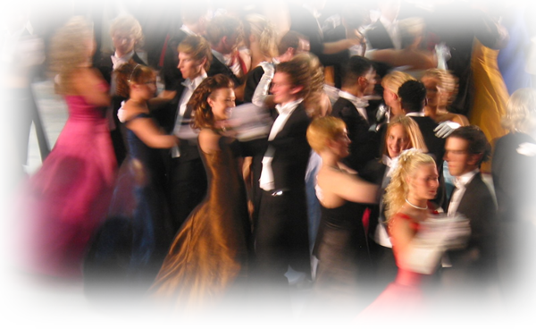
An APPOINTED TIME:
a time to mourn
and a time to dance,
Notes:
Mourning = FREE = from http://commons.wikimedia.org/wiki/File:Tarnak_farms_incident_memorial_2.jpg
Dancing = FREE = from http://www.sxc.hu/photo/160351

Slide 19
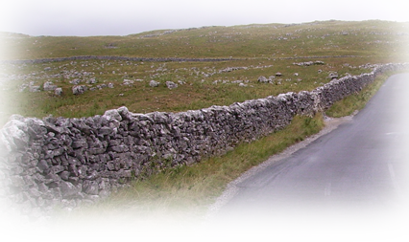
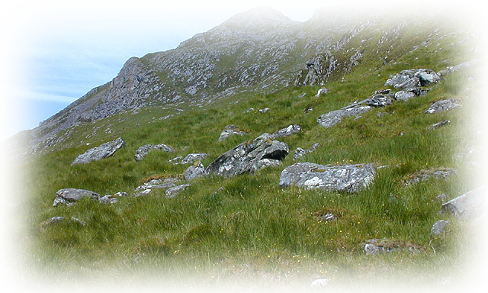
An APPOINTED TIME:
⁵ a time to scatter stones
and a time to gather
Notes:
Scattered stones = FREE = from http://commons.wikimedia.org/wiki/File:Southern_slopes_of_Sg%C3%B9rr_nan_Spainteach_-_geograph.org.uk_-_1049555.jpg
Stone wall = FREE = from http://commons.wikimedia.org/wiki/File:Dry_stone_wall_Malham_03.JPG

Slide 20


An APPOINTED TIME:
a time to embrace
and a time to refrain,
Notes:
Embrace = FREE = from http://commons.wikimedia.org/wiki/File:US_Navy_040724-N-2510L-015_Lt._Shane_Groover_embraces_his_girlfriend_during_a_homecoming_celebration_at_Naval_Station_Oceana,_Virginia_Beach,_Va.jpg
Praying hands =FREE = from Morgue File

Slide 21


An APPOINTED TIME:
⁶ a time to search
and a time to give up,
Notes:
Magnifying Glass = FREE = from http://www.sxc.hu/browse.phtml?f=download&id=485865
Stop Sign = FREE =from http://www.sxc.hu/browse.phtml?f=download&id=1334670

Slide 22

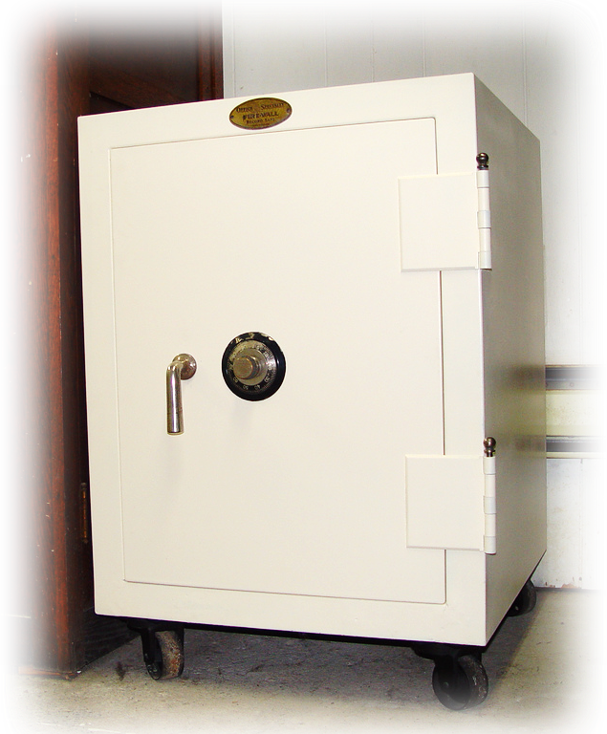
An APPOINTED TIME:
a time to keep
and a time to throw away,
Notes:
Safe = FREE = from http://commons.wikimedia.org/wiki/File:Safe-deposit_box.jpg
Trash can = FREE = from http://www.sxc.hu/photo/1209088

Slide 23
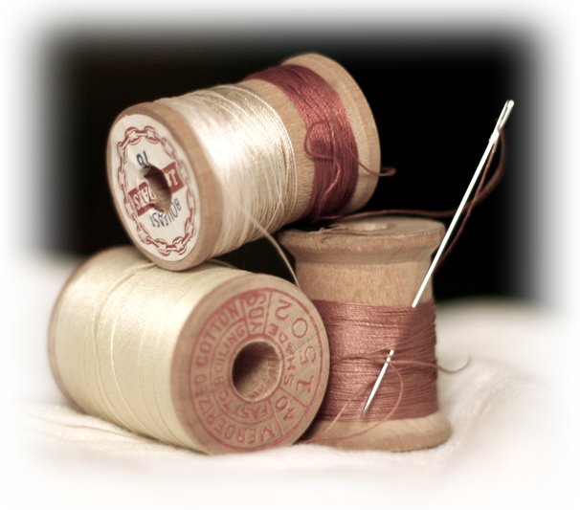

An APPOINTED TIME:
⁷ a time to tear
and a time to mend,
Notes:
Torn pants = FREE = from http://www.sxc.hu/photo/1069763
Needle Thread = FREE = from http://www.sxc.hu/browse.phtml?f=download&id=1008402

Slide 24


An APPOINTED TIME:
and a time to speak,
a time to be silent
Notes:
Shhh woman = FREE = from http://www.dreamstime.com/silence-stock-images-imagefree1615024
Talk on phone = FREE = from http://www.dreamstime.com/blond-girl-with-mobile-phone-stock-images-imagefree2741254

Slide 25


An APPOINTED TIME:
⁸ a time to love
and a time to hate,
Notes:
Valentine Candy = FREE = from http://www.sxc.hu/browse.phtml?f=download&id=452631
Hate = FREE = from http://www.sxc.hu/photo/1071936

Slide 26
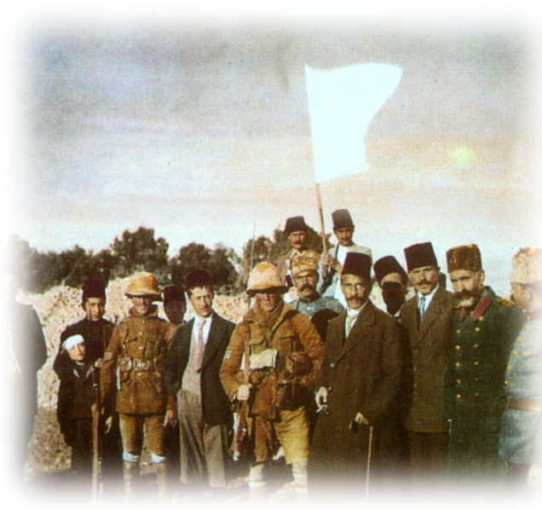
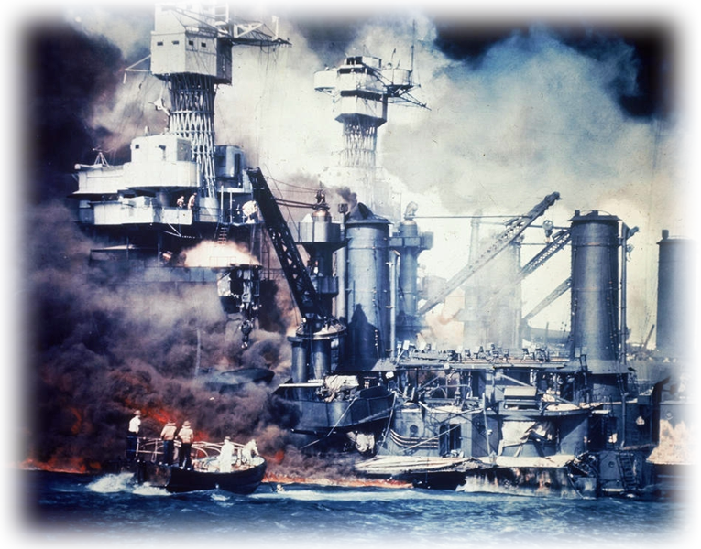
An APPOINTED TIME:
a time for war
and a time for peace.
Notes:
Pearl Harbor = FREE =from http://commons.wikimedia.org/wiki/File:USS_West_Virginia;014824.jpg
Surrender in Jerusalem = FREE = from http://upload.wikimedia.org/wikipedia/commons/2/2a/JerusalemSurrenders.jpg

Slide 27
The POINT:
God appoints EVERYTHING
that comes to pass.
God Rules!

Slide 28
God Rules: QUESTIONED
?
⁹ What does the worker gain from his toil?
Why try?
If everything is appointed, why try?

Slide 29
God Rules: EXPLAINED
Here’s why you try...
Here’s what matters ...

Slide 30
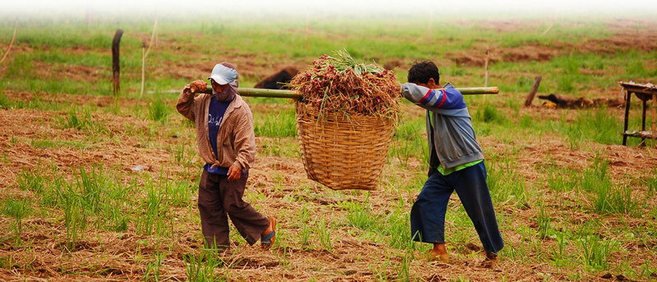
His Rule is: MAN RELATED
¹⁰ I have seen the burden God has laid on men.
wearisome trouble
See 1 Cor 10:13
Notes:
Burden = FREE =from http://www.sxc.hu/photo/862400

Slide 31
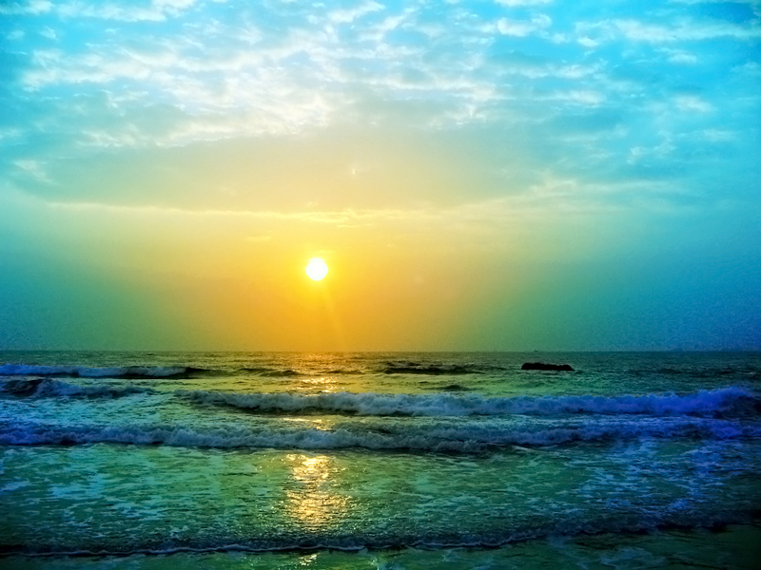
His Rule is: BEAUTIFUL
¹¹ He has made everything beautiful in its time.
Lit. = “His” (KJV)
3rd person masculine singular suffix on the word “time.”
See Romans 8:28;
Gen 45:5,7; 50:20
Notes:
Beautiful Sunset = FREE = from http://www.sxc.hu/browse.phtml?f=download&id=1018484

Slide 32


His Rule is: PENETRATING
¹¹ ... He has also set eternity in the hearts of men;
See 2 Peter 1:4
Notes:
Heart = FREE = from http://www.sxc.hu/browse.phtml?f=download&id=1318184

Slide 33
It’s: INCOMPREHENSIBLE
¹¹ ... yet they cannot fathom what God has done from beginning to end.

Slide 34

It’s: INCOMPREHENSIBLE
¹¹ ... yet they cannot fathom what God has done from beginning to end.
See 1 Cor 2:10
Notes:
Under Water = FREE = from http://www.sxc.hu/photo/1021580

Slide 35

His Rule is: BEST
¹² I know that there is nothing better for men than to be happy and do good while they live.
¹³ That everyone may eat and drink, and find satisfaction in all his toil--this is the gift of God.
Notes:
Blue ribbon = FREE = from http://www.sxc.hu/photo/1294754

Slide 36

His Rule is: FOREVER
¹⁴ I know that everything God does will endure forever;
Notes:
Cross = FREE = from http://www.sxc.hu/photo/1363217

Slide 37

His Rule is: UNCHANGING
¹⁴ ... nothing can be added to it and nothing taken from it.
+ -
Notes:
Plus & Minus = FREE = from http://commons.wikimedia.org/wiki/File:PlusMinus.svg

Slide 38

His Rule is: AWESOME
¹⁴ ... God does it so that men will revere him.
Notes:
Praying hands = FREE = from http://www.sxc.hu/photo/405036

Slide 39
Final EXPLAINATION

Slide 40

We are ACCOUNTABLE
¹⁵ Whatever is has already been, and what will be has been before; and God will call the past to account.
See Eccl 12:13,14
Notes:
Gavel = FREE =from http://www.sxc.hu/photo/952313

Slide 41
Take this with you...
Time is the period between two eternities ...
We live, act and move in it ...
God RULES time ... He appoints everything ...
Don’t lose heart over the burdens ... Instead,
REVERE Him ... Let Him fill eternity within ...
He makes everything BEAUTIFUL in His time.

Slide 42
LET’S PRAY!
Notes:
Balloon background = https://pixabay.com/illustrations/background-balloon-colorful-color-1500060/
World = edited from https://pixabay.com/photos/planet-earth-earth-planet-global-4427436/

