Slide 1



Be happy in an…
Notes:
Balloon background = https://pixabay.com/illustrations/background-balloon-colorful-color-1500060/
World = edited from https://pixabay.com/photos/planet-earth-earth-planet-global-4427436/
World = edited from https://pixabay.com/photos/planet-earth-earth-planet-global-4427436/
Copyright © 2006−2021. All rights reserved. Bible Point is a registered trademark of Dennis Henderson. All other trademarks acknowledged.
Bible Point contains graphics from Bible Point artists. These illustrations belong to Bible Point and the respective artists. You may use the designs and illustrations for graphical illustration of lessons free and without special permission, provided they are not used in any way that maligns the Christian faith. Furthermore, republication or production of any illustration by any other graphic service whether it be in book, in a machine-readable form, or in any other design resource is strictly prohibited. Furthermore, they cannot be duplicated or resold as any other form of publishing, clip art, or graphic resource.
So What does it mean? (A simple translations of the legal jargon)
So, if you don’t own the presentation(s), graphic(s), and text(s) how can you legally use them? The purchase of the license allows you to use all the images in the product. However, the actual ownership and copyright of the presentation(s), graphic(s), and text(s) remain the property of Bible Point and its licensors. If you had plans on using this product in your “for sale” work—think again!
License Agreement
Article 1: License Grant
All the graphics and text in Bible Point presentations (excluding quotes from the Bible and stated sources) are the intellectual and real property of Bible Point and its licensors, and is protected by law, including United States copyright laws and international treaties. Bible Point grants to you a license:
1. To use the presentation in a single church, single school, or single office of a Christian organization.
2. To make a single archival back-up copy of the program.
3. To modify the presentation(s) and merge with other presentations in a single church, school, or Christian organization.
4. To transfer to another party if that party agrees to accept the terms and conditions of this agreement, and you do not retain any copies of the presentation, whether printed, machine readable, modified, or merged form.
Article 2: Terms
This license is effective until terminated. You may terminate the license at any time by destroying the presentation(s), graphic(s), or text(s) together with all copies, modifications and merged portions in any form. Bible Point may terminate your license if you fail to comply with this Agreement. You agree, upon such termination, for any reason, to destroy the presentation(s), graphics, and text(s) with all copies, modifications, and merged portions in any form.
Article 3: Disclaimers
1. Bible Point presentations, graphics, and texts are licensed to you As Is. You, the consumer, bear the entire risk relating to the quality and performance of the presentation(s), graphic(s), or text(s). In no event will Bible Point be liable for damages resulting from any defect.
2. Thirty-day limited warrantee on disks. Bible Point warrants the disks to be free of defects in material and workmanship under normal use for 30 days after purchase. During the 30-day period you may return a defective presentation, graphic, or text with proof of purchase and it will be replaced without charge, unless the presentation is damaged by misuse.
Article 4: General
1. You may not sub-license, assign, or transfer the license of the presentation(s), graphic(s), or text(s) except as provided by this Agreement.
2. This Agreement will be governed by the laws of the State of Michigan.
So What does it mean? (A simple translations of the legal jargon)
May I let someone borrow or copy my licensed Bible Point presentation (even after I modified it)? As long as it is within your local church, or single school, or the immediate office of a Christian organization you may. Otherwise, please refer the person interested in borrowing to: http://www.biblepoint.com or E-mail: dennis@DrDH.net with any related questions.

Slide 2

The PREMISE: Meaningless
² "Meaningless! Meaningless!" says the Teacher. "Utterly meaningless! Everything is meaningless.”
Notes:
https://www.publicdomainpictures.net/en/view-image.php?image=44463&picture=fuel-gauge

Slide 3
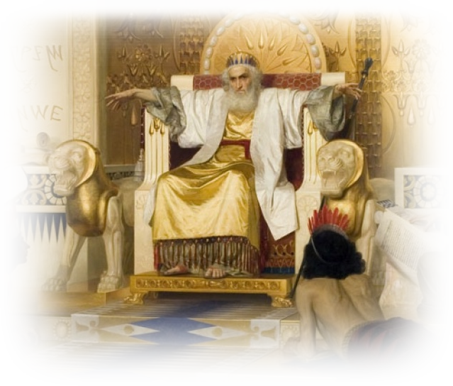
Remember …
^{1:12} I, the Teacher, was king over Israel in Jerusalem .… ¹⁷ Then I applied myself to the understanding of wisdom, and also of madness and folly …

Slide 4

Be happy in an…
Notes:
Balloon background = https://pixabay.com/illustrations/background-balloon-colorful-color-1500060/
World = edited from https://pixabay.com/photos/planet-earth-earth-planet-global-4427436/
Be Happy in an UNFULFILLING World …
Fulfillment is NOT found in …
PLEASURE - What you feel
PROJECTS - What you do
POSESSIONS - What you have
PRESTIGE - What you are
PLENTY - What amount you have
PRUDENCE - What you know
PERFORMANCE - What you achieve
Fulfillment IS found in …
God’s Gift of Satisfaction
God’s Gift of Enjoyment
God’s Gift of Wisdom
God’s Gift of Knowledge
God’s Gift of Happiness

Slide 5
Fulfilment is not found in …
Notes:
Be Happy in an UNFULFILLING World …
Fulfillment is NOT found in …
PLEASURE - What you feel
PROJECTS - What you do
POSESSIONS - What you have
PRESTIGE - What you are
PLENTY - What amount you have
PRUDENCE - What you know
PERFORMANCE - What you achieve
Fulfillment IS found in …
God’s Gift of Satisfaction
God’s Gift of Enjoyment
God’s Gift of Wisdom
God’s Gift of Knowledge
God’s Gift of Happiness

Slide 6
1. PLEASURES - What you feel
^{2:1} I thought in my heart, …
Notes:
Be Happy in an UNFULFILLING World …
Fulfillment is NOT found in …
PLEASURE - What you feel
PROJECTS - What you do
POSESSIONS - What you have
PRESTIGE - What you are
PLENTY - What amount you have
PRUDENCE - What you know
PERFORMANCE - What you achieve
Fulfillment IS found in …
God’s Gift of Satisfaction
God’s Gift of Enjoyment
God’s Gift of Wisdom
God’s Gift of Knowledge
God’s Gift of Happiness

Slide 7
1. PLEASURES - What you feel
^{2:1} I thought in my heart,
"Come now, I will test you with pleasure to find out what is good."

Slide 8

Pleasures of Life …
^{2:1} I thought in my heart,
"Come now, I will test you with pleasure to find out what is good." But that also proved to be meaningless.
Notes:
https://pixabay.com/vectors/smiley-happy-face-smile-lucky-559124/

Slide 9

Pleasures of Laughter
² "Laughter," I said, "is foolish. And what does pleasure accomplish?"
Notes:
https://freesvg.org/laughing-smiley

Slide 10
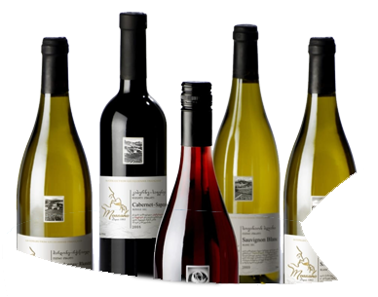
Pleasures of Wine
³ I tried cheering myself with wine, and embracing folly--my mind still guiding me with wisdom. I wanted
to see what was worth-
while for men to do
under heaven during
the few days of their lives.

Slide 11
2. PROJECTS - What you do
⁴ I undertook great projects:

Slide 12

Housing Projects
⁴ I undertook great projects: I built houses for myself and planted vineyards. ⁵ I made gardens and parks and planted all kinds of
fruit trees in them. ⁶
I made reservoirs to water groves of flourishing trees.
Notes:
https://www.goodfreephotos.com/albums/united-states/north-carolina/raleigh/governors-mansion-raleigh-north-carolina.jpg

Slide 13

Vineyard Projects
⁴ I undertook great projects: I built houses for myself and planted vineyards. ⁵ I made gardens and parks and planted all kinds of
fruit trees in them. ⁶
I made reservoirs to water groves of flourishing trees.
Notes:
https://pixabay.com/photos/grapes-grape-vine-purple-green-4725102/

Slide 14

Garden Projects
⁴ I undertook great projects: I built houses for myself and planted vineyards. ⁵ I made gardens and parks and planted all kinds of
fruit trees in them. ⁶
I made reservoirs to water groves of flourishing trees.
Notes:
https://www.publicdomainpictures.net/en/view-image.php?image=294552&picture=sunken-garden

Slide 15

Civil Projects
⁴ I undertook great projects: I built houses for myself and planted vineyards. ⁵ I made gardens and parks and planted all kinds of
fruit trees in them. ⁶
I made reservoirs to water groves of flourishing trees.
Notes:
https://www.pikist.com/free-photo-xocig

Slide 16

3. POSESSIONS - What you have
⁷ I bought …
Notes:
https://www.flickr.com/photos/investmentzen/29842674784

Slide 17

Possessions of People
⁷ I bought male and female slaves and had other slaves who were born in my house.
Notes:
https://www.flickr.com/photos/29320962@N07/9251526404

Slide 18
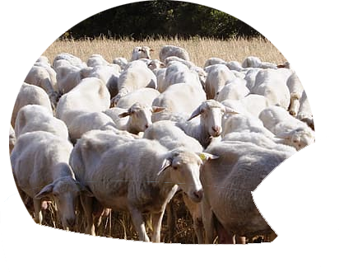
Possessions of Herds
⁷ I bought male and female slaves and had other slaves who were born in my house. I also owned more herds and flocks than anyone in Jerusalem before me.
Notes:
https://www.pikrepo.com/nvnpp/herd-of-sheep-on-green-grass-field-during-daytime

Slide 19
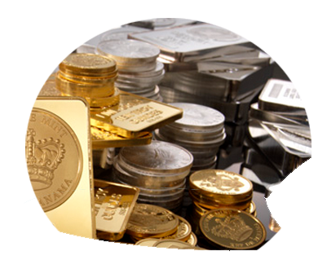
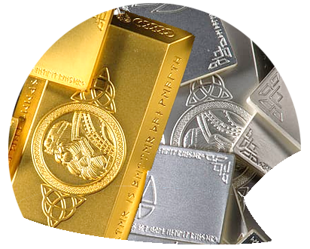
Possessions of Treasures
⁸ I amassed silver and gold for myself, and the treasure of kings and provinces.
Notes:
https://www.flickr.com/photos/digitalcurrency/2438941120

Slide 20

Possessions of Entertainers
⁸ I amassed silver and gold for myself, and the treasure of kings and provinces.
I acquired men and women singers …
Notes:
https://upload.wikimedia.org/wikipedia/commons/d/d3/Zesrandy_choir_2.JPG

Slide 21

Possessions of Harem
⁸ I amassed silver
and gold for myself,
and the treasure of
kings and provinces.
I acquired men and
women singers, and
a harem as well—the
delights of the heart of man.
Notes:
https://www.needpix.com/photo/download/632441/harem-eastern-girl-barn-princess-east-story-dress-magic-smile
and what gives a man sensual delight– a harem of beautiful concubines! (Ecc 2:8 NET)
He had seven hundred wives of royal birth and three hundred concubines, and his wives led him astray.
(1Ki 11:3 NIV)

Slide 22
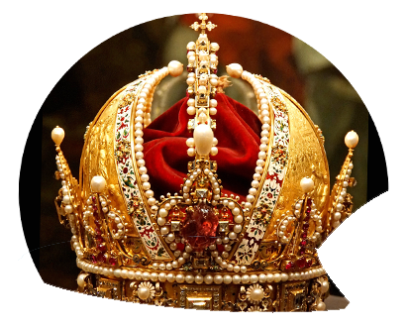
4. PRESTIGE - What you are
⁹ I became greater by far than anyone in Jerusalem before me. In all this my wisdom stayed with me.
Notes:
https://www.flickr.com/photos/archer10/32121434203
and what gives a man sensual delight– a harem of beautiful concubines! (Ecc 2:8 NET)
He had seven hundred wives of royal birth and three hundred concubines, and his wives led him astray.
(1Ki 11:3 NIV)

Slide 23
5. PLENTY - What amount you have
¹⁰ I denied myself nothing my eyes desired; I refused my heart no pleasure. My heart took delight in all my work, and this was the reward for all my labor.
Notes:
and what gives a man sensual delight– a harem of beautiful concubines! (Ecc 2:8 NET)
He had seven hundred wives of royal birth and three hundred concubines, and his wives led him astray.
(1Ki 11:3 NIV)

Slide 24
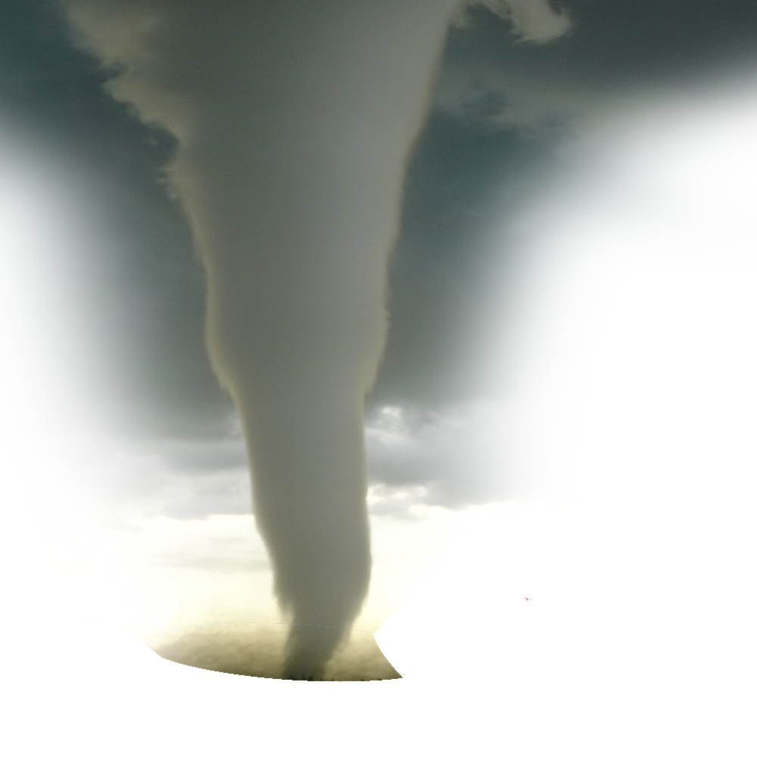
Initial Analysis …
¹¹ Yet when I surveyed all that my hands had done and what I had toiled to achieve, everything was meaningless, a chasing after the wind; nothing was gained under the sun.
Notes:
https://upload.wikimedia.org/wikipedia/commons/9/98/F5_tornado_Elie_Manitoba_2007.jpg

Slide 25
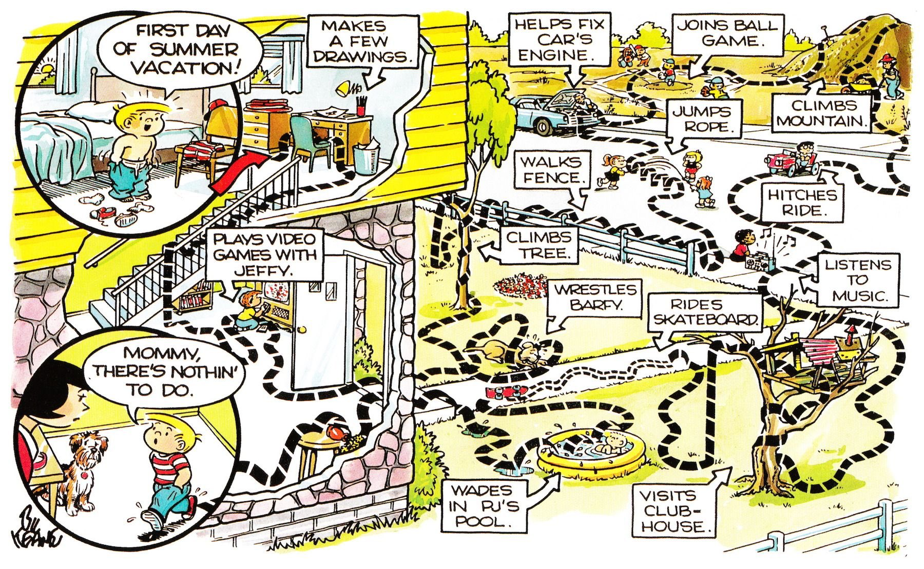

Notes:
http://www.benzilla.com/
Everything Solomon is saying is found in this page from the book of the Bible called Family Circus.

Slide 26
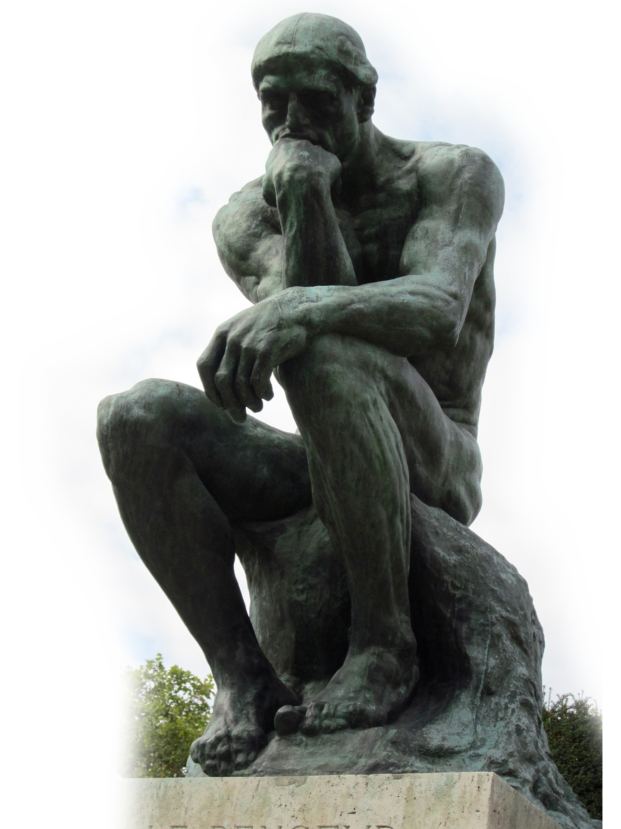

6. PRUDENCE - What you know
¹² Then I turned my thoughts to consider wisdom, and also madness and folly.
What more can the king's successor do than what has already been done?
Notes:
https://pixabay.com/photos/the-thinker-bronze-sculpture-rodin-1090227/
https://pixabay.com/photos/fool-court-jester-clown-funny-1476189/
Wise man on one end, a madman (lunatic) on the other end, and the fool in the middle.
Brilliant vs insane with the idiot in the middle.
Who could test this any better than I have?

Slide 27
6. PRUDENCE - What you know
¹³ I saw that wisdom is better than folly, just as light is better than darkness.
¹⁴ The wise man
has eyes in his head, while the fool walks
in the darkness;
Notes:
https://pixabay.com/photos/the-thinker-bronze-sculpture-rodin-1090227/
https://pixabay.com/photos/fool-court-jester-clown-funny-1476189/
Wisdom wins! Hands down!
The wise see ahead while the fool is in the dark

Slide 28
6. PRUDENCE - What you know
but I came to realize that the same fate overtakes them both. ¹⁵ Then I thought in my heart, "The fate of the fool will overtake me also. What then do I gain by being wise?" I said in my heart, "This too is meaningless."
WHY?
Notes:
But the great exception.
One exception: both the fool and the wise have something in common.
Which renders even wisdom as meaningless.

Slide 29

Consider Wisdom’s Equalizer!
¹⁶ For the wise man, like the fool, will not be long remembered; in days to come both will be forgotten. Like the fool, the wise man too must die!
Notes:
https://pixabay.com/photos/cemetery-grave-stones-grave-2773827/
The great equalizer. Wisdom does not prevent death.

Slide 30
7. PERFORMANCE - What you achieve
¹⁷ So I hated life, because the work that is done under the sun was grievous to me. All of it is meaningless, a chasing after the wind.
WHY?
Notes:
PERFORMANCE - What you achieve

Slide 31
Achievements will be Left …
¹⁸ I hated all the things I had toiled for under the sun, because I must leave them to the one who comes after me.
Notes:
https://pixabay.com/photos/cemetery-grave-stones-grave-2773827/
My brother Dave built up a great company and sold it only to die and leave all that he made to someone else

Slide 32
Achievements left to a FOOL
¹⁹ And who knows whether he will be a wise man or a fool? Yet he will have control over all the work into which I have poured my effort and skill
under the sun. This
too is meaningless.
Notes:
https://pixabay.com/photos/the-thinker-bronze-sculpture-rodin-1090227/
https://pixabay.com/photos/fool-court-jester-clown-funny-1476189/

Slide 33
Achievements to Undeserving!
²⁰ So my heart began to despair over all my toil-some labor under the sun.
²¹ For a man may do his
work with wisdom, know-
ledge and skill, and then
he must leave all he
owns to someone who
has not worked for it.
Notes:
https://pixabay.com/photos/the-thinker-bronze-sculpture-rodin-1090227/
https://pixabay.com/photos/fool-court-jester-clown-funny-1476189/

Slide 34
Achievements to Undeserving!
²⁰ So my heart began to despair over all my toil-some labor under the sun. ²¹ For a man may do his work with wisdom, knowledge and skill, and then he must leave all he
owns to someone who
has not worked for it.
This too is meaningless
and a great misfortune.

Slide 35
Achievements are Useless!
²² What does a man get for all the toil and anxious striving with which he labors under the sun?
²³ All his days his work is pain and grief; even at night his mind does not rest.
This too is meaningless.

Slide 36
FULFILLMENT IS FOUND IN …

Slide 37

1. God’s Gift of SATISFACTION
²⁴ A man can do nothing better than to eat and drink and find satisfaction in his work. This too, I see, is from the hand of God,
Notes:
For to the one who pleases him, God gives wisdom, knowledge, and joy, but to the sinner, he gives the task of amassing wealth– only to give it to the one who pleases God. This task of the wicked is futile– like chasing the wind! (Ecc 2:26 NET)

Slide 38

2. God’s Gift of ENJOYMENT
²⁵ for without him, who can eat or find enjoyment?
Notes:
You see when you enjoy your job you are not working, you are living!
For to the one who pleases him, God gives wisdom, knowledge, and joy, but to the sinner, he gives the task of amassing wealth– only to give it to the one who pleases God. This task of the wicked is futile– like chasing the wind! (Ecc 2:26 NET)

Slide 39

3. God’s Gift of WISDOM
²⁶ To the man who pleases him,
God gives wisdom, …
… Christ, ³ in whom are hidden
all the treasures of wisdom
…. (Col 2:2-3)
Notes:
For to the one who pleases him, God gives wisdom, knowledge, and joy, but to the sinner, he gives the task of amassing wealth– only to give it to the one who pleases God. This task of the wicked is futile– like chasing the wind! (Ecc 2:26 NET)

Slide 40
3. God’s Gift of KNOWLEDGE
²⁶ To the man who pleases him,
God gives wisdom, knowledge …
… Christ, ³ in whom are hidden
all the treasures of wisdom
and knowledge. (Col 2:2-3)
Notes:
For to the one who pleases him, God gives wisdom, knowledge, and joy, but to the sinner, he gives the task of amassing wealth– only to give it to the one who pleases God. This task of the wicked is futile– like chasing the wind! (Ecc 2:26 NET)

Slide 41

3. God’s Gift of HAPPINESS!
²⁶ To the man who pleases him,
God gives wisdom, knowledge
and happiness …
God … has blessed us in
the heavenly realms with
every spiritual blessing
in Christ. (Eph 1:3)
Notes:
For to the one who pleases him, God gives wisdom, knowledge, and joy, but to the sinner, he gives the task of amassing wealth– only to give it to the one who pleases God. This task of the wicked is futile– like chasing the wind! (Ecc 2:26 NET)

Slide 42

Conclusion: Some never do …
²⁶ To the man who pleases him,
God gives wisdom, knowledge
and happiness, but to the
sinner he gives the task of
gathering and storing up
wealth to hand it over to
the one who pleases God.
Notes:
For the Christian we store it up in heaven as well!
For the unbeliever it is only for now—to be given to someone else, which is meaningless and chasing the ever evasive wind.

Slide 43
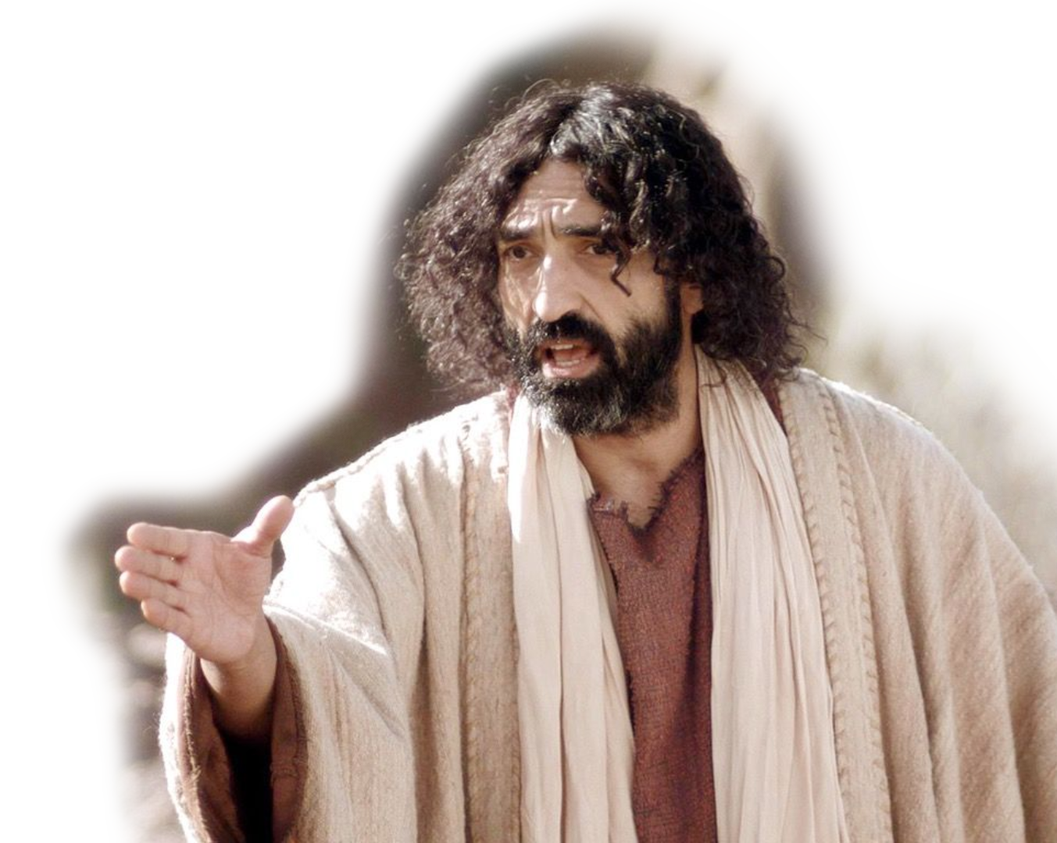
Conclusion: Some never do …
^{Mat 25:28} " 'Take the talent from him and give it to the one who has the ten talents. 29 For everyone who has will be given more, and he will have an abundance. Whoever does
not have, even what he
has will be taken from him.
Notes:
For the Christian we store it up in heaven as well!
For the unbeliever it is only for now—to be given to someone else, which is meaningless and chasing the ever evasive wind.

Slide 44
Conclusion: Some never do …
²⁶ To the man who pleases him, God gives wisdom, knowledge and happiness, but to the sinner he gives the task of
gathering and storing up
wealth to hand it over to
the one who pleases God.
This too is meaningless, a
chasing after the wind.
Notes:
For the Christian we store it up in heaven as well!
For the unbeliever it is only for now—to be given to someone else, which is meaningless and chasing the ever evasive wind.

Slide 45


Final Thought:
If fulfillment is found in God’s Gift,
Notes:
https://www.pikrepo.com/fkqkw/red-and-white-floral-gift-box

Slide 46
Final Thought:
If fulfillment is found in God’s Gift,
then you need God’s gift
to fill your world.
Notes:
https://www.pikrepo.com/fkqkw/red-and-white-floral-gift-box

Slide 47
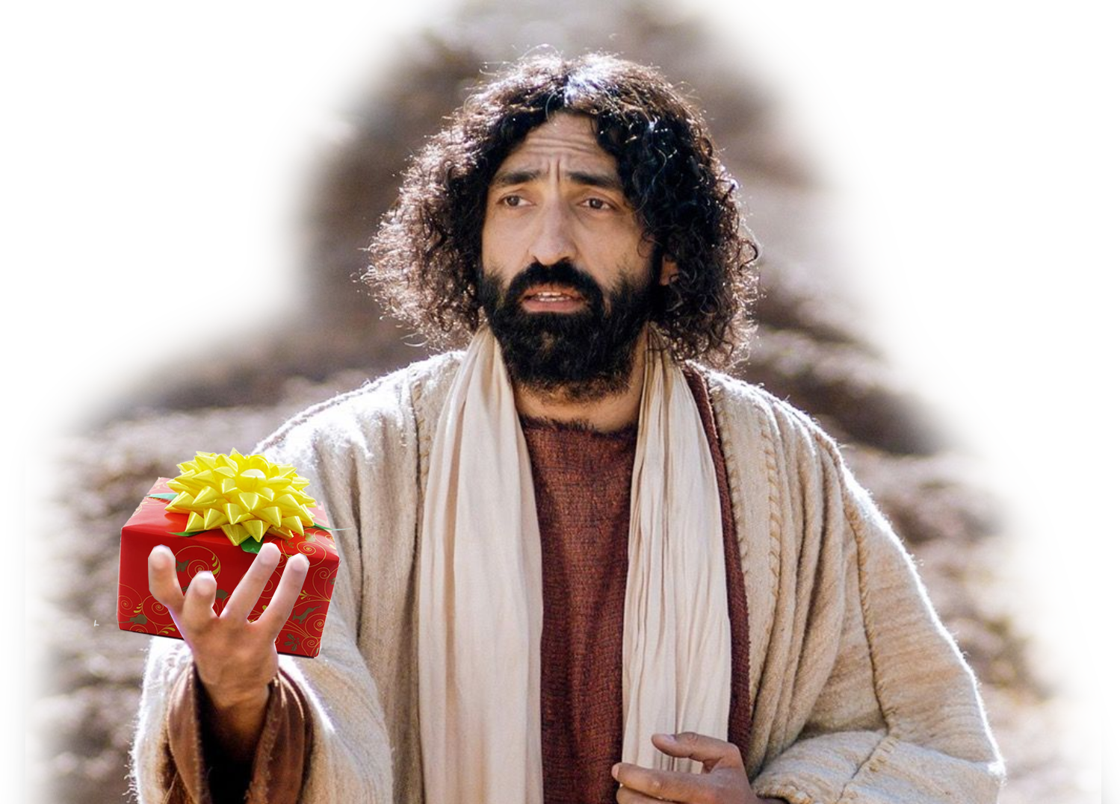
Final Thought:
For the wages of sin is death, but the gift of God is eternal life in Christ Jesus our Lord.
^{Rom 6:23}
Notes:
Eternal life as quantity is never ending …
Eternal life as quality is always fulfilling!

Slide 48
Let’s pray now …
TO BE HAPPY!

