Slide 1


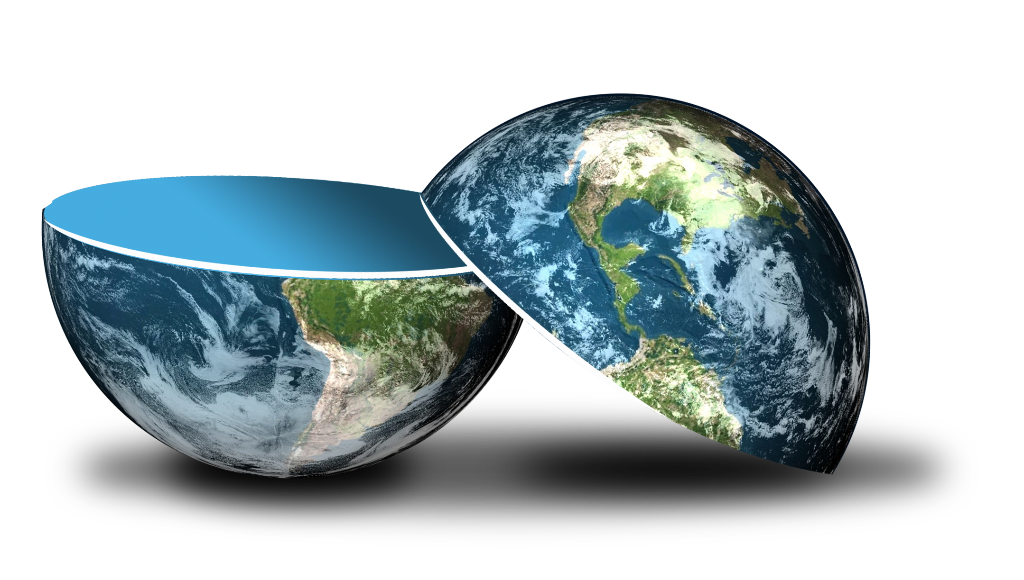
Be happy in an…
Notes:
Balloon background = https://pixabay.com/illustrations/background-balloon-colorful-color-1500060/
World = edited from https://pixabay.com/photos/planet-earth-earth-planet-global-4427436/
Copyright © 2006−2021. All rights reserved. Bible Point is a registered trademark of Dennis Henderson. All other trademarks acknowledged.
Bible Point contains graphics from Bible Point artists. These illustrations belong to Bible Point and the respective artists. You may use the designs and illustrations for graphical illustration of lessons free and without special permission, provided they are not used in any way that maligns the Christian faith. Furthermore, republication or production of any illustration by any other graphic service whether it be in book, in a machine-readable form, or in any other design resource is strictly prohibited. Furthermore, they cannot be duplicated or resold as any other form of publishing, clip art, or graphic resource.
So What does it mean? (A simple translations of the legal jargon)
So, if you don’t own the presentation(s), graphic(s), and text(s) how can you legally use them? The purchase of the license allows you to use all the images in the product. However, the actual ownership and copyright of the presentation(s), graphic(s), and text(s) remain the property of Bible Point and its licensors. If you had plans on using this product in your “for sale” work—think again!
License Agreement
Article 1: License Grant
All the graphics and text in Bible Point presentations (excluding quotes from the Bible and stated sources) are the intellectual and real property of Bible Point and its licensors, and is protected by law, including United States copyright laws and international treaties. Bible Point grants to you a license:
1. To use the presentation in a single church, single school, or single office of a Christian organization.
2. To make a single archival back-up copy of the program.
3. To modify the presentation(s) and merge with other presentations in a single church, school, or Christian organization.
4. To transfer to another party if that party agrees to accept the terms and conditions of this agreement, and you do not retain any copies of the presentation, whether printed, machine readable, modified, or merged form.
Article 2: Terms
This license is effective until terminated. You may terminate the license at any time by destroying the presentation(s), graphic(s), or text(s) together with all copies, modifications and merged portions in any form. Bible Point may terminate your license if you fail to comply with this Agreement. You agree, upon such termination, for any reason, to destroy the presentation(s), graphics, and text(s) with all copies, modifications, and merged portions in any form.
Article 3: Disclaimers
1. Bible Point presentations, graphics, and texts are licensed to you As Is. You, the consumer, bear the entire risk relating to the quality and performance of the presentation(s), graphic(s), or text(s). In no event will Bible Point be liable for damages resulting from any defect.
2. Thirty-day limited warrantee on disks. Bible Point warrants the disks to be free of defects in material and workmanship under normal use for 30 days after purchase. During the 30-day period you may return a defective presentation, graphic, or text with proof of purchase and it will be replaced without charge, unless the presentation is damaged by misuse.
Article 4: General
1. You may not sub-license, assign, or transfer the license of the presentation(s), graphic(s), or text(s) except as provided by this Agreement.
2. This Agreement will be governed by the laws of the State of Michigan.
So What does it mean? (A simple translations of the legal jargon)
May I let someone borrow or copy my licensed Bible Point presentation (even after I modified it)? As long as it is within your local church, or single school, or the immediate office of a Christian organization you may. Otherwise, please refer the person interested in borrowing to: http://www.biblepoint.com or E-mail: dennis@DrDH.net with any related questions.

Slide 2
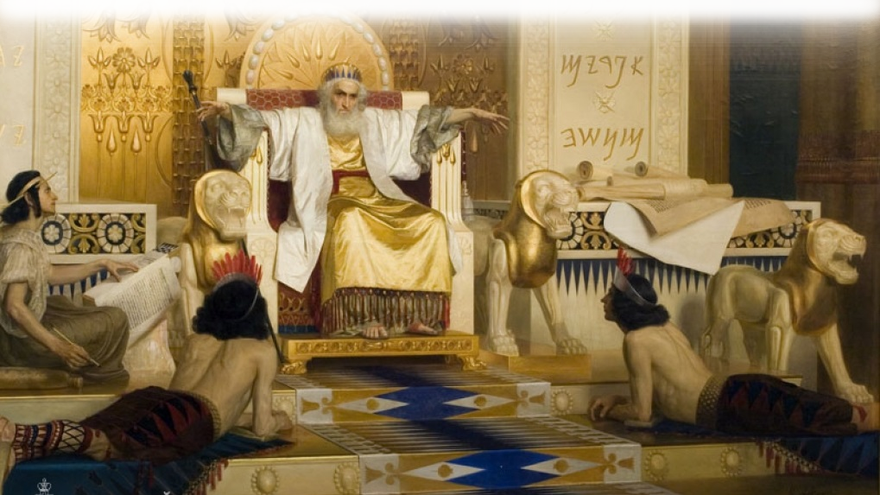
1. The TEACHER: Solomon
¹ The words of the Teacher, son of David, king in Jerusalem:
Notes:
Solomon = FREE = from
The words of Koheleth (LXX = ekklesiastou) = Teacher/Preacher = Name of the Book. When you say Ecclesiates you are speaking Greek – it means Teacher/preacher.
Whose words -- Son of David who is king in Jerusalem (tracitionally taken to be Solomon)
While Proverbs and Song of Songs was probably written in his younger days—Ecclesiastes was most likely written in his latter reflective years of old age.

Slide 3
2. The PREMISE: Emptiness
² "Meaningless! Meaningless!" says the Teacher. "Utterly meaningless! Everything is meaningless.”
Notes:
https://www.publicdomainpictures.net/en/view-image.php?image=44463&picture=fuel-gauge
Meaningless = hebel (Hebrew) = emptiness as it was translated into the Greek using the Greek word for emptiness.
This term occurs 38 times in the book. Notice the emphasis here four times in one verse and the final time here he adds “Everything” is meaningless or “Emptty”
This world and life itself is empty. That’s his premise.

Slide 4
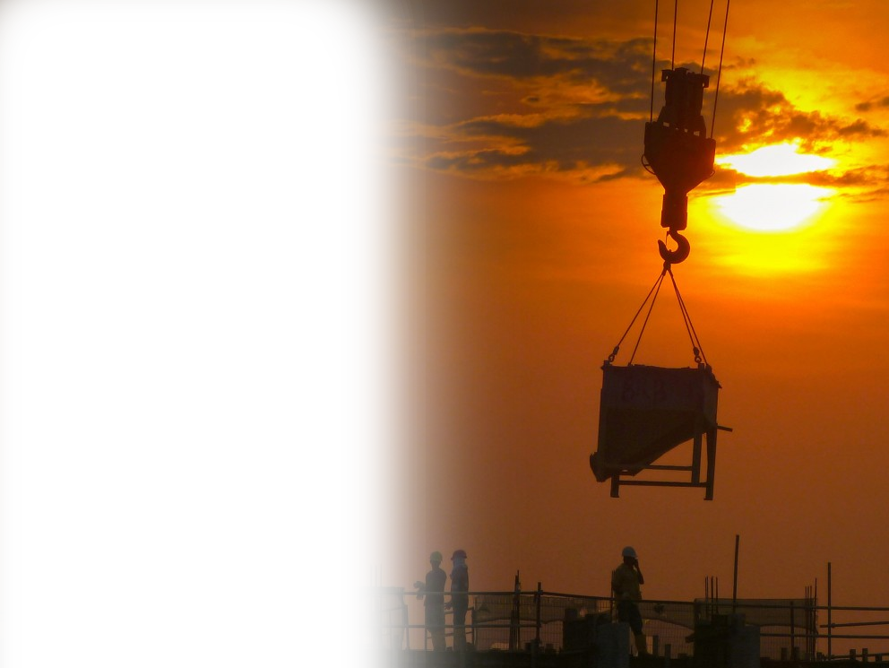
3. The QUESTION: What’s the use?
³ What does man gain from all his labor at which he toils under the sun?
What’s
the use?
Notes:
https://pxhere.com/en/photo/983717
What’s the gain, profit, surplus, what is left after the labor. It’s the opposite of empty. What do you get, what do you gain by living?
Here’s the rhetorical question = what do you gain from everything you do, if everything is meaningless. “What is the Use of anything! So pessimistic!

Slide 5
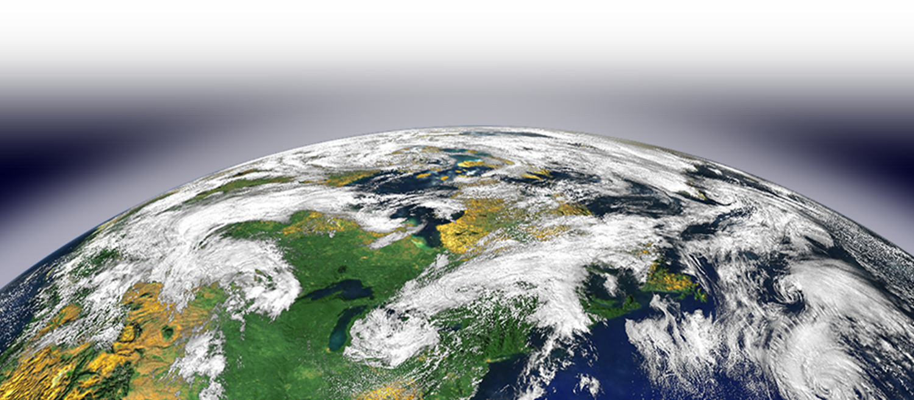
4. PERSPECTIVE: Here Below
³ What does man gain from all his labor at which he
toils under the sun?
Without God
Notes:
https://www.jpl.nasa.gov/news/news.php?feature=4541
Under the sun is his way of saying here on earth. Horizontal living. Not vertically with heaven and God in mind.
Living for yourself and the stuff of this earth = is meaningless!!!! It is empty!.

Slide 6

5. The CYCLES: Repeated
Notes:
Now he begins to illustrate the empty meaninglessness by the cycles of life.

Slide 7
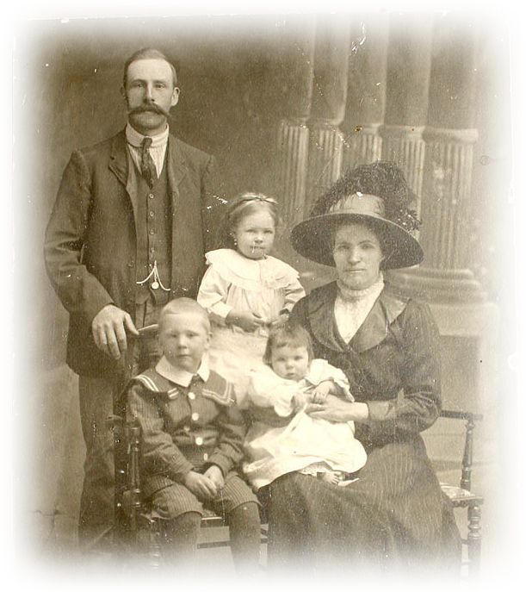
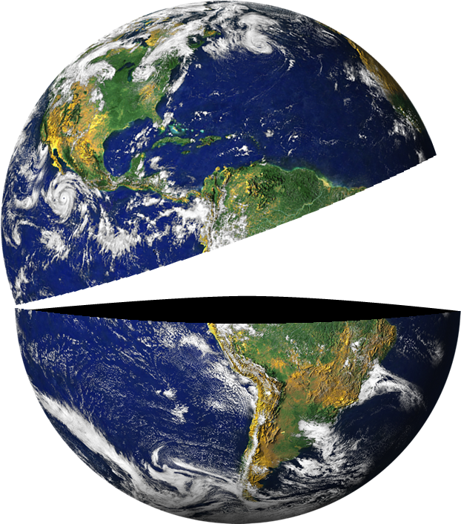
The GENERATION Cycle
⁴ Generations come and generations go, but the earth remains forever.
Notes:
Old family picture = FREE = from http://www.sxc.hu/photo/517748

Slide 8

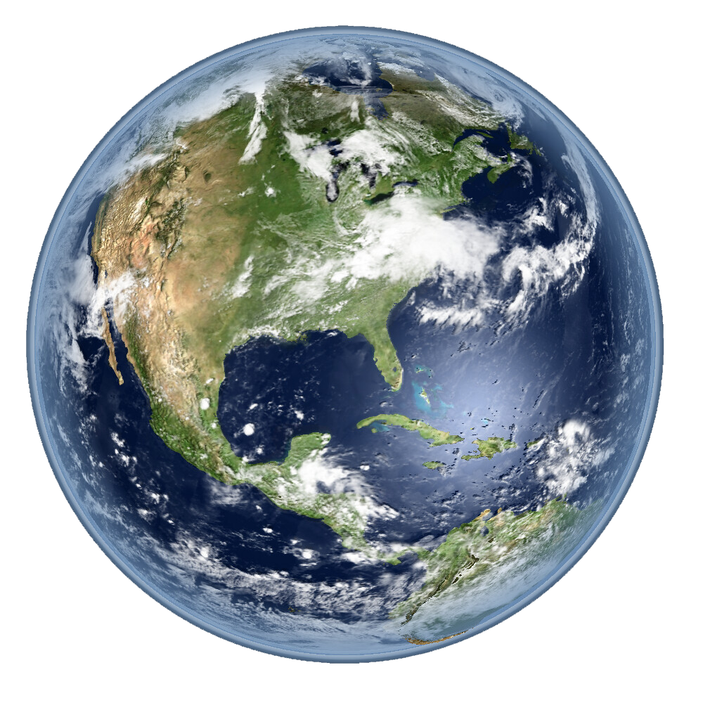
The SOLAR Cycle
⁵ The sun rises and the sun sets,
and hurries back to where it rises.
Notes:
Sun = FREE = from http://commons.wikimedia.org/wiki/File:The_sun_fire_sky.JPG

Slide 9
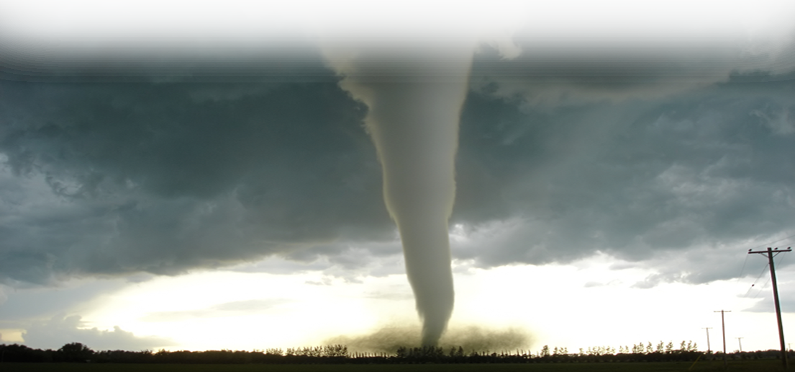
The WIND Cycle
⁶ The wind blows to the south and turns to the north; round and round it goes, ever returning on its course.
Notes:
Tornado = FREE = from http://upload.wikimedia.org/wikipedia/commons/9/98/F5_tornado_Elie_Manitoba_2007.jpg

Slide 10
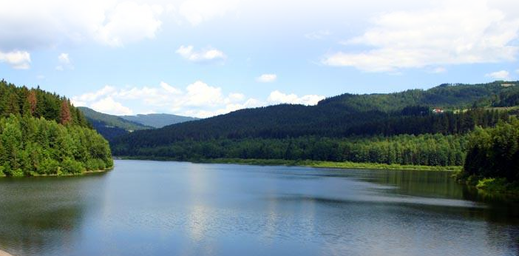
The WATER Cycle
⁷ All streams flow into the sea, yet the sea is never full. To the place the streams come from, there they return again.
Notes:
River = FREE = from http://commons.wikimedia.org/wiki/File:Wisla_075.jpg

Slide 11
6. EMPTINESS: Not Enough

Slide 12
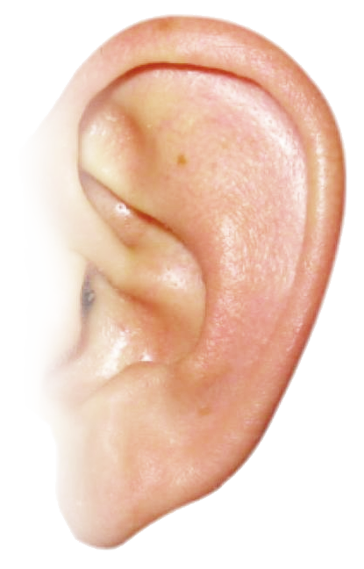
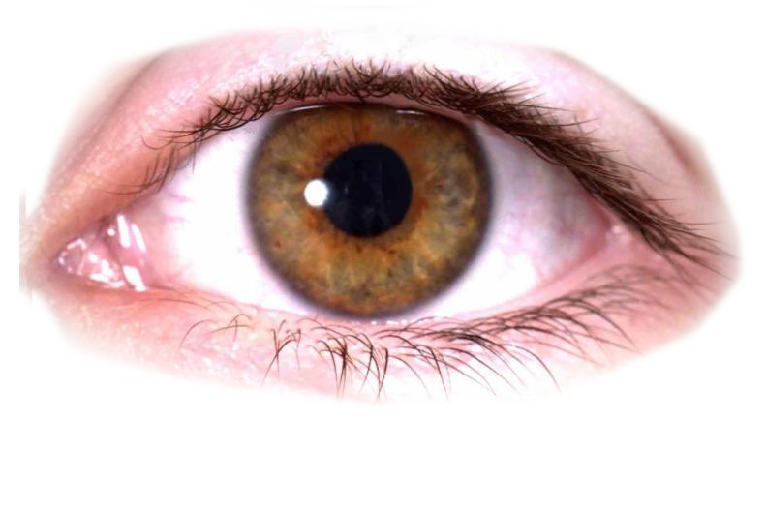
“Not Enough”
⁸ All things are wearisome, more than one can say. The eye never has enough of seeing, nor the ear its fill of hearing.
Notes:
Ear and eye = FREE = https://kids-flashcards.com/en/free-printable/face-flashcards-in-english#gsc.tab=0

Slide 13
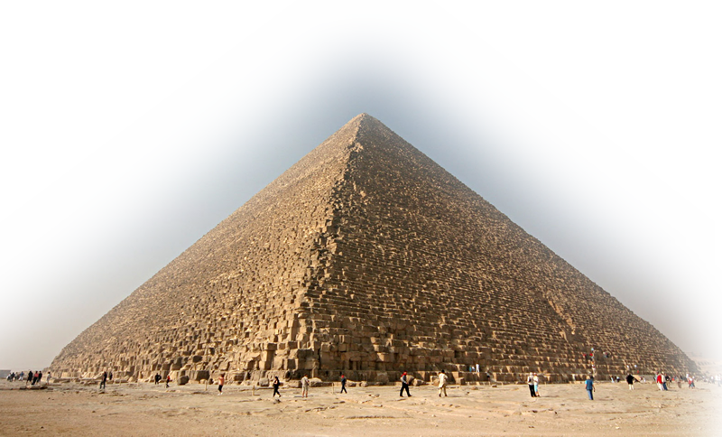
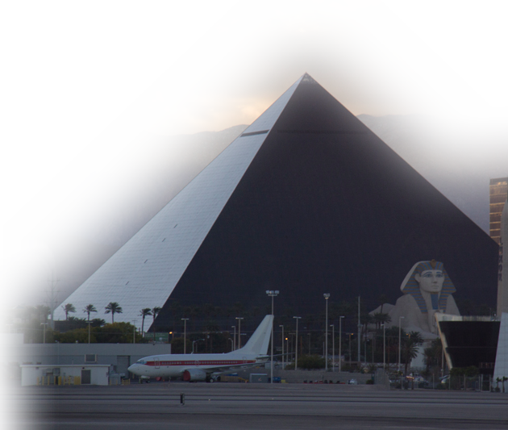
“Nothing New”
⁹ What has been will be again, what has been done will be done again; there is nothing new under the sun.
Notes:
Great Pyramid= FREE = from http://upload.wikimedia.org/wikipedia/commons/e/e3/Kheops-Pyramid.jpg
Luxor Hotel Vegas = FREE = from http://commons.wikimedia.org/wiki/File:The_Luxor_From_Airport.jpg

Slide 14

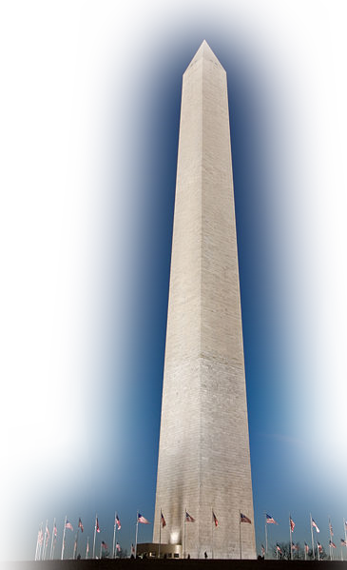
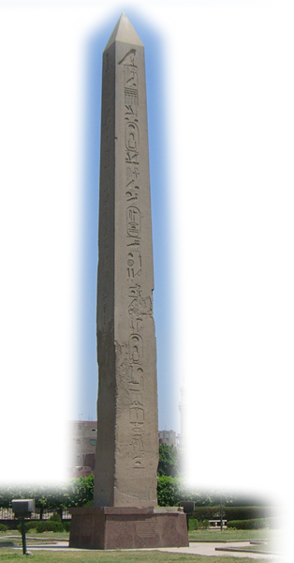
“Nothing New”
¹⁰ Is there anything of which one can say, "Look! This is something new"?
It was here already, long ago; it was here before our time.
Notes:
Egyptian Obelisk = FREE = from http://commons.wikimedia.org/wiki/File:Heliopolis200501.JPG
Washington Monument = FREE = from http://commons.wikimedia.org/wiki/File:Washington_Monument_Dusk_Jan_2006.jpg
Sears towers = FREE = from http://upload.wikimedia.org/wikipedia/commons/e/e5/Sears_tower_orthogonal.jpg

Slide 15
“No Memory”
¹¹ There is no remembrance of men of old, and even those who are yet to come will not be remembered by those who follow.
Ctrl + Alt
+ Delete
Notes:
Even worse in our day = Cancel Culture!

Slide 16
Nothing Satisfies
(No inner peace)
(Never satisfy for long)
(Can’t take it with you)
(Is that all there is?)
(Time is up eventually)
(Can’t buy happiness)
(You’re going down)
(A fool will mess it up)
(You are growing old)
Not Intellect
Not Pleasures
Not Materialism
Not Careers
Not Long Life
Not Money
Not Prestige
Not Politics
Not Youthfulness

Slide 17
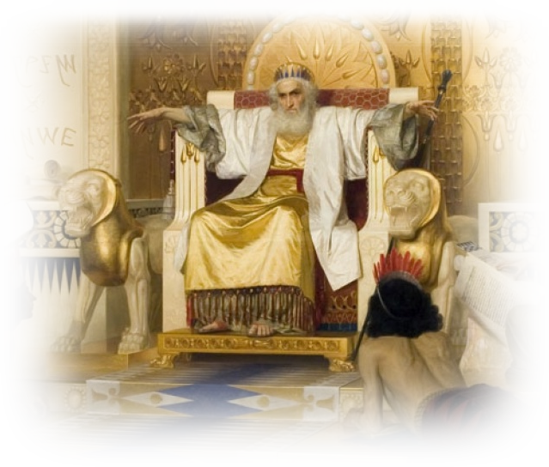
7. The PURSUIT: To Study
¹² I, the Teacher, was king over Israel in Jerusalem. ¹³ I devoted myself to study and to explore by wisdom all that is done under heaven.

Slide 18
7. The PURSUIT: To Study
¹² …. What a heavy burden God has laid on men! ¹⁴ I have seen all the things that are done under the sun; all of them are meaningless, a chasing after the wind.

Slide 19
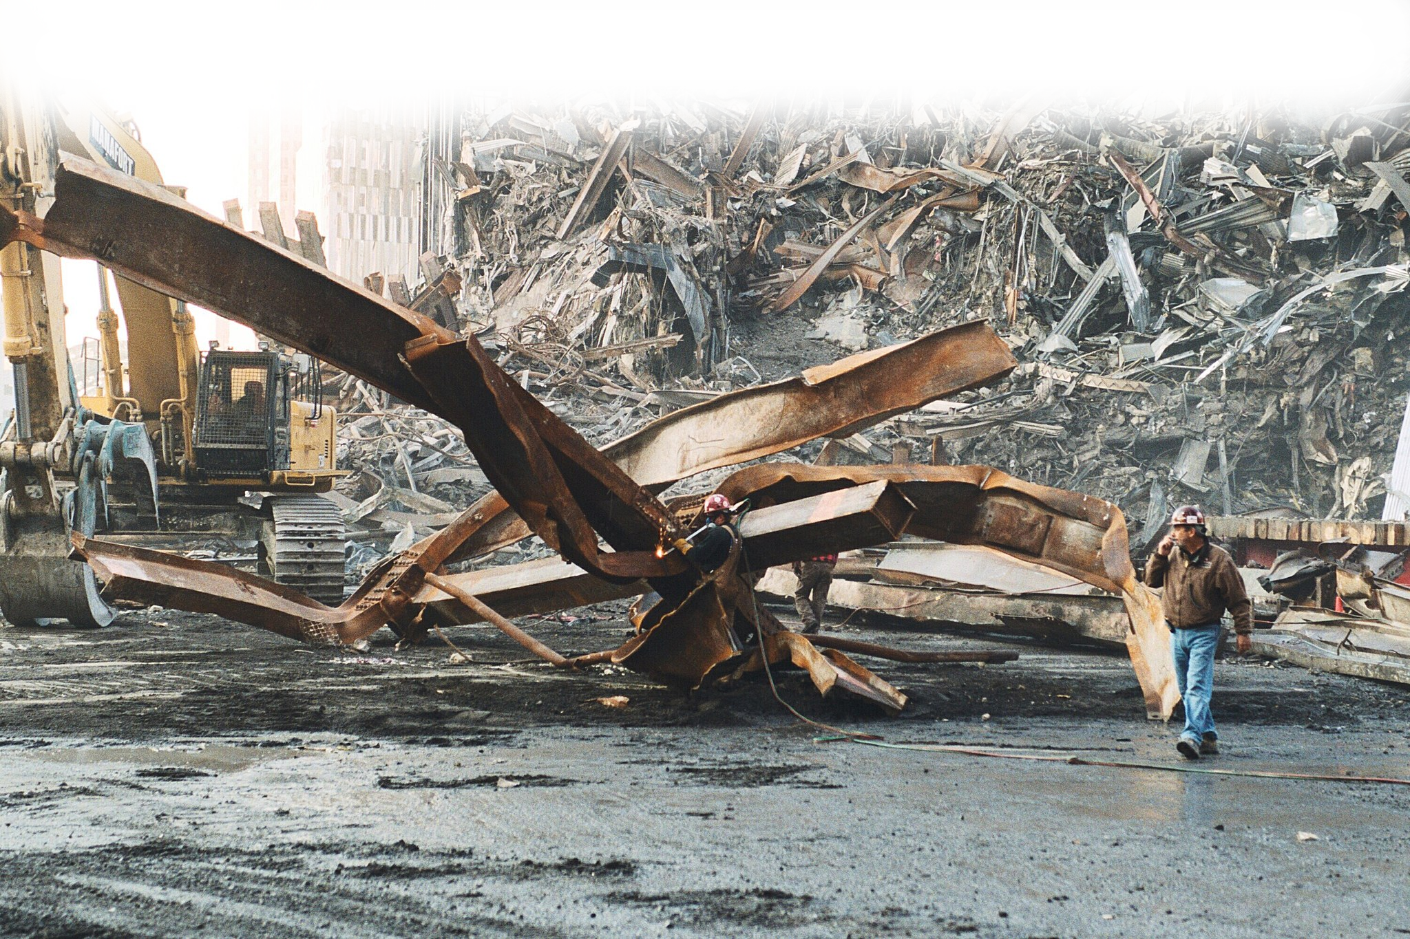
7. The PURSUIT: To Study
¹⁵ What is twisted cannot be straightened; what is lacking cannot be counted.
Notes:
https://commons.wikimedia.org/wiki/File:Debris_pile_at_Ground_Zero-World_Trade_Center_site-NYC.jpg
Not everything can be changed or fixed!
Abortion can not be fixed—you cannot bring the baby back!.

Slide 20
7. The PURSUIT: To Study
¹⁶ I thought to myself, "Look, I have grown and increased in wisdom more than anyone who has ruled over Jerusalem before me; I have experienced much of wisdom and knowledge."

Slide 21
7. The PURSUIT: To Study
¹⁷ Then I applied myself to the understanding of wisdom, and also of madness and folly, but I learned that this, too, is a chasing after the wind.
WISDOM
VS
FOLLY

Slide 22
7. The PURSUIT: To Study
¹⁸ For with much wisdom comes much sorrow; the more knowledge, the more grief.
Notes:
The more you learn – the more you know you don’t know!
All goes back to Eden – Promised to have eyes open KNOWING good and evil. And brought sin and misery. It was a false promise.

Slide 23

8.The CURE:
Chapter 12:8-14
Notes:
https://upload.wikimedia.org/wikipedia/commons/3/34/%22Miracle_Cure%21%22_Health_Fraud_Scams_%288528312890%29.jpg
The cure is not found in chapter 1; you have to go to the end of the book, to the last chapter, chapter 12.:8ff.

Slide 24
Who Says there’s a
CURE to this emptiness?

Slide 25
The TEACHER: Solomon
^{12:8} ...says the Teacher....
⁹ Not only was the Teacher wise, but also he imparted knowledge to the people .…
¹⁰ The Teacher searched….

Slide 26
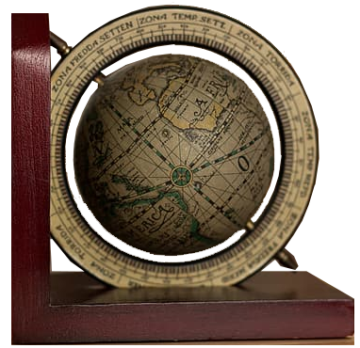
His PREMISE: “Emptiness”
⁸ "Meaningless! Meaningless!" says the Teacher. "Everything is meaningless!"
Meaningless!
"Everything
Meaningless!
Notes:
https://www.pikrepo.com/fanmg/brown-book-beside-brown-bookend

Slide 27
The STUDY: For Truth
The Teacher searched to find just the right words, and what he wrote was upright and true.
Notes:
I’m not sure everyone grapes the significance of the Bible being God’s Word.
Do you believe this book is God’s Word. It is inspired by God. It is Authorataative for your life and beliefs, It is inerrant.
IT IS TRUE!!!

Slide 28
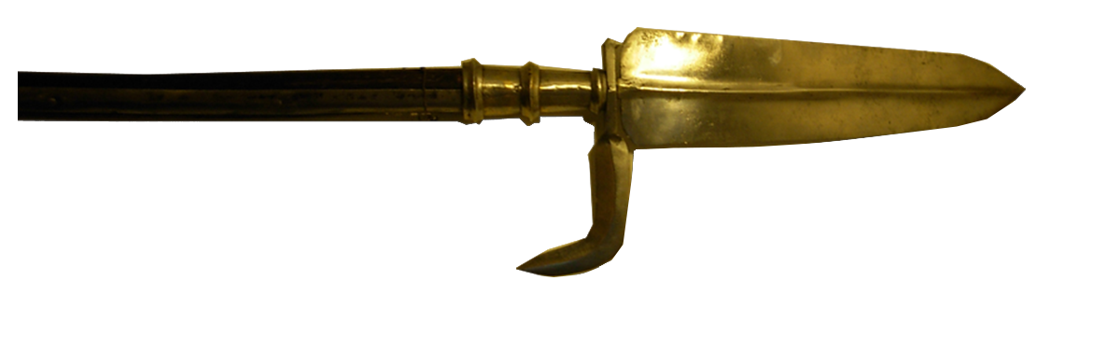
The TRUTH is CONVICTING
¹¹ The words of the wise are like goads, their collected sayings like firmly embedded nails--given by one Shepherd.
Notes:
Goad = FREE = from http://commons.wikimedia.org/wiki/File:Spear_-_partyzana_-_in_Muzeum_Zag%C5%82%C4%99bia.JPG

Slide 29
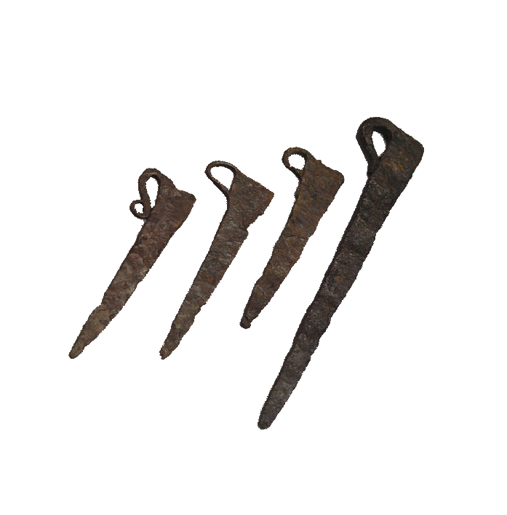
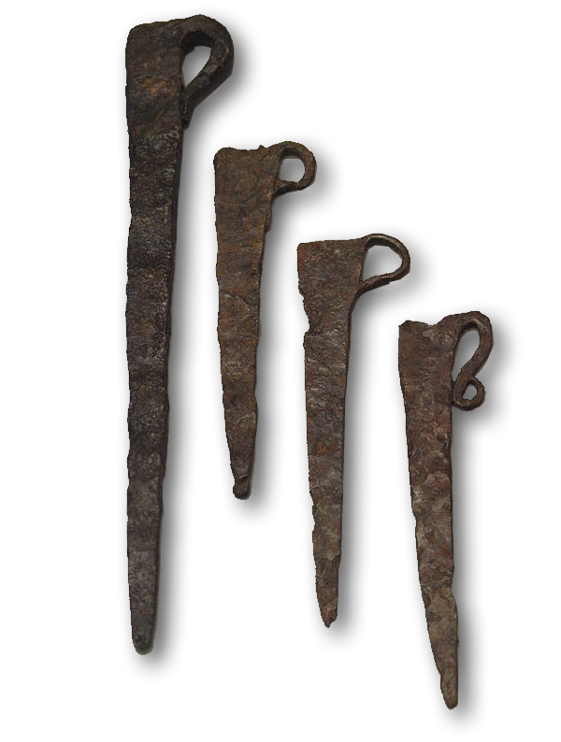
The TRUTH is SECURITY:
¹¹ The words of the wise are like goads, their collected sayings like firmly embedded nails--given by one Shepherd.
Notes:
Goad = FREE = from http://commons.wikimedia.org/wiki/File:Spear_-_partyzana_-_in_Muzeum_Zag%C5%82%C4%99bia.JPG
Roman Tent Nails = FREE = from http://commons.wikimedia.org/wiki/File:Roman_Tent-pegs.jpg

Slide 30

The TRUTH is IRREPLACABLE:
¹² Be warned, my son, of anything in addition to them. Of making many books there is no end, and much study wearies the body.
Notes:
Warning Sign = FREE = from http://www.sxc.hu/browse.phtml?f=download&id=991899

Slide 31

The CURE to Emptiness

Slide 32

8. The CURE: Fear God
¹³ Now all has been heard; here is the conclusion of the matter: Fear God and keep his commandments, for this is the
whole duty of man.
Notes:
Man praying = LICENSED and NOT FOR REUSE. To reuse elsewhere get a license from http://www.dreamstime.com/item.php?imageid=4274457

Slide 33
Go ABOVE the sun
¹³ Now all has been heard; here is the conclusion of the matter: Fear God and keep his commandments, for this is the
whole duty of man.
Notes:
Man praying = LICENSED and NOT FOR REUSE. To reuse elsewhere get a license from http://www.dreamstime.com/item.php?imageid=4274457

Slide 34
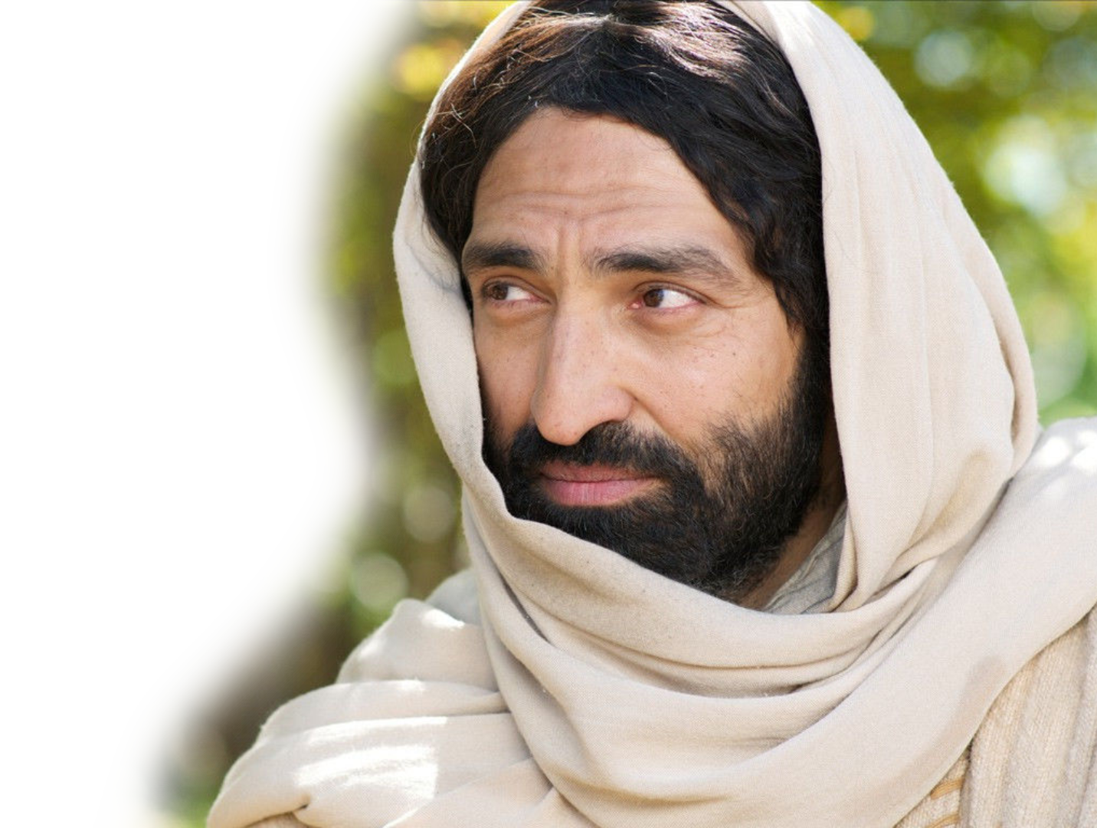
Go ABOVE the sun–to the Son
¹³ Now all has been heard; here is the conclusion of the matter: Fear God and keep his commandments, for this is the
whole duty of man.
"If you love me, you will obey what I command." (John 14:15)
Notes:
Man praying = LICENSED and NOT FOR REUSE. To reuse elsewhere get a license from http://www.dreamstime.com/item.php?imageid=4274457

Slide 35
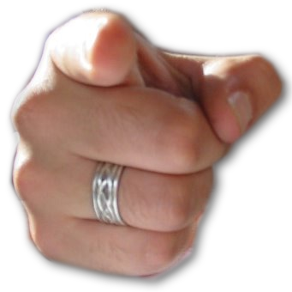
The TRUTH is PRACTICAL:
¹³ Now all has been heard; here is the conclusion of the matter: Fear God and keep his commandments, for this is
the whole duty of man.
³¹ So whether you eat or drink or whatever you do, do it all for the glory of God. (1Cor 10:31)
Notes:
Finger Pointing = FREE = from http://www.sxc.hu/browse.phtml?f=download&id=534732
Notice the italicized words. They are added for clarification.
Really, it says “this is the whole” thing! This is it in it’s totality.
1 Cor 10:31

Slide 36

The TRUTH is REASONABLE:
¹⁴ For God will bring every deed into judgment, including every hidden thing, whether it is good or evil.
Notes:
Scales = FREE = from http://commons.wikimedia.org/wiki/File:Scale_of_justice_2_new.jpeg

Slide 37
Final Thought:
Stop the emptiness!
How?

Slide 38

Final Thought:
Come to the only one who can fully satisfy!
I have come that they may
have life, and have it to the
full. (John 10:10)
Notes:
Splash https://www.premioscodespa.com/

Slide 39

Let’s pray now …
TO BE HAPPY!

