Slide 1

Notes:
Map background = FREE = from http://www.sxc.hu/browse.phtml?f=download&id=1129385

Slide 2
Beyond the Now Age
MY PREMISE:
A consistent literal, grammatical, and historical interpretation of the Scriptures leads to “Dispensationalism.”
WHAT IS THAT?

Slide 3
The Word Dispensationalism...
comes from the Greek word for a “steward.” Three things are involved:
1) A Master: who gives a responsibility to the steward.
2) A Steward: who receives a responsibility from his
master.
3) And a Stewardship: responsibility--what must be
accounted for.

Slide 4
Dispensationalists advocate ...
1) God is the Master—he gives responsibilities (the employer) … the “Dispenser!”
2) Mankind is the steward—mankind receives responsibilities (the employee) … the “dispensee!”
3) Dispensations = the responsibility given (steward-ship) (the employment)…the “dispensation!”

Slide 5
Now, because God gave His revelation “progressively” (not a single installment!) there are distinguishable economies (dispensations) in which He gave different responsibilities to mankind.
This is most easily developed with a chart:

Slide 6
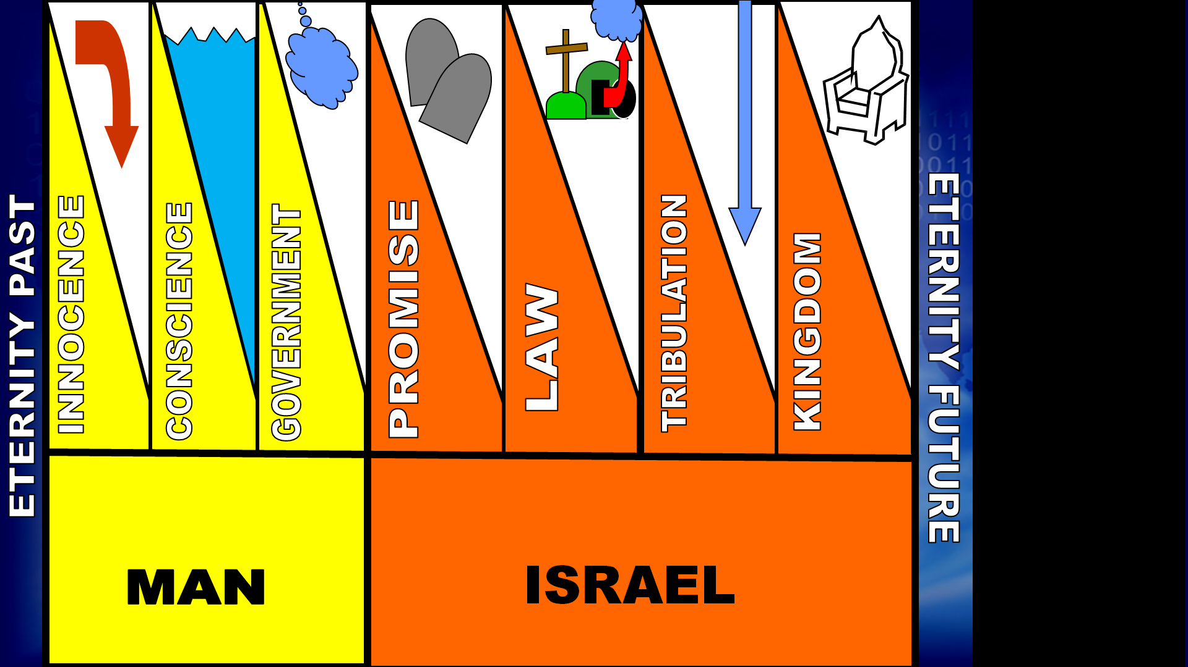

Slide 18
DELAY

Slide 19
CHURCH
CHURCH

Slide 20
CHURCH
CHURCH

Slide 21
Any Questions?

Slide 22
CHURCH
CHURCH

Slide 23
Keys Terms include:
Second Coming (Rapture and Revelation)
Resurrection (Life, Damnation)
Millennium (Pre-, Post-, A-)
Tribulation (Pre-, Mid-, Post-, Prewrath-, Partial-,Great-)
Judgment (Seat, of the Nations, Great White)
Judgment day (of Lord, of Christ)
Destinies (Heaven and Hell)

Slide 24
The Second Coming
Predicted—John 14:3; Acts 1:11
John 14:3 And if I go and prepare a place for you, I will come back and take you to be with me that you also may be where I am.
Acts 1:11 This same Jesus, who has been taken from you into heaven, will come back in the same way you have seen him go into heaven."

Slide 25

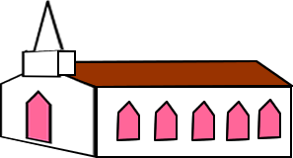
The Second Coming
…is in phases
1- Rapture (in the air): 1 Thes 4:16-18; 1 Cor 15:51-52; 2 Cor 5:1-10
  2- Revelation (to the earth): Matt 24:30-31; Rev 19:11-21
(Tribulation)
(Mill.)

Slide 26
Rapture
The term “rapture”
is from the Latin
Vulgate (rapiemur)
for “caught up”
in 1 Thes 4:17.

Slide 27
Rapture
The term “rapture”
is from the Latin
Vulgate (rapiemur)
for “caught up”
in 1 Thes 4:17.

Slide 28
Rapture
The term “rapture”
is from the Latin
Vulgate (rapiemur)
for “caught up”
in 1 Thes 4:17.

Slide 29
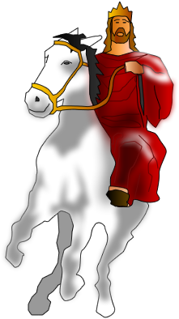
Revelation
The word “revelation” is used for both the last book of the Bible and the grand event of that book: the return of Christ to the earth to establish His kingdom (Rev.19:11).
(Tribulation)
(Mill.)

Slide 30
The Resurrection
Two Kinds:
  --To Life --To Damnation
John 5:28-29 "Do not be amazed at this, for a time is coming when all who are in their graves will hear his voice 29 and come out-- those who have done good will rise to live, and those who have done evil will rise to be condemned.

Slide 31
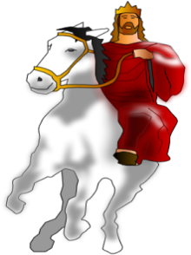




The Resurrection to Life
Takes place in phases: Resurrection Program
  1- Christ’s (first fruits) 1 Cor 15:20
  2- Rapture (at Christ’s coming) 1 Cor 15:51-52; 1 Thes 4:16-17
  3- Tribulation Saints (end of Trib) Daniel 12:2; Rev 20:3-5
  4- Millennial Saints Rev 20:12-15
(Trib.)
(Millennium)

Slide 32



Resurrection to Damnation
John 5:29 “those who have done evil will rise to be condemned.”
Revelation 20:12-15 12 And I saw the dead, great and small, standing before the throne … The dead were judged …. 15 If anyone's name was not found written in the book of life, he was thrown into the lake of fire.

Slide 33
Any Questions?

Slide 34
REVELAT
I
ON
GWT
RAPTURE
CHURCH
CHURCH

Slide 35
Millennium
The Word “millennium” is not found in the Bible!
  The Latin mille = 1,000
  The Latin annus = year
  The Greek = chilia occurs only in Rev. 20:2, 3
(Millennium = 1,000 years)

Slide 36
2 He seized the dragon, that ancient serpent, who is the devil, or Satan, and bound him for a thousand years. 3 He threw him into the Abyss, and locked and sealed it over him, to keep him from deceiving the nations anymore until the thousand years were ended. After that, he must be set free for a short time.
The Word “millennium” is not found in the Bible!

Slide 37
Millennium
⁴ … And I saw the souls of those who had been beheaded because of their testimony for Jesus and because of the word of God. They had not worshiped the beast or his image and had not received his mark on their foreheads or their hands. They came to life and reigned with Christ a thousand years.
The Word “millennium” is not found in the Bible!

Slide 38
Millennium
It refers to a 1,000 year reign of the Christ over a literal KINGDOM of God on the earth.
Various views include:
  Pre-Millennialism
  Post-Millennialism
  A-Millennialism
(Millennium = 1,000 years)

Slide 39
PRE-Millennialism
Holds that the return of Christ will be BEFORE a literal 1,000 year reign as king over a literal kingdom on earth.
1000 YEARS

Slide 40
POST-Millennialism
Holds that the return of Christ will be AFTER a literal 1,000 year reign of righteousness is brought about by the church as the
kingdom of God.
1000 YEARS

Slide 41
A-Millennialism
Holds that the return of Christ will be WHENEVER because the kingdom of Christ is spiritual and is going on right now in the hearts of believers. There is no literal kingdom. The term “1,000 years” is symbolic for a long time.

Slide 42
Tribulation
The term “tribulation” is from the King James
version of Matthew 24-25.
It is used to refer to a future
time of terrible distress to the
world and Israel.
(Tribulation)

Slide 43
Tribulation
It will last seven years (Dan 9:27)
Other terms for it include:
  Daniels 70th “Seven” (“Week” KJV)
  the Day of the LORD (Ez 30:3)
  Time of Jacob’s Trouble (Jer 30:7)
7 YR PERIOD
( Tribulation )

Slide 44
GREAT-Tribulation
Refers to the second half of the “tribulation” period and begins when the “abomination that causes desolation” appears in the temple.
(Mat 24:15-24; Daniel 9:27).
TRIB
3 1/2
7 YR PERIOD
( Tribulation )

Slide 45
GREAT-Tribulation
Other references to the “great tribulation include:
  Time of Jacob’s trouble (Jer 30:7)
  Time, times and ½ time (Dan 12:7)
  1,260 days (Rev 11:3)
  Great day of their wrath (Rev 6:17)
7 YR PERIOD
TRIB
3 1/2
( Tribulation )

Slide 46
PRE-Tribulation
Means that the “rapture of the church” will take place BEFORE the “tribulation” begins.
TRIBUALTATION
LAST 3 1/2

Slide 47
POST-Tribulation
Means that the “rapture of the church” will take place at the END OF or AFTER the “tribulation.”
TRIBUALTATION
LAST 3 1/2

Slide 48
MID-Tribulation
Means that the “rapture of the church” will take place in the MIDDLE of the “tribulation” period.
TRIBUALTATION
LAST 3 1/2

Slide 49
PRE-WRATH-Tribulation
Means that the “rapture of the church” will take place PRIOR TO THE WRATH associated with the “tribulation” period.
TRIBUALTATION
LAST 3 1/2

Slide 50
PARTIAL-Tribulation
Means that only those waiting and watching for Christ will be taken in the rapture—those not ready will be left to endure the “tribulation” period.
Matthew 25:1-13 “Ten Virgins”
¹³ "Therefore keep watch,
because you do not know the day or the hour.

Slide 51
Any Questions?

Slide 52
REVELAT
I
ON
GWT
RAPTURE
CHURCH
CHURCH

Slide 53
JUDGMENT
Judgment falls into different categories:
  The Judgment Seat of Christ
  (For church-age believers!)
  The Judgment of the Nations
  (For survivors of Tribulation)
  The Great White Throne Judgment
  (For all un-judged at the end)

Slide 54
Judgment SEAT of Christ
Βηματοj Place of reward. (2 Cor 5:10;
Rom 14:10; 1 Cor 3:9-15). Takes place in heaven.
No condemnation (Rom. 8:1) For the believer’s condemnation was paid for at the cross!
(Judgment Seat)
(Church)
( Tribulation )
(Millen.)

Slide 55
Judgment SEAT of Christ
1 Cor 3: 11 For no one can lay any foundation other than the one already laid, which is Jesus Christ. 12 If any man builds on this foundation using gold, silver, costly stones, wood, hay or straw, 13 his work will be shown for what it is, because the Day will bring it to light. It will be revealed with fire, and the fire will test the quality of each man's work.

Slide 56
Judgment SEAT of Christ
14 If what he has built survives, he will receive his reward. 15 If it is burned up, he will suffer loss; he himself will be saved, but only as one escaping through the flames.

Slide 57
Judgment of the NATIONS
Mat 25:31-46 31 "When the Son of Man comes … he will sit on his throne in heavenly glory. 32 All the nations will be gathered before him, and he will Separate the people one from another as a shepherd
separates the sheep from the goats.
33 He will put the sheep on his right
and the goats on his left.
SHEEP
GOATS
(Judg. Seat)
(Church)
( Tribulation )
(Millen.)

Slide 58
Judgment of the NATIONS
34 "Then the King will say to those on his right, 'Come, …take your inheritance, the kingdom prepared for you since the creation of the world. …41 "Then he will say to those on his left, 'Depart from me,
you who are cursed, into the
eternal fire prepared for the
devil and his angels. …
SHEEP
GOATS
(Judg. Seat)
(Church)
( Tribulation )
(Millen.)

Slide 59
Judgment of the NATIONS
46 "Then they will go away to eternal punishment, but the righteous to eternal life."
SHEEP
GOATS
(Judg. Seat)
(Church)
( Tribulation )
(Millen.)

Slide 60
GREAT WHITE THRONE Judgment
Rev 20:11-15 Then I saw a great white throne and him who was seated on it. Earth and sky fled from his presence, and there was no place
for them. 12 And I saw the dead, great
and small, standing before the
throne, and books were opened.
(Church)
( Trib )
(Millennium)

Slide 61
GREAT WHITE THRONE Judgment
Another book was opened, which is the book of life. The dead were judged according to what they had done as recorded in the books.
13 The sea gave up the dead that
were in it, and death and Hades gave
up the dead that were in them, and
each person was judged ...

Slide 62
GREAT WHITE THRONE Judgment
... according to what he had done. 14 Then death and Hades were thrown into the lake of fire. The lake of fire is the second death.
15 If anyone's name was not found
written in the book of life, he was
thrown into the lake of fire.

Slide 63
[Judgment] Day of …
The LORD:
  Day of Darkness--Tribulation
  Day of Light—Millennial blessing (ON EARTH!)
NIGHT
judgment
tribulation
DAY
blessing
millennium

Slide 64
[Judgment] Day of …
Christ:
  Day of Fire (1 Cor 3:11-13)
  Day of Reward and Loss of Reward (1 Cor 11:14-15)
  (IN HEAVEN)

Slide 65
Final Destinies
Heaven
  Paradise (Lk 23:43; 2 Cor 12:4)
  3rd Heaven (2 Cor 12:2)
  Father’s House (John 14:2)
  New Jerusalem (Rev 21-22)
Hell
  Eternal Fire or the Lake of Fire (Mat 25:41; Rev 20:15)
  Sheol/Hades (Lk 16:23)
  Gehenna (Mat 18:19)

Slide 66
REVELAT
I
ON
GWT
RAPTURE
CHURCH
CHURCH

Slide 67
Any Questions?

Slide 68
Next Time … Daniel
The Key to Prophecy
Read Daniel 1-6

