Slide 1
Christmas: A Sight for Sore Eyes

Slide 2
The idiom:
“Sight for sore eyes”
means “A welcome sight”
Our passage today tells of a man of God (Simeon) and a woman of God (Anna) who both see Christmas as a welcome sight.
Notes:
Not everyone is looking for the real meaning of Christmas today, nor were they then!
The other day I saw one of those cartoons that would really be funny if it weren't so true. It pictured two ladies hurrying down the street obviously busy Christmas shopping. They pass a window with a nativity scene. One turns to the other and says with a disturbed look, "Wouldn't you know it? Somebody is always pushing religion. Now we can't even have Christmas without it!"
Two were... A man and a woman. All we know of them is in this single text of scripture – but it tells us a lot.

Slide 3
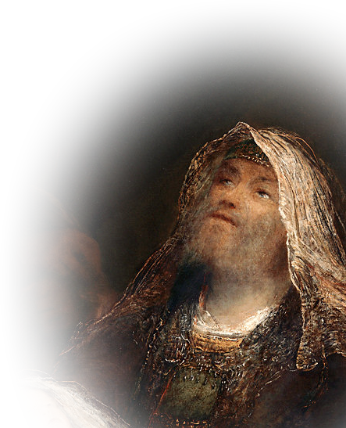
A Man of God
²⁵ Now there was a man in Jerusalem called Simeon,
WITH GODLY CHARACTERISTICS...

Slide 4
He was RIGHTEOUS:
²⁵ Now there was a man in Jerusalem called Simeon, who was righteous and devout. He was waiting for the consolation of Israel, and the Holy Spirit was upon him.

Slide 5
He was DEVOUT:
²⁵ Now there was a man in Jerusalem called Simeon, who was righteous and devout. He was waiting for the consolation of Israel, and the Holy Spirit was upon him.

Slide 6
He was PATIENT:
²⁵ Now there was a man in Jerusalem called Simeon, who was righteous and devout. He was waiting for the consolation of Israel, and the Holy Spirit was upon him.

Slide 7
He was SPIRITUAL:
²⁵ Now there was a man in Jerusalem called Simeon, who was righteous and devout. He was waiting for the consolation of Israel, and the Holy Spirit was upon him.

Slide 8
He was SPIRITUAL:
²⁵ Now there was a man in Jerusalem called Simeon, who was righteous and devout. He was waiting for the consolation of Israel, and the Holy Spirit was upon him.
All qualities we need today...

Slide 9
A Man of God’s WORD:

Slide 10
A Man of God’s Word:
²⁶ It had been revealed to him by the Holy Spirit that he would not die before he had seen the Lord's Christ.
Today, we need people of His Word.
Notes:
He had only one important item on his Bucket list

Slide 11
A SENSITIVE Man of God:

Slide 12
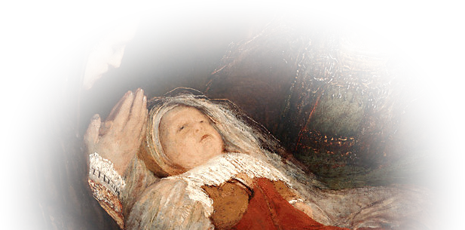
A SENSITIVE Man of God:
²⁷ Moved by the Spirit, he went into the temple courts. When the parents brought in the child Jesus to do for him what the custom of the Law required,
We need sensitivity today too.

Slide 13
The PRAISE of A Man of God:

Slide 14
The PRAISE of A Man of God:
²⁹ "Sovereign Lord, ...

Slide 15
PRAISE for God’s PROMISE:
²⁹ "Sovereign Lord, as you have promised, you now dismiss your servant in peace.

Slide 16
PRAISE for God’s SALVATION:
³⁰ For my eyes have seen your salvation, ³¹ which you have prepared in the sight of all people, ³² a light for revelation to the Gentiles and for glory to your people Israel.“

Slide 17
PRAISE for God’s ENLIGHTENMENT:
³⁰ For my eyes have seen your salvation, ³¹ which you have prepared in the sight of all people, ³² a light for revelation to the Gentiles and for glory to your people Israel.“

Slide 18
PRAISE for God’s ENLIGHTENMENT:
³⁰ For my eyes have seen your salvation, ³¹ which you have prepared in the sight of all people, ³² a light for revelation to the Gentiles and for glory to your people Israel.“
That’s why we praise Him too!

Slide 19
How parents responded to him:
³³ The child's father and mother marveled at what was said about him.

Slide 20
The BLESSING from a Man of God:
³⁴ Then Simeon blessed them
and said to Mary, his mother:

Slide 21
BLESSING the Child’s DESTINY:
"This child is destined to cause the falling and rising of many in Israel, and to be a sign that will be spoken against, ³⁵ so that the thoughts of many hearts will be revealed. And a sword will pierce your own soul too."

Slide 22
BLESSING the Child’s DESTINY:
"This child is destined to cause the falling and rising of many in Israel, and to be a sign that will be spoken against, ³⁵ so that the thoughts of many hearts will be revealed. And a sword will pierce your own soul too."

Slide 23
BLESSING the Child’s DESTINY:
"This child is destined to cause the falling and rising of many in Israel, and to be a sign that will be spoken against, ³⁵ so that the thoughts of many hearts will be revealed. And a sword will pierce your own soul too."

Slide 24
BLESSING the Child’s DESTINY:
"This child is destined to cause the falling and rising of many in Israel, and to be a sign that will be spoken against, ³⁵ so that the thoughts of many hearts will be revealed. And a sword will pierce your own soul too."

Slide 25
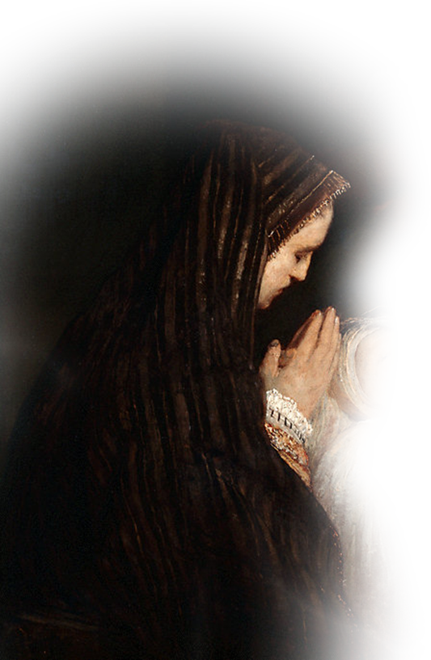
A Woman of God:
WITH GODLY CHARACTERISTICS...

Slide 26
She was a PROPHETESS:
³⁶ There was also a prophetess, Anna, the daughter of Phanuel, of the tribe of Asher. She was very old; she had lived with her husband seven years after her marriage, ³⁷ and then was a widow until she was eighty-four.

Slide 27
She was VERY OLD: over 100 years
³⁶ There was also a prophetess, Anna, the daughter of Phanuel, of the tribe of Asher. She was very old; she had lived with her husband seven years after her marriage, ³⁷ and then was a widow until she was eighty-four.
Never too old!

Slide 28
She was DEVOUT:
She never left the temple but worshiped night and day, fasting and praying.
Ministry never ends!

Slide 29
She was Sensitive to God:
³⁸ Coming up to them at that very moment, she gave thanks to God and spoke about the child to all who were looking forward to the redemption of Jerusalem.
We need sensitive women today!

Slide 30
Parents response to her:
³⁹ When Joseph and Mary had done everything required by the Law of the Lord, they returned to Galilee to their own town of Nazareth. ⁴⁰ And the child grew and became strong....

Slide 31
Let’s sum it up:
Christmas THEN focused on:
National leaders--Caesar Augustus’ whim
Commoners--Shepherd in fields
Elderly--God fearing believers
Christmas NOW--Nothing has changed
God is still in control of the nations
The common person seem to find him first
The elderly seem far more sensitive to Him

Slide 32
Let’s Pray

