Slide 1
The Signs of Christmas – Then & Now
Notes:
Star Cross = Licensed and NOT FOR REUESE elsewhere = To reuse get a license from http://www.bigstockphoto.com/image-3712689/stock-photo-christian-cross-in-stars

Slide 2
Three sets of Signs:
Pointing TO Christmas: Old Testament signs

Slide 3
Three sets of Signs:
Pointing TO Christmas: Old Testament signs
Pointing AT Christmas: Christmas Day signs

Slide 4
Three sets of Signs:
Pointing TO Christmas: Old Testament signs
Pointing AT Christmas: Christmas Day signs
Pointing BACK TO Christmas: Present day signs

Slide 5
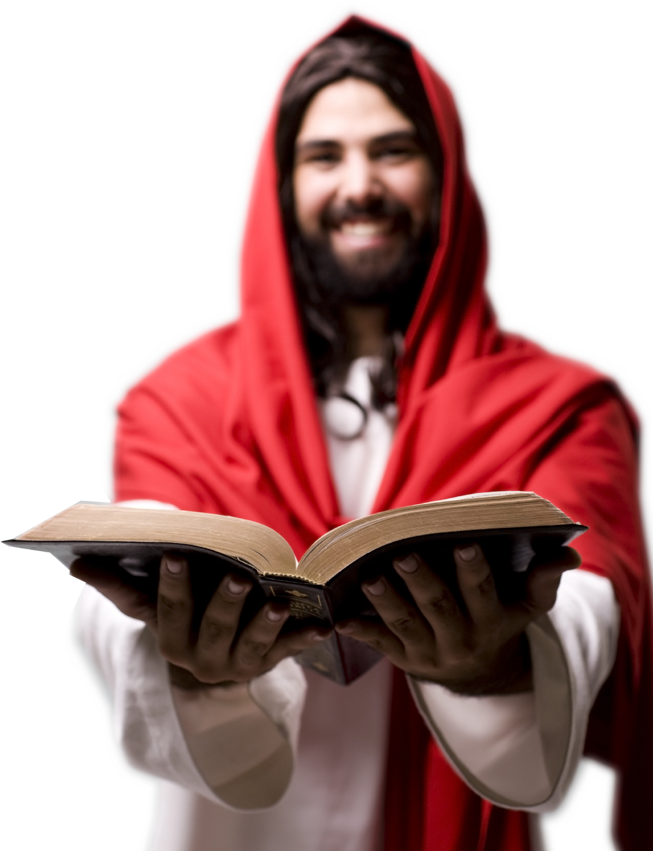
Pointing TO ...
These are the Scriptures that testify about me, John 5:39
Notes:
Jesus with bible = LICENSED AND NOT FOR REUSE ELSEWHERE = To use get a license from istockphoto.com

Slide 6
Pointing TO ...
²⁷ And beginning with Moses and all the Prophets, he explained to them what was said in all the Scriptures concerning himself. Luke 24:27

Slide 7
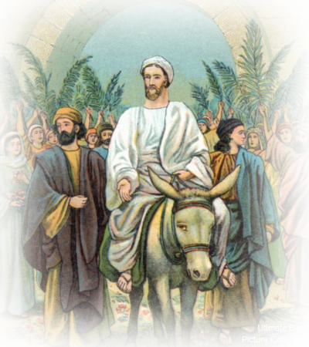
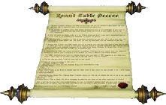
1-Time: Daniel 9:25-26
²⁵ From the issuing of the decree to restore and rebuild Jerusalem until the Anointed One, the ruler, comes, ...
32AD
445 BC
483 years
Notes:
Triumphal entry = FREE = public domain

Slide 8
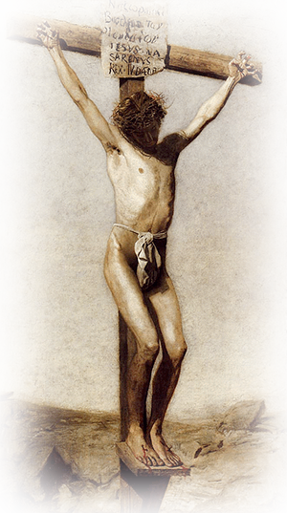
1-Time: Daniel 9:25-26
²⁶ After ... the Anointed One will be cut off ....
445 BC
483 years

Slide 9
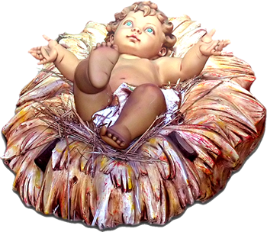
1-Time: Daniel 9:25-26
²⁶ After ... the Anointed One will be cut off ....
445 BC
483 years
Notes:
Baby in manger = FREE = from http://www.rgbstock.com/photo/mjBX5oc/Baby+in+a+manger+2

Slide 10
2-Location: Micah 5:2
² "But you, Bethlehem ... out of you will come for me one who will be ruler over Israel, whose origins are from of old, from ancient times. “

Slide 11
3-Mission: Zechariah 9:9
⁹ Rejoice greatly, O Daughter of Zion! Shout, Daughter of Jerusalem! See, your king comes to you, righteous and having salvation, gentle and riding on a donkey, on a colt, the foal of a donkey.

Slide 12
3-Mission: Isaiah 53
⁶ We all, like sheep, have gone astray, each of us has turned to his own way; and the LORD has laid on him the iniquity of us all. (Isa 53:6 NIV)

Slide 13
4-Method: Isaiah 7:14
¹⁴ Therefore the Lord himself will give you a sign: The virgin will be with child and will give birth to a son, and will call him Immanuel.
Notes:
Pregnant woman = FREE = from http://www.rgbstock.com/download/Graphic-girl/mGucmlw.jpg

Slide 14
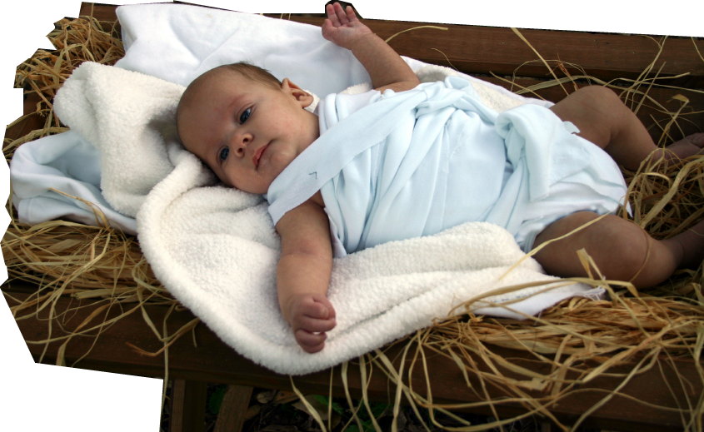
5-Gender: Isaiah 7:14
¹⁴ Therefore the Lord himself will give you a sign: The virgin will be with child and will give birth to a son, and will call him Immanuel.

Slide 15
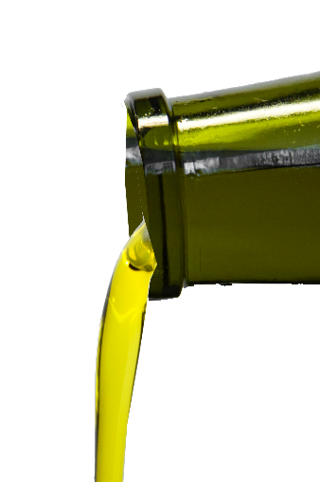
6-Messiah: Psalm 2:2
“until the Anointed One, the ruler” Dan 9:25
² The kings of the earth take their stand and the rulers gather together against the LORD and against his Anointed One. Ps 2:2

Slide 16
7-Divinity: Isaiah 9:6
⁶ For to us a child is born, to us a son is given, and the government will be on his shoulders. And he will be called Wonderful Counselor, Mighty God, Everlasting Father, Prince of Peace.
Notes:
Olive Oil = FREE = from http://www.sxc.hu/browse.phtml?f=download&id=1162606

Slide 17
Seven Signs ...
1-Time
2-Location
3-Mission
4-Method
5-Gender
6-Messiah
7- Divinity

Slide 18
Pointing AT: Luke 2:11
1-Time ..........
2-Location.....
3-Mission......
4-Method.......
5-Gender.......
6-Messiah.....
7- Divinity......
¹¹ Today
in the town of David
a Savior
has been born to you;
he is
Christ
the Lord.

Slide 19
Pointing AT: Three-fold Sign
¹² This will be a sign to you: You will find a baby wrapped in cloths and lying in a manger.”

Slide 20
Pointing AT: Three-fold Sign
¹² This will be a sign to you: You will find a baby wrapped in cloths and lying in a manger.”

Slide 21
Pointing AT: Three-fold Sign
¹² This will be a sign to you: You will find a baby wrapped in cloths and lying in a manger.”

Slide 22
Pointing AT: Three-fold Sign
¹⁵ When the angels had left them and gone into heaven, the shepherds said to one another, "Let's go to Bethlehem and see this thing that has happened, which the Lord has told us about.”

Slide 23
Pointing AT: Three-fold Sign
¹⁶ So they hurried off and found Mary and Joseph, and the baby, who was lying in the manger. ¹⁷ When they had seen him, they spread the word concerning what had been told them about this child,

Slide 24
Pointing AT: Three-fold Sign
¹⁸ and all who heard it were amazed at what the shepherds said to them. ¹⁹ But Mary treasured up all these things and pondered them in her heart.

Slide 25
Pointing AT: Three-fold Sign
²⁰ The shepherds returned, glorifying and praising God for all the things they had heard and seen, which were just as they had been told.

Slide 26
Pointing AT: Three-fold Sign
¹² This will be a sign to you:
Pointing TO:
Pointing BACK:
AT

Slide 27
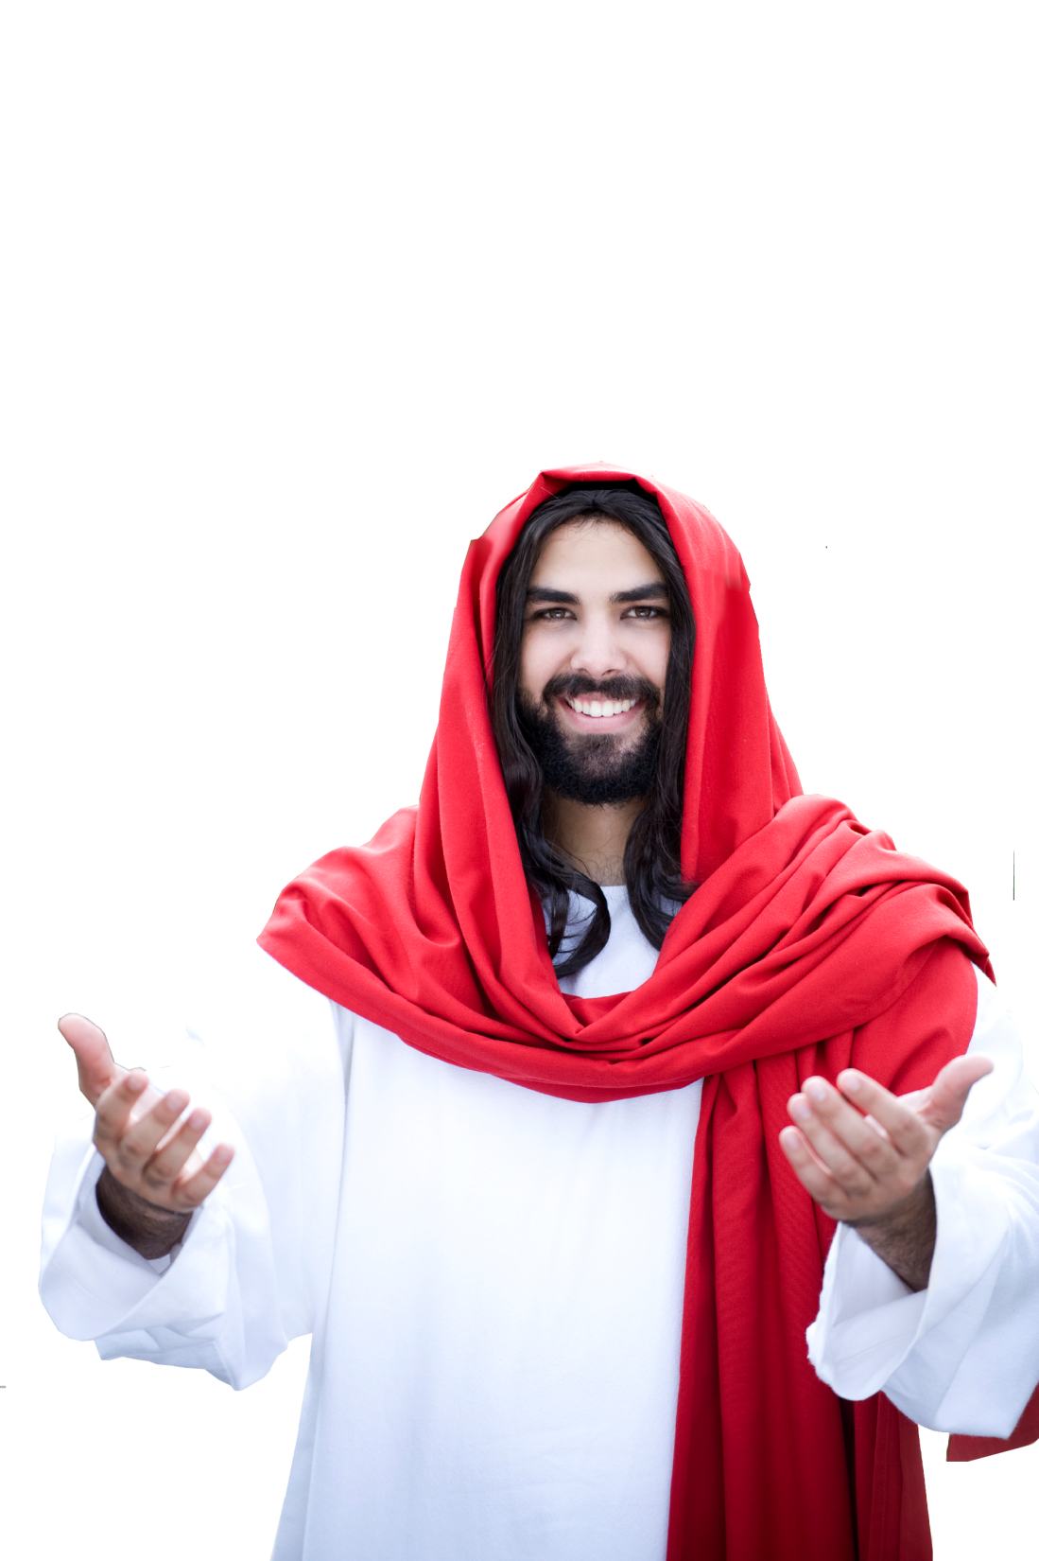
Pointing Back: John 20
³⁰ Jesus did many other miraculous signs in the presence of his disciples, which are not recorded in this book.

Slide 28
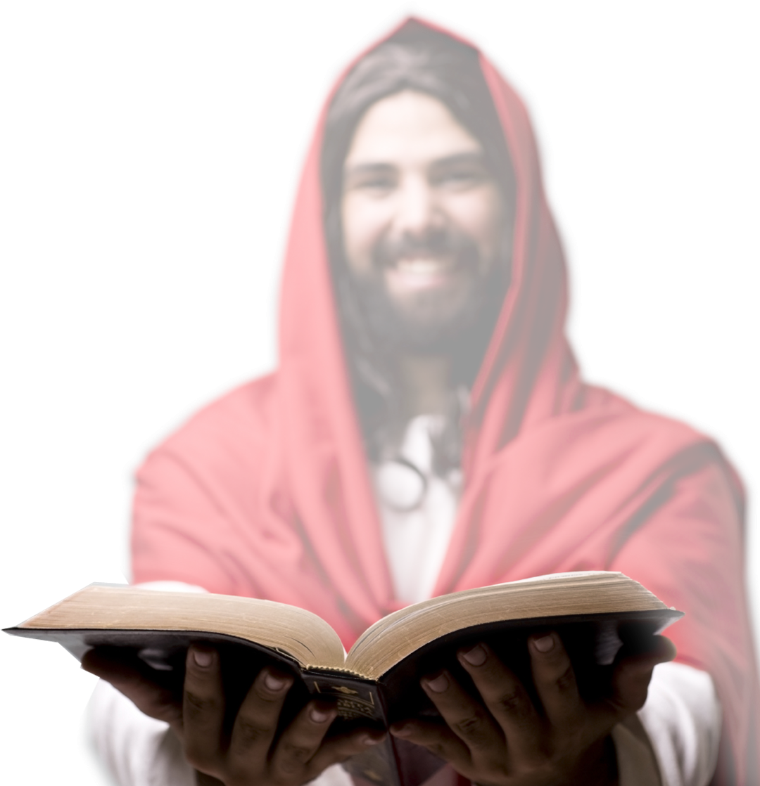
Pointing Back
³¹ But these are written that you may believe that Jesus is the Christ, the Son of God, and that by believing you may have life in his name. John 20:30-31

Slide 29
Pointing Back
³¹ But these are written that you may believe that Jesus is the Christ, the Son of God, and that by believing you may have life in his name. John 20:30-31

Slide 30
Pointing Back
³¹ But these are written that you may believe that Jesus is the Christ, the Son of God, and that by believing you may have life in his name. John 20:30-31

Slide 31
Let’ sum it up Christmas Signs
Signs pointing TO = Old Testament Prophecies
Signs pointing AT = Luke 2 Shepherds
Signs pointing BACK = Rest of the Bible YOU!
It’s like this ...

Slide 32
Let’ sum it up Christmas Signs
All of the past, present, and future point to HIM!

Slide 33
Let’s Pray

