Slide 1
Christmas Then & Now!

Slide 2
Christmas & Caesar's Whim
Notes:
Star Cross = Licensed and NOT FOR REUESE elsewhere = To reuse get a license from http://www.bigstockphoto.com/image-3712689/stock-photo-christian-cross-in-stars

Slide 3
The truth claim for today
God is in control of everything!

Slide 4
The truth claim TEXT...
¹ In those days Caesar Augustus issued a decree that a census should be taken of the entire Roman world. ² (This was the first census that took place while Quirinius was governor of Syria.) ³ And everyone went to his own town to register. Luke 2:1-3

Slide 5
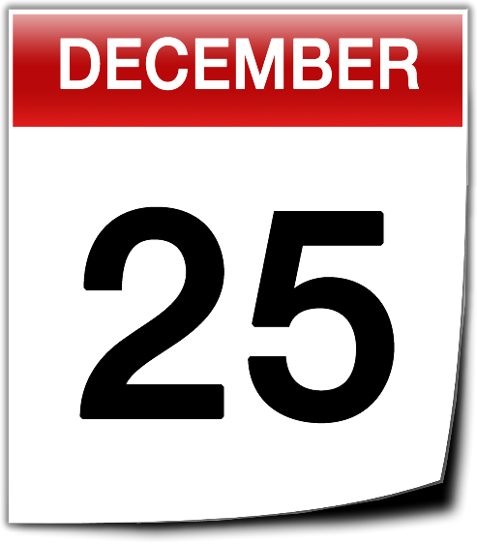
Luke 2:1 In those days...

Slide 6
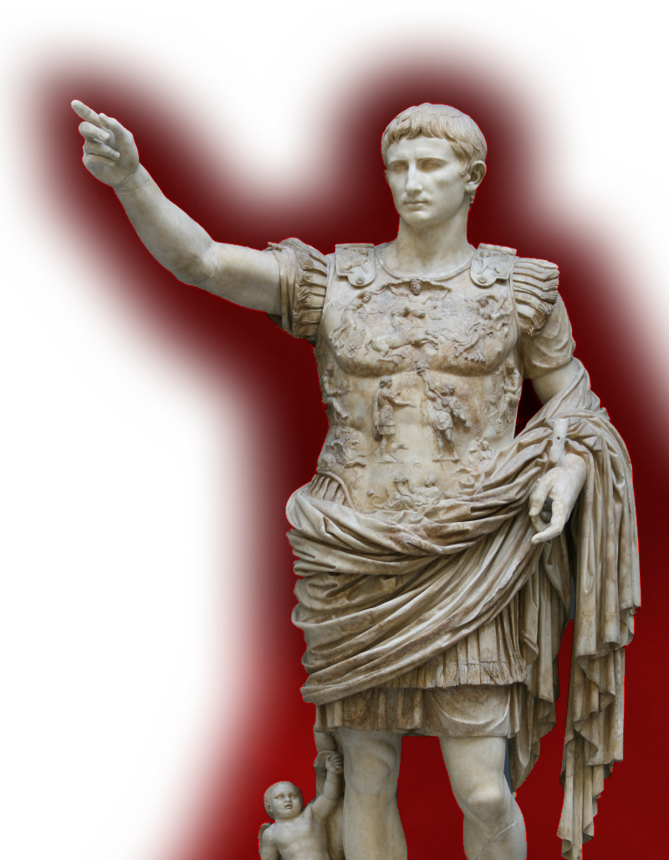
2:1 In those days Caesar Augustus
September 23, 63 BC – August 19, 14 AD

Slide 7
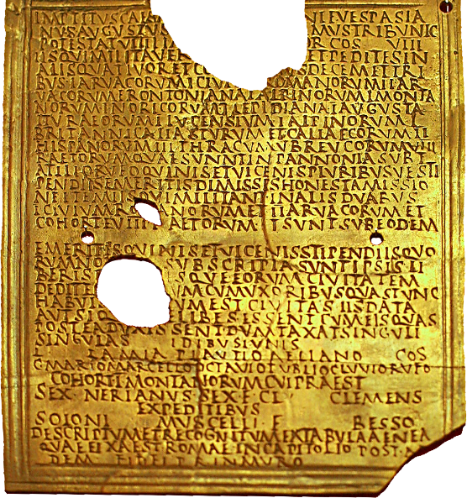
issued a decree that a census should be taken
The actual decree seems to no longer exist.
Notes:
The decree is not found in any secular history sources.
This photo is of a military diploma = FREE = from http://en.wikipedia.org/wiki/File:Roman_military_diploma_Carnuntum_00.jpg

Slide 8
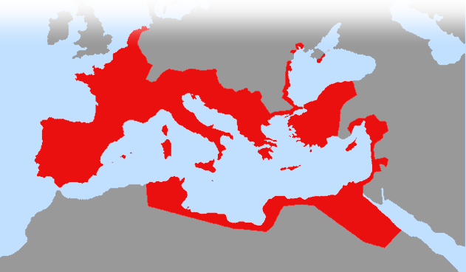
of the entire Roman world.

Slide 9
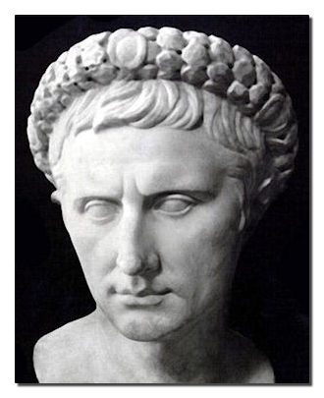
More specifically ...
² (This was the first census that took place while Quirinius was governor of Syria.) Luke 2:2
Notes:
Farrar Cambridge Greek Testament for Schools and Colleges Commentary on Luke 1884 p.109
Dating issue – suggested resolution:
The word “first” = prior
The words “took place” = “took effect”
The words “was governor” = “though not actually governor of Syria, might be called such as on of the twenty taxers or commissioners of Augustus.
4) The suggestion that He was twice governor of Syria, once in BC 4 when he began the census (which may have been ordered, as Tertullian says, by Varus, or by P. Sentius Saturninus); and one in AD 6 when he carried it to completion.
In any case this put the birth somewhere before 6AD.

Slide 10
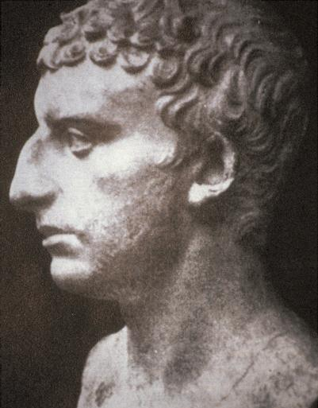
Now Cyrenius ... was of great dignity, came at this time into Syria, with a few others, being sent by Caesar to be a judge of that nation, and to take an account of their substance.
*Josephus Antiquities of the Jews, Book XVIII
Notes:
Josephus helps us, he mentions that Quirinius was “a judge of that nation” that Luke calls a governor. Later he does actually become the Govenor. Luke appears to be noting

Slide 11
WHY?
³ And everyone went to his own town to register. Luke 2:3
Notes:
Bthlehem = FREE = sxc

Slide 12
It was NOT Roman custom to so...
Romans require registration at the place of birth or residence—not of family ancestry!
According to Roman custom, it was unnecessary for Joseph to go to Bethlehem!

Slide 13
Caesar’s Whim...
“Caesar Augustus issued a decree ...” that required everyone to go... “to his own town to register.”
WHY?

Slide 14
Because God controls Kings
The king's heart is in the hand of the LORD; he directs it like a watercourse wherever he pleases. Proverbs 21:1

Slide 15
Because it was prophecied
² "But you, Bethlehem Ephrathah, though you are small among the clans of Judah, out of you will come for me one who will be ruler over Israel, whose origins are from of old, from ancient times.” Micah 5:2

Slide 16
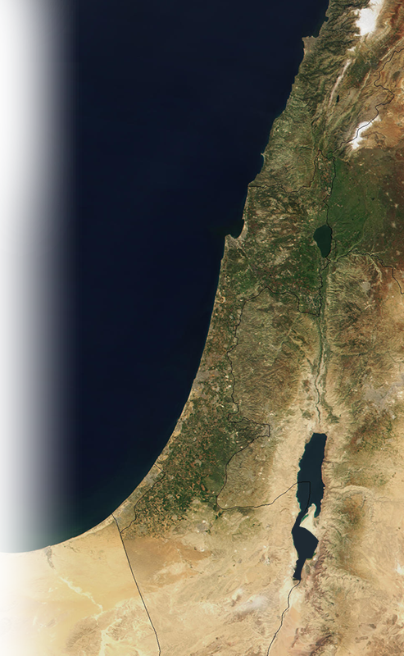
So Joseph and Mary traveled
⁴ So Joseph also went up from the town of Nazareth in Galilee to Judea, to Bethlehem the town of David, because he belonged to the house and line of David.
⁵ He went there to register with Mary, who was pledged to be married to him and was expecting a child.

Slide 17
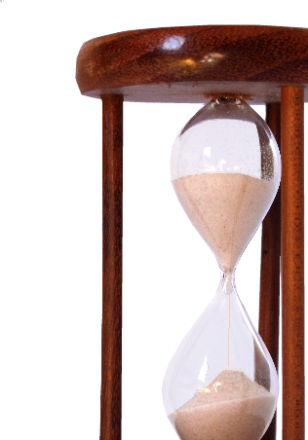
Arriving at the precise time
⁴ But when the time had fully come, God sent his Son, born of a woman, born under law,
⁵ to redeem those under law, that we might receive the full rights of sons. Galatians 4:4-5

Slide 18
Arriving at the precise time
⁶ While they were there, the time came for the baby to be born, ⁷ and she gave birth to her firstborn, a son. She wrapped him in cloths and placed him in a manger, because there was no room for them in the inn.

Slide 19
Caesar was not the only king...

Slide 20
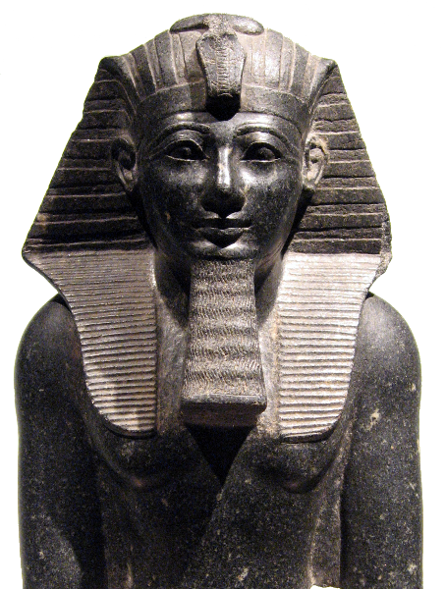
Pharaoh...
Pharaoh had a dream: ... seven cows, sleek and fat, ... ³ After them, seven other cows, ugly and gaunt,
Notes:
Egyptian depicted here is Thutmose III – Not the Hyksos Pharaoh of Joseph’s time. Image is free from http://en.wikipedia.org/wiki/File:Thutmosis_III_wien_front.jpg

Slide 21
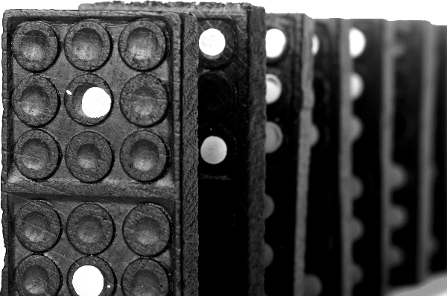
Pharaoh...
⁴ And the cows that were ugly and gaunt ate up the seven sleek, fat cows.
Gen 41:2-4
Notes:
Egyptian depicted here is Thutmose III – Not the Hyksos Pharaoh of Joseph’s time. Image is free from http://en.wikipedia.org/wiki/File:Thutmosis_III_wien_front.jpg
Dominos = FREE = from http://www.rgbstock.com/download/johnnyberg/mkjRdp2.jpg

Slide 22
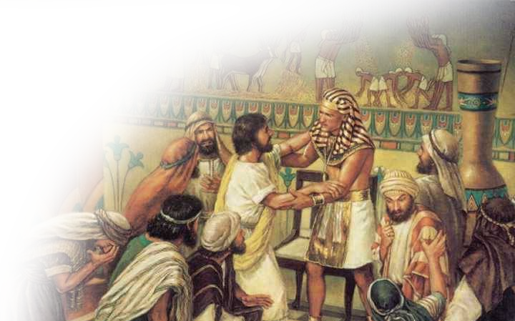
Pharaoh...
You intended to harm me, but God intended it for good to accomplish what is now being done, the saving of many lives. Gen 50:20
Notes:
Joseph =
Need to replace – from http://susantaylorblock.com/wp-content/uploads/2012/03/joseph.jpg

Slide 23
Pharaoh...
Pharaoh had a dream: Gen 41:1
God used Pharaoh’s dream to fulfill His promise to save His people.
Notes:
Egyptian depicted here is Thutmose III – Not the Hyksos Pharaoh of Joseph’s time. Image is free from http://en.wikipedia.org/wiki/File:Thutmosis_III_wien_front.jpg

Slide 24
Xerxes ... Sleepless night ...

Slide 25
Xerxes ... Sleepless night ...
That night the king could not sleep; so he ordered the book of the chronicles, the record of his reign, to be brought in and read to him. Esther 6:1

Slide 26
Xerxes
"If I have found favor with you, O king, and if it pleases your majesty, grant me my life--this is my petition. And spare my people--this is my request. Esther 7:3

Slide 27
Xerxes ... sleepless night ...
God used Xerxes sleeplessness to put in motion the events to save a nation.

Slide 28
Caesar was not the only king...
But God used his whim to set in motion the salvation of the world.

Slide 29
That was then ... this is now.

Slide 30
God is still using kings...
to set the stage for the Second Advent of Christ

Slide 31
God is still using kings...
³ And if I go and prepare a place for you, I will come back and take you to be with me that you also may be where I am. John 14:3

Slide 32
God is still using kings...
This same Jesus, who has been taken from you into heaven, will come back in the same way you have seen him go into heaven." Act 1:11
Notes:
Angel = FREE = from http://upload.wikimedia.org/wikipedia/commons/c/c7/Giotto_di_Bondone_-_No._14_Annunciation_-_The_Angel_Gabriel_Sent_by_God_-_WGA09190.jpg

Slide 33
Between the two advents ...
²⁸ And we know that in all things God works for the good of those who love him, who have been called according to his purpose. Rom 8:28
Notes:
Gears = FREE =from http://www.sxc.hu/browse.phtml?f=download&id=1379212

Slide 34
God has control...
Over whims
Over dreams
Over sleeplessness
Over everything

Slide 35
The truth claim for today
God is in control of everything!

Slide 36
Let’s Pray

