Slide 1
“…it’s coming…”
Notes:
BACKGROUND = pixabay.com/illustrations/fractal-blue-swirl-vortex-abstract-14680/

Slide 2
Destruction is coming!
ROARING
LION!

Slide 3
Destruction is coming!
FIRE
AHEAD!

Slide 4
Destruction is coming!
PREPARE TO MEET GOD!

Slide 5
Destruction is coming!
WOE!

Slide 6
Destruction is coming!
RIPE FOR
JUDGMENT

Slide 7
Destruction is coming!
it’s coming

Slide 8
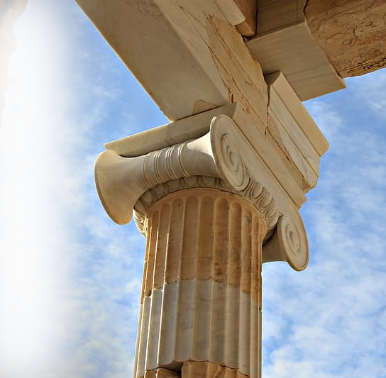
You cannot ESCAPE it!
^{9:1} I saw the Lord standing by the altar, and he said: "Strike the tops of the pillars so that the thresholds shake. Bring them down on the heads of all the people; those who are left I will kill with the sword. Not one will get away, none will escape.
Notes:
http://p0.pikrepo.com/preview/629/331/brown-concrete-pillar.jpg

Slide 9
You cannot ESCAPE it!
^{9:1} I saw the Lord standing by the altar, and he said: "Strike the tops of the pillars so that the thresholds shake. Bring them down on the heads of all the people; those who are left I will kill with the sword. Not one will get away, none will escape.

Slide 10
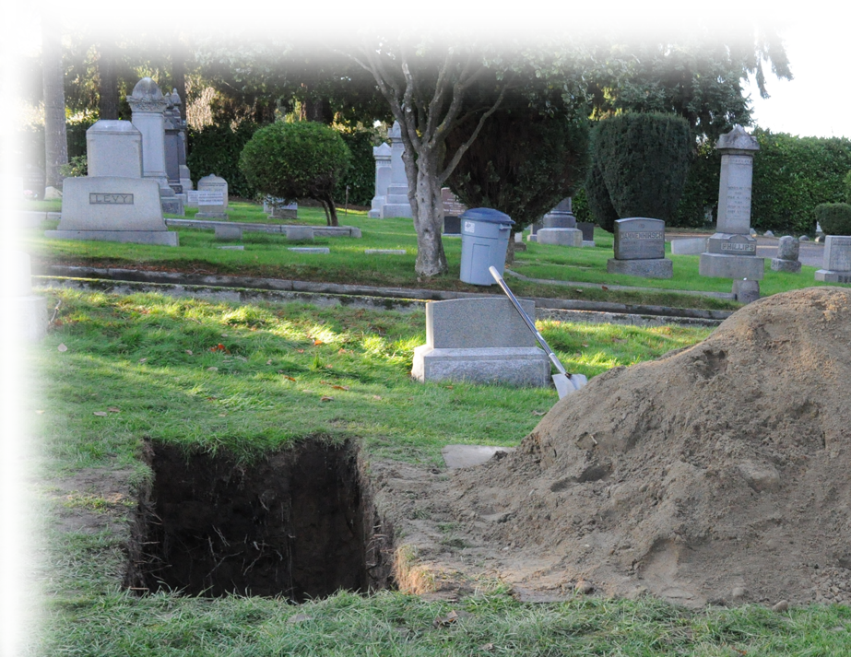
You cannot HIDE from it!
² Though they dig down to the depths of the grave, from there my hand will take them. Though they climb up to the heavens, from there I will bring them down.
Notes:
upload.wikimedia.org/wikipedia/commons/9/92/Seattle_-_Hills_of_Eternity_Cemetery_08.jpg

Slide 11
You cannot HIDE from it!
² Though they dig down to the depths of the grave, from there my hand will take them. Though they climb up to the heavens, from there I will bring them down.

Slide 12
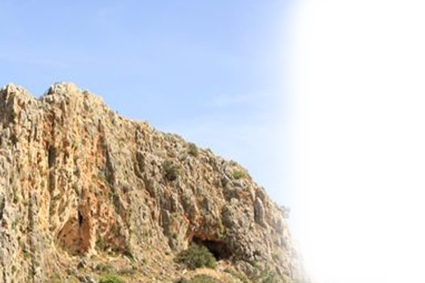
You cannot HIDE from it!
³ Though they hide themselves on the top of Carmel, there I will hunt them down and seize them. Though they hide from me at the bottom of the sea, there I will command the serpent to bite them.

Slide 13
You cannot HIDE from it!
³ Though they hide themselves on the top of Carmel, there I will hunt them down and seize them. Though they hide from me at the bottom of the sea, there I will command the serpent to bite them.
Notes:
i2.pickpik.com/photos/94/283/771/underwater-sea-ocean-plankton-blue-preview.jpg
Serpent = probably a sea serpent

Slide 14
You cannot EVADE it!
⁴ Though they are driven into exile by their enemies, there I will command the sword to slay them. I will fix my eyes upon them for evil and not for good."

Slide 15
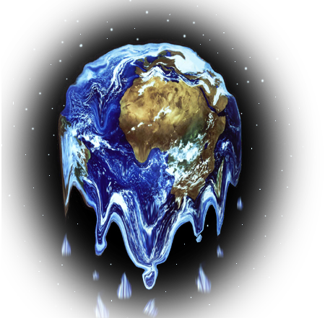
You cannot WITHSTAND it!
⁵ The Lord, the LORD Almighty, he who touches the earth and it melts, and all who live in it mourn-- the whole land rises like the Nile, then sinks like the river of Egypt-- ⁶ he who builds his lofty palace in the heavens and sets its foundation on the earth, who calls for the waters of the sea and pours them out over the face of the land-- the LORD is his name.
Notes:
www.flickr.com/photos/lesjameshumor/2931617679

Slide 16
You cannot CLAIM PRIVILEDGE from it
⁷ "Are not you Israelites the same to me as the Cushites?" declares the LORD. "Did I not bring Israel up from Egypt, the Philistines from Caphtor and the Arameans from Kir?
Notes:
https://pixabay.com/photos/justice-statue-lady-justice-2060093/

Slide 17
You cannot CLAIM PRIVILEDGE from it
⁸ "Surely the eyes of the Sovereign LORD are on the sinful kingdom. I will destroy it from the face of the earth--
Notes:
pixabay.com/photos/assassination-attempt-crime-scene-268910/

Slide 18
You cannot OVERTAKE it!
⁹ "For I will give the command, and I will shake the house of Israel among all the nations as grain is shaken in a sieve, and not a pebble will reach the ground. ¹⁰ All the sinners among my people will die by the sword, all those who say, 'Disaster will not overtake or meet us.'
Notes:
https://flickr.com/photos/worldbank/2183806066

Slide 19
…it’s coming…
“yet”
“but” (NLT)
“nevertheless” (NASB)
“saving that” (KJV)
“except” (ESV)
"yet I will not totally destroy the house of Jacob," declares the LORD. 9:8b
Notes:
He uses three synonyms:
Repair = Wall up
Restore = Raise up
Build = Build up

Slide 20
…it’s coming…
“yet”
"yet I will not totally destroy the house of Jacob," declares the LORD. 9:8b

Slide 21
HOW CAN YOU BE SAVED FROM IT?
RESTORATION
IS COMING!

Slide 22
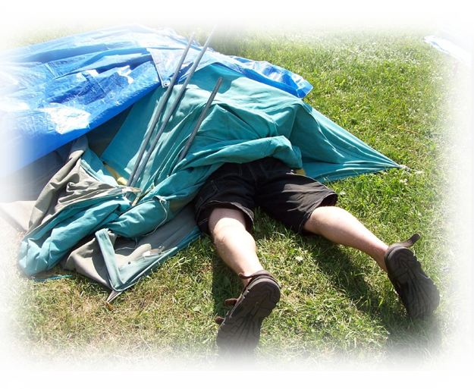
It’s NEEDED 9:11
¹¹ "In that day I will restore David's fallen tent. I will repair its broken places, restore its ruins, and build it as it used to be, ¹² so that they may possess the remnant of Edom and all the nations that bear my name," declares the LORD, who will do these things.
Notes:
www.flickr.com/photos/raptortheangel/187782497

Slide 23
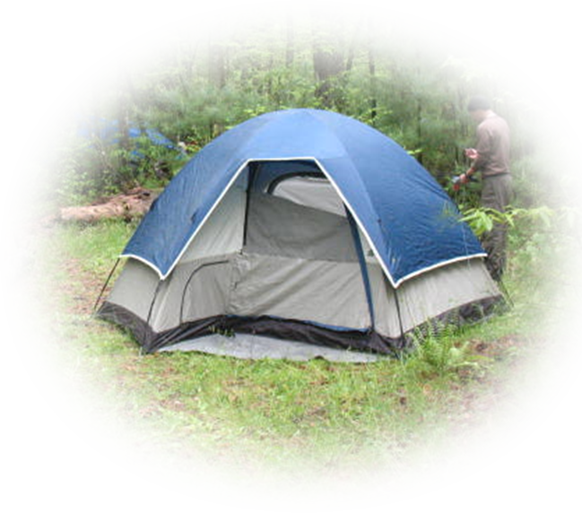
It’s DESCRIBED 9:11
¹¹ "In that day I will restore David's fallen tent. I will repair its broken places, restore its ruins, and build it as it used to be, ¹² so that they may possess the remnant of Edom and all the nations that bear my name," declares the LORD, who will do these things.
Notes:
As it used to be = the nation Israel, not the church!

Slide 24
It’s DESCRIBED 9:11
¹¹ "In that day I will restore David's fallen tent. I will repair its broken places, restore its ruins, and build it as it used to be, ¹² so that they may possess the remnant of Edom and all the nations that bear my name," declares the LORD, who will do these things.
Notes:
As it used to be = the nation Israel, not the church!

Slide 25
Its PURPOSE 9:12
¹¹ "In that day I will restore David's fallen tent. I will repair its broken places, restore its ruins, and build it as it used to be, ¹² so that they may possess the remnant of Edom and all the nations that bear my name," declares the LORD, who will do these things.
Notes:
pixabay.com/vectors/united-nations-logo-organization-40418/
pixabay.com/vectors/star-david-symbol-823404/
Right now the world dominates Israel – day is coming when Israel will be restored and dominate the world—when King Jesus returns to set up His Kingdom for 1000 years.
Haggai says as much too …

Slide 26
Its TIME 9:11, 13
¹¹ "In that day I will restore David's fallen tent.
¹³ "The days are coming,"
…it’s coming…
Notes:
paper ripped = pixabay.com/photos/ripped-paper-torn-through-broken-2034946/
As it used to be = the nation Israel, not the church!

Slide 27
Its TIME 9:11, 13
¹¹ "In that day I will restore David's fallen tent.
¹³ "The days are coming,“ declares the LORD, "when the reaper will be overtaken by the plowman and the planter by the one treading grapes. New wine will drip from the mountains and flow from all the hills.
Notes:
As it used to be = the nation Israel, not the church!

Slide 28
Its HEART 9:14
¹⁴ I will bring back my exiled people Israel; they will rebuild the ruined cities and live in them. They will plant vineyards and drink their wine; they will make gardens and eat their fruit.
Notes:
pixabay.com/photos/wine-splash-glass-red-alcohol-1543170/

Slide 29
Its HEART 9:14
¹⁵ I will plant Israel in their own land, never again to be uprooted from the land I have given them," says the LORD your God.
Notes:
www.pexels.com/photo/crop-photo-of-person-planting-seedling-in-garden-soil-4207910/

Slide 30
Who is Restored? Remnant of Israel!
9:8b"yet I will not totally destroy the house of Jacob," declares the LORD.

Slide 31
Who is Restored? Remnant of Israel!
¹¹ "In that day I will restore David's fallen tent. I will repair its broken places, restore its ruins, and build it as it used to be…

Slide 32
Who is Restored? Remnant of Nations!
¹¹ "In that day I will restore David's fallen tent. I will repair its broken places, restore its ruins, and build it as it used to be, ¹² so that they may possess the remnant of Edom and all the nations that bear my name," declares the LORD, who will do these things.

Slide 33
God always has a remnant!
Romans 11:5 So too, at the present time there is a remnant chosen by grace. 6 And if by grace, then it is no longer by works; if it were, grace would no longer be grace.

Slide 34
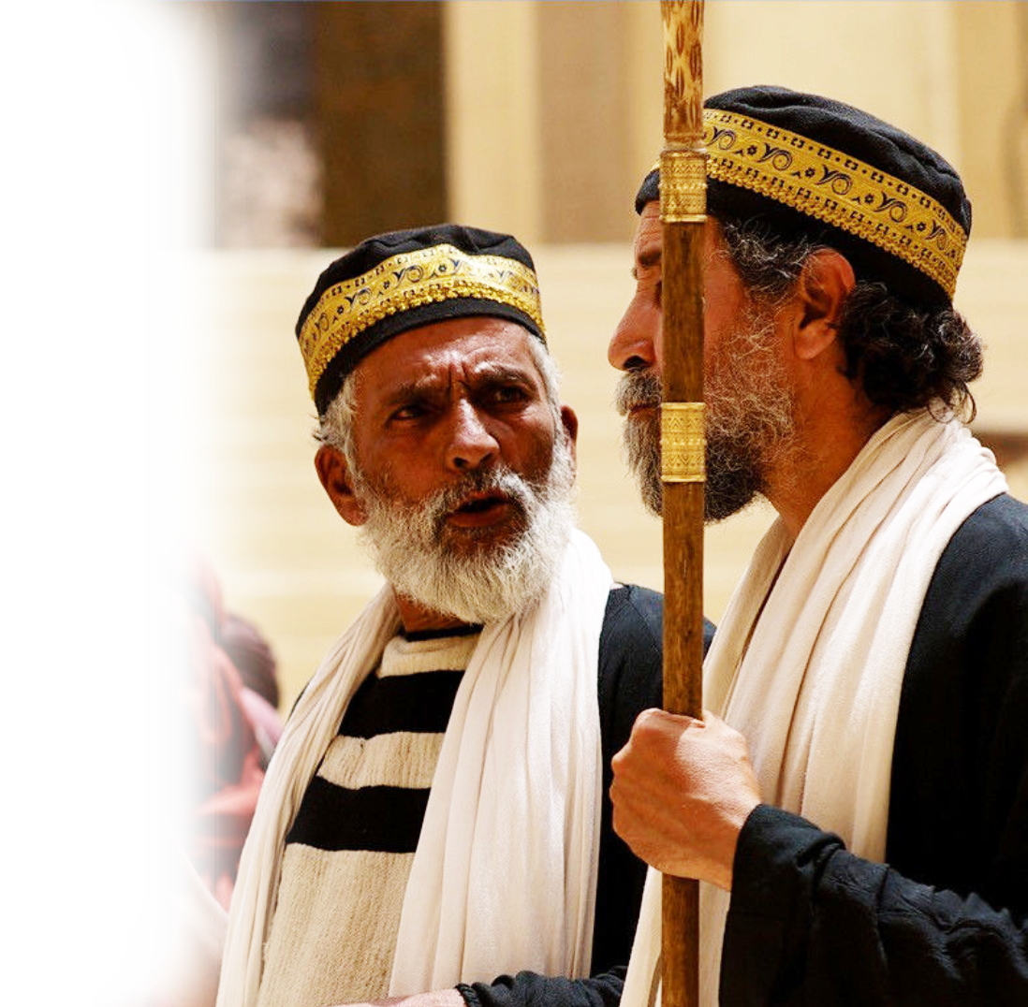
The Jerusalem Council Acts 15
Pharisees stood up and said, "The Gentiles must be circumcised and required to obey the law of Moses."

Slide 35
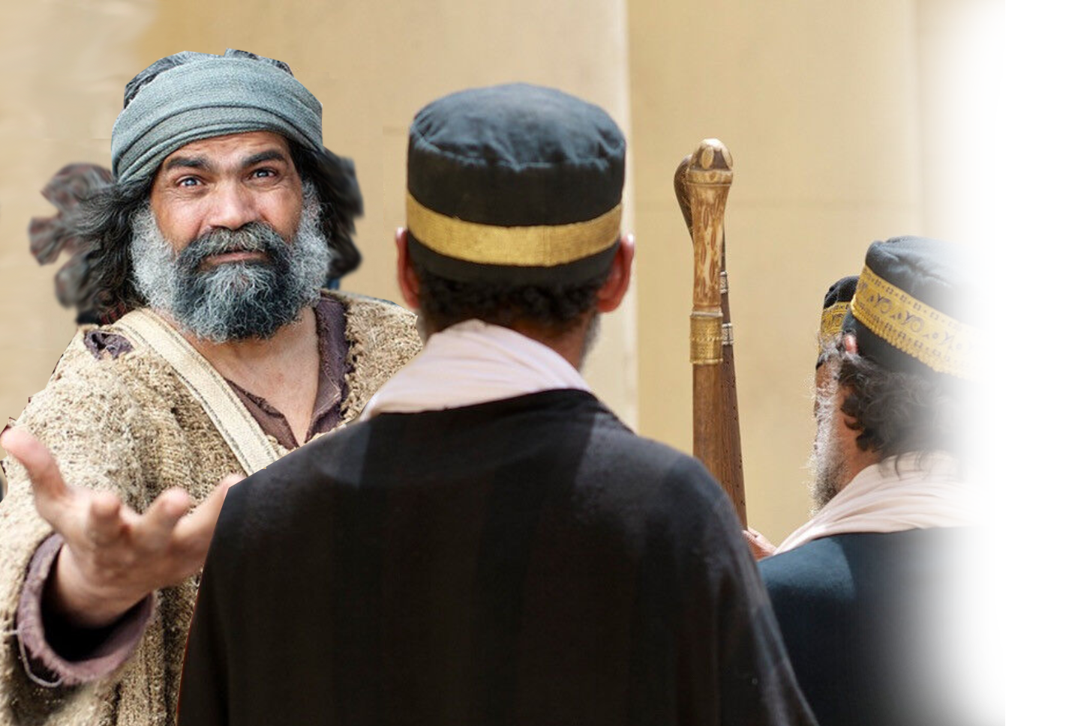
The Jerusalem Council Acts 15
⁷ Peter … addressed them ….
¹¹ "No! We believe it is through the grace of our Lord Jesus that we are saved, just as they are."

Slide 36
The Jerusalem Council Acts 15
⁷ Peter … addressed them ….
¹¹ "No! We believe it is through the grace of our Lord Jesus that we are saved, just as they are."
¹⁵ The words of the prophets are in agreement with this, as it is written:

Slide 37
The Jerusalem Council Acts 15
¹⁶ " 'After this I will return and rebuild David's fallen tent. Its ruins I will rebuild, and I will restore it, ¹⁷ that the remnant of men may seek the Lord, and all the Gentiles who bear my name, says the Lord …. "
The point: God has always intended to save a remnant of Gentiles by grace and through faith.

Slide 38
How do you Receive Restoration?
^{Ephesians 2:8} For it is by grace you have been saved, through faith--and this not from yourselves, it is the gift of God-- ⁹ not by works, so that no one can boast.

Slide 39
How do you Receive Restoration?
^{Ephesians 2:8} For it is by grace you have been saved, through faith--and this not from yourselves, it is the gift of God-- ⁹ not by works, so that no one can boast.

Slide 40
How do you Receive Restoration?
^{Ephesians 2:8} For it is by grace you have been saved, through faith--and this not from yourselves, it is the gift of God-- ⁹ not by works, so that no one can boast.
WORKS

Slide 41
So, what do we learn?

Slide 42
It’s coming …
Destruction
^{Romans 6:23a}
For the wages of sin is death, …
Restoration
^{Romans 6:23b}
… but the gift of God is eternal life in Christ Jesus our Lord.

Slide 43
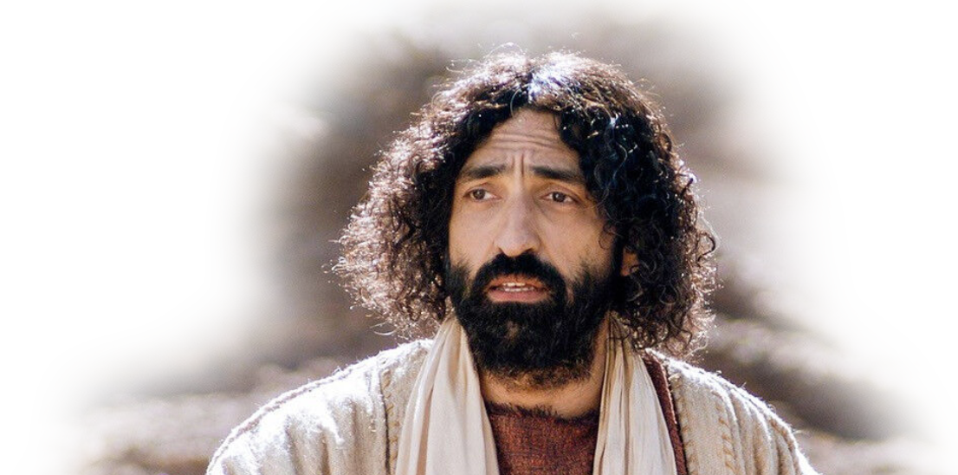
It’s coming …
Destruction
^{John 3:18b}
but whoever does not believe stands condemned already because he has not believed in the name of God's one and only Son.
Restoration
^{John 3:18a}
¹⁸ Whoever believes in him is not condemned,

Slide 44
It’s coming …
Destruction
^{John 3:36b}
but whoever rejects the Son will not see life, for God's wrath remains on him."
Restoration
^{John 3:36a}
Whoever believes in the Son has eternal life,

Slide 45
Accept Him Today!
Let’s Pray!

