Slide 1
Avoiding a Bitter End 8:1-14
I will make that time … like a bitter day. (Amos 8:10)
Notes:
www.flickr.com/photos/volk/3404715209
Copyright © 2006−2021. All rights reserved. Bible Point is a registered trademark of Dennis Henderson. All other trademarks acknowledged.
Bible Point contains graphics from Bible Point artists. These illustrations belong to Bible Point and the respective artists. You may use the designs and illustrations for graphical illustration of lessons free and without special permission, provided they are not used in any way that maligns the Christian faith. Furthermore, republication or production of any illustration by any other graphic service whether it be in book, in a machine-readable form, or in any other design resource is strictly prohibited. Furthermore, they cannot be duplicated or resold as any other form of publishing, clip art, or graphic resource.
So What does it mean? (A simple translations of the legal jargon)
So, if you don’t own the presentation(s), graphic(s), and text(s) how can you legally use them? The purchase of the license allows you to use all the images in the product. However, the actual ownership and copyright of the presentation(s), graphic(s), and text(s) remain the property of Bible Point and its licensors. If you had plans on using this product in your “for sale” work—think again!
License Agreement
Article 1: License Grant
All the graphics and text in Bible Point presentations (excluding quotes from the Bible and stated sources) are the intellectual and real property of Bible Point and its licensors, and is protected by law, including United States copyright laws and international treaties. Bible Point grants to you a license:
1. To use the presentation in a single church, single school, or single office of a Christian organization.
2. To make a single archival back-up copy of the program.
3. To modify the presentation(s) and merge with other presentations in a single church, school, or Christian organization.
4. To transfer to another party if that party agrees to accept the terms and conditions of this agreement, and you do not retain any copies of the presentation, whether printed, machine readable, modified, or merged form.
Article 2: Terms
This license is effective until terminated. You may terminate the license at any time by destroying the presentation(s), graphic(s), or text(s) together with all copies, modifications and merged portions in any form. Bible Point may terminate your license if you fail to comply with this Agreement. You agree, upon such termination, for any reason, to destroy the presentation(s), graphics, and text(s) with all copies, modifications, and merged portions in any form.
Article 3: Disclaimers
1. Bible Point presentations, graphics, and texts are licensed to you As Is. You, the consumer, bear the entire risk relating to the quality and performance of the presentation(s), graphic(s), or text(s). In no event will Bible Point be liable for damages resulting from any defect.
2. Thirty-day limited warrantee on disks. Bible Point warrants the disks to be free of defects in material and workmanship under normal use for 30 days after purchase. During the 30-day period you may return a defective presentation, graphic, or text with proof of purchase and it will be replaced without charge, unless the presentation is damaged by misuse.
Article 4: General
1. You may not sub-license, assign, or transfer the license of the presentation(s), graphic(s), or text(s) except as provided by this Agreement.
2. This Agreement will be governed by the laws of the State of Michigan.
So What does it mean? (A simple translations of the legal jargon)
May I let someone borrow or copy my licensed Bible Point presentation (even after I modified it)? As long as it is within your local church, or single school, or the immediate office of a Christian organization you may. Otherwise, please refer the person interested in borrowing to: http://www.biblepoint.com or E-mail: dennis@DrDH.net with any related questions.

Slide 2

The Fact of a Bitter End 8:1-3
Amos 8:1 This is what the Sovereign LORD showed me: a basket of ripe fruit.
Ripe for judgment THEN.
Notes:
Is the silence directed to Amos to stop pleading for Israel?
Is America ripe for judgment too?
What’s in our “fruit basket?”

Slide 3
The Fact of a Bitter End 8:1-3
"A basket of ripe
fruit," I answered.
² "What do you see,
Amos?" he asked.
Notes:
Is the silence directed to Amos to stop pleading for Israel?
Is America ripe for judgment too?
What’s in our “fruit basket?”

Slide 4
The Fact of a Bitter End 8:1-3
Then the LORD said to me, "The time is ripe for my people Israel; I will spare them no longer.
Notes:
Is the silence directed to Amos to stop pleading for Israel?
Is America ripe for judgment too?
What’s in our “fruit basket?”

Slide 5
The Fact of a Bitter End 8:1-3
³ "In that day," declares the Sovereign LORD, "the songs in the temple will turn to wailing. Many, many bodies--flung everywhere! Silence!"
Notes:
Is the silence directed to Amos to stop pleading for Israel?
He says, HUSH!
Is America ripe for judgment too?
What’s in our “fruit basket?”

Slide 6
Ripe for Judgment NOW
Is America Ripe for Judgment?
Notes:
Is the silence directed to Amos to stop pleading for Israel?
Is America ripe for judgment too?
What’s in our “fruit basket?”

Slide 7
Is America Ripe for Judgment?
God has been removed from the schools
Destruction of marriage – No fault divorce
Break down of the family – Father absent homes
Abortion on demand – Murder in the womb
Homosexuality celebrated – Acceptable sins
Gay marriage legalized – Desecration of marriage
Gender Identity crisis – Compromising science
Transsexual operation on kids – Violent child abuse
Notes:
Is the silence directed to Amos to stop pleading for Israel?
Is America ripe for judgment too?
What’s in our “fruit basket?”

Slide 8
You tell me …
Are we about to go over the edge?
Notes:
Is the silence directed to Amos to stop pleading for Israel?
Is America ripe for judgment too?
What’s in our “fruit basket?”

Slide 9
You tell me …
The wicked shall be turned into hell, And all the nations that forget God. (Psalm 9:17 NKJ)
Are we RIPE?
Notes:
Is the silence directed to Amos to stop pleading for Israel?
Is America ripe for judgment too?
What’s in our “fruit basket?”

Slide 10
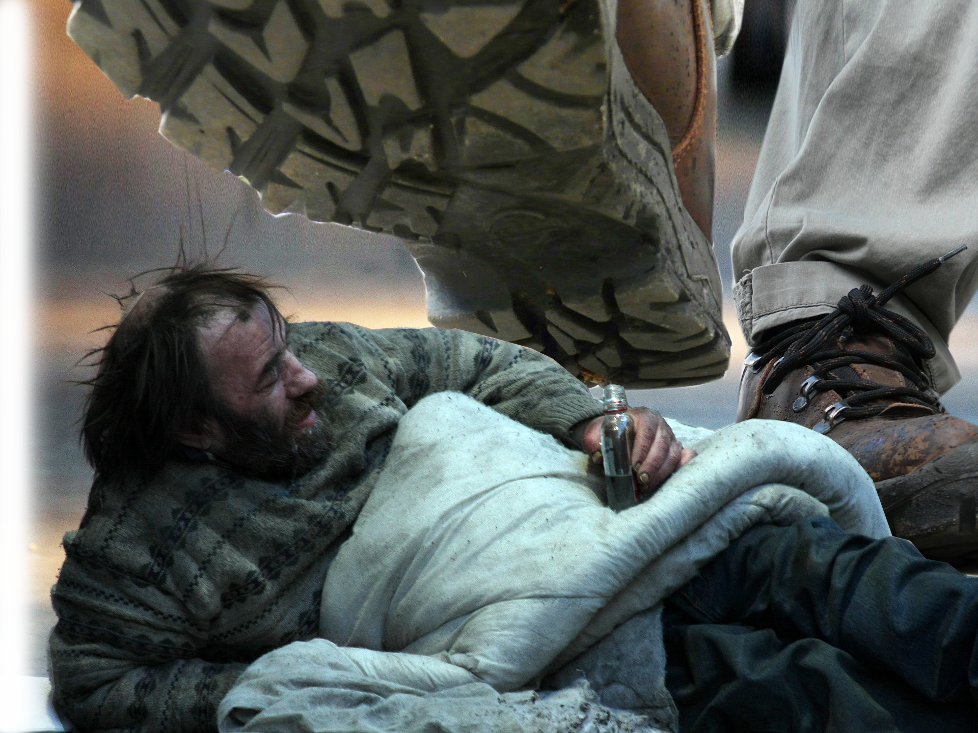
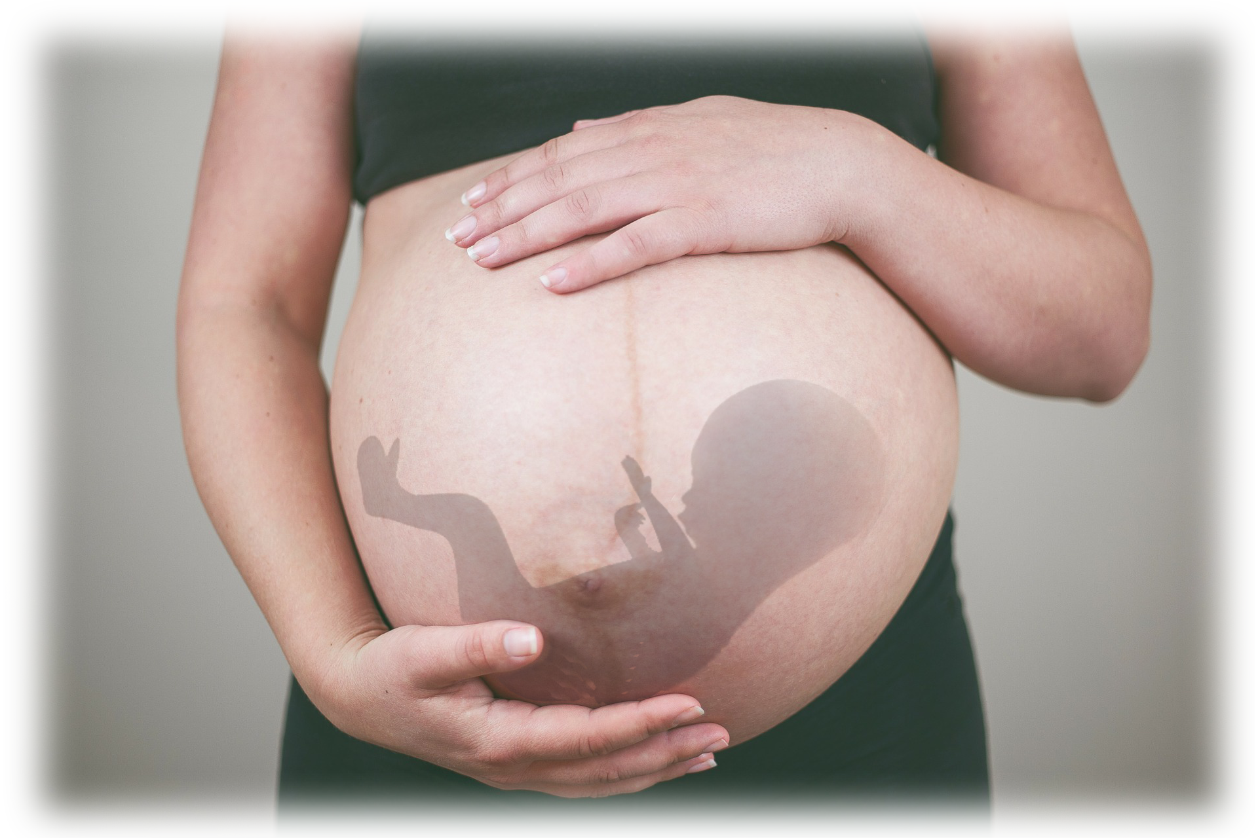
The Reason for a Bitter End 8:4-6
ABUSES:
1) Of the Vulnerable
⁴ Hear this, you who
trample the needy
and do away with
the poor of the land,
Notes:
www.flickr.com/photos/8176740@N05/2401850562/
www.publicdomainpictures.net/en/view-image.php?image=68828&picture=trampled-underfoot
The most vulnerable—the most vulnerable in our society is the baby in the womb. We don’t just trample—but stab in the neck and suck their brains out. It’s horrific.
I don’t know how a Christian could vote for a prochoice candidate without sinning against Almighty God and taking us to the brink as a nation!
Then there are those who are poor and needy economically, socially, even racially.

Slide 11
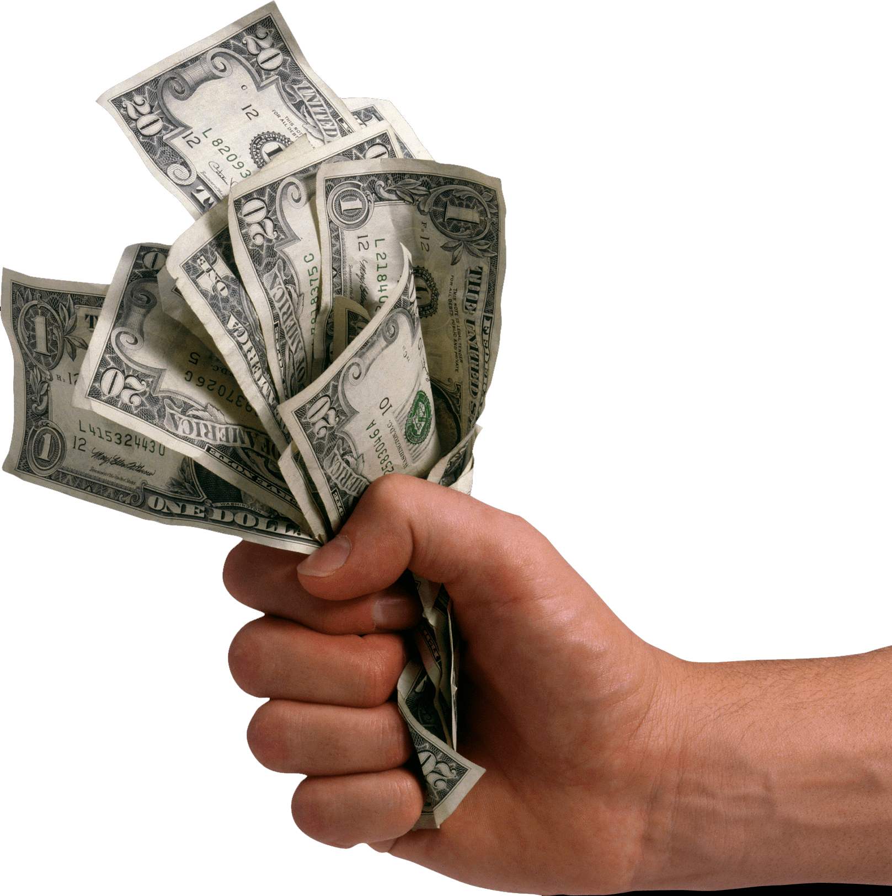
The Reason for a Bitter End 8:4-6
ABUSES:
2) Of Worship
⁵ saying, "When will the New Moon be over that we may sell grain, and the Sabbath be ended that we may market wheat?"
Notes:
freepngimg.com/png/6122-money-in-hand-png-image-dollars-in-hands
All about the dollar. Not about worshipping the Lord.
Let’s get religion out of the way so we can make a buck.
This is a total disregard for the Lord, Worship, the holy. It is all about profit.
The Lord, worship, and the sacred all are in the way of accomplishing their desire, greed for more.
Politicians today abuse religion both on the left and the right.
President Biden pretends to be a loyal Roman Catholic—but he is not!

Slide 12
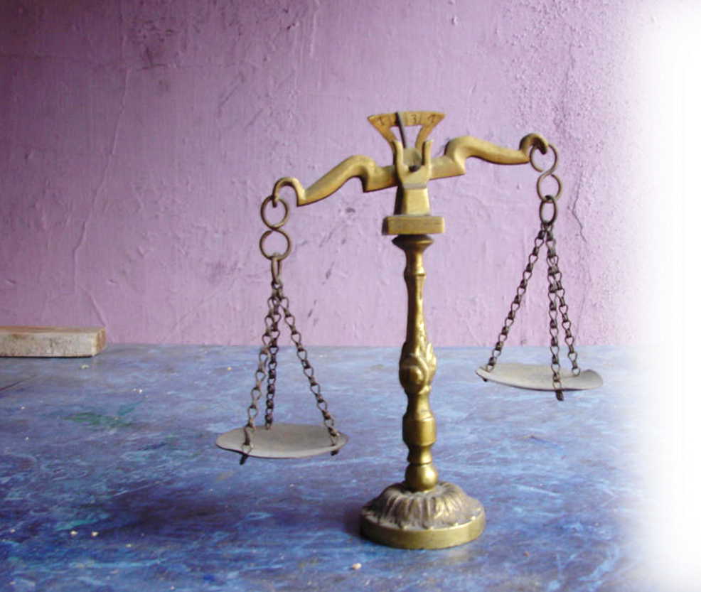
The Reason for a Bitter End 8:4-6
ABUSES:
3) Of Business
⁵ --skimping the measure, boosting the price and cheating with dishonest scales, ⁶ buying the poor with silver and the needy for a pair of sandals, selling even the sweepings with the wheat.
Notes:
Cheating – Dishonesty – Abusing – sweeping with wheat = putting the dirt in with the wheat to make the measure heavier and more costly. CHEATING
Big tech does not care about you—they only care about a profit. They don’t care about right or wrong. They only care about a profit.
Our governments policies are inflating the cost of living and not raising the wages to compensate.
Inflation since I was a kid is about ten times over. I could get a pack of gum for a nickel – today 50 cents. Then a bottle of pop for a dime – plus 2 cents for bottle deposit. Not about a buck. It goes on..
Minimum wage was $1.65 and now it is 9.65 not 10.65. Furthermore, with coming inflation and a stagnate economy we will render experience another stagnation like in the days of President Jimmy Carter.

Slide 13

The Promise of a Bitter End 8:7-14
⁷ The LORD has sworn by the Pride of Jacob:
"I will never forget anything they have done.”
Notes:
Never forgets … not even when He forgives. Remember Amos "Therefore this is what I will do to you, Israel, and because I will do this to you, prepare to meet your God, O Israel." (Amo 4:12 NIV)
The expression “To forgive and to forget” is not true. God is omniscient—he never forgot anything.
When He forgives he remembers exactly what He has done with our sin. He nailed it to the cross. He buried it in the depths of the sea—he has removed it from us as far aa the east is from the west.

Slide 14
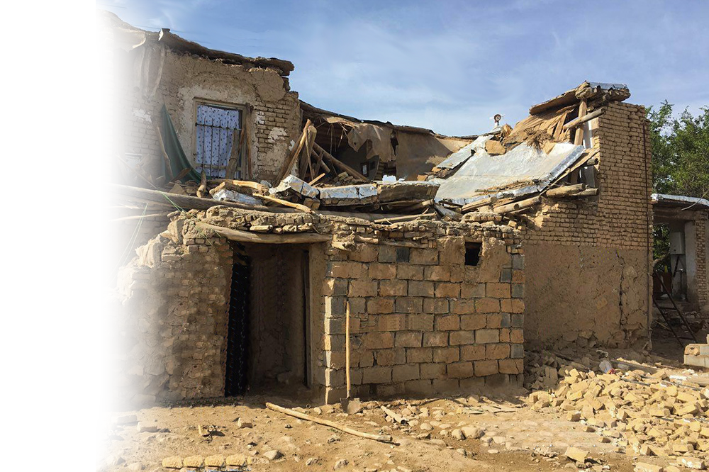
Earthquakes 8:8
⁸ "Will not the land tremble for this, and all who live in it mourn? The whole land will rise like the Nile; it will be stirred up and then sink like the river of Egypt.
Hebrews 12:28
Therefore, since we are receiving a kingdom that cannot be shaken, let us be thankful, and so worship God acceptably with reverence and awe
Notes:
th.bing.com/th/id/R294fb2a959ec4c0ca6f940b13266a537?rik=eOEb7P%2fXD8ukdw&riu=http%3a%2f%2fifpnews.com%2fwp-content%2fuploads%2f2017%2f05%2fEarthquake-bojnourd-15.jpg&ehk=noePX032MKCN9VOmC7J%2bRju2%2b9mx5DSAUuJyWcacsnI%3d&risl=&pid=ImgRaw
Earthquakes 8
This is the opposite of Hebrews 12:28 Therefore, since we are receiving a kingdom that cannot be shaken, let us be thankful, and so worship God acceptably with reverence and awe, (Heb 12:28 NIV)
Nile River rises as much as: Typical heights of flood were 45 feet (13.7 metres) at Aswan, 38 feet (11.6 metres) at Luxor (and Thebes) and 25 feet (7.6 metres) at Cairo.
Darkness 9
Mourning 10
Famine 11
Desperation 12
Faint 13
Fall 14
⁶ He inquired of the LORD, but the LORD did not answer him by dreams or Urim or prophets. (1Sa 28:6 NIV)

Slide 15
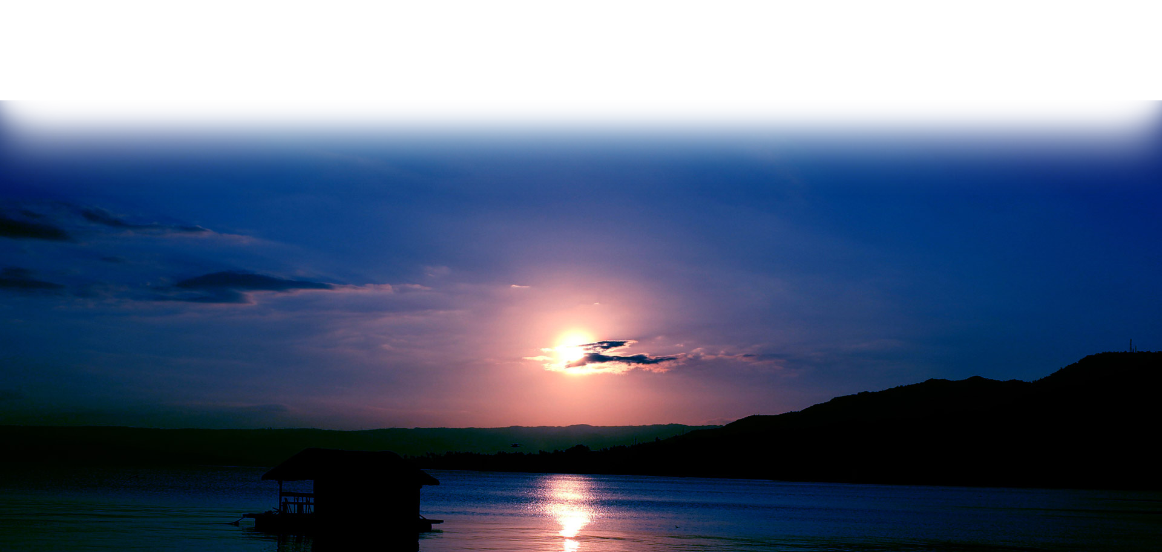
Darkness 8:9
⁹ "In that day," declares the Sovereign LORD, "I will make the sun go down at noon and darken the earth in broad daylight.
⁴ But you, brothers, are not in darkness so that this day should surprise you like a thief. ⁵ You are all sons of the light and sons of the day (1Thessalonians 5:4-5 )
Notes:
www.publicdomainpictures.net/en/view-image.php?image=29235&picture=blue-sunset-background
Earthquakes 8
Darkness 9
Thisis the opposite of:
“in that day” is a reference to the Day of the Lord already mentioned in Chapter 5, 6
Mourning 10
Famine 11
Desperation 12
Faint 13
Fall 14
⁶ He inquired of the LORD, but the LORD did not answer him by dreams or Urim or prophets. (1Sa 28:6 NIV)

Slide 16
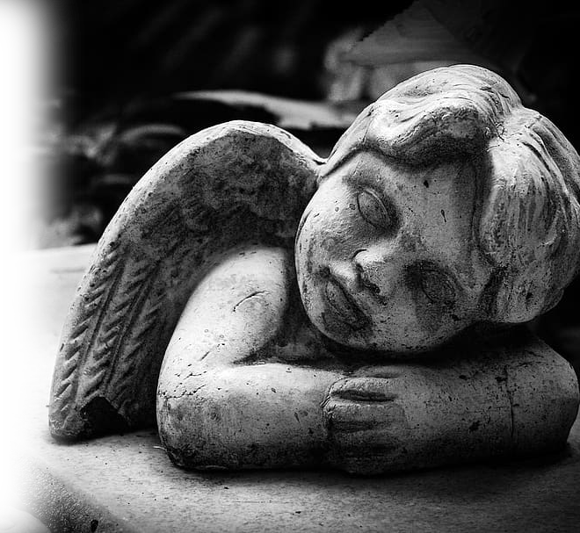
Mourning 8:10
¹⁰ I will turn your religious feasts into mourning and all your singing into weeping. I will make all of you wear sackcloth and shave your heads. I will make that time like mourning for an only son and the end of it like a bitter day.
¹² Rejoice and be glad, because great is your reward in heaven, (Matthew 5:12 )
Notes:
Earthquakes 8
Darkness 9
Mourning 10
This is the opposite of
¹² Rejoice and be glad, because great is your reward in heaven, (Mat 5:12 NIV)
Famine 11
Desperation 12
Faint 13
Fall 14
⁶ He inquired of the LORD, but the LORD did not answer him by dreams or Urim or prophets. (1Sa 28:6 NIV)

Slide 17

Famine 8:11
¹¹ "The days are coming," declares the Sovereign LORD, "when I will send a famine through the land-- not a famine of food or a thirst for water, but a famine of hearing the words of the LORD.
Psalm 23
¹ A psalm of David. The LORD is my shepherd, I shall not be in want.
² He makes me lie down in green pastures, he leads me beside quiet waters,
³ he restores my soul. He guides me in paths of righteousness for his name's sake.
⁴ Even though I walk through the valley of the shadow of death, I will fear no evil,
for you are with me; your rod and your staff, they comfort me.
⁵ You prepare a table before me in the presence of my enemies. You anoint my head with oil; my cup overflows.
⁶ Surely goodness and love will follow me all the days of my life, and I will dwell in the house of the LORD forever.
Psalm 119:11
I have hidden your word in my heart that I might not sin against you.
Notes:
Bible pixabay.com/photos/old-book-blank-spread-vintage-1762892/

Slide 18
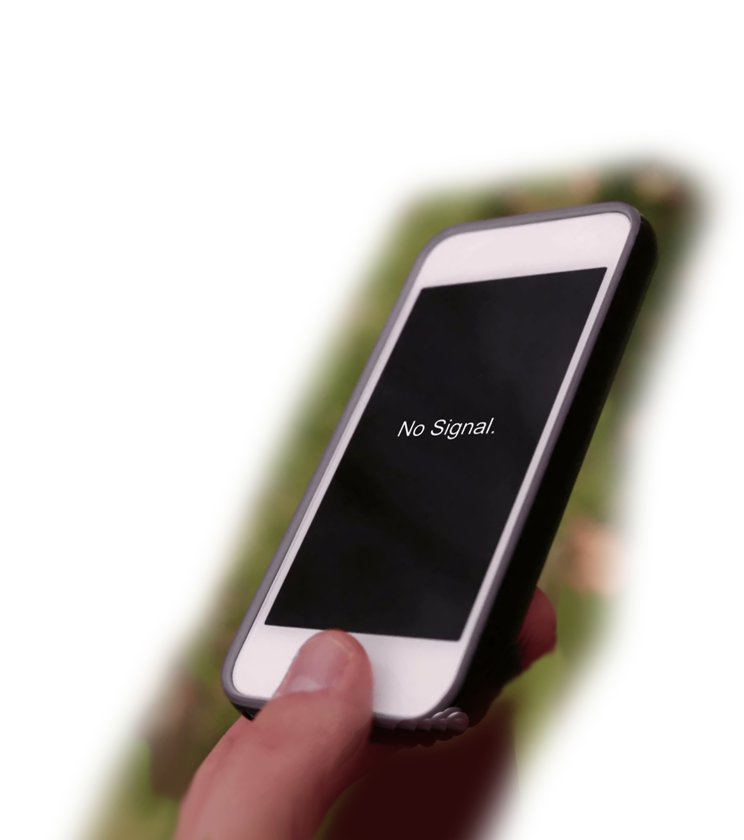
Lost 8:12
¹² Men will stagger from sea to sea and wander from north to east, searching for the word of the LORD, but they will not find it.
"Ask and it will be given to you;
seek and you will find;
knock and the door will be opened to you. (Mat 7:7 )
Notes:
Earthquakes 8
Darkness 9
Mourning 10
Famine 11
Lost 12
⁶ He inquired of the LORD, but the LORD did not answer him by dreams or Urim or prophets. (1Sa 28:6 NIV)
Faint 13
Fall 14

Slide 19
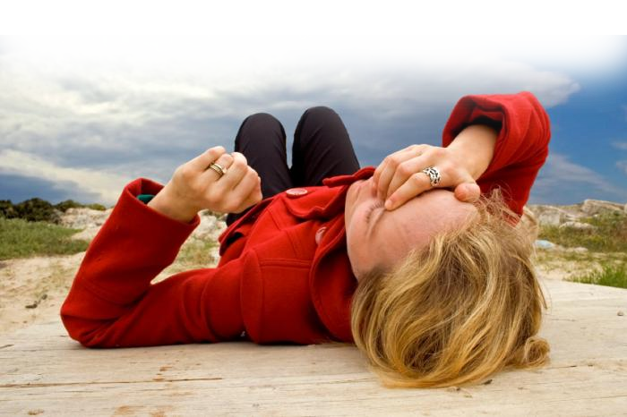
Faint 8:13
¹³ "In that day "the lovely young women and strong young men will faint because of thirst.
But they who wait for the LORD shall renew their strength; they shall mount up with wings like eagles; they shall run and not be weary; they shall walk and not faint. (Isaiah 40:31 ESV)
Notes:
www.emergency-live.com/it/wp-content/uploads/2016/07/woman-fainting-syncope.jpg
Opposite of Isaiah 40:31 ³¹ but those who hope in the LORD will renew their strength. They will soar on wings like eagles; they will run and not grow weary, they will walk and not be faint.
(Isa 40:31-1 NIV)
Earthquakes 8
Darkness 9
Mourning 10
Famine 11
Desperation 12
Faint 13
Fall 14
⁶ He inquired of the LORD, but the LORD did not answer him by dreams or Urim or prophets. (1Sa 28:6 NIV)

Slide 20
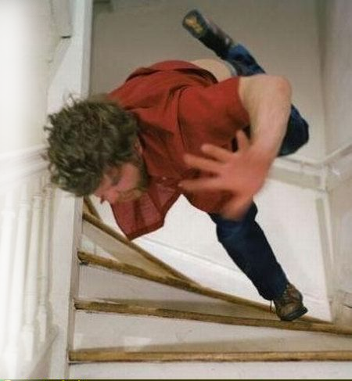
Fallen 8:14
¹⁴ They who swear by the shame of Samaria, or say, 'As surely as your god lives, O Dan,' or, 'As surely as the god of Beersheba lives'-- they will fall, never to rise again."
… Be all the more eager to make your calling and election sure. For if you do these things, you will never fall,
(2Peter 1:10)
Notes:
fall-down-stairs.jpg (450×505) (prosper.org.au)
Appears to be a downward sequence
Earthquakes 8 First, shaken
Darkness 9 Second, In the dark
Mourning 10 Third, Mourning losses
Famine 11 Fourth,
Desperation 12
Faint 13
Fall 14

Slide 21
So, How Should We Respond to Bitter Days Ahead?
Do not be surprised! We’re ripe too!

Slide 22
So, How Should We Respond to Bitter Days Ahead?
Do not be surprised! We’re ripe too!
Understand God has a reason for bitter days!

Slide 23
So, How Should We Respond to Bitter Days Ahead?
Do not be surprised! We’re ripe too!
Understand God has a reason for them!
God does not forget!

Slide 24
So, How Should We Respond to Bitter Days Ahead?
Do not be surprised! We’re ripe too!
Understand God has a reason for them!
God does not forget!
Hide God’s Word in
your heart!
Psalm 23
¹ A psalm of David. The LORD is my shepherd, I shall not be in want.
² He makes me lie down in green pastures, he leads me beside quiet waters,
³ he restores my soul. He guides me in paths of righteousness for his name's sake.
⁴ Even though I walk through the valley of the shadow of death, I will fear no evil,
for you are with me; your rod and your staff, they comfort me.
⁵ You prepare a table before me in the presence of my enemies. You anoint my head with oil; my cup overflows.
⁶ Surely goodness and love will follow me all the days of my life, and I will dwell in the house of the LORD forever.

Slide 25

So, How Should We Respond to Bitter Days Ahead?
Do not be surprised! We’re ripe too!
Understand God has a reason for them!
God does not forget His promises!
Hide God’s Word in
your heart!
Wait upon the Lord!
Notes:
t1.daumcdn.net/thumb/R1280x0.fjpg/?fname=http://t1.daumcdn.net/brunch/service/user/4uTn/image/Xd2bdCIIyqunjLCN_LFUWU0wFiA.jpg

Slide 26
Is there anyway to stop it?
If my people, who are called by my name, will humble themselves and pray and seek my face and turn from their wicked ways, then will I hear from heaven and will forgive their sin and will heal their land. (2Chronicles 7:14 )

Slide 27
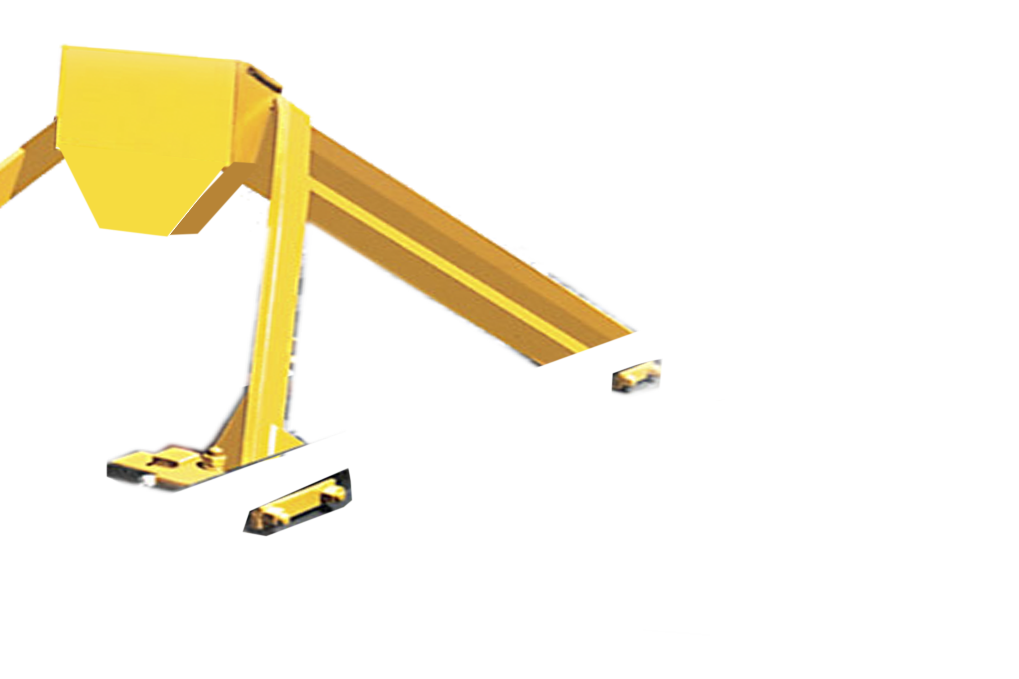
Pray & Repent!

