Slide 1

HELP! I’m Struggling
Here!
Notes:
Copyright © 2006−2021. All rights reserved. Bible Point is a registered trademark of Dennis Henderson. All other trademarks acknowledged.
Bible Point contains graphics from Bible Point artists. These illustrations belong to Bible Point and the respective artists. You may use the designs and illustrations for graphical illustration of lessons free and without special permission, provided they are not used in any way that maligns the Christian faith. Furthermore, republication or production of any illustration by any other graphic service whether it be in book, in a machine-readable form, or in any other design resource is strictly prohibited. Furthermore, they cannot be duplicated or resold as any other form of publishing, clip art, or graphic resource.
So What does it mean? (A simple translations of the legal jargon)
So, if you don’t own the presentation(s), graphic(s), and text(s) how can you legally use them? The purchase of the license allows you to use all the images in the product. However, the actual ownership and copyright of the presentation(s), graphic(s), and text(s) remain the property of Bible Point and its licensors. If you had plans on using this product in your “for sale” work—think again!
License Agreement
Article 1: License Grant
All the graphics and text in Bible Point presentations (excluding quotes from the Bible and stated sources) are the intellectual and real property of Bible Point and its licensors, and is protected by law, including United States copyright laws and international treaties. Bible Point grants to you a license:
1. To use the presentation in a single church, single school, or single office of a Christian organization.
2. To make a single archival back-up copy of the program.
3. To modify the presentation(s) and merge with other presentations in a single church, school, or Christian organization.
4. To transfer to another party if that party agrees to accept the terms and conditions of this agreement, and you do not retain any copies of the presentation, whether printed, machine readable, modified, or merged form.
Article 2: Terms
This license is effective until terminated. You may terminate the license at any time by destroying the presentation(s), graphic(s), or text(s) together with all copies, modifications and merged portions in any form. Bible Point may terminate your license if you fail to comply with this Agreement. You agree, upon such termination, for any reason, to destroy the presentation(s), graphics, and text(s) with all copies, modifications, and merged portions in any form.
Article 3: Disclaimers
1. Bible Point presentations, graphics, and texts are licensed to you As Is. You, the consumer, bear the entire risk relating to the quality and performance of the presentation(s), graphic(s), or text(s). In no event will Bible Point be liable for damages resulting from any defect.
2. Thirty-day limited warrantee on disks. Bible Point warrants the disks to be free of defects in material and workmanship under normal use for 30 days after purchase. During the 30-day period you may return a defective presentation, graphic, or text with proof of purchase and it will be replaced without charge, unless the presentation is damaged by misuse.
Article 4: General
1. You may not sub-license, assign, or transfer the license of the presentation(s), graphic(s), or text(s) except as provided by this Agreement.
2. This Agreement will be governed by the laws of the State of Michigan.
So What does it mean? (A simple translations of the legal jargon)
May I let someone borrow or copy my licensed Bible Point presentation (even after I modified it)? As long as it is within your local church, or single school, or the immediate office of a Christian organization you may. Otherwise, please refer the person interested in borrowing to: http://www.biblepoint.com or E-mail: dennis@DrDH.net with any related questions.

Slide 2
Struggling with the LORD

Slide 3

Struggling with what He Saw
Amos 7:1 This is what the Sovereign LORD showed me:

Slide 4
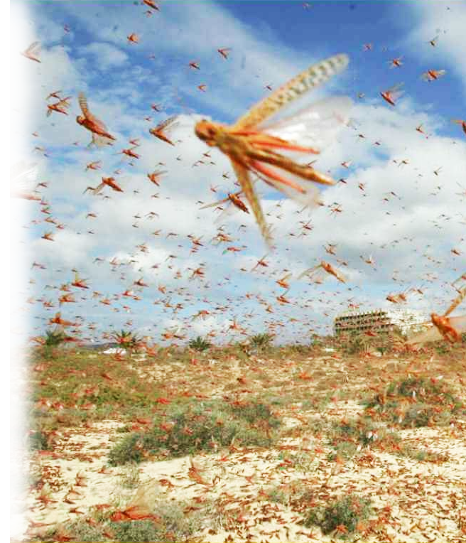
The Locust Vision 7:1-3
Amos 7:1 This is what the Sovereign LORD showed me: He was preparing swarms of locusts after the king's share had been harvested and just as the second crop was coming up.
Notes:
Locust = http://factly.in/wp-content/uploads/2020/06/Locust-Swarms_Featured-Image.jpg

Slide 5
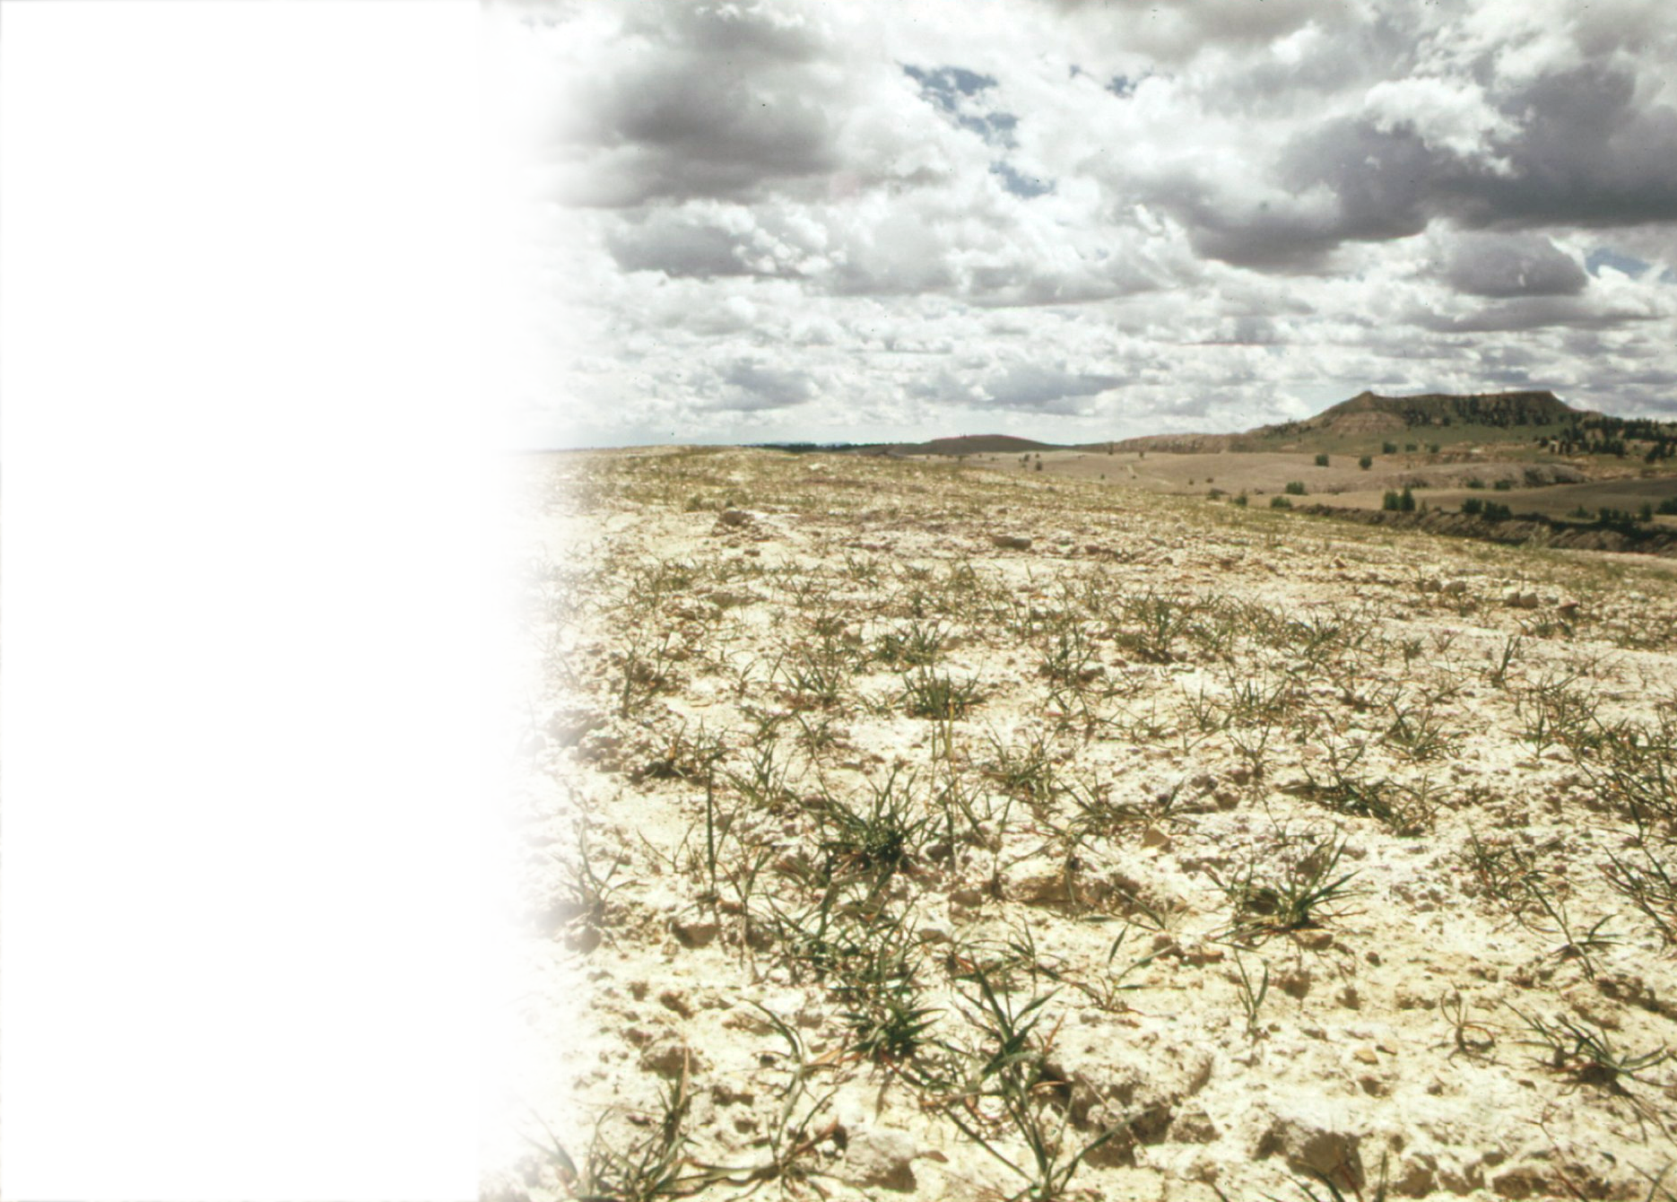
The Locust Vision 7:1-3
² When they had stripped
the land clean, I cried out, "Sovereign LORD, forgive!
How can Jacob survive? He
is so small!"
³ So the LORD relented.
"This will not happen,"
the LORD said.
⁴ This is what the Sovereign LORD showed me: The Sovereign LORD was calling for judgment by fire; it dried up the great deep and devoured the land.
⁵ Then I cried out, "Sovereign LORD, I beg you, stop! How can Jacob survive? He is so small!"
⁶ So the LORD relented. "This will not happen either," the Sovereign LORD said.
⁷ This is what he showed me: The Lord was standing by a wall that had been built true to plumb, with a plumb line in his hand.
⁸ And the LORD asked me, "What do you see, Amos?" "A plumb line," I replied. Then the Lord said, "Look, I am setting a plumb line among my people Israel; I will spare them no longer.
⁹ "The high places of Isaac will be destroyed and the sanctuaries of Israel will be ruined; with my sword I will rise against the house of Jeroboam."
(Amo 7:1-9 NIV)
Notes:
https://upload.wikimedia.org/wikipedia/commons/thumb/4/47/RECLAMATION_EFFORT_OF_STRIP_MINED_LAND_NEAR_COLSTRIP._OLD_STOCK_PILES_ARE_FLATTENED_AND_PLANTED._DRY_CLIMATE_AND..._-_NARA_-_549132.jpg/2048px-RECLAMATION_EFFORT_OF_STRIP_MINED_LAND_NEAR_COLSTRIP._OLD_STOCK_PILES_ARE_FLATTENED_AND_PLANTED._DRY_CLIMATE_AND..._-_NARA_-_549132.jpg

Slide 6
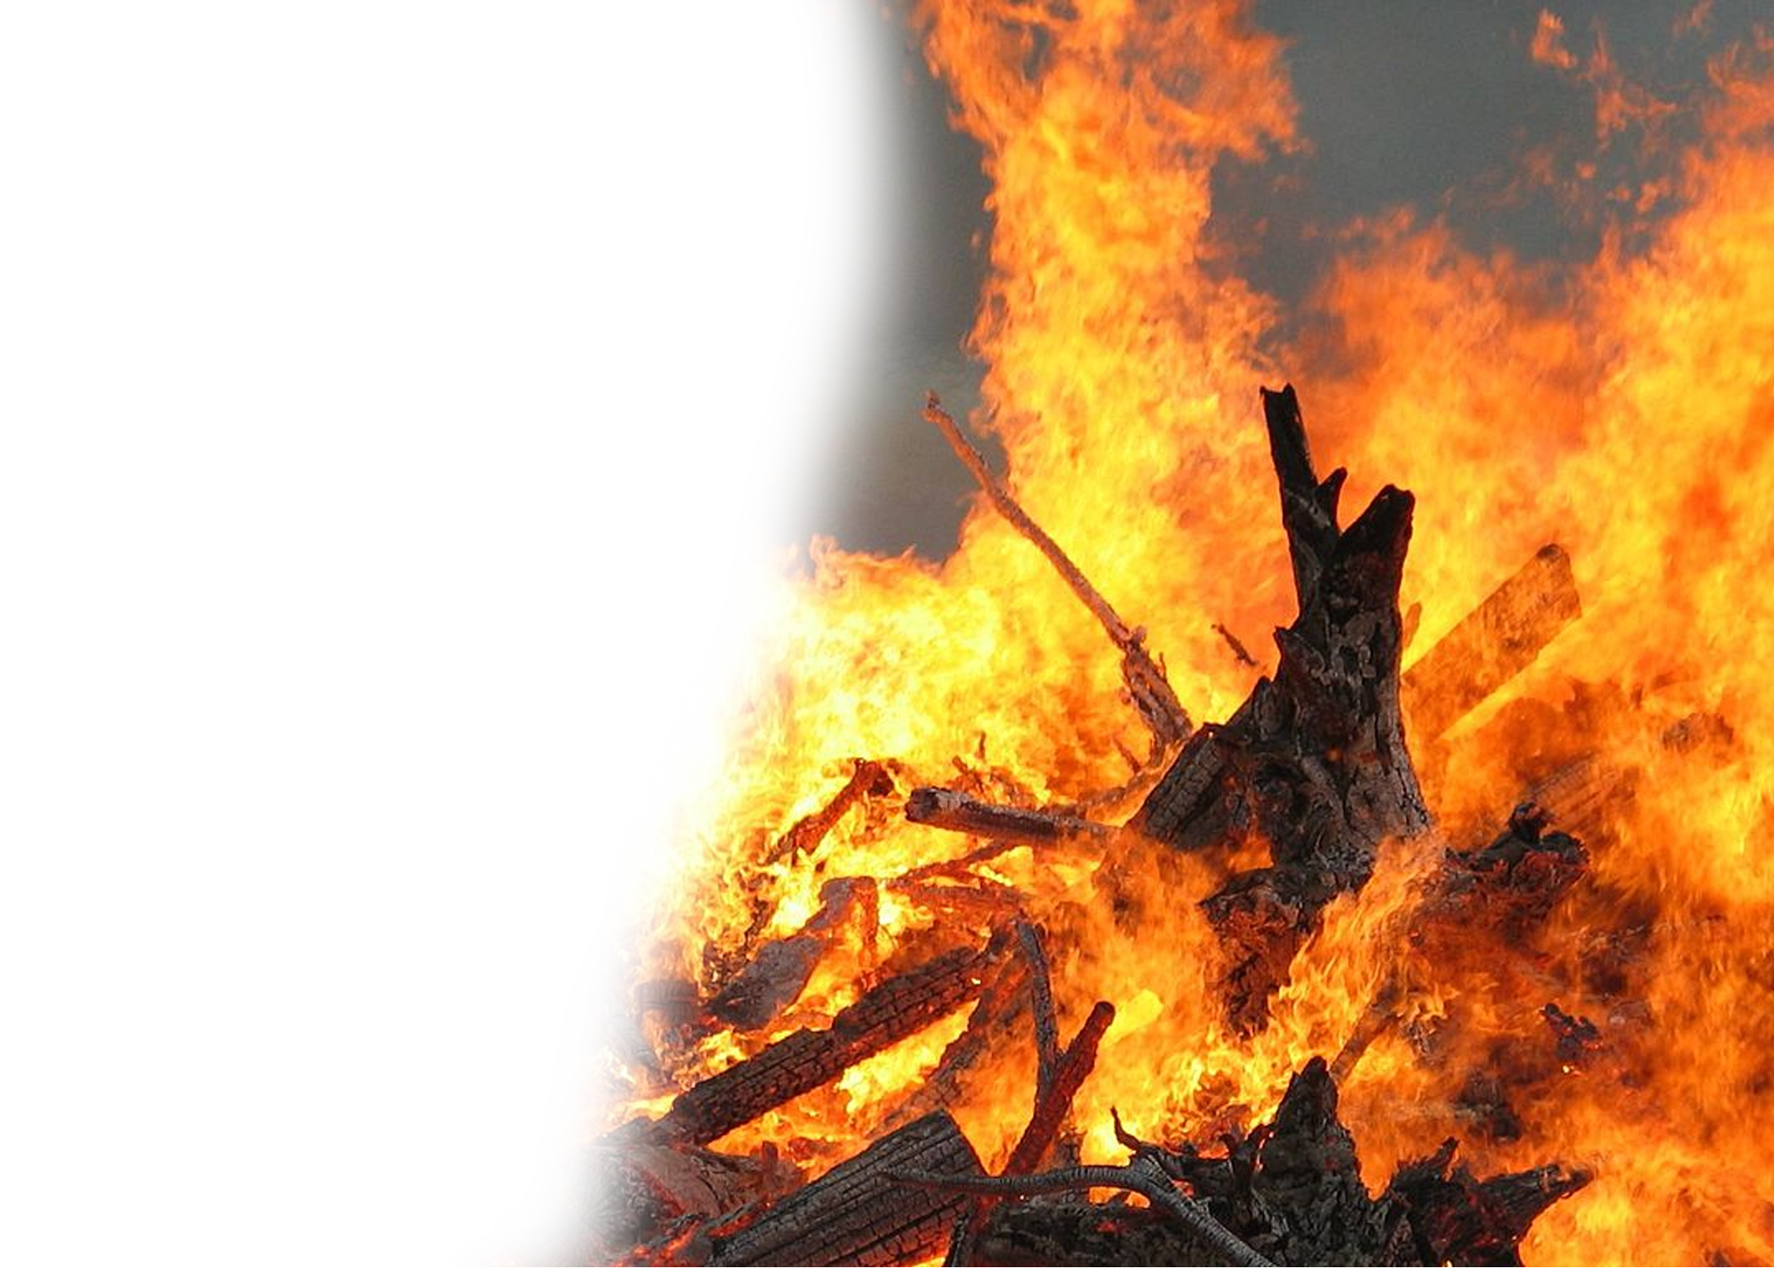
The Fire Vision 7:4-6
⁴ This is what the Sovereign LORD
showed me: The Sovereign LORD
was calling for judgment by fire;
it dried up the great deep and
devoured the land.
⁵ Then I cried out, "Sovereign
LORD, I beg you, stop! How
can Jacob survive? He is so small!“
⁶ So the LORD relented. "This will not happen either," the Sovereign LORD said.
⁷ This is what he showed me: The Lord was standing by a wall that had been built true to plumb, with a plumb line in his hand.
⁸ And the LORD asked me, "What do you see, Amos?" "A plumb line," I replied. Then the Lord said, "Look, I am setting a plumb line among my people Israel; I will spare them no longer.
⁹ "The high places of Isaac will be destroyed and the sanctuaries of Israel will be ruined; with my sword I will rise against the house of Jeroboam."
(Amo 7:1-9 NIV)
Notes:
https://upload.wikimedia.org/wikipedia/commons/thumb/7/72/Large_fire.jpg/1024px-Large_fire.jpg

Slide 7
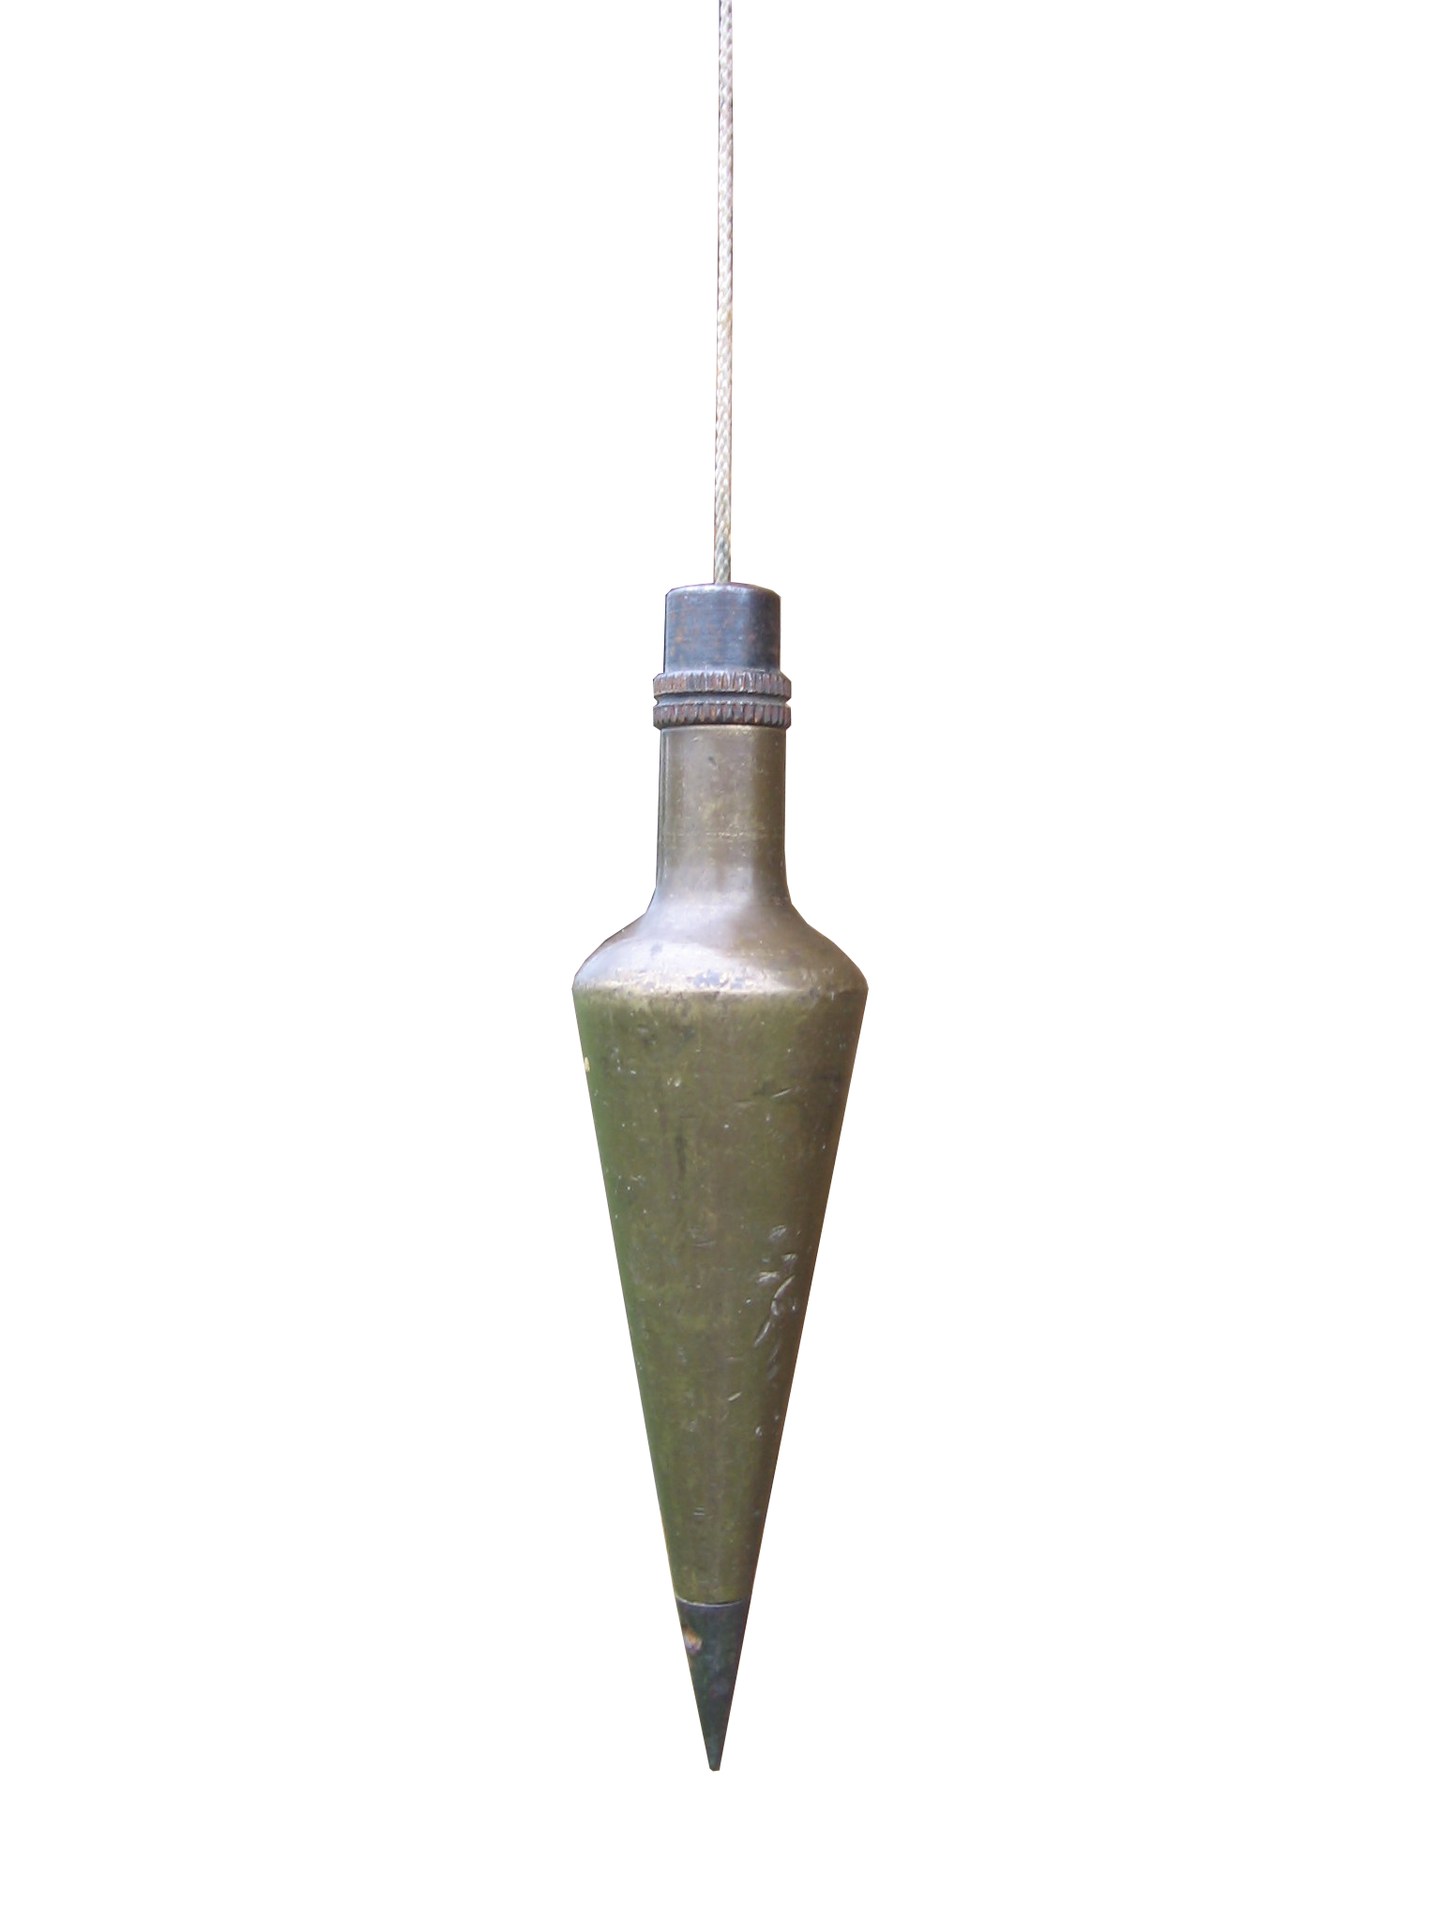
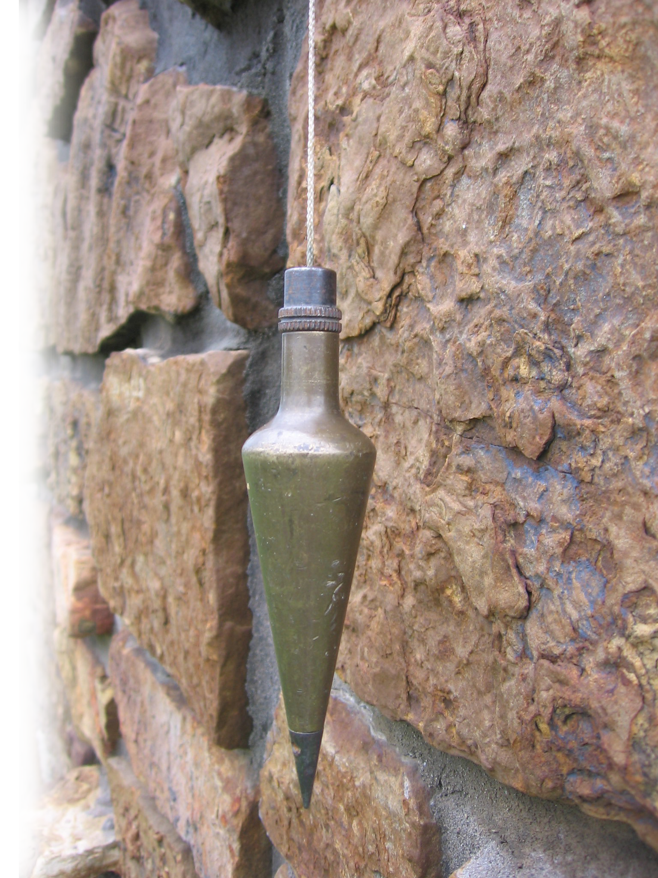
The Plumb Vision 7:7-9
⁷ This is what he showed me: The Lord was standing by a wall that had been built true to plumb, with a plumb line in his hand.
Notes:
Plumbline https://www.flickr.com/photos/arator/249770397

Slide 8
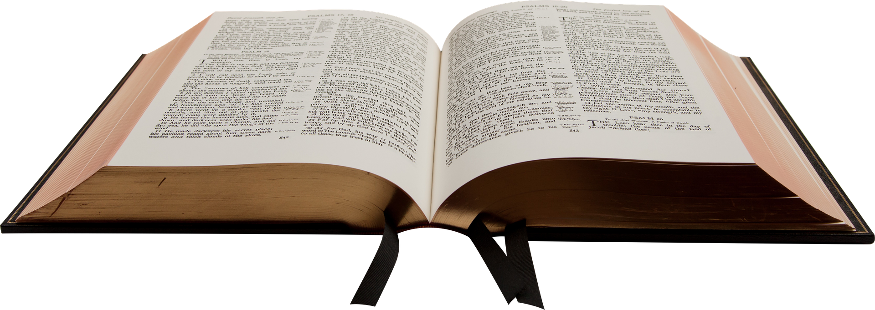
The Plumb Vision 7:7-9
⁸ And the LORD asked me, "What do you see, Amos?" "A plumb line," I replied. Then the Lord said, "Look, I am setting a plumb line among my people Israel; I will spare them no longer.
Notes:
https://pixabay.com/photos/bible-book-christian-holy-reading-1108074/

Slide 9
The Plumb Vision 7:7-9
⁹ "The high places of Isaac will be destroyed and the sanctuaries of Israel will be ruined; with my sword I will rise against the house of Jeroboam."
Notes:
This time Amos does not plea for little sinful Israel. He leaves the judgment to God.

Slide 10
Struggling with the Authorities 7:10-17
Notes:
Like some liberal minister going to President Biden and saying, “Pastor Dennis is conspiring against you in his church because he is calling out your sins of murdering babies by executive order and God is going to judge your for it.”
Listen to me, “God is going to judge him—as he judged them!”
This is nothing new—Acts “Stop preaching that Jesus is raised from the dead!”

Slide 11
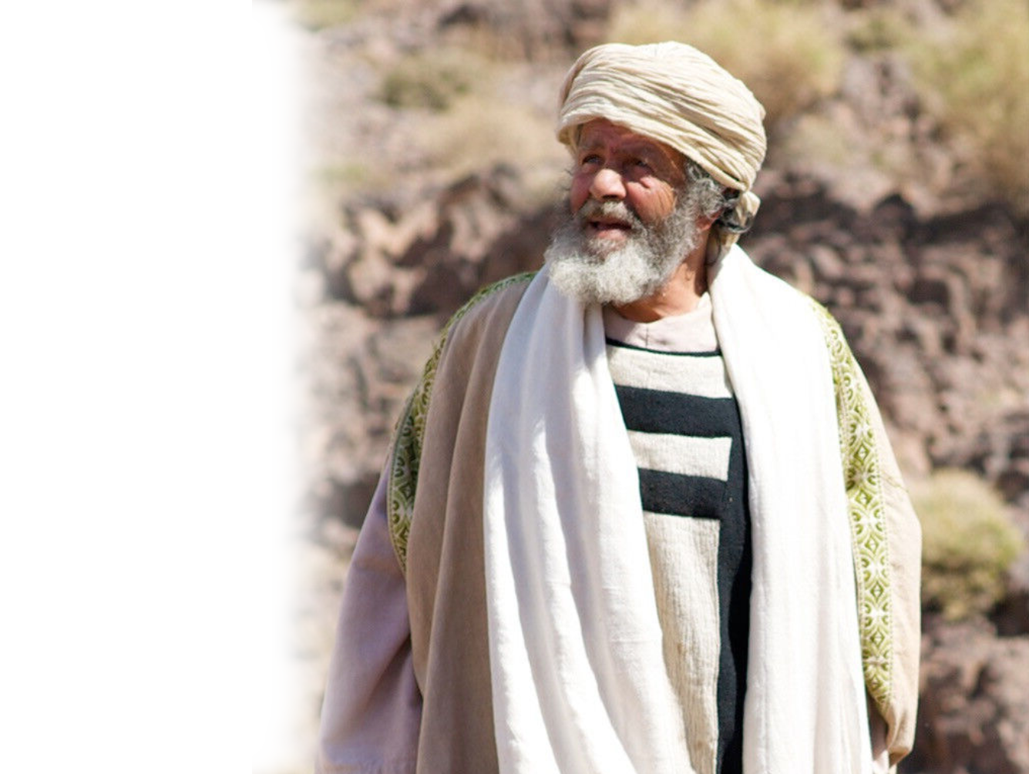
Struggling with the Authorities 7:10-17
¹⁰ Then Amaziah the priest of Bethel sent a message to Jeroboam king of Israel:
"Amos is raising a conspiracy against you in the very heart of Israel. The land cannot bear all
his words.
Notes:
Like some liberal minister going to President Biden and saying, “Pastor Dennis is conspiring against you in his church because he is calling out your sins of murdering babies by executive order and God is going to judge your for it.”
Listen to me, “God is going to judge him—as he judged them!”
This is nothing new—Acts “Stop preaching that Jesus is raised from the dead!”

Slide 12
Struggling with the Authorities 7:10-17
¹¹ For this is what Amos is saying:
" 'Jeroboam will die by the sword, and Israel will surely go into exile, away from their native land.' "
Notes:
Like some liberal minister going to President Biden and saying, “Pastor Dennis is conspiring against you in his church because he is calling out your sins of murdering babies by executive order and God is going to judge your for it.”
Listen to me, “God is going to judge him—as he judged them!”
This is nothing new—Acts “Stop preaching that Jesus is raised from the dead!”

Slide 13

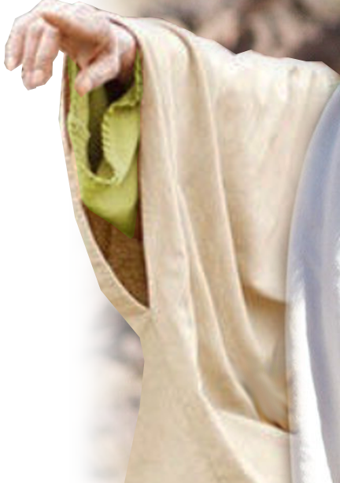
Struggling with the Authorities 7:10-17
¹² Then Amaziah said to Amos, "Get out, you seer! Go back
to the land of Judah.
Earn your bread
there and do your
prophesying there. ¹³
Don't prophesy anymore
at Bethel, because this is
the king's sanctuary and
the temple of the kingdom."
Notes:
Like some liberal minister going to President Biden and saying, “Pastor Dennis is conspiring against you in his church because he is calling out your sins of murdering babies by executive order and God is going to judge your for it.”
Listen to me, “God is going to judge him—as he judged them!”
This is nothing new—Acts “Stop preaching that Jesus is raised from the dead!”

Slide 14
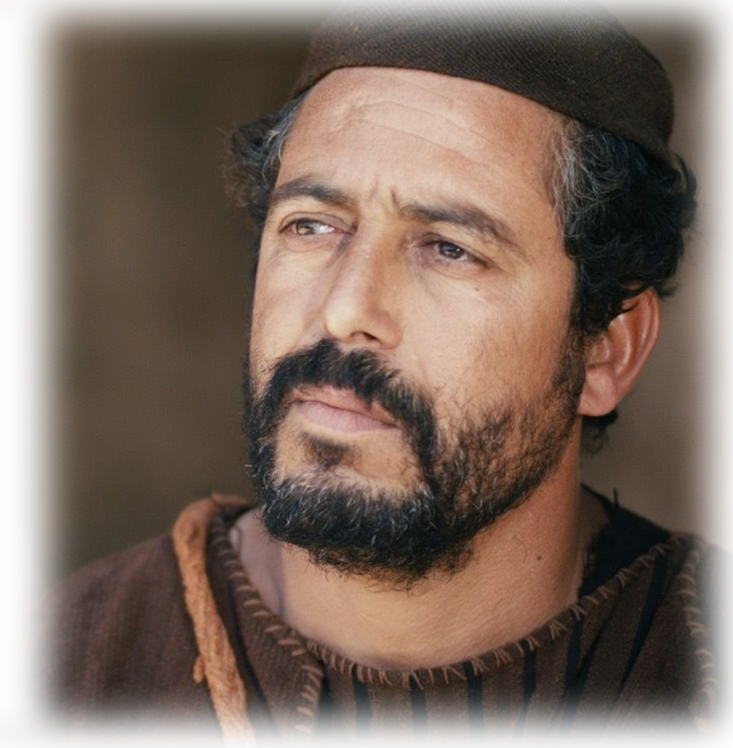
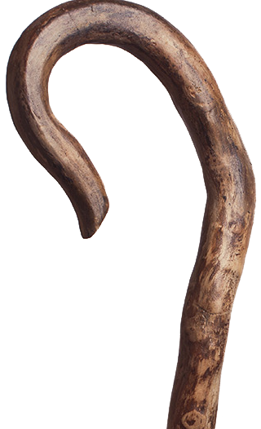

Struggling with the Authorities 7:10-17
¹⁴ Amos answered Amaziah, "I was neither a prophet
nor a prophet's son, but
I was a shepherd, and I
also took care of sycamore-fig trees.
Notes:
Like some liberal minister going to President Biden and saying, “Pastor Dennis is conspiring against you in his church because he is calling out your sins of murdering babies by executive order and God is going to judge your for it.”
Listen to me, “God is going to judge him—as he judged them!”
This is nothing new—Acts “Stop preaching that Jesus is raised from the dead!”

Slide 15
Struggling with the Authorities 7:10-17
¹⁵ But the LORD took me from tending the flock and said to me, 'Go, prophesy to my people Israel.'
¹⁶ Now then, hear the word of the LORD. You say, " 'Do not prophesy against Israel, and stop preaching against the house of Isaac.'
Notes:
Like some liberal minister going to President Biden and saying, “Pastor Dennis is conspiring against you in his church because he is calling out your sins of murdering babies by executive order and God is going to judge your for it.”
Listen to me, “God is going to judge him—as he judged them!”
This is nothing new—Acts “Stop preaching that Jesus is raised from the dead!”

Slide 16

Struggling with the Authorities 7:10-17
¹⁷ "Therefore this is what the LORD says: " 'Your wife will become a prostitute in the city, and your sons and daughters will fall by the sword. Your land will be measured and divided up, and you yourself will die in a pagan country. And Israel will certainly go into exile, away from their native land.' "
Notes:
Like some liberal minister going to President Biden and saying, “Pastor Dennis is conspiring against you in his church because he is calling out your sins of murdering babies by executive order and God is going to judge your for it.”
Listen to me, “God is going to judge him—as he judged them!”
This is nothing new—Acts “Stop preaching that Jesus is raised from the dead!”

Slide 17
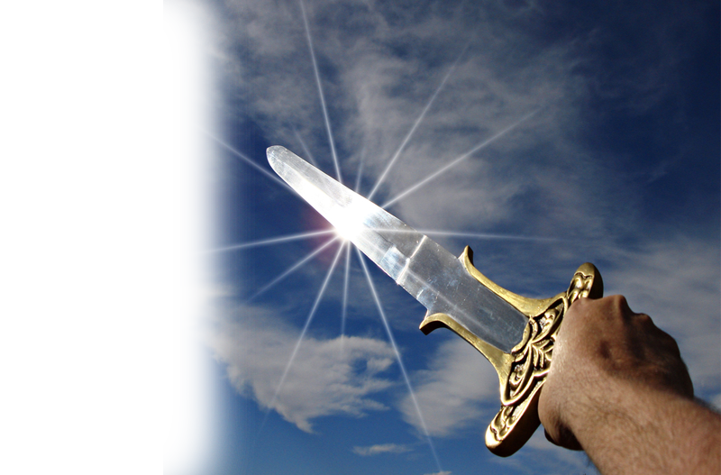
Struggling with the Authorities 7:10-17
¹⁷ "Therefore this is what the LORD says: " 'Your wife will become a prostitute in the city, and your sons and daughters will fall by the sword. Your land will be measured and divided up, and you yourself will die in a pagan country. And Israel will certainly go into exile, away from their native land.' "
Notes:
Sword https://www.goodfreephotos.com/cache/weapons/hand-holding-sword_800.jpg?cached=1522543788
Like some liberal minister going to President Biden and saying, “Pastor Dennis is conspiring against you in his church because he is calling out your sins of murdering babies by executive order and God is going to judge your for it.”
Listen to me, “God is going to judge him—as he judged them!”
This is nothing new—Acts “Stop preaching that Jesus is raised from the dead!”

Slide 18
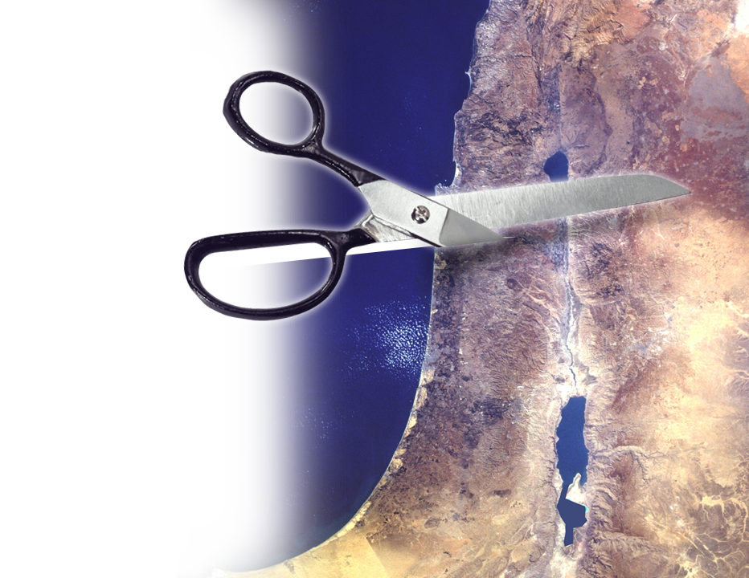
Struggling with the Authorities 7:10-17
¹⁷ "Therefore this is what the LORD says: " 'Your wife will become a prostitute in the city, and your sons and daughters will fall by the sword. Your land will be measured and divided up, and you yourself will die in a pagan country. And Israel will certainly go into exile, away from their native land.' "
Notes:
https://freepngimg.com/png/1867-hair-scissors-png-image
Like some liberal minister going to President Biden and saying, “Pastor Dennis is conspiring against you in his church because he is calling out your sins of murdering babies by executive order and God is going to judge your for it.”
Listen to me, “God is going to judge him—as he judged them!”
This is nothing new—Acts “Stop preaching that Jesus is raised from the dead!”

Slide 19
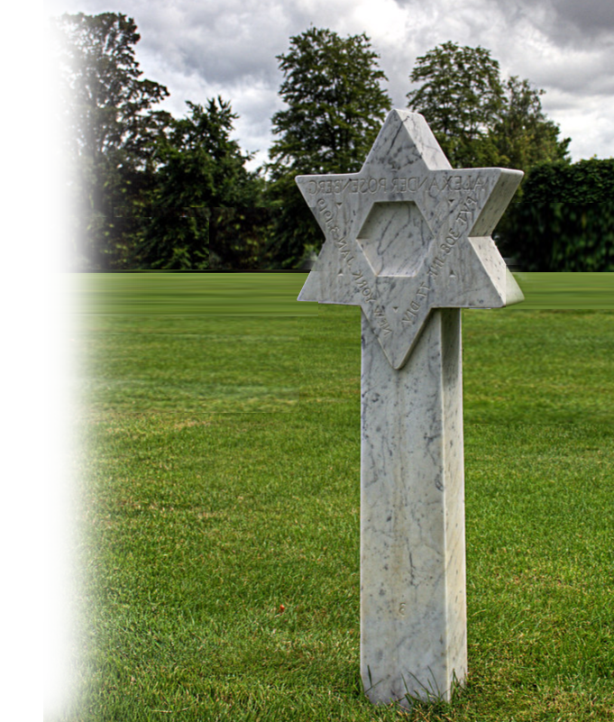
Struggling with the Authorities 7:10-17
¹⁷ "Therefore this is what the LORD says: " 'Your wife will become a prostitute in the city, and your sons and daughters will fall by the sword. Your land will be measured and divided up, and you yourself will die in a pagan country. And Israel will certainly go into exile, away from their native land.' "
Notes:
Grave = www.flickr.com/photos/mauricedb/1209368629
Like some liberal minister going to President Biden and saying, “Pastor Dennis is conspiring against you in his church because he is calling out your sins of murdering babies by executive order and God is going to judge your for it.”
Listen to me, “God is going to judge him—as he judged them!”
This is nothing new—Acts “Stop preaching that Jesus is raised from the dead!”

Slide 20
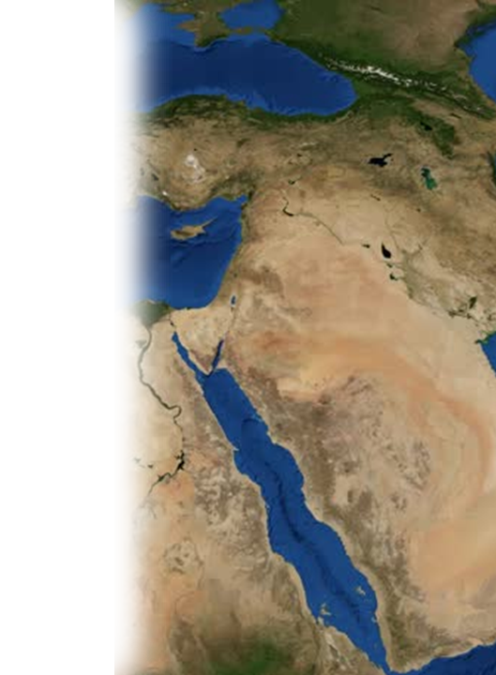
Struggling with the Authorities 7:10-17
¹⁷ "Therefore this is what the LORD says: " 'Your wife will become a prostitute in the city, and your sons and daughters will fall by the sword. Your land will be measured and divided up, and you yourself will die in a pagan country. And Israel will certainly go into exile, away from their native land.' "
Notes:
Sword https://www.goodfreephotos.com/cache/weapons/hand-holding-sword_800.jpg?cached=1522543788
Like some liberal minister going to President Biden and saying, “Pastor Dennis is conspiring against you in his church because he is calling out your sins of murdering babies by executive order and God is going to judge your for it.”
Listen to me, “God is going to judge him—as he judged them!”
This is nothing new—Acts “Stop preaching that Jesus is raised from the dead!”

Slide 21
HELP!
I’m Struggling
Here!

Slide 22
Probably you are struggling too!

Slide 23
So what do you do?
1- Look to the Lord – He will show you what to do!

Slide 24
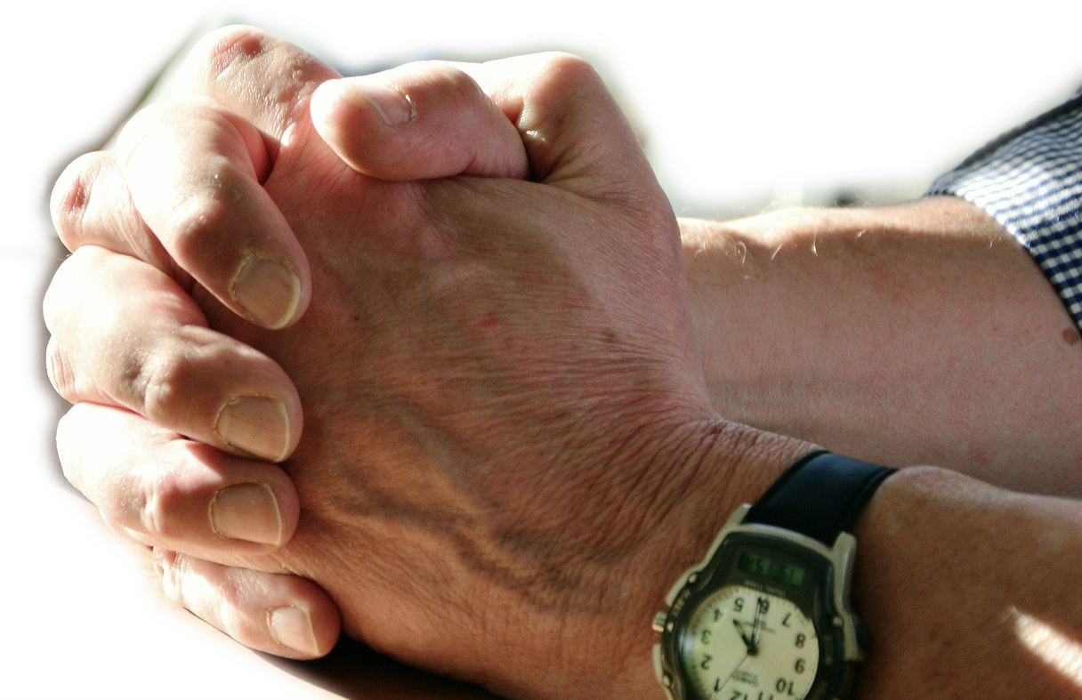
So what do you do?
1- Look to the Lord – He will show you what to do!
2- Plead with the Lord—Do some holy complaining!
Notes:
pixabay.com/photos/hands-pray-prayer-praying-hands-2168901/

Slide 25

So what do you do?
1- Look to the Lord – He will show you what to do!
2- Plead with the Lord—Do some holy complaining!
3- Expect that others won’t get you, when you do!
Notes:
www.flickr.com/photos/83633410@N07/7658298768

Slide 26
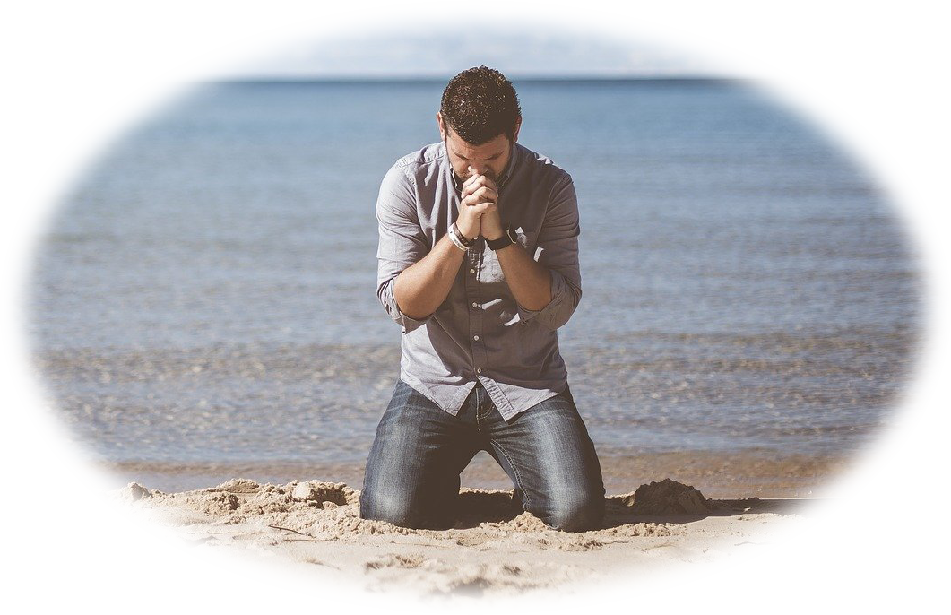
So what do you do?
1- Look to the Lord – He will show you what to do!
2- Plead with the Lord—Do some holy complaining!
3- Expect that others won’t get you, when you do!
4- Humble yourself before the LORD!

Slide 27
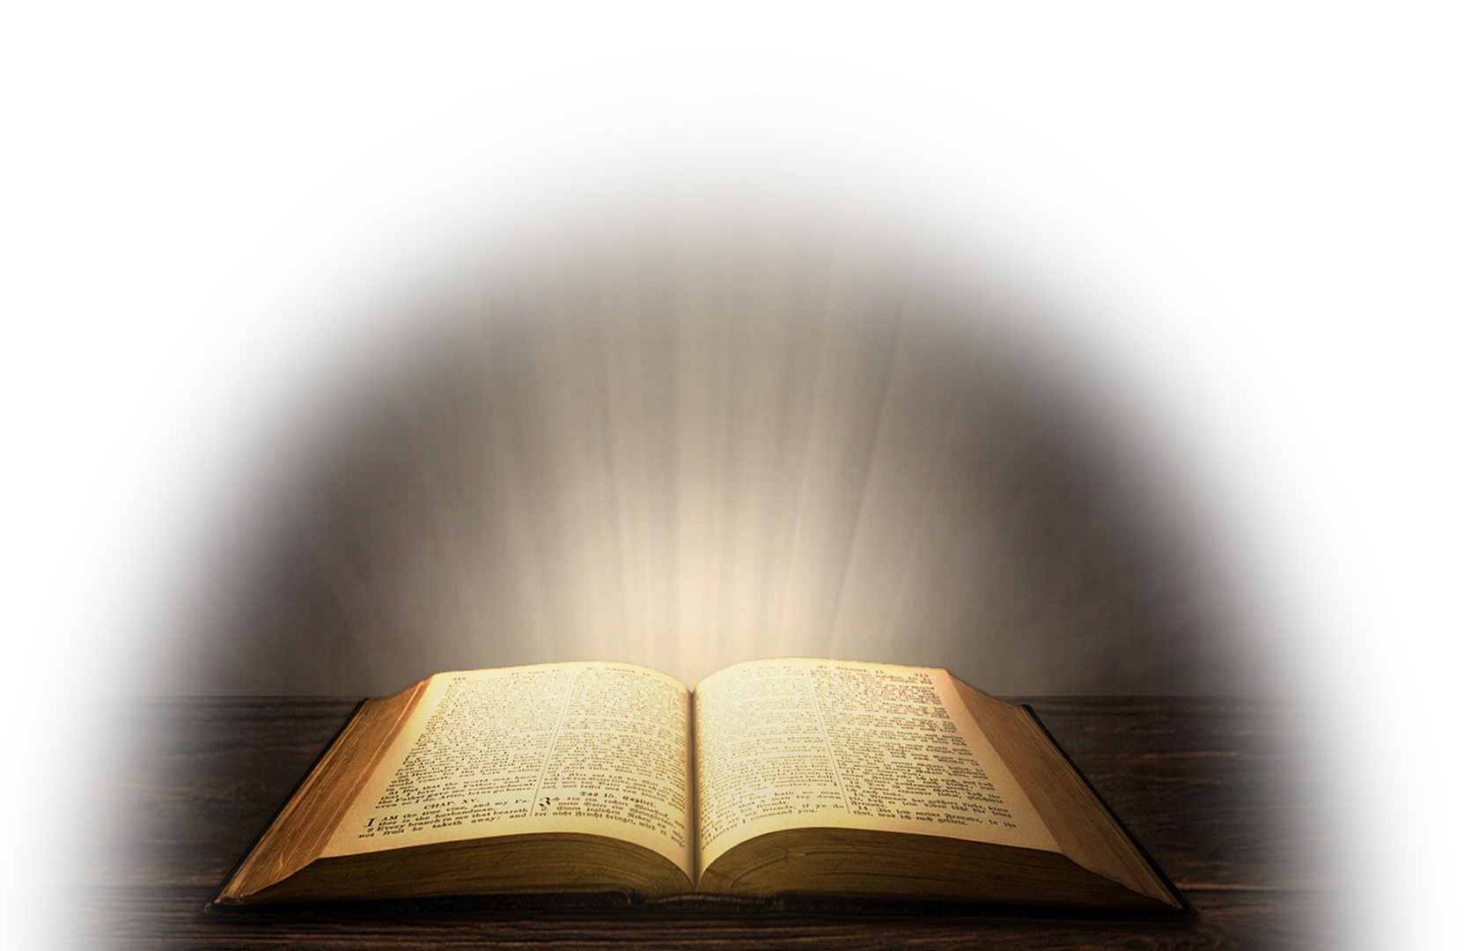
So what do you do?
1- Look to the Lord—He will show you what to do!
2- Plead with the Lord—Do some holy complaining!
3- Expect that others won’t get you, when you do!
4- Humble yourself before the LORD!
5- Stay true to the Word—He will HELP!

Slide 28
LET’S PRAY!

