Slide 1
WOE
Notes:
grunge-danger | Dave | Flickr
Copyright © 2006−2021. All rights reserved. Bible Point is a registered trademark of Dennis Henderson. All other trademarks acknowledged.
Bible Point contains graphics from Bible Point artists. These illustrations belong to Bible Point and the respective artists. You may use the designs and illustrations for graphical illustration of lessons free and without special permission, provided they are not used in any way that maligns the Christian faith. Furthermore, republication or production of any illustration by any other graphic service whether it be in book, in a machine-readable form, or in any other design resource is strictly prohibited. Furthermore, they cannot be duplicated or resold as any other form of publishing, clip art, or graphic resource.
So What does it mean? (A simple translations of the legal jargon)
So, if you don’t own the presentation(s), graphic(s), and text(s) how can you legally use them? The purchase of the license allows you to use all the images in the product. However, the actual ownership and copyright of the presentation(s), graphic(s), and text(s) remain the property of Bible Point and its licensors. If you had plans on using this product in your “for sale” work—think again!
License Agreement
Article 1: License Grant
All the graphics and text in Bible Point presentations (excluding quotes from the Bible and stated sources) are the intellectual and real property of Bible Point and its licensors, and is protected by law, including United States copyright laws and international treaties. Bible Point grants to you a license:
1. To use the presentation in a single church, single school, or single office of a Christian organization.
2. To make a single archival back-up copy of the program.
3. To modify the presentation(s) and merge with other presentations in a single church, school, or Christian organization.
4. To transfer to another party if that party agrees to accept the terms and conditions of this agreement, and you do not retain any copies of the presentation, whether printed, machine readable, modified, or merged form.
Article 2: Terms
This license is effective until terminated. You may terminate the license at any time by destroying the presentation(s), graphic(s), or text(s) together with all copies, modifications and merged portions in any form. Bible Point may terminate your license if you fail to comply with this Agreement. You agree, upon such termination, for any reason, to destroy the presentation(s), graphics, and text(s) with all copies, modifications, and merged portions in any form.
Article 3: Disclaimers
1. Bible Point presentations, graphics, and texts are licensed to you As Is. You, the consumer, bear the entire risk relating to the quality and performance of the presentation(s), graphic(s), or text(s). In no event will Bible Point be liable for damages resulting from any defect.
2. Thirty-day limited warrantee on disks. Bible Point warrants the disks to be free of defects in material and workmanship under normal use for 30 days after purchase. During the 30-day period you may return a defective presentation, graphic, or text with proof of purchase and it will be replaced without charge, unless the presentation is damaged by misuse.
Article 4: General
1. You may not sub-license, assign, or transfer the license of the presentation(s), graphic(s), or text(s) except as provided by this Agreement.
2. This Agreement will be governed by the laws of the State of Michigan.
So What does it mean? (A simple translations of the legal jargon)
May I let someone borrow or copy my licensed Bible Point presentation (even after I modified it)? As long as it is within your local church, or single school, or the immediate office of a Christian organization you may. Otherwise, please refer the person interested in borrowing to: http://www.biblepoint.com or E-mail: dennis@DrDH.net with any related questions.

Slide 2
WOE
To the IGNORANT!
Notes:
grunge-danger | Dave | Flickr
grunge-danger | Dave | Flickr
Sermon title today is one word: WOE!
One word- WOE – says it all. A cry of despair. It is the feeling of deep despair.
Men, you know like when you forget your wife’s birthday or anniversary.
I know this feeling, like telling the congregation to “Not call my wife” and her letting me know that I was wrong for what I have said. That sinking feeling of despair and doom.
Ladies, you know when the car behind you turns on the siren and flashing lights.
That’s nothing compared to the WOE that is coming. Can you imagine what it will be like when you stand before the Judgment Seat Of Christ? When you have to give an accoung to Christ for everything you have ever done or said? Well, that exactly how Isaiah the prophet felt …
Isaiah the prophet also had that sinking feeling of despair and doom – but for much more justified reasons:
The prophet Isaiah used it when he realized he has seen the Christ. Yes, that’s right, Isaiah who lived 700 years before Christ, saw Him (John 12:41). Isaiah 6: 1-5
Isaiah 6:1 In the year that King Uzziah died, I saw the Lord seated on a throne, high and exalted, and the train of his robe filled the temple.
² Above him were seraphs, each with six wings: With two wings they covered their faces, with two they covered their feet, and with two they were flying.
³ And they were calling to one another: "Holy, holy, holy is the LORD Almighty; the whole earth is full of his glory."
⁴ At the sound of their voices the doorposts and thresholds shook and the temple was filled with smoke.
⁵ "Woe to me!" I cried. "I am ruined! For I am a man of unclean lips, and I live among a people of unclean lips, and my eyes have seen the King, the LORD Almighty."
(Isa 6:1-5 NIV)
Woe is a word to depict your complete despair due to the fact that you are doomed.
Our text today has four WOES.
⁵ So I said: "Woe is me, for I am undone! Because I am a man of unclean lips, And I dwell in the midst of a people of unclean lips; For my eyes have seen the King, The LORD of hosts." (Isa 6:5 NKJ)
Woe to the Ignorance 5:18-27
About the Day of the Lord: a time of
Despair 5:18
Darkness 5:18, 20
Doom 5:19
About the Sin of their day
Hypocritical Worship 5:21-24
Unconcerned about people5:24
Forgetting the past 5:25-27
Woe to the Complacent 6:1-2
In False Security 6:1
In False Reality 6:2
Woe to my Indulgence 6:3-7
Indulgent Luxury 6:3-4
Indulgent Entertainment 6:5
Indulgent Leisure 6:6-7
Woe to the Arrogant 6:8-14
Arrogance leads to Death 6:8-10
Arrogance leads to Destruction 6:11-13
Arrogance leads to Defeat 6:14

Slide 3
Woe to the IGNORANT!
5¹⁸ Woe to you who long for the day of the LORD! Why do you long for the day of the LORD? That day will be darkness, not light.
²⁰ Will not the day of the LORD …
The Day of the LORD!
What is it?
Notes:
Woe to the Ignorance 5:18-27
About the Day of the Lord: a time of
Despair 5:18
Darkness 5:18, 20
Doom 5:19
About the Sin of their day
Hypocritical Worship 5:21-24
Unconcerned about people5:24
Forgetting the past 5:25-27
Woe to the Complacent 6:1-2
In False Security 6:1
In False Reality 6:2
Woe to my Indulgence 6:3-7
Indulgent Luxury 6:3-4
Indulgent Entertainment 6:5
Indulgent Leisure 6:6-7
Woe to the Arrogant 6:8-14
Arrogance leads to Death 6:8-10
Arrogance leads to Destruction 6:11-13
Arrogance leads to Defeat 6:14

Slide 4
Woe to the IGNORANT!
5¹⁸ Woe to you who long for the day of the LORD! Why do you long for the day of the LORD?
That day will be darkness, not light
²⁰ Will not the day of the LORD be darkness
The Day of the LORD is time period of both darkness
and light. It is the Tribulation and the Kingdom.
Notes:
Woe to the Ignorance 5:18-27
About the Day of the Lord: a time of
Despair 5:18
Darkness 5:18, 20
Doom 5:19
About the Sin of their day
Hypocritical Worship 5:21-24
Unconcerned about people5:24
Forgetting the past 5:25-27
Woe to the Complacent 6:1-2
In False Security 6:1
In False Reality 6:2
Woe to my Indulgence 6:3-7
Indulgent Luxury 6:3-4
Indulgent Entertainment 6:5
Indulgent Leisure 6:6-7
Woe to the Arrogant 6:8-14
Arrogance leads to Death 6:8-10
Arrogance leads to Destruction 6:11-13
Arrogance leads to Defeat 6:14

Slide 5

Woe to the IGNORANT!
¹⁹ It will be as though a man fled from a lion only to meet a bear, as though he entered his house and rested his hand on the wall only to have a snake bite him.
Notes:
Woe to the Ignorance 5:18-27
About the Day of the Lord: a time of
Despair 5:18
Darkness 5:18, 20
Doom 5:19
About the Sin of their day
Hypocritical Worship 5:21-24
Unconcerned about people5:24
Forgetting the past 5:25-27
Woe to the Complacent 6:1-2
In False Security 6:1
In False Reality 6:2
Woe to my Indulgence 6:3-7
Indulgent Luxury 6:3-4
Indulgent Entertainment 6:5
Indulgent Leisure 6:6-7
Woe to the Arrogant 6:8-14
Arrogance leads to Death 6:8-10
Arrogance leads to Destruction 6:11-13
Arrogance leads to Defeat 6:14

Slide 6

Woe to the IGNORANT!
¹⁹ It will be as though a man fled from a lion only to meet a bear, as though he entered his house and rested his hand on the wall only to have a snake bite him.
Notes:
https://p1.pxfuel.com/preview/618/450/457/bear-brown-bear-teddy-bear-hairy.jpg
Woe to the Ignorance 5:18-27
About the Day of the Lord: a time of
Despair 5:18
Darkness 5:18, 20
Doom 5:19
About the Sin of their day
Hypocritical Worship 5:21-24
Unconcerned about people5:24
Forgetting the past 5:25-27
Woe to the Complacent 6:1-2
In False Security 6:1
In False Reality 6:2
Woe to my Indulgence 6:3-7
Indulgent Luxury 6:3-4
Indulgent Entertainment 6:5
Indulgent Leisure 6:6-7
Woe to the Arrogant 6:8-14
Arrogance leads to Death 6:8-10
Arrogance leads to Destruction 6:11-13
Arrogance leads to Defeat 6:14

Slide 7

Woe to the IGNORANT!
¹⁹ It will be as though a man fled from a lion only to meet a bear, as though he entered his house and rested his hand on the wall only to have a snake bite him.
Notes:
https://upload.wikimedia.org/wikipedia/commons/thumb/5/5f/Whole_in_gypsum_wall_%2B_plastic_foil.JPG/2048px-Whole_in_gypsum_wall_%2B_plastic_foil.JPGWoe to the Ignorance 5:18-27
www.freepik.com/free-photo/man-is-reaching-his-hand-push-fire-alarm-hand-station_3806472.htm#page=1&query=hand%20pushing%20wall&position=3
www.survivalkit.com/blog/wp-content/uploads/2018/04/snake1-800x768.jpg
About the Day of the Lord: a time of
Despair 5:18
Darkness 5:18, 20
Doom 5:19
About the Sin of their day
Hypocritical Worship 5:21-24
Unconcerned about people5:24
Forgetting the past 5:25-27
Woe to the Complacent 6:1-2
In False Security 6:1
In False Reality 6:2
Woe to my Indulgence 6:3-7
Indulgent Luxury 6:3-4
Indulgent Entertainment 6:5
Indulgent Leisure 6:6-7
Woe to the Arrogant 6:8-14
Arrogance leads to Death 6:8-10
Arrogance leads to Destruction 6:11-13
Arrogance leads to Defeat 6:14

Slide 8
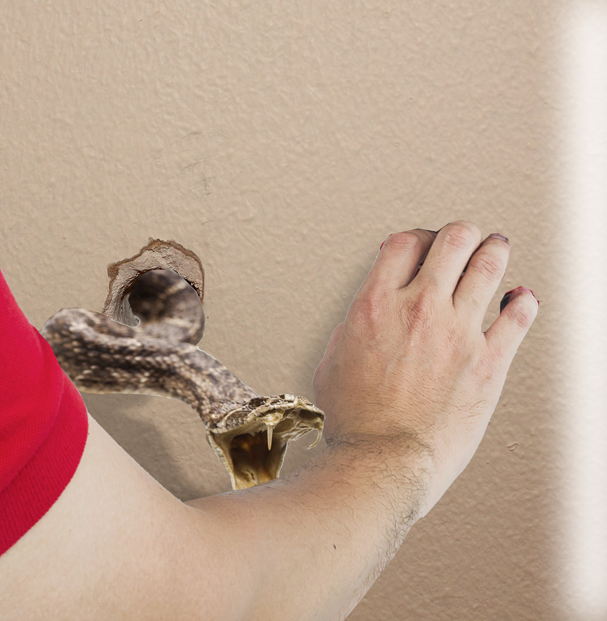
Woe to the IGNORANT!
¹⁹ It will be as though a man fled from a lion only to meet a bear, as though he entered his house and rested his hand on the wall only to have a snake bite him.
Notes:
https://p1.pxfuel.com/preview/618/450/457/bear-brown-bear-teddy-bear-hairy.jpg
From frying pan to fire
when it rains, it pours
to be kicked while they are down
Misfortunes never come alone
Woe to the Ignorance 5:18-27
About the Day of the Lord: a time of
Despair 5:18
Darkness 5:18, 20
Doom 5:19
About the Sin of their day
Hypocritical Worship 5:21-24
Unconcerned about people5:24
Forgetting the past 5:25-27
Woe to the Complacent 6:1-2
In False Security 6:1
In False Reality 6:2
Woe to my Indulgence 6:3-7
Indulgent Luxury 6:3-4
Indulgent Entertainment 6:5
Indulgent Leisure 6:6-7
Woe to the Arrogant 6:8-14
Arrogance leads to Death 6:8-10
Arrogance leads to Destruction 6:11-13
Arrogance leads to Defeat 6:14

Slide 9
Woe to the IGNORANT!
Wail, for the day of the LORD is near; it will come like destruction from the Almighty. (Isaiah 13:6)
²⁰ Will not the day of the LORD be darkness, not light-- pitch-dark, without a ray of brightness?
Notes:
The Prophet is not sugar coating it.
Like a Dr who has to tell you that you only have days or at best a week to live. Bad news bearer.
False prophets lie to you—No, God will never judge like that!
Woe to the Ignorance 5:18-27
About the Day of the Lord: a time of
Despair 5:18
Darkness 5:18, 20
Doom 5:19
About the Sin of their day
Hypocritical Worship 5:21-24
Unconcerned about people5:24
Forgetting the past 5:25-27
Woe to the Complacent 6:1-2
In False Security 6:1
In False Reality 6:2
Woe to my Indulgence 6:3-7
Indulgent Luxury 6:3-4
Indulgent Entertainment 6:5
Indulgent Leisure 6:6-7
Woe to the Arrogant 6:8-14
Arrogance leads to Death 6:8-10
Arrogance leads to Destruction 6:11-13
Arrogance leads to Defeat 6:14

Slide 10
Woe to the IGNORANT!
See, the day of the LORD is coming--a cruel day, with wrath and fierce anger-- to make the land desolate and destroy the sinners within it. (Isaiah 13:9)
²⁰ Will not the day of the LORD be darkness, not light-- pitch-dark, without a ray of brightness?
Notes:
The Prophet is not sugar coating it.
Like a Dr who has to tell you that you only have days or at best a week to live. Bad news bearer.
False prophets lie to you—No, God will never judge like that!
Woe to the Ignorance 5:18-27
About the Day of the Lord: a time of
Despair 5:18
Darkness 5:18, 20
Doom 5:19
About the Sin of their day
Hypocritical Worship 5:21-24
Unconcerned about people5:24
Forgetting the past 5:25-27
Woe to the Complacent 6:1-2
In False Security 6:1
In False Reality 6:2
Woe to my Indulgence 6:3-7
Indulgent Luxury 6:3-4
Indulgent Entertainment 6:5
Indulgent Leisure 6:6-7
Woe to the Arrogant 6:8-14
Arrogance leads to Death 6:8-10
Arrogance leads to Destruction 6:11-13
Arrogance leads to Defeat 6:14

Slide 11
Woe to the IGNORANT!
How awful that day will be! None will be like it. It will be a time of trouble for Jacob, but he will be saved out of it. (Jeremiah 30:7)
²⁰ Will not the day of the LORD be darkness, not light-- pitch-dark, without a ray of brightness?
Notes:
The Prophet is not sugar coating it.
Like a Dr who has to tell you that you only have days or at best a week to live. Bad news bearer.
False prophets lie to you—No, God will never judge like that!
Woe to the Ignorance 5:18-27
About the Day of the Lord: a time of
Despair 5:18
Darkness 5:18, 20
Doom 5:19
About the Sin of their day
Hypocritical Worship 5:21-24
Unconcerned about people5:24
Forgetting the past 5:25-27
Woe to the Complacent 6:1-2
In False Security 6:1
In False Reality 6:2
Woe to my Indulgence 6:3-7
Indulgent Luxury 6:3-4
Indulgent Entertainment 6:5
Indulgent Leisure 6:6-7
Woe to the Arrogant 6:8-14
Arrogance leads to Death 6:8-10
Arrogance leads to Destruction 6:11-13
Arrogance leads to Defeat 6:14

Slide 12
Woe to the IGNORANT!
But that day belongs to the Lord, the LORD Almighty-- a day of vengeance, for vengeance on his foes. (Jeremiah 46:10)
²⁰ Will not the day of the LORD be darkness, not light-- pitch-dark, without a ray of brightness?
Notes:
The Prophet is not sugar coating it.
Like a Dr who has to tell you that you only have days or at best a week to live. Bad news bearer.
False prophets lie to you—No, God will never judge like that!
Woe to the Ignorance 5:18-27
About the Day of the Lord: a time of
Despair 5:18
Darkness 5:18, 20
Doom 5:19
About the Sin of their day
Hypocritical Worship 5:21-24
Unconcerned about people5:24
Forgetting the past 5:25-27
Woe to the Complacent 6:1-2
In False Security 6:1
In False Reality 6:2
Woe to my Indulgence 6:3-7
Indulgent Luxury 6:3-4
Indulgent Entertainment 6:5
Indulgent Leisure 6:6-7
Woe to the Arrogant 6:8-14
Arrogance leads to Death 6:8-10
Arrogance leads to Destruction 6:11-13
Arrogance leads to Defeat 6:14

Slide 13
Woe to the IGNORANT!
For the day is near, the day of the LORD is near-- a day of clouds, a time of doom for the nations. (Ezekiel 30:3)
²⁰ Will not the day of the LORD be darkness, not light-- pitch-dark, without a ray of brightness?
Notes:
The Prophet is not sugar coating it.
Like a Dr who has to tell you that you only have days or at best a week to live. Bad news bearer.
False prophets lie to you—No, God will never judge like that!
Woe to the Ignorance 5:18-27
About the Day of the Lord: a time of
Despair 5:18
Darkness 5:18, 20
Doom 5:19
About the Sin of their day
Hypocritical Worship 5:21-24
Unconcerned about people5:24
Forgetting the past 5:25-27
Woe to the Complacent 6:1-2
In False Security 6:1
In False Reality 6:2
Woe to my Indulgence 6:3-7
Indulgent Luxury 6:3-4
Indulgent Entertainment 6:5
Indulgent Leisure 6:6-7
Woe to the Arrogant 6:8-14
Arrogance leads to Death 6:8-10
Arrogance leads to Destruction 6:11-13
Arrogance leads to Defeat 6:14

Slide 14
Woe to the IGNORANT!
Alas for that day! For the day of the LORD is near; it will come like destruction from the Almighty. (Joel 1:15)
²⁰ Will not the day of the LORD be darkness, not light-- pitch-dark, without a ray of brightness?
Notes:
The Prophet is not sugar coating it.
Like a Dr who has to tell you that you only have days or at best a week to live. Bad news bearer.
False prophets lie to you—No, God will never judge like that!
Woe to the Ignorance 5:18-27
About the Day of the Lord: a time of
Despair 5:18
Darkness 5:18, 20
Doom 5:19
About the Sin of their day
Hypocritical Worship 5:21-24
Unconcerned about people5:24
Forgetting the past 5:25-27
Woe to the Complacent 6:1-2
In False Security 6:1
In False Reality 6:2
Woe to my Indulgence 6:3-7
Indulgent Luxury 6:3-4
Indulgent Entertainment 6:5
Indulgent Leisure 6:6-7
Woe to the Arrogant 6:8-14
Arrogance leads to Death 6:8-10
Arrogance leads to Destruction 6:11-13
Arrogance leads to Defeat 6:14

Slide 15
Woe to the IGNORANT!
… for the day of the LORD is coming. It is close at hand-- ² a day of darkness and gloom, a day of clouds and blackness .… Such as never was of old nor ever will be in ages to come. (Joel 2:1-2)
²⁰ Will not the day of the LORD be darkness, not light-- pitch-dark, without a ray of brightness?
Notes:
https://p1.pxfuel.com/preview/618/450/457/bear-brown-bear-teddy-bear-hairy.jpg
Woe to the Ignorance 5:18-27
About the Day of the Lord: a time of
Despair 5:18
Darkness 5:18, 20
Doom 5:19
About the Sin of their day
Hypocritical Worship 5:21-24
Unconcerned about people5:24
Forgetting the past 5:25-27
Woe to the Complacent 6:1-2
In False Security 6:1
In False Reality 6:2
Woe to my Indulgence 6:3-7
Indulgent Luxury 6:3-4
Indulgent Entertainment 6:5
Indulgent Leisure 6:6-7
Woe to the Arrogant 6:8-14
Arrogance leads to Death 6:8-10
Arrogance leads to Destruction 6:11-13
Arrogance leads to Defeat 6:14

Slide 16
Woe to the IGNORANT!
"The great day of the LORD is near-- near and coming quickly. Listen! The cry on the day of the LORD will be bitter, the shouting of the warrior there.
(Zephaniah 1:14)
²⁰ Will not the day of the LORD be darkness, not light-- pitch-dark, without a ray of brightness?
Notes:
https://p1.pxfuel.com/preview/618/450/457/bear-brown-bear-teddy-bear-hairy.jpg
Woe to the Ignorance 5:18-27
About the Day of the Lord: a time of
Despair 5:18
Darkness 5:18, 20
Doom 5:19
About the Sin of their day
Hypocritical Worship 5:21-24
Unconcerned about people5:24
Forgetting the past 5:25-27
Woe to the Complacent 6:1-2
In False Security 6:1
In False Reality 6:2
Woe to my Indulgence 6:3-7
Indulgent Luxury 6:3-4
Indulgent Entertainment 6:5
Indulgent Leisure 6:6-7
Woe to the Arrogant 6:8-14
Arrogance leads to Death 6:8-10
Arrogance leads to Destruction 6:11-13
Arrogance leads to Defeat 6:14

Slide 17
Woe to the IGNORANT!
1 Thessalonians 5
² for you know very well that the day of the Lord will come like a thief in the night. …
⁴ But you, brothers, are not in darkness so that this day should surprise you like a thief.
5
²⁰ Will not the day of the LORD be darkness, not light-- pitch-dark, without a ray of brightness?
Notes:
https://p1.pxfuel.com/preview/618/450/457/bear-brown-bear-teddy-bear-hairy.jpg
Woe to the Ignorance 5:18-27
About the Day of the Lord: a time of
Despair 5:18
Darkness 5:18, 20
Doom 5:19
About the Sin of their day
Hypocritical Worship 5:21-24
Unconcerned about people5:24
Forgetting the past 5:25-27
Woe to the Complacent 6:1-2
In False Security 6:1
In False Reality 6:2
Woe to my Indulgence 6:3-7
Indulgent Luxury 6:3-4
Indulgent Entertainment 6:5
Indulgent Leisure 6:6-7
Woe to the Arrogant 6:8-14
Arrogance leads to Death 6:8-10
Arrogance leads to Destruction 6:11-13
Arrogance leads to Defeat 6:14

Slide 18
Woe to the IGNORANT!
⁵ You are all sons of the light and sons of the day. We do not belong to the night or to the darkness .… ⁹ For God did not appoint us to suffer wrath but to receive salvation through our Lord Jesus Christ.
²⁰ Will not the day of the LORD be darkness, not light-- pitch-dark, without a ray of brightness?
Notes:
https://p1.pxfuel.com/preview/618/450/457/bear-brown-bear-teddy-bear-hairy.jpg
Woe to the Ignorance 5:18-27
About the Day of the Lord: a time of
Despair 5:18
Darkness 5:18, 20
Doom 5:19
About the Sin of their day
Hypocritical Worship 5:21-24
Unconcerned about people5:24
Forgetting the past 5:25-27
Woe to the Complacent 6:1-2
In False Security 6:1
In False Reality 6:2
Woe to my Indulgence 6:3-7
Indulgent Luxury 6:3-4
Indulgent Entertainment 6:5
Indulgent Leisure 6:6-7
Woe to the Arrogant 6:8-14
Arrogance leads to Death 6:8-10
Arrogance leads to Destruction 6:11-13
Arrogance leads to Defeat 6:14

Slide 19

Woe to the IGNORANT!
IGNORANT WORSHIP
²¹ "I hate, I despise your religious feasts; I cannot stand your assemblies.
Notes:
https://c2.staticflickr.com/4/3292/2944049443_2c14e57e47_b.jpg
Woe to the Ignorance 5:18-27
About the Day of the Lord: a time of
Despair 5:18
Darkness 5:18, 20
Doom 5:19
About the Sin of their day
Hypocritical Worship 5:21-24
Unconcerned about people5:24
Forgetting the past 5:25-27
Woe to the Complacent 6:1-2
In False Security 6:1
In False Reality 6:2
Woe to my Indulgence 6:3-7
Indulgent Luxury 6:3-4
Indulgent Entertainment 6:5
Indulgent Leisure 6:6-7
Woe to the Arrogant 6:8-14
Arrogance leads to Death 6:8-10
Arrogance leads to Destruction 6:11-13
Arrogance leads to Defeat 6:14

Slide 20

Woe to the IGNORANT!
IGNORANT OFFERINGS
²² Even though you bring me burnt offerings and grain offerings, I will not accept them. Though you bring choice fellowship offerings, I will have no regard for them.
²³ Away with the noise of your songs! I will not listen to the music of your harps.
²⁴ But let justice roll on like a river, righteousness like a never-failing stream!
²⁵ "Did you bring me sacrifices and offerings forty years in the desert, O house of Israel?
²⁶ You have lifted up the shrine of your king, the pedestal of your idols, the star of your god-- which you made for yourselves.
²⁷ Therefore I will send you into exile beyond Damascus," says the LORD, whose name is God Almighty.
(Amo 5:18-27 NIV)
Notes:
https://www.flickr.com/photos/landerholm/6859392170/
Woe to the Ignorance 5:18-27
About the Day of the Lord: a time of
Despair 5:18
Darkness 5:18, 20
Doom 5:19
About the Sin of their day
Hypocritical Worship 5:21-24
Unconcerned about people5:24
Forgetting the past 5:25-27
Woe to the Complacent 6:1-2
In False Security 6:1
In False Reality 6:2
Woe to my Indulgence 6:3-7
Indulgent Luxury 6:3-4
Indulgent Entertainment 6:5
Indulgent Leisure 6:6-7
Woe to the Arrogant 6:8-14
Arrogance leads to Death 6:8-10
Arrogance leads to Destruction 6:11-13
Arrogance leads to Defeat 6:14

Slide 21

Woe to the IGNORANT!
IGNORANT SINGING
²³ Away with the noise of your songs! I will not listen to the music of your harps.
Notes:
https://pixabay.com/photos/man-singer-singing-voice-vocal-5431169/
Woe to the Ignorance 5:18-27
About the Day of the Lord: a time of
Despair 5:18
Darkness 5:18, 20
Doom 5:19
About the Sin of their day
Hypocritical Worship 5:21-24
Unconcerned about people5:24
Forgetting the past 5:25-27
Woe to the Complacent 6:1-2
In False Security 6:1
In False Reality 6:2
Woe to my Indulgence 6:3-7
Indulgent Luxury 6:3-4
Indulgent Entertainment 6:5
Indulgent Leisure 6:6-7
Woe to the Arrogant 6:8-14
Arrogance leads to Death 6:8-10
Arrogance leads to Destruction 6:11-13
Arrogance leads to Defeat 6:14

Slide 22
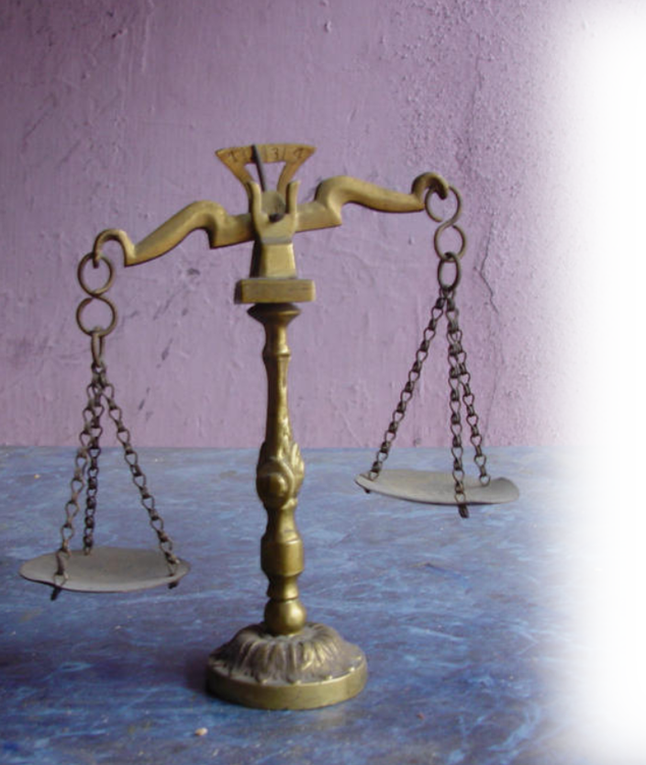
Woe to the IGNORANT!
IGNORANT INJUSTICES
²⁴ But let justice roll on like a river, righteousness like a never-failing stream!
Notes:
www.deviantart.com/rick--hunter/art/Unfair-scale-1-149667590
Woe to the Ignorance 5:18-27
About the Day of the Lord: a time of
Despair 5:18
Darkness 5:18, 20
Doom 5:19
About the Sin of their day
Hypocritical Worship 5:21-24
Unconcerned about people5:24
Forgetting the past 5:25-27
Woe to the Complacent 6:1-2
In False Security 6:1
In False Reality 6:2
Woe to my Indulgence 6:3-7
Indulgent Luxury 6:3-4
Indulgent Entertainment 6:5
Indulgent Leisure 6:6-7
Woe to the Arrogant 6:8-14
Arrogance leads to Death 6:8-10
Arrogance leads to Destruction 6:11-13
Arrogance leads to Defeat 6:14

Slide 23

Woe to the IGNORANT!
IGNORANT OF HISTORY
²⁵ "Did you bring me sacrifices and offerings forty years in the desert, O house of Israel?
Notes:
https://www.bing.com/images/search?view=detailV2&ccid=H8kOtGco&id=7F2EC99318EE19064A276C2EB615DAE6D8530DF0&thid=OIP.H8kOtGco8Nnk2hY6erwMxAAAAA&mediaurl=https%3a%2f%2fimages-na.ssl-images-amazon.com%2fimages%2fI%2f41Zj3wTIjLL._SY291_BO1%2c204%2c203%2c200_QL40_ML2_.jpg&exph=293&expw=197&q=historical+books+of+the+bible&simid=608039353382803412&ck=2D0907BB277B68F2C683E62CBC8EAA09&selectedIndex=100&FORM=IRPRST&ajaxhist=0
Woe to the Ignorance 5:18-27
About the Day of the Lord: a time of
Despair 5:18
Darkness 5:18, 20
Doom 5:19
About the Sin of their day
Hypocritical Worship 5:21-24
Unconcerned about people5:24
Forgetting the past 5:25-27
Woe to the Complacent 6:1-2
In False Security 6:1
In False Reality 6:2
Woe to my Indulgence 6:3-7
Indulgent Luxury 6:3-4
Indulgent Entertainment 6:5
Indulgent Leisure 6:6-7
Woe to the Arrogant 6:8-14
Arrogance leads to Death 6:8-10
Arrogance leads to Destruction 6:11-13
Arrogance leads to Defeat 6:14

Slide 24
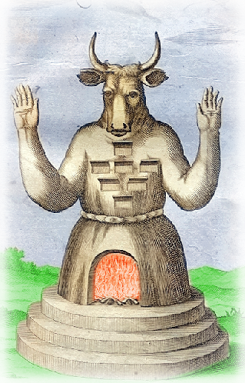
Woe to the IGNORANT!
IGNORANT IDOLATRY
²⁶ You have lifted up the shrine of your king, the pedestal of your idols, the star of your god-- which you made for yourselves.
Notes:
en.wikipedia.org/wiki/Moloch
Molech was the god who required infant sacrifices—kind of like our abortion industry.
Woe to the Ignorance 5:18-27
About the Day of the Lord: a time of
Despair 5:18
Darkness 5:18, 20
Doom 5:19
About the Sin of their day
Hypocritical Worship 5:21-24
Unconcerned about people5:24
Forgetting the past 5:25-27
Woe to the Complacent 6:1-2
In False Security 6:1
In False Reality 6:2
Woe to my Indulgence 6:3-7
Indulgent Luxury 6:3-4
Indulgent Entertainment 6:5
Indulgent Leisure 6:6-7
Woe to the Arrogant 6:8-14
Arrogance leads to Death 6:8-10
Arrogance leads to Destruction 6:11-13
Arrogance leads to Defeat 6:14

Slide 25
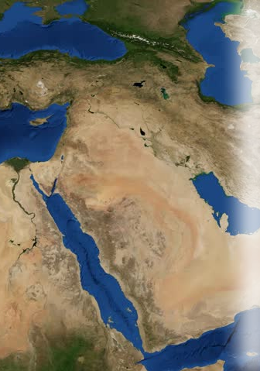
Woe to the IGNORANT!
IGNORANT CONSEQUENCES
²⁷ Therefore I will send you into exile beyond Damascus," says the LORD, whose name is God Almighty.
Notes:
https://p1.pxfuel.com/preview/618/450/457/bear-brown-bear-teddy-bear-hairy.jpg
Woe to the Ignorance 5:18-27
About the Day of the Lord: a time of
Despair 5:18
Darkness 5:18, 20
Doom 5:19
About the Sin of their day
Hypocritical Worship 5:21-24
Unconcerned about people5:24
Forgetting the past 5:25-27
Woe to the Complacent 6:1-2
In False Security 6:1
In False Reality 6:2
Woe to my Indulgence 6:3-7
Indulgent Luxury 6:3-4
Indulgent Entertainment 6:5
Indulgent Leisure 6:6-7
Woe to the Arrogant 6:8-14
Arrogance leads to Death 6:8-10
Arrogance leads to Destruction 6:11-13
Arrogance leads to Defeat 6:14

Slide 26

Woe to the COMPLACENT!
^{6:1} Woe to you who are complacent in Zion, and
to you who feel secure
on Mount Samaria, you notable men of the foremost nation, to whom the people of Israel come!
Notes:
https://live.staticflickr.com/64/185309831_31f60bbd92_b.jpg
Like saying, “Woe, to you who are complacent in America, feeling secure in your government, your politicians …
They are advanceing the “Critical Theory” which is nothing more that the principles of Marxism and Communism set to a new generation. It is setting two groups against one another to divide and conquer. When setting the bourgeoise against the proletariat, rich against the poor did not work because of the middle class—they have turned to race and boldly call it the “Critical Race Theory”—pitting white against black and black against white. There is not place for critical theory in the church.
²⁸ There is neither Jew nor Greek, slave nor free, male nor female, for you are all one in Christ Jesus. (Gal 3:28 NIV)
There is no racial, social, or gender divisions in the body of Christ. We are all one.
Don’t accept it lying down. We believe all lives, every life matters—including the unborn life no matter what race, social status, and gender.
We cannot be complacent and let it go. Why, because it is an evil.
Woe to the Ignorance 5:18-27
About the Day of the Lord: a time of
Despair 5:18
Darkness 5:18, 20
Doom 5:19
About the Sin of their day
Hypocritical Worship 5:21-24
Unconcerned about people5:24
Forgetting the past 5:25-27
Woe to the Complacent 6:1-2
In False Security 6:1
In False Reality 6:2
Woe to my Indulgence 6:3-7
Indulgent Luxury 6:3-4
Indulgent Entertainment 6:5
Indulgent Leisure 6:6-7
Woe to the Arrogant 6:8-14
Arrogance leads to Death 6:8-10
Arrogance leads to Destruction 6:11-13
Arrogance leads to Defeat 6:14

Slide 27
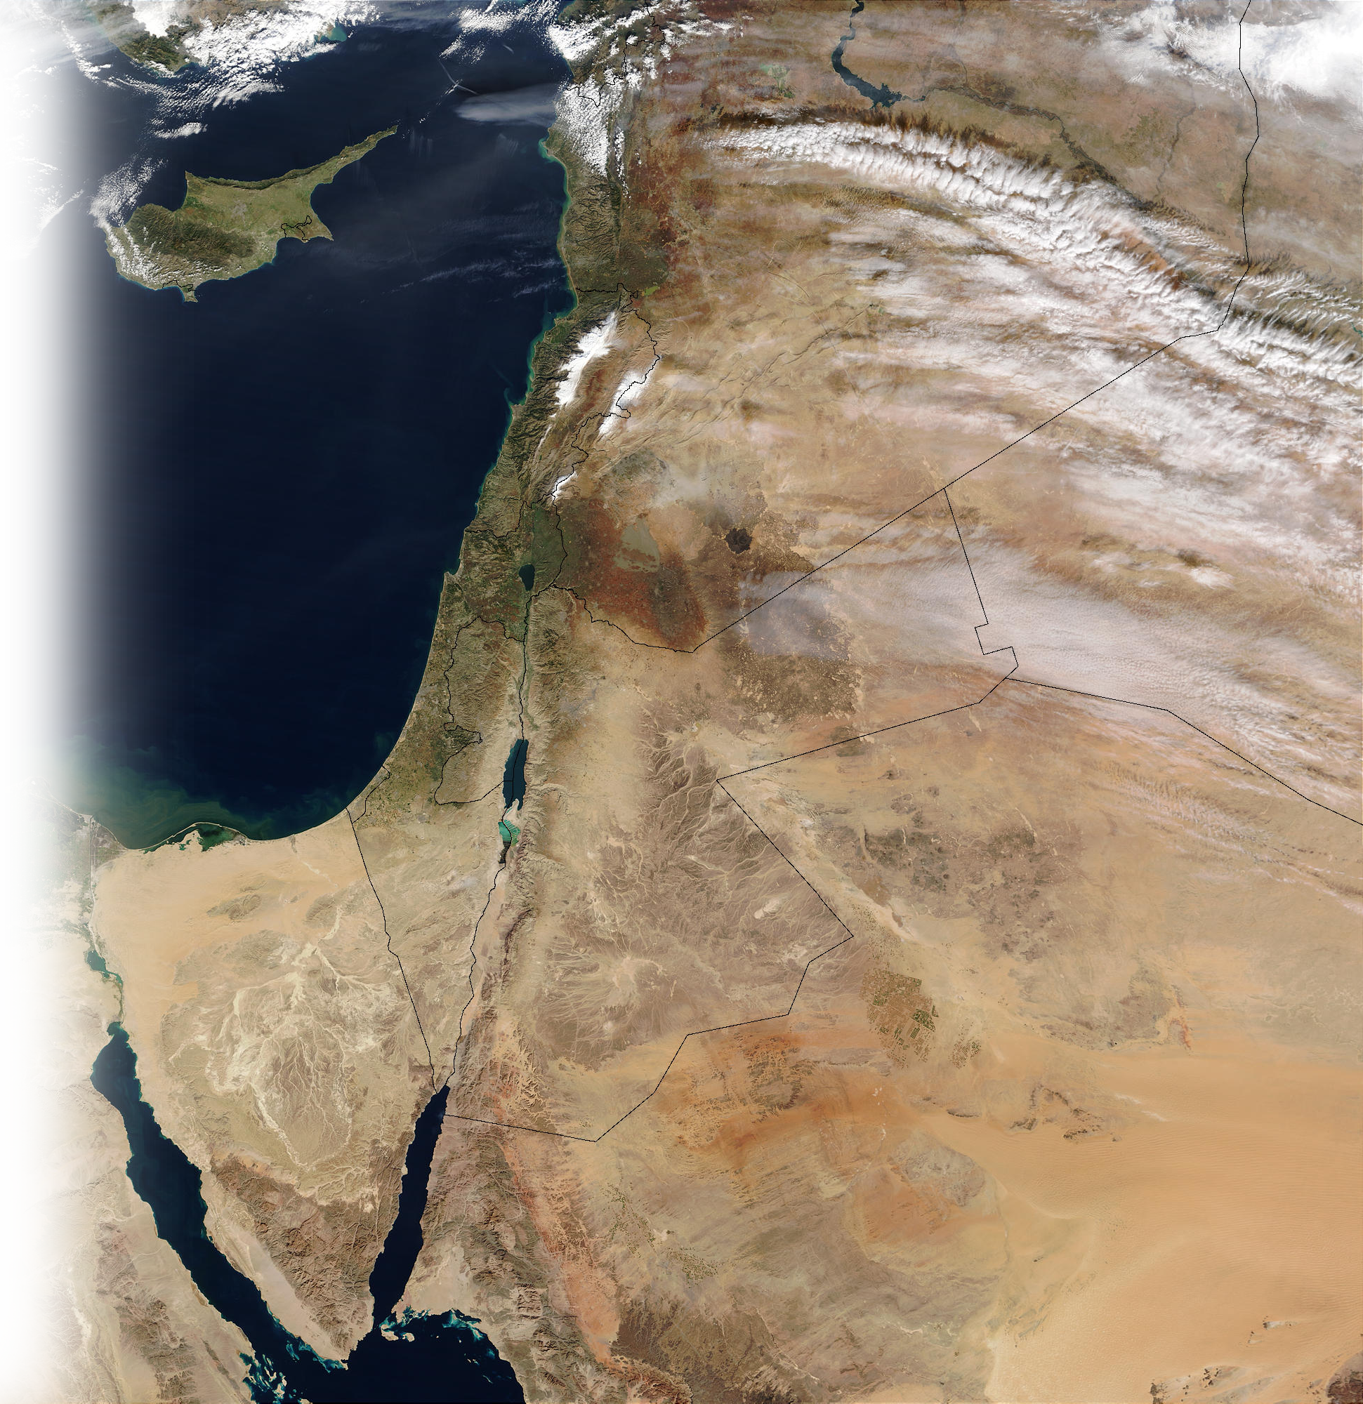
Woe to the COMPLACENT!
Calneh
Hamath
² Go to Calneh and look at it; go from there to great Hamath, and then go down to Gath in Philistia. Are they better off than your two kingdoms? Is their land larger than yours?
Israel
Judah
Gath
Notes:
Go to the communist nations and see how critical theory works.
In the past it was critical CLASS theory—now, replaced with critical RACE theory. It is the same Marxism and Communism, by a new name.
Go to Cuba, Go to Venezuela, Go to Russia, Go to China – see how critical theory works there.
Don’t be complacent or you will be like them!
Woe to the Ignorance 5:18-27
About the Day of the Lord: a time of
Despair 5:18
Darkness 5:18, 20
Doom 5:19
About the Sin of their day
Hypocritical Worship 5:21-24
Unconcerned about people5:24
Forgetting the past 5:25-27
Woe to the Complacent 6:1-2
In False Security 6:1
In False Reality 6:2
Woe to my Indulgence 6:3-7
Indulgent Luxury 6:3-4
Indulgent Entertainment 6:5
Indulgent Leisure 6:6-7
Woe to the Arrogant 6:8-14
Arrogance leads to Death 6:8-10
Arrogance leads to Destruction 6:11-13
Arrogance leads to Defeat 6:14

Slide 28

Woe to the INDULGENT!
INDULGENT PROCRASTINATION
³ You put off the evil day and bring near a reign of terror.
⁴ You lie on beds inlaid with ivory and lounge on your couches. You dine on choice lambs and fattened calves.
Notes:
Woe to the Ignorance 5:18-27
About the Day of the Lord: a time of
Despair 5:18
Darkness 5:18, 20
Doom 5:19
About the Sin of their day
Hypocritical Worship 5:21-24
Unconcerned about people5:24
Forgetting the past 5:25-27
Woe to the Complacent 6:1-2
In False Security 6:1
In False Reality 6:2
Woe to my Indulgence 6:3-7
Indulgent Luxury 6:3-4
Indulgent Entertainment 6:5
Indulgent Leisure 6:6-7
Woe to the Arrogant 6:8-14
Arrogance leads to Death 6:8-10
Arrogance leads to Destruction 6:11-13
Arrogance leads to Defeat 6:14

Slide 29
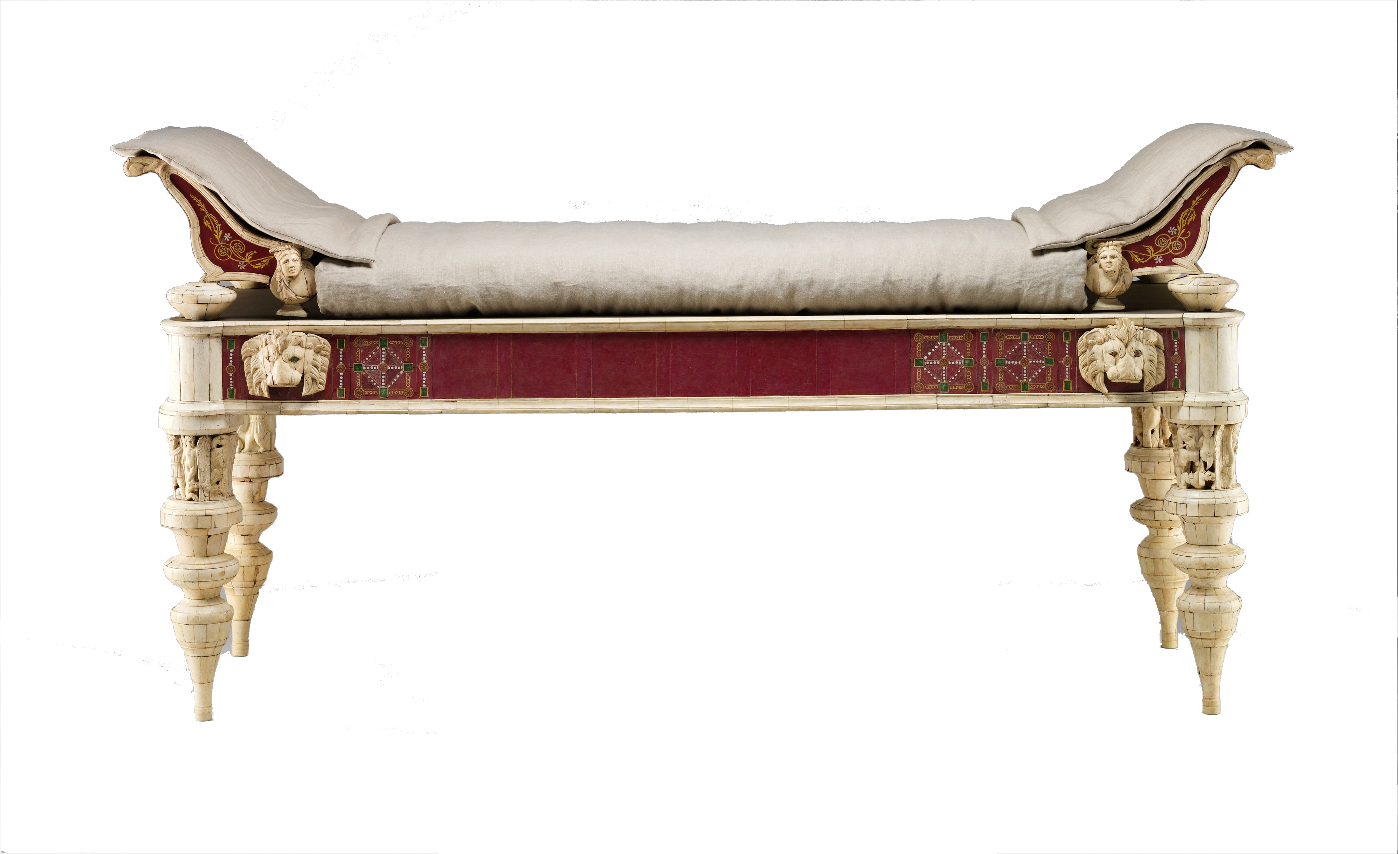
Woe to the INDULGENT!
INDULGENT LUXURY
⁴ You lie on beds inlaid with ivory and lounge on your couches. You dine on choice lambs and fattened calves.
Notes:
www.metmuseum.org/art/collection/search/249232
Woe to the Ignorance 5:18-27
About the Day of the Lord: a time of
Despair 5:18
Darkness 5:18, 20
Doom 5:19
About the Sin of their day
Hypocritical Worship 5:21-24
Unconcerned about people5:24
Forgetting the past 5:25-27
Woe to the Complacent 6:1-2
In False Security 6:1
In False Reality 6:2
Woe to my Indulgence 6:3-7
Indulgent Luxury 6:3-4
Indulgent Entertainment 6:5
Indulgent Leisure 6:6-7
Woe to the Arrogant 6:8-14
Arrogance leads to Death 6:8-10
Arrogance leads to Destruction 6:11-13
Arrogance leads to Defeat 6:14

Slide 30
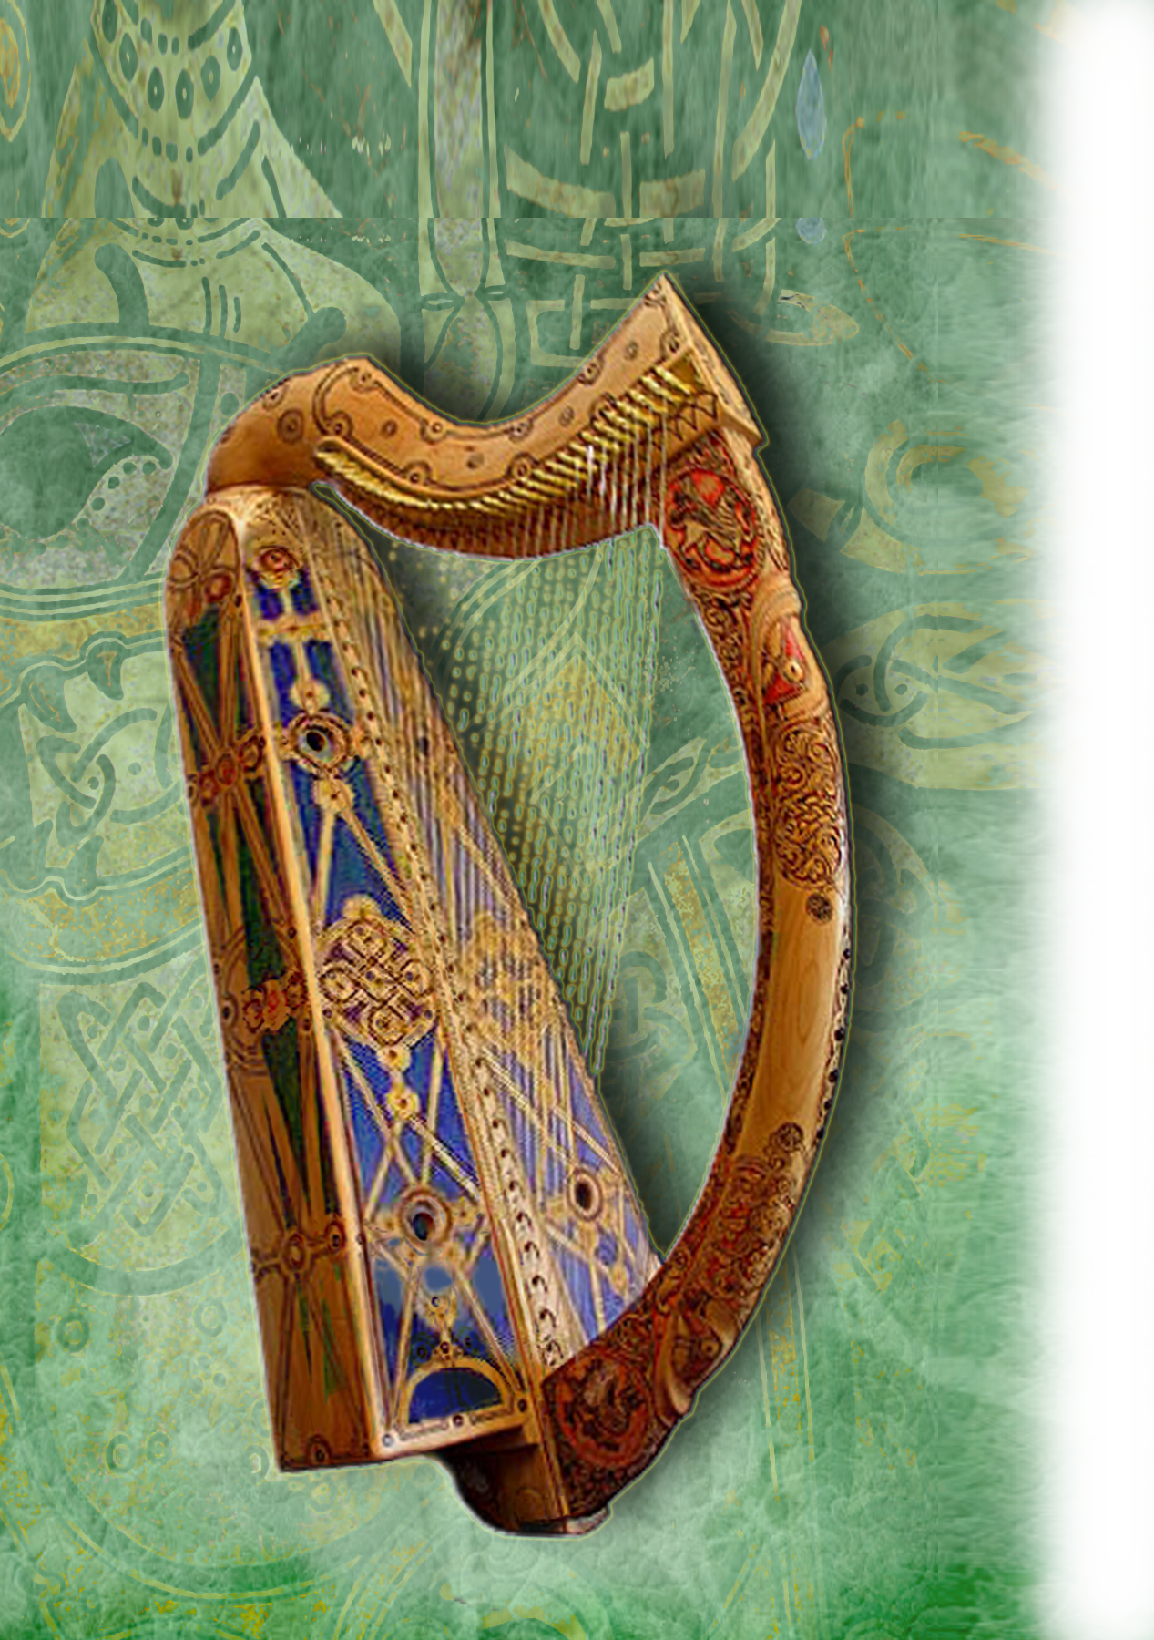
Woe to the INDULGENT!
INDULGENT ENTERTAINMENT
⁵ You strum away on your harps like David and improvise on musical instruments.
Notes:
Http://http://1.bp.blogspot.com/-u4JEdVgWd10/UBiB8iW3DGI/AAAAAAAADKw/mErxAUzAwEw/s1600/
Woe to the Ignorance 5:18-27
About the Day of the Lord: a time of
Despair 5:18
Darkness 5:18, 20
Doom 5:19
About the Sin of their day
Hypocritical Worship 5:21-24
Unconcerned about people5:24
Forgetting the past 5:25-27
Woe to the Complacent 6:1-2
In False Security 6:1
In False Reality 6:2
Woe to my Indulgence 6:3-7
Indulgent Luxury 6:3-4
Indulgent Entertainment 6:5
Indulgent Leisure 6:6-7
Woe to the Arrogant 6:8-14
Arrogance leads to Death 6:8-10
Arrogance leads to Destruction 6:11-13
Arrogance leads to Defeat 6:14

Slide 31

Woe to the INDULGENT!
INDULGENT EXCESSES
⁶ You drink wine by the bowlful and use the finest lotions, but you do not grieve over the ruin of Joseph.
Notes:
https://c.pxhere.com/photos/e3/e4/wine_bowl_glass_of_wine_glass_of_red_wine-1074889.jpg!d
Woe to the Ignorance 5:18-27
About the Day of the Lord: a time of
Despair 5:18
Darkness 5:18, 20
Doom 5:19
About the Sin of their day
Hypocritical Worship 5:21-24
Unconcerned about people5:24
Forgetting the past 5:25-27
Woe to the Complacent 6:1-2
In False Security 6:1
In False Reality 6:2
Woe to my Indulgence 6:3-7
Indulgent Luxury 6:3-4
Indulgent Entertainment 6:5
Indulgent Leisure 6:6-7
Woe to the Arrogant 6:8-14
Arrogance leads to Death 6:8-10
Arrogance leads to Destruction 6:11-13
Arrogance leads to Defeat 6:14

Slide 32

Woe to the INDULGENT!
INDULGENT CONSEQUENCES
⁷ Therefore you will be among the first to go into exile; your feasting and lounging will end.
Notes:
Woe to the Ignorance 5:18-27
About the Day of the Lord: a time of
Despair 5:18
Darkness 5:18, 20
Doom 5:19
About the Sin of their day
Hypocritical Worship 5:21-24
Unconcerned about people5:24
Forgetting the past 5:25-27
Woe to the Complacent 6:1-2
In False Security 6:1
In False Reality 6:2
Woe to my Indulgence 6:3-7
Indulgent Luxury 6:3-4
Indulgent Entertainment 6:5
Indulgent Leisure 6:6-7
Woe to the Arrogant 6:8-14
Arrogance leads to Death 6:8-10
Arrogance leads to Destruction 6:11-13
Arrogance leads to Defeat 6:14

Slide 33
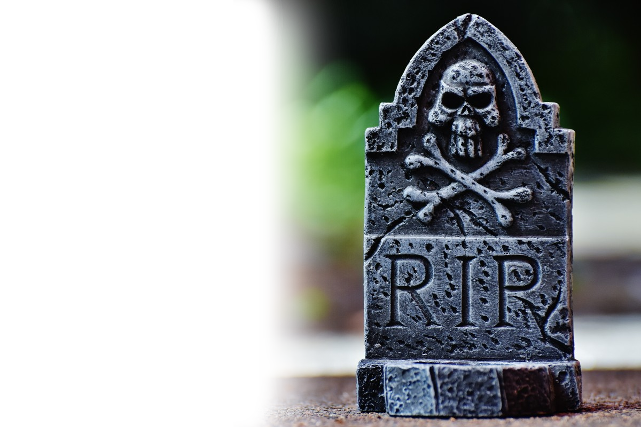
Woe to the ARROGANT!
ARROGANCE LEADS TO DEATH
⁸ The Sovereign LORD has sworn by himself--the LORD God Almighty declares: "I abhor the pride of Jacob and detest his fortresses; I will deliver up the city and everything in it."
Notes:
https://pxhere.com/en/photo/545374
Although he doesn’t say woe, this is still under the former woe—but does seem to challenge their arrogance so I call is a Woe to the arrogant.
Woe to the Ignorance 5:18-27
About the Day of the Lord: a time of
Despair 5:18
Darkness 5:18, 20
Doom 5:19
About the Sin of their day
Hypocritical Worship 5:21-24
Unconcerned about people5:24
Forgetting the past 5:25-27
Woe to the Complacent 6:1-2
In False Security 6:1
In False Reality 6:2
Woe to my Indulgence 6:3-7
Indulgent Luxury 6:3-4
Indulgent Entertainment 6:5
Indulgent Leisure 6:6-7
Woe to the Arrogant 6:8-14
Arrogance leads to Death 6:8-10
Arrogance leads to Destruction 6:11-13
Arrogance leads to Defeat 6:14

Slide 34
Woe to the ARROGANT!
ARROGANCE LEADS TO DEATH
⁹ If ten men are left in one house, they too will die. ¹⁰ And if a relative who is to burn the bodies comes to carry them out of the house and asks anyone still hiding there, "Is anyone with you?"
Notes:
Woe to the Ignorance 5:18-27
About the Day of the Lord: a time of
Despair 5:18
Darkness 5:18, 20
Doom 5:19
About the Sin of their day
Hypocritical Worship 5:21-24
Unconcerned about people5:24
Forgetting the past 5:25-27
Woe to the Complacent 6:1-2
In False Security 6:1
In False Reality 6:2
Woe to my Indulgence 6:3-7
Indulgent Luxury 6:3-4
Indulgent Entertainment 6:5
Indulgent Leisure 6:6-7
Woe to the Arrogant 6:8-14
Arrogance leads to Death 6:8-10
Arrogance leads to Destruction 6:11-13
Arrogance leads to Defeat 6:14

Slide 35
Woe to the ARROGANT!
ARROGANCE LEADS TO DEATH
and he says, "No," then he will say, "Hush! We must not mention the name of the LORD.“
Notes:
Woe to the Ignorance 5:18-27
About the Day of the Lord: a time of
Despair 5:18
Darkness 5:18, 20
Doom 5:19
About the Sin of their day
Hypocritical Worship 5:21-24
Unconcerned about people5:24
Forgetting the past 5:25-27
Woe to the Complacent 6:1-2
In False Security 6:1
In False Reality 6:2
Woe to my Indulgence 6:3-7
Indulgent Luxury 6:3-4
Indulgent Entertainment 6:5
Indulgent Leisure 6:6-7
Woe to the Arrogant 6:8-14
Arrogance leads to Death 6:8-10
Arrogance leads to Destruction 6:11-13
Arrogance leads to Defeat 6:14

Slide 36
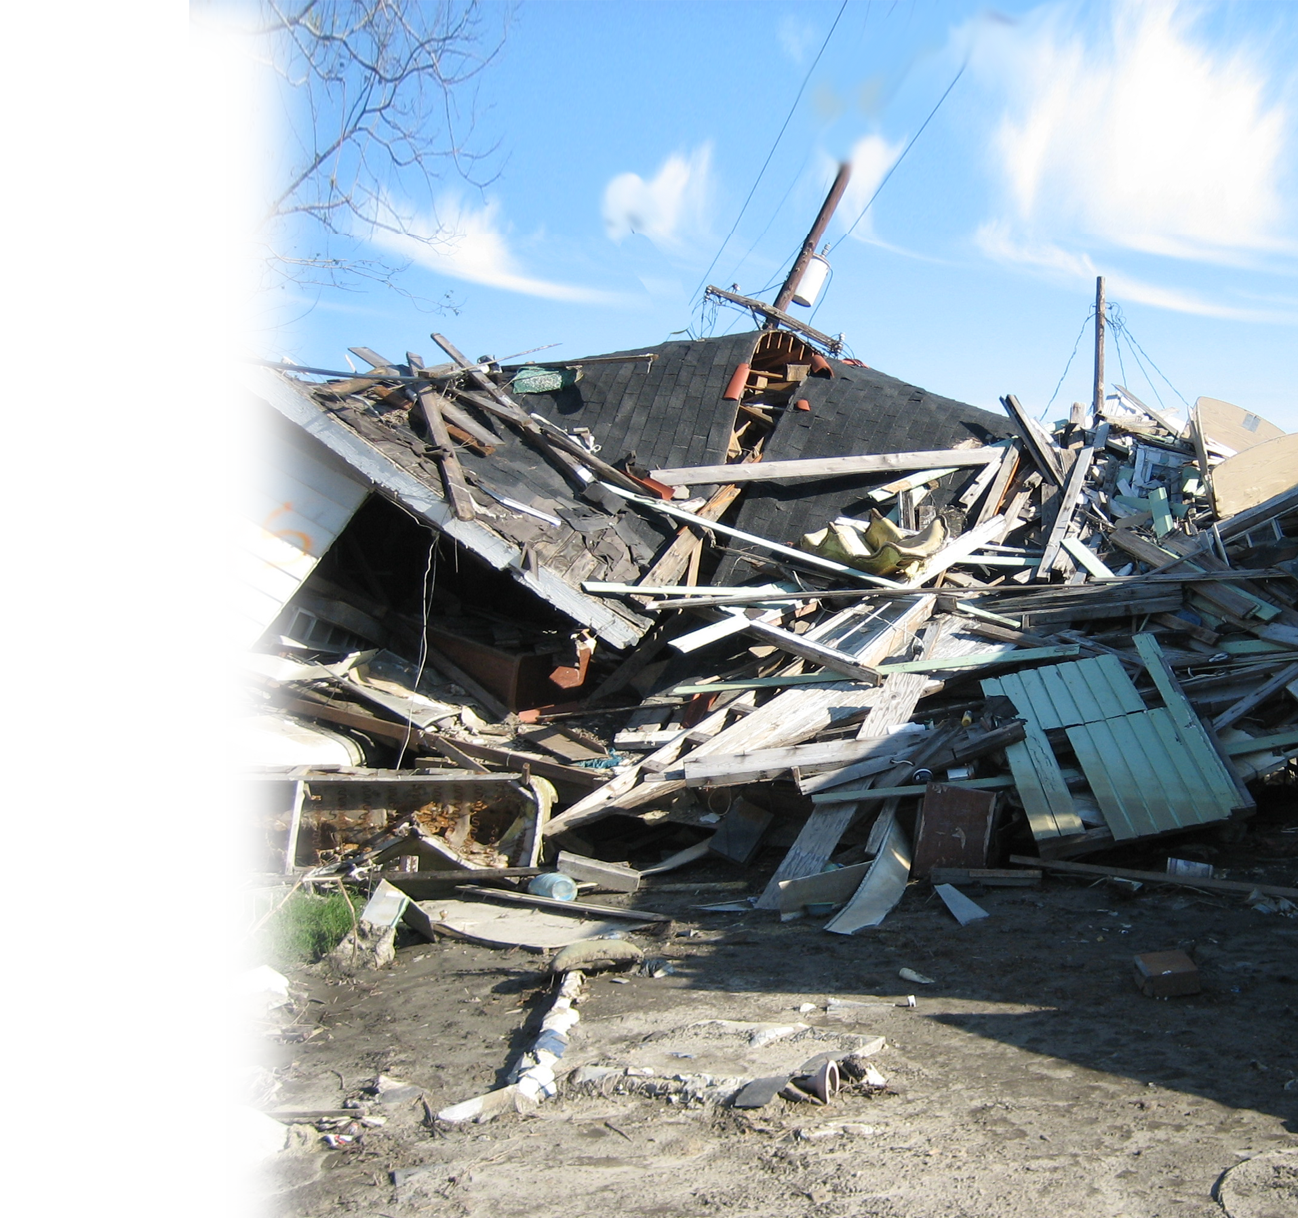
Woe to the ARROGANT!
ARROGANCE LEADS TO DESTRUCTION
¹¹ For the LORD has given
the command, and he will
smash the great house into
pieces and the small house
into bits.
Notes:
https://upload.wikimedia.org/wikipedia/commons/c/c3/CollapseHouse5Low9.jpg
Woe to the Ignorance 5:18-27
About the Day of the Lord: a time of
Despair 5:18
Darkness 5:18, 20
Doom 5:19
About the Sin of their day
Hypocritical Worship 5:21-24
Unconcerned about people5:24
Forgetting the past 5:25-27
Woe to the Complacent 6:1-2
In False Security 6:1
In False Reality 6:2
Woe to my Indulgence 6:3-7
Indulgent Luxury 6:3-4
Indulgent Entertainment 6:5
Indulgent Leisure 6:6-7
Woe to the Arrogant 6:8-14
Arrogance leads to Death 6:8-10
Arrogance leads to Destruction 6:11-13
Arrogance leads to Defeat 6:14

Slide 37
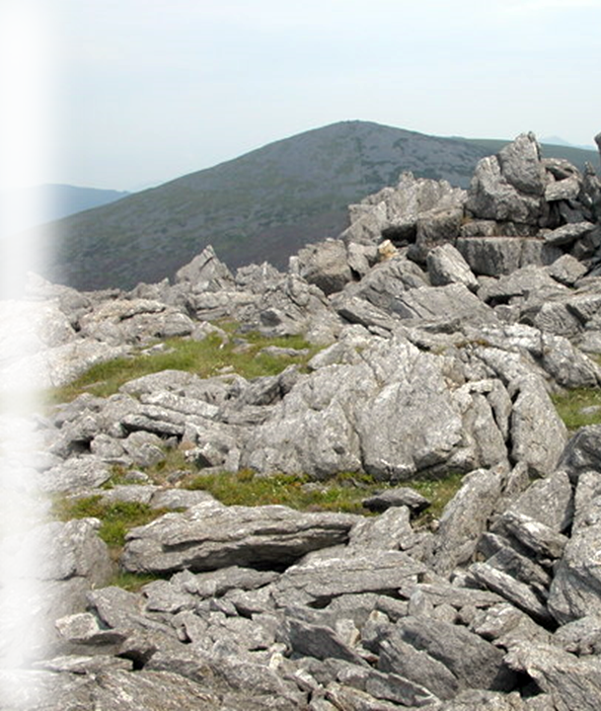
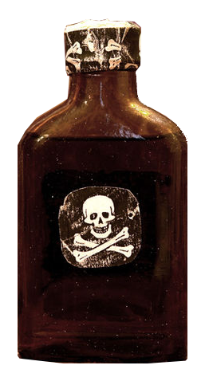
Woe to the ARROGANT!
ARROGANCE LEADS TO DESTRUCTION
¹² Do horses run on the rocky crags? Does one plow there with oxen?
But you have turned justice into poison and the fruit of righteousness into bitterness--
Notes:
Crags = https://upload.wikimedia.org/wikipedia/commons/6/68/Crags_on_summit_of_Mynydd_Graig_Goch_-_geograph.org.uk_-_196667.jpg
Woe to the Ignorance 5:18-27
About the Day of the Lord: a time of
Despair 5:18
Darkness 5:18, 20
Doom 5:19
About the Sin of their day
Hypocritical Worship 5:21-24
Unconcerned about people5:24
Forgetting the past 5:25-27
Woe to the Complacent 6:1-2
In False Security 6:1
In False Reality 6:2
Woe to my Indulgence 6:3-7
Indulgent Luxury 6:3-4
Indulgent Entertainment 6:5
Indulgent Leisure 6:6-7
Woe to the Arrogant 6:8-14
Arrogance leads to Death 6:8-10
Arrogance leads to Destruction 6:11-13
Arrogance leads to Defeat 6:14

Slide 38
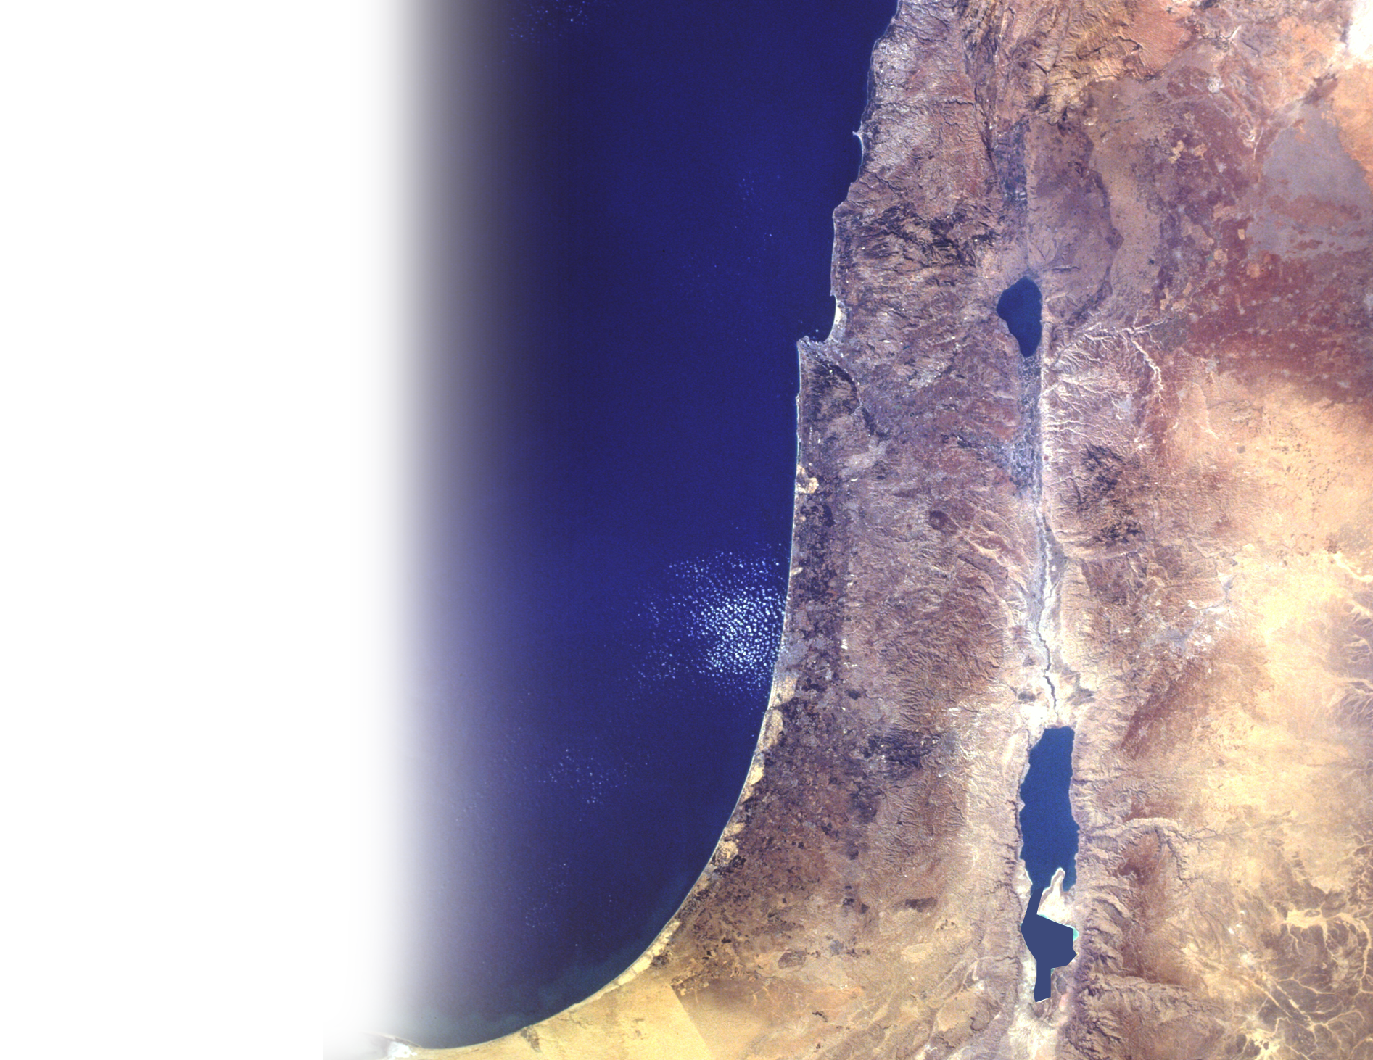
Woe to the ARROGANT!
ARROGANCE LEADS TO DESTRUCTION
¹³ you who rejoice in the
conquest of Lo Debar and say,
"Did we not take Karnaim by
our own strength?"
Lo Debar
Notes:
https://eol.jsc.nasa.gov/SearchPhotos/photo.pl?mission=STS41G&roll=120&frame=56
Lo Debar is pronounced by Amos with a slight change to a vowel to indicate the so-called victory as “No thing” or as we would say today, “nothing.”
They were arrogant to think that their victory was something. It was nothing because it was done in their own strength.
See Expositors Bible Commentary on Amos 7:13
Woe to the Ignorance 5:18-27
About the Day of the Lord: a time of
Despair 5:18
Darkness 5:18, 20
Doom 5:19
About the Sin of their day
Hypocritical Worship 5:21-24
Unconcerned about people5:24
Forgetting the past 5:25-27
Woe to the Complacent 6:1-2
In False Security 6:1
In False Reality 6:2
Woe to my Indulgence 6:3-7
Indulgent Luxury 6:3-4
Indulgent Entertainment 6:5
Indulgent Leisure 6:6-7
Woe to the Arrogant 6:8-14
Arrogance leads to Death 6:8-10
Arrogance leads to Destruction 6:11-13
Arrogance leads to Defeat 6:14

Slide 39
Woe to the ARROGANT!
ARROGANCE LEADS TO DEFEAT
¹⁴ For the LORD God Almighty declares, "I will stir up a nation against you, O house of Israel, that will oppress you all the way from Lebo Hamath to the valley of the Arabah."
Lebo-
Hamath
Arabah
Notes:
Woe to the Ignorance 5:18-27
About the Day of the Lord: a time of
Despair 5:18
Darkness 5:18, 20
Doom 5:19
About the Sin of their day
Hypocritical Worship 5:21-24
Unconcerned about people5:24
Forgetting the past 5:25-27
Woe to the Complacent 6:1-2
In False Security 6:1
In False Reality 6:2
Woe to my Indulgence 6:3-7
Indulgent Luxury 6:3-4
Indulgent Entertainment 6:5
Indulgent Leisure 6:6-7
Woe to the Arrogant 6:8-14
Arrogance leads to Death 6:8-10
Arrogance leads to Destruction 6:11-13
Arrogance leads to Defeat 6:14

Slide 40

WHAT’S THE POINT?
Heb 10:30-31
³⁰ For we know him who said, "It is mine to avenge; I will repay," and again, "The Lord will judge his people." ³¹ It is a dreadful thing to fall into the hands of the living God.
Notes:
https://www.deviantart.com/urbanbushido/art/The-Hand-of-God-215248847
Quotes Deuteronomy 32:35-36

Slide 41
WHAT’S THE POINT?
Isaiah saw the Lord and said …
WOE
is me!
Amos heard the Lord and said …
WOE
to you!

Slide 42
WHAT’S THE POINT?
Don’t be …
IGNORANT
COMPLACENT
INDULGENT
ARROGANT
Instead, Be …
WISE
CONCERNED
MODERATE
HUMBLE

Slide 43
LET’S PRAY!

