Slide 1
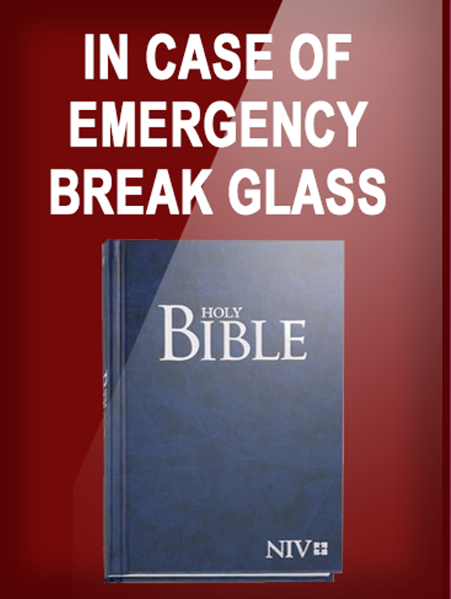
HOW TO AVOID DISASTER
Notes:
Copyright © 2006−2021. All rights reserved. Bible Point is a registered trademark of Dennis Henderson. All other trademarks acknowledged.
Bible Point contains graphics from Bible Point artists. These illustrations belong to Bible Point and the respective artists. You may use the designs and illustrations for graphical illustration of lessons free and without special permission, provided they are not used in any way that maligns the Christian faith. Furthermore, republication or production of any illustration by any other graphic service whether it be in book, in a machine-readable form, or in any other design resource is strictly prohibited. Furthermore, they cannot be duplicated or resold as any other form of publishing, clip art, or graphic resource.
So What does it mean? (A simple translations of the legal jargon)
So, if you don’t own the presentation(s), graphic(s), and text(s) how can you legally use them? The purchase of the license allows you to use all the images in the product. However, the actual ownership and copyright of the presentation(s), graphic(s), and text(s) remain the property of Bible Point and its licensors. If you had plans on using this product in your “for sale” work—think again!
License Agreement
Article 1: License Grant
All the graphics and text in Bible Point presentations (excluding quotes from the Bible and stated sources) are the intellectual and real property of Bible Point and its licensors, and is protected by law, including United States copyright laws and international treaties. Bible Point grants to you a license:
1. To use the presentation in a single church, single school, or single office of a Christian organization.
2. To make a single archival back-up copy of the program.
3. To modify the presentation(s) and merge with other presentations in a single church, school, or Christian organization.
4. To transfer to another party if that party agrees to accept the terms and conditions of this agreement, and you do not retain any copies of the presentation, whether printed, machine readable, modified, or merged form.
Article 2: Terms
This license is effective until terminated. You may terminate the license at any time by destroying the presentation(s), graphic(s), or text(s) together with all copies, modifications and merged portions in any form. Bible Point may terminate your license if you fail to comply with this Agreement. You agree, upon such termination, for any reason, to destroy the presentation(s), graphics, and text(s) with all copies, modifications, and merged portions in any form.
Article 3: Disclaimers
1. Bible Point presentations, graphics, and texts are licensed to you As Is. You, the consumer, bear the entire risk relating to the quality and performance of the presentation(s), graphic(s), or text(s). In no event will Bible Point be liable for damages resulting from any defect.
2. Thirty-day limited warrantee on disks. Bible Point warrants the disks to be free of defects in material and workmanship under normal use for 30 days after purchase. During the 30-day period you may return a defective presentation, graphic, or text with proof of purchase and it will be replaced without charge, unless the presentation is damaged by misuse.
Article 4: General
1. You may not sub-license, assign, or transfer the license of the presentation(s), graphic(s), or text(s) except as provided by this Agreement.
2. This Agreement will be governed by the laws of the State of Michigan.
So What does it mean? (A simple translations of the legal jargon)
May I let someone borrow or copy my licensed Bible Point presentation (even after I modified it)? As long as it is within your local church, or single school, or the immediate office of a Christian organization you may. Otherwise, please refer the person interested in borrowing to: http://www.biblepoint.com or E-mail: dennis@DrDH.net with any related questions.

Slide 2

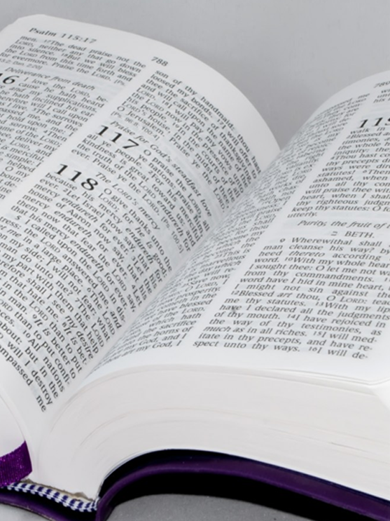
Hear the Word 5:1-3
¹ Hear this word, O house of Israel, this lament I take up concerning you:
Notes:
https://www.publicdomainpictures.net/en/view-image.php?image=53426&picture=bible-open-to-psalm-118
There is a reason why the preacher was demanding that they Hear the Word of God. Because it is inspired by God.

Slide 3
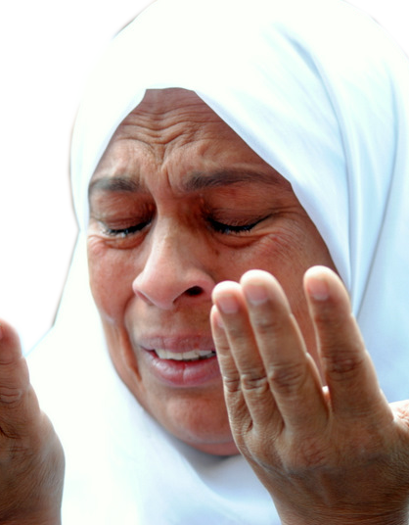
Hear the Word 5:1-3
¹ Hear this word, O house of Israel, this lament I take up concerning you:
Notes:
www.flickr.com/photos/lilianwagdy/5716587679
Lament is a funeral song, a dirge—death has occurred. Here it is a death of a nation.

Slide 4
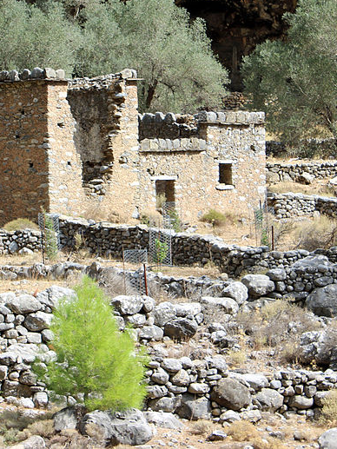
Hear the Word 5:1-3
¹ Hear this word, O house of Israel, this lament I take up concerning you:
² "Fallen is Virgin Israel, never to rise again, deserted in her own land, with no one to lift her up."
Notes:
https://upload.wikimedia.org/wikipedia/commons/thumb/9/96/Ruins_of_Samaria_village_–_01.jpg/1024px-Ruins_of_Samaria_village_–_01.jpg
Described as a virgin because she died so young. In the bloom of life—she died. It is always so sad when you do a funeral—but especially so when it is a youth.
She never borne children for the glory of God.
Never to rise again.

Slide 5
Hear the Word 5:1-3
³ This is what the Sovereign LORD says: "The city that marches out a thousand strong for Israel will have only a hundred left; the town that marches out a hundred strong will have only ten left."
90%
LOSS
Notes:
https://upload.wikimedia.org/wikipedia/commons/thumb/9/96/Ruins_of_Samaria_village_–_01.jpg/1024px-Ruins_of_Samaria_village_–_01.jpg
90% loss—taken captive—never to return to the land. That 10% that remained were then mixed with gentiles resulting in a mixed race later to be called “Samaritans” whom the Jews in great prejudice hated.

Slide 6

Seek the Lord 5:4-6
SEEK HIM WHO GIVES LIFE
⁴ This is what the LORD says to the house of Israel: "Seek me and live; ⁵ do not seek Bethel, do not go to Gilgal, do not journey to Beersheba. For Gilgal will surely go into exile, and Bethel will be reduced to nothing.“
LORD
Notes:
https://www.pexels.com/photo/selective-focus-photo-of-magnifying-glass-1194775/
This is a gracious invitation … Amos is not just preaching doom and judgment—he is preaching grace and salvation that comes from turning to the Lord to live.
Isaiah preached the same later to the southern kingdom of Judah in Isaiah 45:22 “Look unto me, and be ye saved, all the ends of the earth: for I am God, and there is none else. (Isa 45:22 KJV)”
On January 6, 1850 young Spurgeon was supposed to join his father at church on a Sunday morning, nine miles from his home. Because of a severe snowstorm he ducked into a Primitive Methodist Chapel in Artillery Street close to his home. Likely few people in England possessed as much knowledge of the Scripture or had heard the Gospel more times than Charles Spurgeon. He stated in his autobiography that “I had heard the plan of salvation by the sacrifice of Jesus from my youth up; but I did not know any more about it in my innermost soul than if I had been born and bred a Hottentot.” He had heard that Primitives “sang so loud it made your head ache,” but he did not care, “I wanted to know how I might be saved, and if they could tell me, it didn’t matter if my head ached.”

Slide 7
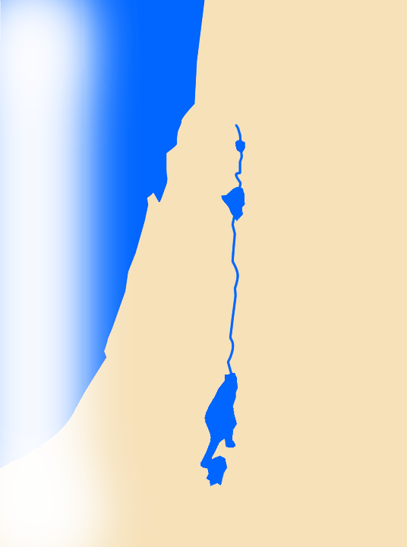
Seek the Lord 5:4-6
SEEK HIM WHO GIVES LIFE
⁴ This is what the LORD says to the house of Israel: "Seek me and live; ⁵ do not seek Bethel, do not go to Gilgal, do not journey to Beersheba. For Gilgal will surely go into exile, and Bethel will be reduced to nothing.“
BETHEL
GILGAL
Beersheba
Notes:
https://www.pexels.com/photo/selective-focus-photo-of-magnifying-glass-1194775/
Bethel and Gilgal indeed where places of worship in the past—but not so in Amos’ day. They had become centers of external, liturgy—motions of religion, but not heartfelt worship of the true and living God. In the NT there is reference to such worship in the church age called, ⁵ having a form of godliness but denying its power. Have nothing to do with them. (2Ti 3:5 NIV)
Don’t go to the weak in faith, but strong in pop psychology, worshipping the creature more than the creator. No, the place of worship was in the temple of God in Jerusalem. Even today, it is our bodies that are the temple of God with the HS in them. When we gather together, we become the church – the temple of the living God.
Don’t seek Him where He is not! Seek Him with all your heart!
Gilgal and Bethel are going down—just as the church that has Jesus on the outside knocking on the door to get in.

Slide 8
Seek the Lord 5:4-6
SEEK HIM WHO TAKES LIFE
⁴ This is what the LORD says to the house of Israel: "Seek me and live; ⁵ do not seek Bethel, do not go to Gilgal, do not journey to Beersheba. For Gilgal will surely go into exile, and Bethel will be reduced to nothing.“
BETHEL
GILGAL
Beersheba
Notes:
https://www.pexels.com/photo/selective-focus-photo-of-magnifying-glass-1194775/
Bethel and Gilgal indeed where places of worship in the past—but not so in Amos’ day. They had become centers of external, liturgy—motions of religion, but not heartfelt worship of the true and living God. In the NT there is reference to such worship in the church age called, ⁵ having a form of godliness but denying its power. Have nothing to do with them. (2Ti 3:5 NIV)
Don’t go to the weak in faith, but strong in pop psychology, worshipping the creature more than the creator. No, the place of worship was in the temple of God in Jerusalem. Even today, it is our bodies that are the temple of God with the HS in them. When we gather together, we become the church – the temple of the living God.
Don’t seek Him where He is not! Seek Him with all your heart!
Gilgal and Bethel are going down—just as the church that has Jesus on the outside knocking on the door to get in.

Slide 9
Seek the Lord 5:4-6
SEEK HIM WHO GIVES LIFE
⁶ Seek the LORD and live, or he will sweep through the house of Joseph like a fire; it will devour, and Bethel will have no one to quench it.
LORD
Notes:
https://www.pexels.com/photo/selective-focus-photo-of-magnifying-glass-1194775/

Slide 10
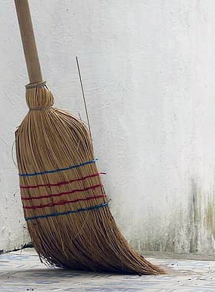
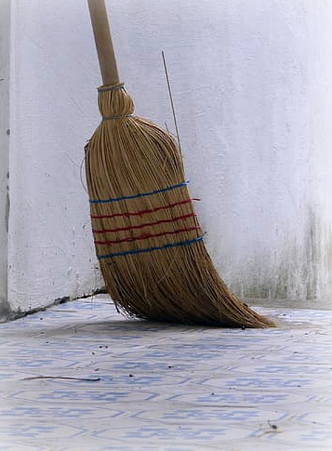
Seek the Lord 5:4-6
SEEK HIM WHO SWEEPS
⁶ Seek the LORD and live, or he will sweep through the house of Joseph like a fire; it will devour, and Bethel will have no one to quench it.
BETHEL
GILGAL
Beersheba
Notes:
https://p0.pikist.com/photos/463/641/broom-door-clear-clean-house-village.jpg
Compare
² "I will sweep away everything from the face of the earth," declares the LORD.
³ "I will sweep away both men and animals; I will sweep away the birds of the air and the fish of the sea. The wicked will have only heaps of rubble when I cut off man from the face of the earth," declares the LORD.
⁴ "I will stretch out my hand against Judah and against all who live in Jerusalem. I will cut off from this place every remnant of Baal, the names of the pagan and the idolatrous priests--
⁵ those who bow down on the roofs to worship the starry host, those who bow down and swear by the LORD and who also swear by Molech,
⁶ those who turn back from following the LORD and neither seek the LORD nor inquire of him.
⁷ Be silent before the Sovereign LORD, for the day of the LORD is near. The LORD has prepared a sacrifice; he has consecrated those he has invited.
(Zep 1:2-7 NIV)

Slide 11
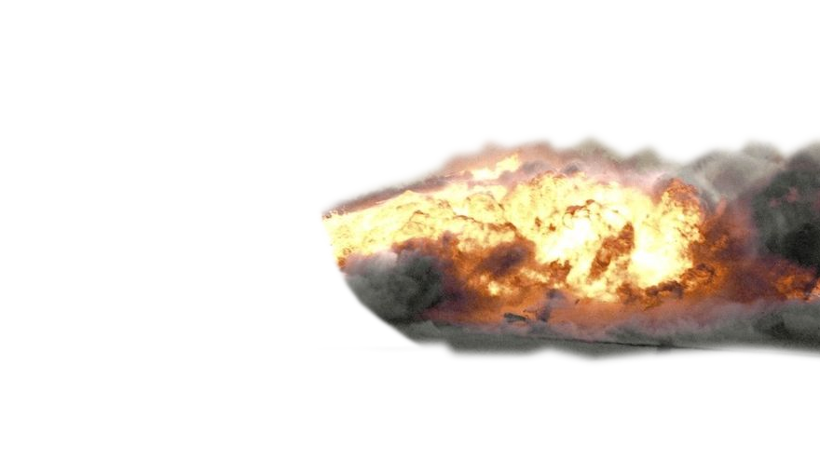
Seek the Lord 5:4-6
SEEK HIM WHO SWEEPS
⁶ Seek the LORD and live, or he will sweep through the house of Joseph like a fire; it will devour, and Bethel will have no one to quench it.
BETHEL
GILGAL
Beersheba
Notes:
Fire = https://upload.wikimedia.org/wikipedia/commons/thumb/0/0d/Controlled_Impact_Demonstration_Fire.jpg/1024px-Controlled_Impact_Demonstration_Fire.jpgCompare
² "I will sweep away everything from the face of the earth," declares the LORD.
³ "I will sweep away both men and animals; I will sweep away the birds of the air and the fish of the sea. The wicked will have only heaps of rubble when I cut off man from the face of the earth," declares the LORD.
⁴ "I will stretch out my hand against Judah and against all who live in Jerusalem. I will cut off from this place every remnant of Baal, the names of the pagan and the idolatrous priests--
⁵ those who bow down on the roofs to worship the starry host, those who bow down and swear by the LORD and who also swear by Molech,
⁶ those who turn back from following the LORD and neither seek the LORD nor inquire of him.
⁷ Be silent before the Sovereign LORD, for the day of the LORD is near. The LORD has prepared a sacrifice; he has consecrated those he has invited.
(Zep 1:2-7 NIV)

Slide 12
Seek the Good 5:7-14
GOOD
Notes:
Tipping the scales of justice for your unjust cause.

Slide 13

Seek the Good 5:7-14
WHO SHOULD SEEK HIM?
⁷ You who turn justice into bitterness and cast righteousness to the ground
Notes:
Tipping the scales of justice for your unjust cause.

Slide 14
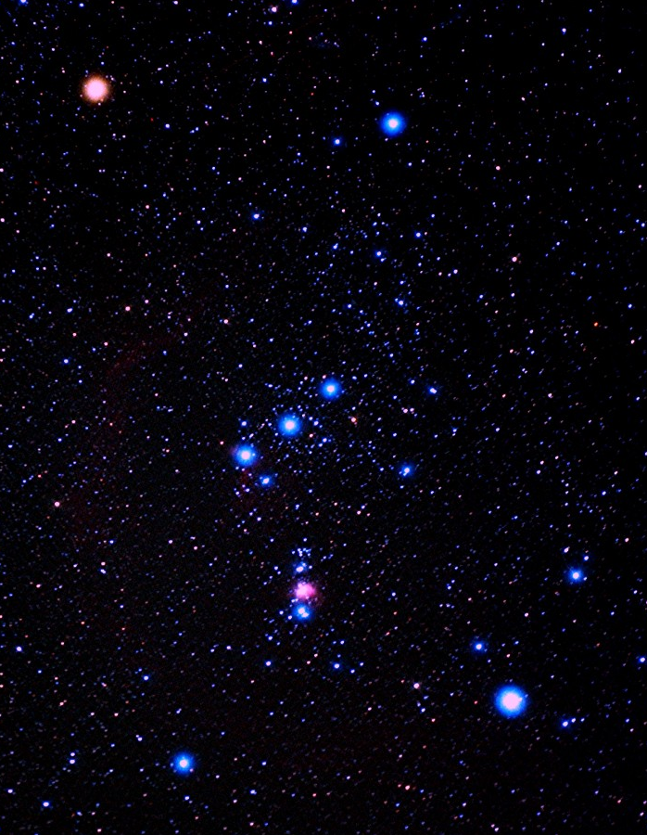
Seek the Good 5:7-14
SEEK HIM WHO CREATES
⁸ (he who made the Pleiades and Orion, who turns blackness into dawn and darkens day into night, who calls for the waters of the sea and pours them out over the face of the land--
Notes:
http://M42+in+Orion.jpg (1024×1024) (bp.blogspot.com)
The parenthesis is to focus on who is the judge that is rendering this judgment—He is the God of heaven and earth.
Look to him and be saved all the ends of the earth—because if you do not—judment awaits.

Slide 15
Seek the Good 5:7-14
SEEK HIM WHO CONTROLS
⁸ (he who made the Pleiades and Orion, who turns blackness into dawn and darkens day into night, who calls for the waters of the sea and pours them out over the face of the land--
Notes:
http://M42+in+Orion.jpg (1024×1024) (bp.blogspot.com)
The parenthesis is to focus on who is the judge that is rendering this judgment—He is the God of heaven and earth.
Look to him and be saved all the ends of the earth—because if you do not—judment awaits.

Slide 16
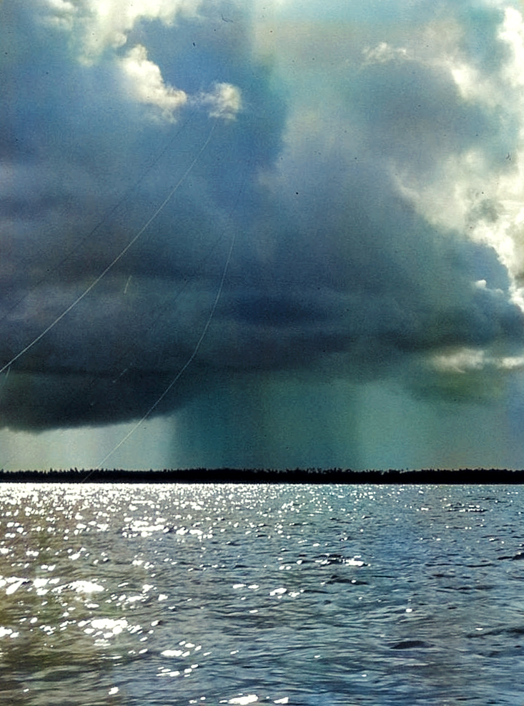
Seek the Good 5:7-14
SEEK HIM WHO CALLS
⁸ (he who made the Pleiades and Orion, who turns blackness into dawn and darkens day into night, who calls for the waters of the sea and pours them out over the face of the land--
Notes:
http://flickr.com/photos/mwanasimba/3197808329
The parenthesis is to focus on who is the judge that is rendering this judgment—He is the God of heaven and earth.
Look to him and be saved all the ends of the earth—because if you do not—judment awaits.

Slide 17
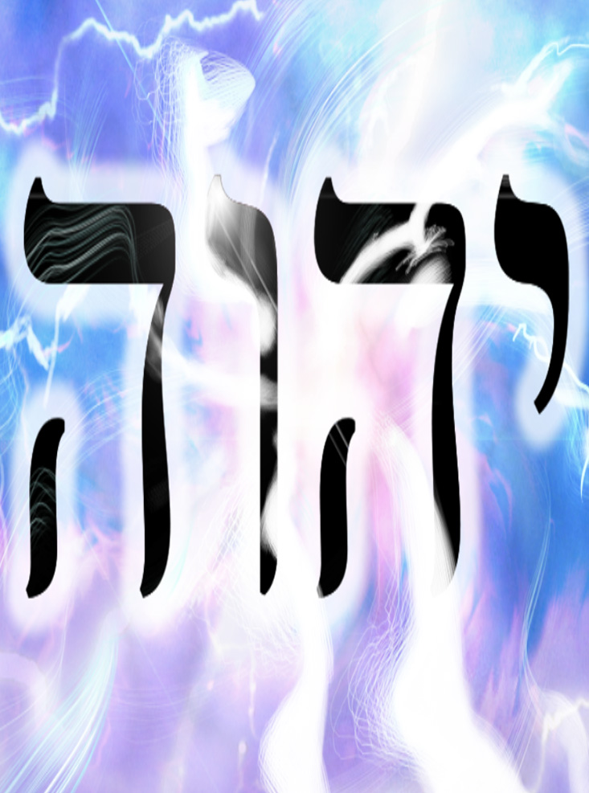
Seek the Good 5:7-14
SEEK HIM WHO SAVES
the LORD is his name– ⁹ he flashes destruction on the stronghold and brings the fortified city to ruin),
Notes:
https://www.deviantart.com/plastikmaniac/art/YHWH-168790092
The parenthesis is to focus on who is the judge that is rendering this judgment—He is the God of heaven and earth.
Look to him and be saved all the ends of the earth—because if you do not—judment awaits.

Slide 18
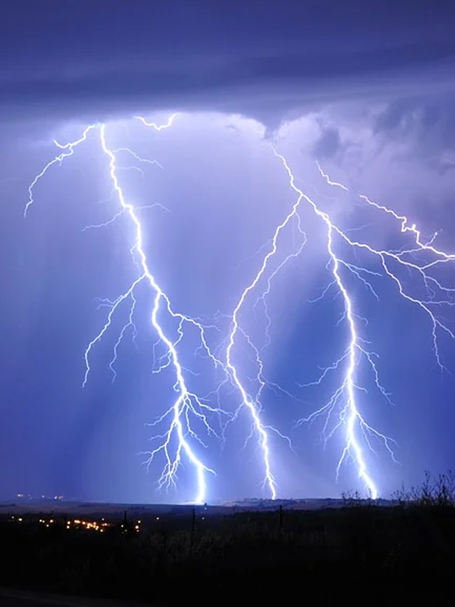
Seek the Good 5:7-14
SEEK HIM WHO DESTROYS
the LORD is his name– ⁹ he flashes destruction on the stronghold and brings the fortified city to ruin),
Notes:
https://cdn.pixabay.com/photo/2017/12/15/11/07/lightning-3020873_960_720.jpg
The parenthesis is to focus on who is the judge that is rendering this judgment—He is the God of heaven and earth.
Look to him and be saved all the ends of the earth—because if you do not—judment awaits.
John 3:16 speaks of salvation
John 3:17 speaks of condemnation
If you do not seek him—you are condemned to be destroyed

Slide 19
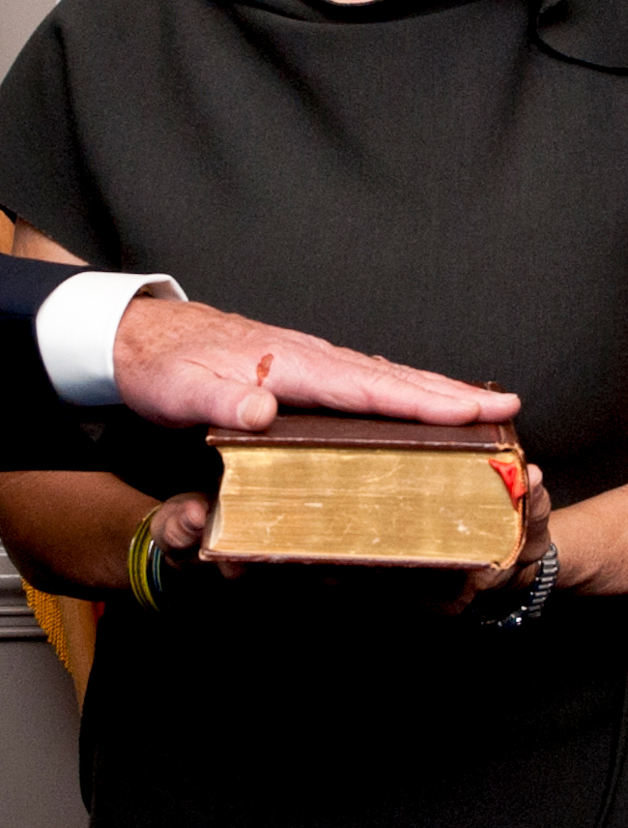
Seek the Good 5:7-14
WHO SHOULD SEEK HIM?
¹⁰ you hate the one who reproves in court and despise him who tells the truth.
Notes:
https://flickr.com/photos/usnavy/8516139708
When people’s minds are so made up that they don’t care about the truth – The Apostle Paul says …
because they refused to love the truth and so be saved.
¹¹ For this reason God sends them a powerful delusion so that they will believe the lie
¹² and so that all will be condemned who have not believed the truth but have delighted in wickedness.
(2Th 2:10-12 NIV)
He judges them by giving them completely over to what they want—the lie. Sad day.

Slide 20
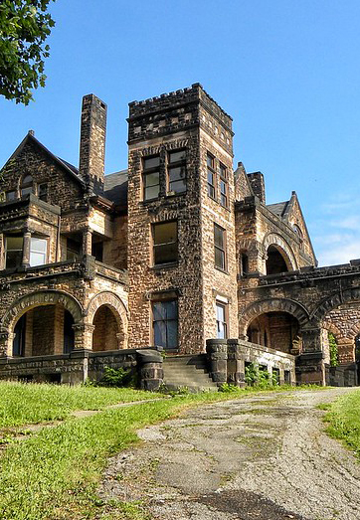
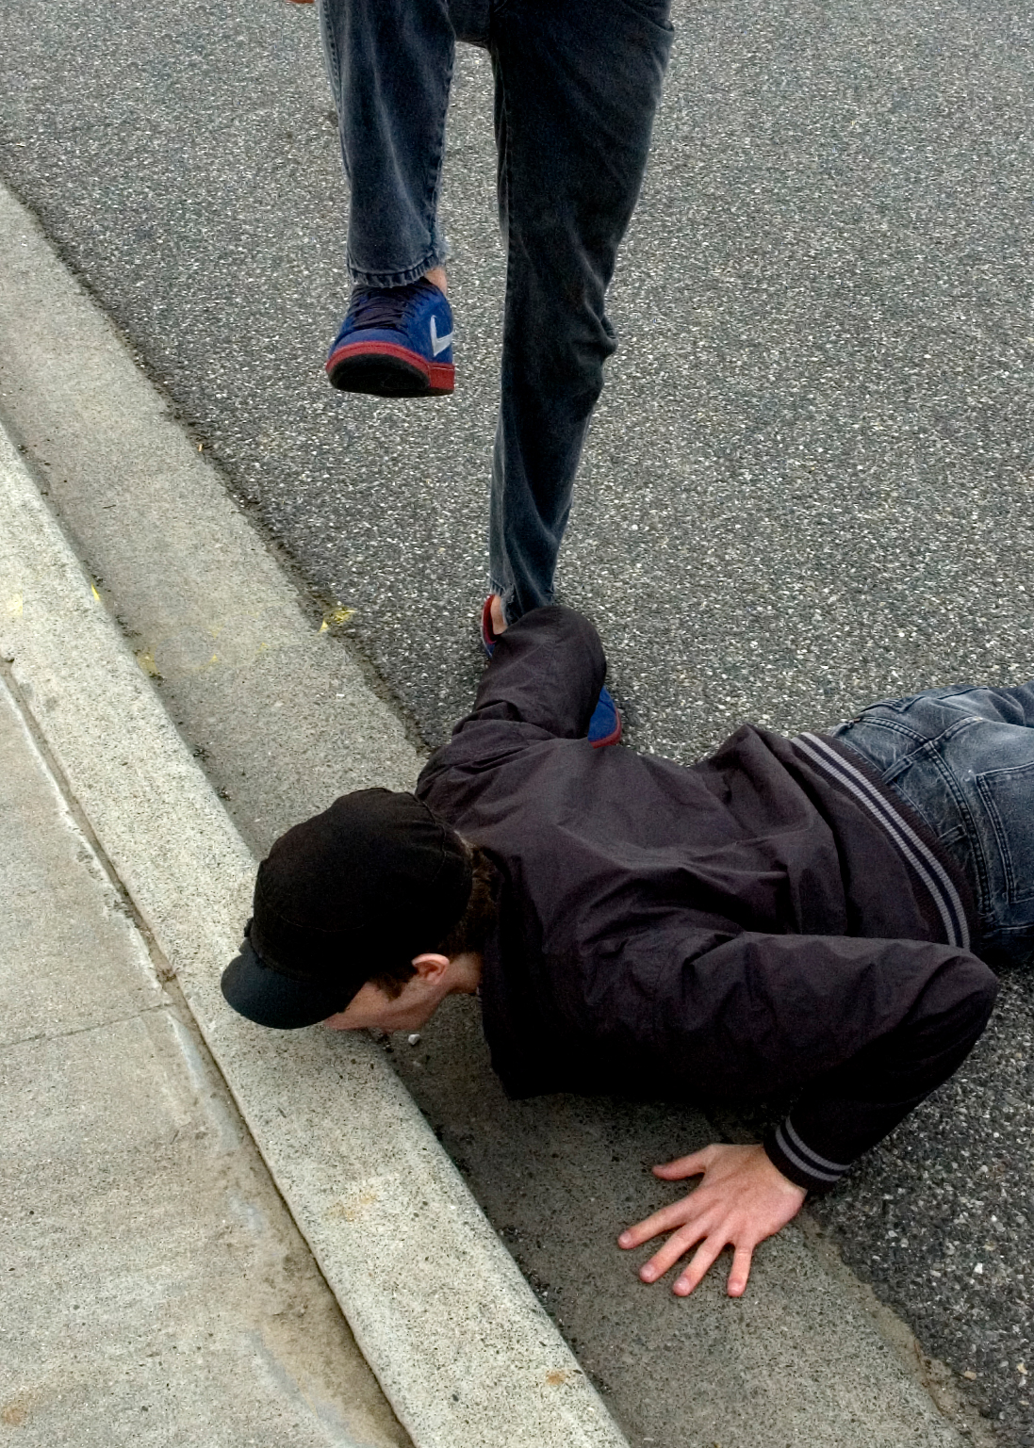
Seek the Good 5:7-14
WHO SHOULD SEEK HIM?
¹¹ You trample on the poor and force him to give you grain. Therefore, though you have built stone mansions, you will not live in them; though you have planted lush vineyards, you will not drink their wine.
Notes:
https://www.flickr.com/photos/shaync/3188741207/

Slide 21
Seek the Good 5:7-14
WHO SHOULD SEEK HIM?
¹¹ You trample on the poor and force him to give you grain. Therefore, though you have built stone mansions, you will not live in them; though you have planted lush vineyards, you will not drink their wine.
Notes:
https://www.flickr.com/photos/shaync/3188741207/

Slide 22

Seek the Good 5:7-14
WHO SHOULD SEEK HIM?
¹¹ You trample on the poor and force him to give you grain. Therefore, though you have built stone mansions, you will not live in them; though you have planted lush vineyards, you will not drink their wine.
Notes:
https://pixabay.com/fr/photos/raisins-vignes-vignoble-fruits-553463/

Slide 23
Seek the Good 5:7-14
WHO SHOULD SEEK HIM?
¹² For I know how many are your offenses and how great your sins. You oppress the righteous and take bribes and you deprive the poor of justice in the courts.

Slide 24

Seek the Good 5:7-14
The SITUATION:
¹³ Therefore the prudent man keeps quiet in such times, for the times are evil.
Notes:
They silence the truth.
As it was back then, so it is today. Cancel culture shuts down those who oppose the injustices that are being done in the name of injustice.
For example, reparations are wrong when they are not imposed on the offender. It is totally wrong to make someone who did not offend make reparations for the person who offended.
You are not to penalize the child for the parents' sins. ²⁰ The soul who sins is the one who will die. The son will not share the guilt of the father, nor will the father share the guilt of the son. The righteousness of the righteous man will be credited to him, and the wickedness of the wicked will be charged against him. (Eze 18:20 NIV)
Because of Cancel Culture the prudent man keeps quiet, or he will be made out to be unjustly as in the wrong when he is in the right.
The times are evil. We live in such evil times today. Doctors are supposed to be protectors of life—yet they abort babies before they can leave the womb. Marriage is a God created institution between a man and a woman—but the evil supreme court ruled against the God’s Word and the tradition of every culture that it is between a man and a woman alone.
The prudent keep quiet—I’m not so prudent! Like Amos, I address the evils of our times.
totally destroyed by the extreme left in our culture.

Slide 25
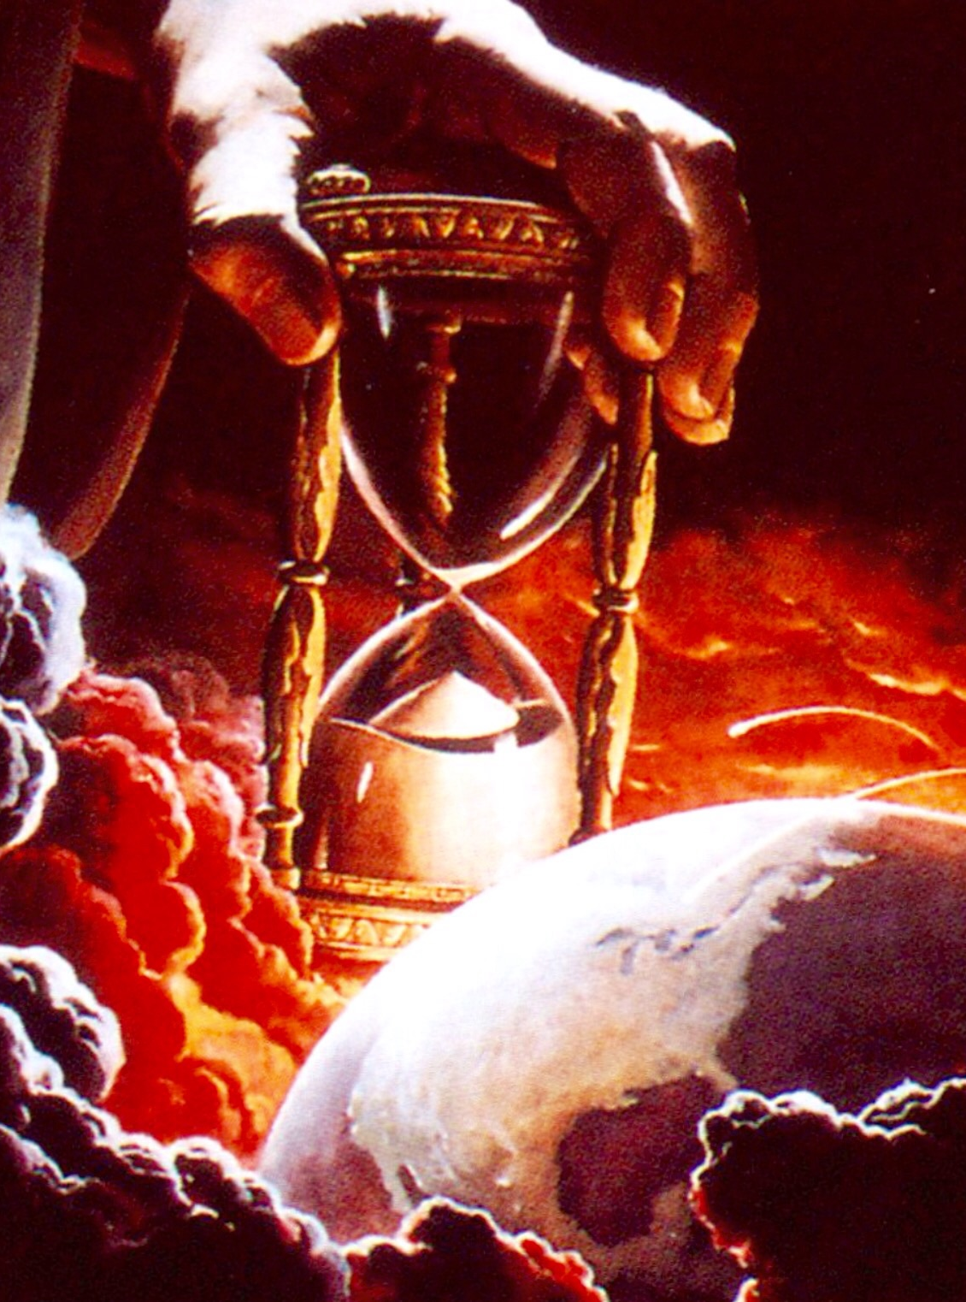
Seek the Good 5:7-14
The SITUATION:
¹³ Therefore the prudent man keeps quiet in such times, for the times are evil.
Notes:
bing.com/images/search?view=detailV2&ccid=NesXGy1p&id=AD41397D15C0312A061B2EB2E5AC84CB3F866A03&thid=OIP.NesXGy1pufZJT3fe7-ivEQHaHo&mediaurl=https%3a%2f%2fth.bing.com%2fth%2fid%2fR35eb171b2d69b9f6494f77deefe8af11%3frik%3dA2qGP8uErOWyLg%26riu%3dhttp%253a%252f%252f3.bp.blogspot.com%252f-6YHdOKYg7kE%252fVPULGuHNTUI%252fAAAAAAAAnqc%252fhX9pbfniwfU%252fs1600%252fGodsHourglass.jpg%26ehk%3dfLXt1X3V9%252f0Lh%252fMlwQV46bpzLEc9jRXxzUY5jpghs7o%253d%26risl%3d%26pid%3dImgRaw&exph=919&expw=892&q=Hourglass+Time+Running+Out&simid=607987929782058869&ck=D51C10FEE67B229270084901F7B97A90&selectedIndex=3&qft=%2bfilterui%3alicenseType-Any&FORM=IRPRST&ajaxhist=0
They silence the truth.
As it was back then, so it is today. Cancel culture shuts down those who oppose the injustices that are being done in the name of injustice.
For example, reparations are wrong when they are not imposed on the offender. It is totally wrong to make someone who did not offend make reparations for the person who offended.
You are not to penalize the child for the parents' sins. ²⁰ The soul who sins is the one who will die. The son will not share the guilt of the father, nor will the father share the guilt of the son. The righteousness of the righteous man will be credited to him, and the wickedness of the wicked will be charged against him. (Eze 18:20 NIV)
Because of Cancel Culture the prudent man keeps quiet, or he will be made out to be unjustly as in the wrong when he is in the right.
The times are evil. We live in such evil times today. Doctors are supposed to be protectors of life—yet they abort babies before they can leave the womb. Marriage is a God created institution between a man and a woman—but the evil supreme court ruled against the God’s Word and the tradition of every culture that it is between a man and a woman alone.
The prudent keep quiet—I’m not so prudent! Like Amos, I address the evils of our times.
totally destroyed by the extreme left in our culture.

Slide 26
Seek the Good 5:7-14
¹⁴ Seek good, not evil, that you may live. Then the LORD God Almighty will be with you, just as you say he is.
GOOD

Slide 27

Hate the Evil 5:15
¹⁵ Hate evil, love good; maintain justice in the courts. Perhaps the LORD God Almighty will have mercy on the remnant of Joseph.
EVIL
Notes:
Hate is a good emotion:
Mal 1:3; 2:16; Romans 9:13
Hosea 2:15; Rev 2:6

Slide 28
Hate the Evil 5:15
GOOD
¹⁵ Hate evil, love good; maintain justice in the courts. Perhaps the LORD God Almighty will have mercy on the remnant of Joseph.
EVIL

Slide 29
Hate the Evil 5:15
¹⁵ Hate evil, love good; maintain justice in the courts. Perhaps the LORD God Almighty will have mercy on the remnant of Joseph.

Slide 30
Hate the Evil 5:15
¹⁵ Hate evil, love good; maintain justice in the courts. Perhaps the LORD God Almighty will have mercy on the remnant of Joseph.
Notes:
what does the LORD require of you? To act justly and to love mercy and to walk humbly with your God. (Mic 6:8 NIV)

Slide 31
What’s here for me?
¹⁷ For God did not send his Son into the world to condemn the world, but to save the world through him. ¹⁸ Whoever believes in him is not condemned, but whoever does not believe stands condemned already because he has not believed in the name of God's one and only Son. (John 3:17-18)

Slide 32
AVOID DISASTER!
Seek the
LORD!

Slide 33
Let’s Pray!

