Slide 1
Avoiding
Respectable Sins!
Notes:
https://pixabay.com/photos/tie-necktie-adjust-adjusting-man-690084/
Copyright © 2006−2021. All rights reserved. Bible Point is a registered trademark of Dennis Henderson. All other trademarks acknowledged.
Bible Point contains graphics from Bible Point artists. These illustrations belong to Bible Point and the respective artists. You may use the designs and illustrations for graphical illustration of lessons free and without special permission, provided they are not used in any way that maligns the Christian faith. Furthermore, republication or production of any illustration by any other graphic service whether it be in book, in a machine-readable form, or in any other design resource is strictly prohibited. Furthermore, they cannot be duplicated or resold as any other form of publishing, clip art, or graphic resource.
So What does it mean? (A simple translations of the legal jargon)
So, if you don’t own the presentation(s), graphic(s), and text(s) how can you legally use them? The purchase of the license allows you to use all the images in the product. However, the actual ownership and copyright of the presentation(s), graphic(s), and text(s) remain the property of Bible Point and its licensors. If you had plans on using this product in your “for sale” work—think again!
License Agreement
Article 1: License Grant
All the graphics and text in Bible Point presentations (excluding quotes from the Bible and stated sources) are the intellectual and real property of Bible Point and its licensors, and is protected by law, including United States copyright laws and international treaties. Bible Point grants to you a license:
1. To use the presentation in a single church, single school, or single office of a Christian organization.
2. To make a single archival back-up copy of the program.
3. To modify the presentation(s) and merge with other presentations in a single church, school, or Christian organization.
4. To transfer to another party if that party agrees to accept the terms and conditions of this agreement, and you do not retain any copies of the presentation, whether printed, machine readable, modified, or merged form.
Article 2: Terms
This license is effective until terminated. You may terminate the license at any time by destroying the presentation(s), graphic(s), or text(s) together with all copies, modifications and merged portions in any form. Bible Point may terminate your license if you fail to comply with this Agreement. You agree, upon such termination, for any reason, to destroy the presentation(s), graphics, and text(s) with all copies, modifications, and merged portions in any form.
Article 3: Disclaimers
1. Bible Point presentations, graphics, and texts are licensed to you As Is. You, the consumer, bear the entire risk relating to the quality and performance of the presentation(s), graphic(s), or text(s). In no event will Bible Point be liable for damages resulting from any defect.
2. Thirty-day limited warrantee on disks. Bible Point warrants the disks to be free of defects in material and workmanship under normal use for 30 days after purchase. During the 30-day period you may return a defective presentation, graphic, or text with proof of purchase and it will be replaced without charge, unless the presentation is damaged by misuse.
Article 4: General
1. You may not sub-license, assign, or transfer the license of the presentation(s), graphic(s), or text(s) except as provided by this Agreement.
2. This Agreement will be governed by the laws of the State of Michigan.
So What does it mean? (A simple translations of the legal jargon)
May I let someone borrow or copy my licensed Bible Point presentation (even after I modified it)? As long as it is within your local church, or single school, or the immediate office of a Christian organization you may. Otherwise, please refer the person interested in borrowing to: http://www.biblepoint.com or E-mail: dennis@DrDH.net with any related questions.

Slide 2
HEBREWS 12:14
Pursue … holiness,
for without it no one will see the Lord.
(NET)

Slide 3
What are Respectable Sins?
Any sins with which we get comfortable,
and stop taking seriously!
Such as …

Slide 4

Seven Old Respectable Sins:
Strong Sexual Craving = Lust
Notes:
nio.com/people/female-women/girl-hand-apple-nature-summer-woman-pretty-portrait-attractive

Slide 5
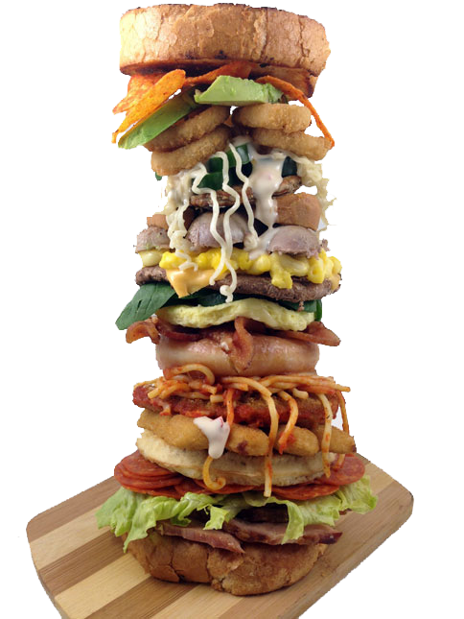
Seven Old Respectable Sins:
Strong Sexual Craving = Lust
Overeating = Gluttony
Notes:
149352953.v2.pressablecdn.com/wp-content/uploads/2014/04/AlphabetSandwich2.jpg

Slide 6

Seven Old Respectable Sins:
Strong Sexual Craving = Lust
Overeating = Gluttony
Selfish Desire for Things = Greed
Notes:
upload.wikimedia.org/wikipedia/commons/thumb/9/95/Greed.jpg/1024px-Greed.jpg

Slide 7

Seven Old Respectable Sins:
Strong Sexual Craving = Lust
Overeating = Gluttony
Selfish Desire for Things = Greed
Laziness = Sloth
Notes:
pexels.com/photo/photo-of-woman-in-blue-spaghetti-strap-top-sleeping-on-a-blue-hammock-3771095/

Slide 8
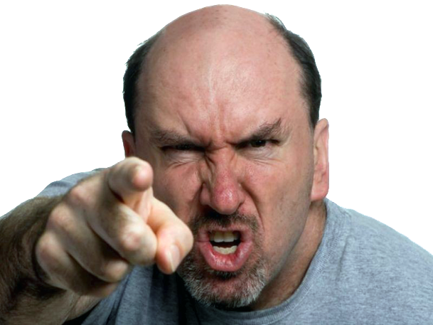
Seven Old Respectable Sins:
Strong Sexual Craving = Lust
Overeating = Gluttony
Selfish Desire for Things = Greed
Laziness = Sloth
Strong Vengeful Anger = Wrath
Notes:
freepngimg.com/png/49411-angry-person-free-clipart-hq

Slide 9

Seven Old Respectable Sins:
Strong Sexual Craving = Lust
Overeating = Gluttony
Selfish Desire for Things = Greed
Laziness = Sloth
Strong Vengeful Anger = Wrath
Desire What Others Possess = Envy
Desire What Others Possess = Envy
Notes:
www.flickr.com/photos/javmorcas/8353385370

Slide 10

Seven Old Respectable Sins:
Strong Sexual Craving = Lust
Overeating = Gluttony
Selfish Desire for Things = Greed
Laziness = Sloth
Strong Vengeful Anger = Wrath
Desire What Others Possess = Envy
Thinking Highly of Oneself = Pride
Notes:
pexels.com/photo/photo-of-woman-in-blue-spaghetti-strap-top-sleeping-on-a-blue-hammock-3771095/

Slide 11

Seven Modern Respectable Sins:
Prochoice = Abortion
Notes:
flickr.com/photos/basetree/7579346960

Slide 12

Seven Modern Respectable Sins:
Prochoice = Abortion
Casual Sex = Adultery / Fornication
Notes:
7. Violent video games – TV shows – horror movies – etc.

Slide 13

Seven Modern Respectable Sins:
Prochoice = Abortion
Casual Sex = Adultery / Fornication
Termination of a Marriage = Divorce
Notes:
www.speakingofchina.com/media/sleep-with-chinese-men-dating-foreign-women/

Slide 14

Seven Modern Respectable Sins:
Prochoice = Abortion
Casual Sex = Adultery / Fornication
Termination of a Marriage = Divorce
Sex with the same sex person = Gayness
Notes:
flickr.com/photos/iip-photo-archive/19080149740/

Slide 15

Seven Modern Respectable Sins:
Prochoice = Abortion
Casual Sex = Adultery / Fornication
Termination of a Marriage = Divorce
Sex with the same sex person = Gayness
Identifying as Transgender
Notes:
7. Violent video games – TV shows – horror movies – etc.

Slide 16

Seven Modern Respectable Sins:
Prochoice = Abortion
Casual Sex = Adultery / Fornication
Termination of a Marriage = Divorce
Sex with the same sex person = Gayness
Identifying as Transgender
Cancel Culture
Notes:
Upload.wikimedia.org/wikipedia/commons/thumb/6/66/Day_of_Silence_2008_Poland_Bydgoszcz.jpg/2048px-Day_of_Silence_2008_Poland_Bydgoszcz.jpg
CANCEL CULTURE is shutting down opposing positions – cancelling any idea that doesn’t agree with you. In Social Media it is shutting down Twitter, Facebook, etc accounts that say things the people in control do not agree with. It is an attack on freedom of speech.
Cancel culture is a modern form of ostracism in which someone is thrust out of social or professional circles – whether it be online, on social media, or in person. Those who are subject to this ostracism are said to have been "cancelled". The expression "cancel culture" has mostly negative connotations and is commonly used in debates on free speech and censorship.

Slide 17
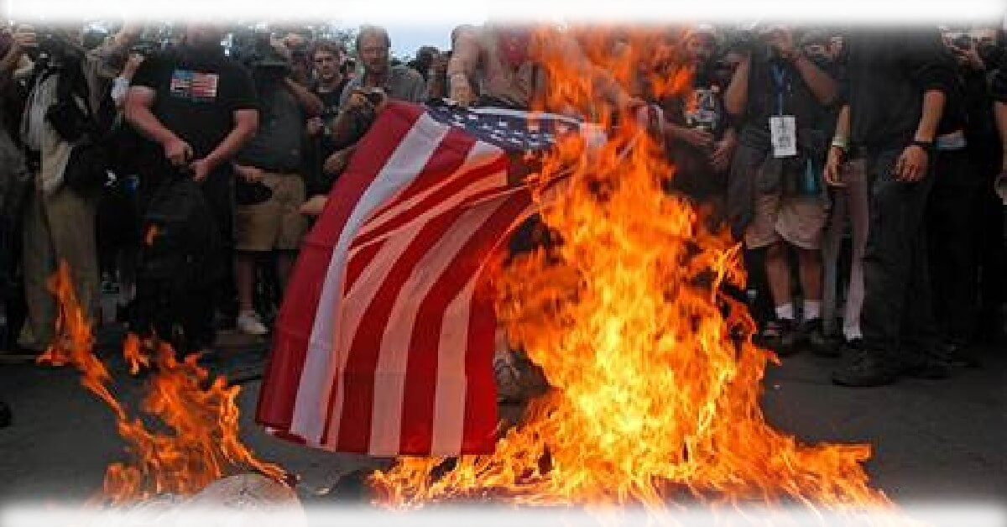
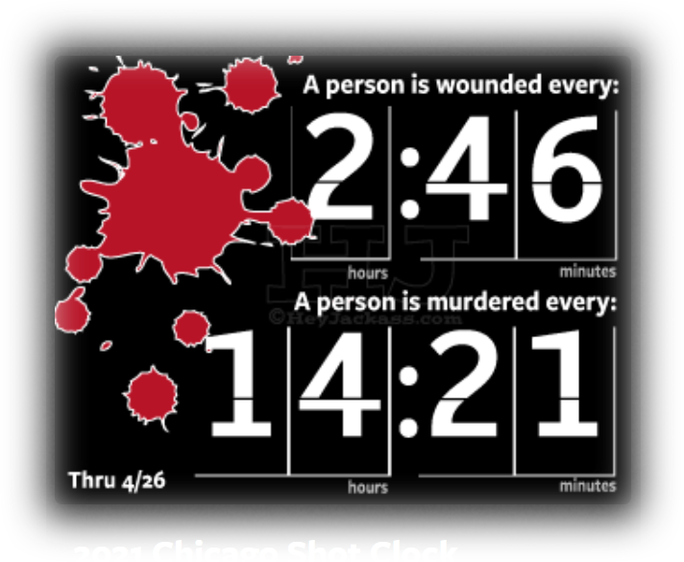
Seven Modern Respectable Sins:
Prochoice = Abortion
Casual Sex = Adultery / Fornication
Termination of a Marriage = Divorce
Sex with the same sex person = Gayness
Identifying as Transgender
Cancel Culture
Violence – Defund Police – Lawlessness
Notes:
images.uncyclomedia.co/uncyclopedia/en/0/0d/Antifa_burning_flags.jpg
7. Violent video games – TV shows – horror movies – etc.

Slide 18
You think I’m going too far?
Wait until you see what Amos points out!

Slide 19
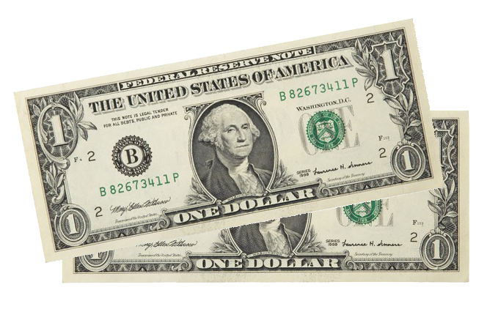

Luxury 4:1-3
734 million live on less than $2 a day.
Notes:
i1.pickpik.com/photos/829/421/248/directory-road-sign-shield-note-preview.jpg
Luxury = the state of great comfort and extravagant living.
You and l live in poverty when compared to Bill Gates and Jeff Bezos.
You and I live in luxury when compared to …
Using the World Bank definition of $1.90/day, as of 2016, roughly 734 million people remained in extreme poverty (or roughly 1 in 10 people worldwide).
There is nothing wrong with wealth or luxury in and of itself. But when it is only self focused and at the expense of others in need it become a respectable sin.
Main outline from Warren Wiersbe

Slide 20

Luxury 4:1-3
4¹ Hear this word, you cows of Bashan on Mount Samaria, you women who oppress the poor and crush the needy and say to your husbands, "Bring us some drinks!"
Notes:
https://upload.wikimedia.org/wikipedia/commons/thumb/8/86/Freeconeday_cowgirl.jpg/1024px-Freeconeday_cowgirl.jpg
Why does he call these wealthy women cows? Because they are fattening up themselves for the slaughter of God’s judgment.
Main outline from Warren Wiersbe

Slide 21
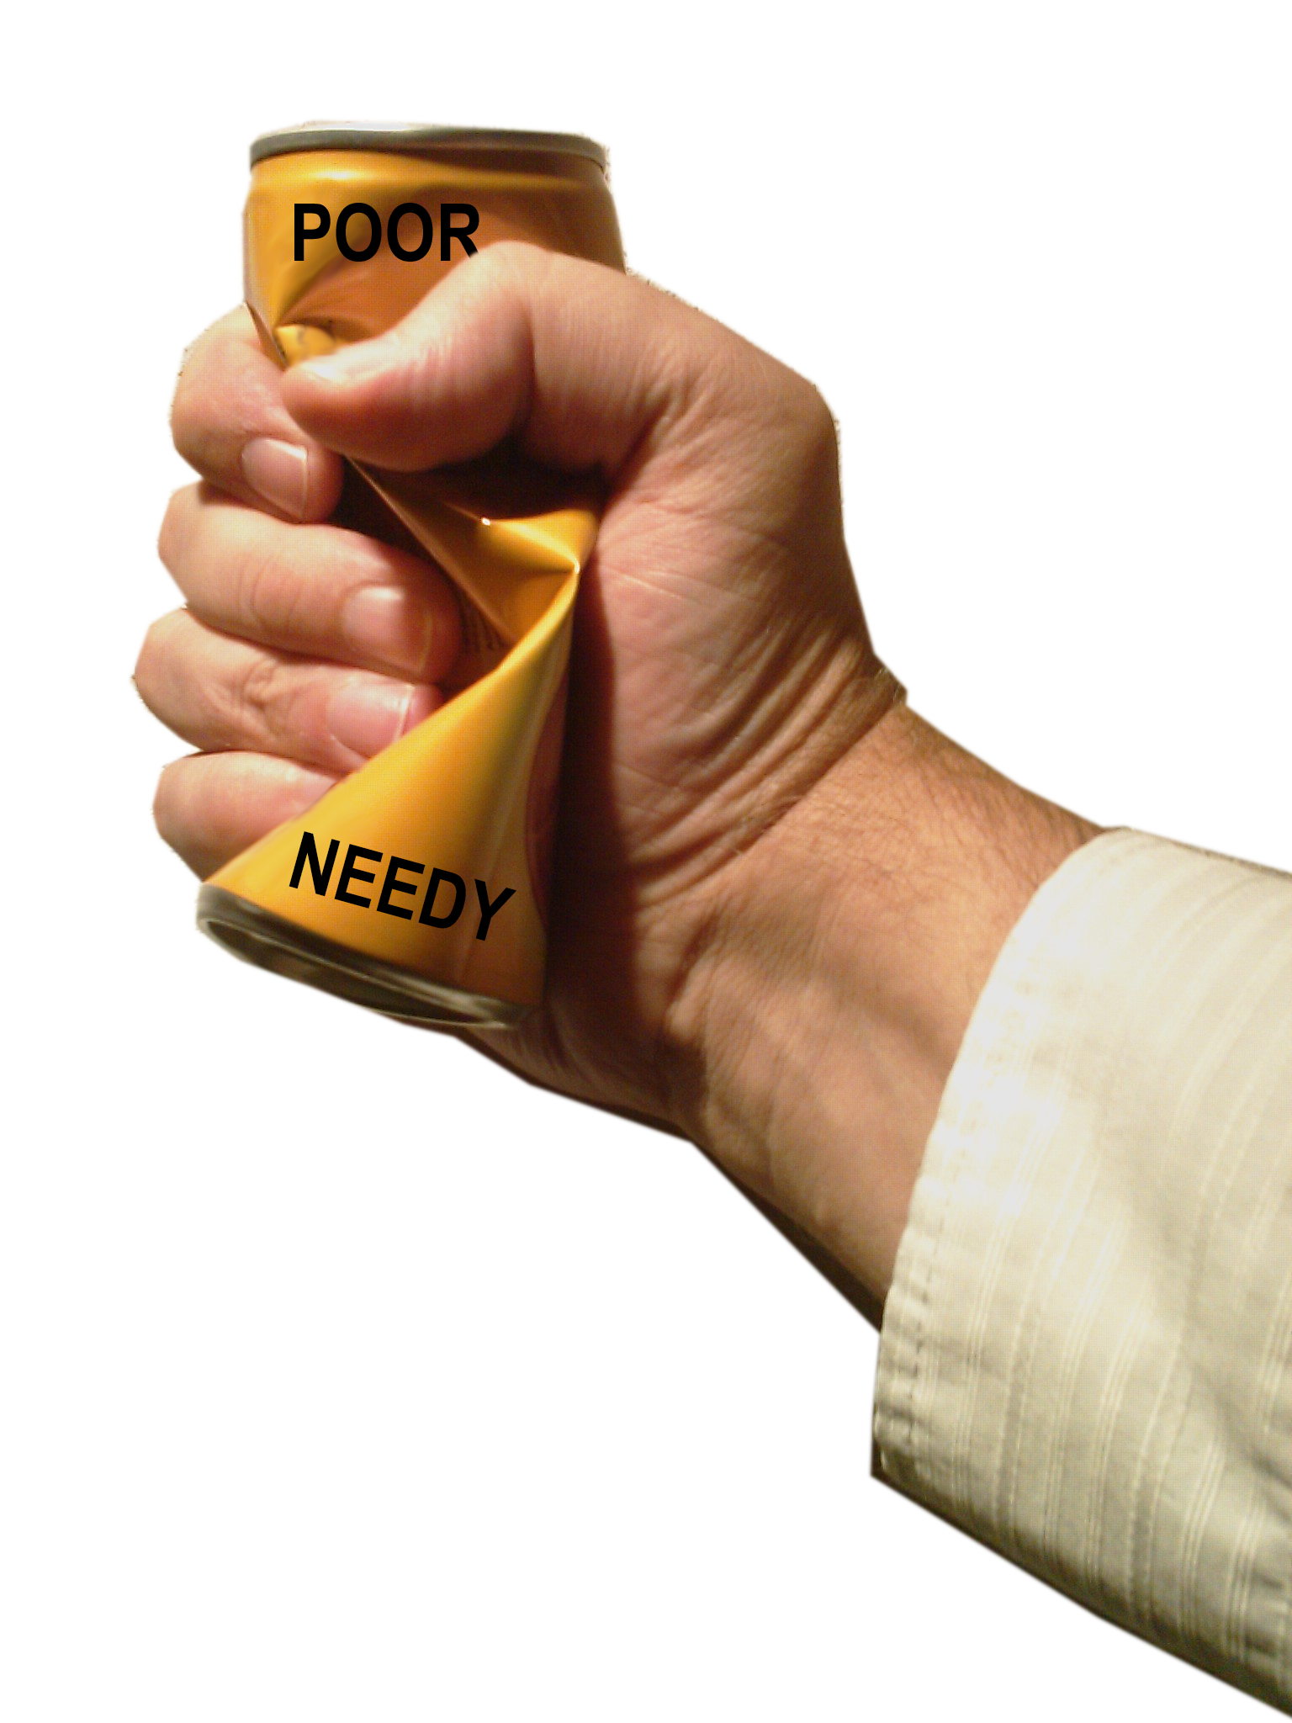
Luxury 4:1-3
4¹ Hear this word, you cows of Bashan on Mount Samaria, you women who oppress the poor and crush the needy and say to your husbands, "Bring us some drinks!"
Notes:
https://upload.wikimedia.org/wikipedia/commons/thumb/8/86/Freeconeday_cowgirl.jpg/1024px-Freeconeday_cowgirl.jpg
https://upload.wikimedia.org/wikipedia/commons/0/02/Crushed_Chocolatemilk_can.jpg
Main outline from Warren Wiersbe
Talk about crushing the needy—Do you know how they abort a baby in the womb who NEEDS the mother’s nutrients to survive?
They crush the baby’s head.
All for there own convenience and luxury of not raising a child.
It is murderous.

Slide 22

Luxury 4:1-3
4¹ Hear this word, you cows of Bashan on Mount Samaria, you women who oppress the poor and crush the needy and say to your husbands, "Bring us some drinks!"
Notes:
https://upload.wikimedia.org/wikipedia/commons/thumb/8/86/Freeconeday_cowgirl.jpg/1024px-Freeconeday_cowgirl.jpg
https://en.wikipedia.org/wiki/Cosmopolitan_(cocktail)
Main outline from Warren Wiersbe
They are so calloused they party over it.

Slide 23

Luxury 4:1-3
² The Sovereign LORD has sworn by his holiness: "The time will surely come when you will be taken away with hooks, the last of you with fishhooks.
Notes:
https://upload.wikimedia.org/wikipedia/commons/thumb/8/86/Freeconeday_cowgirl.jpg/1024px-Freeconeday_cowgirl.jpg
Main outline from Warren Wiersbe

Slide 24

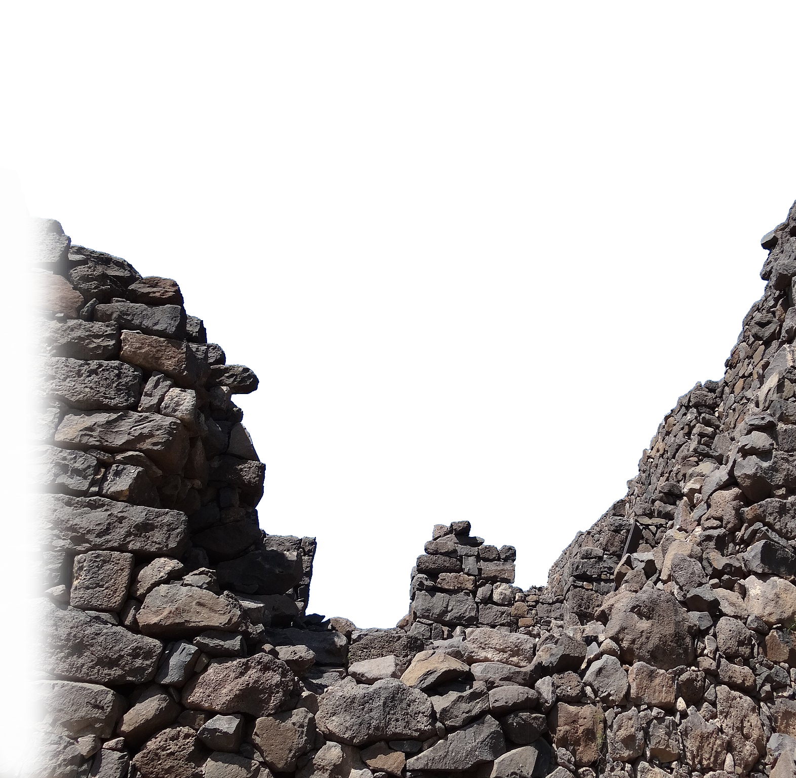
Luxury 4:1-3
³ You will each go straight out through breaks in the wall, and you will be cast out toward Harmon, " declares the LORD.
Notes:
https://upload.wikimedia.org/wikipedia/commons/thumb/8/86/Freeconeday_cowgirl.jpg/1024px-Freeconeday_cowgirl.jpg
httsp://upload.wikimedia.org/wikipedia/commons/thumb/b/b9/Gamla_–_Breach_in_the_Wall_%284%29.JPG/2048px-Gamla_–_Breach_in_the_Wall_%284%29.JPG
Declares the LORD occurs seven times in our passage today.
When you can’t afford to give your tithe to the Lord because of the extravagance of your lifestyle --- you are guilty of the respectable sin of Luxury!
Harmon is a place name that has long been lost. Kind of like the people who were taken and never returned—the lost 10 tribes of Israel.

Slide 25
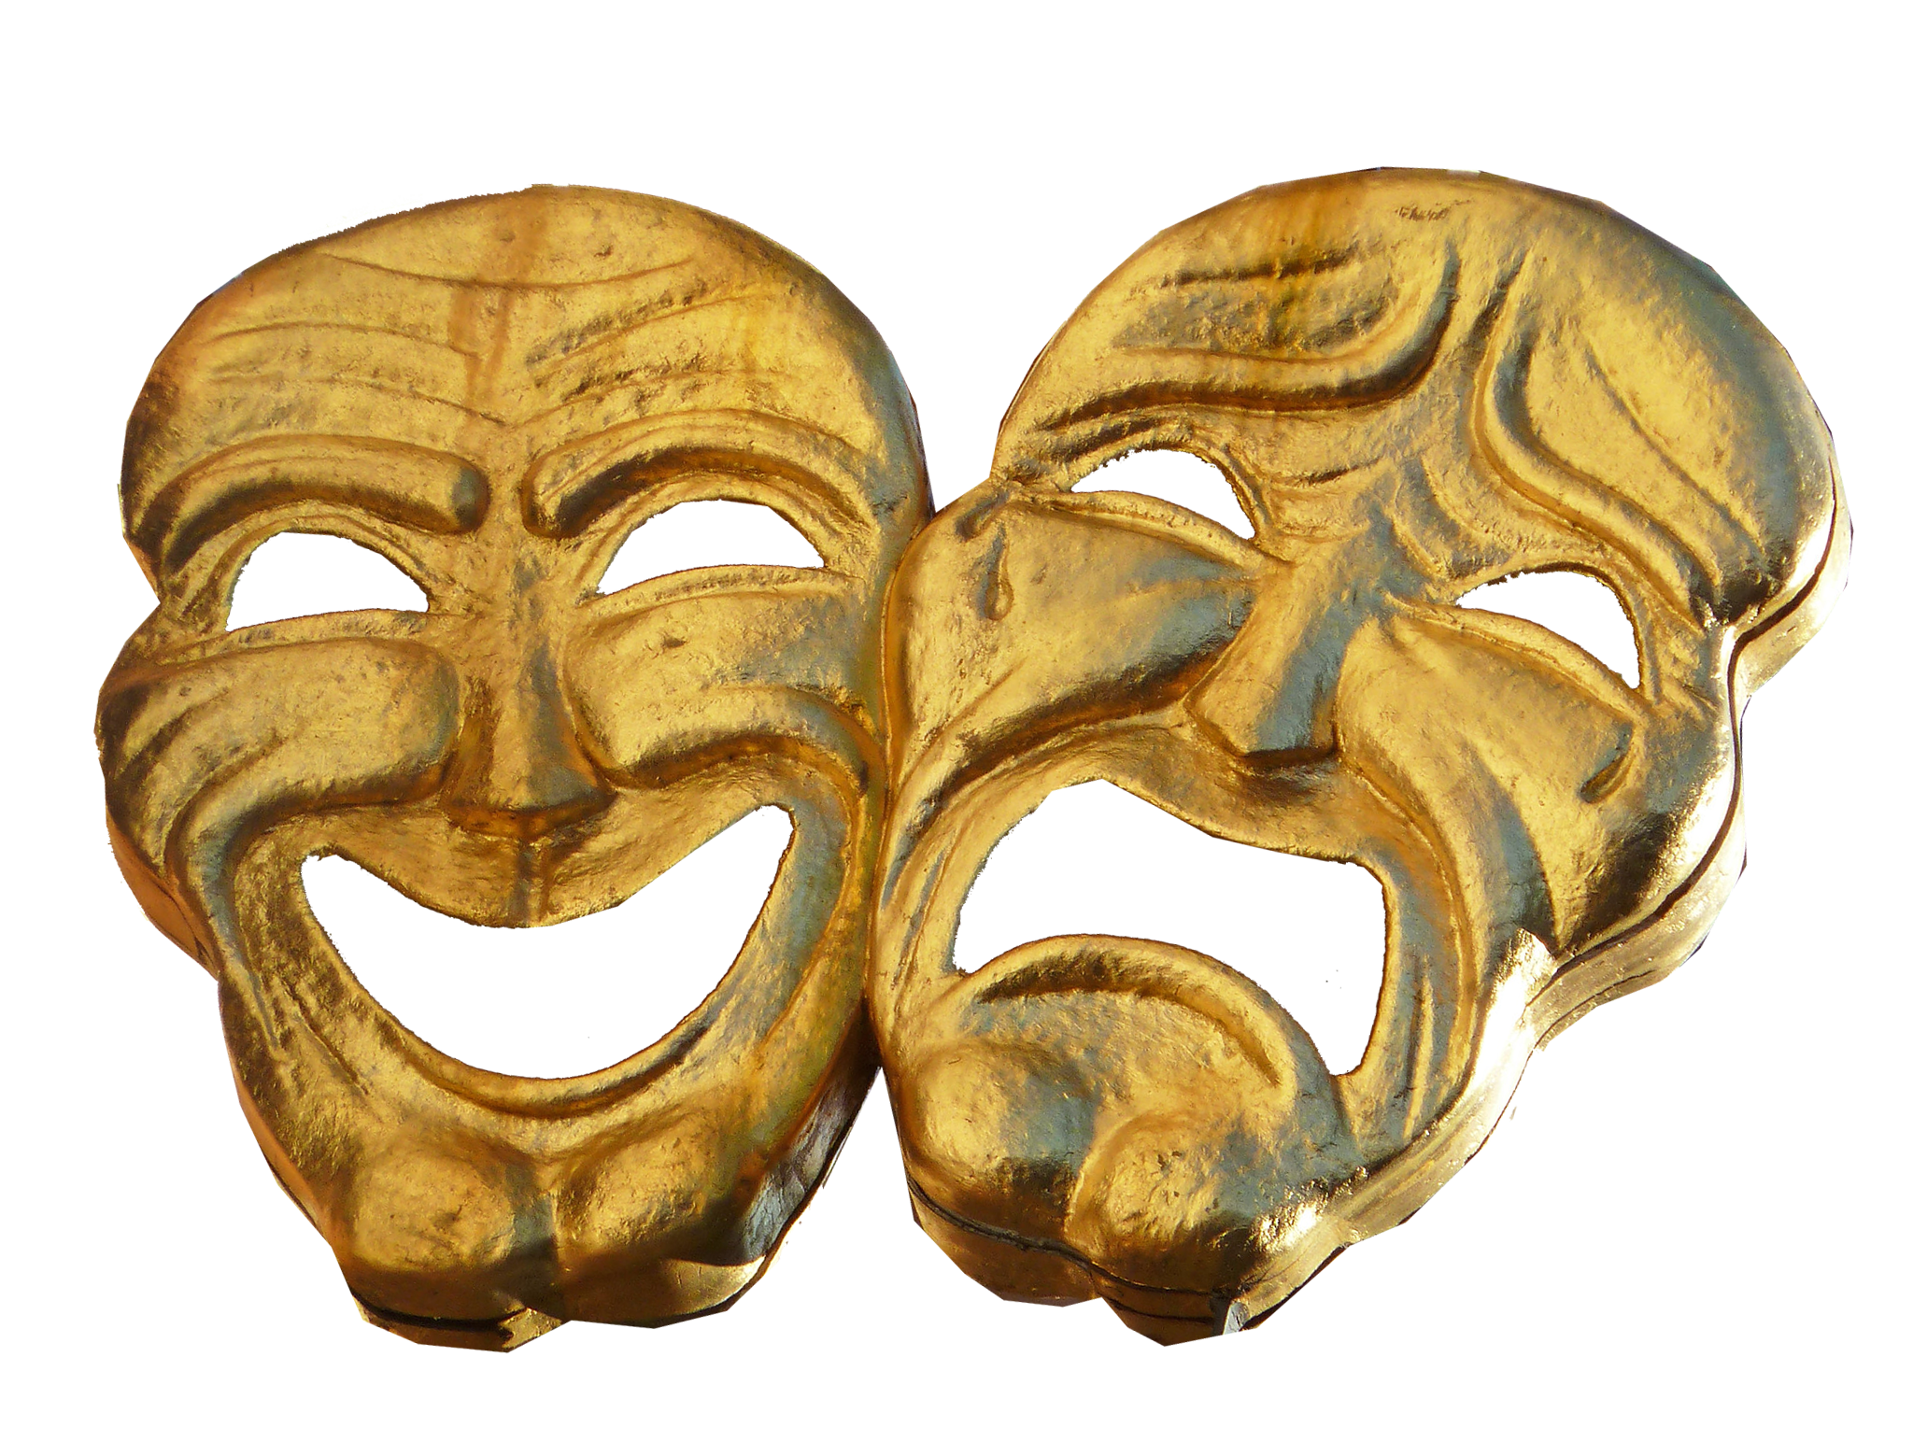
Hypocrisy 4:4-5
Notes:
flickr.com/photos/atoach/8094737104
Those who take verses out of context can use a verse like this to say “God wants me to sin!”
This is tongue in cheek. They are sinning and God say go ahead—judgment is coming.

Slide 26

Hypocrisy 4:4-5
⁴ "Go to Bethel and sin; go to
Gilgal and sin yet more.
BETHEL
GILGAL
Notes:
Those who take verses out of context can use a verse like this to say “God wants me to sin!”
God is being facetious here—treating a very serious matter in an almost humorous way.
This is tongue in cheek. They are sinning and God and he says “go ahead—judgment is coming.”

Slide 27
Hypocrisy 4:4-5
⁴ "Go to Bethel and sin; go to
Gilgal and sin yet more.
BETHEL
GILGAL

Slide 28
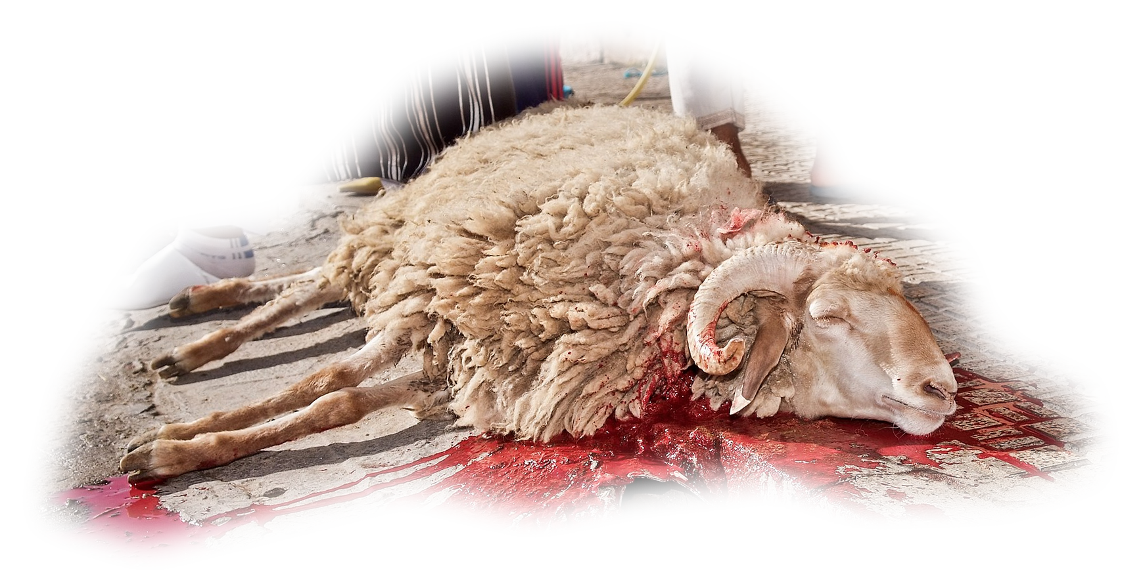
Hypocrisy 4:4-5
⁴ "Go to Bethel and sin; go to
Gilgal and sin yet more. Bring
your sacrifices every morning,
BETHEL
GILGAL
Notes:
http://upload.wikimedia.org/wikipedia/commons/thumb/a/a4/Animal_sacrifice_at_Eid_at_Adha_14.jpg/2048px-Animal_sacrifice_at_Eid_at_Adha_14.jpg
To obey is better than sacrifice, and to heed is better than the fat of rams. (1Sa 15:22 NIV)

Slide 29
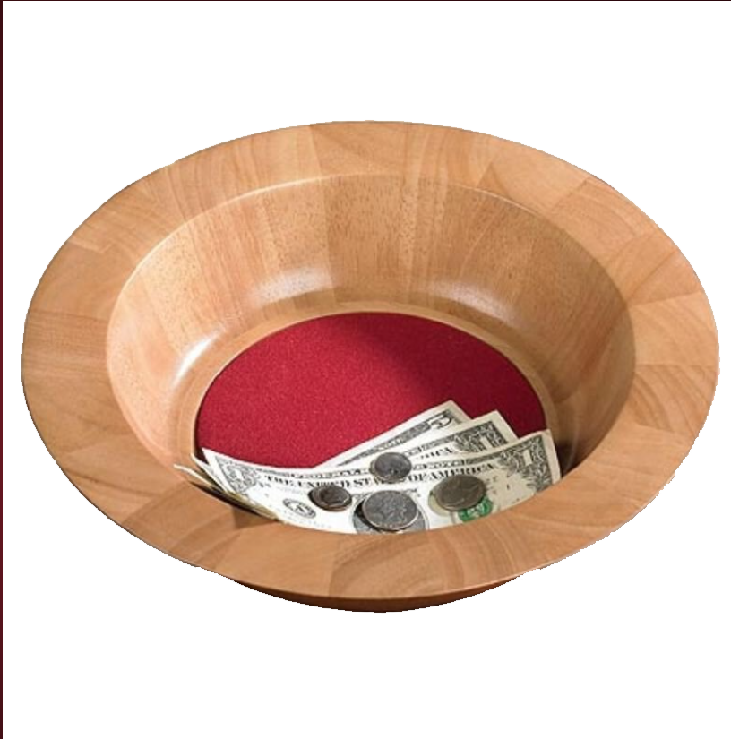
Hypocrisy 4:4-5
⁴ "Go to Bethel and sin; go to
Gilgal and sin yet more. Bring
your sacrifices every morning,
your tithes every three years. ⁵
BETHEL
GILGAL
Notes:
Tithes of the third year were to go to the Levites to live off of (see Deut 14:28-29)

Slide 30
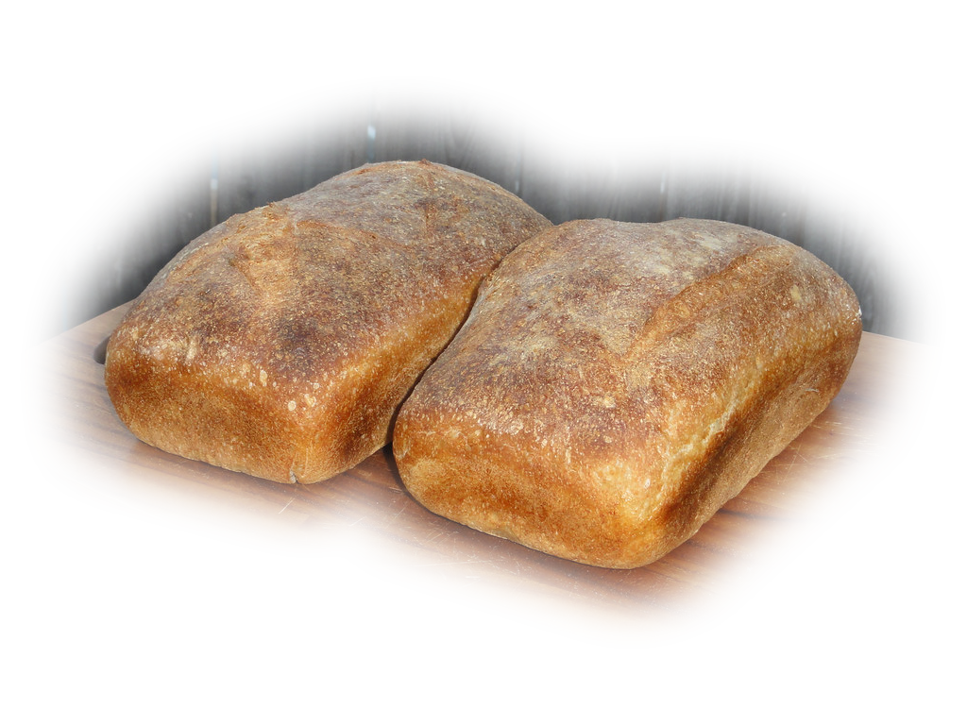

Hypocrisy 4:4-5
⁴ "Go to Bethel and sin; go to
Gilgal and sin yet more. Bring
your sacrifices every morning,
your tithes every three years. ⁵
Burn leavened bread as a thank
offering and brag about your
freewill offerings-- boast about
them, you Israelites, for this is
what you love to do," declares the Sovereign LORD.
BETHEL
GILGAL
Notes:
https://live.staticflickr.com/7176/6834510130_a7a1eaf4dd_b.jpg
Leavened is a picture of sin. They were supposed to use unleavened bread. So point is there worship was corrupted by hypocricy.

Slide 31
Hypocrisy 4:4-5
⁴ "Go to Bethel and sin; go to
Gilgal and sin yet more. Bring
your sacrifices every morning,
your tithes every three years. ⁵
Burn leavened bread as a thank
offering and brag about your
freewill offerings-- boast about
them, you Israelites, for this is
what you love to do," declares the Sovereign LORD.
BETHEL
GILGAL
Notes:
https://live.staticflickr.com/7176/6834510130_a7a1eaf4dd_b.jpg
Leavened is a picture of sin. They were supposed to use unleavened bread. So point is there worship was corrupted by hypocricy.

Slide 32
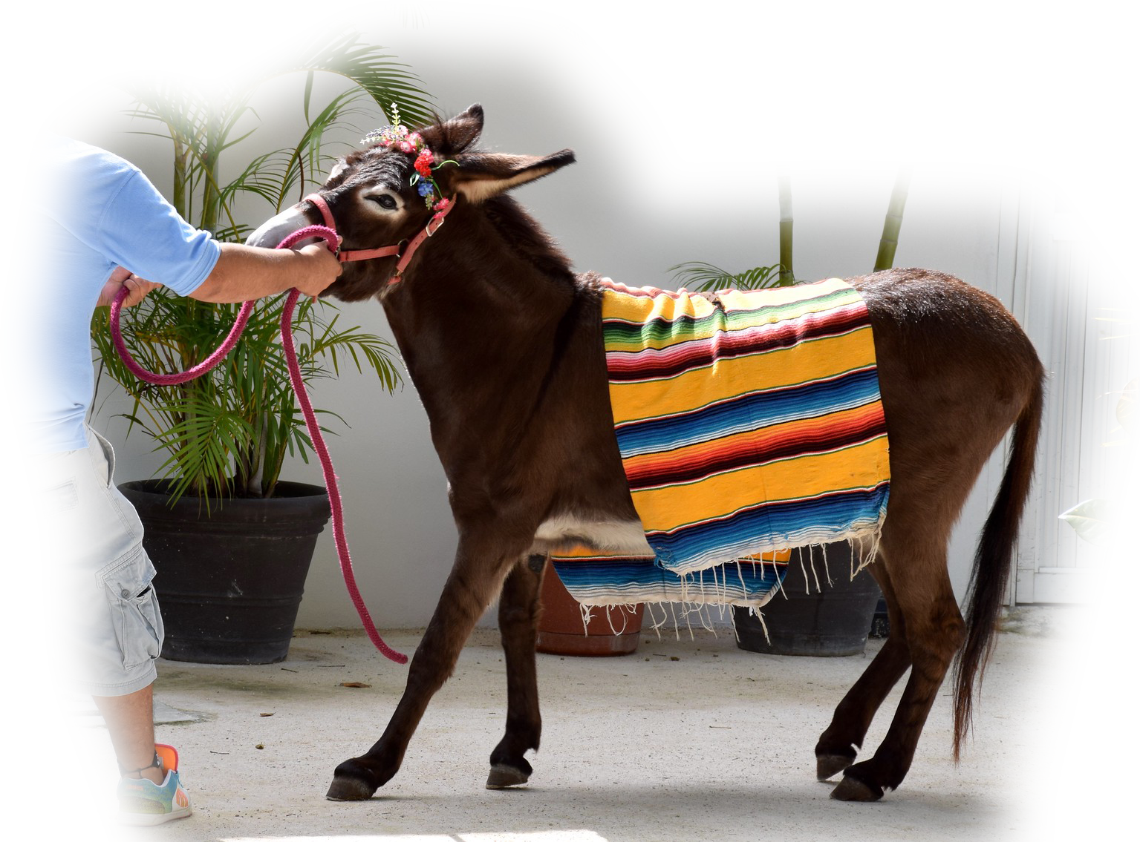
Obstinacy 4:6-13 (Stubborn)
Notes:
An Obstinate person is a STUBORN person.
Five times it says, “Yet you have not returned to me”
Famine 6
Drought 7-8
Destruction 9
Sickness 10
Defeat 10b
Catastrophe 11
Ultimately 12-13

Slide 33
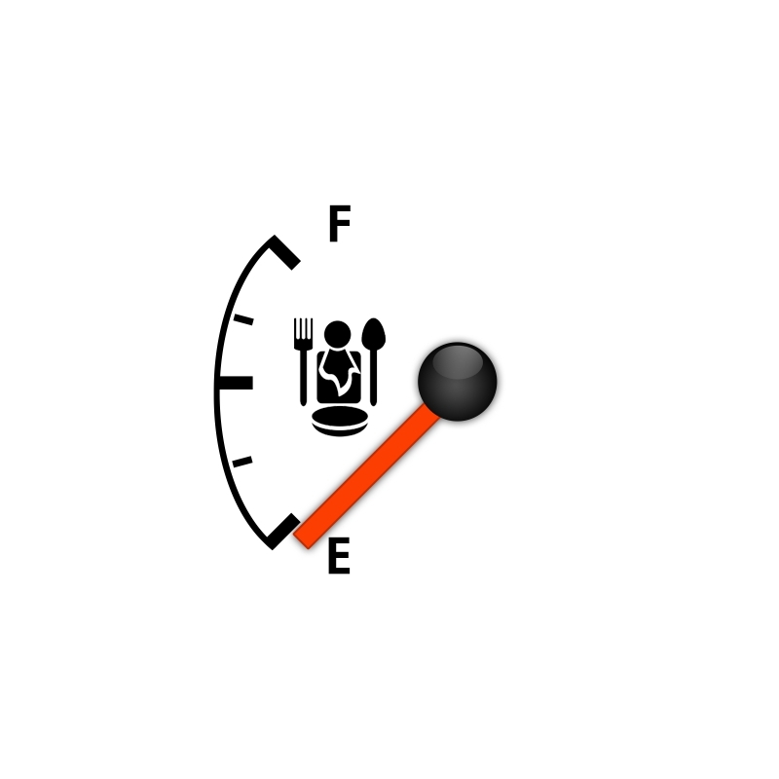
Obstinacy 4:6-13 (Famine)
⁶ "I gave you empty stomachs in every city and lack of bread in every town, yet you have not returned to me," declares the LORD.
Notes:
An Obstinate person is a STUBORN person.
Five times it says, “Yet you have not returned to me”
Famine 6
Drought 7-8
Destruction 9
Sickness 10
Defeat 10b
Catastrophe 11
Ultimately 12-13

Slide 34
Obstinacy 4:6-13 (Famine)
⁶ "I gave you empty stomachs in every city and lack of bread in every town, yet you have not returned to me," declares the LORD.
Notes:
Five times it says, “Yet you have not returned to me”
Famine 6
Drought 7-8
Destruction 9
Sickness 10
Defeat 10b
Catastrophe 11
Ultimately 12-13

Slide 35

Obstinacy 4:6-13 (Drought)
⁷ "I also withheld rain from you when the harvest was still three months away. I sent rain on one town, but withheld it from another. One field had rain; another had none and dried up. ⁸ People staggered from town to town for water but did not get enough to drink, yet you have not returned to me," declares the LORD.
Notes:
Five times it says, “Yet you have not returned to me”
Famine 6
Drought 7-8
Destruction 9
Sickness 10
Defeat 10b
Catastrophe 11
Ultimately 12-13

Slide 36
Obstinacy 4:6-13 (Drought)
⁷ "I also withheld rain from you when the harvest was still three months away. I sent rain on one town, but withheld it from another. One field had rain; another had none and dried up. ⁸ People staggered from town to town for water but did not get enough to drink, yet you have not returned to me," declares the LORD.
Notes:
Five times it says, “Yet you have not returned to me”
Famine 6
Drought 7-8
Destruction 9
Sickness 10
Defeat 10b
Catastrophe 11
Ultimately 12-13

Slide 37


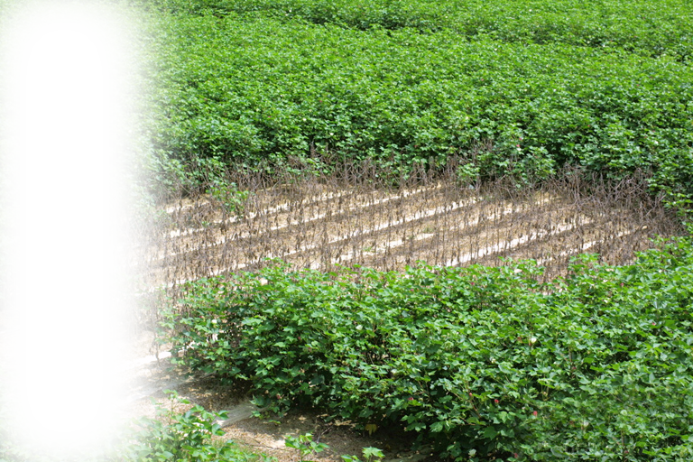
Obstinacy 4:6-13 (Destruction
⁹ "Many times I struck your gardens and vineyards, I struck them with blight and mildew. Locusts devoured your fig and olive trees, yet you have not returned to me," declares the LORD.
Notes:
https://live.staticflickr.com/2435/3816978078_797a5276ff_b.jpg
https://www.ipmimages.org/browse/detail.cfm?imgnum=1242075

Slide 38
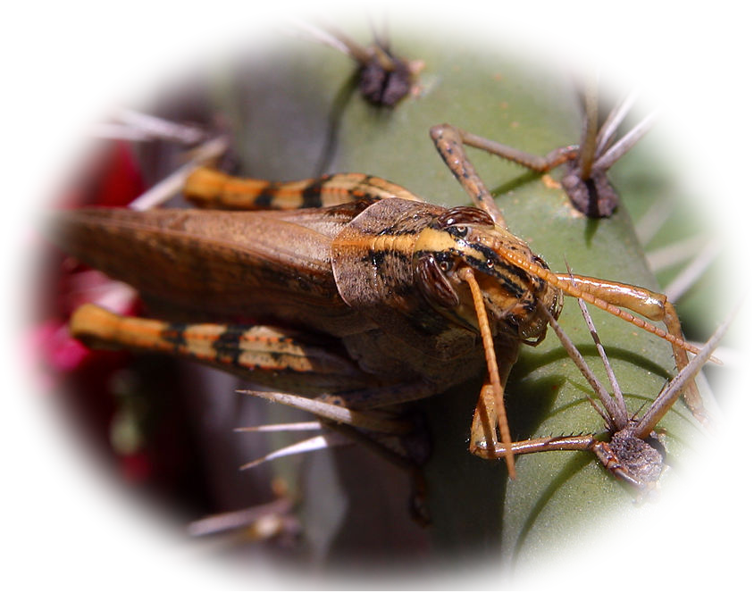
Obstinacy 4:6-13 (Destruction)
⁹ "Many times I struck your gardens and vineyards, I struck them with blight and mildew. Locusts devoured your fig and olive trees, yet you have not returned to me," declares the LORD.
Notes:
Five times it says, “Yet you have not returned to me”
Famine 6
Drought 7-8
Destruction 9
Sickness 10
Defeat 10b
Catastrophe 11
Ultimately 12-13

Slide 39
Obstinacy 4:6-13 (Destruction)
⁹ "Many times I struck your gardens and vineyards, I struck them with blight and mildew. Locusts devoured your fig and olive trees, yet you have not returned to me," declares the LORD.
Notes:
Five times it says, “Yet you have not returned to me”
Famine 6
Drought 7-8
Destruction 9
Sickness 10
Defeat 10b
Catastrophe 11
Ultimately 12-13

Slide 40
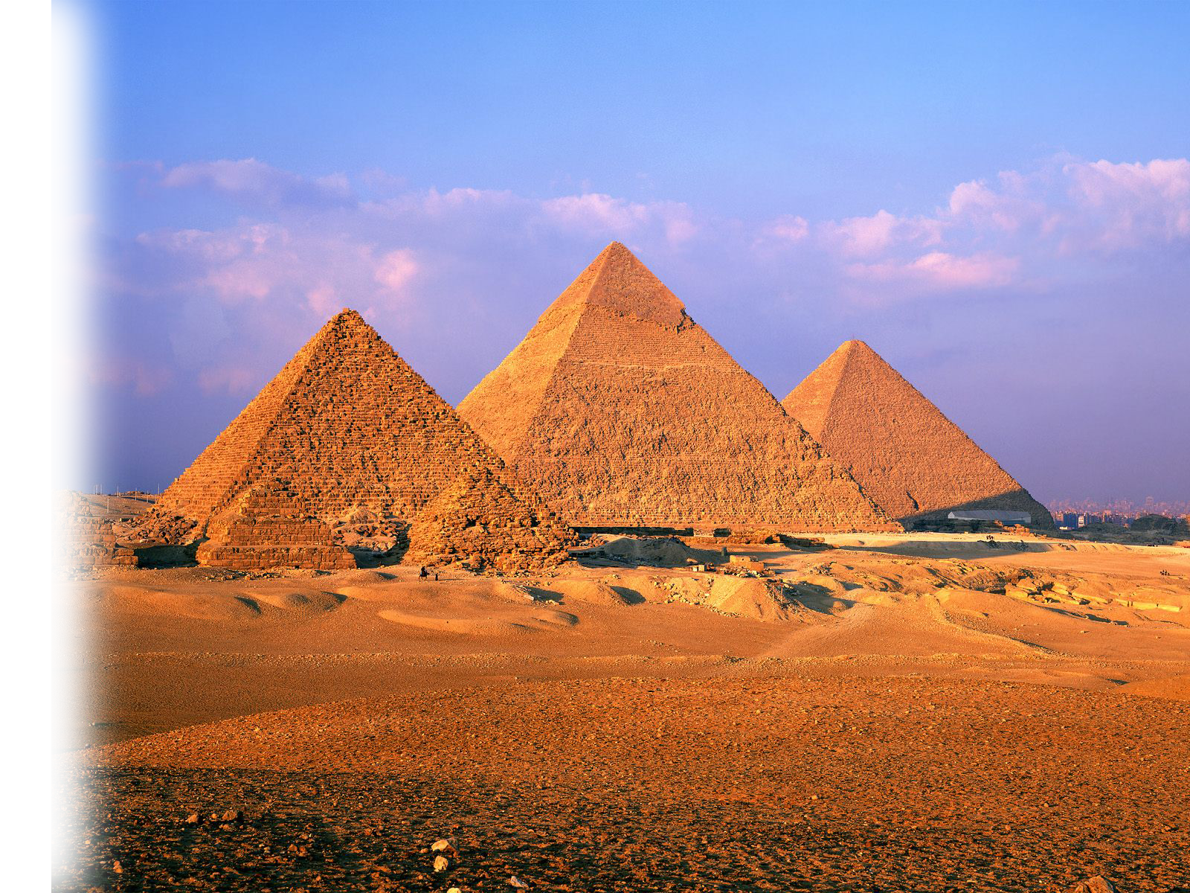
Obstinacy 4:6-13 (Plagues)
¹⁰ "I sent plagues among you as I did to Egypt.
I killed your young men with the sword, along with your captured horses. I filled your nostrils with the stench of your camps, yet you have not returned to me," declares the LORD.
Notes:
https://www.flickr.com/photos/53344659@N05/4978440899

Slide 41
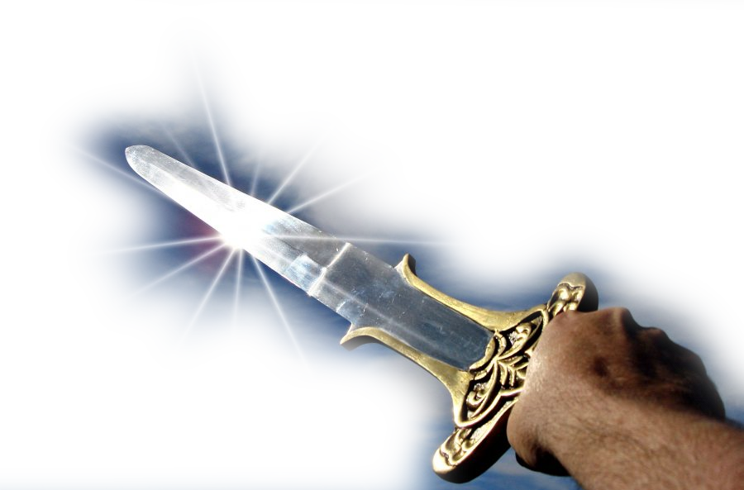
Obstinacy 4:6-13 (Warfare)
¹⁰ "I sent plagues among you as I did to Egypt.
I killed your young men with the sword, along with your captured horses. I filled your nostrils with the stench of your camps, yet you have not returned to me," declares the LORD.
Notes:
pixnio.com/miscellaneous/hand-sword

Slide 42
Obstinacy 4:6-13 (Warfare)
¹⁰ "I sent plagues among you as I did to Egypt.
I killed your young men with the sword, along with your captured horses. I filled your nostrils with the stench of your camps, yet you have not returned to me," declares the LORD.
Notes:
Five times it says, “Yet you have not returned to me”
Famine 6
Drought 7-8
Destruction 9
Sickness 10
Defeat 10b
Catastrophe 11
Ultimately 12-13

Slide 43
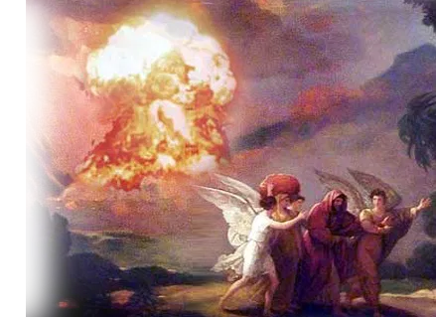
Obstinacy 4:6-13 (Catastrophe)
¹¹ "I overthrew some of you as I overthrew Sodom and Gomorrah. You were like a burning stick snatched from the fire, yet you have not returned to me," declares the LORD.
Notes:
https://i0.wp.com/www.traslacoladelarata.com/wp-content/uploads/2014/03/sodom_gomorrah_2.jpg

Slide 44
Obstinacy 4:6-13 (Catastrophe)
¹¹ "I overthrew some of you as I overthrew Sodom and Gomorrah. You were like a burning stick snatched from the fire, yet you have not returned to me," declares the LORD.
Notes:
Five times it says, “Yet you have not returned to me”
Famine 6
Drought 7-8
Destruction 9
Sickness 10
Defeat 10b
Catastrophe 11
Ultimately 12-13

Slide 45

Obstinacy 4:6-13 (Ultimately)
¹² "Therefore this is what I will do to you, Israel, and because I will do this to you, prepare to meet your God, O Israel.“
Notes:
Five times it says, “Yet you have not returned to me”
Famine 6
Drought 7-8
Destruction 9
Sickness 10
Defeat 10b
Catastrophe 11
Ultimately 12-13

Slide 46
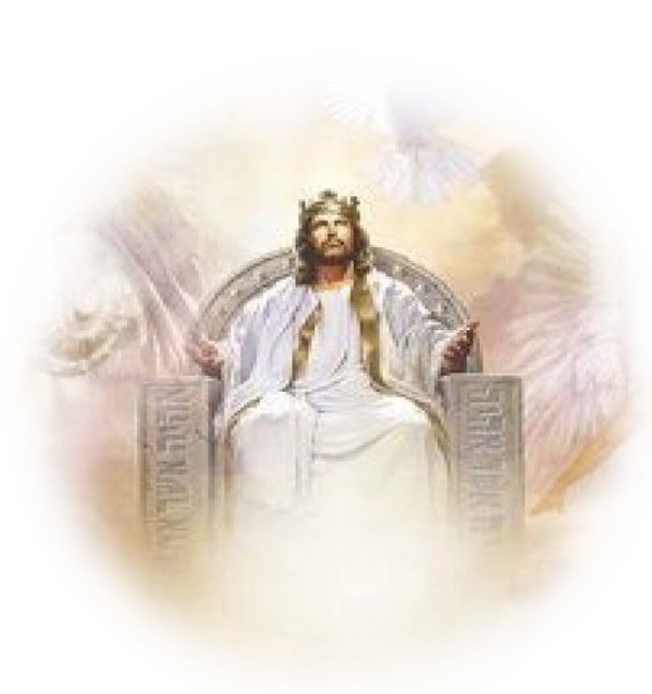
Obstinacy 4:6-13 (Ultimately)
¹² "Therefore this is what I will do to you, Israel, and because I will do this to you, prepare to meet your God, O Israel.“
Notes:
www.heirsofthefather.com/wp-content/uploads/2019/07/jesus-kingdom-767x383@2x-814x406@2x.jpg

Slide 47

Obstinacy 4:6-13 (Ultimately)
¹³ He who forms the mountains, creates the wind, and reveals his thoughts to man, he who turns dawn to darkness, and treads the high places of the earth-- the LORD God Almighty is his name.
Notes:
Five times it says, “Yet you have not returned to me”
Famine 6
Drought 7-8
Destruction 9
Sickness 10
Defeat 10b
Catastrophe 11
Ultimately 12-13

Slide 48
So, How Do You Avoid Respectable Sin?

Slide 49
1. Return to the Lord
⁶ "you have not returned to me," declares the LORD.
⁸ "you have not returned to me," declares the LORD.
⁹ "you have not returned to me," declares the LORD.
¹⁰ "you have not returned to me," declares the LORD.
¹¹ "you have not returned to me," declares the LORD.

Slide 50

2. Just Say “NO”
¹¹ For the grace of God that brings salvation has appeared to all men. ¹² It teaches us to say "No" to ungodliness and worldly passions, and to live self-controlled, upright and godly lives in this present age, (Titus 2:11-12)

Slide 51
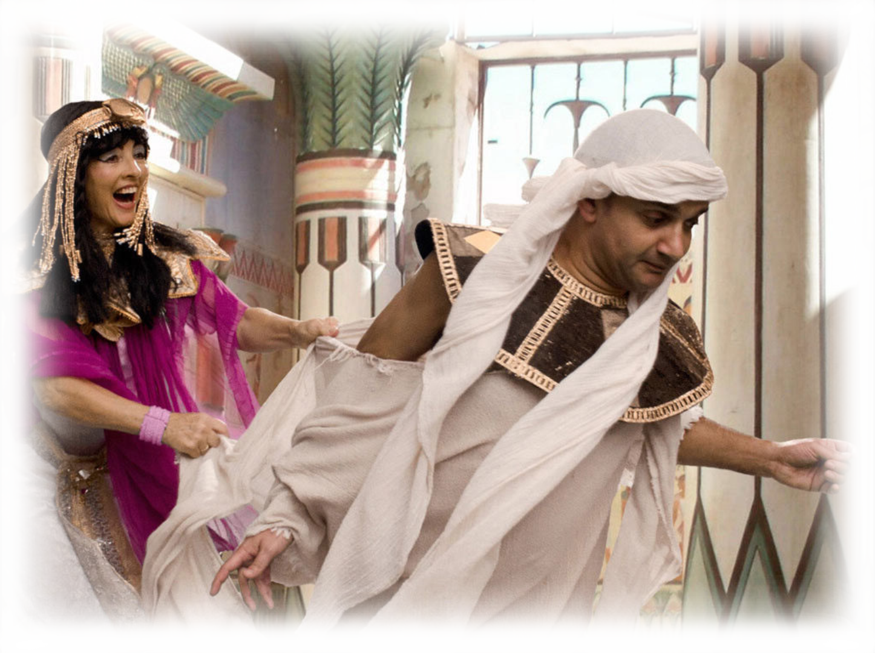
3. Flee from Respectable Sins
Flee the
evil desires of youth (2Tim. 2:22)
Notes:
Story of Joseph

Slide 52

4. Live by the Spirit
¹⁶ So I say, live by the Spirit, and you will not gratify the desires of the sinful nature. ¹⁷ For the sinful nature desires what is contrary to the Spirit, and the Spirit what is contrary to the sinful nature. They are in conflict with each other, so that you do not do what you want. (Galatians 5:16-17)

Slide 53
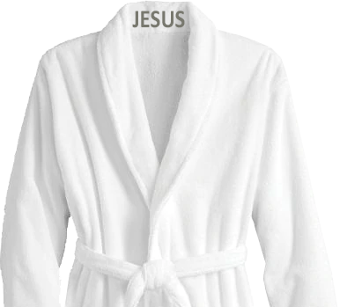
5. Put On JESUS
But put on the Lord Jesus Christ, and make no provision for the flesh, to gratify its desires. (Romans 13:14 ESV)

Slide 54

6. Renew Your Mind
¹ … offer your bodies as living sacrifices, holy and pleasing to God … ² Do not conform any longer to the pattern
of this world, but be transformed by the renewing of your mind. (Romana 12:1-2)
Notes:
pixabay.com/photos/woman-face-rays-brain-knowledge-4388764/

Slide 55
6. Renew Your Mind
… whatever is true,
whatever is noble,
whatever is right,
whatever is pure,
whatever is lovely,
whatever is admirable—
if anything is excellent or praiseworthy—
think about such things. (Philippians 4:8)

Slide 56

7. Pray for Help
¹⁶ Let us then approach the throne of grace with confidence, so that we may receive mercy and find grace to help us in our time of need. (Hebrews 4:16)

Slide 57
So, What’s the Point?
You can avoid Respectable Sins
when you return to the Lord!

Slide 58
LET’S PRAY!

