Slide 1

God is Calling!
Are you listening?
Notes:
https://commons.wikimedia.org/wiki/File:Apple-iphone-technology-blur_(23698642934).jpg
Copyright © 2006−2021. All rights reserved. Bible Point is a registered trademark of Dennis Henderson. All other trademarks acknowledged.
Bible Point contains graphics from Bible Point artists. These illustrations belong to Bible Point and the respective artists. You may use the designs and illustrations for graphical illustration of lessons free and without special permission, provided they are not used in any way that maligns the Christian faith. Furthermore, republication or production of any illustration by any other graphic service whether it be in book, in a machine-readable form, or in any other design resource is strictly prohibited. Furthermore, they cannot be duplicated or resold as any other form of publishing, clip art, or graphic resource.
So What does it mean? (A simple translations of the legal jargon)
So, if you don’t own the presentation(s), graphic(s), and text(s) how can you legally use them? The purchase of the license allows you to use all the images in the product. However, the actual ownership and copyright of the presentation(s), graphic(s), and text(s) remain the property of Bible Point and its licensors. If you had plans on using this product in your “for sale” work—think again!
License Agreement
Article 1: License Grant
All the graphics and text in Bible Point presentations (excluding quotes from the Bible and stated sources) are the intellectual and real property of Bible Point and its licensors, and is protected by law, including United States copyright laws and international treaties. Bible Point grants to you a license:
1. To use the presentation in a single church, single school, or single office of a Christian organization.
2. To make a single archival back-up copy of the program.
3. To modify the presentation(s) and merge with other presentations in a single church, school, or Christian organization.
4. To transfer to another party if that party agrees to accept the terms and conditions of this agreement, and you do not retain any copies of the presentation, whether printed, machine readable, modified, or merged form.
Article 2: Terms
This license is effective until terminated. You may terminate the license at any time by destroying the presentation(s), graphic(s), or text(s) together with all copies, modifications and merged portions in any form. Bible Point may terminate your license if you fail to comply with this Agreement. You agree, upon such termination, for any reason, to destroy the presentation(s), graphics, and text(s) with all copies, modifications, and merged portions in any form.
Article 3: Disclaimers
1. Bible Point presentations, graphics, and texts are licensed to you As Is. You, the consumer, bear the entire risk relating to the quality and performance of the presentation(s), graphic(s), or text(s). In no event will Bible Point be liable for damages resulting from any defect.
2. Thirty-day limited warrantee on disks. Bible Point warrants the disks to be free of defects in material and workmanship under normal use for 30 days after purchase. During the 30-day period you may return a defective presentation, graphic, or text with proof of purchase and it will be replaced without charge, unless the presentation is damaged by misuse.
Article 4: General
1. You may not sub-license, assign, or transfer the license of the presentation(s), graphic(s), or text(s) except as provided by this Agreement.
2. This Agreement will be governed by the laws of the State of Michigan.
So What does it mean? (A simple translations of the legal jargon)
May I let someone borrow or copy my licensed Bible Point presentation (even after I modified it)? As long as it is within your local church, or single school, or the immediate office of a Christian organization you may. Otherwise, please refer the person interested in borrowing to: http://www.biblepoint.com or E-mail: dennis@DrDH.net with any related questions.

Slide 2
God is Calling!
Are you listening?
Notes:
https://commons.wikimedia.org/wiki/File:Apple-iphone-technology-blur_(23698642934).jpg

Slide 3
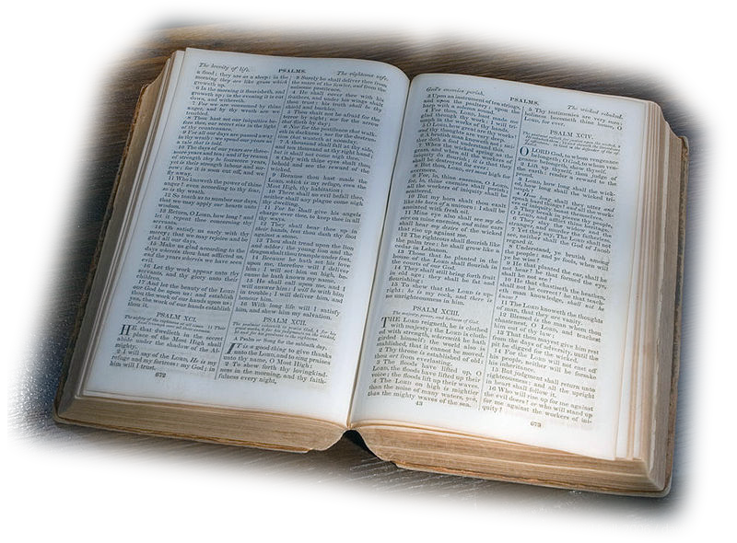
God Calls His People 3:1-2
Through His Word
¹ Hear this word the LORD has spoken against you, O people of Israel--against the whole family I brought up out of Egypt: ² "You only have I chosen of all the families of the earth; therefore I will punish you for all your sins."
Notes:
https://en.m.wikipedia.org/wiki/File:Bible-open.jpg
Amos 3:1-15 the main outline is taken from Warren Wiersbe Bible Commentary
God Called Israel 3:1-2 / God Calls His People
God Called Amos 3:3-8 / God Calls His Preachers
God Called Witnesses 3:9-10 / God Calls His Witnesses
God Called for Judgment 3:11-15 / God Calls His

Slide 4
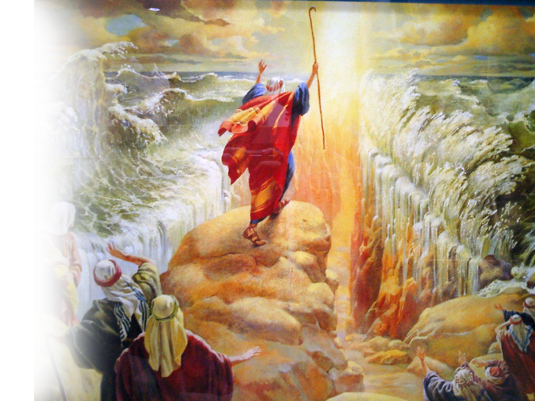
God Calls His People 3:1-2
Through His Salvation
¹ Hear this word the LORD has spoken against you, O people of Israel--against the whole family I brought up out of Egypt: ² "You only have I chosen of all the families of the earth; therefore I will punish you for all your sins."
Notes:
https://en.m.wikipedia.org/wiki/File:Bible-open.jpg
Amos 3:1-15 the main outline is taken from Warren Wiersbe Bible Commentary
God Called Israel 3:1-2
God Called Amos 3:3-8
God Called Witnesses 3:9-10
God Called for Judgment 3:11-15

Slide 5

God Calls His People 3:1-2
Through His Election
¹ Hear this word the LORD has spoken against you, O people of Israel--against the whole family I brought up out of Egypt: ² "You only have I chosen of all the families of the earth; therefore I will punish you for all your sins."
Notes:
https://en.m.wikipedia.org/wiki/File:Bible-open.jpg
Amos 3:1-15 the main outline is taken from Warren Wiersbe Bible Commentary
God Called Israel 3:1-2
God Called Amos 3:3-8
God Called Witnesses 3:9-10
God Called for Judgment 3:11-15

Slide 6
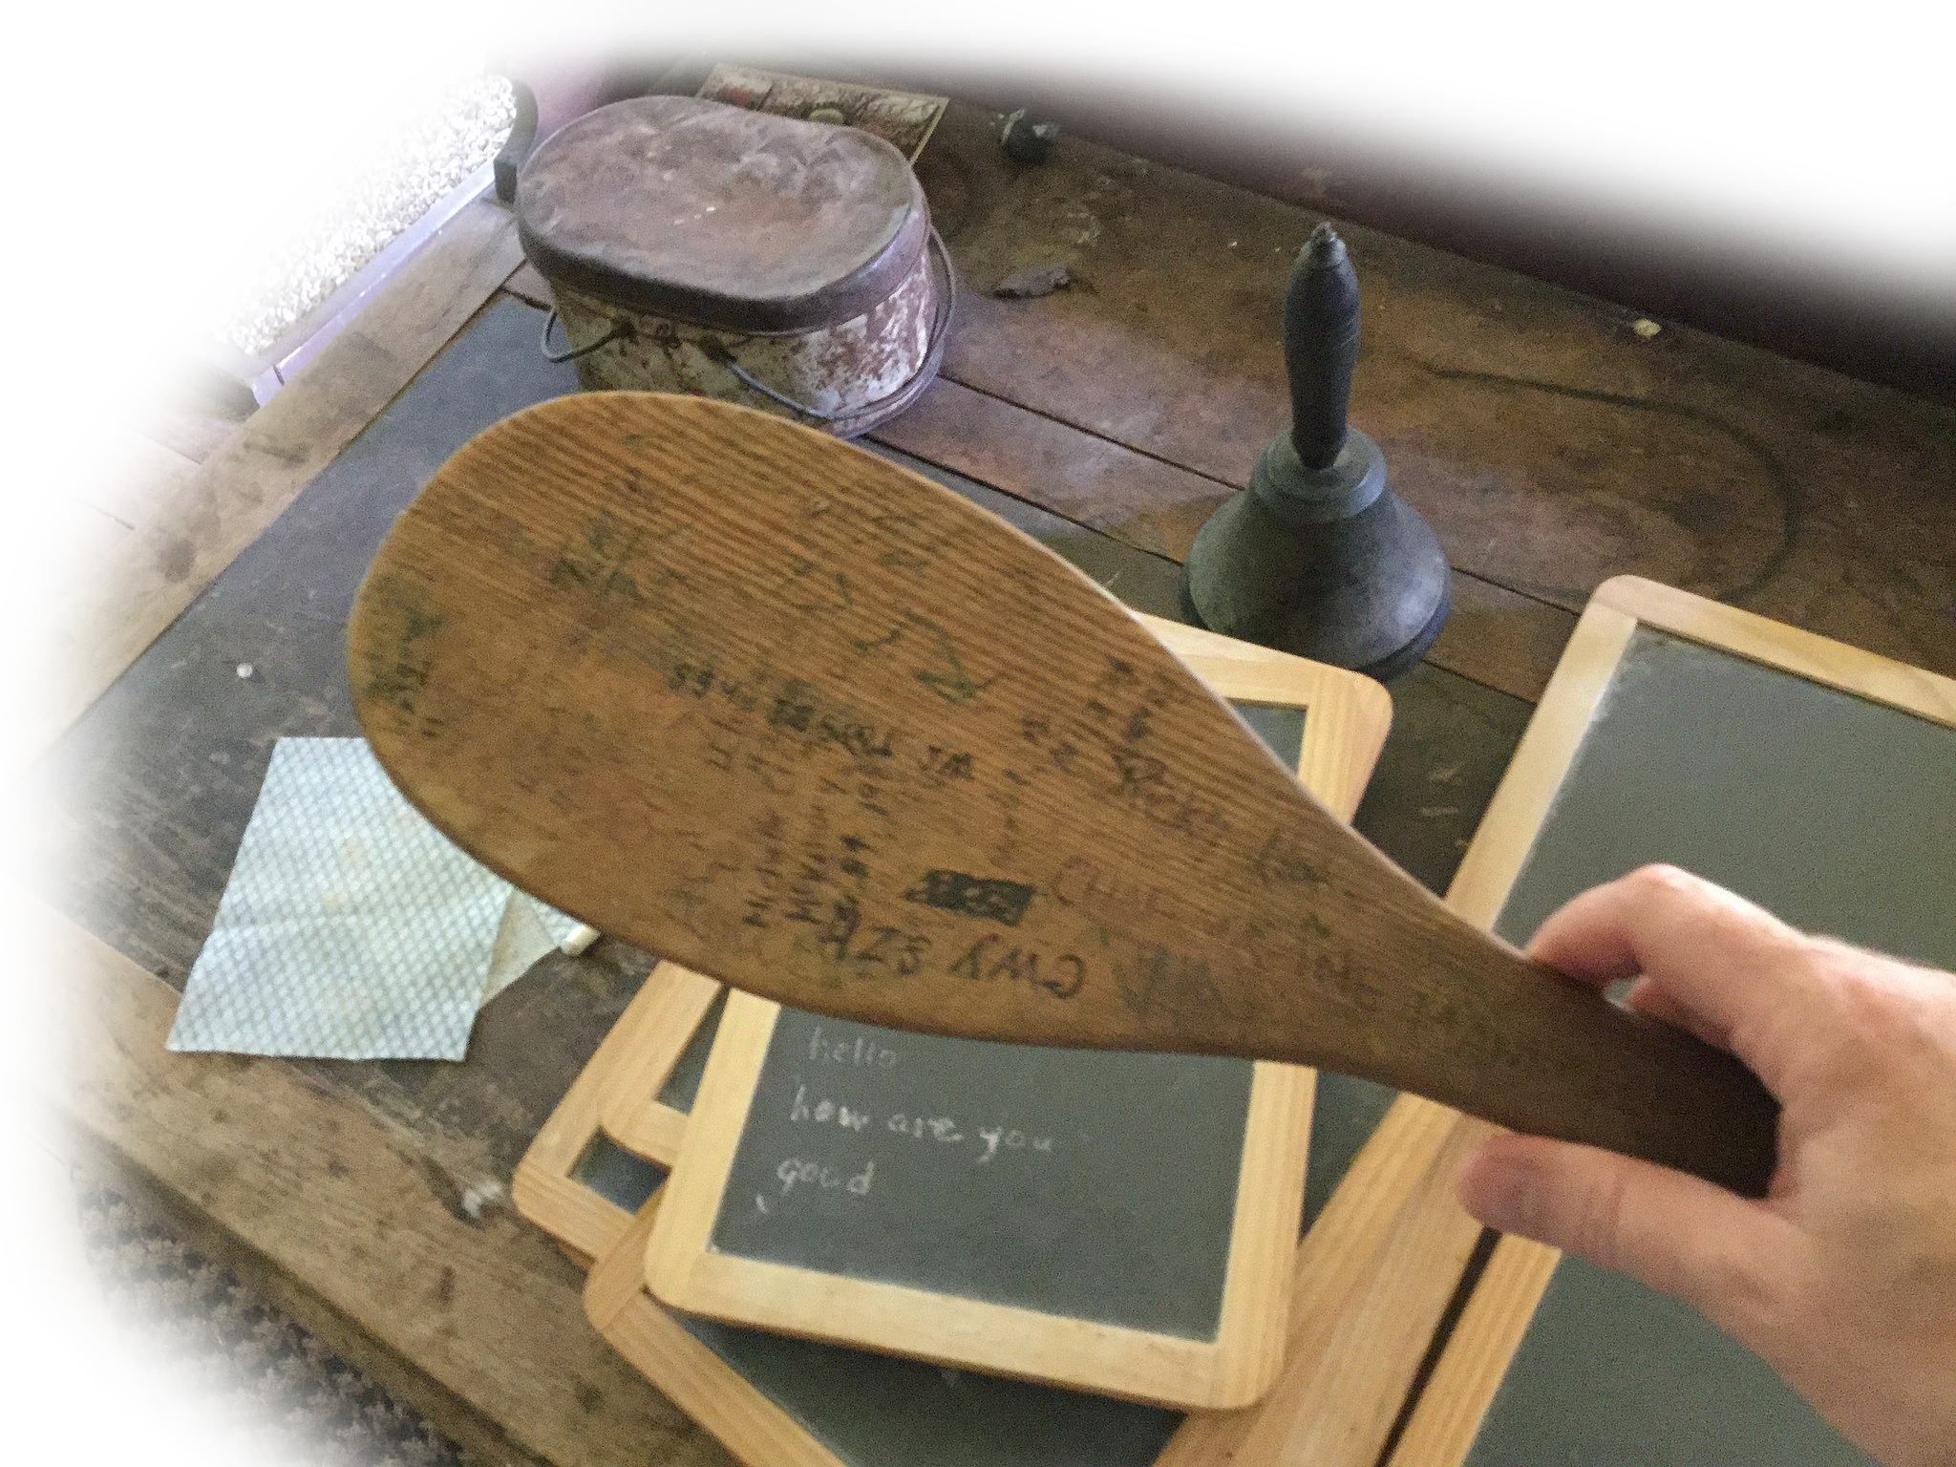
God Calls His People 3:1-2
Through His Discipline
¹ Hear this word the LORD has spoken against you, O people of Israel--against the whole family I brought up out of Egypt: ² "You only have I chosen of all the families of the earth; therefore I will punish you for all your sins."
Notes:
https://commons.wikimedia.org/wiki/File:Cherokee_Heritage_Center_-_Village_school_-_wood_paddle_with_multiple_signs_(2015-05-27_13.55.27_by_Wesley_Fryer).jpg
The word “punish” in Hebrew is “visit.” As a child when we were in need of discipline my mother would say, “You better settle down or I’m going to land on you!” Now what did “I’m going to land on you” mean? It meant with paddle in hand she was going to have that paddle make a landing on my rear!” That’s the Hebrew “I will visit you for all your “wrong activities.”
עֲוֹנֶיךָ: 231 ×: activity that is crooked or wrong: offenses
Amos 3:1-15 the main outline is taken from Warren Wiersbe Bible Commentary
God Called Israel 3:1-2
God Called Amos 3:3-8
God Called Witnesses 3:9-10
God Called for Judgment 3:11-15

Slide 7
God Calls His People 3:1-2
Through His Discipline
¹ Hear this word the LORD has spoken against you, O people of Israel--against the whole family I brought up out of Egypt: ² "You only have I chosen of all the families of the earth; therefore I will punish you for all your sins."
visit
Notes:
https://commons.wikimedia.org/wiki/File:Cherokee_Heritage_Center_-_Village_school_-_wood_paddle_with_multiple_signs_(2015-05-27_13.55.27_by_Wesley_Fryer).jpg
The word “punish” in Hebrew is “visit.” As a child when we were in need of discipline my mother would say, “You better settle down or I’m going to land on you!” Now what did “I’m going to land on you” mean? It meant with paddle in hand she was going to have that paddle make a landing on my rear!” That’s the Hebrew “I will visit you for all your “wrong activities.”
עֲוֹנֶיךָ: 231 ×: activity that is crooked or wrong: offenses
Amos 3:1-15 the main outline is taken from Warren Wiersbe Bible Commentary
God Called Israel 3:1-2
God Called Amos 3:3-8
God Called Witnesses 3:9-10
God Called for Judgment 3:11-15

Slide 8
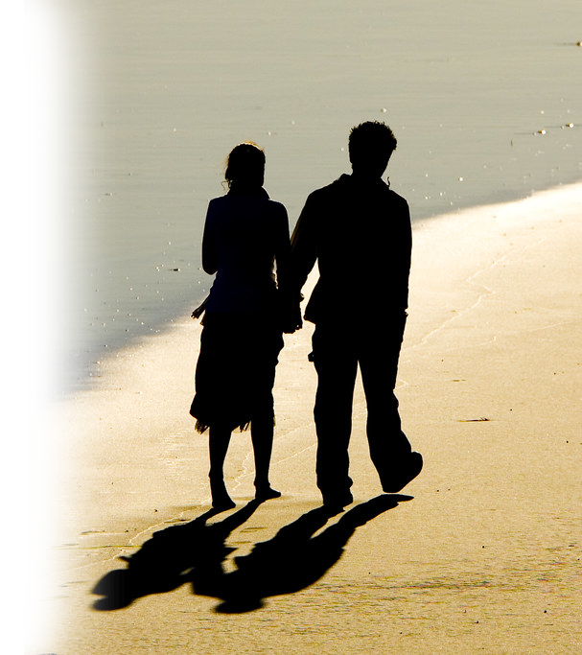
God Calls His Preacher 3:3-8
³ Do two walk together unless they have agreed to do so?
NO!

Slide 9

God Calls His Preacher 3:3-8
⁴ Does a lion roar in the thicket when he has no prey? Does he growl in his den when he has caught nothing?
NO!

Slide 10
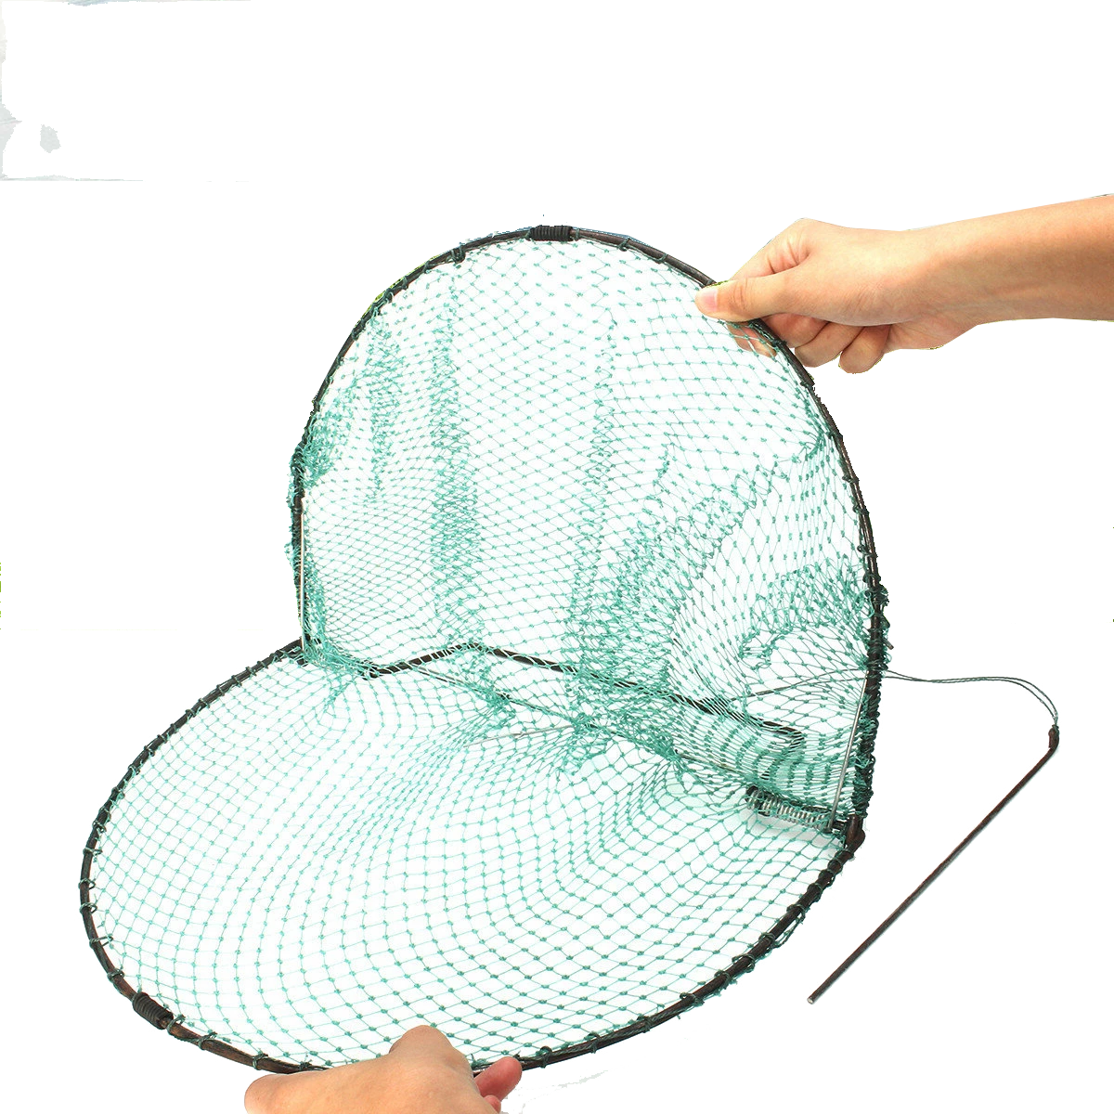
God Calls His Preacher 3:3-8
⁵ Does a bird fall into a trap on the ground where no snare has been set? Does a trap spring up from the earth when there is nothing to catch?
NO!

Slide 11
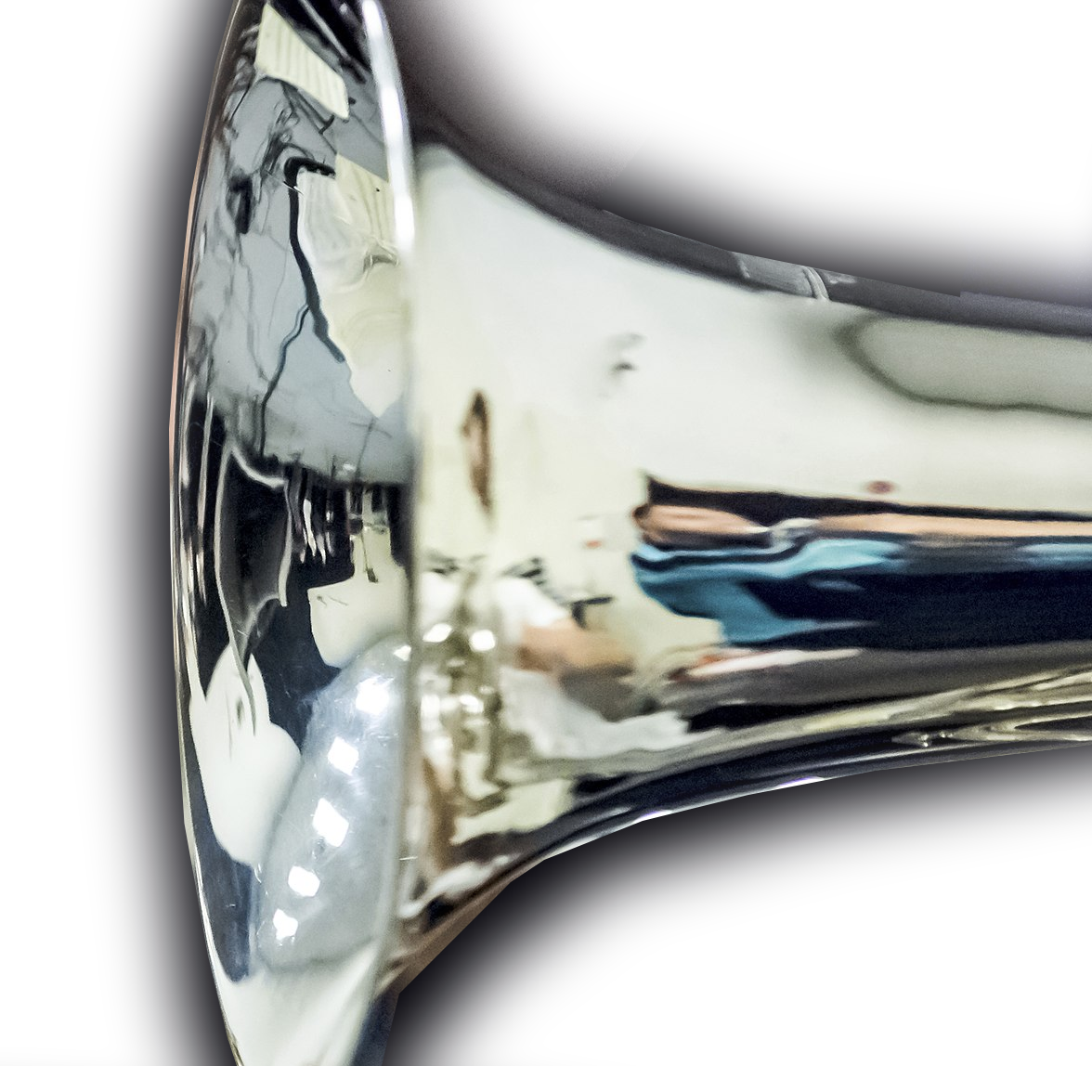
God Calls His Preacher 3:3-8
⁶ When a trumpet sounds in a city, do not the people tremble? When disaster comes to a city, has not the LORD caused it?
YES!
Notes:
https://upload.wikimedia.org/wikipedia/commons/thumb/0/04/7_Trumpets_Music_Band.jpg/2048px-7_Trumpets_Music_Band.jpg

Slide 12
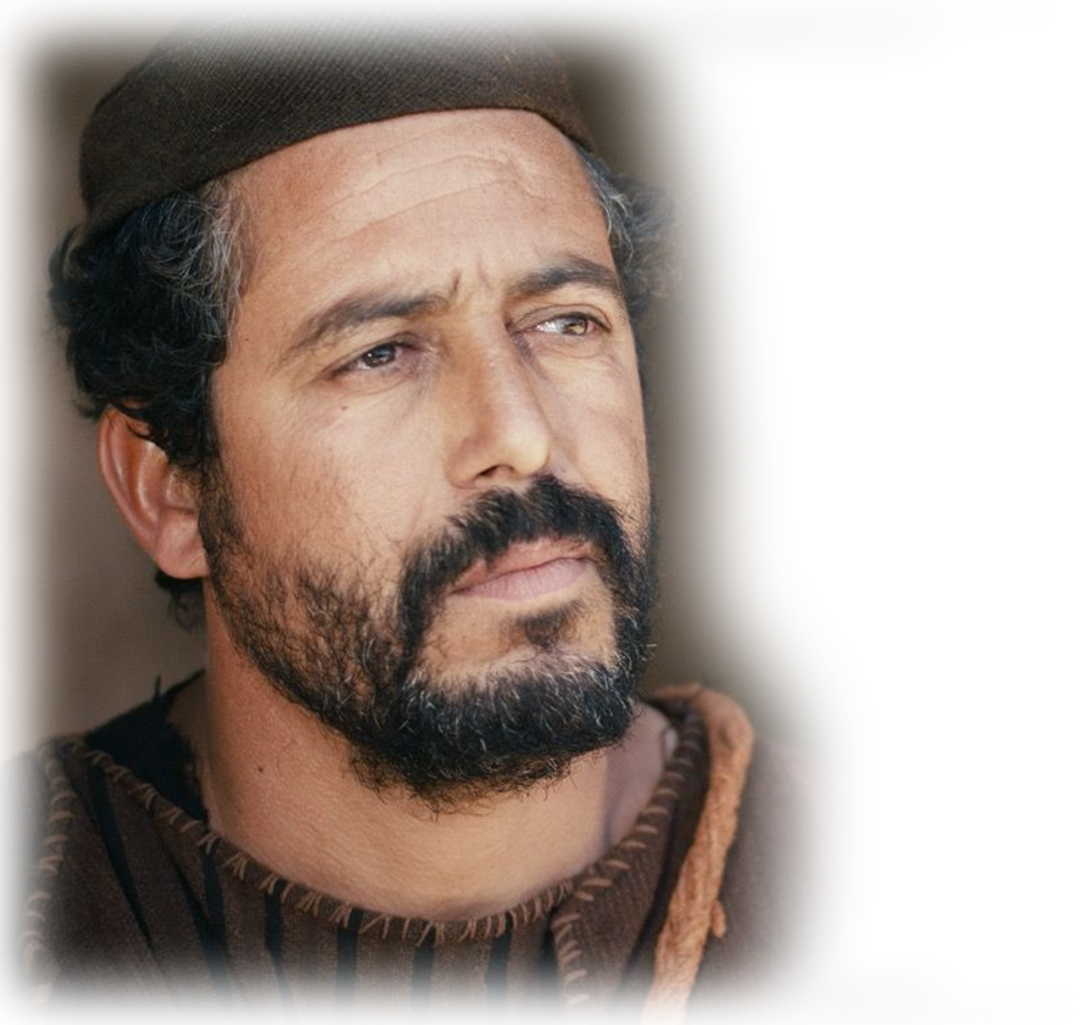
God Calls His Preacher 3:3-8
SO THEN…
⁷ Surely the Sovereign LORD does nothing without revealing his plan to his servants the prophets.
Notes:
God always give his people a “Heads Up.”
That’s why we have a Bible—that’s why you have a preacher!

Slide 13
God Calls His Preacher 3:3-8
SO THEN…
⁸ The lion has roared-- who will not fear? The Sovereign LORD has spoken-- who can but prophesy?
Notes:
The Lion Roared – Amos 1:1-2
The Soveriegn has spoken – “Thus says the Lord, three strikes and you are out—I’m pitching wrath balls!
How can I not preach what the Lord has revealed?
As a Pastor, I must preach the Word to the evils of our times—to do otherwise would be to be a false shepherd in Israel or the church.
I do believe that the Lord is roaring from heaven against all the social ills of our times:
Removed God from the Schools and have filled them with WOKE, communist, propaganda to change history.
Removed God from the birth process and teach that you assign sexuality and NOT GOD AT CONCEPTION
Removed God from thinking altogether.
The Lion will roar! We must be afraid.
God’s Word speaks! I must preach!

Slide 14
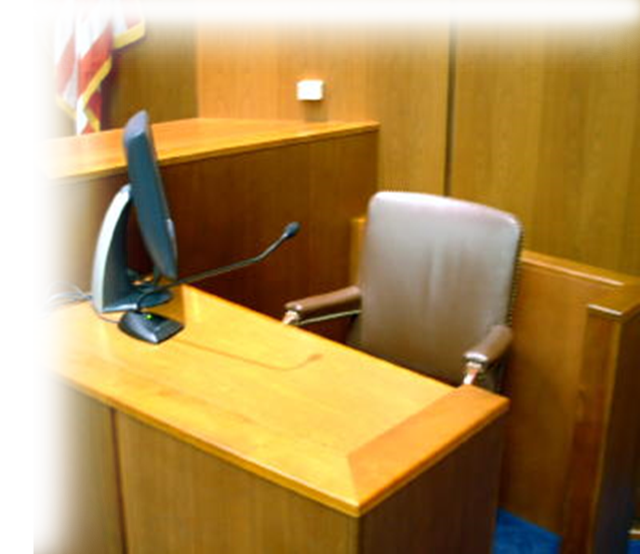
God Calls His Witnesses 3:9-10
The Witnesses SUMMONED:
⁹ Proclaim to the fortresses of Ashdod and to the fortresses of Egypt:
Notes:
Israel was to be a witness to the nations—but here God is calling the nations to be a witness of Israel. To testify against her.
They do not know how to do right.

Slide 15
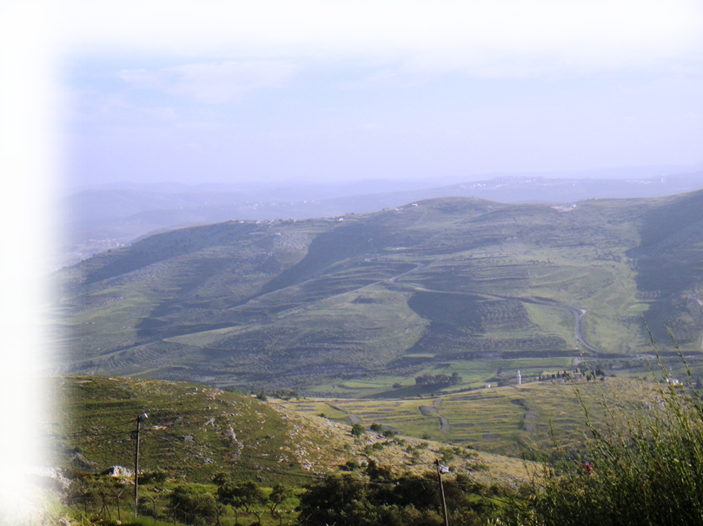
God Calls His Witnesses 3:9-10
The Witnesses’ PERSPECTIVE:
⁹ Proclaim to the fortresses of Ashdod and to the fortresses of Egypt: "Assemble yourselves on the mountains of Samaria; see the great unrest within her and the oppress-ion among her people.“ ¹⁰ "They do not know how to do right," declares the LORD, "who hoard plunder and loot in their fortresses."
Notes:
upload.wikimedia.org/wikipedia/commons/7/7c/גבעות_יצהר.JPG
Israel was to be a witness to the nations—but here God is calling the nations to be a witness of Israel. To testify against her.
They do not know how to do right.

Slide 16
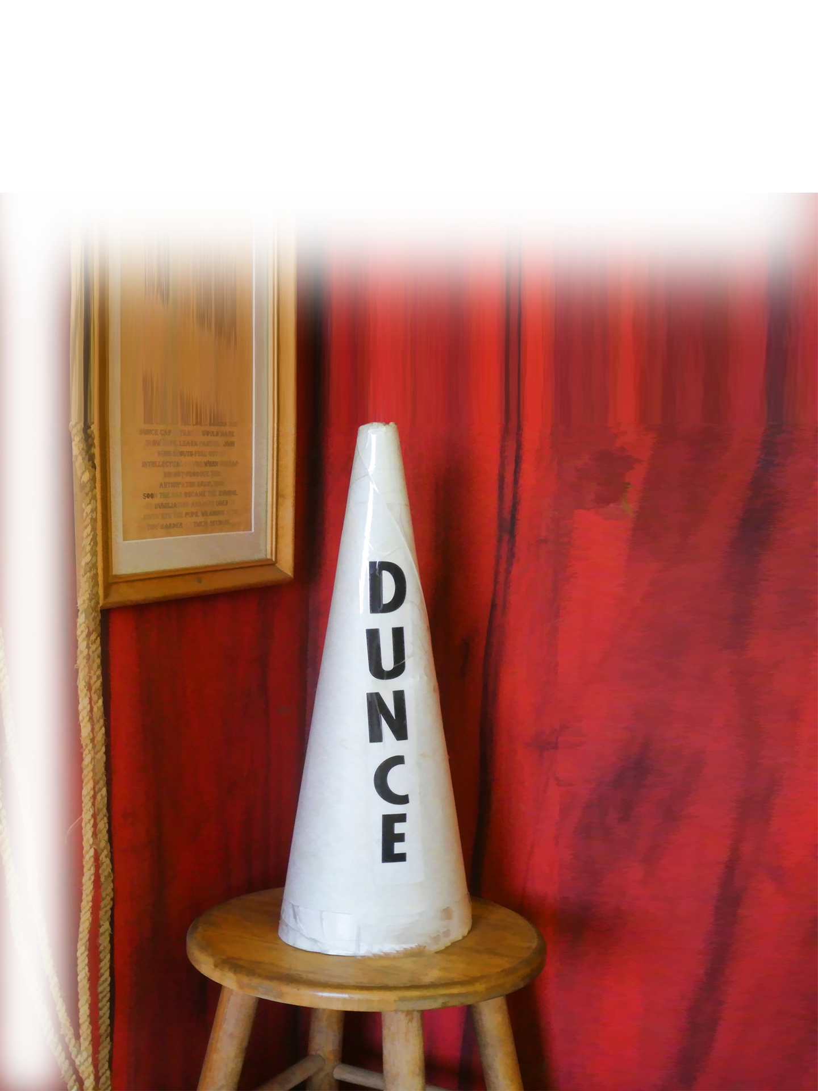
God Calls His Witnesses 3:9-10
The Witnesses of IGNORANCE:
⁹ Proclaim to the fortresses of Ashdod and to the fortresses of Egypt: "Assemble yourselves on the mountains of Samaria; see the great unrest within her and the oppress-ion among her people.“ ¹⁰ "They do not know how to do right," declares the LORD, "who hoard plunder and loot in their fortresses."
Notes:
www.publicdomainpictures.net/en/view-image.php?image=269133&picture=dunce-hat
Israel was to be a witness to the nations—but here God is calling the nations to be a witness of Israel. To testify against her.
They do not know how to do right.

Slide 17

God Calls His Witnesses 3:9-10
The Witness of GUILTINESS:
⁹ Proclaim to the fortresses of Ashdod and to the fortresses of Egypt: "Assemble yourselves on the mountains of Samaria; see the great unrest within her and the oppress-ion among her people.“ ¹⁰ "They do not know how to do right," declares the LORD, "who hoard plunder and loot in their fortresses."
Notes:
p0.pxfuel.com/preview/675/24/869/guilty-finger-suggest-interpretation.jpg
Israel was to be a witness to the nations—but here God is calling the nations to be a witness of Israel. To testify against her.
They do not know how to do right.

Slide 18
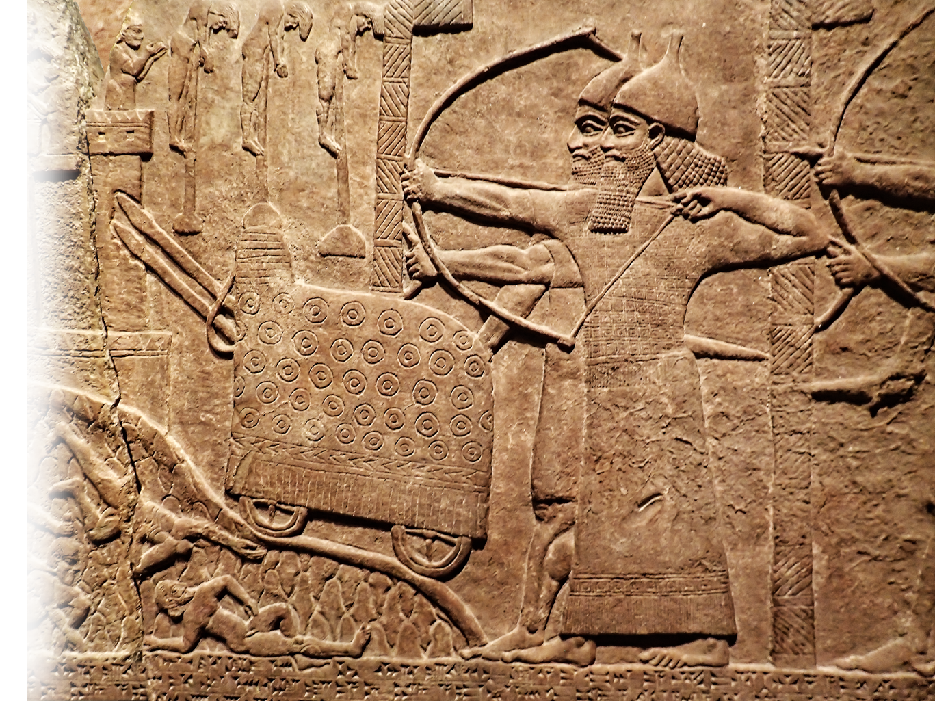
God Calls for Judgment 3:11-15
¹¹ Therefore this is what the Sovereign LORD says: "An enemy will overrun the land; he will pull down your strongholds and plunder your fortresses."
Notes:
https://en.wikipedia.org/wiki/Military_history_of_the_Neo-Assyrian_Empire#/media/File:Assyrian_relief_of_attack_on_an_enemy_town_during_the_reign_of_Tiglath-Pileser_III_720-743_BCE_from_his_palace_at_Kalhu_(Nimrud).jpg

Slide 19
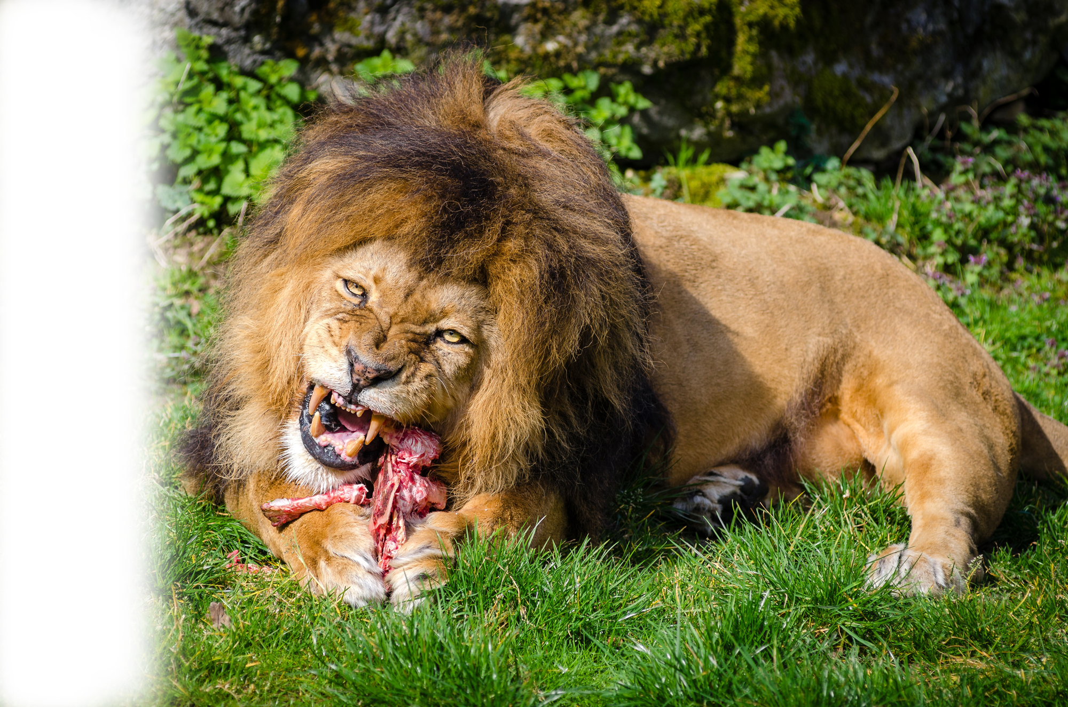
God Calls for Judgment 3:11-15
¹² This is what the LORD says: "As a shepherd saves from the lion's mouth only two leg bones or a piece of an ear, so will the Israelites be saved, those who sit in Samaria on the edge of their beds and in Damascus on their couches."
Notes:
https://en.wikipedia.org/wiki/Carnivore#/media/File:Carnivore-lion.jpg

Slide 20
God Calls for Judgment 3:11-15
¹² This is what the LORD says: "As a shepherd saves from the lion's mouth only two leg bones or a piece of an ear, so will the Israelites be saved, those who sit in Samaria on the edge of their beds and in Damascus on their couches."
Notes:
https://en.wikipedia.org/wiki/Carnivore#/media/File:Carnivore-lion.jpg

Slide 21
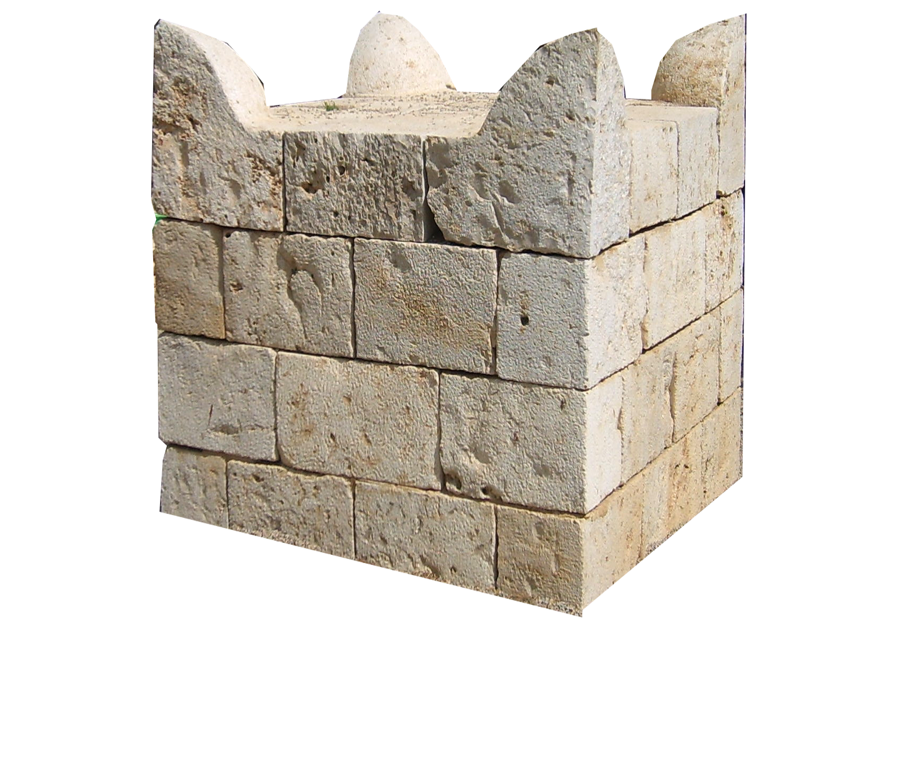
God Calls for Judgment 3:11-15
¹³ "Hear this and testify against the house of Jacob," declares the Lord, the LORD God Almighty. ¹⁴ "On the day I punish Israel for her sins, I will destroy the altars of Bethel; the horns of the altar will be cut off and fall to the ground.
Notes:
https://upload.wikimedia.org/wikipedia/commons/7/71/Tel_Be%27er_Sheva_Altar_2007041.JPG

Slide 22
God Calls for Judgment 3:11-15
¹³ "Hear this and testify against the house of Jacob," declares the Lord, the LORD God Almighty. ¹⁴ "On the day I punish Israel for her sins, I will destroy the altars of Bethel; the horns of the altar will be cut off and fall to the ground.
visit
Notes:
https://upload.wikimedia.org/wikipedia/commons/7/71/Tel_Be%27er_Sheva_Altar_2007041.JPG

Slide 23
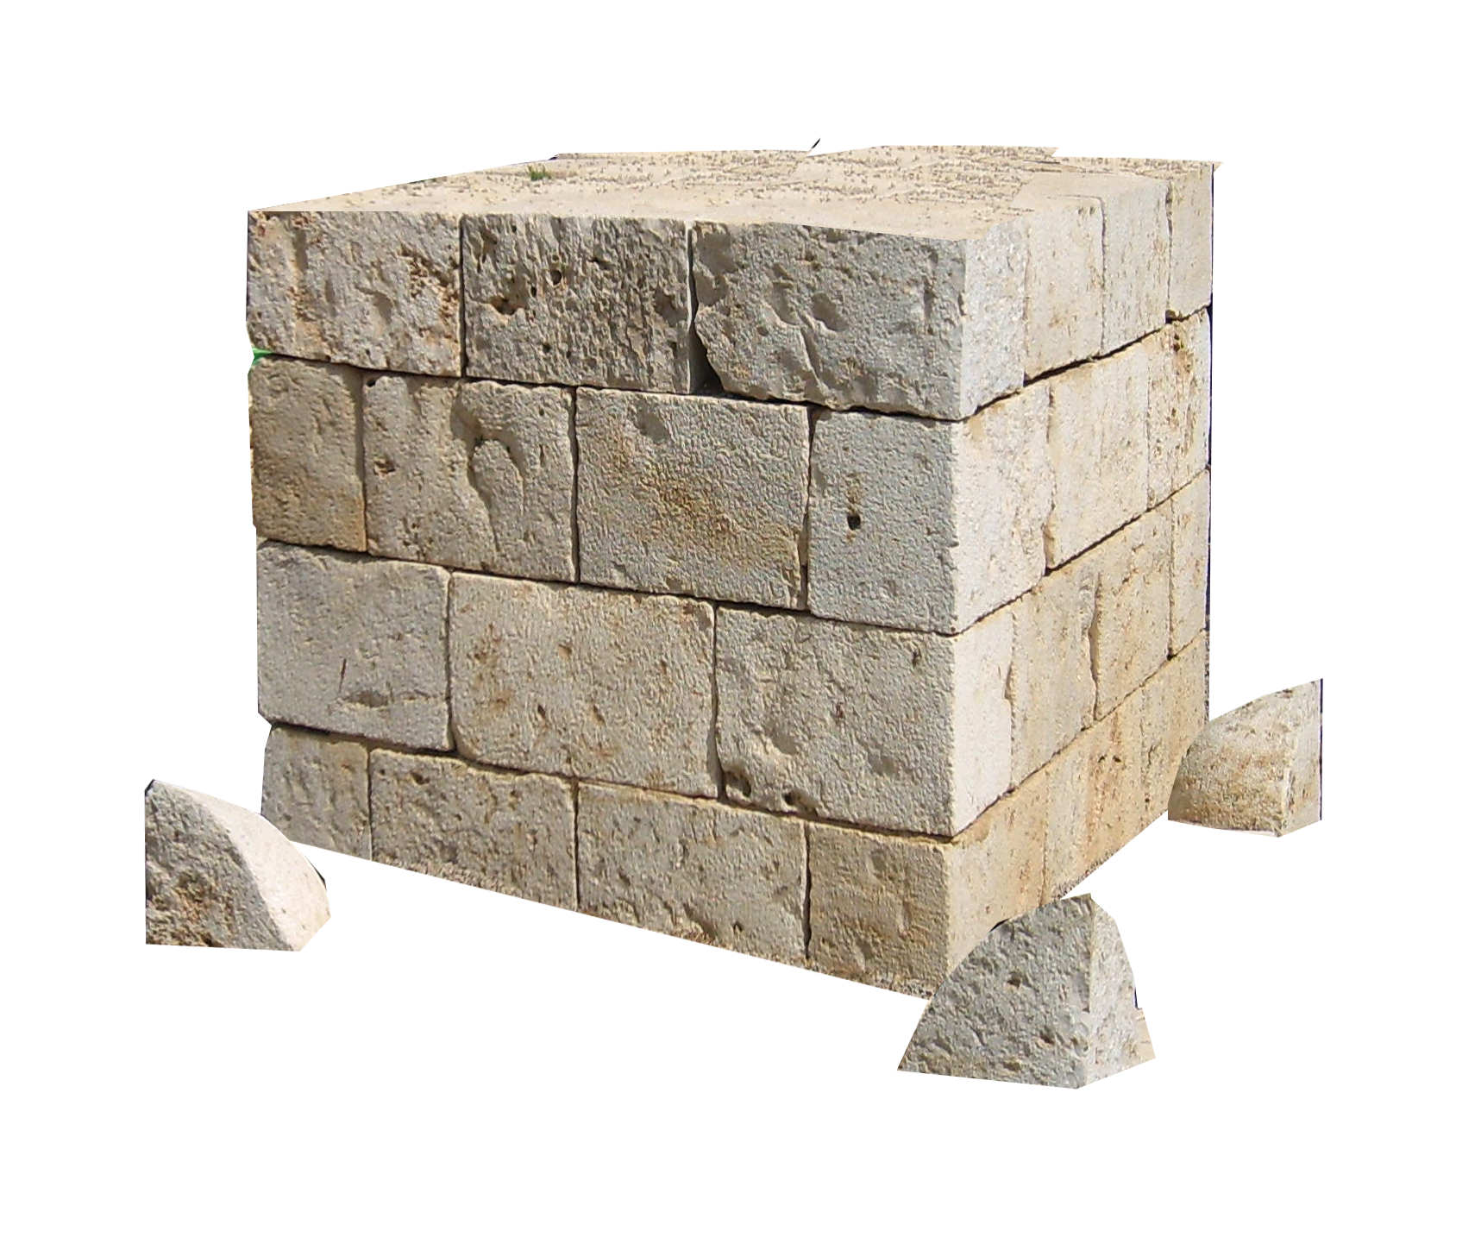
God Calls for Judgment 3:11-15
¹³ "Hear this and testify against the house of Jacob," declares the Lord, the LORD God Almighty. ¹⁴ "On the day I punish Israel for her sins, I will destroy the altars of Bethel; the horns of the altar will be cut off and fall to the ground.
Notes:
https://upload.wikimedia.org/wikipedia/commons/7/71/Tel_Be%27er_Sheva_Altar_2007041.JPG

Slide 24
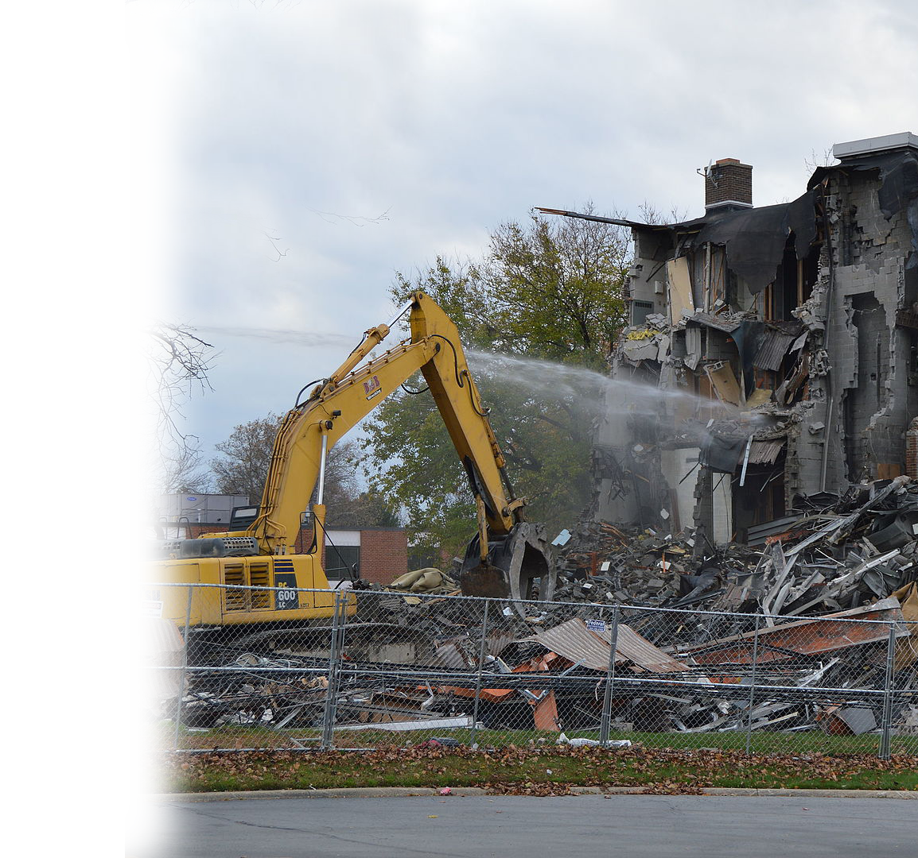
God Calls for Judgment 3:11-15
¹⁵ I will tear down the winter house along with the summer house; the houses adorned with ivory will be destroyed and the mansions will be demolished," declares the LORD.
Notes:
https://en.wikipedia.org/wiki/Dust_abatement#/media/File:Painesville_building_demolition.jpg

Slide 25
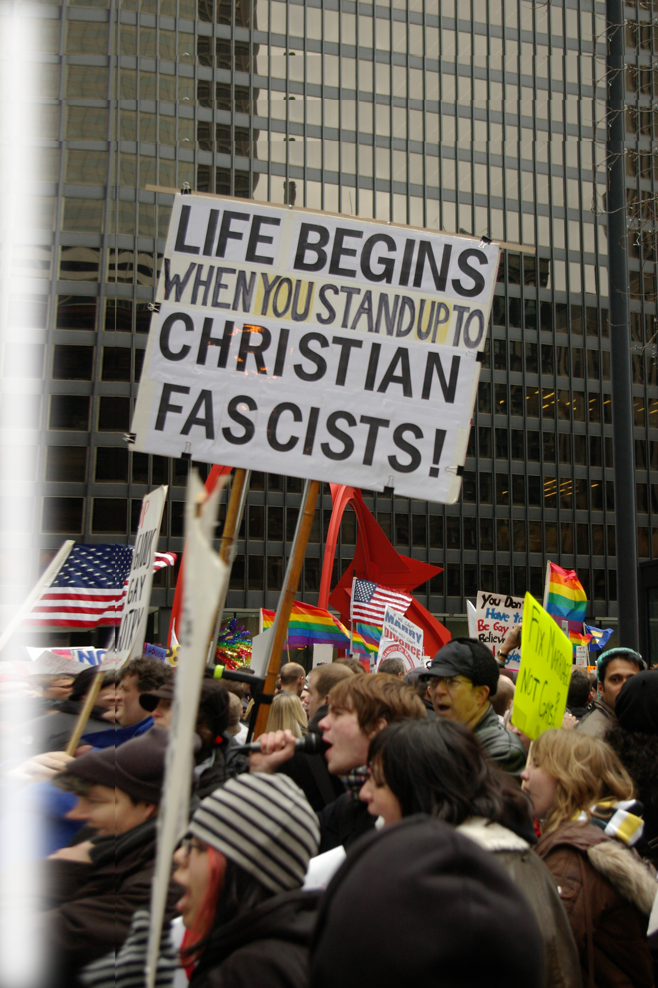
God Calls for Judgment 3:11-15
^{1 Peter 4:16} However, if you suffer as a Christian, do not be ashamed, but praise God that you bear that name.
¹⁷ For it is time for judgment to begin with the family of God; and if it begins with us, what will the outcome be for those who do not obey the gospel of God?
Notes:
https://upload.wikimedia.org/wikipedia/commons/6/6c/Anti-Christian_sign_in_Federal_Plaza_Chicago.jpg

Slide 26
God Called for Judgment 3:11-15
^{1 Peter 4:16} However, if you suffer as a Christian, do not be ashamed, but praise God that you bear that name.
¹⁷ For it is time for judgment to begin with the family of God; and if it begins with us, what will the outcome be for those who do not obey the gospel of God?
Notes:
https://upload.wikimedia.org/wikipedia/commons/6/6c/Anti-Christian_sign_in_Federal_Plaza_Chicago.jpg

Slide 27
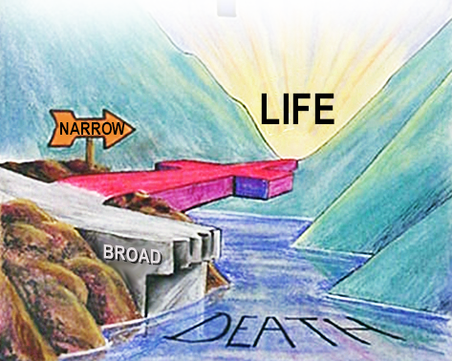
God Called for Judgment 3:11-15
¹⁸ And, "If it is hard for the righteous to be saved, what will become of the ungodly and the sinner?"
Notes:
How hard? So hard that you cannot save yourself! You have to have Jesus save you.
Because if you don’t …. You have no hope at all.
Narrow and broad gate and road
¹³ "Enter through the narrow gate. For wide is the gate and broad is the road that leads to destruction, and many enter through it.
¹⁴ But small is the gate and narrow the road that leads to life, and only a few find it.
(Mat 7:13-14 NIV)

Slide 28
God Called for Judgment 3:11-15
¹⁸ And, "If it is hard for the righteous to be saved, what will become of the ungodly and the sinner?"
Notes:
Narrow and broad gate and road
¹³ "Enter through the narrow gate. For wide is the gate and broad is the road that leads to destruction, and many enter through it.
¹⁴ But small is the gate and narrow the road that leads to life, and only a few find it.
(Mat 7:13-14 NIV)

Slide 29
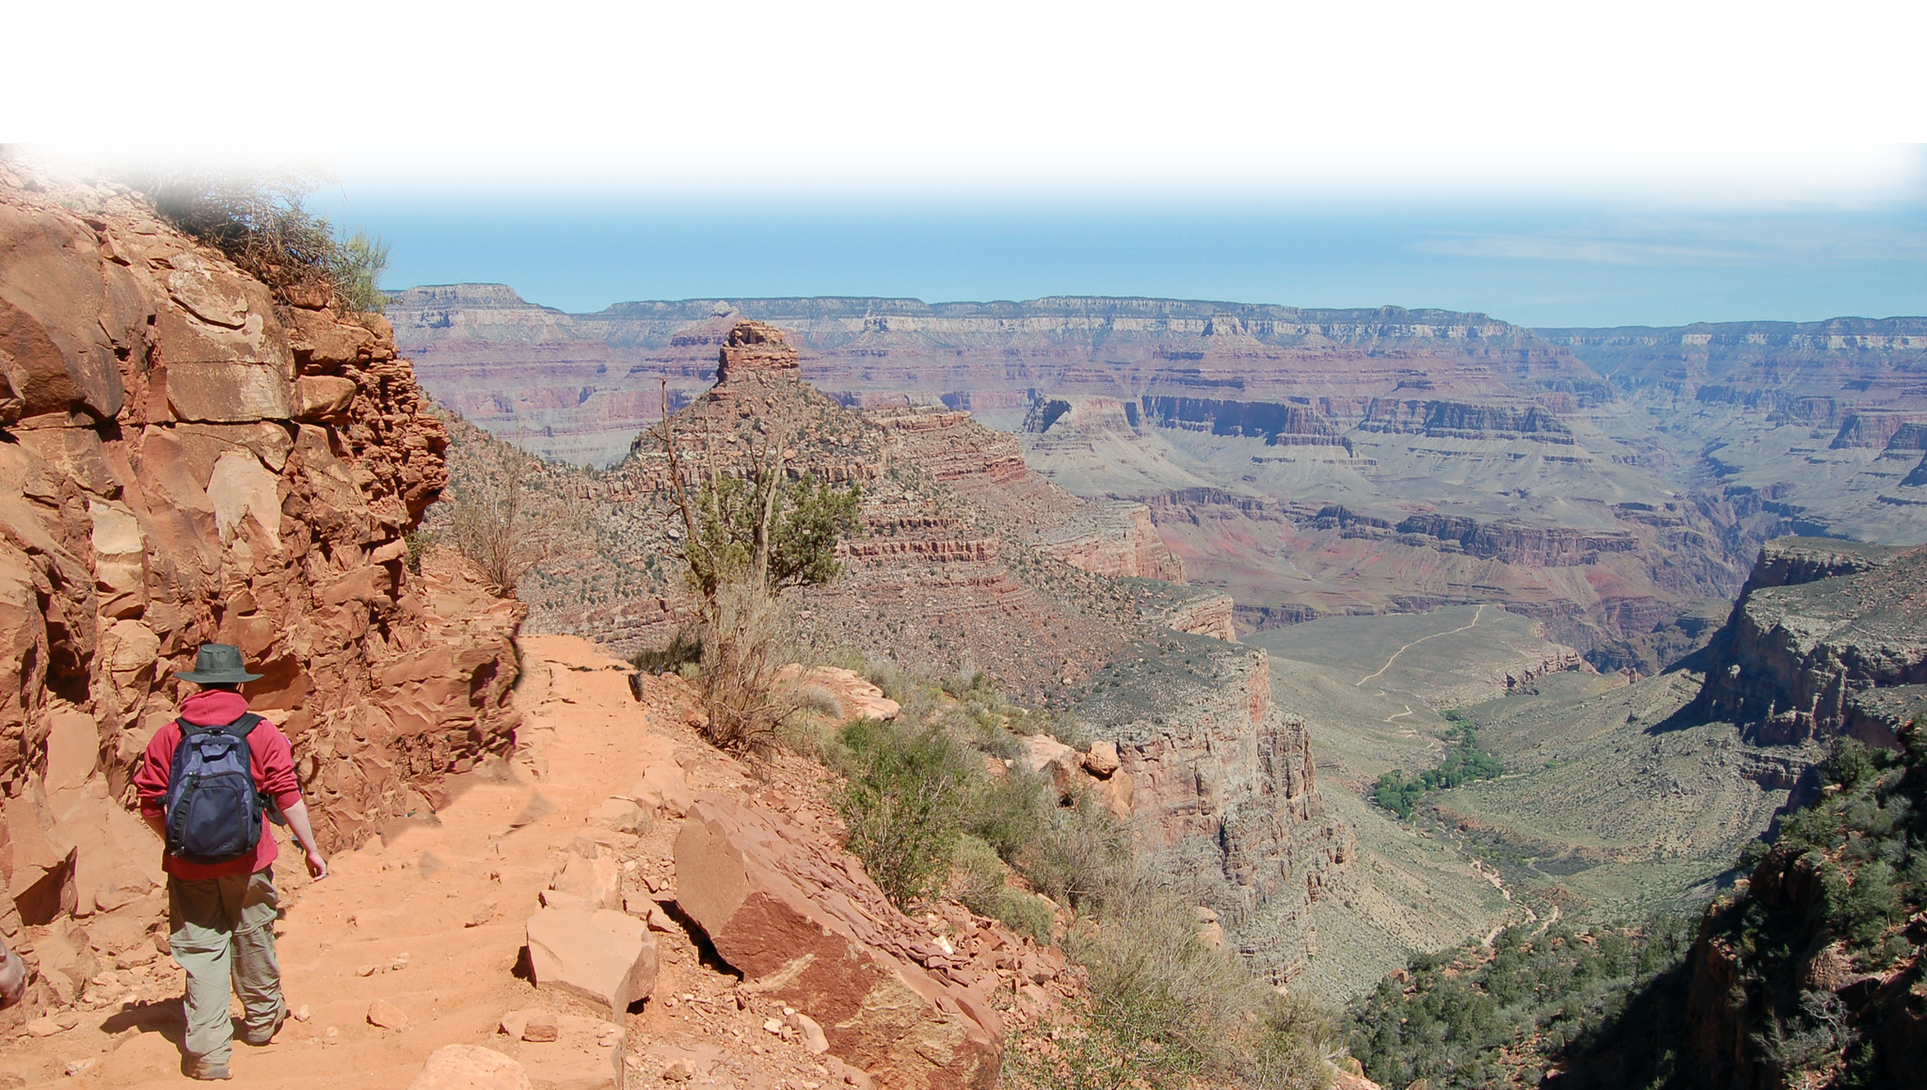
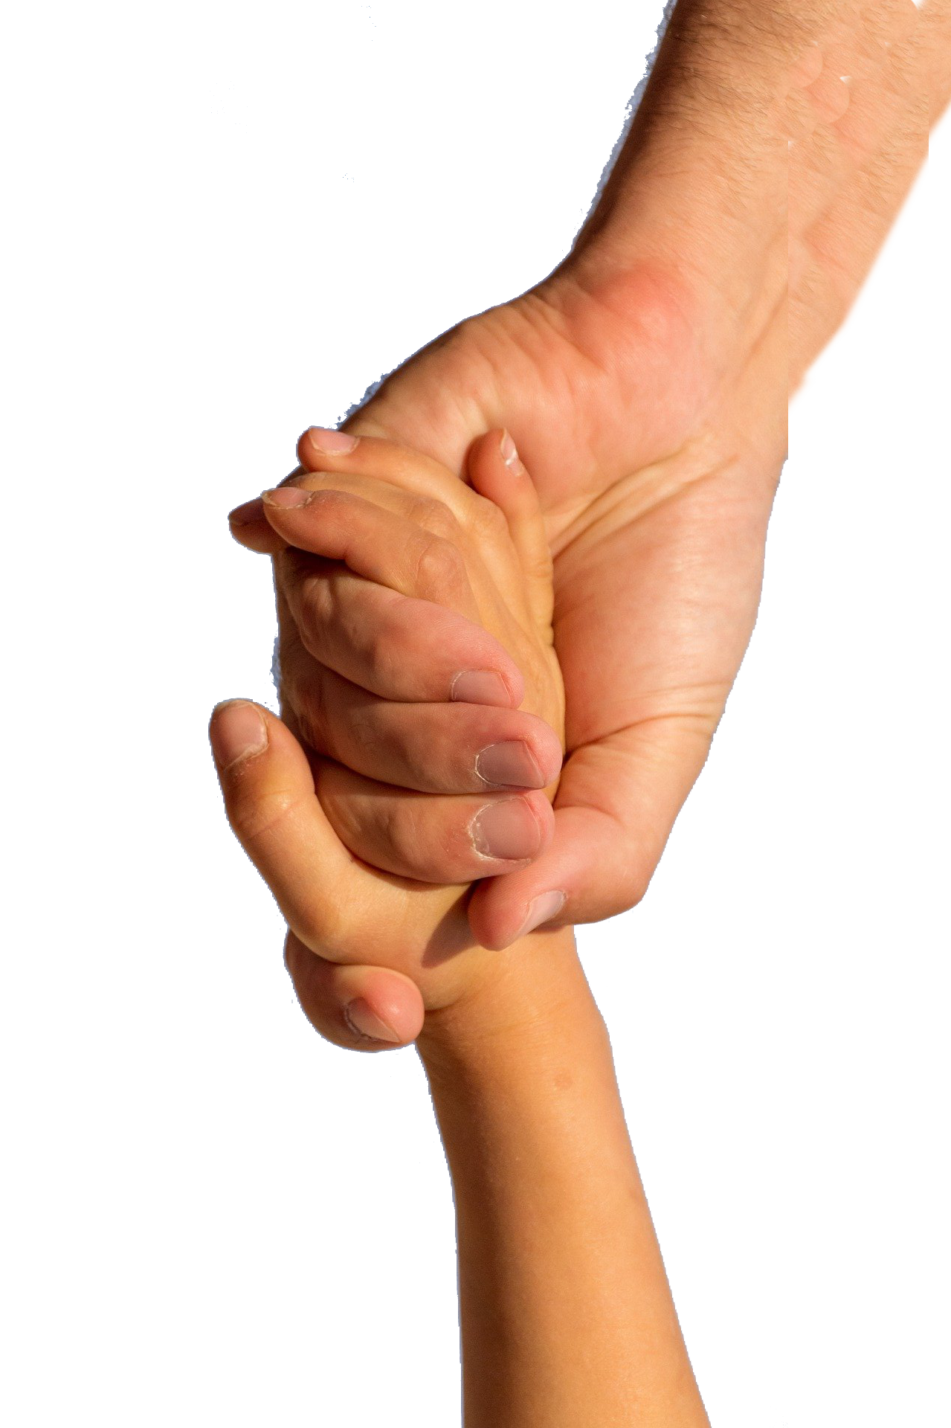
God Called for Judgment 3:11-15
¹⁹ So then, those who suffer according to God's will should commit themselves to their faithful Creator and continue to do good.
Notes:
pixabay.com/photos/assist-assistance-blue-care-child-4582129/
Commit … https://www.flickr.com/photos/grand_canyon_nps/5446827686
A man was walking on a pitch black night when he fell over a cliff. On the way down, he managed to grab hold of a small tree sprouting out of the side of the precipice. Desperately he began to call out for help and a voice answered, "What do you want?" "I'm stuck down here holding on to a tree." he replied. "I can't hold on too much longer. Can you help me?" "Yes," came the reply. "Who are you ?" the man asked. "I'm God," replied the voice. "What do you want me to do?" asked the man. "Let go of the tree." For a while there was silence. Then the man called out and said, "Is there anyone else up there?“
That’s the person on the broad path. They don’t let go and trust God!
They don’t trust His faithfulness
But we who are on the narrow road, that led to the entrance of the cross. When God calls on us to let go of ourselves – we do so!
That’s called faith as in a commitment.
Narrow and broad gate and road
¹³ "Enter through the narrow gate. For wide is the gate and broad is the road that leads to destruction, and many enter through it.
¹⁴ But small is the gate and narrow the road that leads to life, and only a few find it.
(Mat 7:13-14 NIV)

Slide 30
That’s the point of Amos!
God is CALLING through His Word.
Are you listening? Or looking for another?
Are you listening to His preacher?
Are you listening to the Witnesses?
Are you listening to His Judgments?
Are you listening to His Salvation?
God is calling today! Are you listening?
Notes:
Listen to His JUDGMENTS: Look what has happened to every socialist country!

