Slide 1
Three Strikes and You’re Out!
Amos 1:3-2:16
Notes:
Background = https://c.pxhere.com/photos/5b/10/Baseball_Closeup_Old_Vintage-1612420.jpg!d
Copyright © 2006−2021. All rights reserved. Bible Point is a registered trademark of Dennis Henderson. All other trademarks acknowledged.
Bible Point contains graphics from Bible Point artists. These illustrations belong to Bible Point and the respective artists. You may use the designs and illustrations for graphical illustration of lessons free and without special permission, provided they are not used in any way that maligns the Christian faith. Furthermore, republication or production of any illustration by any other graphic service whether it be in book, in a machine-readable form, or in any other design resource is strictly prohibited. Furthermore, they cannot be duplicated or resold as any other form of publishing, clip art, or graphic resource.
So What does it mean? (A simple translations of the legal jargon)
So, if you don’t own the presentation(s), graphic(s), and text(s) how can you legally use them? The purchase of the license allows you to use all the images in the product. However, the actual ownership and copyright of the presentation(s), graphic(s), and text(s) remain the property of Bible Point and its licensors. If you had plans on using this product in your “for sale” work—think again!
License Agreement
Article 1: License Grant
All the graphics and text in Bible Point presentations (excluding quotes from the Bible and stated sources) are the intellectual and real property of Bible Point and its licensors, and is protected by law, including United States copyright laws and international treaties. Bible Point grants to you a license:
1. To use the presentation in a single church, single school, or single office of a Christian organization.
2. To make a single archival back-up copy of the program.
3. To modify the presentation(s) and merge with other presentations in a single church, school, or Christian organization.
4. To transfer to another party if that party agrees to accept the terms and conditions of this agreement, and you do not retain any copies of the presentation, whether printed, machine readable, modified, or merged form.
Article 2: Terms
This license is effective until terminated. You may terminate the license at any time by destroying the presentation(s), graphic(s), or text(s) together with all copies, modifications and merged portions in any form. Bible Point may terminate your license if you fail to comply with this Agreement. You agree, upon such termination, for any reason, to destroy the presentation(s), graphics, and text(s) with all copies, modifications, and merged portions in any form.
Article 3: Disclaimers
1. Bible Point presentations, graphics, and texts are licensed to you As Is. You, the consumer, bear the entire risk relating to the quality and performance of the presentation(s), graphic(s), or text(s). In no event will Bible Point be liable for damages resulting from any defect.
2. Thirty-day limited warrantee on disks. Bible Point warrants the disks to be free of defects in material and workmanship under normal use for 30 days after purchase. During the 30-day period you may return a defective presentation, graphic, or text with proof of purchase and it will be replaced without charge, unless the presentation is damaged by misuse.
Article 4: General
1. You may not sub-license, assign, or transfer the license of the presentation(s), graphic(s), or text(s) except as provided by this Agreement.
2. This Agreement will be governed by the laws of the State of Michigan.
So What does it mean? (A simple translations of the legal jargon)
May I let someone borrow or copy my licensed Bible Point presentation (even after I modified it)? As long as it is within your local church, or single school, or the immediate office of a Christian organization you may. Otherwise, please refer the person interested in borrowing to: http://www.biblepoint.com or E-mail: dennis@DrDH.net with any related questions.

Slide 2
Before Baseball, the Expression was:
For three sins, even for four …
and I will judge you.

Slide 3
In a ball game you know …
Who’s on the mound: The Pitcher
Who’s at the plate: The Batter
What kind of pitch: Chooses a pitch to throw
Why that kind? Because Batters have Weakness
What is the call: Strikes & Outs – Balls & Walks
Notes:
Rules = Because “high, low, outside or inside”

Slide 4
In a ball game you know …
Who’s on the mound: “This is what the Lord says”
Who’s at the plate: “of (name) …”
What kind of pitch: “I will not turn back my wrath”
Why that kind? “Because ______________ …
What is the call: “I will send fire” or “I will destroy”
Notes:
Rules = Because “high, low, outside or inside”

Slide 5
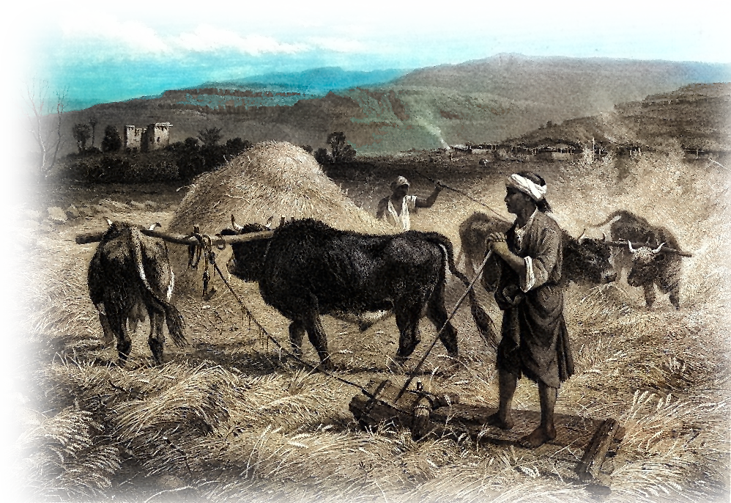
The First Batter: Damascus
Mound: “This is what the Lord says”
Plate: “For three sins of Damascus even for four”
Pitch: “I will not turn back my wrath”
Why? “Because …
she threshed Gilead with
sledges having iron teeth”
Notes:
http://upload.wikimedia.org/wikipedia/commons/6/6d/Threshing-sledge.png
³ This is what the LORD says: "For three sins of Damascus, even for four, I will not turn back my wrath. Because she threshed Gilead with sledges having iron teeth,
⁴ I will send fire upon the house of Hazael that will consume the fortresses of Ben-Hadad.
⁵ I will break down the gate of Damascus; I will destroy the king who is in the Valley of Aven and the one who holds the scepter in Beth Eden. The people of Aram will go into exile to Kir," says the LORD.
(Amo 1:3-5 NIV)

Slide 6
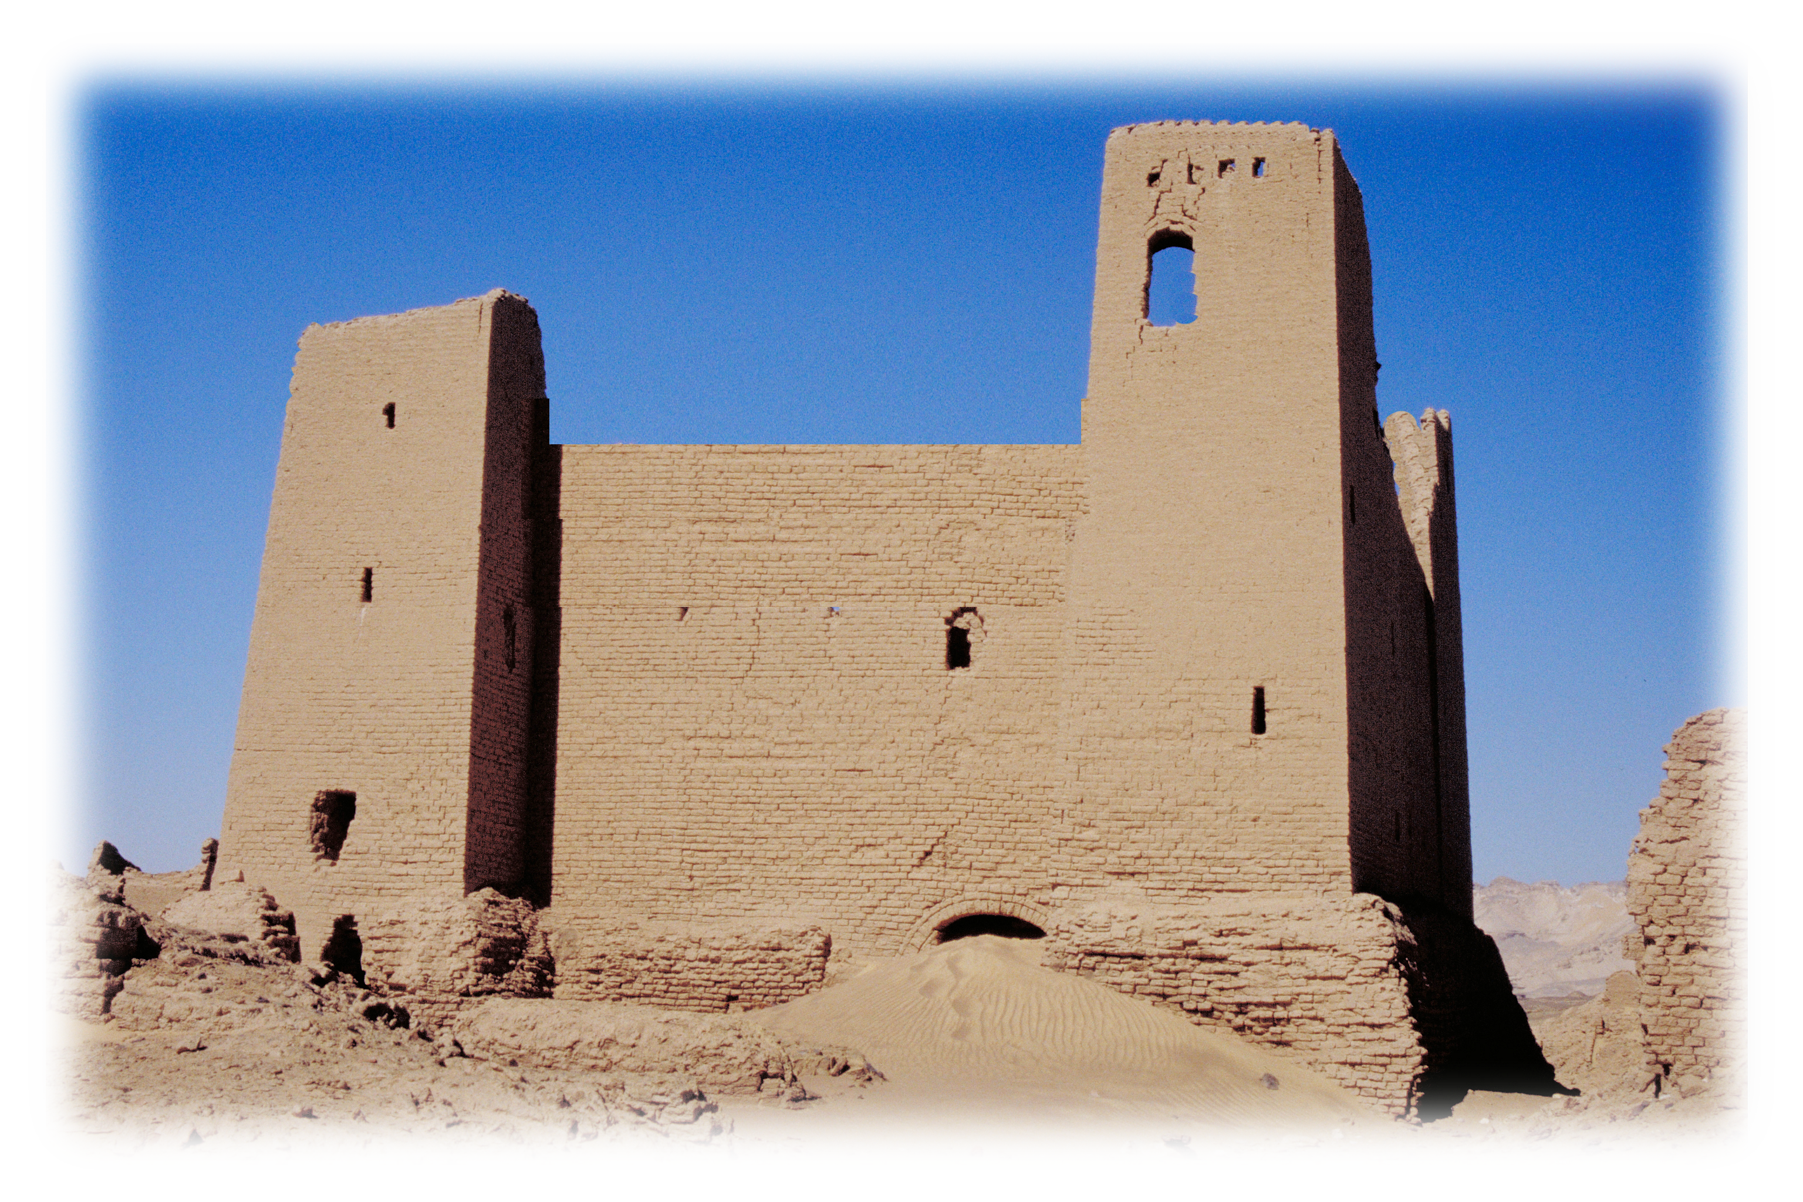
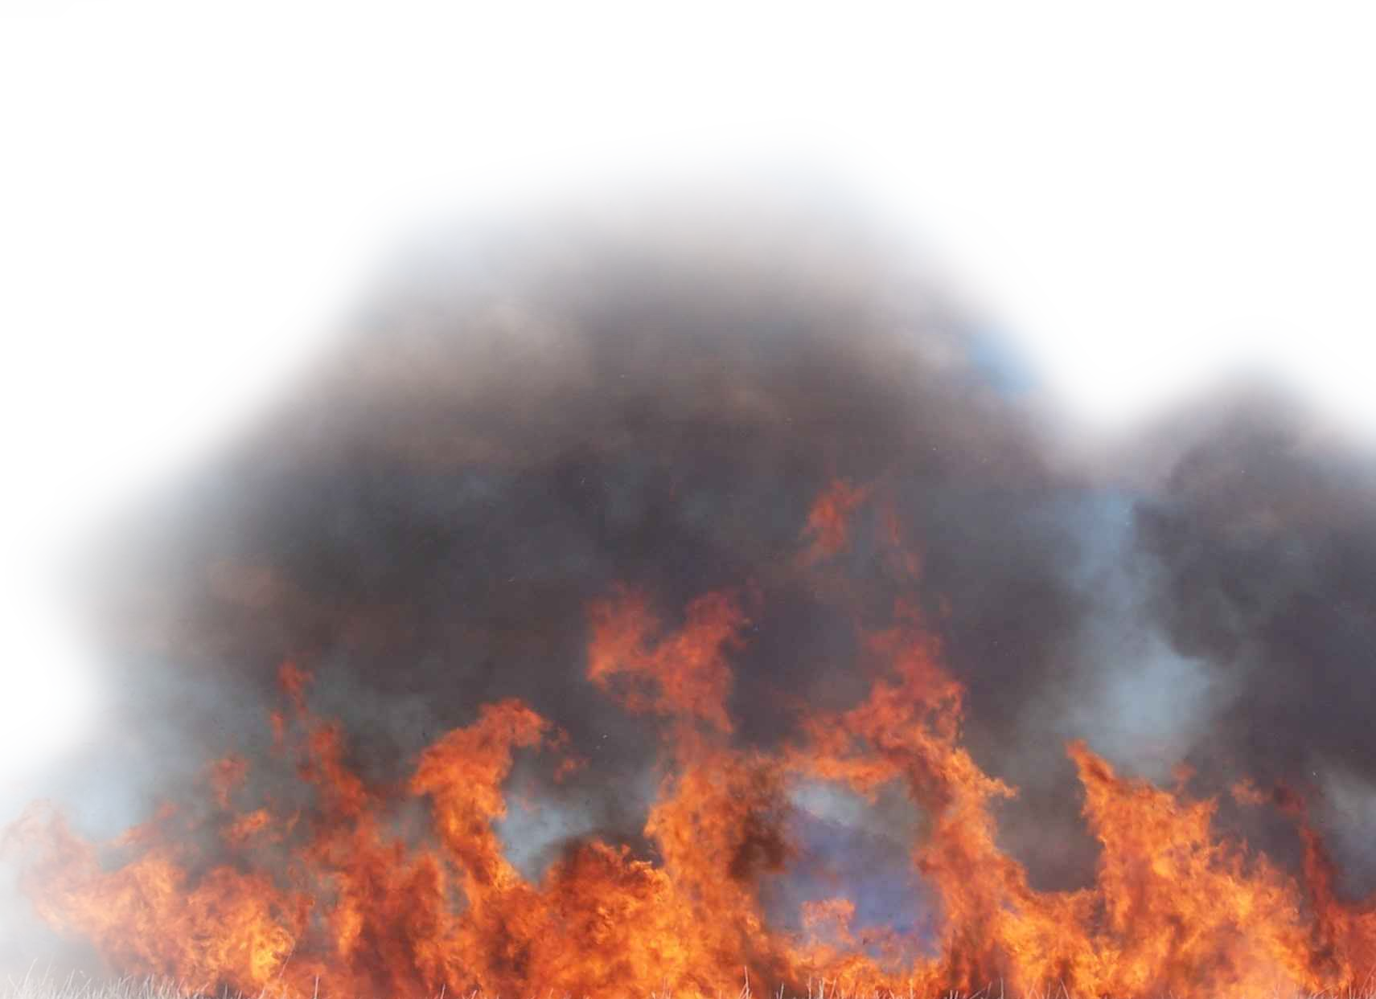
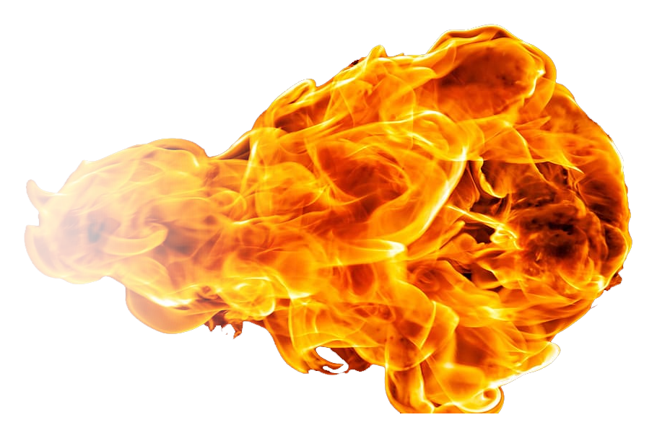
The First Batter: Damascus
Mound: “This is what the Lord says”
Plate: “For 3 sins of Damascus even for 4”
Pitch: “I will not turn back my wrath”
Why? “Because she threshed Gilead with sledges …
Call:
⁴ “I will send fire upon the house of Hazael that will consume the fortresses of Ben-Hadad.” ⁵ I will break down the gate of Damascus; I will destroy …
Notes:
upload.wikimedia.org/wikipedia/commons/3/3e/Ummm_el-Dabadib%2C_fortress_(I).jpg

Slide 7
The First Batter: Damascus
Mound: “This is what the Lord says”
Plate: “For 3 sins of Damascus even for 4”
Pitch: “I will not turn back my wrath”
Why? “Because she threshed Gilead with sledges …
Call:
⁵ … the king who is in the Valley of Aven and the one who holds the scepter in Beth Eden. The people of Aram will go into exile to Kir," says the LORD.
Notes:
upload.wikimedia.org/wikipedia/commons/3/3e/Ummm_el-Dabadib%2C_fortress_(I).jpg

Slide 8
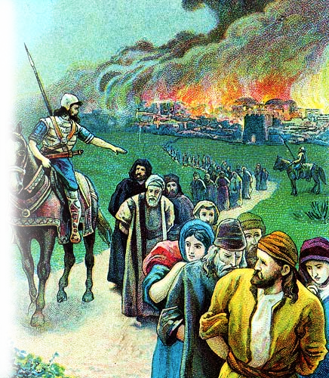
The Second Batter: Gaza
Mound: “This is what the Lord says”
Plate: “For three sins of Gaza even for four”
Pitch: “I will not turn back my wrath”
Why? ⁷ … Because …
she took captive
whole communities and
sold them to Edom
Notes:
http://upload.wikimedia.org/wikipedia/commons/6/6d/Threshing-sledge.png
⁶ This is what the LORD says: "For three sins of Gaza, even for four, I will not turn back my wrath. Because she took captive whole communities and sold them to Edom,
⁷ I will send fire upon the walls of Gaza that will consume her fortresses.
⁸ I will destroy the king of Ashdod and the one who holds the scepter in Ashkelon. I will turn my hand against Ekron, till the last of the Philistines is dead," says the Sovereign LORD.
(Amo 1:6-8 NIV)

Slide 9
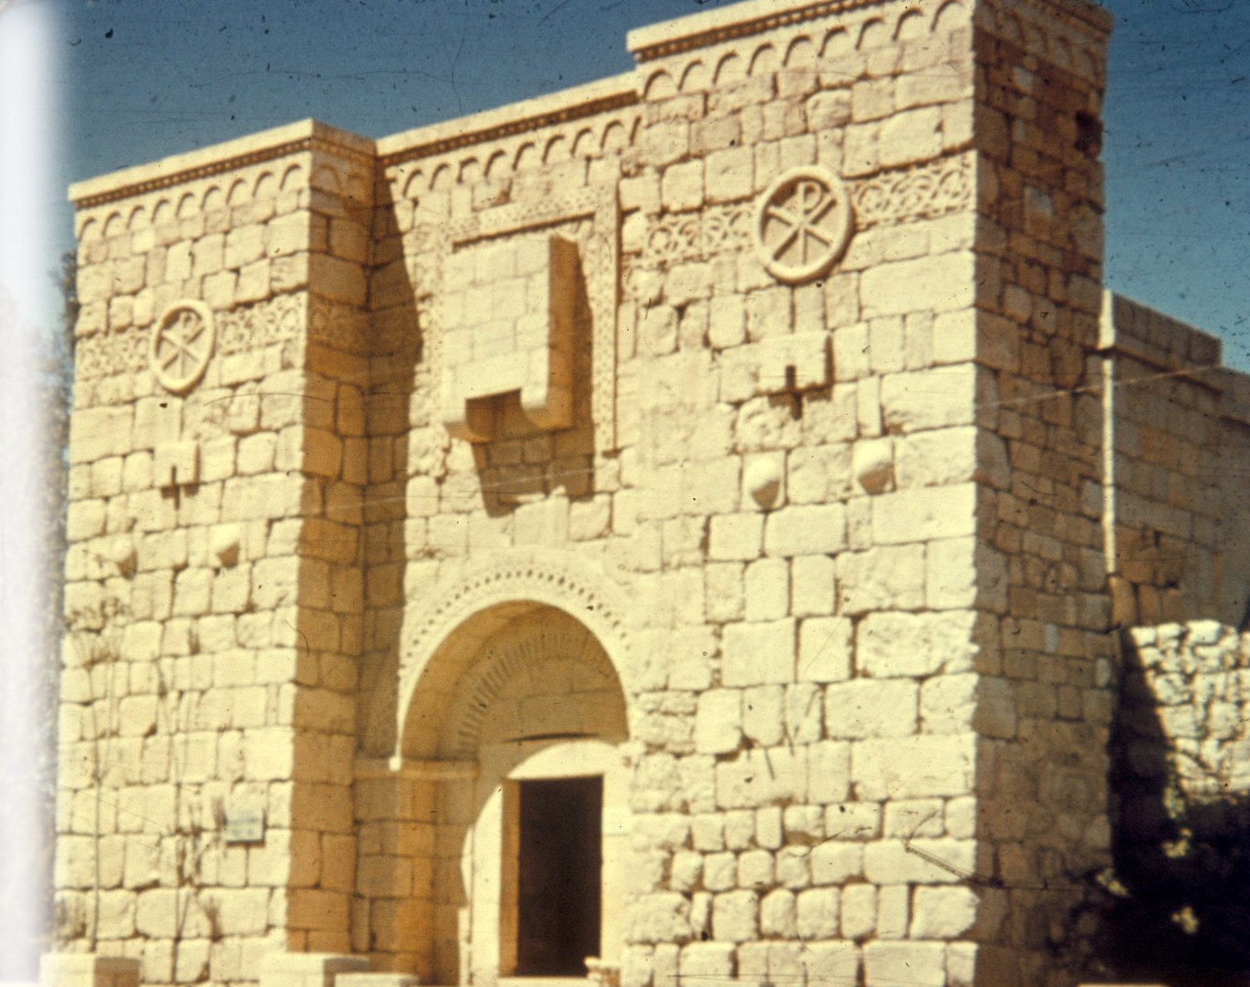
The Second Batter: Gaza
Mound: ”
Plate:
Pitch: my wrath”
Why? with sledges …
Call: ⁷ I will send fire upon the walls of Gaza that will consume her fortresses.
Notes:
upload.wikimedia.org/wikipedia/commons/5/59/Damascus%2C_Palmyra_and_Baalbek._Damascus%2C_St._Paul's_Wall%2C_restored_LOC_matpc.22982.jpg

Slide 10
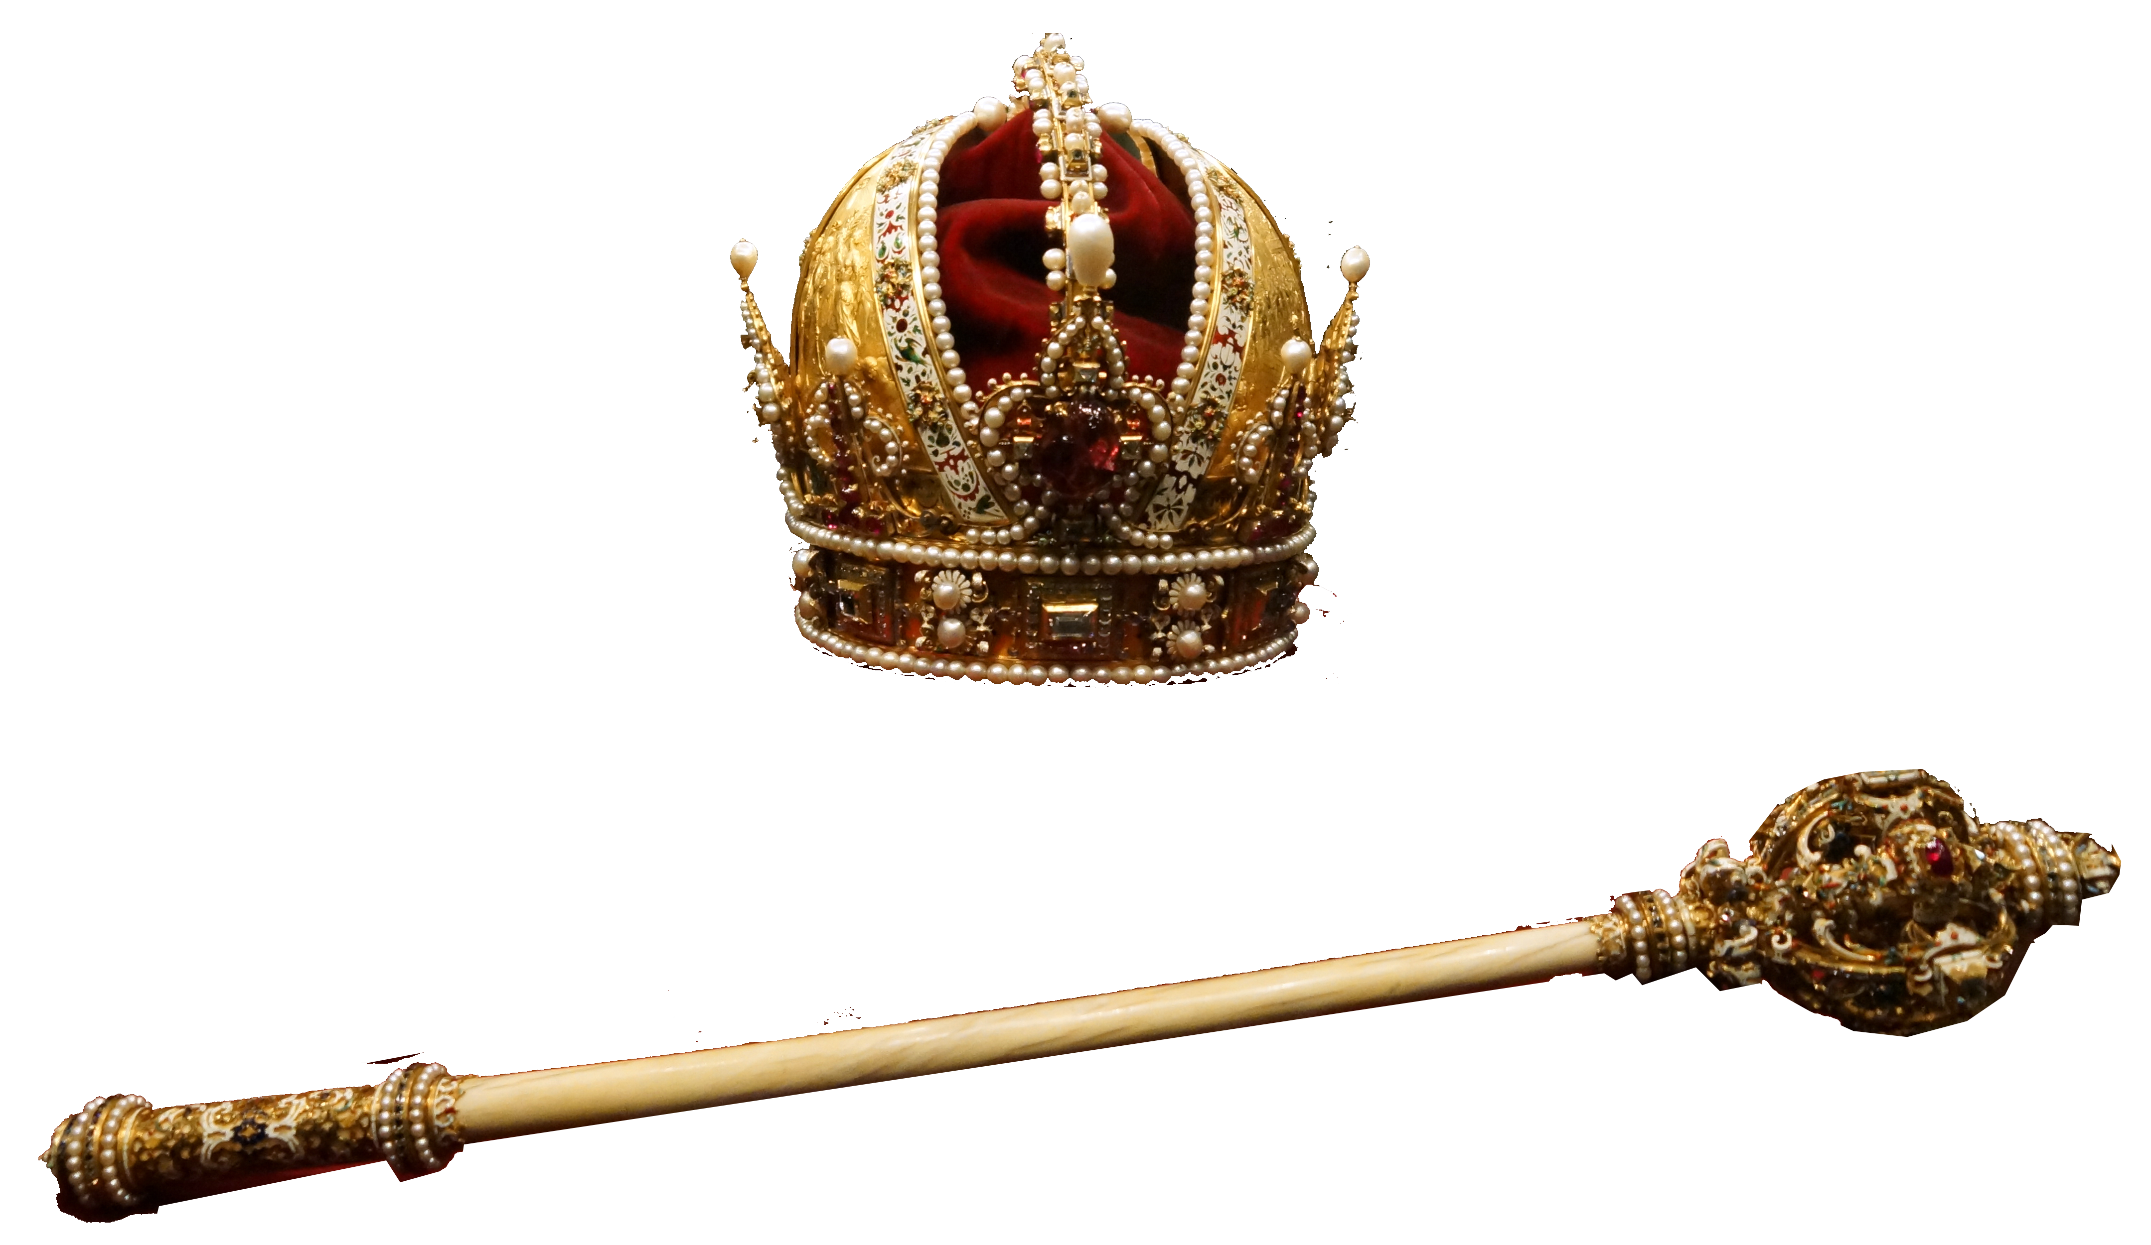
The Second Batter: Gaza
Mound: ”
Plate:
Pitch: my wrath”
Why? with sledges …
Call: I will destroy the king of Ashdod and the one who holds the scepter in Ashkelon. I will turn my hand against Ekron, till the last of the Philistines is dead…"
Notes:
upload.wikimedia.org/wikipedia/commons/thumb/d/d0/Imperial_Crown_Orb_and_Sceptre_of_Austria_(Imperial_Treasury).jpg/1200px-Imperial_Crown_Orb_and_Sceptre_of_Austria_(Imperial_Treasury).jpg

Slide 11
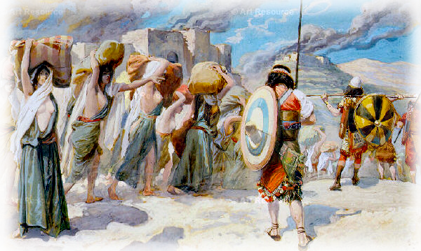
The Third Batter: Tyre
Mound: “This is what the Lord says”
Plate: “For three sins of Tyre even for four”
Pitch: “I will not turn back my wrath”
Why? ⁹ … Because …
she sold whole communities of captives to
Edom, disregarding a treaty of brotherhood,
Notes:
http://en.wikipedia.org/wiki/Matot#/media/File:Tissot_The_Women_of_Midian_Led_Captive_by_the_Hebrews.jpg

Slide 12
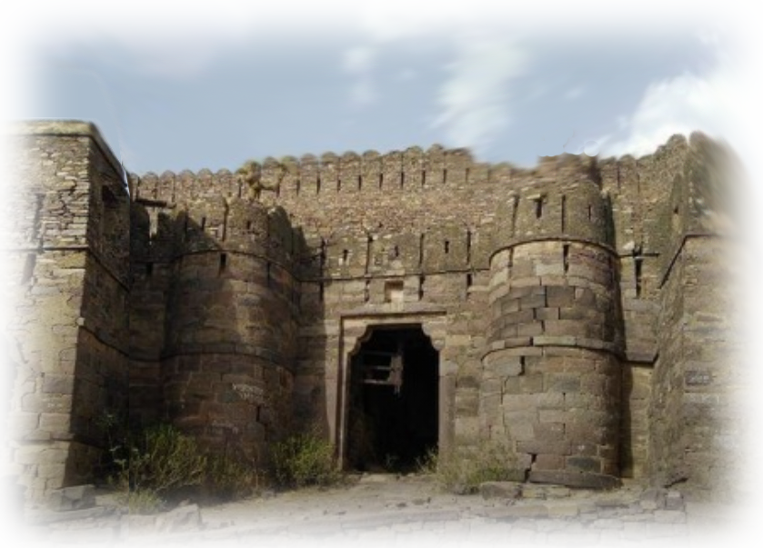
The Third Batter: Tyre
Mound: “This is what the Lord says”
Plate: “For 3 sins of Damascus even for 4”
Pitch: “I will not turn back my wrath”
Why? “Because she threshed Gilead with sledges …
Call: ¹⁰ I will send fire upon the walls of Tyre that will consume her fortresses."
Notes:
www.tripnight.com/rajasthan-tourism/sawai-madhopur/detail-about-khandar-fort

Slide 13
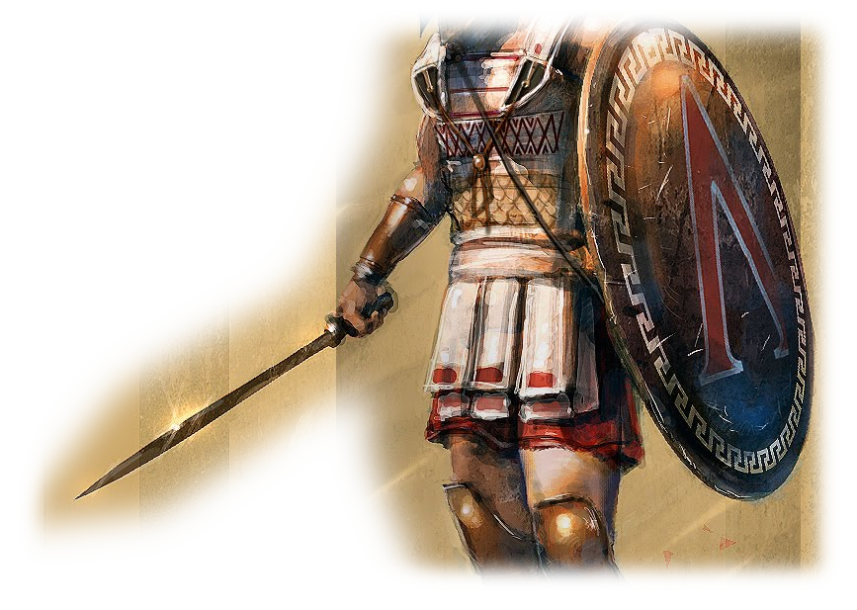
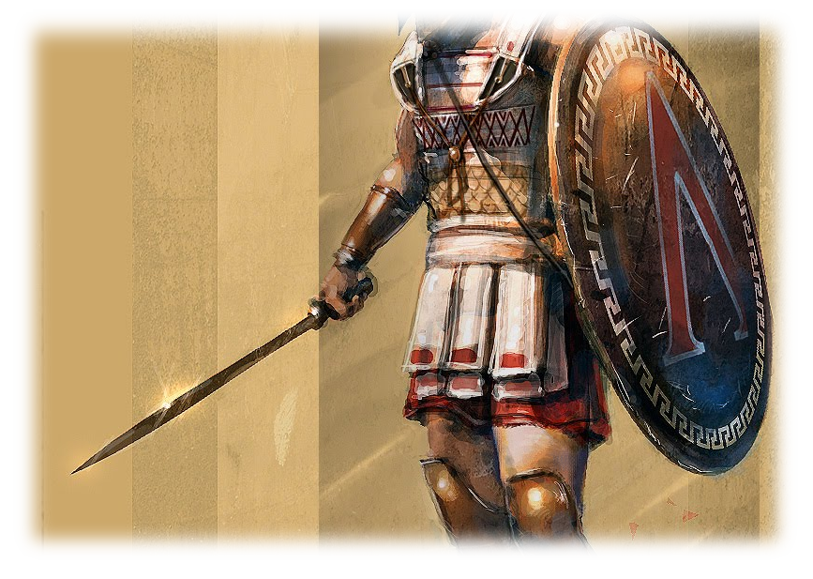
The Fourth Batter: Edom
Mound: “This is what the Lord says”
Plate: “For three sins of Edom even for four”
Pitch: “I will not turn back my wrath”
Why? ^{11 “}Because he pursued
his brother with a sword, stifling all compassion, because his anger raged continually and his fury flamed unchecked”
Notes:
vridar.org/wp-content/uploads/2017/10/hoplite.jpg
Because he pursued his brother with a sword, stifling all compassion, because his anger raged continually and his fury flamed unchecked,
¹² I will send fire upon Teman that will consume the fortresses of Bozrah."
(Amo 1:11-12 NIV)

Slide 14
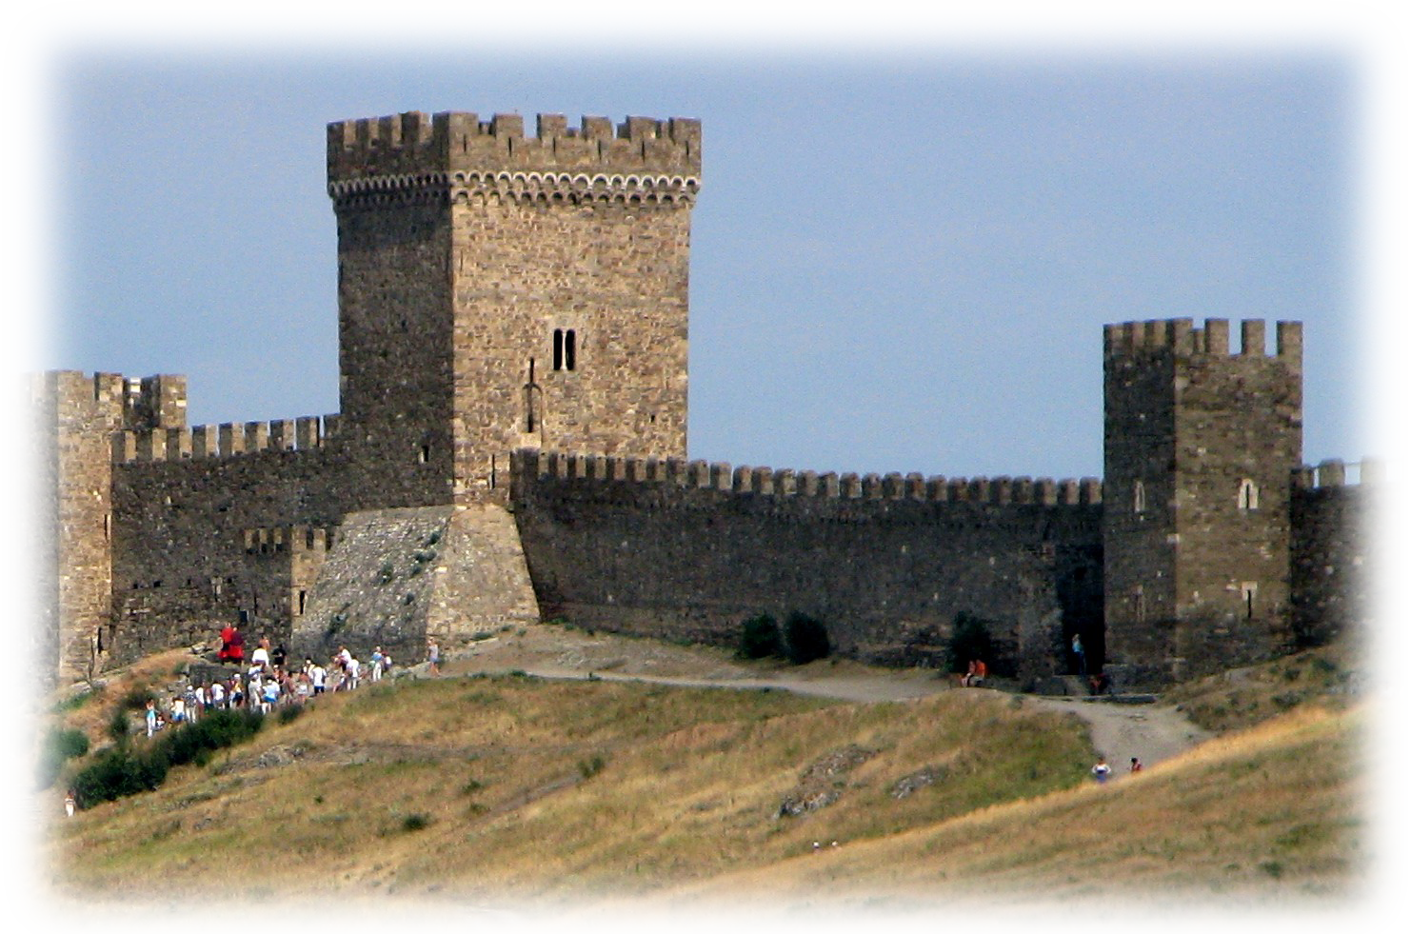
The Fourth Batter: Edom
Mound: “This is what the Lord says”
Plate: “For 3 sins of Damascus even for 4”
Pitch: “I will not turn back my wrath”
Why? “Because she threshed Gilead with sledges …
Call: ¹² I will send fire upon Teman that will consume the fortresses of Bozrah."
Notes:
www.flickr.com/photos/bilk/2801065926/in/pool-east_european_ecotourism

Slide 15
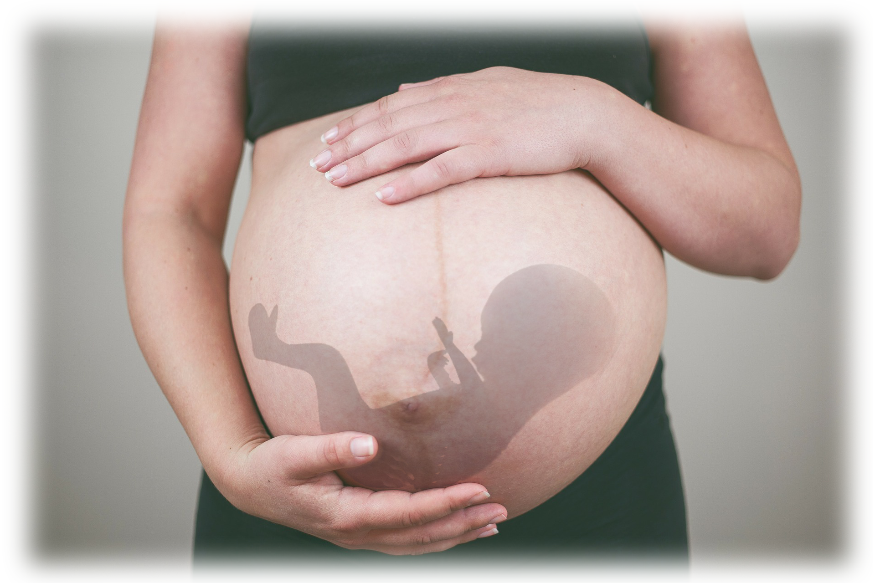
The Fifth Batter: Ammon
Mound: “This is what the Lord says”
Plate: “For three sins of Ammon even for four”
Pitch: “I will not turn back my wrath”
Why? ¹³ Because …
he ripped open the pregnant women of
Gilead in order to extend his borders,
Notes:
pixabay.com/photos/pregnant-belly-mother-maternity-193850/
This is the sin of abortion for your own connivence. The women were no threat to them nationally—but the children were potential future warriors. So they aborted the babies.
God was angered at this abortion! God is angry at all abortion. Etc.
¹³ This is what the LORD says: "For three sins of Ammon, even for four, I will not turn back my wrath. Because he ripped open the pregnant women of Gilead in order to extend his borders,
¹⁴ I will set fire to the walls of Rabbah that will consume her fortresses amid war cries on the day of battle, amid violent winds on a stormy day.
¹⁵ Her king will go into exile, he and his officials together," says the LORD.
(Amo 1:13-15 NIV)

Slide 16
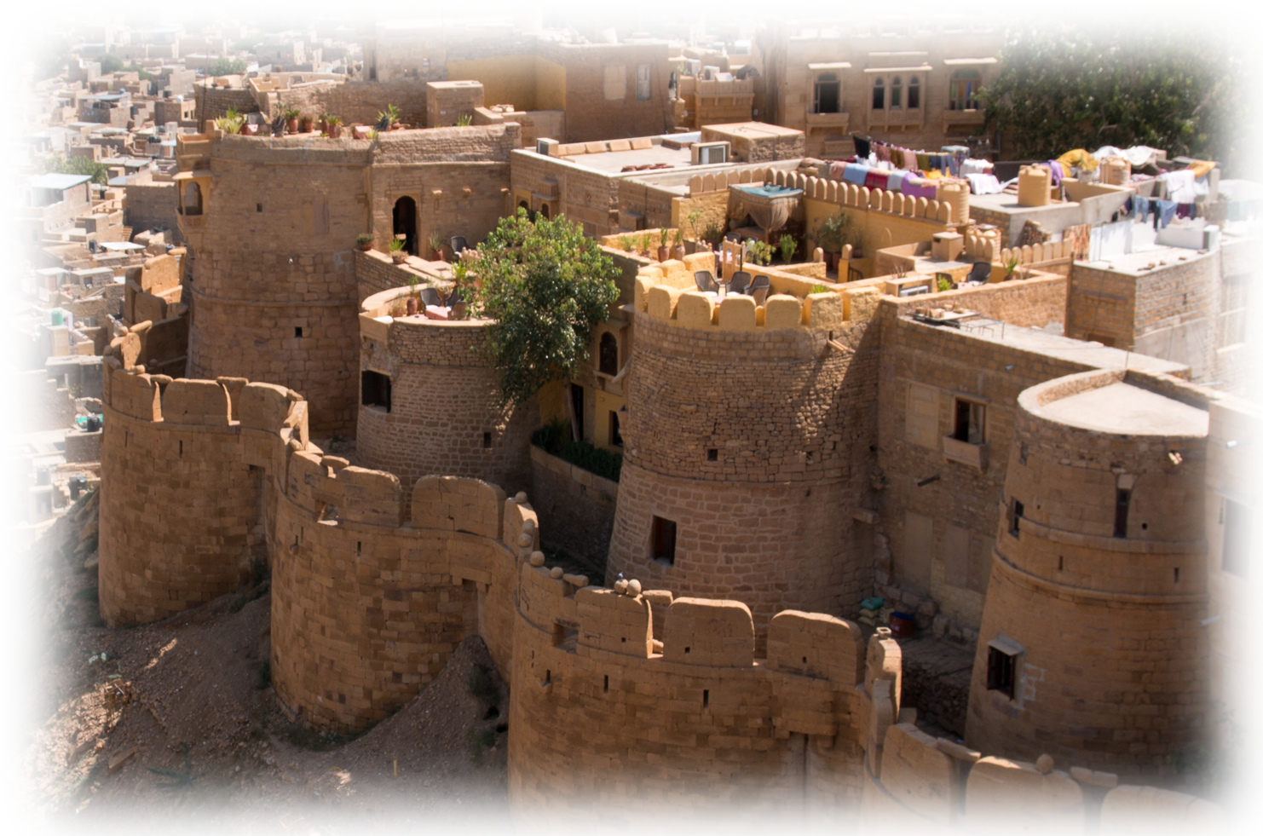
The Fifth Batter: Ammon
Mound: “This is what the Lord says”
Plate: “For 3 sins of Damascus even for 4”
Pitch: “I will not turn back my wrath”
Why? “Because she threshed Gilead with sledges …
Call: ¹⁴ I will set fire to the walls of Rabbah that will consume her fortresses amid war cries on the day of battle, amid violent winds on a stormy day. Her king will go into exile
Notes:
http://upload.wikimedia.org/wikipedia/commons/6/66/Jaisalmer_Fort_Palace_Museum-6-Barbicane_walls-20131010.jpg
¹³ This is what the LORD says: "For three sins of Ammon, even for four, I will not turn back my wrath. Because he ripped open the pregnant women of Gilead in order to extend his borders,
¹⁴ I will set fire to the walls of Rabbah that will consume her fortresses amid war cries on the day of battle, amid violent winds on a stormy day.
¹⁵ Her king will go into exile, he and his officials together," says the LORD.
(Amo 1:13-15 NIV)

Slide 17
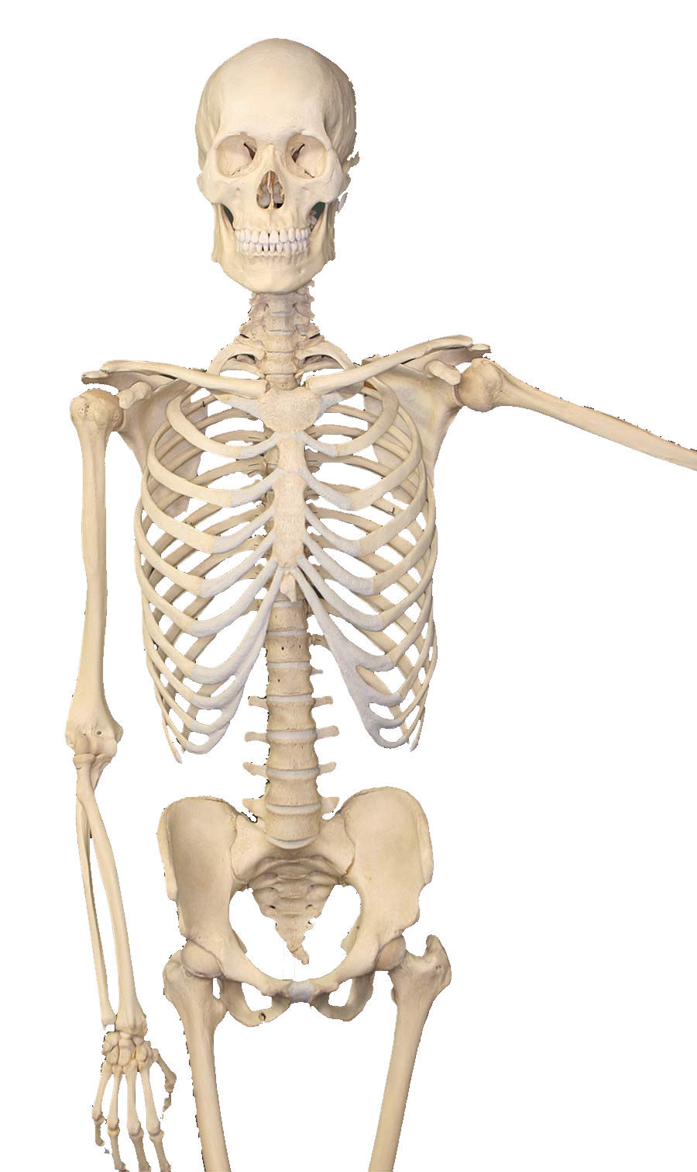
The Sixth Batter: Moab
Mound: “This is what the Lord says”
Plate: “For three sins of Moab even for four”
Pitch: “I will not turn back my wrath”
Why? ^{2:1} … Because he burned,
as if to lime, the bones
of Edom's king,
Notes:
Wiki – skeleton
This is an evil that God did not tolerate: It’s like the democrats not happy with the fact they voted President Trump out of office—they had to impeach him after he was out as well.
They were not satisfied that the king was dead—they had to desecrate them too!
God has said, Vengeance is mine, I will repay. This sin is acting as God in judgment.

Slide 18
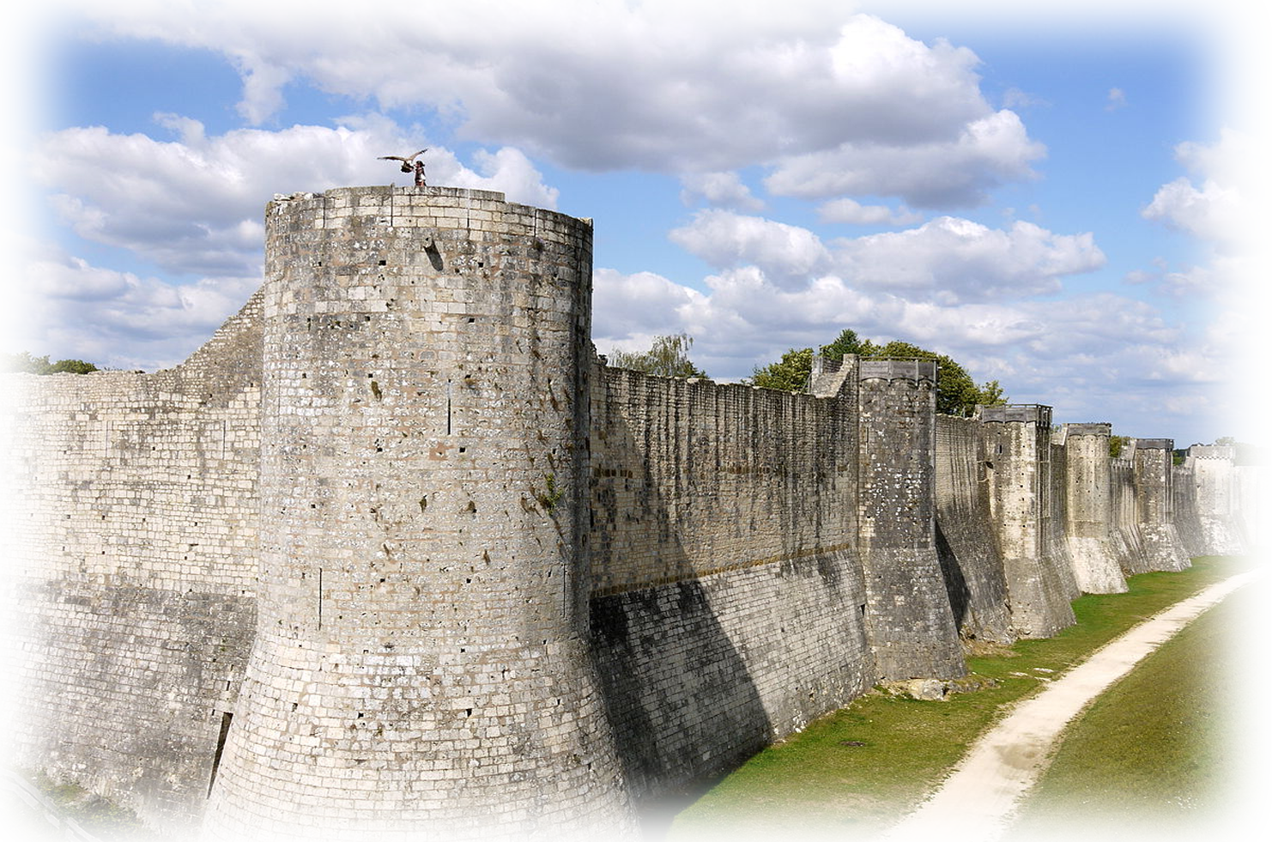
The Sixth Batter: Moab
Mound: “This is what the Lord says”
Plate: “For 3 sins of Damascus even for 4”
Pitch: “I will not turn back my wrath”
Why? “Because she threshed Gilead with sledges …
Call: ² I will send fire upon Moab that will consume the fortresses of Kerioth. Moab will go down in great tumult amid war cries and the blast of the trumpet. ³ I will destroy her ruler and kill all her officials with him
Notes:
http://commons.wikimedia.org/wiki/File:Medieval_fortifications_of_Provins_P1120608.JPG

Slide 19
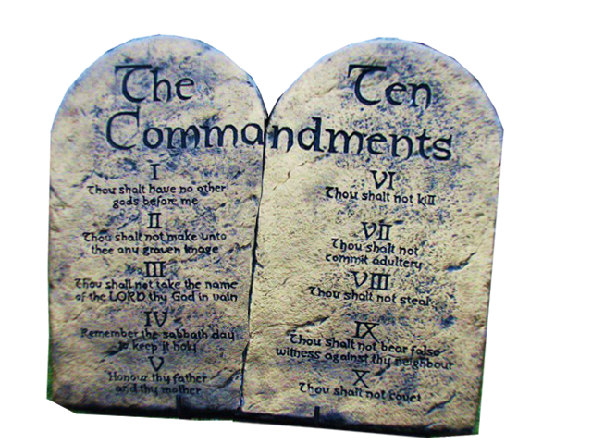

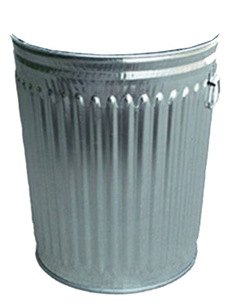
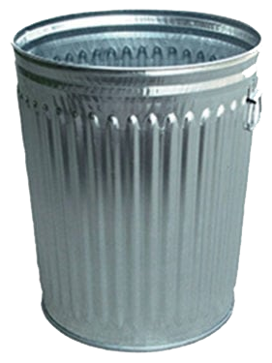
The Seventh Batter: Judah
Mound: “This is what the Lord says”
Plate: “For three sins of Judah even for four”
Pitch: “I will not turn back my wrath”
Why? ⁴ … “Because they have rejected
the law of the LORD and have not kept
his decrees, because they have been led
astray by false gods, the gods their ancestors followed”
Notes:
parkwarehouse.com/wp-content/uploads/2018/02/heavy-duty-economy-can-galvanized-collection-round-trash-receptacle-24-gallon-450tr950-1-640x800.jpg
The Ten Commandments | Picture taken of a display of the Ten… | Flickr

Slide 20
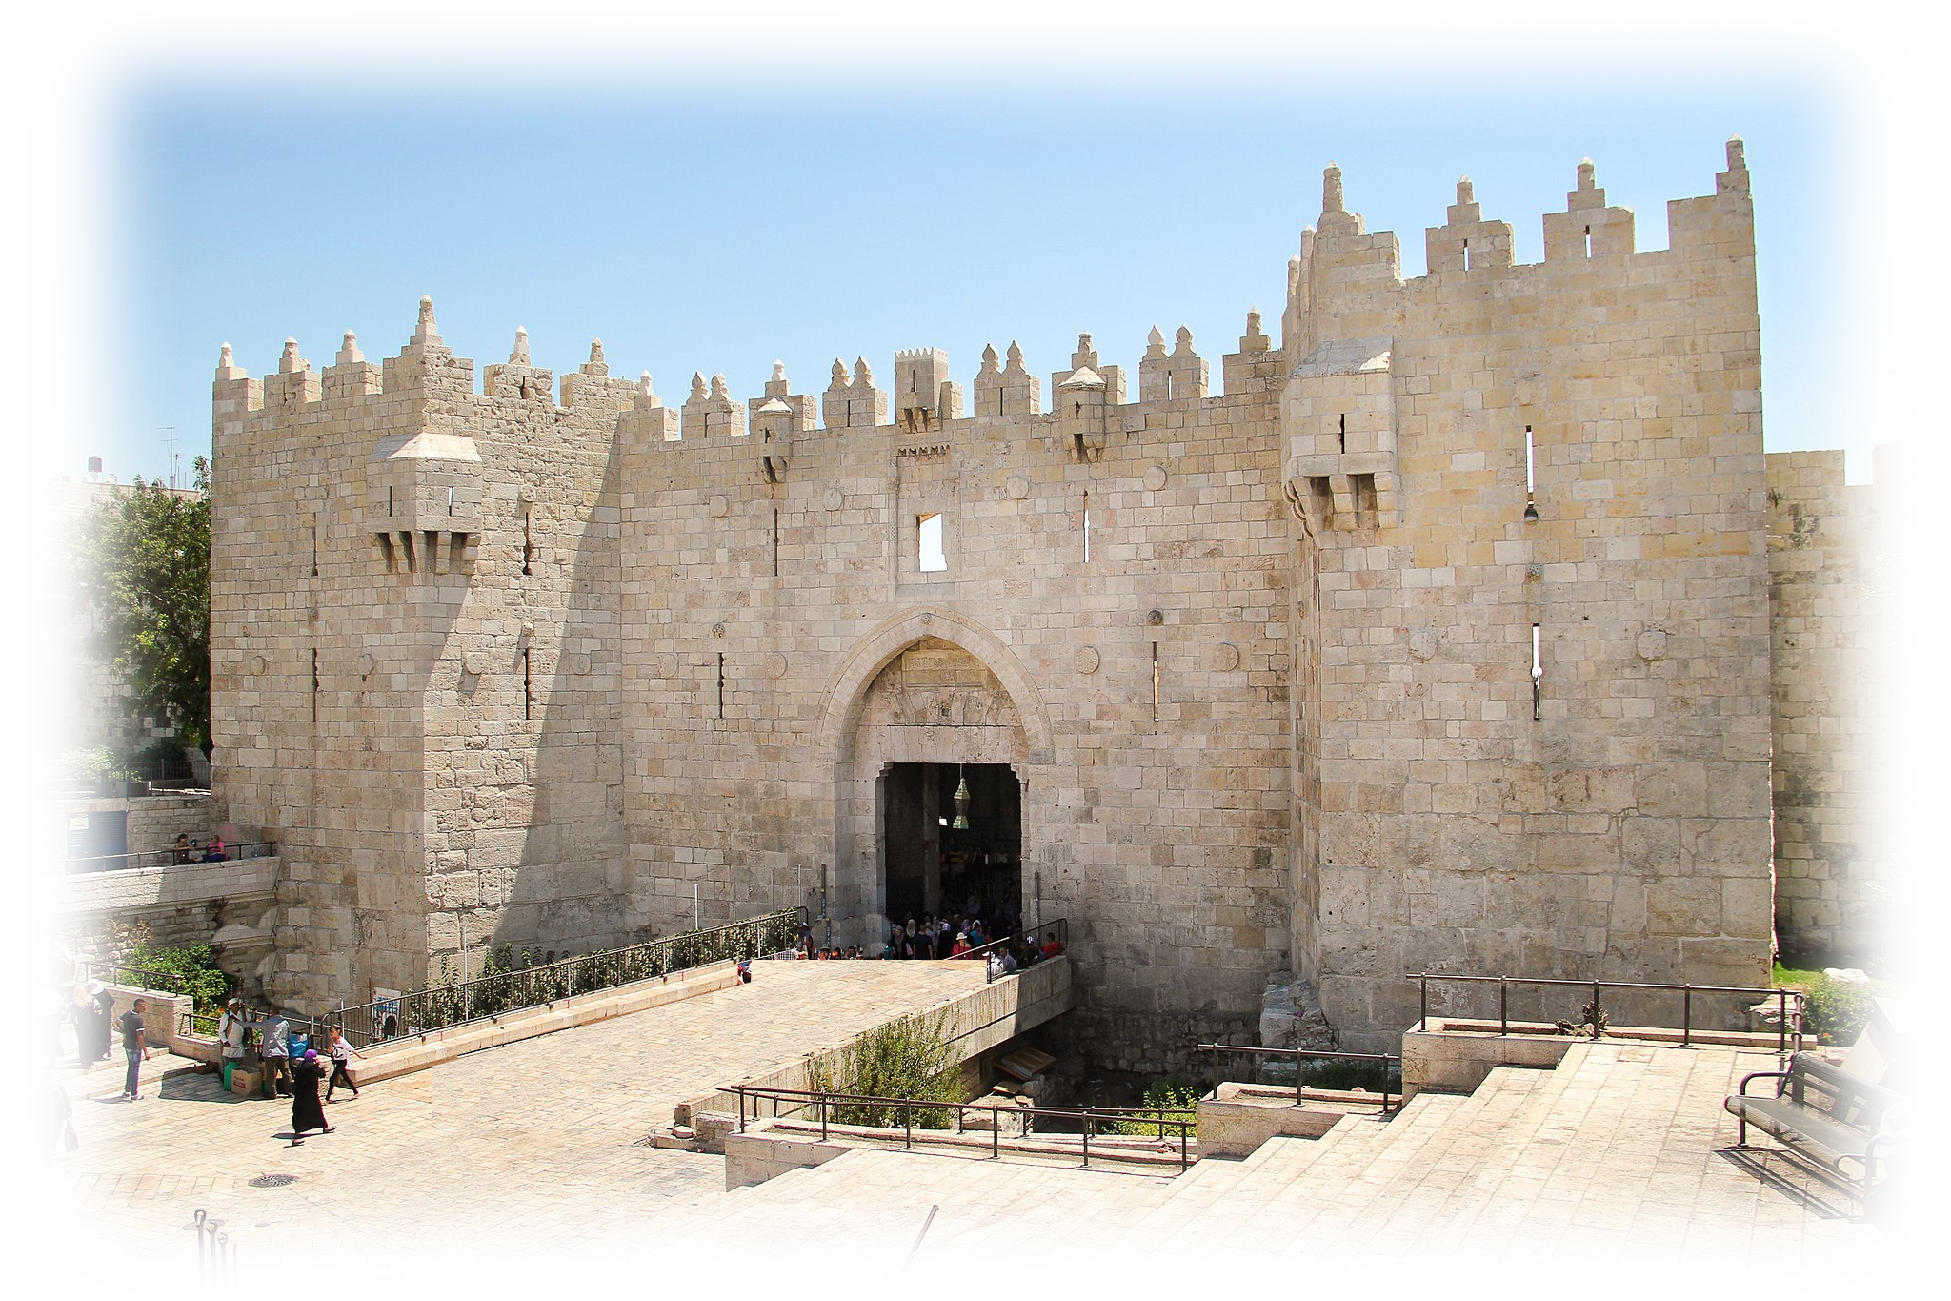
The Seventh Batter: Judah
Mound: “This is what the Lord says”
Plate: “For 3 sins of Damascus even for 4”
Pitch: “I will not turn back my wrath”
Why? “Because she threshed Gilead with sledges …
Call: ⁵ I will send fire upon Judah that will consume the fortresses of Jerusalem."
Notes:
http://upload.wikimedia.org/wikipedia/commons/6/6d/Threshing-sledge.png

Slide 21
Notice:
Damascus
Gaza
Tyre
Edom
Ammon
Moab
Judah
Israel

Slide 22
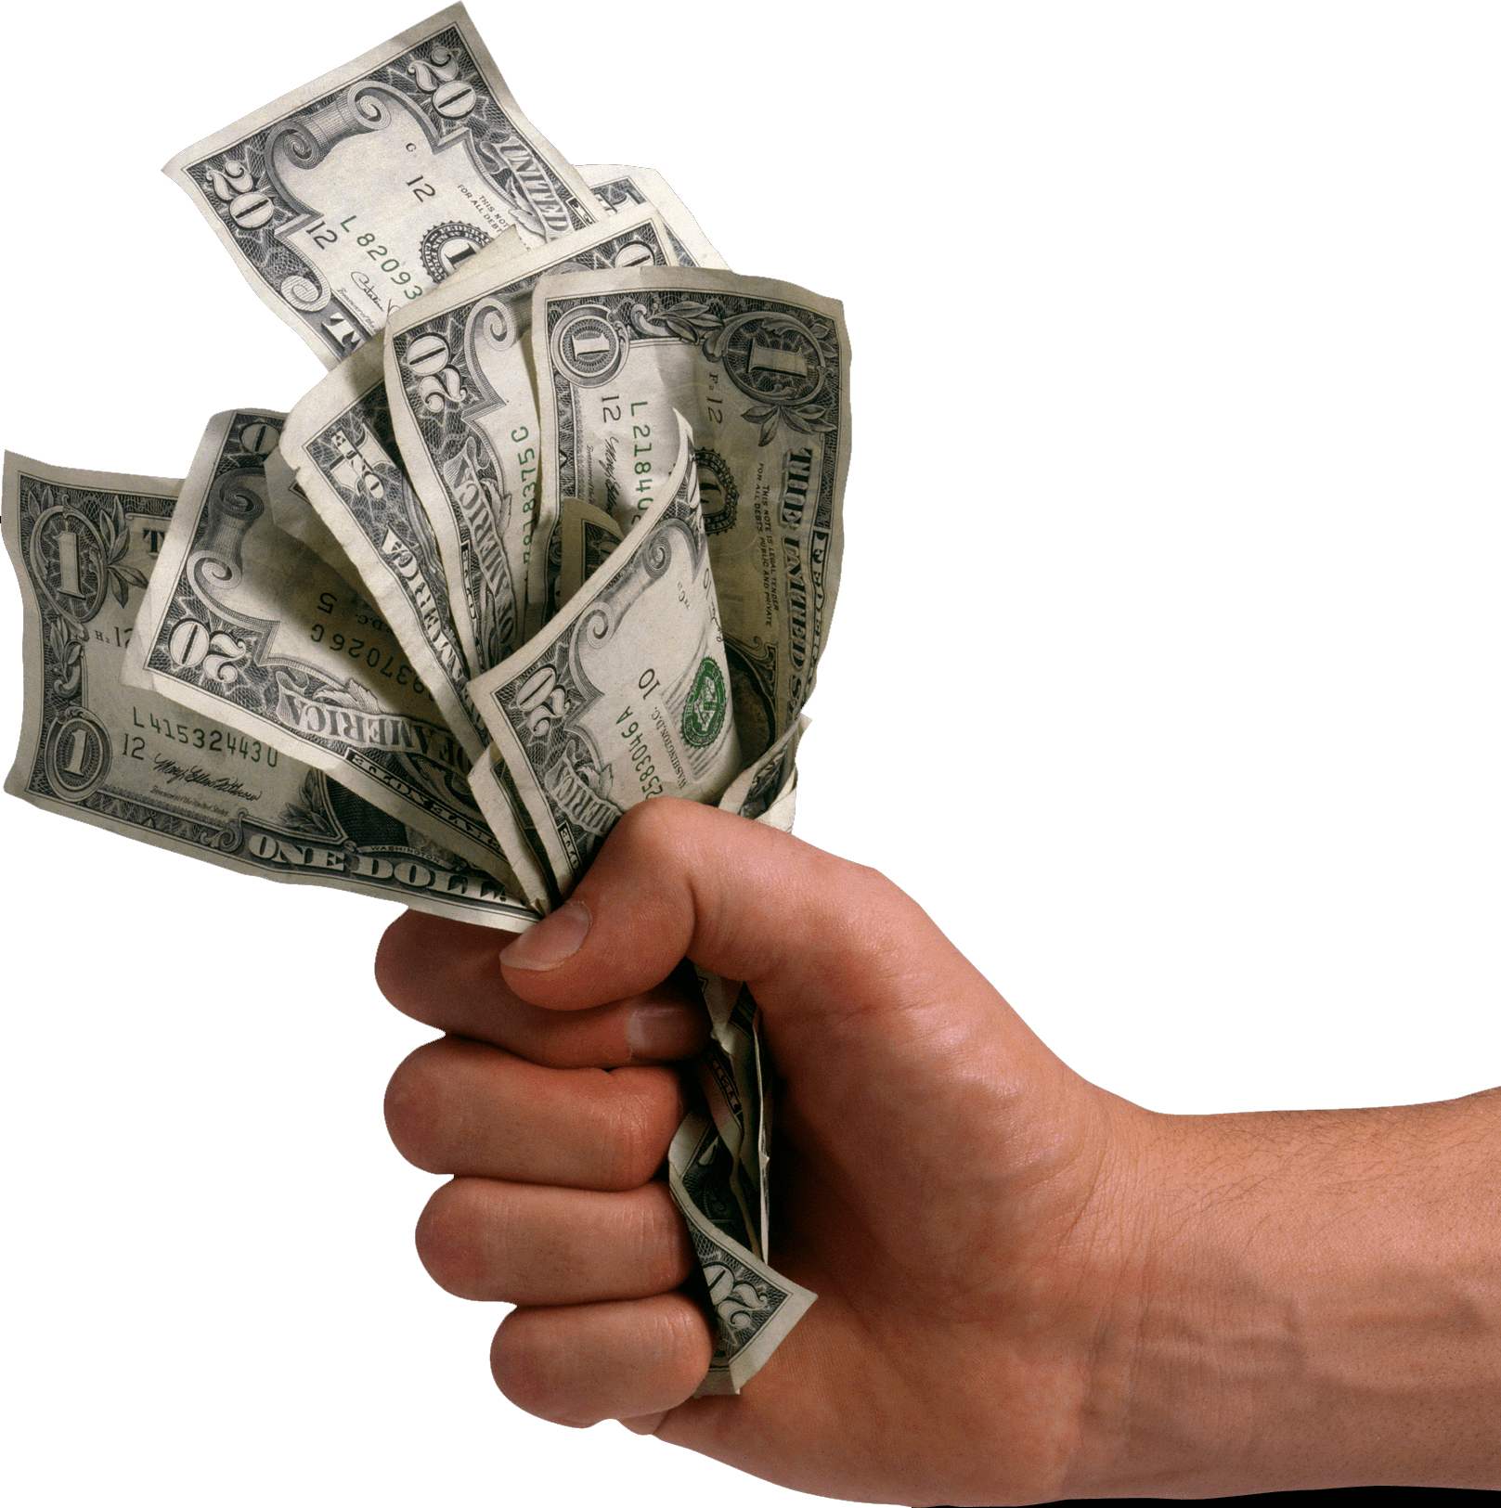
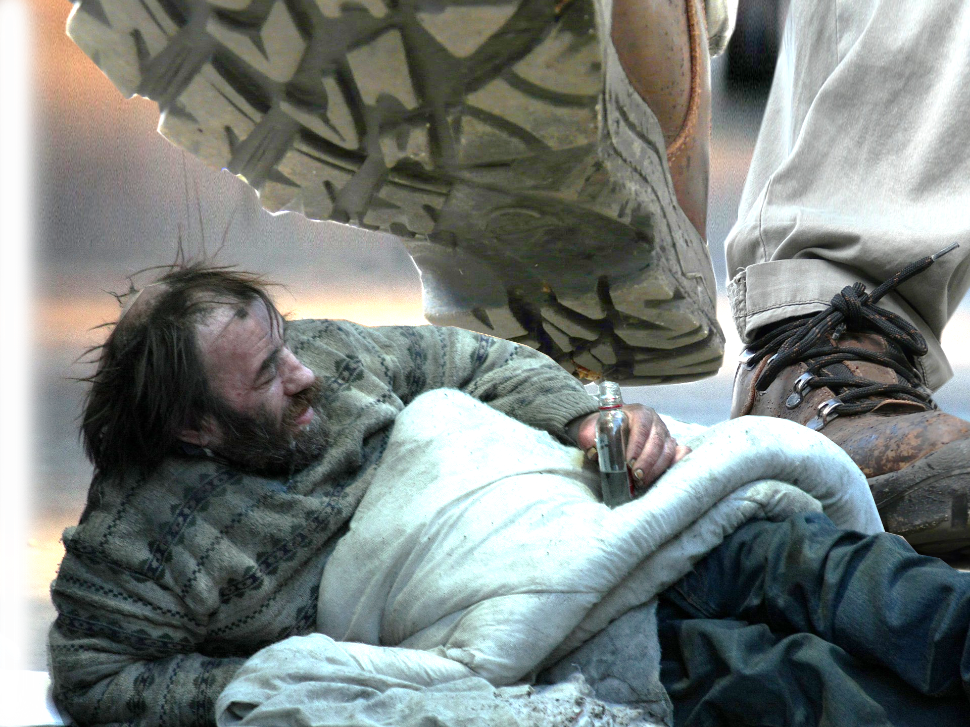

The Eighth Batter: Israel
Mound: “This is what the Lord says”
Plate: “For three sins of Israel even for four”
Pitch: “I will not turn back my wrath”
Why? 1] They sell the righteous for
silver, and the needy for a pair of sandals.
2] ⁷ They trample on the heads of the poor as upon the dust of the ground and deny justice to the oppressed.
Notes:
Sold = pngimg.com/image/87249

Slide 23
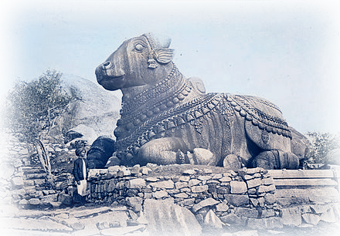
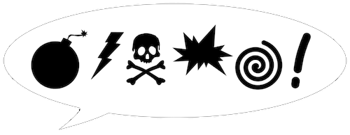
The Eighth Batter: Israel
Mound: “This is what the Lord says”
Plate: “For three sins of Israel even for four”
Pitch: “I will not turn back my wrath”
Why? 3] Father and son use the
same girl and so profane my holy name.
4] ⁸ They lie down beside every altar on garments taken in pledge. In the house of their god they drink wine taken as fines.
Notes:
upload.wikimedia.org/wikipedia/commons/thumb/b/b6/Nandibull.jpg/440px-Nandibull.jpg

Slide 24
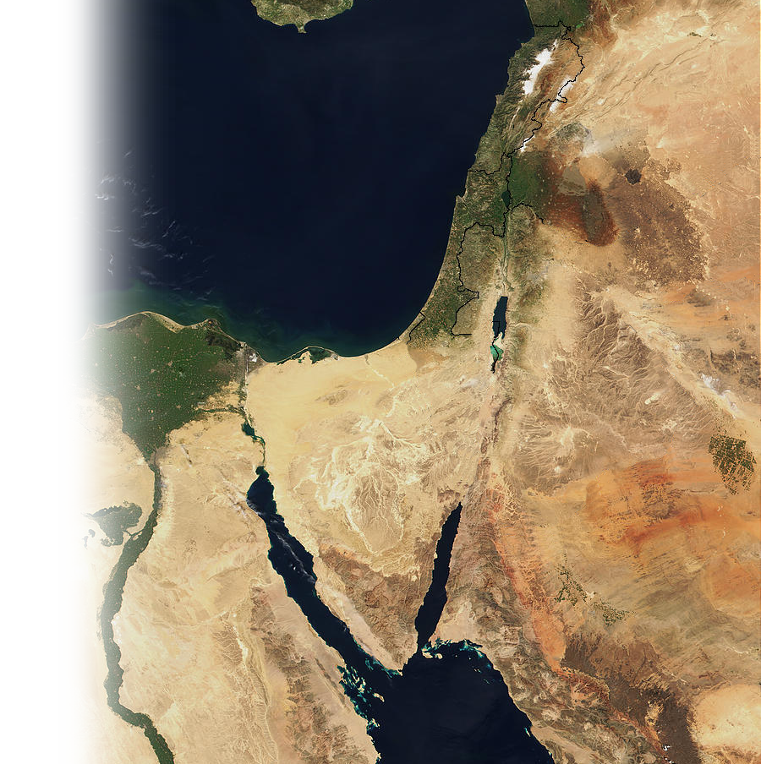
The Eighth Batter: Israel
After all I have done for you:
1] ⁹ "I destroyed the Amorite before them, though he was tall as the cedars and strong as the oaks. I destroyed his fruit above and his roots below
Notes:
Map = www.parstimes.com/MODIS/MiddleEast.A2002.jpg

Slide 25
The Eighth Batter: Israel
After all I have done for you:
2] ¹⁰ "I brought you up out of Egypt, and I led you forty years in the desert to give you the land of the Amorites.
Notes:
http://upload.wikimedia.org/wikipedia/commons/6/6d/Threshing-sledge.png

Slide 26
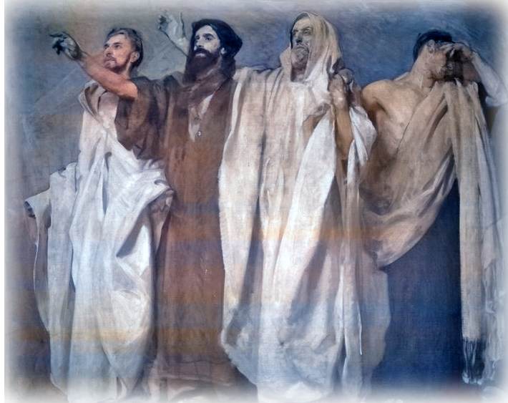
The Eighth Batter: Israel
After all I have done for you:
3] ¹¹ I also raised up prophets from among your sons and Nazirites from among your young men. Is this not true, people of Israel?" declares the LORD.
Notes:
flickr.com/photos/boston_public_library/7727592776

Slide 27
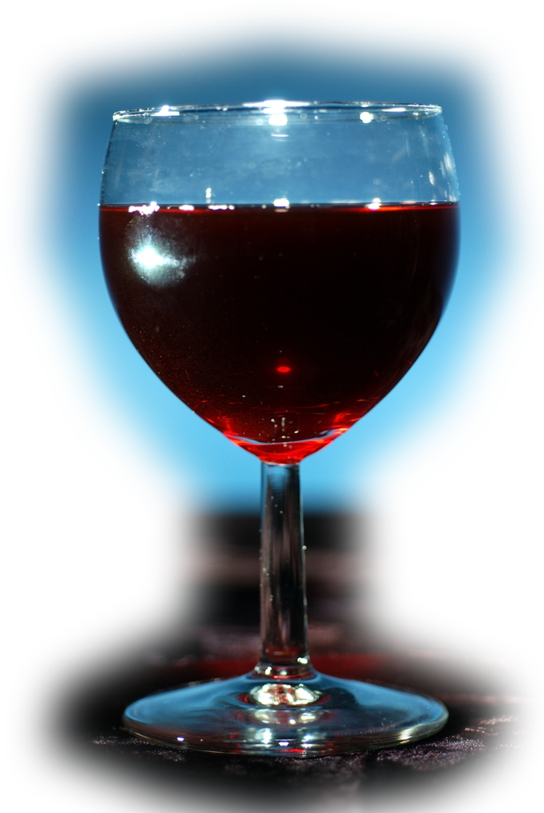
The Eighth Batter: Israel
After all I have done for you:
4] ¹² "But you made the Nazirites drink wine and commanded the prophets not to prophesy.
Notes:
www.scienceimage.csiro.au/library/food/i/3333/red-wine/

Slide 28
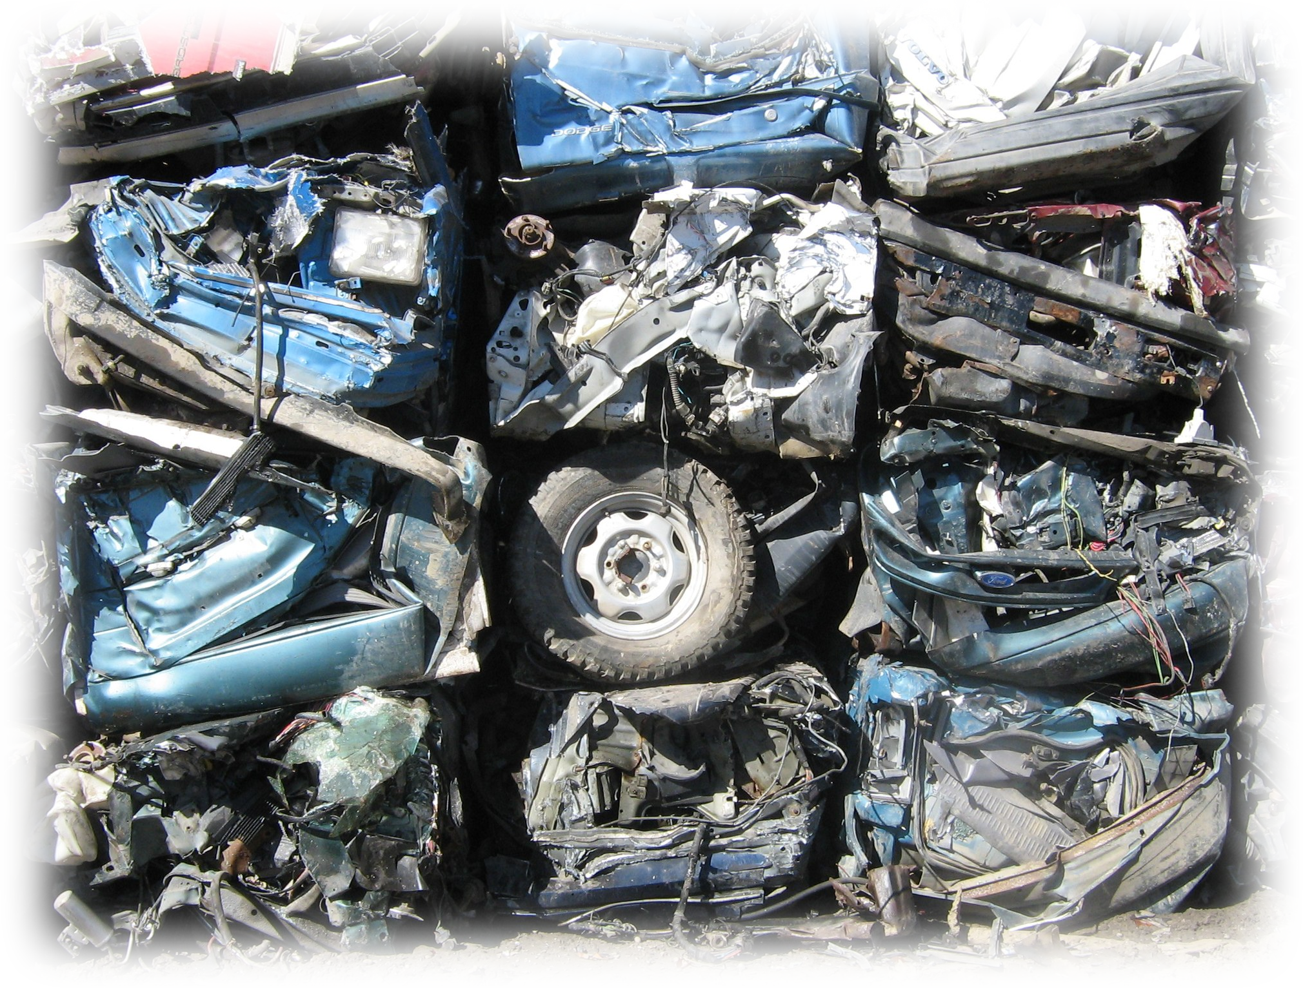
The Eighth Batter: Israel
Now then:
¹³ "Now then, I will crush you as a cart crushes when loaded with grain. ¹⁴ The swift will not escape, the strong will not muster their strength, and the warrior will not save his life.
Notes:
http://upload.wikimedia.org/wikipedia/commons/6/6d/Threshing-sledge.png

Slide 29
The Eighth Batter: Israel
Now then:
¹⁵ The archer will not stand his ground, the fleet-footed soldier will not get away, and the horseman will not save his life. ¹⁶ Even the bravest warriors will flee naked on that day," his is what the Lord says”
she threshed Gilead with sledges …
Notes:
http://upload.wikimedia.org/wikipedia/commons/6/6d/Threshing-sledge.png

Slide 30

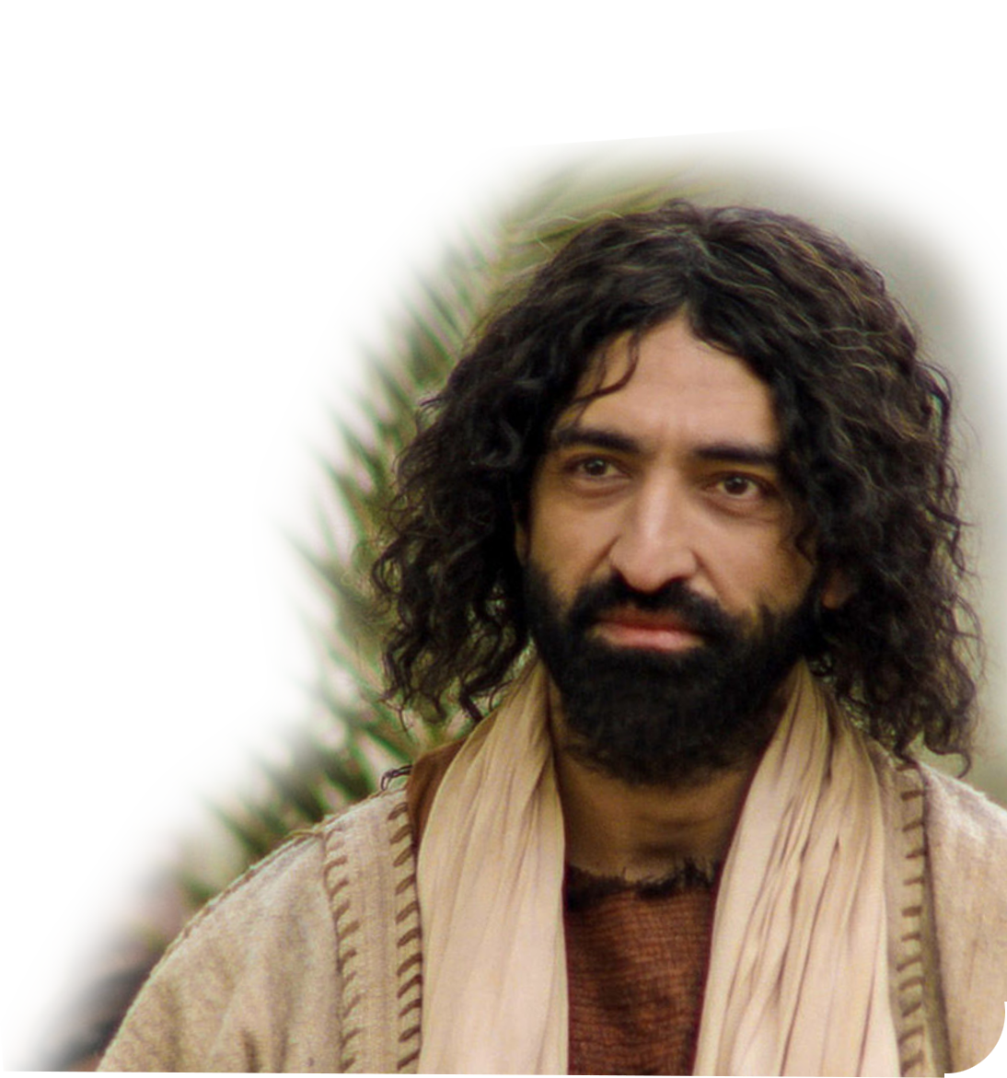
The Nineth Batter: YOU!
God is the pitcher on the MOUND …
You are the batter at the PLATE …
God is throwing the FAST BALL …
You will swing and MISS …
Unless, you have a pinch hitter! Who?
JESUS WILL PINCH HIT FOR YOU!
He will coach you to play the game …

Slide 31
So, what’s the point?
You don’t have to strike out!
You can hit a home run!
How?
Make Jesus your Coach to …

Slide 32
Do the Opposite
Damascus – Help (not thresh)
Gaza – Be true (don’t sell out)
Tyre – Keep your word
Edom – Be compassionate
Ammon – Be Pro-Life
Moab – Be meek
Judah – Keep the Word
Israel – Bless the LORD

Slide 33
LET’S PRAY!
(and then go play ball!)

