Slide 1
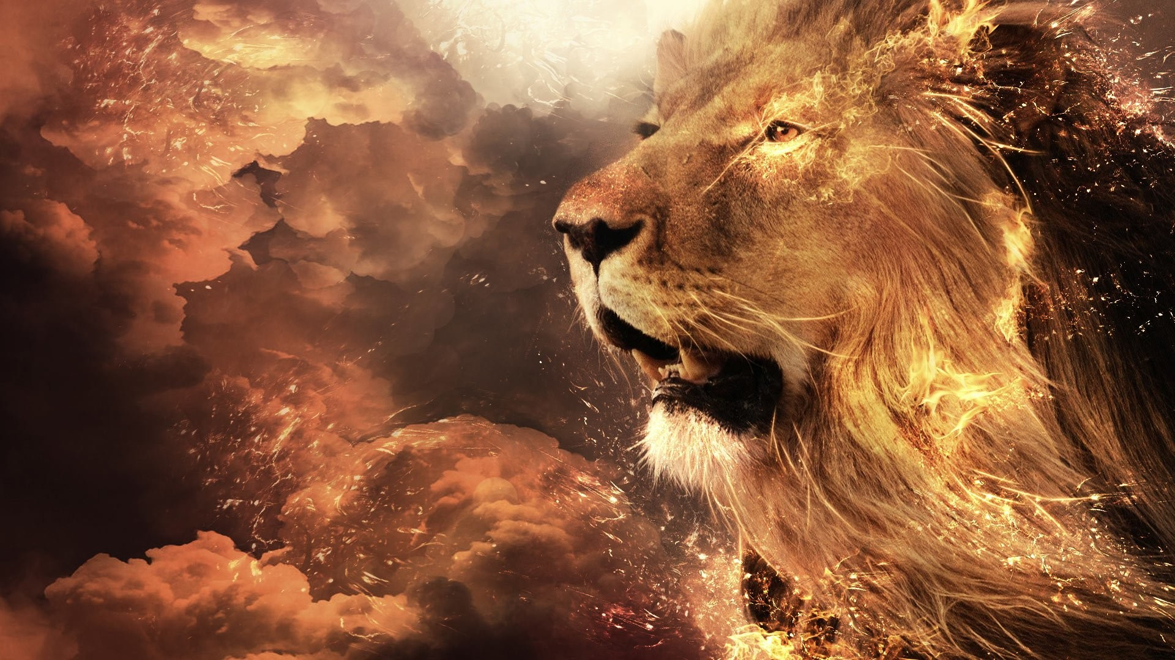
Did a LION
Just ROAR?
Notes:
https://cutewallpaper.org/21/hd-lion-background/68-Roaring-Lion-Wallpapers-on-WallpaperPlay.jpg
Copyright © 2006−2021. All rights reserved. Bible Point is a registered trademark of Dennis Henderson. All other trademarks acknowledged.
Bible Point contains graphics from Bible Point artists. These illustrations belong to Bible Point and the respective artists. You may use the designs and illustrations for graphical illustration of lessons free and without special permission, provided they are not used in any way that maligns the Christian faith. Furthermore, republication or production of any illustration by any other graphic service whether it be in book, in a machine-readable form, or in any other design resource is strictly prohibited. Furthermore, they cannot be duplicated or resold as any other form of publishing, clip art, or graphic resource.
So What does it mean? (A simple translations of the legal jargon)
So, if you don’t own the presentation(s), graphic(s), and text(s) how can you legally use them? The purchase of the license allows you to use all the images in the product. However, the actual ownership and copyright of the presentation(s), graphic(s), and text(s) remain the property of Bible Point and its licensors. If you had plans on using this product in your “for sale” work—think again!
License Agreement
Article 1: License Grant
All the graphics and text in Bible Point presentations (excluding quotes from the Bible and stated sources) are the intellectual and real property of Bible Point and its licensors, and is protected by law, including United States copyright laws and international treaties. Bible Point grants to you a license:
1. To use the presentation in a single church, single school, or single office of a Christian organization.
2. To make a single archival back-up copy of the program.
3. To modify the presentation(s) and merge with other presentations in a single church, school, or Christian organization.
4. To transfer to another party if that party agrees to accept the terms and conditions of this agreement, and you do not retain any copies of the presentation, whether printed, machine readable, modified, or merged form.
Article 2: Terms
This license is effective until terminated. You may terminate the license at any time by destroying the presentation(s), graphic(s), or text(s) together with all copies, modifications and merged portions in any form. Bible Point may terminate your license if you fail to comply with this Agreement. You agree, upon such termination, for any reason, to destroy the presentation(s), graphics, and text(s) with all copies, modifications, and merged portions in any form.
Article 3: Disclaimers
1. Bible Point presentations, graphics, and texts are licensed to you As Is. You, the consumer, bear the entire risk relating to the quality and performance of the presentation(s), graphic(s), or text(s). In no event will Bible Point be liable for damages resulting from any defect.
2. Thirty-day limited warrantee on disks. Bible Point warrants the disks to be free of defects in material and workmanship under normal use for 30 days after purchase. During the 30-day period you may return a defective presentation, graphic, or text with proof of purchase and it will be replaced without charge, unless the presentation is damaged by misuse.
Article 4: General
1. You may not sub-license, assign, or transfer the license of the presentation(s), graphic(s), or text(s) except as provided by this Agreement.
2. This Agreement will be governed by the laws of the State of Michigan.
So What does it mean? (A simple translations of the legal jargon)
May I let someone borrow or copy my licensed Bible Point presentation (even after I modified it)? As long as it is within your local church, or single school, or the immediate office of a Christian organization you may. Otherwise, please refer the person interested in borrowing to: http://www.biblepoint.com or E-mail: dennis@DrDH.net with any related questions.
Christian Lion Joke:
Two guys are walking through a game park & they come across a lion that has not eaten for days.
The lion starts chasing the two men. They run as fast as they can and the one guy starts getting tired and decides to say a prayer, "Please turn this lion into a Christian, Lord."
He looks to see if the lion is still chasing and he sees the lion on its knees. Happy to see his prayer answered, he turns around and heads towards the lion.
As he comes closer to the lion, he hears the it saying a prayer: "Thank you Lord for the food I am about to receive."

Slide 2

The National Scene:
Globally—at peace
Notes:
https://www.amazon.com/Spinning-Geography-Students-Teachers-Rotating/dp/B084YY13WQ
Christian Lion Joke:
Two guys are walking through a game park & they come across a lion that has not eaten for days.
The lion starts chasing the two men. They run as fast as they can and the one guy starts getting tired and decides to say a prayer, "Please turn this lion into a Christian, Lord."
He looks to see if the lion is still chasing and he sees the lion on its knees. Happy to see his prayer answered, he turns around and heads towards the lion.
As he comes closer to the lion, he hears the it saying a prayer: "Thank you Lord for the food I am about to receive."

Slide 3

The National Scene:
Globally—at peace
Economically—prosperous
Notes:
https://upload.wikimedia.org/wikipedia/commons/3/37/Money-2180330_1920.jpg

Slide 4

The National Scene:
Globally—at peace
Economically—prosperous
Politically—corrupt
Notes:
http://clipart-library.com/clip-art/democrat-donkey-transparent-background-4.htm

Slide 5

The National Scene:
Globally—at peace
Economically—prosperous
Politically—corrupt
Socially—immoral
Notes:
https://pxhere.com/en/photo/772286

Slide 6
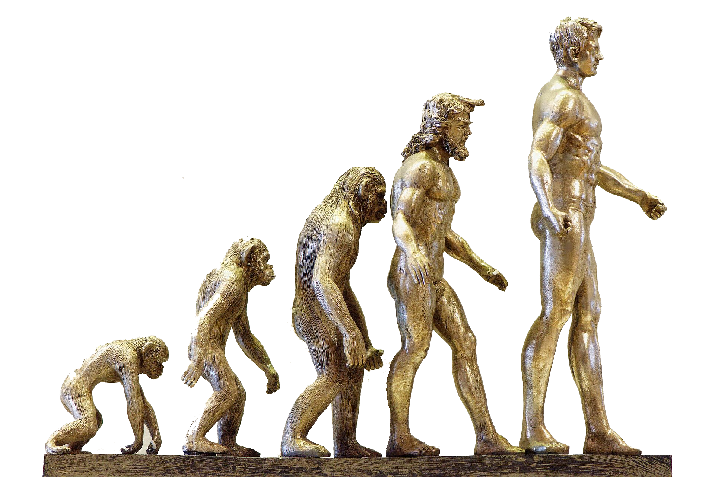
The National Scene:
Globally—at peace
Economically—prosperous
Politically—corrupt
Socially—immoral
Spiritually—apostate
Notes:
https://pixabay.com/photos/evolution-development-forward-4107273/

Slide 7
The National Scene:
Globally—at peace 1:1
Economically—prosperous 8:5
Politically—corrupt 2:6; 5:10
Socially—immoral 2:6-8; 4:1; 5:11
Spiritually—apostate 2:12; 3:1,10

Slide 8
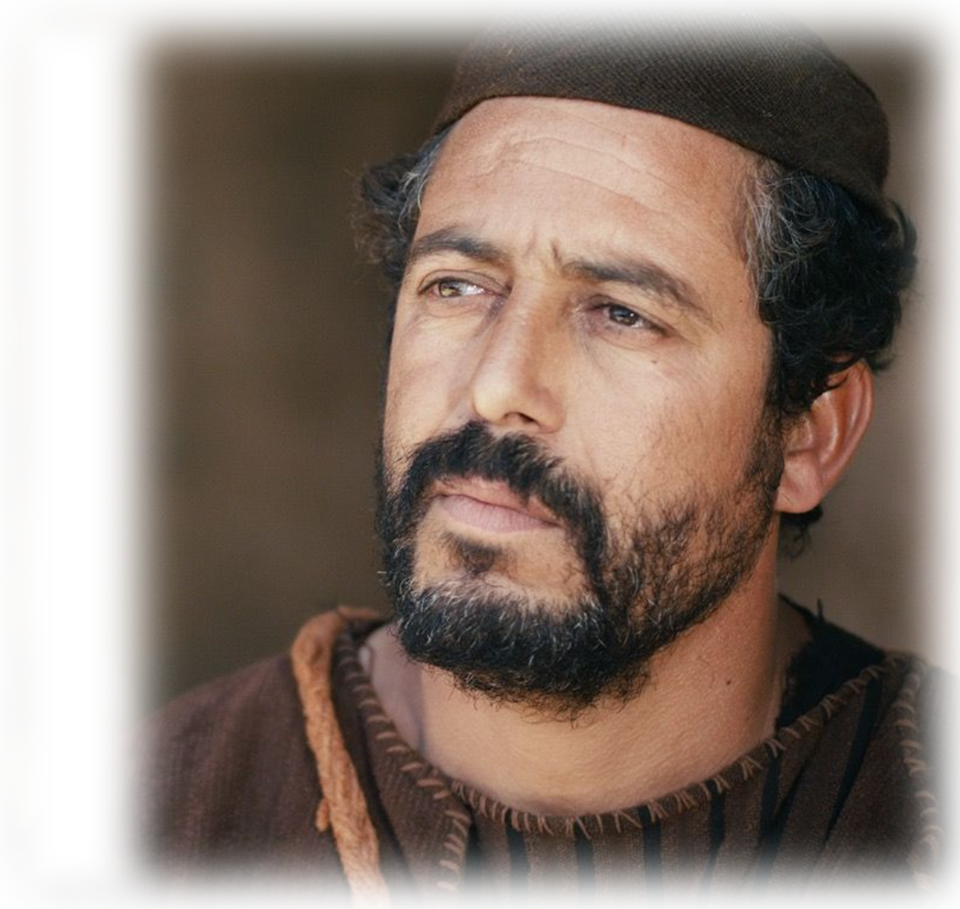
Meet the Prophet:
The words of Amos,
“Burdened””
No genealogy .
Notes:
Matthew

Slide 9
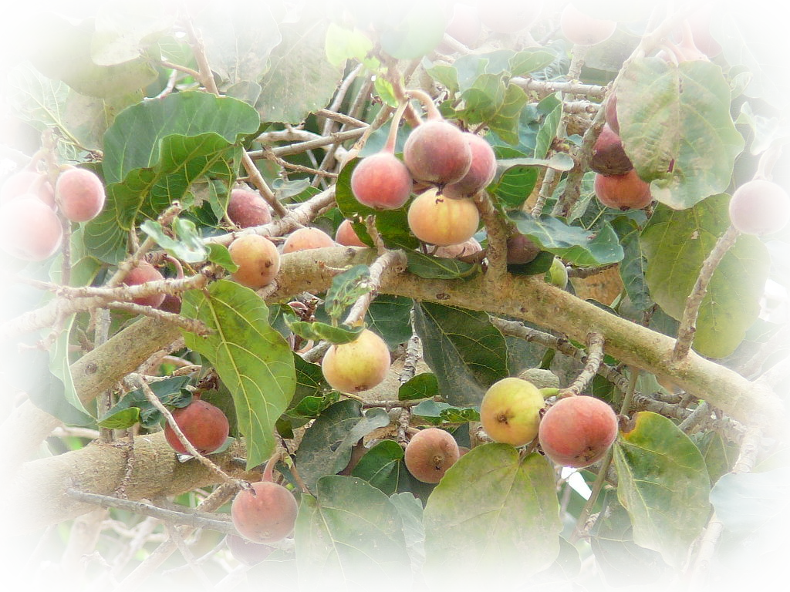
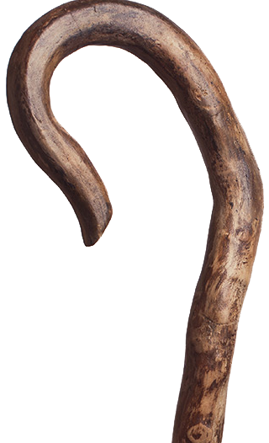
Meet the Prophet:
The words of Amos, one of the shepherds
^{7:14} I was a
shepherd, and
I also took care of sycamore-fig trees.
Notes:
https://upload.wikimedia.org/wikipedia/commons/thumb/d/df/Ficus_sycomorus_0003.jpg/1024px-Ficus_sycomorus_0003.jpg

Slide 10
Meet the Prophet:
The words of Amos, one of the shepherds
^{7:15} But the LORD took me from tending the flock
and said to me, 'Go, prophesy to my people Israel.'

Slide 11
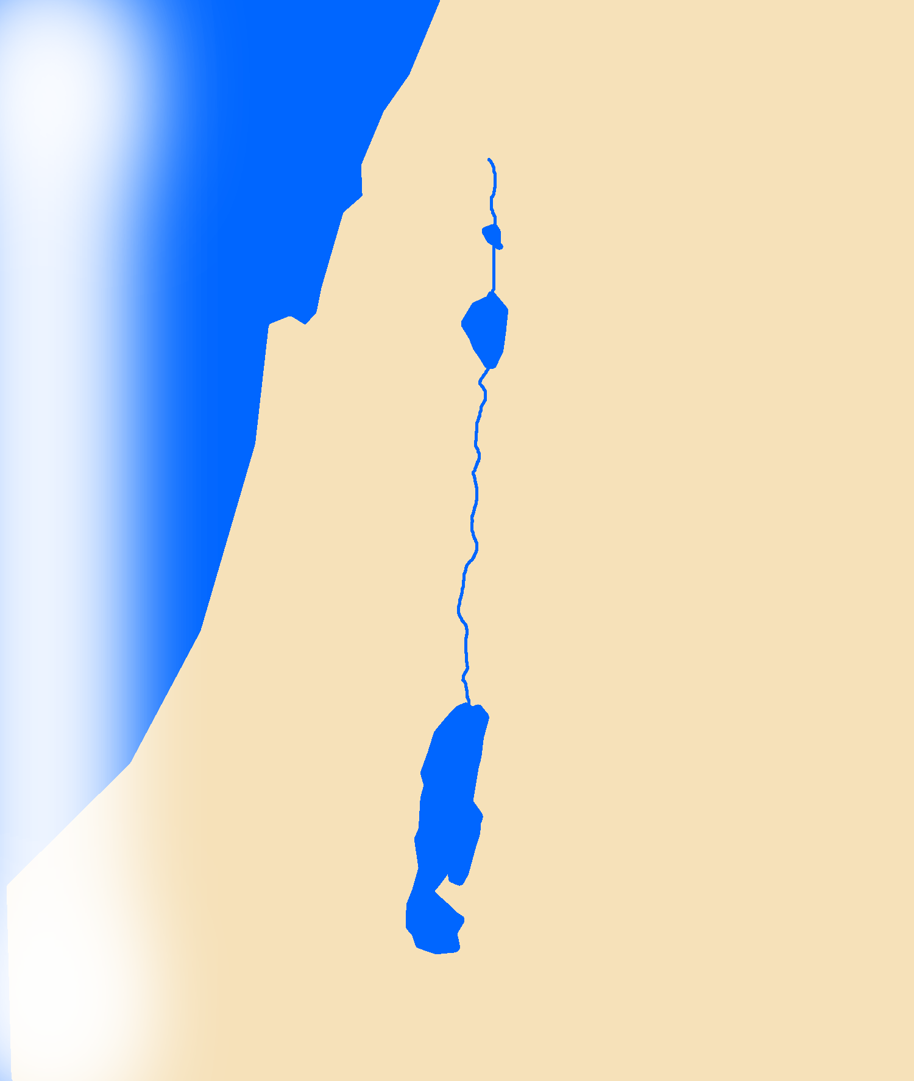

Meet the Prophet:
The words of Amos, one of the shepherds
^{7:15} But the LORD took me from tending the flock
and said to me, 'Go, prophesy to my people Israel.'

Slide 12
Meet the Prophet:
The words of Amos, one of the shepherds of Tekoa
He was called to
minister to:
Samaria of Israel
Notes:
See illustration of Weirsbe—preacher

Slide 13
Meet the Prophet:
The words of Amos, one of the shepherds of Tekoa--what he saw concerning Israel

Slide 14

His Times:
760 - 750 B.C.
Peace, Prosperity,
and Corruption
The words of Amos, one of the shepherds of Tekoa--what he saw concerning Israel two years before the earthquake, when Uzziah was king of Judah and Jeroboam son of Jehoash was king of Israel.

Slide 15

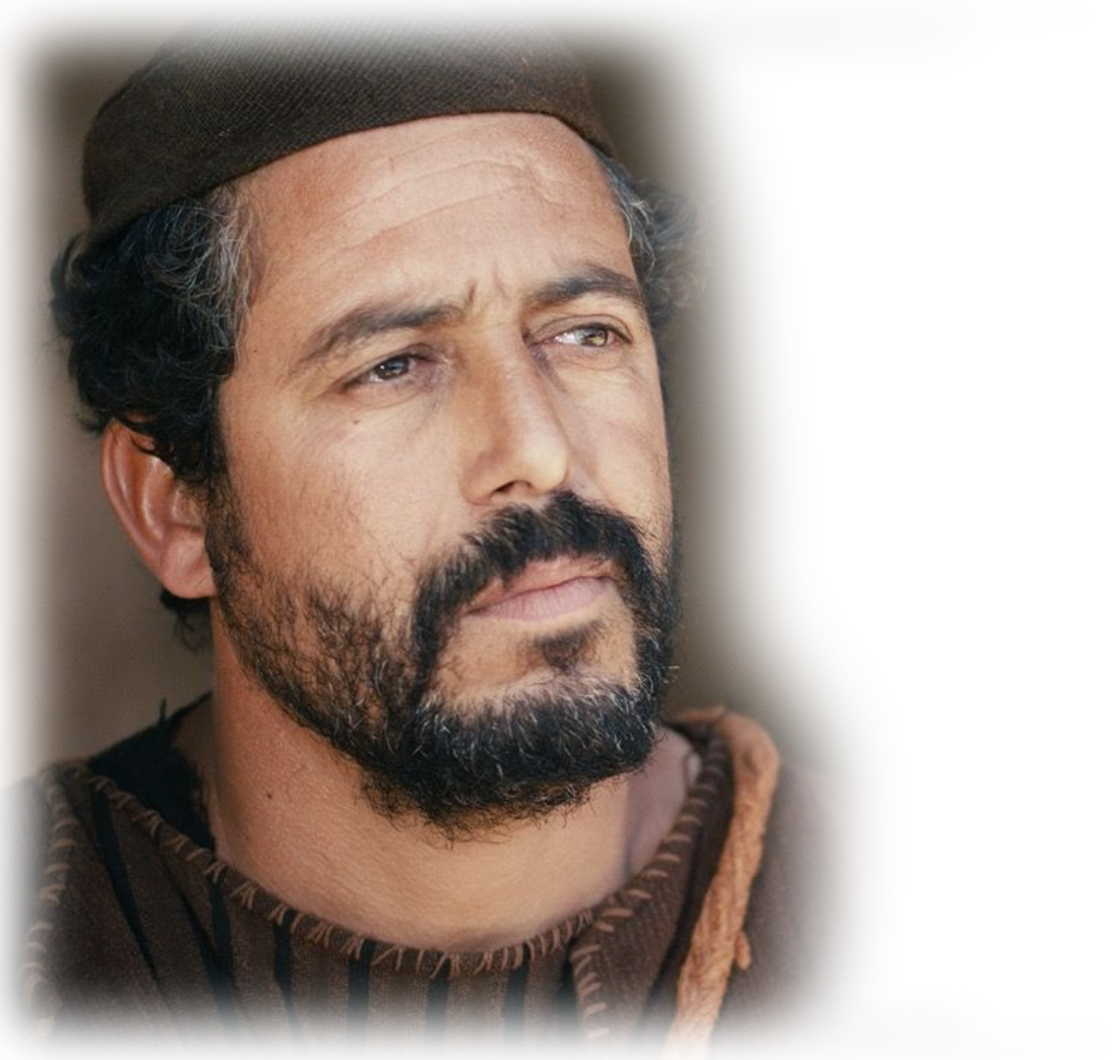
His Text:
2 He said:
"The LORD roars from Zion and thunders from Jerusalem”
^{Joel} ^{3:16}
The LORD will roar from Zion and thunder from Jerusalem;

Slide 16
And the meaning?
2 He said:
"The LORD roars from Zion and thunders from Jerusalem”
^{3:4} Does a lion roar in the thicket when he has no prey?
Notes:
The Lord is about to devour His prey!

Slide 17
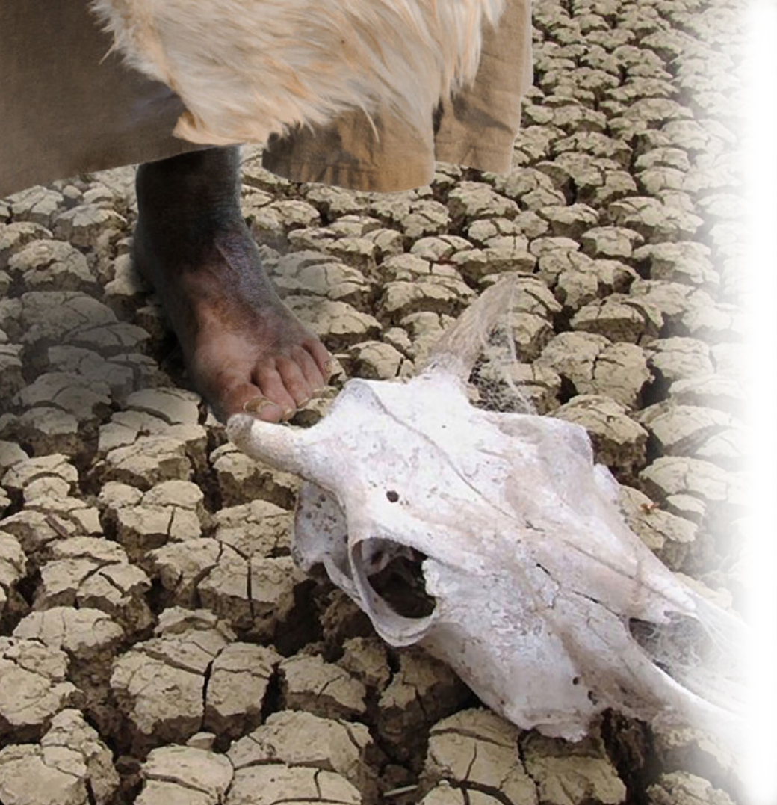
And the meaning?
“…the pastures of the shepherds dry up, and the top of Carmel withers.“
^{1Ki 17:1} Elijah … said … there will be neither dew nor rain in the next few years except at my word."
Notes:
Where do we find dry pastures in connection with the top of Carmel?
1 Kings 17:1

Slide 18
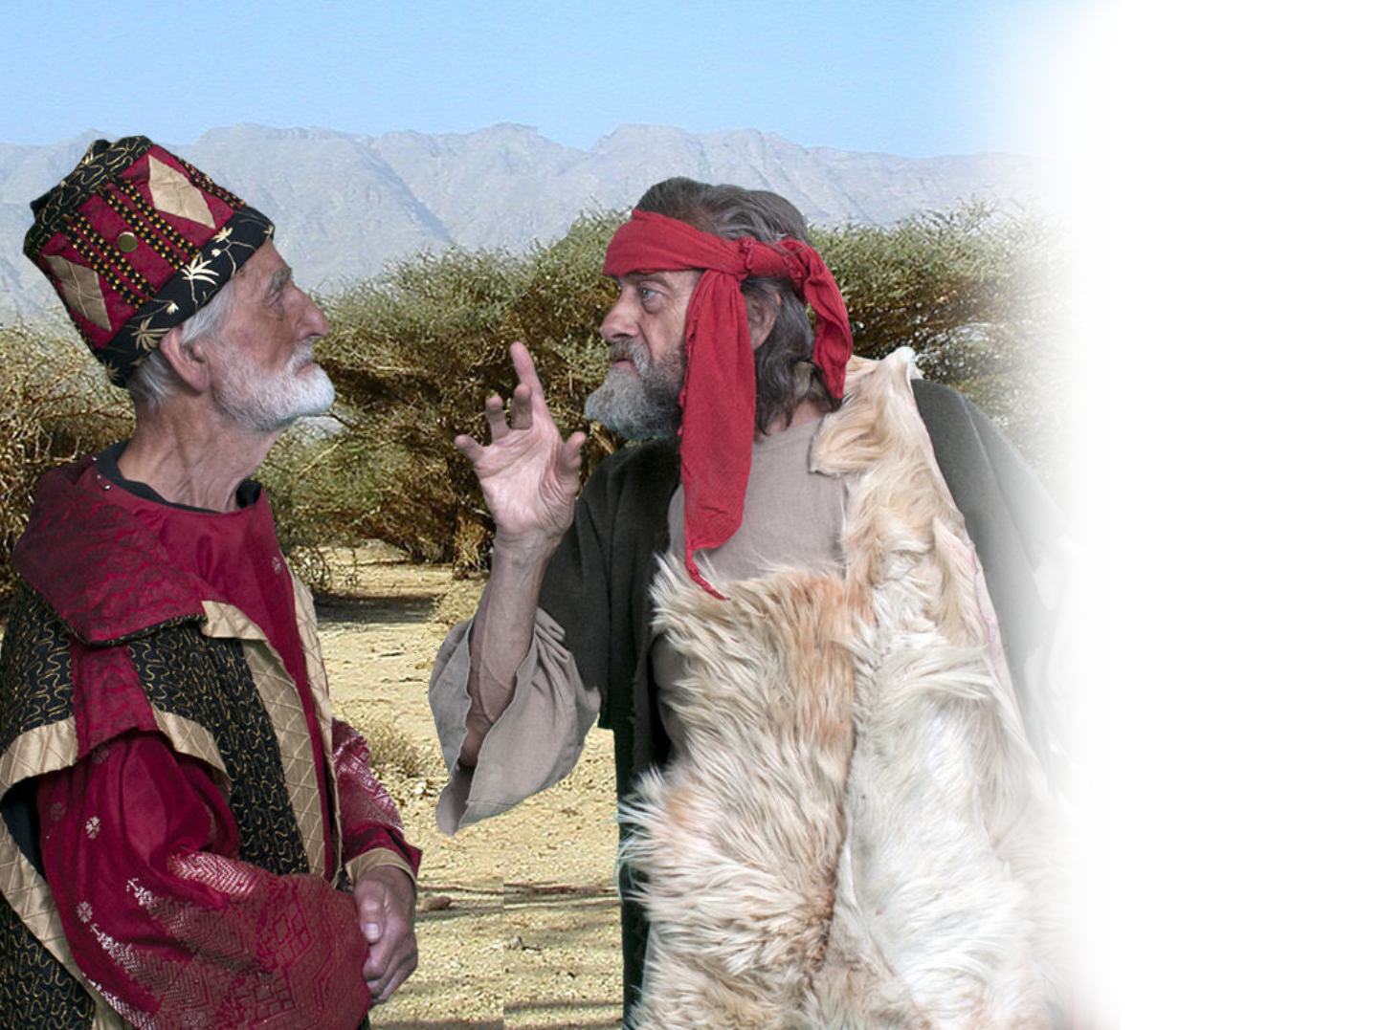
And the meaning?
“… and the top of Carmel withers.“
¹⁶ … Ahab went to meet Elijah. ¹⁸ Elijah replied. “… You have abandoned the LORD's commands and have followed the Baals.
Notes:
What happened at the top of Mount Carmel?
A Show Down …

Slide 19
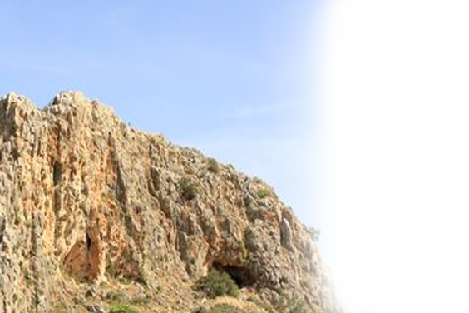
And the meaning?
“… and the top of Carmel withers.“
^{1Ki 18:19} … meet me on Mount Carmel. And bring the four hundred and fifty prophets of Baal and the four hundred prophets of Asherah, ….
Notes:
https://www.pinterest.com/pin/3870349657780909/
What happened at the top of Mount Carmel?
A Show Down …

Slide 20
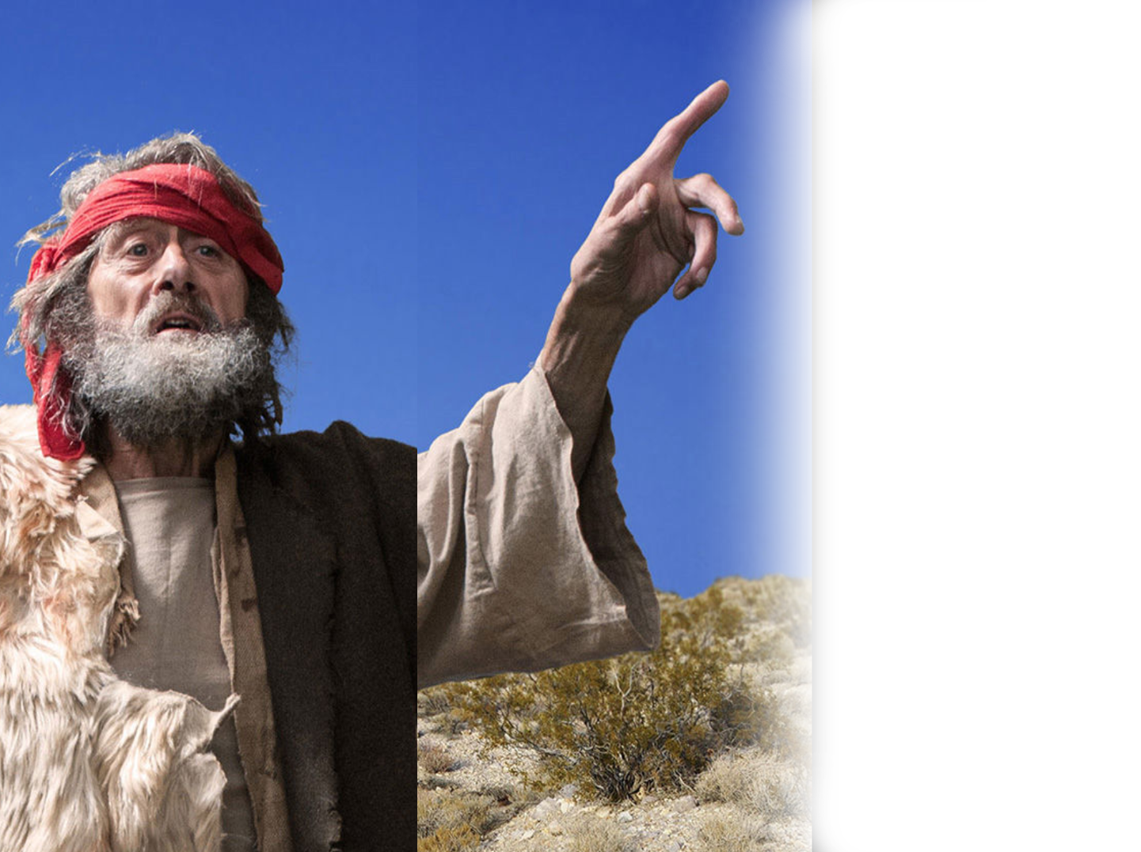
And the meaning?
^{18:21} Elijah went before the people and said, "How long will you waver between two opinions? If the LORD is God, follow him; but if Baal is God, follow him." But the people said nothing.
Notes:
What happened at the top of Mount Carmel?
A Show Down …

Slide 21
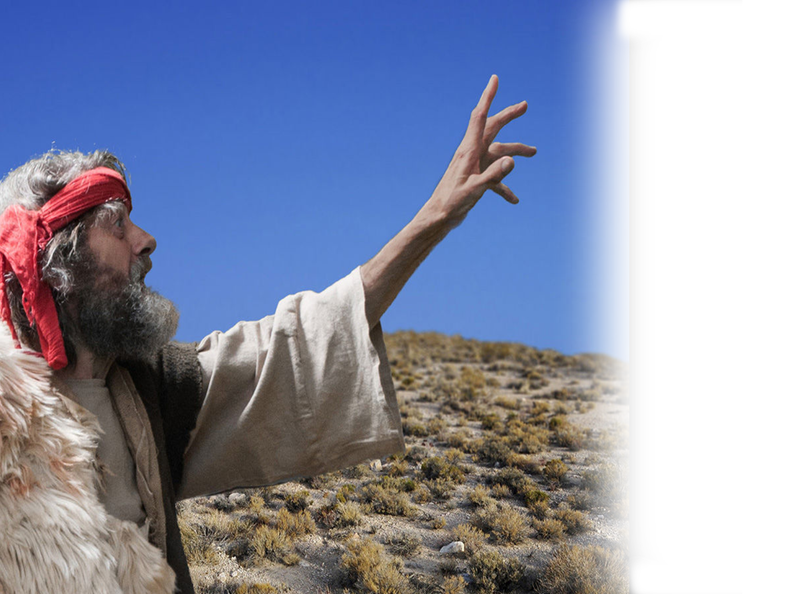
And the meaning?
²³ … prepare the other bull and put it on the wood but not set fire to it. ²⁴ Then you call on the name of your god, and I will call on the name of the LORD. The god who answers by fire--he is God."
Notes:
Now Elijah the Tishbite, from Tishbe in Gilead, said to Ahab, "As the LORD, the God of Israel, lives, whom I serve, there will be neither dew nor rain in the next few years except at my word." (1Ki 17:1 NIV)

Slide 22
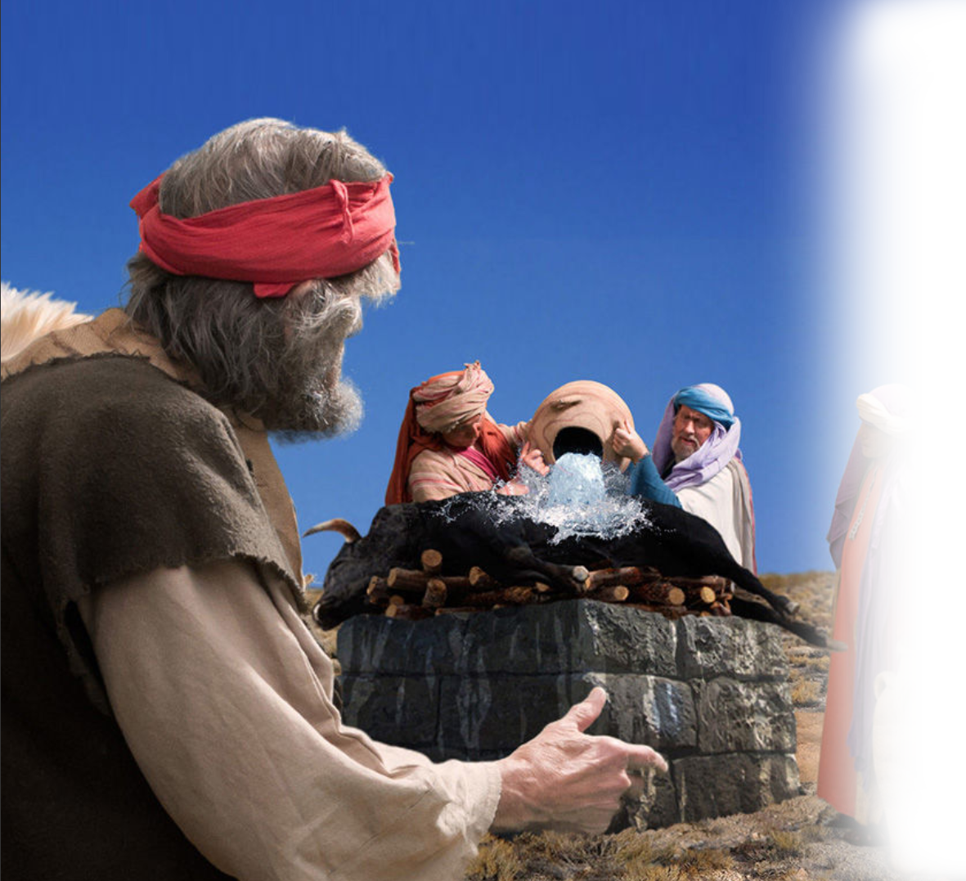
And the meaning?
³² With the stones he built an altar in the name of the LORD, and he dug a trench around it …. ³³ Fill four large jars with water and pour it on the offering … ³⁵ and even filled the trench.
Notes:
Now Elijah the Tishbite, from Tishbe in Gilead, said to Ahab, "As the LORD, the God of Israel, lives, whom I serve, there will be neither dew nor rain in the next few years except at my word." (1Ki 17:1 NIV)

Slide 23
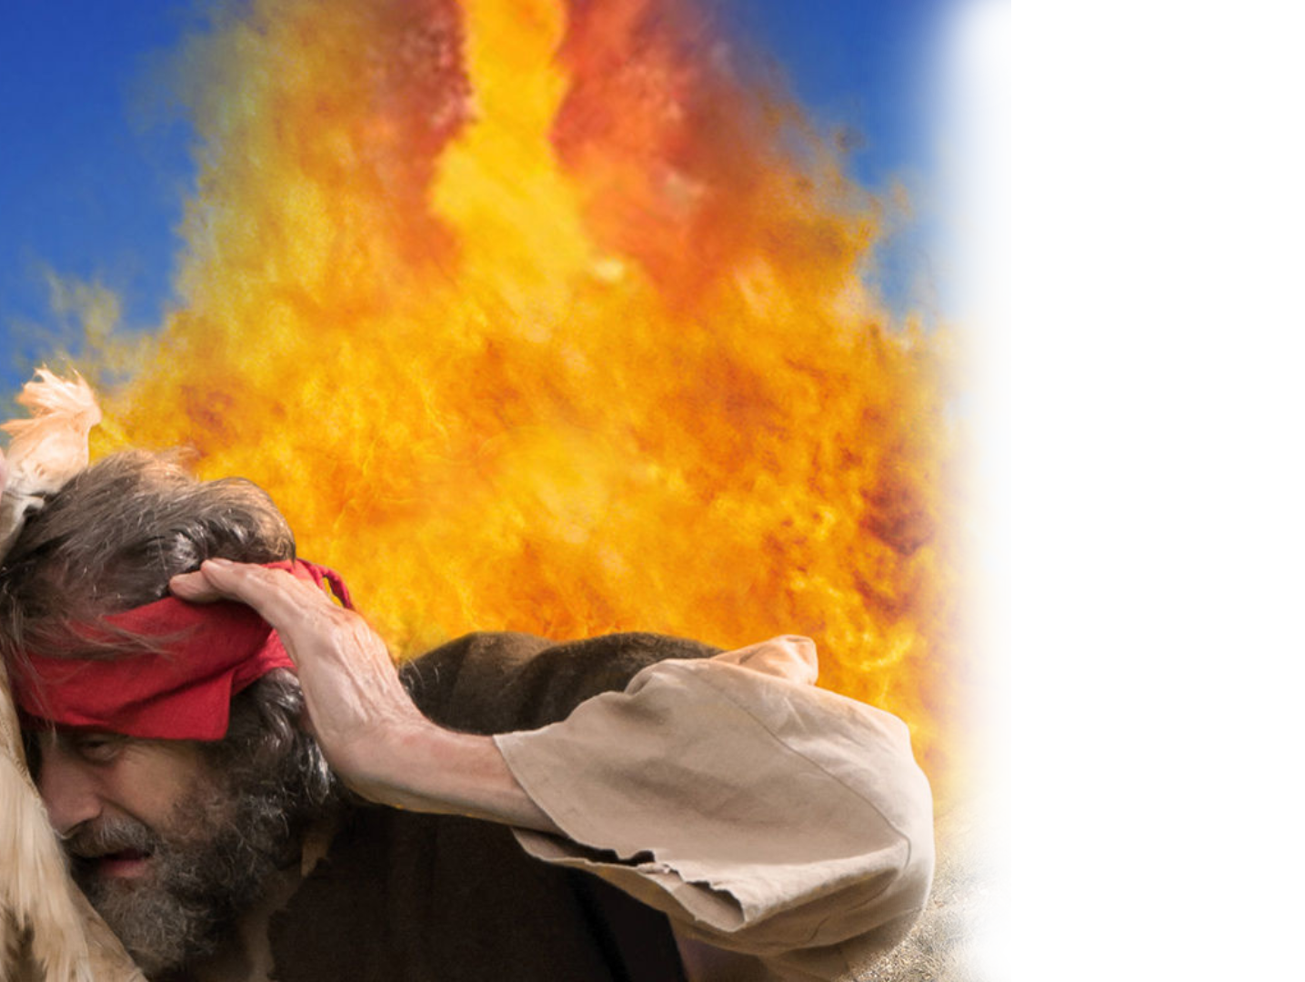
And the meaning?
³⁶ Elijah stepped forward and prayed …
³⁸ Then the fire of the LORD fell and burned up the sacrifice, the wood, the stones and the soil, and also licked up the water in the trench.
Notes:
Now Elijah the Tishbite, from Tishbe in Gilead, said to Ahab, "As the LORD, the God of Israel, lives, whom I serve, there will be neither dew nor rain in the next few years except at my word." (1Ki 17:1 NIV)

Slide 24
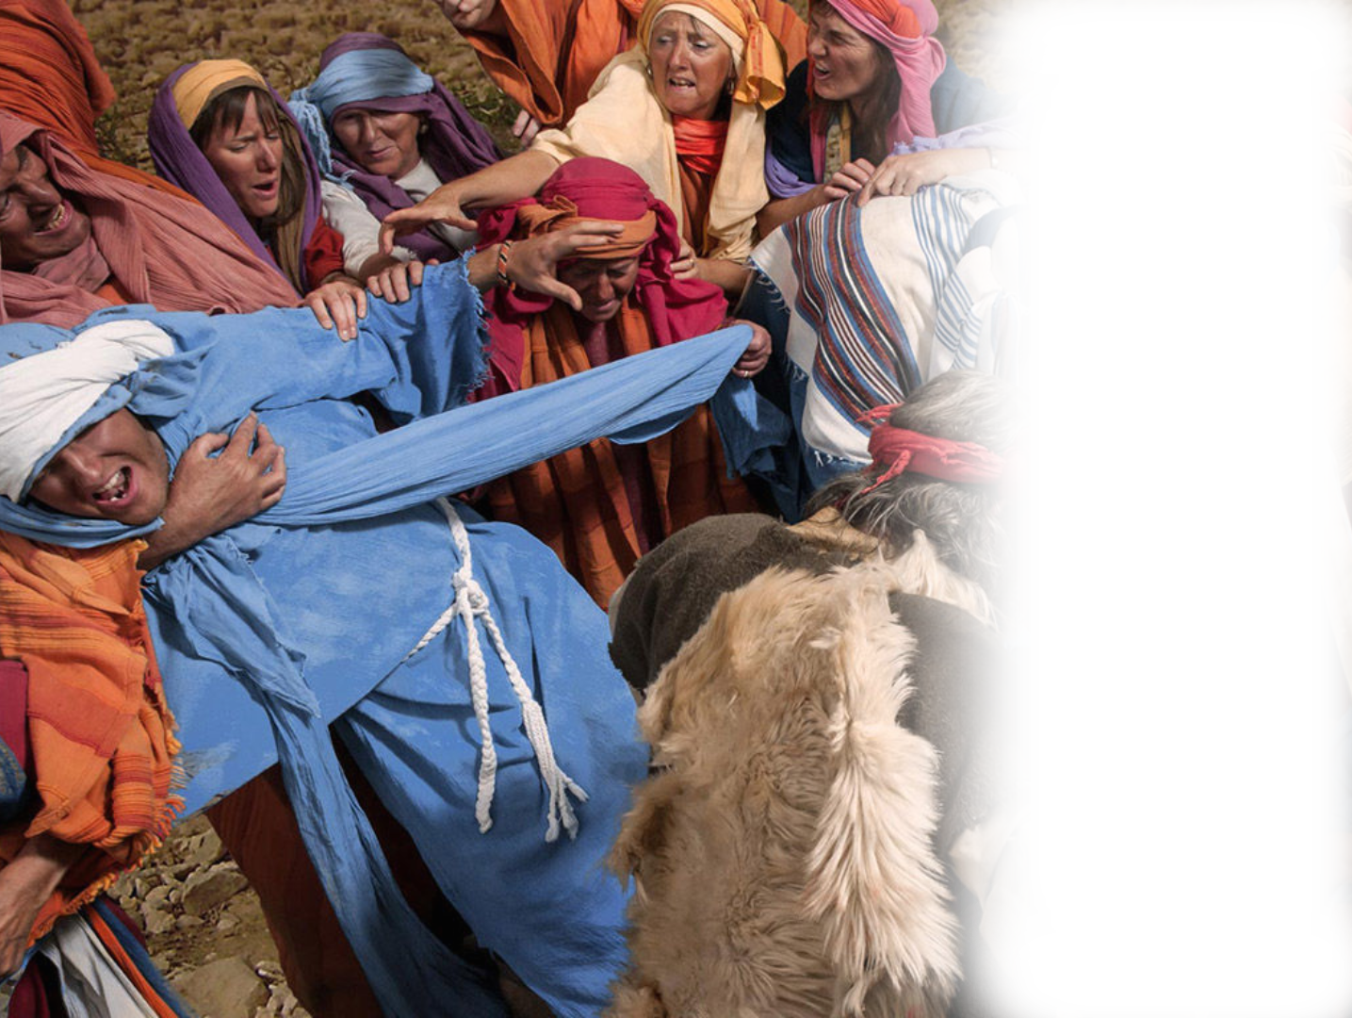
And the meaning?
⁴⁰ Then Elijah commanded them, "Seize the prophets of Baal. Don't let anyone get away!" They seized them, and Elijah had them brought down to the Kishon Valley and slaughtered there.
Notes:
Now Elijah the Tishbite, from Tishbe in Gilead, said to Ahab, "As the LORD, the God of Israel, lives, whom I serve, there will be neither dew nor rain in the next few years except at my word." (1Ki 17:1 NIV)

Slide 25
His Text:
2 He said: “The LORD roars from Zion and thunders from Jerus-alem; the pastures of the shepherds dry up, and the top of Carmel withers.”
A Showdown is COMING!

Slide 26
Did a LION
Just ROAR?
Notes:
https://cutewallpaper.org/21/hd-lion-background/68-Roaring-Lion-Wallpapers-on-WallpaperPlay.jpg

Slide 27
What’s the Solution:
^{5:4} Seek me and live
^{5:6} Seek the LORD and live
^{5:14} Seek good, not evil, that you may live.

Slide 28
Take the Challenge …
"How long will you waver between two opinions? If the LORD is God, follow him!”
How do you follow Him?
Seek Him, Seek Him, Seek Him!

Slide 29
Let’s Pray

