Slide 1
ACTS 20:22-23:24
www.BiblePoint.com
2011 © Single Initiative LLC
Notes:
Copyright © 2000-2011. All rights reserved. Bible Point is a registered trademark of Single Initiative, LLC. All other trademarks acknowledged.
Bible Point contains graphics from Bible Point artists. These illustrations belong to Bible Point and the respective artists. You may use the designs and illustrations for graphical illustration of lessons free and without special permission, provided they are not used in any way that maligns the Christian faith. Furthermore, republication or production of any illustration by any other graphic service whether it be in book, in a machine-readable form, or in any other design resource is strictly prohibited. Furthermore, they cannot be duplicated or resold as any other form of publishing, clip art, or graphic resource.
So What does it mean? (A simple translations of the legal jargon)
So, if you don’t own the presentation(s), graphic(s), and text(s) how can you legally use them? The purchase of the license allows you to use all the images in the product. However, the actual ownership and copyright of the presentation(s), graphic(s), and text(s) remain the property of Bible Point and its licensors. If you had plans on using this product in your “for sale” work—think again!
License Agreement
Article 1: License Grant
All the graphics and text in Bible Point presentations (excluding quotes from the Bible and stated sources) are the intellectual and real property of Bible Point and its licensors, and is protected by law, including United States copyright laws and international treaties. Bible Point grants to you a license:
1. To use the presentation in a single church, single school, or single office of a Christian organization.
2. To make a single archival back-up copy of the program.
3. To modify the presentation(s) and merge with other presentations in a single church, school, or Christian organization.
4. To transfer to another party if that party agrees to accept the terms and conditions of this agreement, and you do not retain any copies of the presentation, whether printed, machine readable, modified, or merged form.
Article 2: Terms
This license is effective until terminated. You may terminate the license at any time by destroying the presentation(s), graphic(s), or text(s) together with all copies, modifications and merged portions in any form. Bible Point may terminate your license if you fail to comply with this Agreement. You agree, upon such termination, for any reason, to destroy the presentation(s), graphics, and text(s) with all copies, modifications, and merged portions in any form.
Article 3: Disclaimers
1. Bible Point presentations, graphics, and texts are licensed to you As Is. You, the consumer, bear the entire risk relating to the quality and performance of the presentation(s), graphic(s), or text(s). In no event will Bible Point be liable for damages resulting from any defect.
2. Thirty-day limited warrantee on disks. Bible Point warrants the disks to be free of defects in material and workmanship under normal use for 30 days after purchase. During the 30-day period you may return a defective presentation, graphic, or text with proof of purchase and it will be replaced without charge, unless the presentation is damaged by misuse.
Article 4: General
1. You may not sub-license, assign, or transfer the license of the presentation(s), graphic(s), or text(s) except as provided by this Agreement.
2. This Agreement will be governed by the laws of the State of Michigan.
So What does it mean? (A simple translations of the legal jargon)
May I let someone borrow or copy my licensed Bible Point presentation (even after I modified it)? As long as it is within your local church, or single school, or the immediate office of a Christian organization you may. Otherwise, please refer the person interested in borrowing to: http://www.biblepoint.com or E-mail: dh@biblepoint.com with any related questions.
---------------------------------------------------------------------------------------------------------------------------
Scripture taken from the HOLY BIBLE, NEW INTERNATIONAL VERSION®. NIV®. Copyright©1973, 1978, 1984 by International Bible Society. Used by permission of Zondervan. All rights reserved.

Slide 2
GOING BEYOND
Notes:
Bible Background = Free image from = http://www.sxc.hu/browse.phtml?f=download&id=1336835

Slide 3
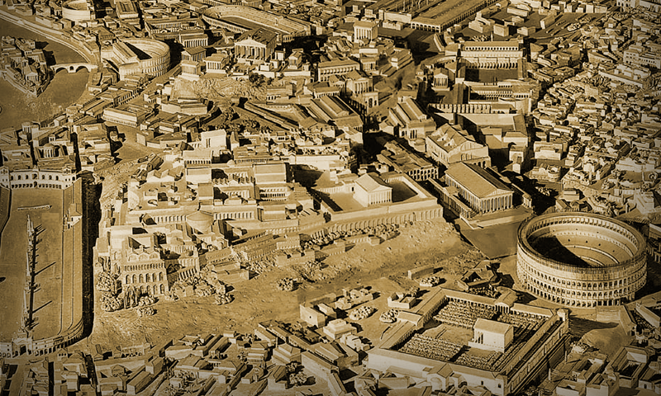
The Book of Acts Ended Abruptly.
There is no...
“and he lived happily ever after. The End.”
In fact, Paul was released from prison and made at least five more stops before the end.

Slide 4
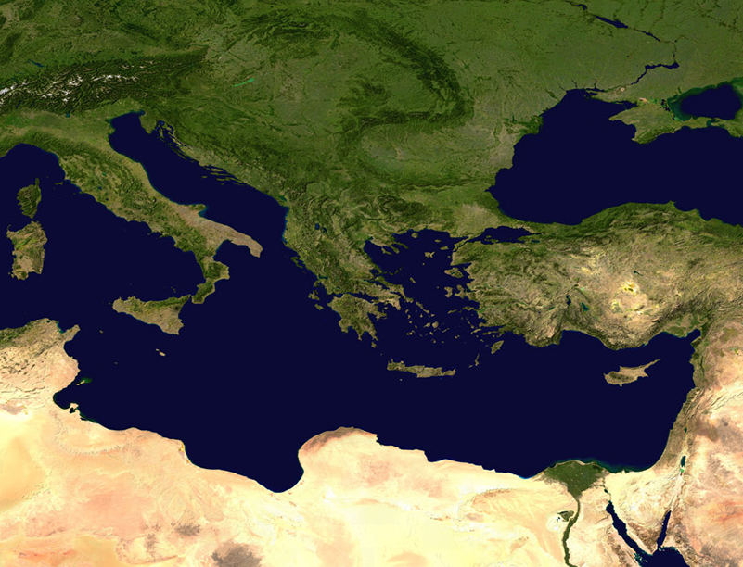
Crete: Titus 1:5
⁵ The reason I left you in Crete
Rome
Crete

Slide 5
Ephesus: 1 Timothy 1:3
³ As I urged you when I went into Macedonia
Rome
Macedonia
Crete

Slide 6
Corinth: 2 Timothy 4:20
²⁰ Erastus stayed in Corinth,
Rome
Macedonia
Corinth
Crete

Slide 7
Miletus: 2 Timothy 4:20
and I left Trophimus sick in Miletus.
Rome
Macedonia
Corinth
Miletus
Crete

Slide 8
Troas: 2 Timothy 4:13
bring the cloak that I left with Carpus at Troas,
Rome
Macedonia
Troas
Corinth
Miletus
Crete

Slide 9
Rome: 2 Timothy 1:17
... in Rome, he searched hard for me until he found me.
Rome
Macedonia
Troas
Corinth
There was no retirement from the faith!
Miletus
Crete

Slide 10
5 Truths from these stops:
God wants us here ...

Slide 11
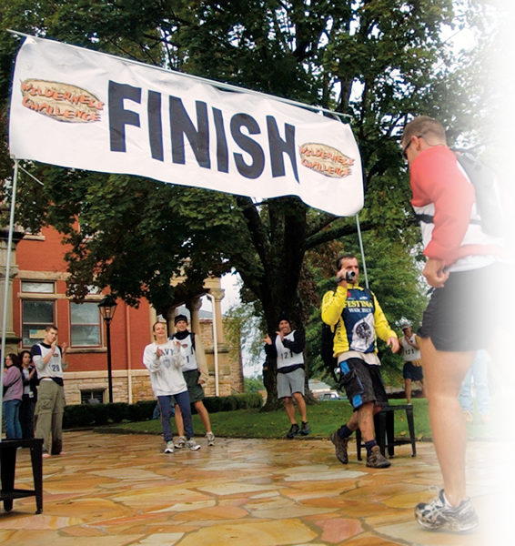
1—To FINISH the work Titus 1:5
⁵ The reason I left you in Crete was that you might straighten out what was left unfinished and appoint elders in every town, as I directed you.
Notes:
Finish line = free = http://upload.wikimedia.org/wikipedia/commons/9/9e/Navy_triathletes_at_the_Finish_Line.jpg

Slide 12
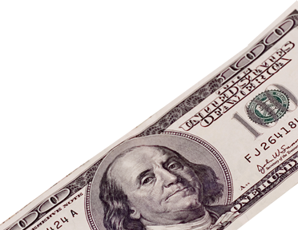
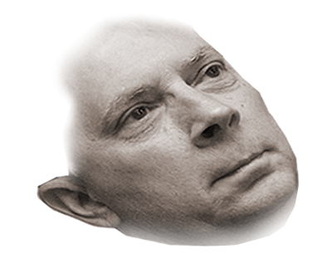
2—To COUNTER error with TRUTH
^{1 Tim 1:3} As I urged you when I went into Macedonia, stay there in Ephesus
so that you may command
certain men not to teach
false doctrines any
longer
Notes:
$100 dollar bill = free =http://www.dreamstime.com/dollar-free-stock-image-imagefree2971794
Dennis Henderson’s face superimposed on the $100 dollar bill = FREE = BiblePoint photo.

Slide 13
2—To COUNTER error with TRUTH
⁴ nor to devote themselves to myths and endless genealogies. These promote controversies rather
than God's work--which is
by faith.
Notes:
$100 dollar bill = free =http://www.dreamstime.com/dollar-free-stock-image-imagefree2971794

Slide 14
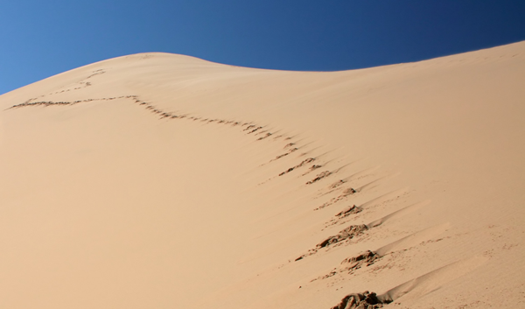
3—To (possibly) GO IT ALONE 2 Tim 4:20
²⁰ Erastus stayed in Corinth, and I left Trophimus sick in Miletus.
Notes:
I have decided to follow Jesus – no turning back, no turning back.
Footprints = Free = dreamstimefree_1056009

Slide 15
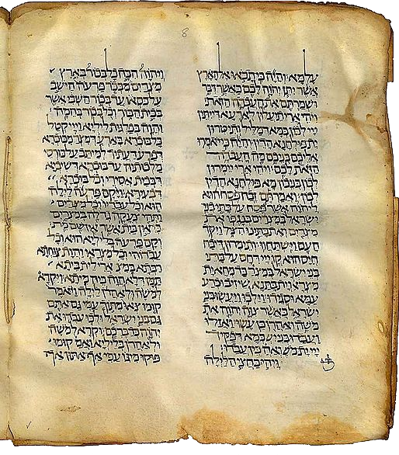
4—To SUPPORT His Servants 2 Tim 4:13
¹³ When you come, bring the cloak that I left with Carpus at Troas, and my scrolls, especially the parchments.
Notes:
Parchment = free = http://commons.wikimedia.org/wiki/File:Targum.jpg

Slide 16

5—To REMAIN True to the End 2 Tim 1:17
^{1:17} On the contrary, when he was in Rome,
he searched hard for me until he found me.

Slide 17
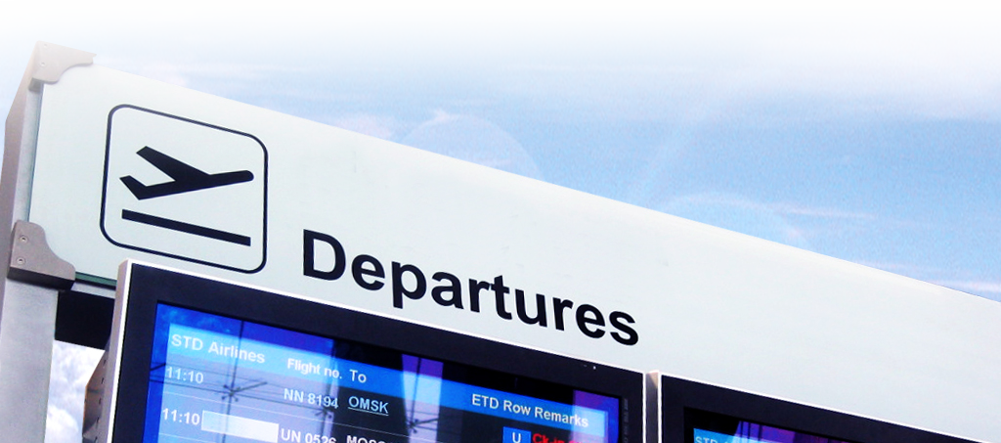
5—To REMAIN True to the End 2 Tim 1:17
^{1:15} You know that everyone in the province of Asia has deserted me, including Phygelus and Hermogenes.
Notes:
Departure sign = Free = http://www.sxc.hu/browse.phtml?f=download&id=954740

Slide 18
5—To REMAIN True to the End 2 Tim 4:9
⁹ Do your best to come to me quickly,
¹⁰ for Demas, because he loved this world, has deserted me and has gone to Thess.

Slide 19


5—To REMAIN True to the End 2 Tim 4:9
¹⁰ Crescens has gone to Galatia, and Titus to Dalmatia. ¹¹ Only Luke is with me. Get Mark and bring him with you, because he is helpful to me in my ministry.

Slide 20
Let’s Sum It All Up
We are here for a purpose:
God wants us ...
1-To FINISH the work
2-To EXEMPLIFY the truth
3-To GO IT ALONE (if needs be)
4-To SUPPORT His servants
5-To REMAIN TRUE to the end

Slide 21
Let’s Pray!

