Slide 1
ACTS 20:22-23:24
www.BiblePoint.com
2011 © Single Initiative LLC
Notes:
Copyright © 2000-2011. All rights reserved. Bible Point is a registered trademark of Single Initiative, LLC. All other trademarks acknowledged.
Bible Point contains graphics from Bible Point artists. These illustrations belong to Bible Point and the respective artists. You may use the designs and illustrations for graphical illustration of lessons free and without special permission, provided they are not used in any way that maligns the Christian faith. Furthermore, republication or production of any illustration by any other graphic service whether it be in book, in a machine-readable form, or in any other design resource is strictly prohibited. Furthermore, they cannot be duplicated or resold as any other form of publishing, clip art, or graphic resource.
So What does it mean? (A simple translations of the legal jargon)
So, if you don’t own the presentation(s), graphic(s), and text(s) how can you legally use them? The purchase of the license allows you to use all the images in the product. However, the actual ownership and copyright of the presentation(s), graphic(s), and text(s) remain the property of Bible Point and its licensors. If you had plans on using this product in your “for sale” work—think again!
License Agreement
Article 1: License Grant
All the graphics and text in Bible Point presentations (excluding quotes from the Bible and stated sources) are the intellectual and real property of Bible Point and its licensors, and is protected by law, including United States copyright laws and international treaties. Bible Point grants to you a license:
1. To use the presentation in a single church, single school, or single office of a Christian organization.
2. To make a single archival back-up copy of the program.
3. To modify the presentation(s) and merge with other presentations in a single church, school, or Christian organization.
4. To transfer to another party if that party agrees to accept the terms and conditions of this agreement, and you do not retain any copies of the presentation, whether printed, machine readable, modified, or merged form.
Article 2: Terms
This license is effective until terminated. You may terminate the license at any time by destroying the presentation(s), graphic(s), or text(s) together with all copies, modifications and merged portions in any form. Bible Point may terminate your license if you fail to comply with this Agreement. You agree, upon such termination, for any reason, to destroy the presentation(s), graphics, and text(s) with all copies, modifications, and merged portions in any form.
Article 3: Disclaimers
1. Bible Point presentations, graphics, and texts are licensed to you As Is. You, the consumer, bear the entire risk relating to the quality and performance of the presentation(s), graphic(s), or text(s). In no event will Bible Point be liable for damages resulting from any defect.
2. Thirty-day limited warrantee on disks. Bible Point warrants the disks to be free of defects in material and workmanship under normal use for 30 days after purchase. During the 30-day period you may return a defective presentation, graphic, or text with proof of purchase and it will be replaced without charge, unless the presentation is damaged by misuse.
Article 4: General
1. You may not sub-license, assign, or transfer the license of the presentation(s), graphic(s), or text(s) except as provided by this Agreement.
2. This Agreement will be governed by the laws of the State of Michigan.
So What does it mean? (A simple translations of the legal jargon)
May I let someone borrow or copy my licensed Bible Point presentation (even after I modified it)? As long as it is within your local church, or single school, or the immediate office of a Christian organization you may. Otherwise, please refer the person interested in borrowing to: http://www.biblepoint.com or E-mail: dh@biblepoint.com with any related questions.
---------------------------------------------------------------------------------------------------------------------------
Scripture taken from the HOLY BIBLE, NEW INTERNATIONAL VERSION®. NIV®. Copyright©1973, 1978, 1984 by International Bible Society. Used by permission of Zondervan. All rights reserved.

Slide 2
To Rome and Beyond!
And so we came to Rome.
(Act 28:14)
Notes:
Background photo of Rome (model) = Free = http://rst.gsfc.nasa.gov/Sect6/tmpBFEF-tmp_tcm20-170148.jpg
Population of Rome = the best guess is based on the number of recipients of the grain dole under Augustus, implying a population of around 800,000-1,200,000. = Larger than Detroit!
Almost a twice as large as the current population of Washington DC = 599,657 in July 2009
At time of Paul’s arrival the Colosseum was not yet under construction. Construction started in 72 AD^{[1]} under the emperor Vespasian and was completed in 80 AD
The population in 2010 of areas ruled by the Roman Empire at its greatest extent (in 117 A.D.) amounted to some 690 million people across 37 modern states.

Slide 3
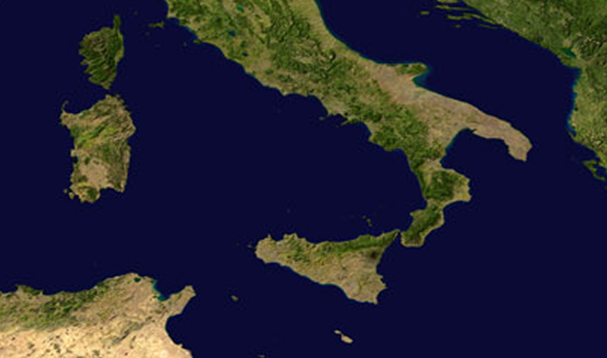
His Roman Encouragement
¹⁵ The brothers there had heard that we were coming, and they traveled as far as the Forum of Appius and the Three Taverns to meet us.
ROME

Slide 4
His Roman Encouragement
At the sight of these men Paul thanked God and was encouraged.
ROME

Slide 5
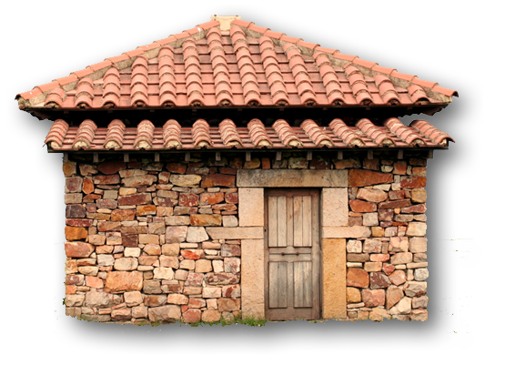
His Roman Incarceration
¹⁶ When we got to Rome,
Paul was allowed to live by himself, with a soldier to guard him.
ROME
Notes:
Roman house = FREE from = http://upload.wikimedia.org/wikipedia/commons/7/71/Campa_07.JPG

Slide 6
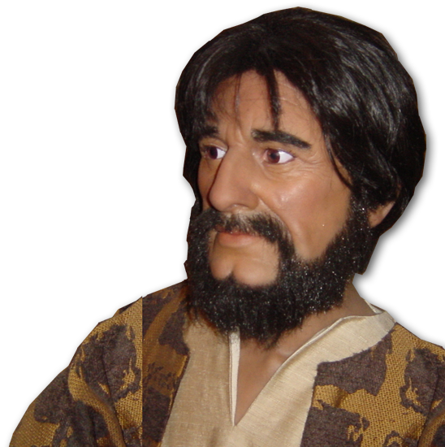
The Roman Jewish Community
¹⁷ Three days later he called together the leaders of the Jews. When they had assembled, Paul said to them:

Slide 7
His Roman Trial Explained
"My brothers, although I have done nothing
against our people or against the customs of
our ancestors, I was arrested in Jerusalem
and handed over to the Romans.

Slide 8
His Roman Trial Explained
¹⁸ They examined me and wanted to release me, because I was not guilty of any crime deserving death. ¹⁹ But when the Jews objected, I was compelled to appeal to Caesar--not that I had any charge to ...

Slide 9
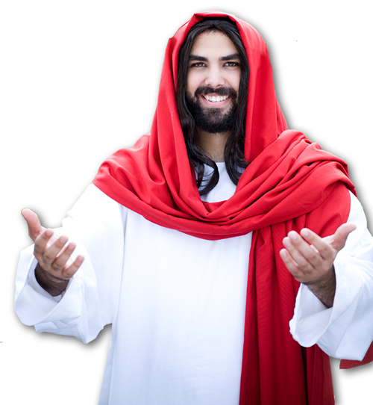
His Roman Trial Explained
bring against my own people.
²⁰ For this reason I have asked to see you and talk with you. It is because of the hope of Israel that I am bound with this chain.“

Slide 10
His Roman Reputation
²¹ They replied,
"We have not received any letters from Judea concerning you, and none of the brothers who have come from there has reported or said anything bad about you. ²² But we want to hear what your views are, for we know that people everywhere are talking against this sect."

Slide 11
His Roman Teaching
²³ They arranged to meet Paul on a certain day, and came in even larger numbers to the place where he was staying. From morning till evening he explained and declared to them the kingdom of God and
tried to convince them about
Jesus from the Law of Moses
and from the Prophets.

Slide 12
The Roman Response
²⁴ Some were convinced by what he said,
but
others would not believe.
²⁵ They disagreed among themselves and began to leave after Paul had made this final statement:

Slide 13
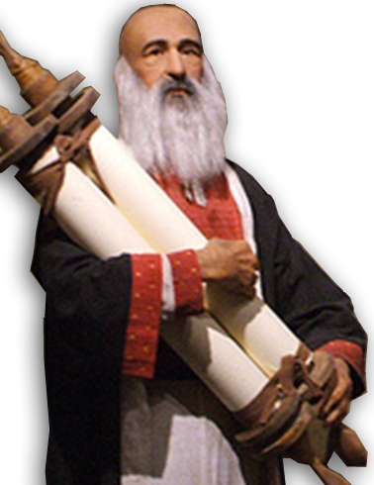
His Authority
"The Holy Spirit spoke the truth to your forefathers when he said through Isaiah the prophet:
Isaiah 6:5 “the LORD Almighty”
John 12:41 “Isaiah said this because he saw Jesus' glory
and spoke about him.”
Notes:
Isaiah = Free with credit to = http://www.flickr.com/photos/singingwitness/4655047954/sizes/o/in/photostream/

Slide 14
His Authority
²⁶ Go to this people and say, "You will be ever hearing but never understanding; you will be ever seeing but never perceiving.” ²⁷ For this people's heart has become calloused; they hardly hear with their ears, and they have closed their eyes.
Notes:
Isaiah = Free with credit to = http://www.flickr.com/photos/singingwitness/4655047954/sizes/o/in/photostream/

Slide 15
His Authority
Otherwise they might see with their eyes, hear with their ears, understand with their hearts and turn, and I would heal them.‘
Notes:
Isaiah = Free with credit to = http://www.flickr.com/photos/singingwitness/4655047954/sizes/o/in/photostream/

Slide 16
His Conclusion
Otherwise they might see with their eyes, hear with their ears, understand with their hearts and turn, and I would heal them.‘
²⁸ "Therefore I want you to know that God's salvation has been sent to the Gentiles, and they will listen!"
Notes:
Isaiah = Free with credit to = http://www.flickr.com/photos/singingwitness/4655047954/sizes/o/in/photostream/

Slide 17
²⁹ And when he had spoken these words, the Jews departed, having a great dispute among themselves. (NAS)

Slide 18
His Roman Ministry
³⁰ For two whole years Paul stayed there in his own rented house and welcomed all who came to see him.
³¹ Boldly and without hindrance he
preached the kingdom of God
and taught about the
Lord Jesus Christ.

Slide 19

Two Bookends
“ ... you will be
my witnesses in Jerusalem, and in all Judea and Samaria, and to the ends of the earth."
(Act 1:8)
“ ... I want you to know that God's salvation has been sent to the Gentiles, and
they will listen!"
(Act 28:28)

Slide 20
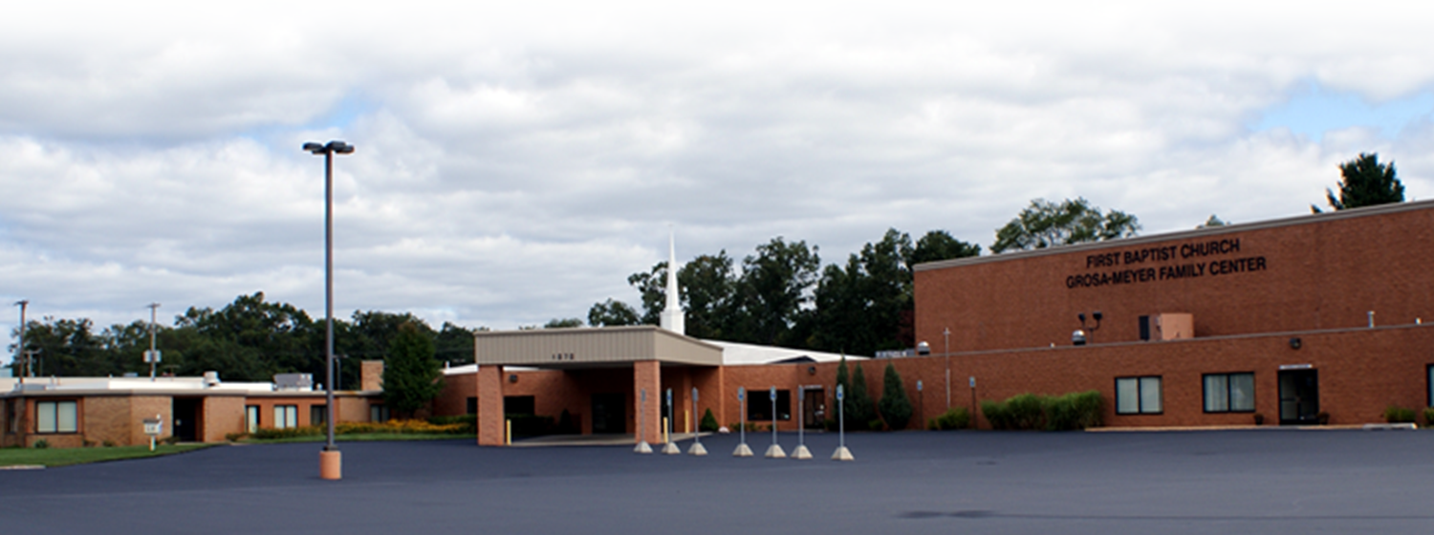
To Rome and Beyond
The Book of Acts has ended
... but it’s not the end of the story.
There is NO “The End.”

Slide 21
Let’s Pray.

