Slide 1
ACTS 20:22-23:24
www.BiblePoint.com
2011 © Single Initiative LLC
Notes:
Copyright © 2000-2011. All rights reserved. Bible Point is a registered trademark of Single Initiative, LLC. All other trademarks acknowledged.
Bible Point contains graphics from Bible Point artists. These illustrations belong to Bible Point and the respective artists. You may use the designs and illustrations for graphical illustration of lessons free and without special permission, provided they are not used in any way that maligns the Christian faith. Furthermore, republication or production of any illustration by any other graphic service whether it be in book, in a machine-readable form, or in any other design resource is strictly prohibited. Furthermore, they cannot be duplicated or resold as any other form of publishing, clip art, or graphic resource.
So What does it mean? (A simple translations of the legal jargon)
So, if you don’t own the presentation(s), graphic(s), and text(s) how can you legally use them? The purchase of the license allows you to use all the images in the product. However, the actual ownership and copyright of the presentation(s), graphic(s), and text(s) remain the property of Bible Point and its licensors. If you had plans on using this product in your “for sale” work—think again!
License Agreement
Article 1: License Grant
All the graphics and text in Bible Point presentations (excluding quotes from the Bible and stated sources) are the intellectual and real property of Bible Point and its licensors, and is protected by law, including United States copyright laws and international treaties. Bible Point grants to you a license:
1. To use the presentation in a single church, single school, or single office of a Christian organization.
2. To make a single archival back-up copy of the program.
3. To modify the presentation(s) and merge with other presentations in a single church, school, or Christian organization.
4. To transfer to another party if that party agrees to accept the terms and conditions of this agreement, and you do not retain any copies of the presentation, whether printed, machine readable, modified, or merged form.
Article 2: Terms
This license is effective until terminated. You may terminate the license at any time by destroying the presentation(s), graphic(s), or text(s) together with all copies, modifications and merged portions in any form. Bible Point may terminate your license if you fail to comply with this Agreement. You agree, upon such termination, for any reason, to destroy the presentation(s), graphics, and text(s) with all copies, modifications, and merged portions in any form.
Article 3: Disclaimers
1. Bible Point presentations, graphics, and texts are licensed to you As Is. You, the consumer, bear the entire risk relating to the quality and performance of the presentation(s), graphic(s), or text(s). In no event will Bible Point be liable for damages resulting from any defect.
2. Thirty-day limited warrantee on disks. Bible Point warrants the disks to be free of defects in material and workmanship under normal use for 30 days after purchase. During the 30-day period you may return a defective presentation, graphic, or text with proof of purchase and it will be replaced without charge, unless the presentation is damaged by misuse.
Article 4: General
1. You may not sub-license, assign, or transfer the license of the presentation(s), graphic(s), or text(s) except as provided by this Agreement.
2. This Agreement will be governed by the laws of the State of Michigan.
So What does it mean? (A simple translations of the legal jargon)
May I let someone borrow or copy my licensed Bible Point presentation (even after I modified it)? As long as it is within your local church, or single school, or the immediate office of a Christian organization you may. Otherwise, please refer the person interested in borrowing to: http://www.biblepoint.com or E-mail: dh@biblepoint.com with any related questions.
---------------------------------------------------------------------------------------------------------------------------
Scripture taken from the HOLY BIBLE, NEW INTERNATIONAL VERSION®. NIV®. Copyright©1973, 1978, 1984 by International Bible Society. Used by permission of Zondervan. All rights reserved.

Slide 2
Surviving the Shipwrecks in Life
Notes:
Shipwreck background = Free from = http://www.blm.gov/or/districts/coosbay/newsroom/index.php
Shipwrecks were an still are a real part of life.
We were at _______ Maine when they unveiled the complementary statue of the sailor at the wheels, complement, family waiting for lost sailors at sea. The very day, early in the morning a tanker collided with a fishing boat in the night an sunk it killing all but one at sea. The fishing boat was a shipwreck.
There are more than just the literal shipwrecks in life. Every one of will in someway experience a shipwreck at some point in life.
Economically, no one expects to experience financial shipwreck and spend their retirement years in poverty.
Relationally, no one expects to experience the pain of a shipwreck marriage and end in divorce or be prematurely widowed.
Physically, no one expects their health to go shipwreck with cancer, heart disease, or worse—failing health of your children.
Ship wrecks are common in life. In a real sense 9-11 was a modern shipwreck in life.
Today I want learn from Paul about surviving the shipwrecks in life.
First thing I notice is that Shipwrecks have stages (this is good to know so you can respond appropriately) :
The start of the shipwreck – start of it—storm brewing on the horizon, like terrorist planning it, just not feeling good, or making a bad money decision,
The storm of the shipwreck – like a bad relationship—arguing, fighting, no love, anger, bitterness, resentment--
The shores of the shipwreck (aftermath) – once divorced you stand on the shores of “Single Again”; once you lose your job, you stand on the shore so “unemployed”
Not everyone survives shipwrecks -- to it’s important to know how to survive!

Slide 3
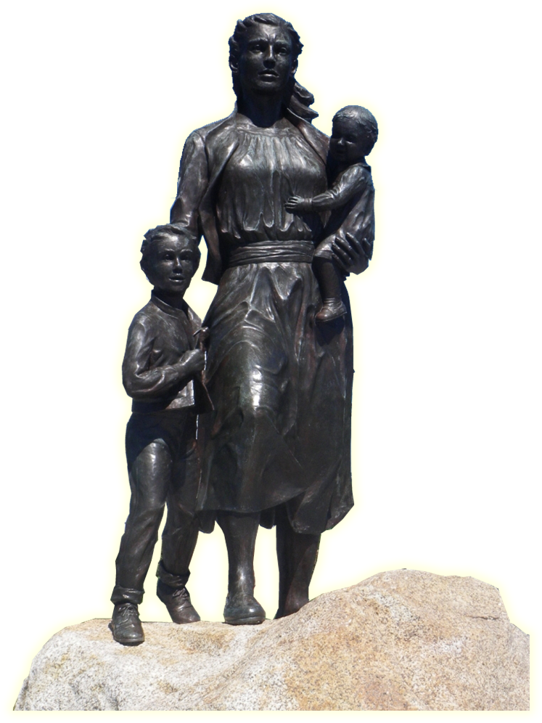
Shipwrecks in Life have 3 parts:
1—Start of the voyage
2—Storm or calamity at sea
3—Shores or aftermath
Notes:
Shipwreck background = FREE for reuse from = http://www.blm.gov/or/districts/coosbay/newsroom/index.php
Shipwrecks were and still are a real part of life.
We were at Glouster, Maine when they unveiled the complementary statue of the sailor at the wheels, complement, family waiting for lost sailors at sea. The very day, early in the morning a tanker collided with a fishing boat in the night an sunk it killing all but one at sea. The fishing boat was a shipwreck.
There are more than just the literal shipwrecks in life. Every one of will in someway experience a shipwreck at some point in life.
Economically, no one expects to experience financial shipwreck and spend their retirement years in poverty.
Relationally, no one expects to experience the pain of a shipwreck marriage and end in divorce or be prematurely widowed.
Physically, no one expects their health to go shipwreck with cancer, heart disease, or worse—failing health of your children.
Ship wrecks are common in life. In a real sense 9-11 was a modern shipwreck in life.
Today I want learn from Paul about surviving the shipwrecks in life.
First thing I notice is that Shipwrecks have stages (this is good to know so you can respond appropriately) :
The start of the shipwreck – start of it—storm brewing on the horizon, like terrorist planning it, just not feeling good, or making a bad money decision,
The storm of the shipwreck – like a bad relationship—arguing, fighting, no love, anger, bitterness, resentment--
The shores of the shipwreck (aftermath) – once divorced you stand on the shores of “Single Again”; once you lose your job, you stand on the shore so “unemployed”
Not everyone survives shipwrecks -- to it’s important to know how to survive!

Slide 4
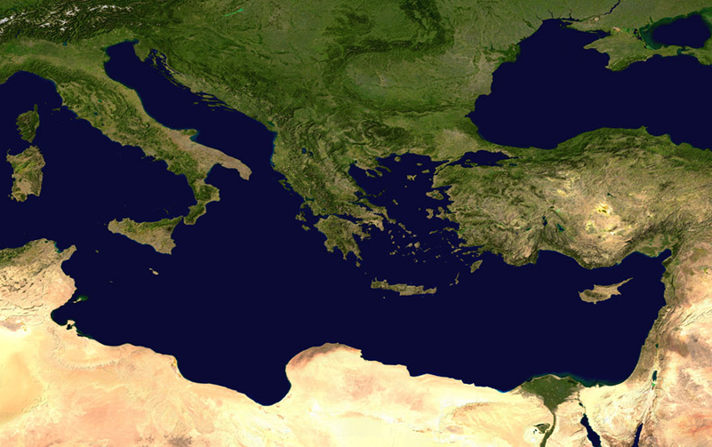
Surviving a Difficult START 27: 1-13
¹ When it was decided that we would sail for Italy,

Slide 5
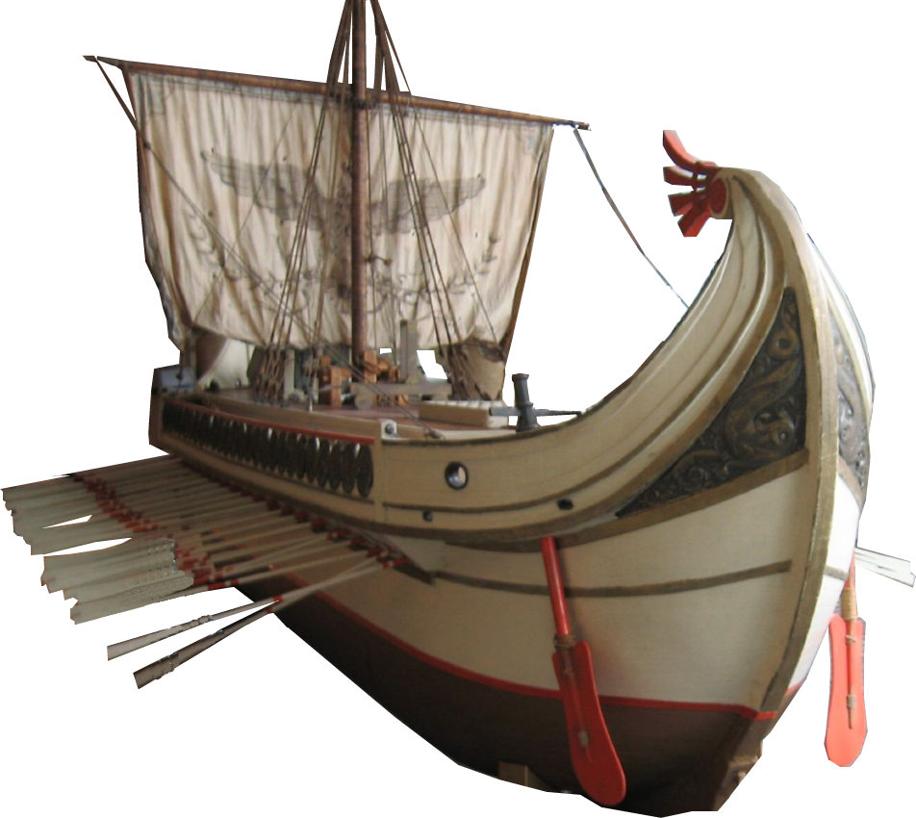
Surviving a Difficult START 27: 1-13
¹ When it was decided that we would sail for Italy, ... ² We boarded a ship ...
and we put out to sea....
Notes:
Roman ship = FREE for reuse =http://www.flickr.com/photos/twbuckner/2396920535/sizes/o/in/photostream/

Slide 6
Surviving a Difficult START 27: 1-13
³ The next day we landed at Sidon; ... ⁴ From there we put out to sea again and passed to the lee of Cyprus because the winds were against us.
Sidon

Slide 7
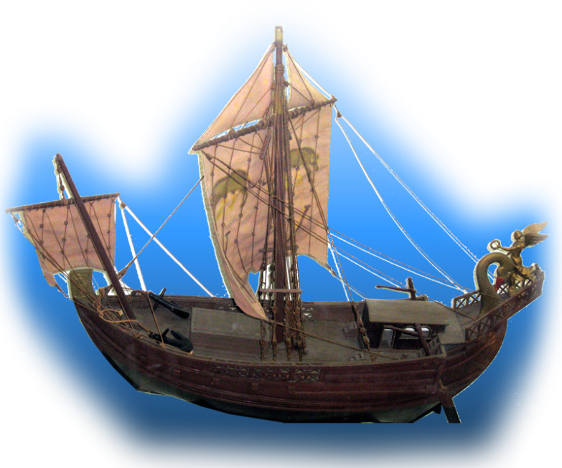
Surviving a Difficult START 27: 1-13
⁵ When we had sailed across the open sea ... we landed at Myra in Lycia.
⁶ There the centurion found an Alexandrian ship sailing for Italy and put us on board.
Myra
Sidon
Notes:
Roman Merchant Ship = FREE from = http://upload.wikimedia.org/wikipedia/commons/3/3c/NMMI_IMG_8754.JPG

Slide 8
Surviving a Difficult START 27: 1-13
⁷ We made slow headway for many days and had difficulty arriving off Cnidus. When the wind did not allow us to hold our course, we sailed to the lee of Crete, opposite Salmone.
⁸ We moved along the coast with difficulty and came to a place called Fair Havens, near the town of Lasea.
Sidon

Slide 9
Surviving a Difficult START 27: 1-13
⁹ Much time had been lost, and sailing had already become dangerous because by now it was after the Fast. So Paul warned them,
Sidon

Slide 10
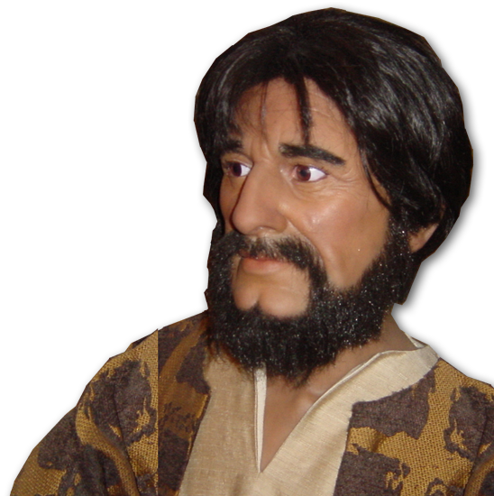
Surviving a Difficult START 27: 1-13
¹⁰ "Men, I can see that our voyage is going to be disastrous and bring great loss to ship and cargo, and to our own lives also."
Sound Advise

Slide 11
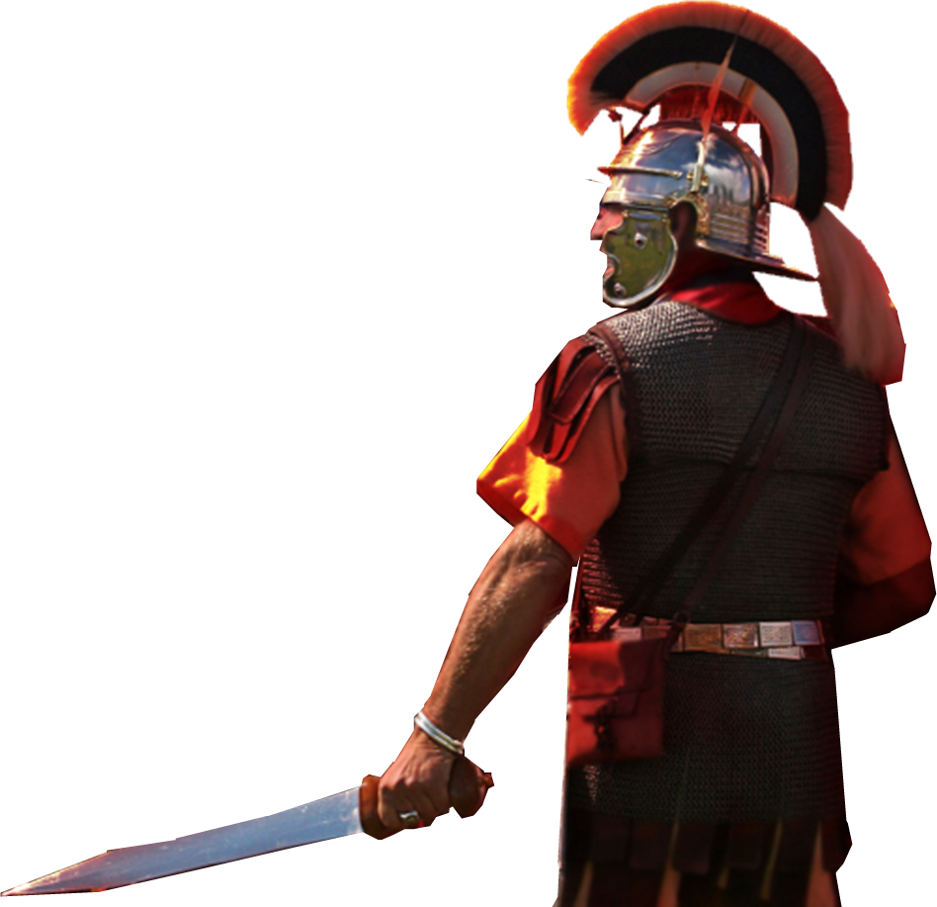
Surviving a Difficult START 27: 1-13
REJECTION
¹¹ But the centurion, instead of listening to what Paul said, followed the advice
of the pilot and of the owner of the
ship. ¹² Since the harbor was
unsuitable to winter in, the majority
decided that we should sail on,
hoping to reach Phoenix and
winter there. ....
Notes:
Roman Soldier = Licensed and NOT FREE for reuse = see previous lessons

Slide 12
Surviving a Difficult START 27: 1-13
¹³ When a gentle south wind began to blow, they thought they had obtained what they wanted; so they weighed anchor and sailed along the shore of Crete.

Slide 13
Surviving a Difficult START 27: 1-13
Sometimes we get into storms for same reasons:
Impatience
Taking expert secular advice
Following the majority
Trusting so called “Ideal Conditions”

Slide 14
Surviving a Difficult STORM 27: 14-44

Slide 15
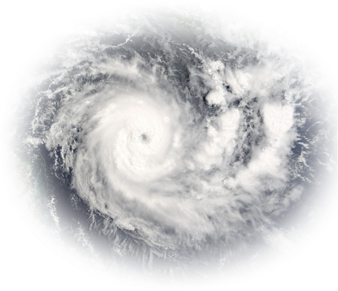
1-Description of the STORM 27: 14-26
¹³ When a gentle south wind began to blow, they ... sailed ....
¹⁴ Before very long, a wind of hurricane force, called the "northeaster," swept down from the island.

Slide 16
1-Description of the STORM 27: 14-26
¹⁵ The ship was caught by the storm and could not head into the wind; so we gave way to it and were driven along. ¹⁶ As we passed to the lee of a small island called Cauda, we were hardly able to make the lifeboat secure.

Slide 17
Surviving a Difficult STORM 27: 14-44
¹⁷ When the men had hoisted it aboard, they passed ropes under the ship itself to hold it together. Fearing that they would run aground on the sandbars of Syrtis, they lowered the sea anchor and let the ship be driven along.
Notes:
Shipwreck background = Free from = http://www.blm.gov/or/districts/coosbay/newsroom/index.php

Slide 18
1-Description of the STORM 27: 14-26
¹⁸ We took such a violent battering from the storm that the next day they began to throw the cargo overboard.
Notes:
Shipwreck background = Free from = http://www.blm.gov/or/districts/coosbay/newsroom/index.php

Slide 19
1-Description of the STORM 27: 14-26
¹⁹ On the third day, they threw the ship's tackle overboard with their own hands.
Notes:
Shipwreck background = Free from = http://www.blm.gov/or/districts/coosbay/newsroom/index.php

Slide 20
1-Description of the STORM 27: 14-26
²⁰ When neither sun nor stars appeared for many days and the storm continued raging, we finally gave up all hope of being saved.
²¹ After the men had gone a long time without food, Paul stood up before them and said:
Notes:
Shipwreck background = Free from = http://www.blm.gov/or/districts/coosbay/newsroom/index.php

Slide 21
2-Leadership in the STORM 27: 21-44
"Men, you should have taken my advice not to sail from Crete; then you would have spared yourselves this damage and loss. ²² But now
I urge you to keep up your courage, because not one of you will be lost; only the ship will be destroyed.
Leadership in the WORD
Notes:
Shipwreck background = Free from = http://www.blm.gov/or/districts/coosbay/newsroom/index.php

Slide 22
2-Leadership in the STORM 27: 21-44
Leadership in the WORD
²³ Last night an angel of the God whose I am and whom I serve stood beside me
²⁴ and said, 'Do not be afraid, Paul. You must stand trial before Caesar; and God has graciously given you the lives of all who sail with you.’
Notes:
Shipwreck background = Free from = http://www.blm.gov/or/districts/coosbay/newsroom/index.php

Slide 23
2-Leadership in the STORM 27: 21-44
Leadership in the WORD
²⁵ So keep up your courage, men, for I have faith in God that it will happen just as he told me. ²⁶ Nevertheless, we must run aground on some island.”
Notes:
Shipwreck background = Free from = http://www.blm.gov/or/districts/coosbay/newsroom/index.php

Slide 24
2-Leadership in the STORM 27: 21-44
²⁷ On the fourteenth night we were still being driven across the Adriatic Sea, when about midnight the sailors sensed they were approaching land.
Notes:
Adriatic Sea was in the ancient world was central Mediterranean. (See FF Bruce Acts)

Slide 25
2-Leadership in the STORM 27: 21-44
²⁸ They took soundings and found that the water was a hundred and twenty feet deep.... later ... ninety feet deep.

Slide 26
2-Leadership in the STORM 27: 21-44
²⁹ Fearing that we would be dashed against the rocks, they dropped four anchors from the stern and prayed for daylight.

Slide 27
2-Leadership in the STORM 27: 21-44
³⁰ In an attempt to escape from the ship,
the sailors let the lifeboat down into the sea, pretending they were going to lower some anchors from the bow.

Slide 28
2-Leadership in the STORM 27: 21-44
³¹ Then Paul said to the centurion and the soldiers,
"Unless these men stay with the ship, you cannot be saved.“
³² So the soldiers cut the ropes that held the lifeboat and let it fall away.
Verbal Warning!
Notes:
Adriatic Sea was in the ancient world was central Mediterranean. (See FF Bruce Acts)

Slide 29
2-Leadership in the STORM 27: 21-44
³³ Just before dawn Paul urged them all to eat.
"For the last fourteen days ... you ... have gone without food.... ³⁴ Now I urge you to take some food. You need it to survive. Not one of you will lose a single hair from his head.“
³⁵ After he said this, he took some bread and gave thanks to God in front of them all. Then he broke it and began to eat.
³⁶ They were all encouraged and ate some food themselves.
³⁷ Altogether there were 276 of us on board.
³⁸ When they had eaten as much as they wanted, they lightened the ship by throwing the grain into the sea.
Notes:
Shipwreck background = Free from = http://www.blm.gov/or/districts/coosbay/newsroom/index.php

Slide 30
2-Leadership in the STORM 27: 21-44
³⁵ After he said this, he took some bread and gave thanks to God in front of them all. Then he broke it and began to eat.
³⁶ They were all encouraged and
ate some food themselves.
³⁷ Altogether there were 276 of us....
³⁸ When they had eaten ... they
lightened the ship by throwing
the grain into the sea.
Example of faith in
the Word

Slide 31
2-Leadership in the STORM 27: 21-44
³⁹ When daylight came, ... they saw a bay with a sandy beach, where they decided to run the ship aground if they could. ⁴⁰ Cutting loose the anchors ... and at the same time untied the ropes that held the rudders. Then they hoisted the foresail to the wind and made for the beach.

Slide 32
2-Leadership in the STORM 27: 21-44
⁴¹ But the ship struck a sandbar and ran aground. The bow stuck fast and would not move, and the stern was broken to pieces by the pounding of the surf.

Slide 33
2-Leadership in the STORM 27: 21-44
⁴² The soldiers planned to kill the prisoners to prevent any of them from swimming away and escaping.
Notes:
Roman Soldier = licensed and NOT FREE for reuse = see previous lessons.

Slide 34
2-Leadership in the STORM 27: 21-44
⁴³ But the centurion wanted to spare Paul's life and kept them from carrying out their plan. He ordered those who could swim to jump overboard first and get to land.
⁴⁴ The rest were to get there on
planks or on pieces of the ship.
In this way everyone reached land in safety.

Slide 35
Surviving the STORMS in Life
You may be in a BIG ONE right now...
One may be right around the corner ...
TRUST THE LORD
and HIS WORD!

Slide 36
Surviving the Storms of Life ...
Acts 28:1 Once safely on shore, we found out that the island was called Malta.

Slide 37
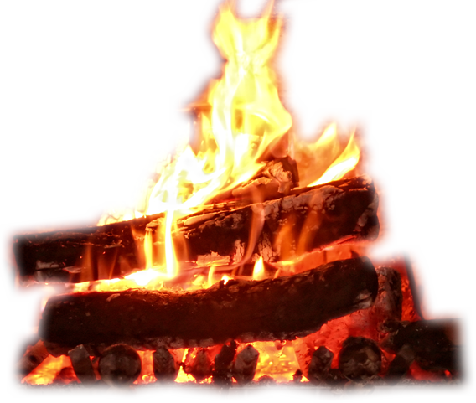
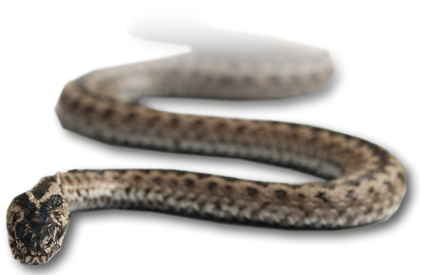
Surviving a Difficult SHORE 28:1-14
² The islanders showed us unusual kindness. They built a fire and welcomed us all because it was raining and cold. ³ Paul gathered a pile of brushwood and, as he put it on the fire, a viper, driven out by the heat, fastened itself on his hand.
Notes:
Fire = Free from = http://www.sxc.hu/browse.phtml?f=download&id=1249777
Viper = Free from = http://www.sxc.hu/browse.phtml?f=download&id=1349081

Slide 38
Surviving a Difficult SHORE 28:1-14
⁴ When the islanders saw the snake hanging from his hand, they said to each other,
"This man must be a murderer;
for though he escaped from the
sea, Justice has not allowed him
to live.“

Slide 39
Surviving a Difficult SHORE 28:1-14
⁵ But Paul shook the snake off into the fire and suffered no ill effects.
⁶ The people expected him to swell up or suddenly fall dead, but after waiting a long time and seeing nothing unusual happen to him, they changed their minds and said he was a god.
Notes:
Fire = Free from = http://www.sxc.hu/browse.phtml?f=download&id=1249777

Slide 40
Surviving a Difficult SHORE 28:1-14
⁷ There was an estate nearby that belonged to ... the chief official of the island. ....
⁸ His father was sick in bed, suffering from fever and dysentery. Paul went in to see him and, after prayer, placed his hands on him and healed him.
⁹ When this had happened, the rest of the sick on the island came and were cured.
Notes:
Fire = Free from = http://www.sxc.hu/browse.phtml?f=download&id=1249777

Slide 41
Surviving a Difficult SHORE 28:1-14
....¹⁰ They honored us in many ways and when we were ready to sail, they furnished us with the supplies we needed.
¹¹ After three months we put out to ship ....
¹⁴ .... And so we came to Rome
Notes:
Fire = Free from = http://www.sxc.hu/browse.phtml?f=download&id=1249777

Slide 42
Surviving a Difficult SHORE 28:1-14
Sometimes the aftermath of a storm is worse than the storm ...
Notes:
Fire = Free from = http://www.sxc.hu/browse.phtml?f=download&id=1249777

Slide 43
Let’s sum it all up
Life can be difficult—with difficult ...
Starts -- Storms -- Shores
How do you survive?
TRUST IN THE LORD AND HIS WORD!

Slide 44
Let’s Pray!

