Slide 1
ACTS 20:22-23:24
www.BiblePoint.com
2011 © Single Initiative LLC
Notes:
Copyright © 2000-2011. All rights reserved. Bible Point is a registered trademark of Single Initiative, LLC. All other trademarks acknowledged.
Bible Point contains graphics from Bible Point artists. These illustrations belong to Bible Point and the respective artists. You may use the designs and illustrations for graphical illustration of lessons free and without special permission, provided they are not used in any way that maligns the Christian faith. Furthermore, republication or production of any illustration by any other graphic service whether it be in book, in a machine-readable form, or in any other design resource is strictly prohibited. Furthermore, they cannot be duplicated or resold as any other form of publishing, clip art, or graphic resource.
So What does it mean? (A simple translations of the legal jargon)
So, if you don’t own the presentation(s), graphic(s), and text(s) how can you legally use them? The purchase of the license allows you to use all the images in the product. However, the actual ownership and copyright of the presentation(s), graphic(s), and text(s) remain the property of Bible Point and its licensors. If you had plans on using this product in your “for sale” work—think again!
License Agreement
Article 1: License Grant
All the graphics and text in Bible Point presentations (excluding quotes from the Bible and stated sources) are the intellectual and real property of Bible Point and its licensors, and is protected by law, including United States copyright laws and international treaties. Bible Point grants to you a license:
1. To use the presentation in a single church, single school, or single office of a Christian organization.
2. To make a single archival back-up copy of the program.
3. To modify the presentation(s) and merge with other presentations in a single church, school, or Christian organization.
4. To transfer to another party if that party agrees to accept the terms and conditions of this agreement, and you do not retain any copies of the presentation, whether printed, machine readable, modified, or merged form.
Article 2: Terms
This license is effective until terminated. You may terminate the license at any time by destroying the presentation(s), graphic(s), or text(s) together with all copies, modifications and merged portions in any form. Bible Point may terminate your license if you fail to comply with this Agreement. You agree, upon such termination, for any reason, to destroy the presentation(s), graphics, and text(s) with all copies, modifications, and merged portions in any form.
Article 3: Disclaimers
1. Bible Point presentations, graphics, and texts are licensed to you As Is. You, the consumer, bear the entire risk relating to the quality and performance of the presentation(s), graphic(s), or text(s). In no event will Bible Point be liable for damages resulting from any defect.
2. Thirty-day limited warrantee on disks. Bible Point warrants the disks to be free of defects in material and workmanship under normal use for 30 days after purchase. During the 30-day period you may return a defective presentation, graphic, or text with proof of purchase and it will be replaced without charge, unless the presentation is damaged by misuse.
Article 4: General
1. You may not sub-license, assign, or transfer the license of the presentation(s), graphic(s), or text(s) except as provided by this Agreement.
2. This Agreement will be governed by the laws of the State of Michigan.
So What does it mean? (A simple translations of the legal jargon)
May I let someone borrow or copy my licensed Bible Point presentation (even after I modified it)? As long as it is within your local church, or single school, or the immediate office of a Christian organization you may. Otherwise, please refer the person interested in borrowing to: http://www.biblepoint.com or E-mail: dh@biblepoint.com with any related questions.
---------------------------------------------------------------------------------------------------------------------------
Scripture taken from the HOLY BIBLE, NEW INTERNATIONAL VERSION®. NIV®. Copyright©1973, 1978, 1984 by International Bible Society. Used by permission of Zondervan. All rights reserved.

Slide 2
Sometimes they just don’t get it!
Notes:
Globe background licensed from Dreamstime http://www.dreamstime.com/best-concept-of-global-business-image10667813 do not reproduce.

Slide 3
Premise:
God wants us to share our faith SOMEWHERE!
Notes:
Globe background licensed from Dreamstime http://www.dreamstime.com/best-concept-of-global-business-image10667813 do not reproduce.

Slide 4
Support for the Premise:
"…you will be my witnesses in Jerusalem, and in all Judea and Samaria, and to the ends of the earth." (Act 1:8)
¹¹ "Take courage! As you have testified about me in Jerusalem, so you must also testify in Rome." (Act 23:11)
Notes:
Globe background licensed from Dreamstime http://www.dreamstime.com/best-concept-of-global-business-image10667813 do not reproduce.

Slide 5
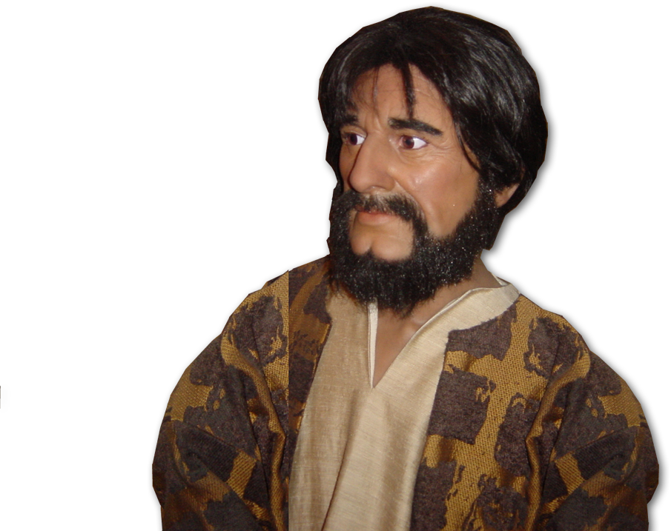
Last week we read ...
^{20:22} "And now, compelled by the Spirit, I am going to Jerusalem, not knowing what will happen to me there.
²³ I only know that in every city the Holy Spirit warns me that prison and hardships are facing me.
Paul was on a MISSION

Slide 6
Last week we read ...
^{20:22} "And now, compelled by the Spirit, I am going to Jerusalem, not knowing what will happen to me there.
²³ I only know that in every city the Holy Spirit warns me that prison and hardships are facing me.
Paul was on a
DIFFICULT MISSION

Slide 7
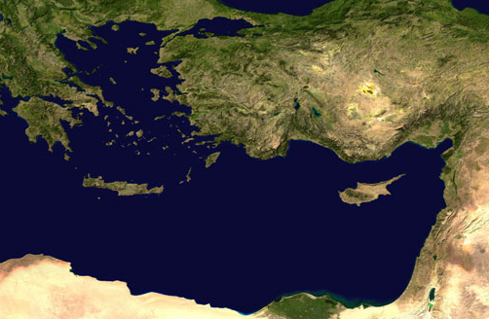
Let’s pick up ...
¹ ... we put out to sea ... ³ After sighting Cyprus and passing to the south of it, we sailed on to Syria. We landed at Tyre ...

Slide 8
Friends don’t get it 21:1-16
⁴ Finding the disciples there, we stayed with them seven days. Through the Spirit they urged Paul not to go on to Jerusalem.

Slide 9
Friends don’t get it 21:1-16
⁵ But when our time was up, we left and continued on our way ... ⁸ ... we reached Caesarea and stayed at the house of Philip the evangelist.

Slide 10
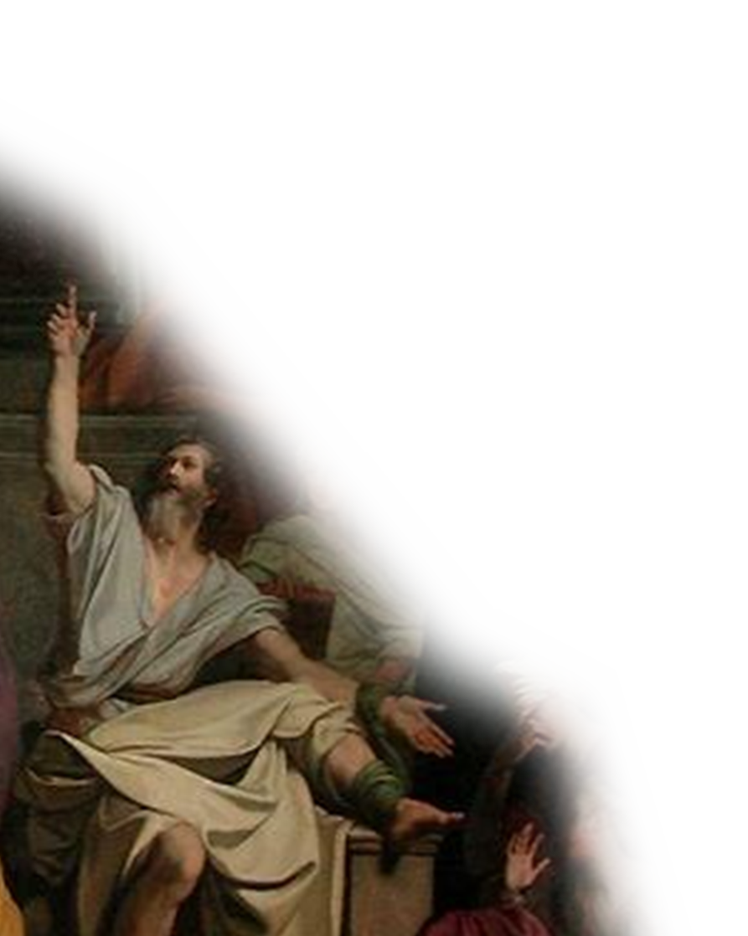
Friends don’t get it 21:1-16
¹⁰ ... Agabus came ... ¹¹ to us, he took Paul's belt, tied his own hands and feet with it and said,
"The Holy Spirit says, 'In this way
the Jews of Jerusalem will bind the owner of this belt and will hand him over to the Gentiles.'
Notes:
Agabus = free = http://upload.wikimedia.org/wikipedia/commons/1/1c/Agabus.JPG

Slide 11
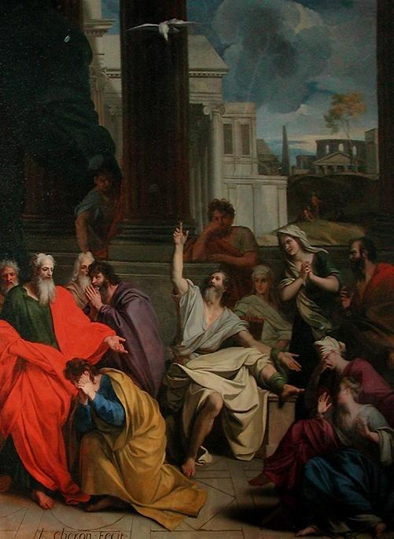
Friends don’t get it 21:1-16
¹² When we heard this, we and the people there pleaded with Paul not to go up to Jerusalem.
Notes:
Agabus = free = http://upload.wikimedia.org/wikipedia/commons/1/1c/Agabus.JPG

Slide 12
Friends don’t get it 21:1-16
¹³ Then Paul answered,
"Why are you weeping and breaking my heart? I am ready not only to be bound, but also to die in Jerusalem for the name of the Lord Jesus.“
Notes:
Agabus = free = http://upload.wikimedia.org/wikipedia/commons/1/1c/Agabus.JPG

Slide 13
Friends don’t get it 21:1-16
¹⁴ When he would not be dissuaded, we gave up and said,
"The Lord's
will be done."
Notes:
Agabus = free = http://upload.wikimedia.org/wikipedia/commons/1/1c/Agabus.JPG

Slide 14
3rd Missionary Journey Ends
¹⁷ When we arrived at Jerusalem,

Slide 15
Churches don’t get it 21:17-26

Slide 16
Churches don’t get it 21:17-26
¹⁸ The next day Paul and the rest of us went to see James, and all the elders were present. ¹⁹ Paul greeted them and reported in detail what God had done among the Gentiles through his ministry. ²⁰ When they heard this, they praised God. Then they said to Paul:

Slide 17
Churches don’t get it 21:17-26
"You see, brother, how many thousands of Jews have believed, and all of them are zealous for the law. ²¹ They have been informed that you teach all the Jews who live among the Gentiles to turn away from Moses, telling them not to circumcise their children or live according to our customs.
²² What shall we do? They will certainly hear that you have come,

Slide 18
Churches don’t get it 21:17-26
²³ so do what we tell you. There are four men with us who have made a vow.
²⁴ Take these men, join in their purification rites and pay their expenses, so that they can have their heads shaved. Then everybody will know there is no truth in these reports about you, but that you yourself are living in obedience to the law.

Slide 19
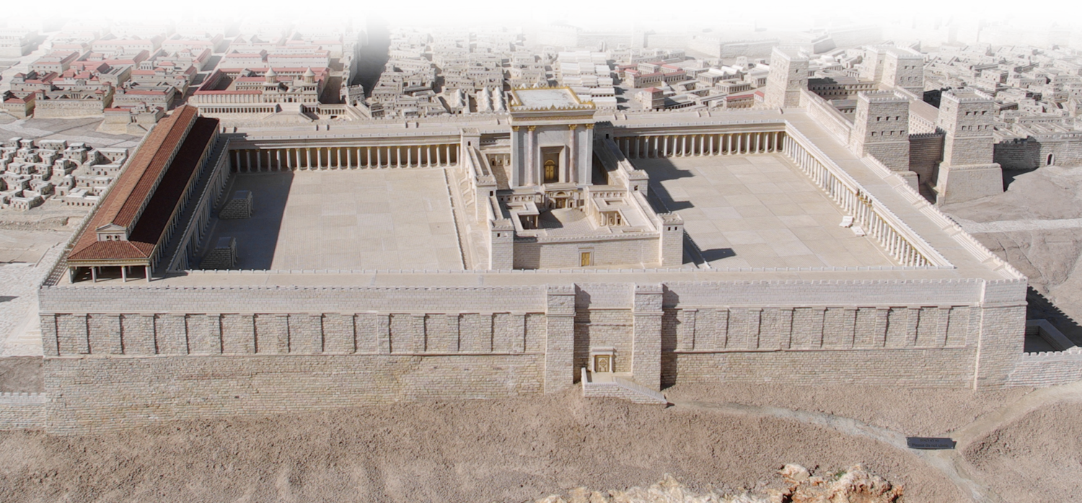
Churches don’t get it 21:17-26
²⁵ As for the Gentile believers, we have written to them our decision that they should abstain from food sacrificed to idols, from blood, from the meat of strangled animals and from sexual immorality.”
Paul ... purified himself along with them. Then he went to the temple ....
Notes:
Temple = See previous lessons.

Slide 20
Religious people don’t get it
21:27-22:29

Slide 21
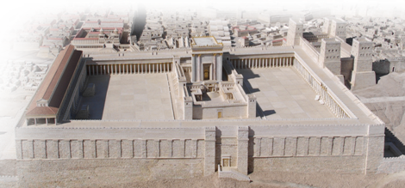
Religious people don’t get it
21:27-22:29
ASIA
²⁷ ...some Jews from the province of Asia saw Paul at the temple. They stirred up the whole crowd and seized him, ²⁸ shouting,

Slide 22
Religious people don’t get it
21:27-22:29
"Men of Israel, help us! This is the man who teaches all men everywhere against our people and our law and this place. And besides, he has brought Greeks into the temple area and defiled this holy place."
²⁹ (They ... assumed that Paul had brought him [a gentile] into the temple area.)

Slide 23
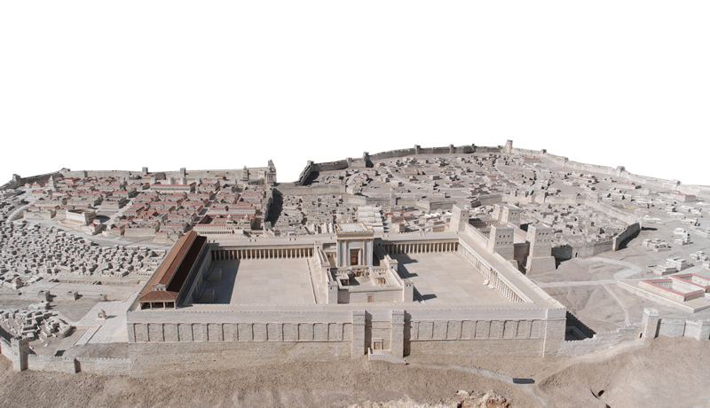
Religious people don’t get it
³⁰ The whole city was aroused, and the people came running from all directions. Seizing Paul, they dragged him from the temple, and immediately the gates were shut.

Slide 24
Religious people don’t get it
³¹ While they were trying to kill him, news reached the commander of the Roman troops that the whole city of Jerusalem was in an uproar.

Slide 25
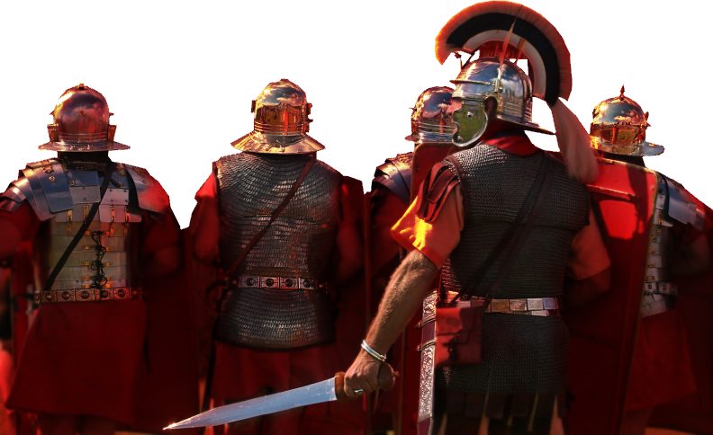
Religious people don’t get it
³² He at once took some officers and soldiers and ran down to the crowd. When the rioters saw the commander and his soldiers, they stopped beating Paul.
Notes:
Romans = Licensed and NOT FOR REUSE = from iStock_000003820420Small

Slide 26
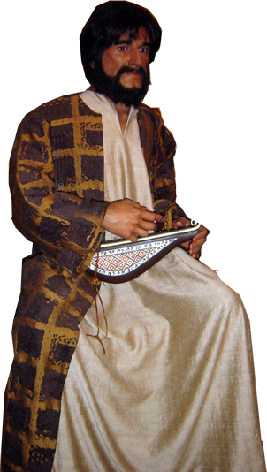
Religious people don’t get it
³³ The commander came up and arrested him and ordered him to be bound with two chains.

Slide 27
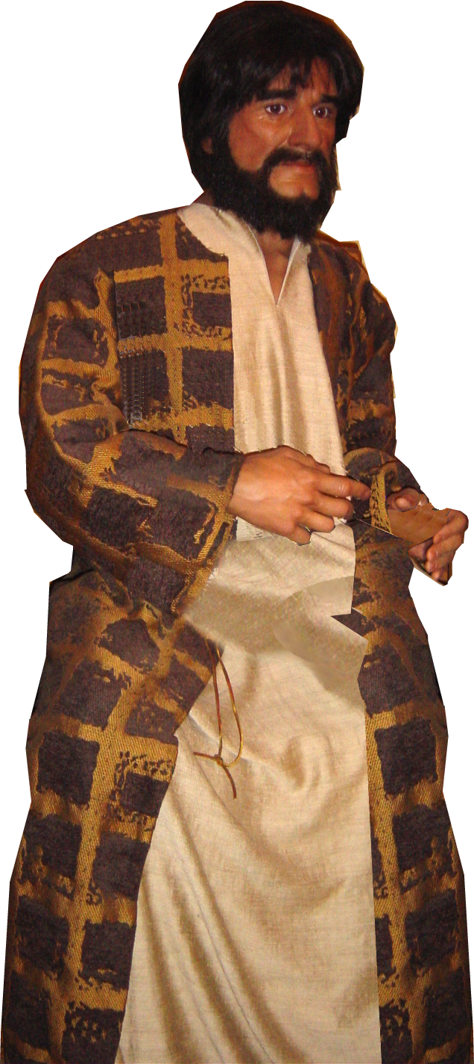
Religious people don’t get it
Paul stood on the steps and motioned to the crowd. When they were all silent, he said to them in Aramaic:

Slide 28
Religious people don’t get it
³ "I am a Jew, ... thoroughly trained in the law of our fathers and was just as zealous for God as any of you are today. ⁴ I persecuted the followers of this Way to their death.... I even ... went there to bring these people as prisoners to Jerusalem to be punished.

Slide 29

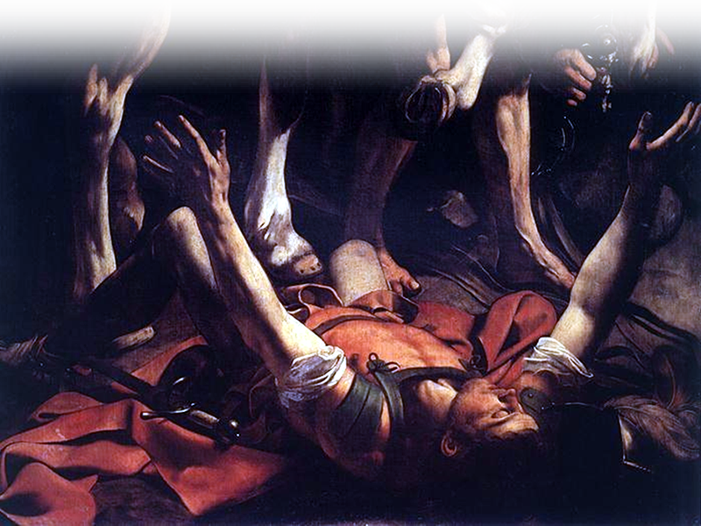
Religious people don’t get it
⁶ "About noon as I came near Damascus, suddenly a bright light from heaven flashed around me. ⁷ I fell to the ground and heard a voice say to me,
Notes:
Paul = by Michelangelo Caravaggio = FREE for reuse= http://commons.wikimedia.org/wiki/File:Michelangelo_Caravaggio_036.jpg

Slide 30

Religious people don’t get it
"Saul, Saul,
why do you
persecute me?”

Slide 31
Religious people don’t get it
"I am Jesus, of Nazareth whom you are persecuting,”
he replied.
⁸ "Who are you,
Lord?"
I asked.
⁴ He fell to the ground and heard a voice say to him, "Saul, Saul, why do you persecute me?"
⁵ "Who are you, Lord?" Saul asked. "I am Jesus, whom you are persecuting," he replied.
(Act 9:3-5 NIV)

Slide 32
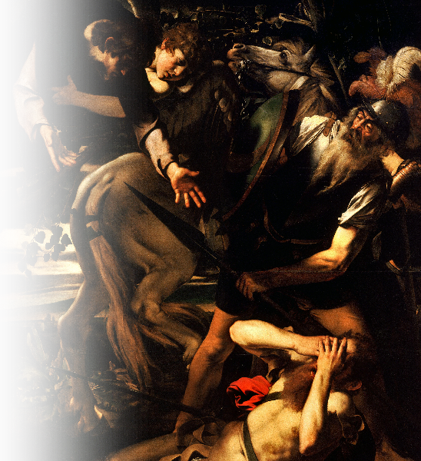
⁹ My companions saw the light, but they did not understand the voice of him who was speaking to me.
¹⁰ " 'What shall I do, Lord?' I asked. “
Notes:
Paul’s Conversion = by Caravaggio = free = http://upload.wikimedia.org/wikipedia/commons/b/bb/The_Conversion_of_Saint_Paul-Caravaggio_%28c._1600-1%29.jpg

Slide 33
'Get up ... and go into Damascus. There you will be told all that you have been assigned
to do.’
Notes:
Paul’s Conversion = by Caravaggio = free = http://upload.wikimedia.org/wikipedia/commons/b/bb/The_Conversion_of_Saint_Paul-Caravaggio_%28c._1600-1%29.jpg

Slide 34
'Get up ... and go into Damascus. There you will be told all that you have been assigned
to do.’
¹¹ My companions led me by the hand into Damascus, because the brilliance of the light had blinded me.
Notes:
Paul’s Conversion = by Caravaggio = free = http://upload.wikimedia.org/wikipedia/commons/b/bb/The_Conversion_of_Saint_Paul-Caravaggio_%28c._1600-1%29.jpg

Slide 35
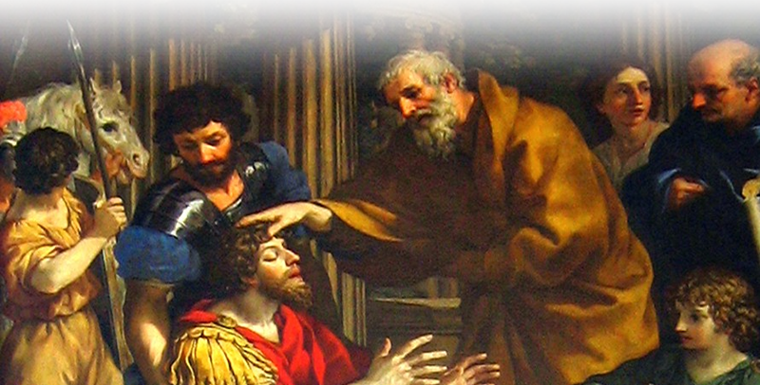
Religious people don’t get it
¹²... Ananias came to see me ....¹³... and said,
'Brother Saul, receive your sight!'
And at that
very moment
I was able
to see him
Notes:
Anannais and Saul = FREE FOR REUSE = from wiki-473px-Saint_Paul_Ananias_Sight_Restored

Slide 36
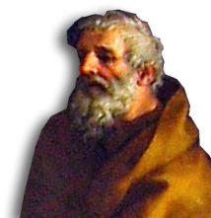
Religious people don’t get it
¹⁴ "Then he [Ananias] said:
'The God of our fathers has chosen you to know his will and to see the Righteous One and to hear words from his mouth. ¹⁵ You will be his witness to all men of what
you have seen and heard.

Slide 37
Religious people don’t get it
¹⁴ "Then he [Ananias] said:
'The God of our fathers has chosen you to know his will and to see the Righteous One and to hear words from his mouth. ¹⁵ You will be his witness to all men of what
you have seen and heard.

Slide 38
Religious people don’t get it
¹⁶ And now what are you waiting for? Get up, be baptized and wash your sins away, calling on his name.‘

Slide 39
Religious people don’t get it
¹⁶ And now what are you waiting for? Get up, be baptized and wash your sins away, calling on his name.‘
Past Participles

Slide 40
Religious people don’t get it
¹⁶ And now what are you waiting for? Get up, be baptized and wash your sins away, calling on his name.‘
WHEN
PREVIOUSLY?
“Having previously arisen,
be baptized and
wash away your sins,
having previously called
upon His name.”

Slide 41
Religious people don’t get it
"I am Jesus, of Nazareth whom you are persecuting,”
⁸ "Who are you,
Lord?"
⁴ He fell to the ground and heard a voice say to him, "Saul, Saul, why do you persecute me?"
⁵ "Who are you, Lord?" Saul asked. "I am Jesus, whom you are persecuting," he replied.
(Act 9:3-5 NIV)

Slide 42
Religious people don’t get it
¹⁰ “ What shall I do, Lord?”
⁴ He fell to the ground and heard a voice say to him, "Saul, Saul, why do you persecute me?"
⁵ "Who are you, Lord?" Saul asked. "I am Jesus, whom you are persecuting," he replied.
(Act 9:3-5 NIV)
"Everyone who calls on the name of the Lord will be saved." (Rom 10:13)

Slide 43
Religious people don’t get it
¹⁷ "When I returned to Jerusalem and was praying at the temple, I fell into a trance

Slide 44
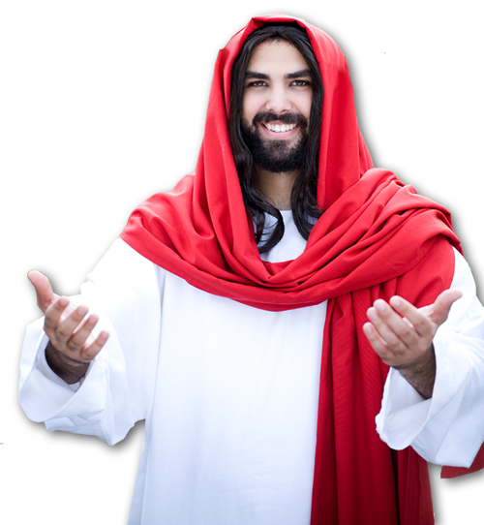
Religious people don’t get it
¹⁸ and saw the Lord speaking.
'Quick!' he said to
me. 'Leave Jerusalem immediately, because
they will not accept your testimony about me.‘

Slide 45
Religious people don’t get it
¹⁹ “Lord, ... these men know that I ... imprison[ed] those who believe ...”

Slide 46
Religious people don’t get it
¹⁹ [regarding] Stephen ..., I stood there giving my approval ... of those who were killing him.'

Slide 47
Religious people don’t get it
²¹ "Then the Lord said to me,
“Go; I will send
you far away to
the Gentiles.”

Slide 48

Religious people don’t get it
²² The crowd listened to Paul until he said this. Then they raised their voices and shouted,
"Rid the earth of him!
He's not fit to live!”
Notes:
Crowd = Licensed and NOT FOR REUSE = from iStock_000013823183XSmall

Slide 49
Politicians don’t get it 22:30-23:10

Slide 50
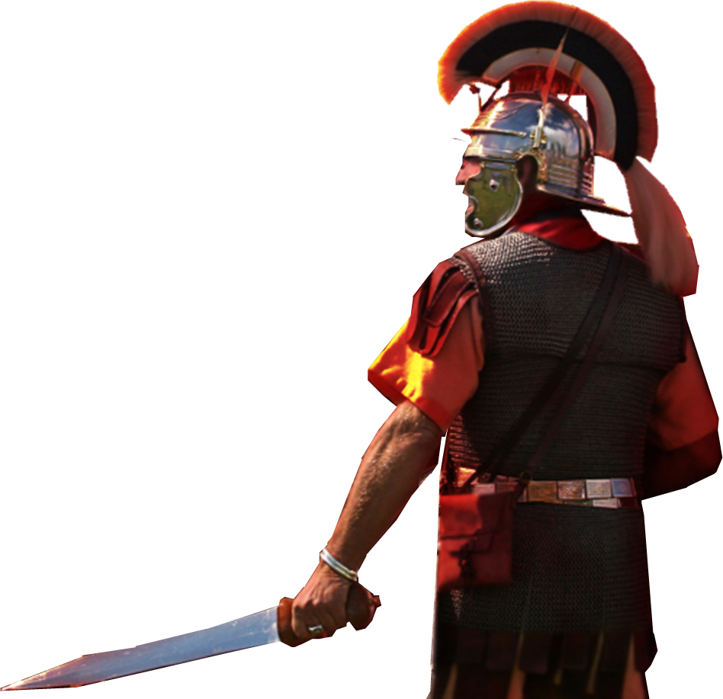
Politicians don’t get it 22:30-23:10
³⁰ The next day, since the commander wanted to find out exactly why Paul was being accused by the Jews, he released him and ordered the chief priests and all the Sanhedrin to assemble. Then he brought Paul and had him stand before them.

Slide 51
Politicians don’t get it 22:30-23:10
⁶ Then Paul, knowing that some of them were Sadducees and the others Pharisees, called out ...,
"My brothers, I am a
Pharisee.... I stand on
trial because of my
hope in the resurrection
of the dead.“

Slide 52
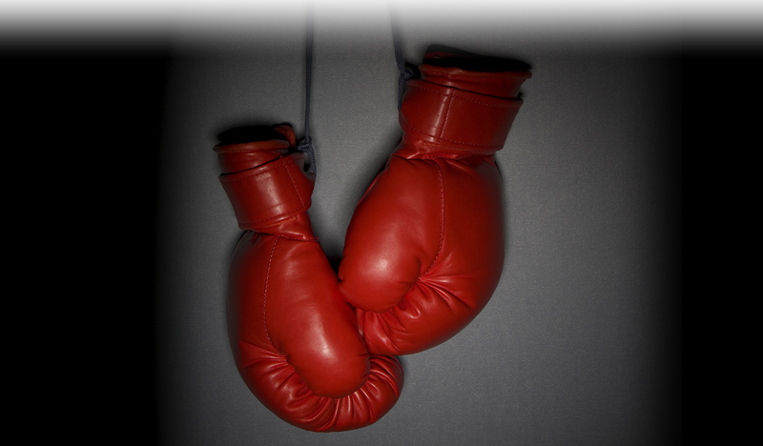
Politicians don’t get it 22:30-23:10
⁷ When he said this, a dispute broke out between the Pharisees and the Sadducees,
Notes:
Boxing gloves = Licensed and NOT FOR REUSE = from iStock_000007843742Large

Slide 53
Politicians don’t get it 22:30-23:10
⁹ There was a great uproar, and some of the teachers of the law who were Pharisees stood up and argued vigorously.
"We find nothing wrong with this man,"
they said.
"What if a spirit or an angel
has spoken to him?"

Slide 54
Adversaries don’t get it 23:12-23

Slide 55
Adversaries don’t get it 23:12-23
¹² The next morning the Jews formed a conspiracy ... not to eat or drink until they had killed Paul. ¹³ More than forty men
were involved in this plot.

Slide 56
Adversaries don’t get it 23:12-23
¹⁶ But when the son of Paul's sister heard of this plot, he went ... and told Paul. ¹⁹ The commander ... drew him aside and asked,
"What is it you
want to tell me?“

Slide 57
Adversaries don’t get it 23:12-23
²⁰ He said:
"The Jews have agreed to ask you to bring Paul before the Sanhedrin ... on ... pretext ... because more than forty of them are waiting in ambush for him. They have taken an oath not to eat or drink until they have killed him. They are ready now, waiting for your consent to their request.”

Slide 58
Adversaries don’t get it 23:12-23
²³ Then he called two of his centurions and ordered them,
"Get ready a detachment of two hundred soldiers, seventy horsemen and two hundred spearmen to go to Caesarea at nine tonight. ²⁴ Provide mounts for Paul so that he may be taken safely to Governor Felix.”

Slide 59
Only the Mission Minded Get it

Slide 60
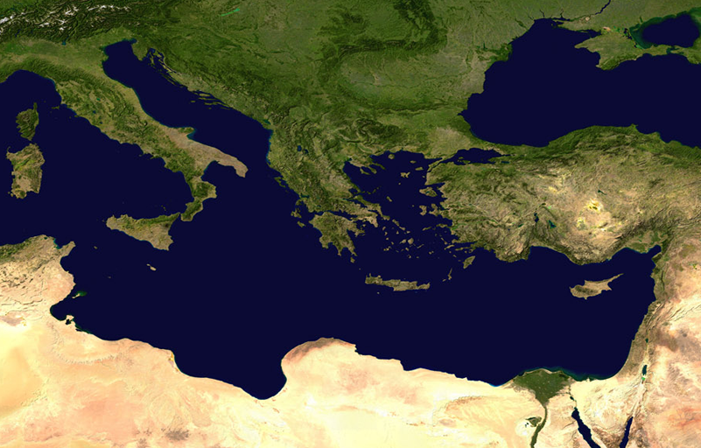
Only the Mission Minded Get it
^{23:11} ... The Lord stood ... said,
"Take courage! As you have testified about me in Jerusalem, so you must also testify in Rome.”

Slide 61
Only the Mission Minded Get it
^{23:11} ... The Lord stood ... said,
"Take courage! As you have testified about me in Jerusalem, so you must also testify in Rome.”

Slide 62
Let me sum up
When you resolve to do the will of God others won’t necessarily get it:
Friends/Family may not get it
Church may not get it
Religious people may not get it
Politicians may not get it
Adversaries may not get it

Slide 63
The Challenge:
Do You Get It?
If so, then what will you do?
Where will you go?

Slide 64
Let’s Pray

