Slide 1
ACTS 20
www.BiblePoint.com
2011 © Single Initiative LLC
Notes:
Copyright © 2000-2011. All rights reserved. Bible Point is a registered trademark of Single Initiative, LLC. All other trademarks acknowledged.
Bible Point contains graphics from Bible Point artists. These illustrations belong to Bible Point and the respective artists. You may use the designs and illustrations for graphical illustration of lessons free and without special permission, provided they are not used in any way that maligns the Christian faith. Furthermore, republication or production of any illustration by any other graphic service whether it be in book, in a machine-readable form, or in any other design resource is strictly prohibited. Furthermore, they cannot be duplicated or resold as any other form of publishing, clip art, or graphic resource.
So What does it mean? (A simple translations of the legal jargon)
So, if you don’t own the presentation(s), graphic(s), and text(s) how can you legally use them? The purchase of the license allows you to use all the images in the product. However, the actual ownership and copyright of the presentation(s), graphic(s), and text(s) remain the property of Bible Point and its licensors. If you had plans on using this product in your “for sale” work—think again!
License Agreement
Article 1: License Grant
All the graphics and text in Bible Point presentations (excluding quotes from the Bible and stated sources) are the intellectual and real property of Bible Point and its licensors, and is protected by law, including United States copyright laws and international treaties. Bible Point grants to you a license:
1. To use the presentation in a single church, single school, or single office of a Christian organization.
2. To make a single archival back-up copy of the program.
3. To modify the presentation(s) and merge with other presentations in a single church, school, or Christian organization.
4. To transfer to another party if that party agrees to accept the terms and conditions of this agreement, and you do not retain any copies of the presentation, whether printed, machine readable, modified, or merged form.
Article 2: Terms
This license is effective until terminated. You may terminate the license at any time by destroying the presentation(s), graphic(s), or text(s) together with all copies, modifications and merged portions in any form. Bible Point may terminate your license if you fail to comply with this Agreement. You agree, upon such termination, for any reason, to destroy the presentation(s), graphics, and text(s) with all copies, modifications, and merged portions in any form.
Article 3: Disclaimers
1. Bible Point presentations, graphics, and texts are licensed to you As Is. You, the consumer, bear the entire risk relating to the quality and performance of the presentation(s), graphic(s), or text(s). In no event will Bible Point be liable for damages resulting from any defect.
2. Thirty-day limited warrantee on disks. Bible Point warrants the disks to be free of defects in material and workmanship under normal use for 30 days after purchase. During the 30-day period you may return a defective presentation, graphic, or text with proof of purchase and it will be replaced without charge, unless the presentation is damaged by misuse.
Article 4: General
1. You may not sub-license, assign, or transfer the license of the presentation(s), graphic(s), or text(s) except as provided by this Agreement.
2. This Agreement will be governed by the laws of the State of Michigan.
So What does it mean? (A simple translations of the legal jargon)
May I let someone borrow or copy my licensed Bible Point presentation (even after I modified it)? As long as it is within your local church, or single school, or the immediate office of a Christian organization you may. Otherwise, please refer the person interested in borrowing to: http://www.biblepoint.com or E-mail: dh@biblepoint.com with any related questions.
---------------------------------------------------------------------------------------------------------------------------
Scripture taken from the HOLY BIBLE, NEW INTERNATIONAL VERSION®. NIV®. Copyright©1973, 1978, 1984 by International Bible Society. Used by permission of Zondervan. All rights reserved.

Slide 2
Going, Going,
Gone!
Notes:
Ship Wake (background) = FREE for reuse = from http://www.sxc.hu/browse.phtml?f=download&id=614475

Slide 3
FAREWELL ...

Slide 4
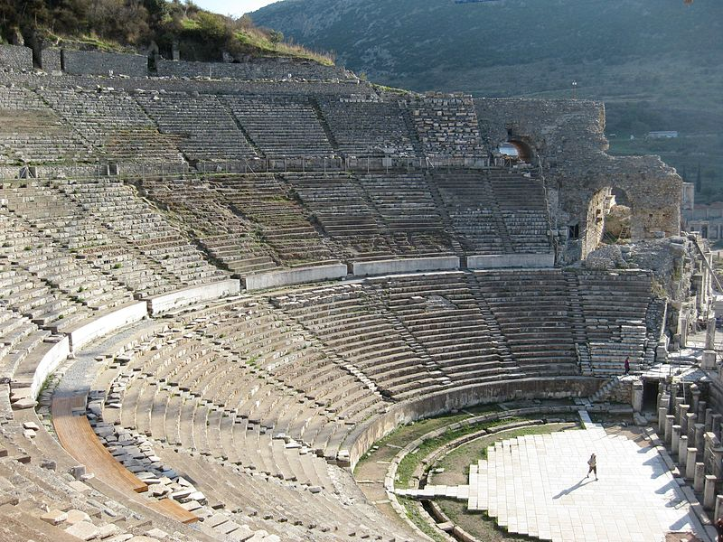
The Farewell Journey 20:1-6
¹ When the uproar had ended, Paul sent for the disciples and, after encouraging them, said good-by and set out for Macedonia.
Notes:
Ephesus = FREE = See previous lesson

Slide 5
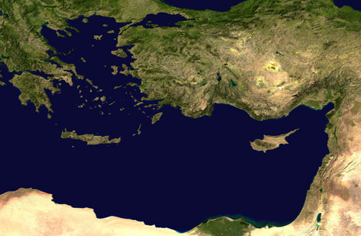
The Farewell Journey 20:1-6
¹ When the uproar had ended, Paul sent for the disciples and, after encouraging them, said good-by and set out for Macedonia.
)

Slide 6
The Farewell Journey 20:1-6
¹ When the uproar had ended, Paul sent for the disciples and, after encouraging them, said good-by and set out for Macedonia.
)

Slide 7
The Farewell Journey 20:1-6
² He traveled through that area, speaking many words of encouragement to the people, and finally arrived in Greece, ³ where he stayed three months.

Slide 8
The Farewell Journey 20:1-6
Because the Jews made a plot against him just as he was about to sail for Syria, he decided to go back through Macedonia.

Slide 9
The Farewell Journey 20:1-6
⁴ He was accompanied by Sopater son of Pyrrhus from Berea, Aristarchus and Secundus from Thessalonica, Gaius from Derbe, Timothy also, and Tychicus and Trophimus from the province of Asia.

Slide 10
The Farewell Journey 20:1-6
⁵ These men went on ahead and waited for us at Troas.⁶ But we sailed from Philippi after the Feast of Unleavened Bread, and five days later joined the others at Troas, where we stayed seven days.

Slide 11
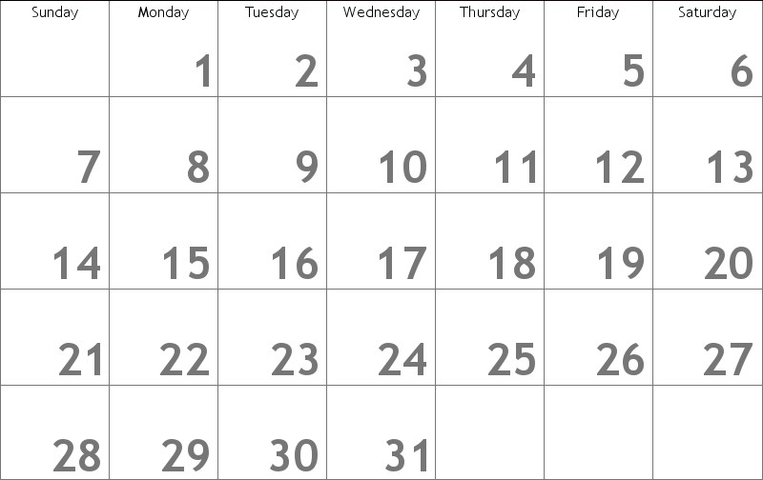
The Farewell Service 20:7-12
⁷ On the first day of the week we came together to break bread

Slide 12
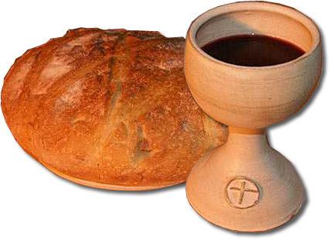
The Farewell Service 20:7-12
⁷ On the first day of the week we came together to break bread.
Notes:
Communion = free = http://www.freefoto.com/images/905/05/905_05_4962---Communion-bread-and-wine_web.jpg

Slide 13
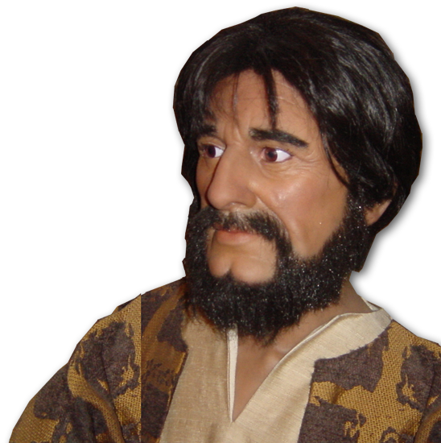
The Farewell Service 20:7-12
⁷ On the first day of the week we came together to break bread. Paul spoke to the people and, because he intended
to leave the next day,
kept on talking
until midnight.

Slide 14
The Farewell Service 20:7-12
⁷ On the first day of the week we came together to break bread. Paul spoke to the people and, because he intended
to leave the next day,
kept on talking
until midnight.

Slide 15


The Farewell Service 20:7-12
⁸ There were many lamps in the upstairs room where we were meeting.
Notes:
Flames = Free =http://www.flickr.com/photos/pshab/519697905/sizes/o/in/photostream/

Slide 16

The Farewell Service 20:7-12
⁹ Seated in a window was a young man named Eutychus, who was sinking into a deep sleep as Paul talked on and on.
Notes:
Flames = Free =http://www.flickr.com/photos/pshab/519697905/sizes/o/in/photostream/
Man sitting =FREE = http://www.sxc.hu/browse.phtml?f=download&id=786038

Slide 17

The Farewell Service 20:7-12
he fell to the ground from the third story and was picked up dead.
Notes:
Flames = Free =http://www.flickr.com/photos/pshab/519697905/sizes/o/in/photostream/
Man sitting =FREE = http://www.sxc.hu/browse.phtml?f=download&id=786038

Slide 18
The Farewell Service 20:7-12
¹⁰ Paul went down, threw himself on the young man and put his arms around him.
"Don't be alarmed,"
he said.
"He's alive!"

Slide 19
The Farewell Service 20:7-12
¹¹ Then he went upstairs again and broke bread and ate. After talking until daylight, he left.

Slide 20
The Farewell Service 20:7-12
¹¹ Then he went upstairs again and broke bread and ate. After talking until daylight, he left.

Slide 21
The Farewell Service 20:7-12
¹¹ Then he went upstairs again and broke bread and ate. After talking until daylight, he left.

Slide 22
The Farewell Service 20:7-12
¹² The people took the young man home alive and were greatly comforted.

Slide 23
The Farewell Message: 20:13-38

Slide 24
The Farewell Message: 20:13-38
¹⁵... we set sail ... and ... arrived at Miletus.

Slide 25
The Farewell Message: 20:13-38
¹⁶ Paul had decided to sail past Ephesus to avoid spending time in the province of Asia, for he was in a hurry to reach Jerusalem,
if possible, by the day of Pentecost.

Slide 26
The Farewell Message: 20:13-38
¹⁷ From Miletus, Paul sent to
Ephesus for the elders of the church.
¹⁸ When they arrived, he said to them:

Slide 27
1-Review of the PAST 13-21
"You know how I lived the whole time I was with you, from the first day I came into the province of Asia. ¹⁹ I served the Lord with great humility and with tears, although I was severely tested by the plots of the Jews.

Slide 28
1-Review of the PAST 13-21
"You know how I lived the whole time I was with you, from the first day I came into the province of Asia. ¹⁹ I served the Lord with great humility and with tears, although I was severely tested by the plots of the Jews.

Slide 29
1-Review of the PAST 13-21
²⁰ You know that I have not hesitated to preach anything that would be helpful to you but have taught you publicly and from house to house.
²¹ I have declared to both Jews and Greeks that they must turn to God in repentance and have faith
in our Lord Jesus.

Slide 30
1-Review of the PAST 13-21
²⁰ You know that I have not hesitated to preach anything that would be helpful to you but have taught you publicly and from house to house.
²¹ I have declared to both Jews and Greeks that they must turn to God in repentance and have faith
in our Lord Jesus.

Slide 31
2-Testimony to the PRESENT 22-27

Slide 32
2-Testimony to the PRESENT 22-27
²² "And now, compelled by the Spirit, I am going to Jerusalem, not knowing what will happen to me there.
²³ I only know that in every city the Holy Spirit warns me that prison and hardships are facing me.

Slide 33
2-Testimony to the PRESENT 22-27
Phil 3:⁷ But whatever was to my profit I now consider loss for the sake of Christ. ... ⁸ I consider them rubbish, that I may gain Christ.
²⁴ However, I consider my life worth nothing to me, if only I may finish the race and complete the task the Lord Jesus has given me--the task of testifying to the gospel of God's grace.
Notes:
Four years later, from prison in Rome he writes very parallel words found in Phil 3: 7-8.

Slide 34
2-Testimony to the PRESENT 22-27
Phil 3:¹³ Forgetting what is behind and straining toward what is ahead, ¹⁴ I press on toward the goal to win the prize for which God has called me....
²⁴ However, I consider my life worth nothing to me, if only I may finish the race and complete the task the Lord Jesus has given me--the task of testifying to the gospel of God's grace.
Notes:
Four years later, from prison in Rome he writes very parallel words found in Phil 3: 7-8.

Slide 35
2-Testimony to the PRESENT 22-27
I am not ashamed of the gospel, because it is the power of God for the salvation of everyone who believes: first for the Jew, then for the Gentile. (Rom 1:16)
²⁴ However, I consider my life worth nothing to me, if only I may finish the race and complete the task the Lord Jesus has given me--the task of testifying to the gospel of God's grace.

Slide 36
2-Testimony to the PRESENT 22-27
²⁵ "Now I know that none of you among whom I have gone about preaching the kingdom will ever see me again. ²⁶ Therefore, I declare to you today that
I am innocent of the blood of all men.

Slide 37
2-Testimony to the PRESENT 22-27
²⁵ "Now I know that none of you among whom I have gone about preaching the kingdom will ever see me again. ²⁶ Therefore, I declare to you today that
I am innocent of the blood of all men.

Slide 38

2-Testimony to the PRESENT 22-27
²⁷ For I have not hesitated to proclaim to you the whole will of God.

Slide 39
3-Warning for the FUTURE 28-38

Slide 40
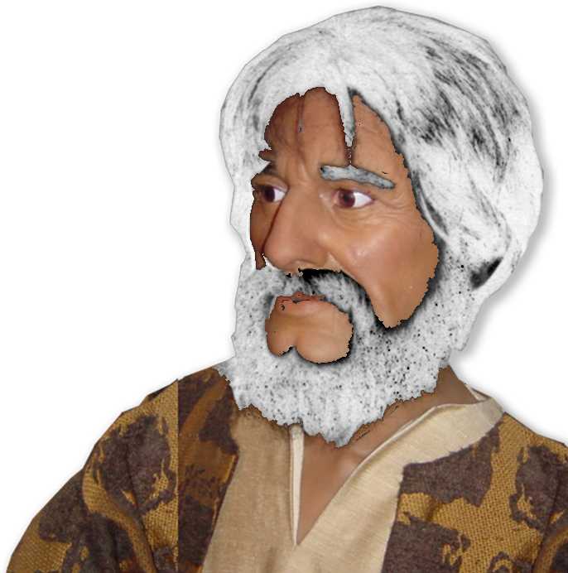
3-Warning for the FUTURE 28-38
REMEMBER
¹⁷ From Miletus, Paul sent to
Ephesus for the elders of the church.
²⁸ Keep watch over yourselves and all the flock of which the Holy Spirit has made you overseers. Be shepherds of the church of God, which he bought with his own blood.

Slide 41
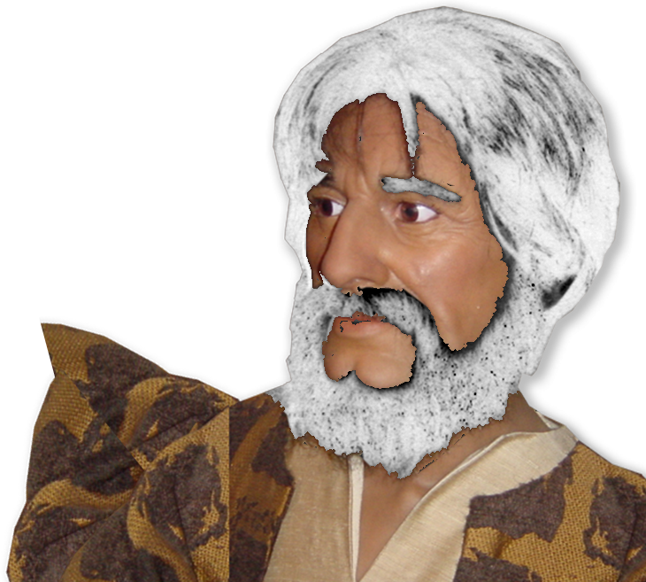

3-Warning for the FUTURE 28-38
REMEMBER
¹⁷ From Miletus, Paul sent to
Ephesus for the elders of the church.
²⁸ Keep watch over yourselves and all the flock of which the Holy Spirit has made you overseers. Be shepherds of the church of God, which he bought with his own blood.

Slide 42

3-Warning for the FUTURE 28-38
REMEMBER
¹⁷ From Miletus, Paul sent to
Ephesus for the elders of the church.
²⁸ Keep watch over yourselves and all the flock of which the Holy Spirit has made you overseers. Be shepherds of the church of God, which he bought with his own blood.

Slide 43
3-Warning for the FUTURE 28-38
REMEMBER
¹⁷ From Miletus, Paul sent to
Ephesus for the elders of the church.
²⁸ Keep watch over yourselves and all the flock of which the Holy Spirit has made you overseers. Be shepherds of the church of God, which he bought with his own blood.

Slide 44
3-Warning for the FUTURE 28-38
REMEMBER
¹⁷ From Miletus, Paul sent to
Ephesus for the elders of the church.
²⁸ Keep watch over yourselves and all the flock of which the Holy Spirit has made you overseers. Be shepherds of the church of God, which he bought with his own blood.
1

Slide 45
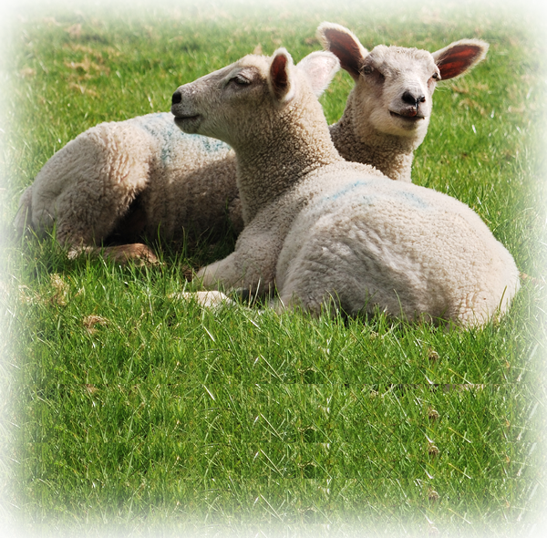
3-Warning for the FUTURE 28-38
REMEMBER
¹⁷ From Miletus, Paul sent to
Ephesus for the elders of the church.
²⁸ Keep watch over yourselves and all the flock of which the Holy Spirit has made you overseers. Be shepherds of the church of God, which he bought with his own blood.
1
2
Notes:
Sheep = FREE = http://www.sxc.hu/browse.phtml?f=download&id=1282621

Slide 46
3-Warning for the FUTURE 28-38
REMEMBER
¹⁷ From Miletus, Paul sent to
Ephesus for the elders of the church.
²⁸ Keep watch over yourselves and all the flock of which the Holy Spirit has made you overseers. Be shepherds of the church of God, which he bought with his own blood.
1
2

Slide 47
3-Warning for the FUTURE 28-38
REMEMBER
¹⁷ From Miletus, Paul sent to
Ephesus for the elders of the church.
²⁸ Keep watch over yourselves and all the flock of which the Holy Spirit has made you overseers. Be shepherds of the church of God, which he bought with his own blood.

Slide 48
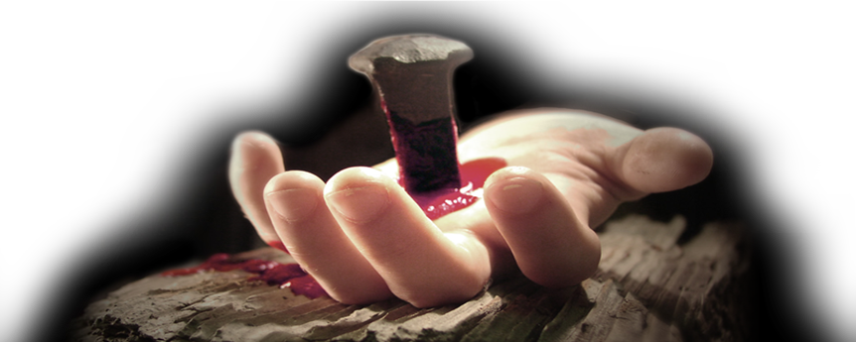
3-Warning for the FUTURE 28-38
REMEMBER
¹⁷ From Miletus, Paul sent to
Ephesus for the elders of the church.
²⁸ Keep watch over yourselves and all the flock of which the Holy Spirit has made you overseers. Be shepherds of the church of God, which he bought with his own blood.
Notes:
Nailed hand = FREE = See previous lessons

Slide 49

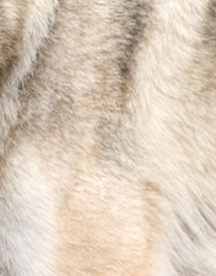
3-Warning for the FUTURE 28-38
²⁹ I know that after I leave, savage wolves will come in among you and will not spare the flock.
³⁰ Even from your own number men will arise and distort the truth in order to draw away disciples after them.
Notes:
Wolf = FREE for reuse = http://www.sxc.hu/browse.phtml?f=download&id=991793

Slide 50

3-Warning for the FUTURE 28-38
³¹ So be on your guard! Remember that for three years I never stopped warning each of you night and day with tears.

Slide 51
3-Warning for the FUTURE 28-38
³² "Now I commit you to God and to the word of his grace, which can build you up and give you an inheritance among all those who are sanctified.
Notes:
Book = FREE for reuse = see previous lessons

Slide 52

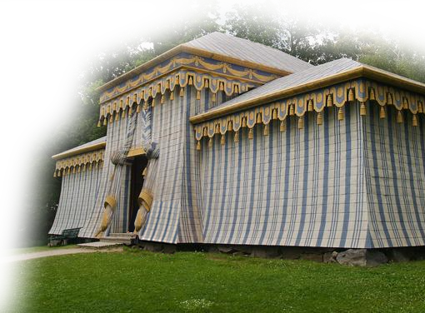
3-Warning for the FUTURE 28-38
³³ I have not coveted anyone's silver or gold or clothing.
³⁴ You yourselves know that these hands of mine have supplied my own needs and the needs
of my companions.
Notes:
Tent = FREE for reuse = see previous lessons

Slide 53
3-Warning for the FUTURE 28-38
³⁵ In everything I did, I showed you that by this kind of hard work we must help the weak, remembering the words the Lord Jesus himself said: 'It is more blessed to give than to receive.‘“

Slide 54
3-Warning for the FUTURE 28-38
³⁶ When he had said this, he knelt down with all of them and prayed. ³⁷ They all wept as they embraced him and kissed him.
³⁸ What grieved them most was
his statement that they would
never see his face again.
Then they accompanied him
to the ship.

Slide 55
Let’s sum up ...
We are all on the journey of life ...
God has something for everyone of us to accomplish.
What is it that He wants you to accomplish with the rest of your life?
What is your “Jerusalem?”

Slide 56
Let me ask a final question ...
If you had to make your final
“Good-Bye”/”Farewell” speech today,
WHAT WOULD YOU SAY?
1—About your past?
2—About your present?
3—About your future?

Slide 57
LET’S PRAY

