Slide 1
ACTS 17-18
www.BiblePoint.com
2011 © Single Initiative LLC
Notes:
Copyright © 2000-2011. All rights reserved. Bible Point is a registered trademark of Single Initiative, LLC. All other trademarks acknowledged.
Bible Point contains graphics from Bible Point artists. These illustrations belong to Bible Point and the respective artists. You may use the designs and illustrations for graphical illustration of lessons free and without special permission, provided they are not used in any way that maligns the Christian faith. Furthermore, republication or production of any illustration by any other graphic service whether it be in book, in a machine-readable form, or in any other design resource is strictly prohibited. Furthermore, they cannot be duplicated or resold as any other form of publishing, clip art, or graphic resource.
So What does it mean? (A simple translations of the legal jargon)
So, if you don’t own the presentation(s), graphic(s), and text(s) how can you legally use them? The purchase of the license allows you to use all the images in the product. However, the actual ownership and copyright of the presentation(s), graphic(s), and text(s) remain the property of Bible Point and its licensors. If you had plans on using this product in your “for sale” work—think again!
License Agreement
Article 1: License Grant
All the graphics and text in Bible Point presentations (excluding quotes from the Bible and stated sources) are the intellectual and real property of Bible Point and its licensors, and is protected by law, including United States copyright laws and international treaties. Bible Point grants to you a license:
1. To use the presentation in a single church, single school, or single office of a Christian organization.
2. To make a single archival back-up copy of the program.
3. To modify the presentation(s) and merge with other presentations in a single church, school, or Christian organization.
4. To transfer to another party if that party agrees to accept the terms and conditions of this agreement, and you do not retain any copies of the presentation, whether printed, machine readable, modified, or merged form.
Article 2: Terms
This license is effective until terminated. You may terminate the license at any time by destroying the presentation(s), graphic(s), or text(s) together with all copies, modifications and merged portions in any form. Bible Point may terminate your license if you fail to comply with this Agreement. You agree, upon such termination, for any reason, to destroy the presentation(s), graphics, and text(s) with all copies, modifications, and merged portions in any form.
Article 3: Disclaimers
1. Bible Point presentations, graphics, and texts are licensed to you As Is. You, the consumer, bear the entire risk relating to the quality and performance of the presentation(s), graphic(s), or text(s). In no event will Bible Point be liable for damages resulting from any defect.
2. Thirty-day limited warrantee on disks. Bible Point warrants the disks to be free of defects in material and workmanship under normal use for 30 days after purchase. During the 30-day period you may return a defective presentation, graphic, or text with proof of purchase and it will be replaced without charge, unless the presentation is damaged by misuse.
Article 4: General
1. You may not sub-license, assign, or transfer the license of the presentation(s), graphic(s), or text(s) except as provided by this Agreement.
2. This Agreement will be governed by the laws of the State of Michigan.
So What does it mean? (A simple translations of the legal jargon)
May I let someone borrow or copy my licensed Bible Point presentation (even after I modified it)? As long as it is within your local church, or single school, or the immediate office of a Christian organization you may. Otherwise, please refer the person interested in borrowing to: http://www.biblepoint.com or E-mail: dh@biblepoint.com with any related questions.
---------------------------------------------------------------------------------------------------------------------------
Scripture taken from the HOLY BIBLE, NEW INTERNATIONAL VERSION®. NIV®. Copyright©1973, 1978, 1984 by International Bible Society. Used by permission of Zondervan. All rights reserved.

Slide 2
Last time ...
We left the Apostle ...

Slide 3
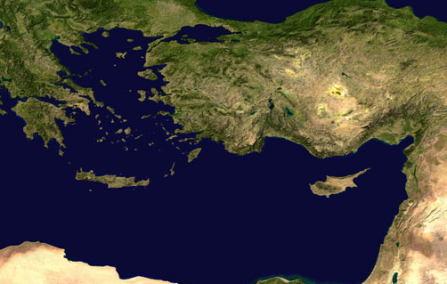
The 2nd Missionary Journey
BYTHYNIA
Mysia
GALATIA
ASIA
Phyrygia
Cilicia
Syria

Slide 4
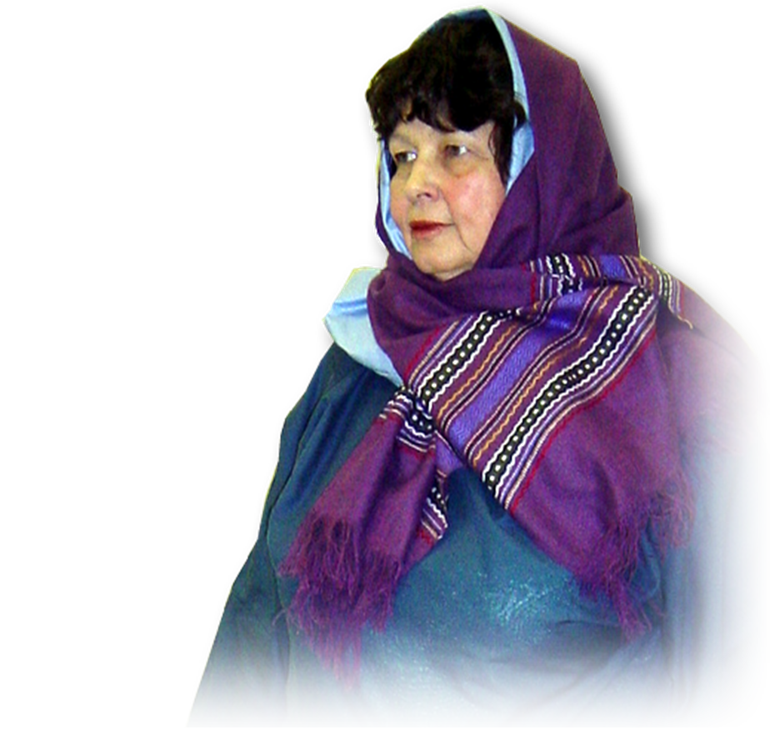
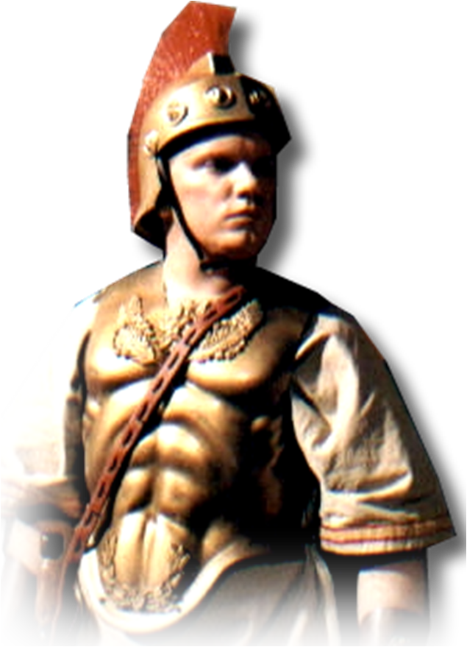
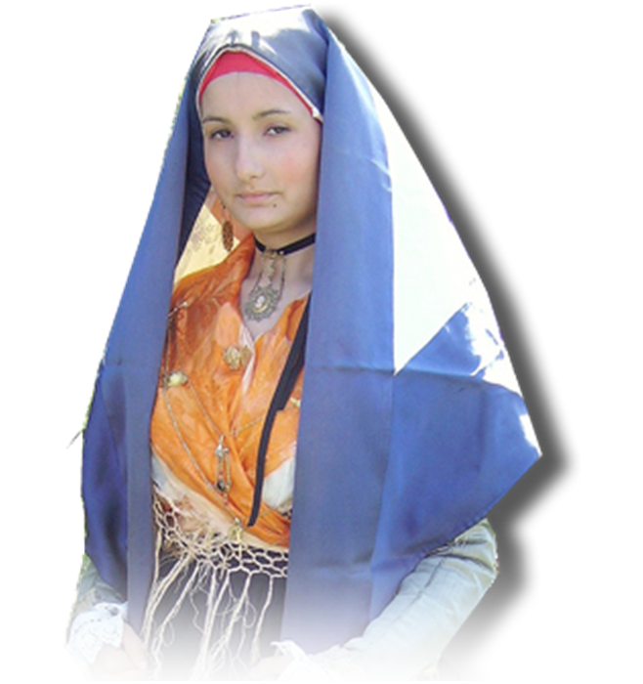

The 2nd Missionary Journey
Philippi
Notes:
People = see previous lesson.

Slide 5
Today’s Premise:
The Gospel
always gets
a REACTION!

Slide 6
Global Market
Reactions

Slide 7
There will be 4 reactions:
1- Resistance
2-Reception
3-Ridicule
4-Reviling

Slide 8
1. Resistance 17:1-9
Thessalonica
¹ When they had passed through Amphipolis and Apollonia, they came to Thessalonica, where there was a Jewish synagogue.

Slide 9
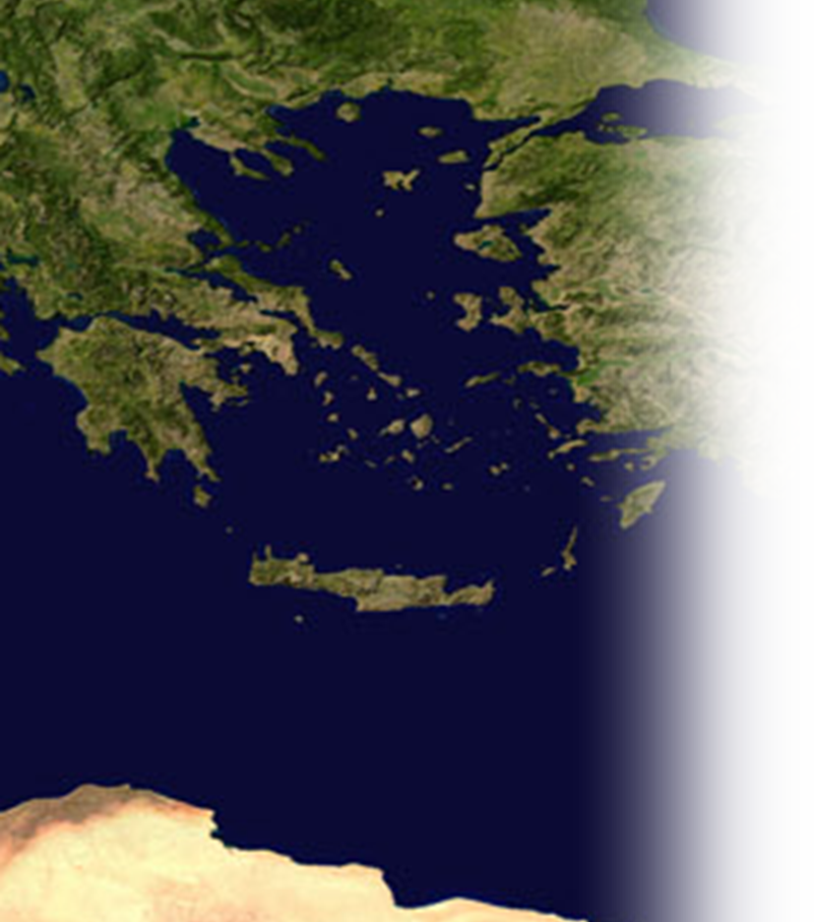
1. Resistance 17:1-9
² As his custom was, Paul went into the synagogue, and on three Sabbath days he reasoned with them from the Scriptures,
From 2 Weeks and 1 Day?
To 3 weeks and 6 days?

Slide 10
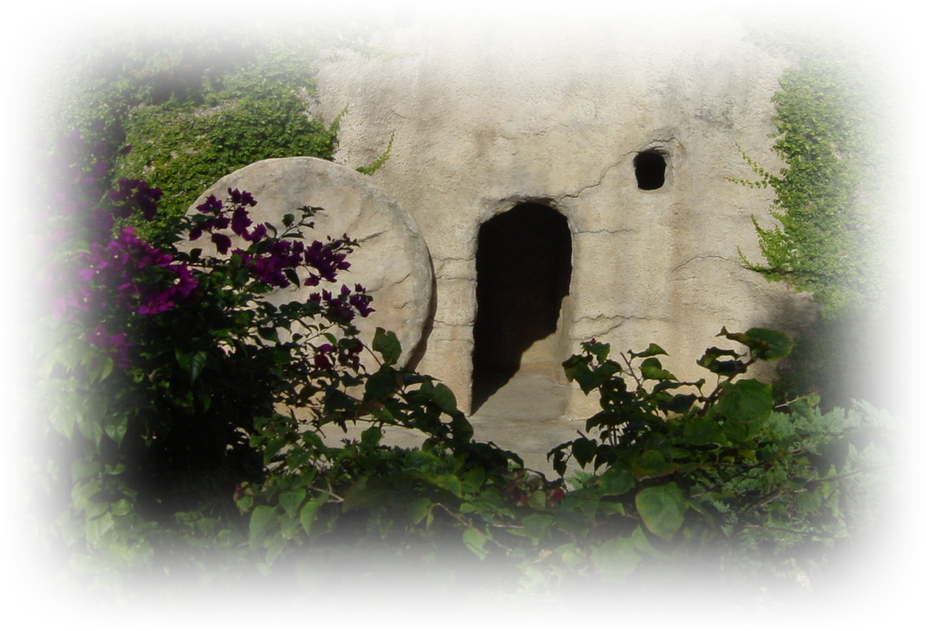
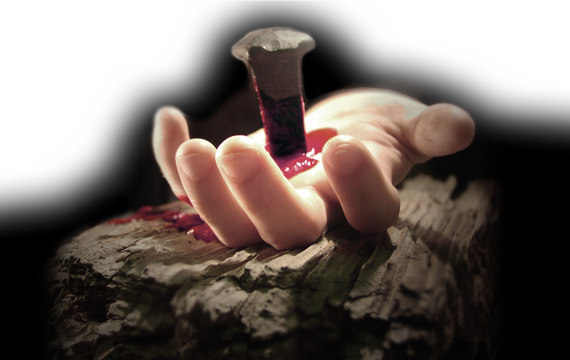
1. Resistance 17:1-9
³ explaining and proving that the Christ had to suffer and rise from the dead.
Notes:
Hand with nail = FREE for reuse = from http://imagebase.davidniblack.com/main.php?g2_itemId=1889
Empty Tomb = FREE for reuse = from BiblePoint photo

Slide 11
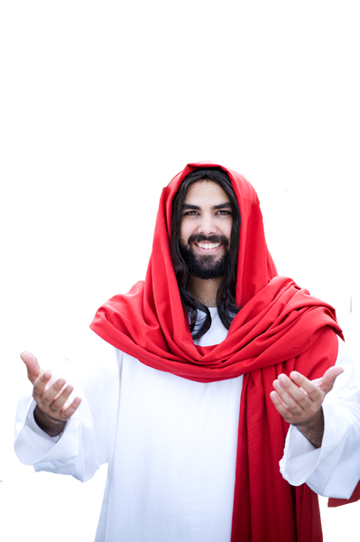
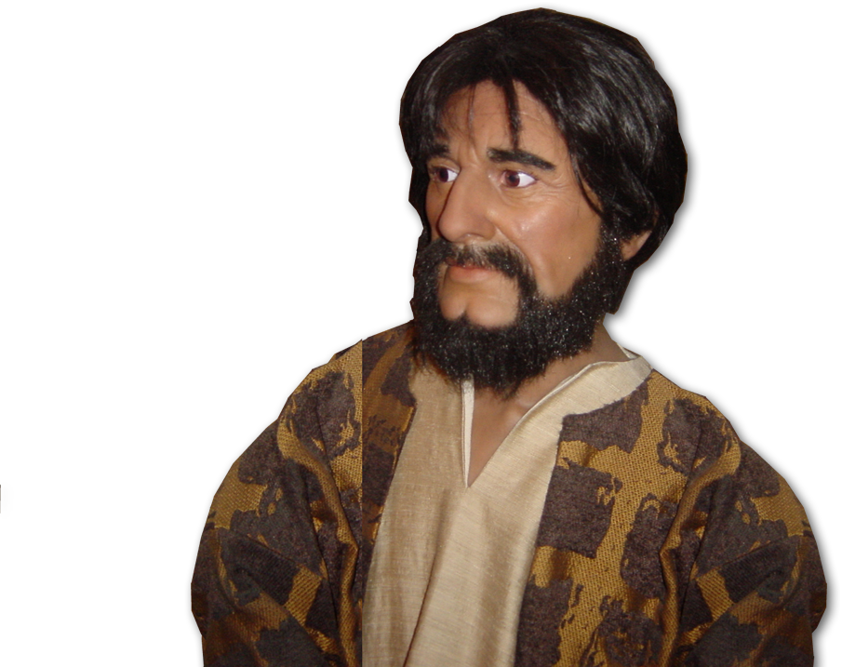
1. Resistance 17:1-9
"This Jesus I am
proclaiming to you
is the Christ,“
he said.
Notes:
Jesus = Licensed and NOT FREE for reuse = istock

Slide 12
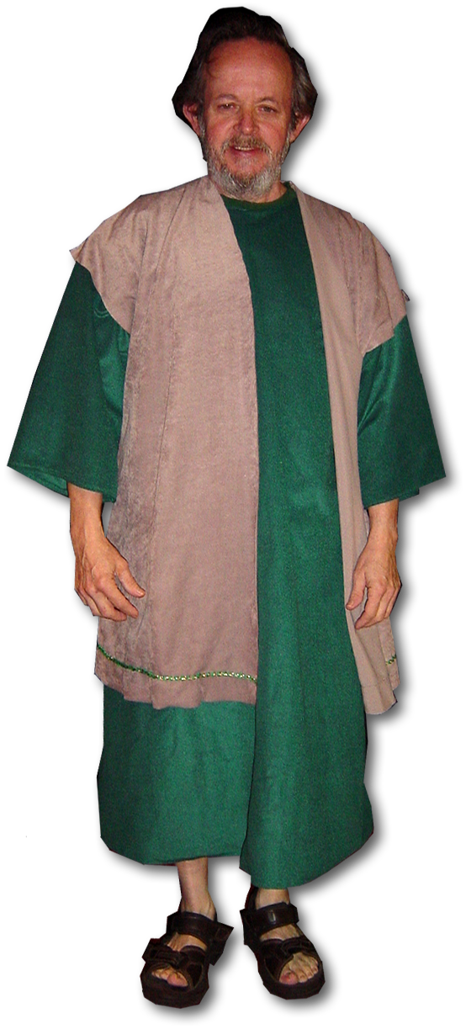
1. Resistance 17:1-9
⁴ Some of the Jews were persuaded and joined Paul and Silas, as did a large number of God-fearing Greeks and not
a few prominent women.
Notes:
Silas = FREE for reuse = BiblePoint photo

Slide 13
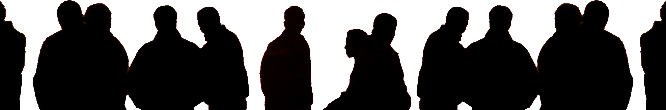
1. Resistance 17:1-9
⁵ But the Jews were jealous; so they rounded up some bad characters from the marketplace, formed a mob and started a riot in the city. They rushed to Jason's house in search of Paul and Silas in order to bring them out to the crowd.
Notes:
Crowd = free from = http://www.flickr.com/photos/thomashawk/4777025004/sizes/o/in/photostream/

Slide 14
1. Resistance 17:1-9
⁶ But when they did not find them, they dragged Jason and some other brothers before the city officials, shouting:
"These men who have caused trouble all over the world have now come here, ⁷ and Jason has welcomed them into his house. They are all defying Caesar's decrees, saying that there is another king, one called Jesus.”
Notes:
Crowd = free = http://www.sxc.hu/browse.phtml?f=download&id=460620

Slide 15
1. Resistance 17:1-9
⁸ When they heard this, the crowd and the city officials were thrown into turmoil.
⁹ Then they made Jason and the others post bond and let them go.

Slide 16
1. Resistance 17:1-9
¹⁰ As soon as it was night, the brothers sent Paul and Silas away to Berea.
Berea

Slide 17
2. Reception 17:10-14

Slide 18
2. Reception 17:10-14
¹⁰ ... On arriving there, they went to the Jewish synagogue.
Berea

Slide 19

2. Reception 17:10-14
¹¹ Now the Bereans were of more noble character than the Thessalonians, for they received the message with great eagerness and examined the Scriptures every day to see if what Paul said was true.
1
2

Slide 20
2. Reception 17:10-14
¹² Many of the Jews believed, as did also a number of prominent Greek women and many Greek men.
.
3
Notes:
Book = FREE for reuse = from dreamstimefree_823501

Slide 21
2. Reception 17:10-14
¹³ When the Jews in Thessalonica learned that Paul was preaching the word of God at Berea, they went there too, agitating the crowds and stirring them up. ¹⁴ The brothers immediately sent Paul to the coast, but Silas and Timothy stayed at Berea.

Slide 22
3. Ridiculed 17:15-24

Slide 23
3. Ridiculed 17:15-24
¹⁵ The men who escorted Paul brought him to Athens and then left with instructions for Silas and Timothy
to join him as
soon as
possible.
Athens

Slide 24
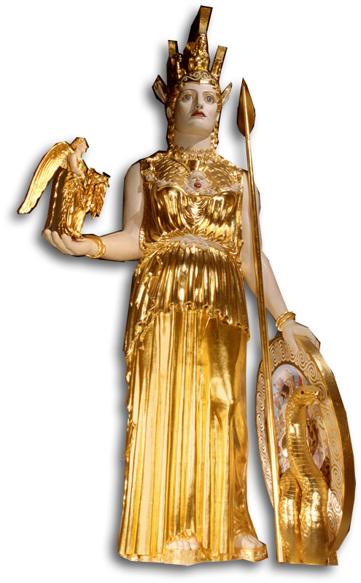
3. Ridiculed 17:15-24
¹⁶ While Paul was waiting for them in Athens, he was greatly distressed to see that the city was full of idols.
Notes:
Atheana Replica in Nashville TN = FREE for reuse from http://upload.wikimedia.org/wikipedia/commons/0/02/Athena_Parthenos_LeQuire.jpg

Slide 25
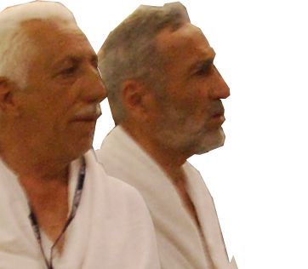
3. Ridiculed 17:15-24
¹⁷ So he reasoned in the synagogue … as well as in the marketplace …. ¹⁸ A group of Epicurean and Stoic philosophers began to dispute with him. Some of them asked,
"What is this babbler
trying to say?"
Others ...
"He seems to be
advocating foreign
gods.”
Notes:
Philosophers = free = http://www.flickr.com/photos/spirosk/4450010589/sizes/o/in/photostream/

Slide 26
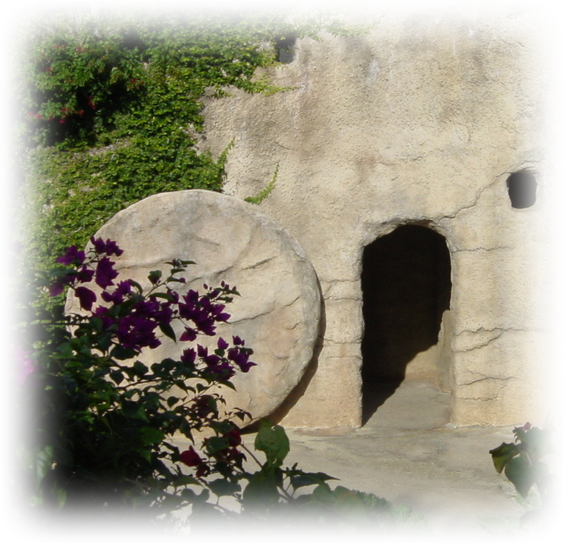
3. Ridiculed 17:15-24
They said this because Paul was preaching the good news about Jesus and the resurrection.
Notes:
Empty tomb = Free = Bible Point

Slide 27
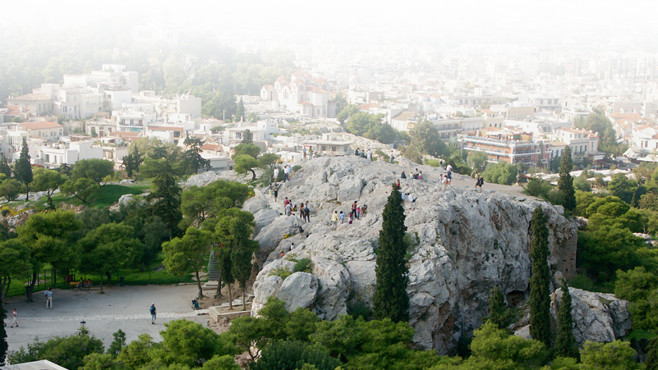
3. Ridiculed 17:15-24
¹⁹ Then they took him and brought him to a meeting of the Areopagus, where they said to him, ...
Notes:
Areopagus = free = http://www.flickr.com/photos/ajbear/299116407/sizes/o/in/photostream/

Slide 28
3. Ridiculed 17:15-24
"May we know what this new teaching is that you are presenting? ²⁰ You are bringing some strange ideas to our ears, and we want to know what they mean."

Slide 29
3. Ridiculed 17:15-24
.... ²² Paul then ... said:
"Men of Athens! I see that in every way you are very religious. ²³ For as I walked around and looked carefully at your objects of worship, I even found an altar with this inscription: TO AN UNKNOWN GOD. Now what you worship as something unknown I am going to proclaim to you.

Slide 30
3. Ridiculed 17:15-24
CREATOR
.... ²² Paul then ... said:
²⁴ "The God who made the world and everything in it is the Lord of heaven and earth and does not live in temples built by hands. ²⁵ And he is not served by human hands, as if he needed anything, because he himself gives all men life and breath and everything else.

Slide 31
3. Ridiculed 17:15-24
CREATOR
PROVIDENCE
²⁶ From one man he made every nation of men, that they should inhabit the whole earth; and he determined the times set for them and the exact places where they should live.
²⁷ God did this so that men would seek him and perhaps reach out for him and find him, though he is not far from each one of us.

Slide 32
3. Ridiculed 17:15-24
CREATOR
PROVIDENCE
REACHABLE
²⁶ From one man he made every nation of men, that they should inhabit the whole earth; and he determined the times set for them and the exact places where they should live.
²⁷ God did this so that men would seek him and perhaps reach out for him and find him, though he is not far from each one of us.

Slide 33
3. Ridiculed 17:15-24
CREATOR
PROVIDENCE
REACHABLE
²⁸ 'For in him we live and move and have our being.' As some of your own poets have said, 'We are his offspring.'
²⁹ "Therefore since we are God's offspring, we should not think that the divine being is like gold or silver or stone--an image made by man's design and skill.

Slide 34
3. Ridiculed 17:15-24
CREATOR
PROVIDENCE
REACHABLE
³⁰ In the past God overlooked such ignorance, but now he commands all people everywhere to repent.
³¹ For he has set a day when he will judge the world with justice by the man he has appointed. He has given proof of this to all men by
raising him from the dead.“

Slide 35
3. Ridiculed 17:15-24
CREATOR
PROVIDENCE
REACHABLE
JUDGE
³⁰ In the past God overlooked such ignorance, but now he commands all people everywhere to repent.
³¹ For he has set a day when he will judge the world with justice by the man he has appointed. He has given proof of this to all men by
raising him from the dead.“

Slide 36
3. Ridiculed 17:15-24
CREATOR
PROVIDENCE
REACHABLE
JUDGE
JESUS
³⁰ In the past God overlooked such ignorance, but now he commands all people everywhere to repent.
³¹ For he has set a day when he will judge the world with justice by the man he has appointed. He has given proof of this to all men by
raising him from the dead.“

Slide 37
3. Ridiculed 17:15-24
³² When they heard about the resurrection of the dead, some of them sneered, but others said,
"We want to hear you
again on this subject.”

Slide 38
3. Ridiculed 17:15-24
³³ At that, Paul left the Council.
³⁴ A few men became followers of Paul and believed. Among them was Dionysius, a member of the Areopagus, also a woman named Damaris, and a number of others.
Notes:
Dionysius = FREE =

Slide 39
4. Reviled 18:1-22

Slide 40
4. Reviled 18:1-22
^{NIV} Acts 18:1 After this, Paul left Athens and went to Corinth.
Corinth

Slide 41
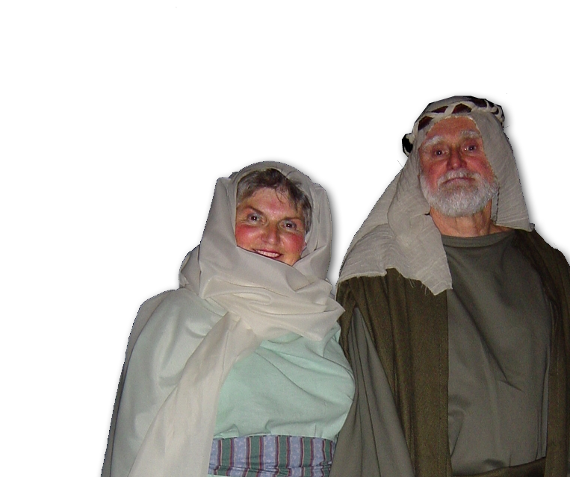
4. Reviled 18:1-22
Corinth
² There he met a Jew named Aquila, a native of Pontus, who had recently come from Italy with his wife Priscilla,
Notes:
Aquila and Priscilla = FREE = Bible Point photo.

Slide 42
4. Reviled 18:1-22
Pontus
BYTHYNIA
Mysia
ASIA
Corinth
Cilicia
² There he met a Jew named Aquila, a native of Pontus, who had recently come from Italy with his wife Priscilla,
Syria

Slide 43
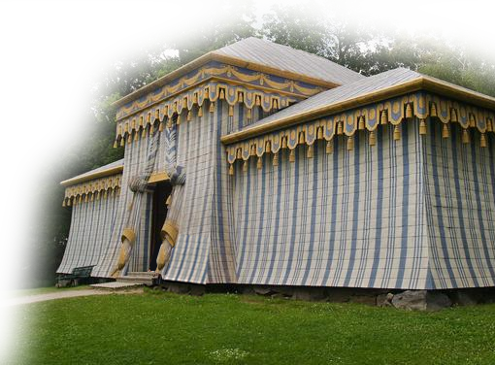
4. Reviled 18:1-22
² ... Paul went to see them, ³ and because he was a tentmaker as
they were, he
stayed and
worked with
them.
Notes:
Tent = Free with citation of credit as follows: http://www.jeremiahblatz.com/personal/pics/Poland_Sweden_Russia_Pictures_July_2007/day4/83_Guard_s_Tent_at_Drottningholm_Palace_Sweden_reg.jpg

Slide 44
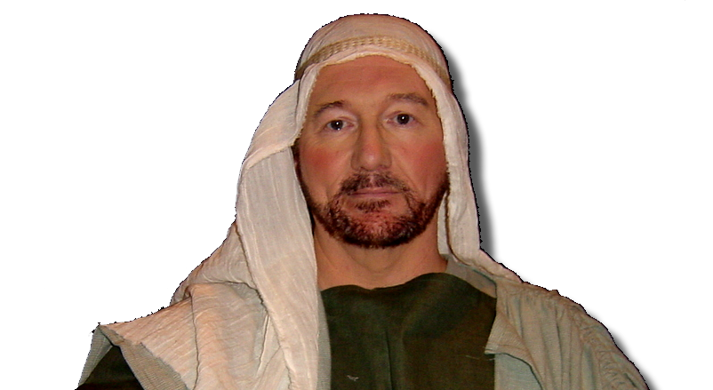
4. Reviled 18:1-22
⁴ Every Sabbath he reasoned in the synagogue, trying to persuade Jews and Greeks. ⁵ When Silas and Timothy came from Macedonia, Paul devoted himself exclusively to preaching,
testifying to the Jews
that Jesus was
the Christ.

Slide 45
4. Reviled 18:1-22
⁶ But when the Jews opposed Paul and became abusive, he shook out his clothes in protest and said to them,
Blasphemous

Slide 46
4. Reviled 18:1-22
⁶ But when the Jews opposed Paul and became abusive, he shook out his clothes in protest and said to them,
"Your blood be on your own
heads! I am clear of my
responsibility. From now on
I will go to the Gentiles."

Slide 47
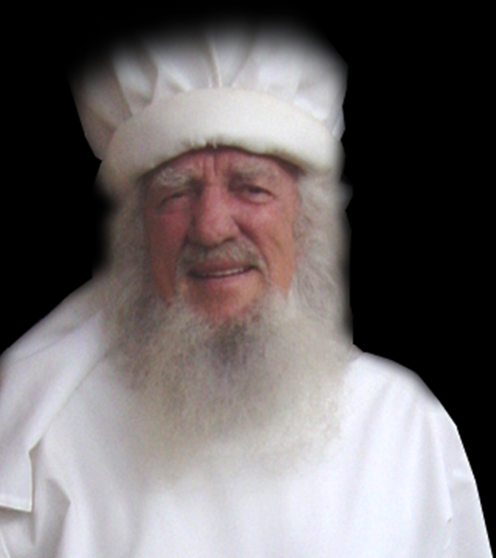
4. Reviled 18:1-22
⁷ Then Paul left the synagogue and went next door to the house of Titius Justus, a worshiper of God.
⁸ Crispus, the synagogue ruler, and his entire household believed
in the Lord; and many of
the Corinthians who heard
him believed and were baptized.
Notes:
Priest = FREE for reuse = from BiblePoint photo

Slide 48
4. Reviled 18:1-22
⁹ One night the Lord spoke to Paul in a vision:
"Do not be afraid; keep on speak-ing, do not be silent. ¹⁰ For I am with you, and no one is going to attack and harm you, because
I have many people in this city.“

Slide 49
4. Reviled 18:1-22
¹¹ So Paul stayed for a year and a half, teaching them the word of God.
Corinth
Notes:
Book = FREE for reuse = see previous lesson

Slide 50
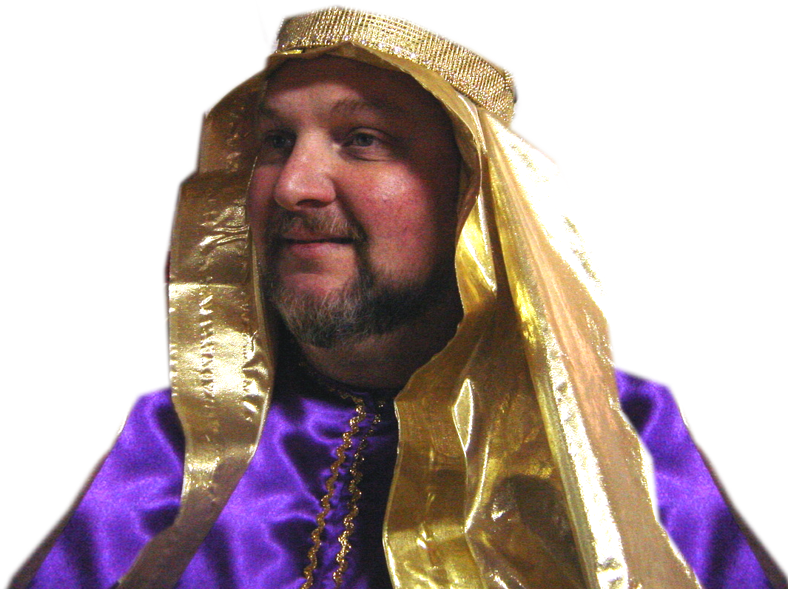
4. Reviled 18:1-22
¹² While Gallio was proconsul of Achaia, the Jews made a united attack on Paul and brought him into court.....
Notes:
Gallio = FREE for reuse from = BiblePoint photo

Slide 51
4. Reviled 18:1-22
¹⁵ [But Gallio said] ...
“It involves questions about words and names and your own law--settle the matter yourselves. I will not be a judge of such things.”
¹⁶ So he had them ejected from the court.

Slide 52
4. Reviled 18:1-22
¹⁷ Then they all turned on Sosthenes the synagogue ruler and beat him
in front of the court. But
Gallio showed no
concern whatever.
¹⁸ Paul stayed on in
Corinth for some time.

Slide 53
4. Reviled 18:1-22
Then he left the brothers and sailed for Syria, ... ¹⁹ They arrived at Ephesus, where Paul left Priscilla and Aquila. ....
Ephesus
Syria

Slide 54
4. Reviled 18:1-22
²¹ Then he set sail from Ephesus. ²² When he landed at Caesarea, he went up and greeted the church and then went down to Antioch.
Ephesus
Syria
Caesarea

Slide 55
The Whole Picture
Thessalonica
Philippi
BYTHYNIA
Berea
Mysia
GALATIA
ASIA
Phyrygia
Corinth
Athens
Cilicia
Syria
Caesarea

Slide 56
So what are we to make of this?
Everywhere we go we are witnesses!
People will react in different ways:
1—Resist it
2—Recieve it
3—Riddicule it
4—Revile it
So don’t ever forget ...

Slide 57
The Gospel
always gets
a REACTION!
And how are you responding today?

Slide 58
Let’s Pray

