Slide 1
ACTS 16:1-40
www.BiblePoint.com
2011 © Single Initiative LLC
Notes:
Copyright © 2000-2011. All rights reserved. Bible Point is a registered trademark of Single Initiative, LLC. All other trademarks acknowledged.
Bible Point contains graphics from Bible Point artists. These illustrations belong to Bible Point and the respective artists. You may use the designs and illustrations for graphical illustration of lessons free and without special permission, provided they are not used in any way that maligns the Christian faith. Furthermore, republication or production of any illustration by any other graphic service whether it be in book, in a machine-readable form, or in any other design resource is strictly prohibited. Furthermore, they cannot be duplicated or resold as any other form of publishing, clip art, or graphic resource.
So What does it mean? (A simple translations of the legal jargon)
So, if you don’t own the presentation(s), graphic(s), and text(s) how can you legally use them? The purchase of the license allows you to use all the images in the product. However, the actual ownership and copyright of the presentation(s), graphic(s), and text(s) remain the property of Bible Point and its licensors. If you had plans on using this product in your “for sale” work—think again!
License Agreement
Article 1: License Grant
All the graphics and text in Bible Point presentations (excluding quotes from the Bible and stated sources) are the intellectual and real property of Bible Point and its licensors, and is protected by law, including United States copyright laws and international treaties. Bible Point grants to you a license:
1. To use the presentation in a single church, single school, or single office of a Christian organization.
2. To make a single archival back-up copy of the program.
3. To modify the presentation(s) and merge with other presentations in a single church, school, or Christian organization.
4. To transfer to another party if that party agrees to accept the terms and conditions of this agreement, and you do not retain any copies of the presentation, whether printed, machine readable, modified, or merged form.
Article 2: Terms
This license is effective until terminated. You may terminate the license at any time by destroying the presentation(s), graphic(s), or text(s) together with all copies, modifications and merged portions in any form. Bible Point may terminate your license if you fail to comply with this Agreement. You agree, upon such termination, for any reason, to destroy the presentation(s), graphics, and text(s) with all copies, modifications, and merged portions in any form.
Article 3: Disclaimers
1. Bible Point presentations, graphics, and texts are licensed to you As Is. You, the consumer, bear the entire risk relating to the quality and performance of the presentation(s), graphic(s), or text(s). In no event will Bible Point be liable for damages resulting from any defect.
2. Thirty-day limited warrantee on disks. Bible Point warrants the disks to be free of defects in material and workmanship under normal use for 30 days after purchase. During the 30-day period you may return a defective presentation, graphic, or text with proof of purchase and it will be replaced without charge, unless the presentation is damaged by misuse.
Article 4: General
1. You may not sub-license, assign, or transfer the license of the presentation(s), graphic(s), or text(s) except as provided by this Agreement.
2. This Agreement will be governed by the laws of the State of Michigan.
So What does it mean? (A simple translations of the legal jargon)
May I let someone borrow or copy my licensed Bible Point presentation (even after I modified it)? As long as it is within your local church, or single school, or the immediate office of a Christian organization you may. Otherwise, please refer the person interested in borrowing to: http://www.biblepoint.com or E-mail: dh@biblepoint.com with any related questions.
---------------------------------------------------------------------------------------------------------------------------
Scripture taken from the HOLY BIBLE, NEW INTERNATIONAL VERSION®. NIV®. Copyright©1973, 1978, 1984 by International Bible Society. Used by permission of Zondervan. All rights reserved.

Slide 2
The Gospel
was never intended
to be kept
to myself!
Notes:
Globe background licensed and NOT FOR REUSE from Dreamstime http://www.dreamstime.com/best-concept-of-global-business-image10667813 do not reproduce.

Slide 3
Penetrating
Global Markets
"…you will be my witnesses in Jerusalem, and in all Judea and Samaria, and to the ends of the earth." (Act 1:8)
Notes:
Globe background licensed from Dreamstime http://www.dreamstime.com/best-concept-of-global-business-image10667813 do not reproduce.

Slide 4
A Fresh Start
The Second Missionary Journey

Slide 5
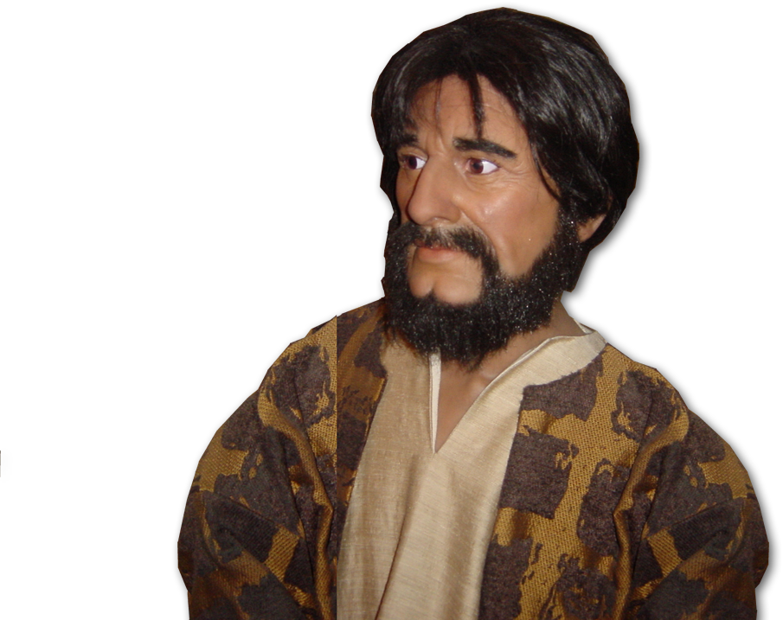
A Fresh Start
^{15:36} Some time later Paul
said to Barnabas,
"Let us go back and
visit the brothers in
all the towns ...“

Slide 6
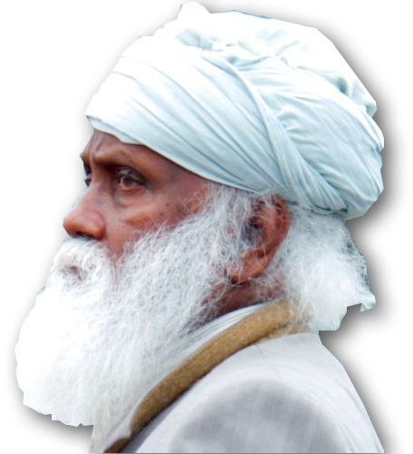
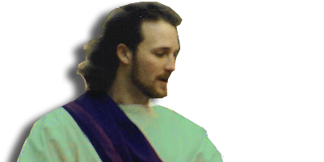
A Fresh Start
³⁷ Barnabas wanted to take John, also called Mark, with them,
³⁸ but Paul did not think it wise to take him, because he had deserted them
Notes:
John Mark = FREE from = http://commons.wikimedia.org/wiki/File:Easter_Parade_1995_-_pageantry_02.jpg

Slide 7
A Fresh Start
³⁹ They had such a sharp disagreement that they parted company

Slide 8
The Result:
Penetrating
Global Markets
Now requires …

Slide 9
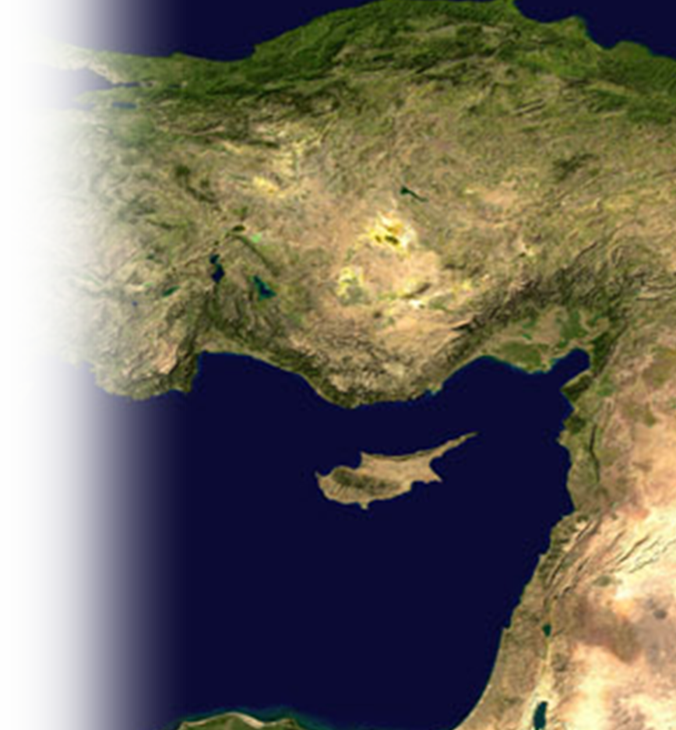
1. New Partners
³⁹ …Barnabas took Mark and sailed for Cyprus,
Notes:
John Mark = FREE from = http://commons.wikimedia.org/wiki/File:Easter_Parade_1995_-_pageantry_02.jpg

Slide 10
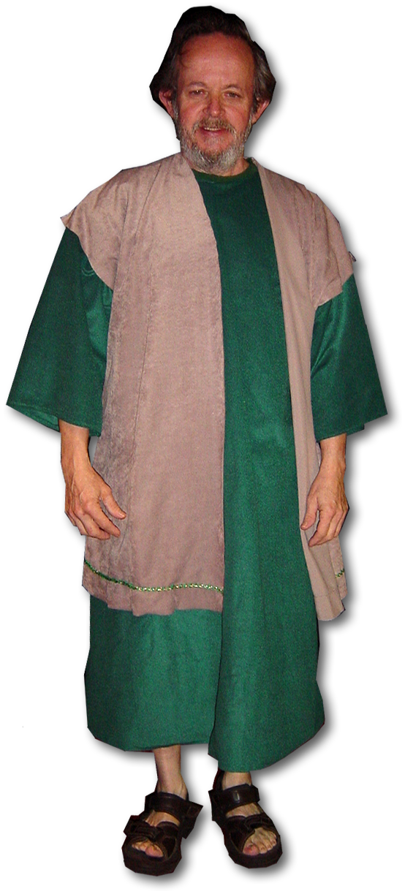
1. New Partners
³⁹ …Barnabas took Mark and sailed for Cyprus, ⁴⁰ but Paul chose Silas and left, commended by the brothers to the grace of the Lord. ⁴¹ He went through Syria and Cilicia, strengthening the churches.
Cilicia
Syria
Notes:
Silas = Free =Bible Point photo.

Slide 11
2. With A New HELPER
Notes:
Timothy = Free = Bible Point Photo

Slide 12
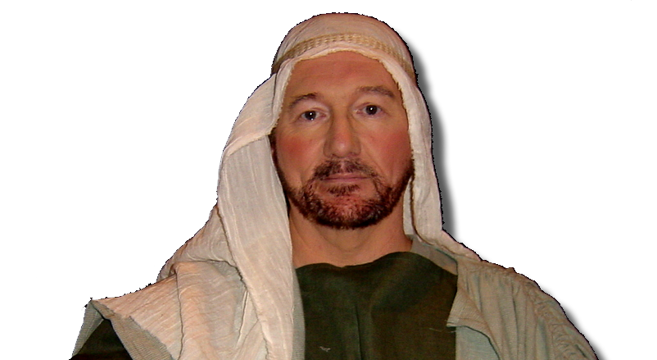
2. With A New HELPER
^{16:1} He came to Derbe and then to Lystra, where a disciple named Timothy lived, whose mother was a Jewess and a believer, but whose father was a Greek.
Notes:
Timothy = Free = Bible Point Photo

Slide 13

2. With A New HELPER
² The brothers at Lystra and Iconium spoke well of him.
³ Paul wanted to take him along on the journey, so he circumcised him because of the Jews who lived in that area, for they all knew that his father was a Greek.
Notes:
Timothy = Free = Bible Point Photo

Slide 14
2. With A New HELPER
⁴ As they traveled from town to town, they delivered the decisions reached by the apostles and elders in Jerusalem for the people to obey.
⁵ So the churches were strengthened in the faith and grew daily in numbers.
GRACE + Nothing
= SALVATION
Give none offence--
Abstain: idol food, immorality, blood

Slide 15
3. With A New VISION

Slide 16
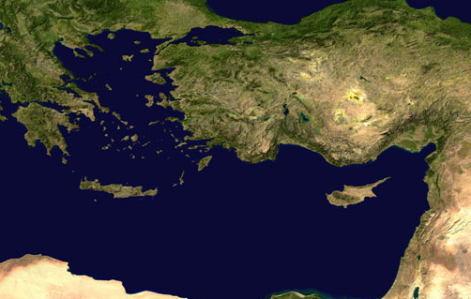
3. With A New VISION
GALATIA
ASIA
Phyrygia
⁶ Paul and
his companions
traveled throughout
the region of Phrygia
and Galatia, having been kept by the Holy Spirit from preaching the word in the province of Asia.
Cilicia
Syria
Notes:
Globe background licensed from Dreamstime http://www.dreamstime.com/best-concept-of-global-business-image10667813 do not reproduce.

Slide 17
3. With A New VISION
BYTHYNIA
Mysia
GALATIA
ASIA
Phyrygia
⁷ When they
came to the
border of Mysia,
they tried to enter Bithynia, but the Spirit of Jesus would not allow them to. ⁸ So they passed by Mysia and went down to Troas.

Slide 18
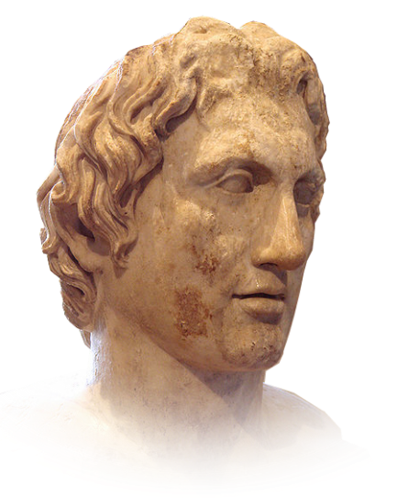
3. With A New VISION
⁹ During the night Paul had a vision of a man of Macedonia standing and begging him,
"Come over to Macedonia and help us.“
Notes:
Macedonian Man = free = http://commons.wikimedia.org/wiki/File:AlexandreLouvre.jpg

Slide 19
4. With A Renewed Mission

Slide 20
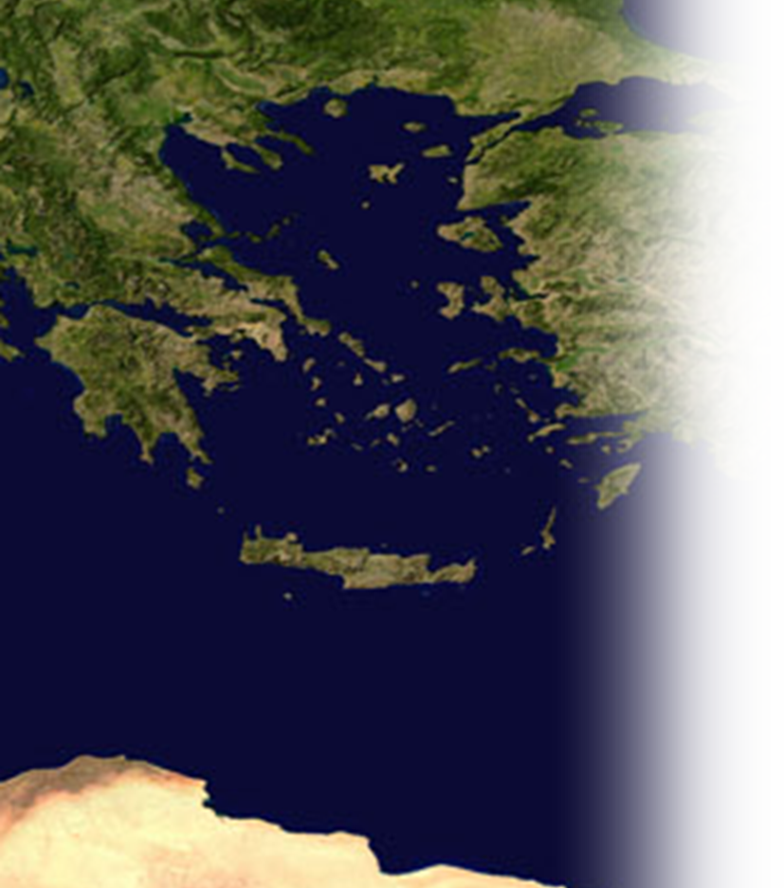
4. With A Renewed Mission
Macedonia
¹⁰ After Paul had seen the vision, we got ready at once to leave for Macedonia, concluding that God had called us to preach the gospel to them.
¹¹ From Troas we put out to sea and sailed straight for Samothrace, and the next day on to Neapolis.

Slide 21
4. With A Renewed Mission
¹² From there we traveled to Philippi, a Roman colony and the leading city of that district of Macedonia. And we stayed there several days.

Slide 22
4. With A Renewed Mission
¹³ On the Sabbath we went outside the city gate to the river, where we expected to find a place of prayer. We sat down and began to speak to the women who had gathered there.

Slide 23
5. With A New Opening
Notes:
Lydia = free = Bible Point photo.

Slide 24
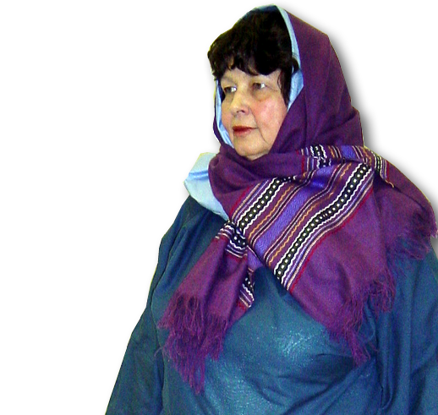
5. With A New Opening
¹⁴ One of those listening was a woman named Lydia, a dealer in purple cloth from the city of Thyatira, who was a worshiper of God. The Lord opened her heart to respond to Paul's message.
Thyatira
Notes:
Lydia = free = Bible Point photo.
Thyatira is in Asia (Turkey) where Paul was forbidden to go. This is similar to John 4 woman at the well.
Jesus “must needs go through Samaria” to rendezvous with the Samarian Woman.
Paul must not go to Asia or Bithynia in order to go to Europe to rendezvous with the “Seller of Purple.”
God has orchestrated all human history to rendezvous with you!

Slide 25
5. With A New Opening
¹⁵ When she and the members of her household were baptized, she invited us to her home.
"If you consider me a
believer in the Lord,"
she said,
"come and stay at
my house."
And she persuaded us.

Slide 26
6. With a New Opposition
Notes:
Young girl = free from = http://www.flickr.com/photos/bryluen/2665936394/sizes/o/in/photostream/

Slide 27
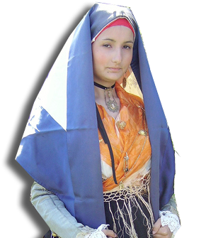
6. With a New Opposition
¹⁶ Once when we were going to the place of prayer, we were met by a slave girl who had a spirit by which she predicted the future. She earned a great deal of money for her owners by fortune-telling.
Notes:
Young girl = free from = http://www.flickr.com/photos/bryluen/2665936394/sizes/o/in/photostream/

Slide 28
6. With a New Opposition
¹⁷ This girl followed Paul and the rest of us, shouting,
"These men are servants of the Most High God, who are telling you the way to be saved.“
¹⁸ She kept this up for many days.

Slide 29
6. With a New Opposition
Finally Paul became so troubled that he turned around and said to the spirit,
"In the name of
Jesus Christ I
command you
to come out
of her!"
At that moment the spirit left her.

Slide 30
6. With a New Opposition
¹⁹ When the owners of the slave girl realized that their hope of making money was gone, they seized Paul and Silas
and dragged them into
the marketplace to
face the authorities.

Slide 31
6. With a New Opposition
²⁰ They brought them before the magistrates and said,
"These men are Jews, and
are throwing our city into
an uproar by advocating
customs unlawful for us
Romans to accept or
practice.”

Slide 32

6. With a New Opposition
²² The crowd joined in the attack against Paul and Silas, and the magistrates ordered them to be stripped and beaten.
²³ After they had been severely flogged, they were thrown into prison, and the jailer was commanded to guard them carefully.
²⁴ Upon receiving such orders, he put them in the inner cell and fastened their feet in the stocks.
Notes:
Jail bars = FREE to Reuse from = sxc-1226063_47301727

Slide 33
6. With a New Opposition
²⁵ About midnight Paul and Silas were praying and singing hymns to God, and the other prisoners were listening to them.
²⁶ Suddenly there was such a violent earthquake that the foundations of the prison were shaken. At once all the prison doors flew open, and everybody's chains came loose.

Slide 34
7. With a New Opportunity

Slide 35
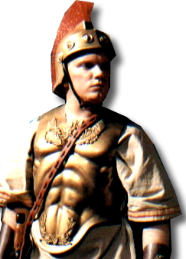
7. With a New Opportunity
²⁷ The jailer woke up, and when he saw the prison doors open, he drew his sword and was about to kill himself because he thought the prisoners had escaped.
Notes:
Roman Soldier = FREE to reuse = BiblePoint photo

Slide 36
7. With a New Opportunity
²⁸ But Paul shouted,
"Don't harm yourself!
We are all here!“

Slide 37
7. With a New Opportunity
²⁹ The jailer called for lights, rushed in and fell trembling before Paul and Silas.
³⁰ He then brought them out and asked …

Slide 38
7. With a New Opportunity
"Sirs, what must I do to be saved?”

Slide 39
7. With a New Opportunity
³¹ They replied, "Believe in the Lord Jesus, and you will be saved--you and your household."

Slide 40
7. With a New Opportunity
³² Then they spoke the word of the Lord to him and to all the others in his house.

Slide 41
7. With a New Opportunity
³³ At that hour of the night the jailer took them and washed their wounds; then immediately he and all his family were baptized.

Slide 42
7. With a New Opportunity
³⁴ The jailer brought them into his house and set a meal before them; he was filled with joy because he had come to believe in God--he and his whole family.

Slide 43
7. With a New Opportunity
³⁴ The jailer brought them into his house and set a meal before them; he was filled with joy because he had come to believe in God--he and his whole family.

Slide 44
7. With a New Opportunity
³⁵ When it was daylight, the magistrates … order: "Release those men."
³⁶ … Now you can leave. Go in peace."
³⁷ But Paul said to the officers: "They beat us publicly without a trial, even though we are Roman citizens, and threw us into prison. And now do they want to get rid of us quietly? No! Let them come themselves and escort us out.“

Slide 45
7. With a New Opportunity
³⁸ The officers reported … that Paul and Silas were Roman citizens…
³⁹ They came to … escorted them from the prison, requesting them to leave the city.
⁴⁰ After Paul and Silas came out of the prison, they went to Lydia's house, where they met with the brothers and encouraged them. Then they left.

Slide 46
A final thought:
The Gospel
was never intended
to be kept
to myself!
Notes:
Globe background licensed from Dreamstime http://www.dreamstime.com/best-concept-of-global-business-image10667813 do not reproduce.

Slide 47
Let’s pray!
Notes:
Globe background licensed from Dreamstime http://www.dreamstime.com/best-concept-of-global-business-image10667813 do not reproduce.

