Slide 1
ACTS 15:1-39
www.BiblePoint.com
2011 © Single Initiative LLC
Notes:
Copyright © 2000-2011. All rights reserved. Bible Point is a registered trademark of Single Initiative, LLC. All other trademarks acknowledged.
Bible Point contains graphics from Bible Point artists. These illustrations belong to Bible Point and the respective artists. You may use the designs and illustrations for graphical illustration of lessons free and without special permission, provided they are not used in any way that maligns the Christian faith. Furthermore, republication or production of any illustration by any other graphic service whether it be in book, in a machine-readable form, or in any other design resource is strictly prohibited. Furthermore, they cannot be duplicated or resold as any other form of publishing, clip art, or graphic resource.
So What does it mean? (A simple translations of the legal jargon)
So, if you don’t own the presentation(s), graphic(s), and text(s) how can you legally use them? The purchase of the license allows you to use all the images in the product. However, the actual ownership and copyright of the presentation(s), graphic(s), and text(s) remain the property of Bible Point and its licensors. If you had plans on using this product in your “for sale” work—think again!
License Agreement
Article 1: License Grant
All the graphics and text in Bible Point presentations (excluding quotes from the Bible and stated sources) are the intellectual and real property of Bible Point and its licensors, and is protected by law, including United States copyright laws and international treaties. Bible Point grants to you a license:
1. To use the presentation in a single church, single school, or single office of a Christian organization.
2. To make a single archival back-up copy of the program.
3. To modify the presentation(s) and merge with other presentations in a single church, school, or Christian organization.
4. To transfer to another party if that party agrees to accept the terms and conditions of this agreement, and you do not retain any copies of the presentation, whether printed, machine readable, modified, or merged form.
Article 2: Terms
This license is effective until terminated. You may terminate the license at any time by destroying the presentation(s), graphic(s), or text(s) together with all copies, modifications and merged portions in any form. Bible Point may terminate your license if you fail to comply with this Agreement. You agree, upon such termination, for any reason, to destroy the presentation(s), graphics, and text(s) with all copies, modifications, and merged portions in any form.
Article 3: Disclaimers
1. Bible Point presentations, graphics, and texts are licensed to you As Is. You, the consumer, bear the entire risk relating to the quality and performance of the presentation(s), graphic(s), or text(s). In no event will Bible Point be liable for damages resulting from any defect.
2. Thirty-day limited warrantee on disks. Bible Point warrants the disks to be free of defects in material and workmanship under normal use for 30 days after purchase. During the 30-day period you may return a defective presentation, graphic, or text with proof of purchase and it will be replaced without charge, unless the presentation is damaged by misuse.
Article 4: General
1. You may not sub-license, assign, or transfer the license of the presentation(s), graphic(s), or text(s) except as provided by this Agreement.
2. This Agreement will be governed by the laws of the State of Michigan.
So What does it mean? (A simple translations of the legal jargon)
May I let someone borrow or copy my licensed Bible Point presentation (even after I modified it)? As long as it is within your local church, or single school, or the immediate office of a Christian organization you may. Otherwise, please refer the person interested in borrowing to: http://www.biblepoint.com or E-mail: dh@biblepoint.com with any related questions.
---------------------------------------------------------------------------------------------------------------------------
Scripture taken from the HOLY BIBLE, NEW INTERNATIONAL VERSION®. NIV®. Copyright©1973, 1978, 1984 by International Bible Society. Used by permission of Zondervan. All rights reserved.

Slide 2
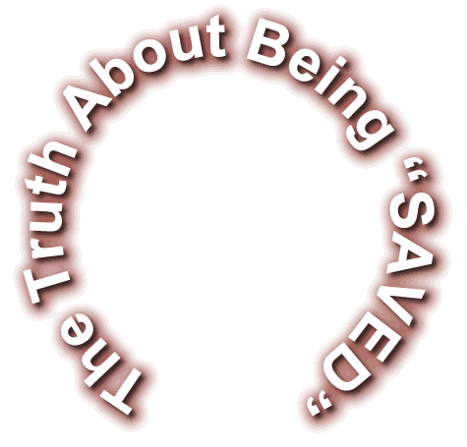
Notes:
Life Ring = Modified = FREE from = http://www.dreamstime.com/freighter-and-life-preserver-free-stock-image-imagefree19588810

Slide 3
The TRUTH:
We believe it is through the grace of our Lord Jesus that we are saved, (Act 15:11)

Slide 4
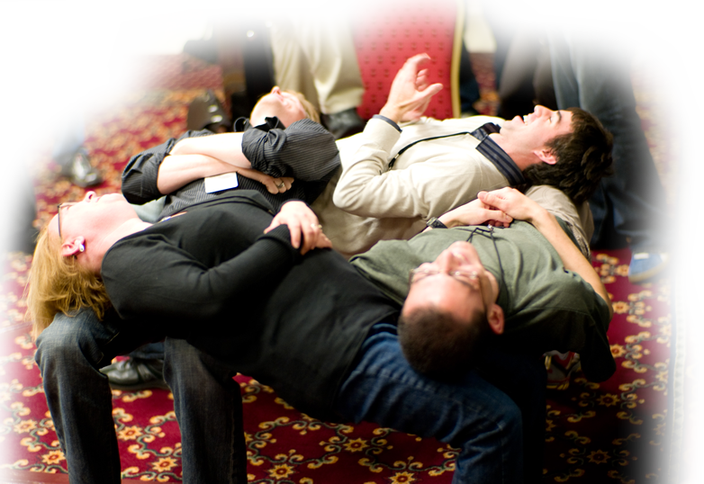
The TRUTH about FAITH
We believe it is through the grace of our Lord Jesus that we are saved, (Act 15:11)
Notes:
Free photo from = http://www.flickr.com/photos/joi/2941559903/

Slide 5
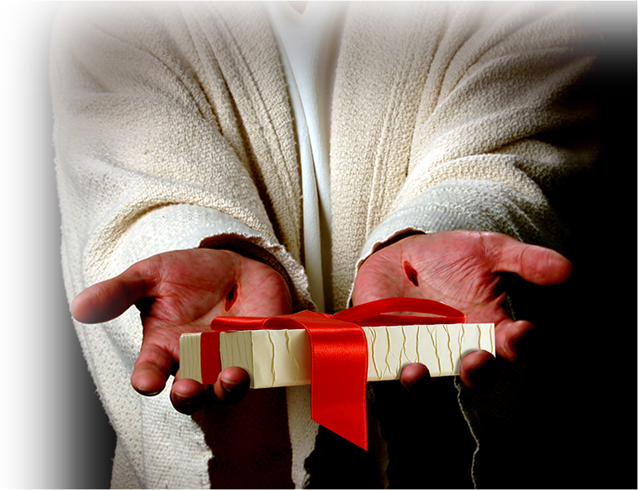
The TRUTH about GRACE
We believe it is through the grace of our Lord Jesus that we are saved, (Act 15:11)

Slide 6
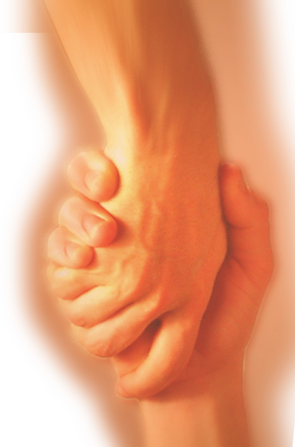
The TRUTH about SALVATION
We believe it is through the grace of our Lord Jesus that we are saved, (Act 15:11)

Slide 7
ERROR #1:

Slide 8
ERROR #1:
Salvation requires more than “grace alone!”
For example…

Slide 9
ERROR #1:
Circumcision
"Unless you are circumcised, according to the custom taught by Moses, you cannot be saved." Act 15:1
Notes:
Knife =free = http://www.sxc.hu/browse.phtml?f=download&id=1226578

Slide 10
ERROR #1:
Circumcision
Baptism
Notes:
Water = free =http://www.dreamstime.com/water-abstract-4-free-stock-image-imagefree1411398

Slide 11
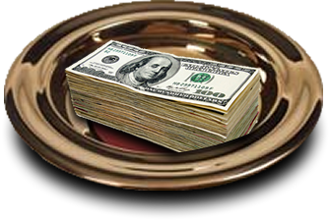
ERROR #1:
Circumcision
Baptism
Good works

Slide 12
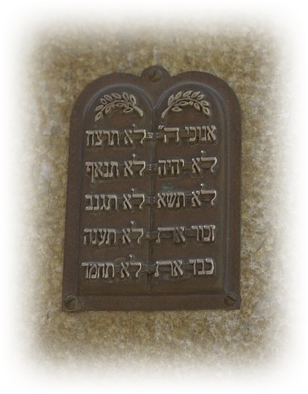
ERROR #1:
Circumcision
Baptism
Good works
Keeping the 10 commandments

Slide 13
ERROR #1:
Circumcision
Baptism
Good works
Keeping the 10 commandments
Being a “Good Person”
Notes:
Thumbs up = free = http://www.dreamstime.com/ok-free-stock-photo-imagefree1598271

Slide 14
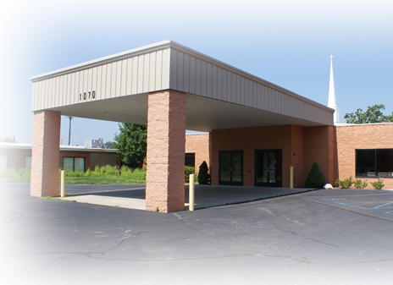
ERROR #1:
Circumcision
Baptism
Good works
Keeping the 10 commandments
Being a “Good Person”
Being a “Church Member”
Notes:
Entrance to church = FREE = BiblePoint photo

Slide 15
ERROR #1:
Circumcision
Baptism
Good works
Keeping the 10 commandments
Being a “Good Person”
Being a “Church Member”
Somehow these are to suppose to “Save you” or at least “Help save you.”

Slide 16
The Truth:
Salvation involves
grace “Plus Nothing!”
No! We believe it is through the grace of our Lord Jesus that we are saved, just as they are." (Act 15:11)

Slide 17
ERROR #2:

Slide 18
ERROR #2:
There are different ways to be saved.
For example …

Slide 19
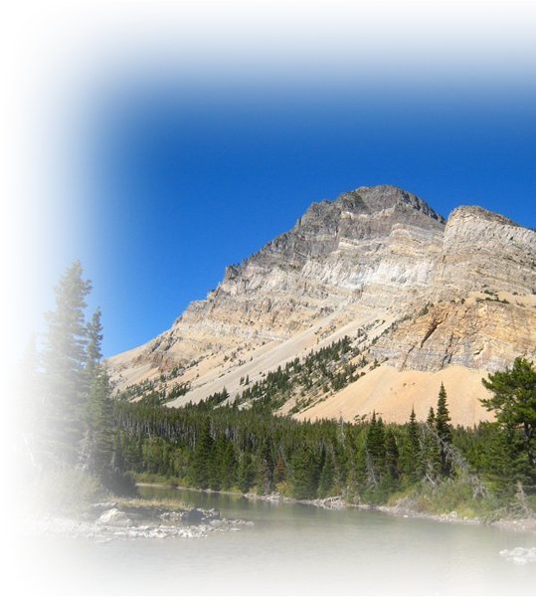
ERROR #2:
GOD
There are different ways to be saved.
For example …
JESUS
Notes:
Mountain free from = http://i.images.cdn.fotopedia.com/flickr-4057498060-hd/US_National_Parks/Montana/Glacier_National_Park_U.S./Lewis_Range/Bear_Mountain/Bear_Mountain_Glacier_County_Montana-Lewis_Range-hd.jpg

Slide 20
ERROR #2:
¹² There is a way that seems right to a man, but in the end it leads to death.
Notes:
SIGN = free with rights reserved (must credit) = http://www.geograph.org.uk/photo/1038787

Slide 21
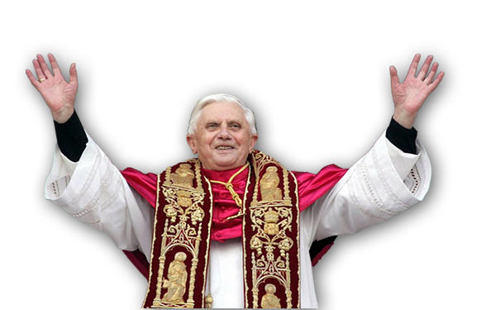
There are not multiple ways …
A Catholic way
Notes:
Pope = free google = from http://hub.webring.org/hub/defendingtraditi

Slide 22
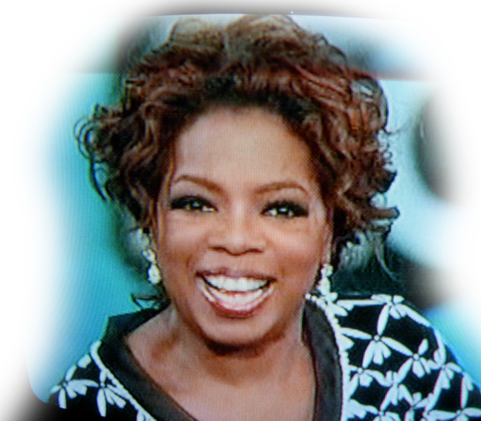
There are not multiple ways …
A Catholic way
A New Ager way
Notes:
Oprah = free = http://www.flickr.com/photos/nayrb7/2176798443/sizes/o/in/photostream/

Slide 23
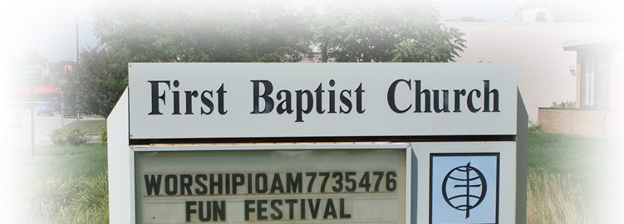
There are not multiple ways …
A Catholic way
A New Ager way
A Baptist way
Notes:
FBC sign = Free = Bible Point

Slide 24
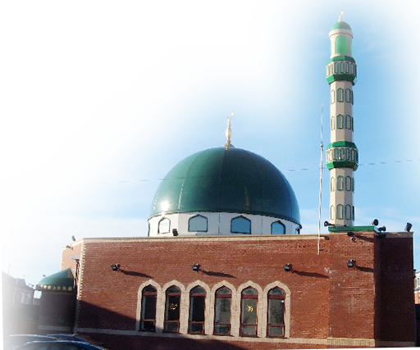
There are not multiple ways …
A Catholic way
A New Ager way
A Baptist way
A Moslem way
Notes:
Google = free for reuse = http://s0.geograph.org.uk/photos/08/38/083815_d8f46b8d.jpg

Slide 25
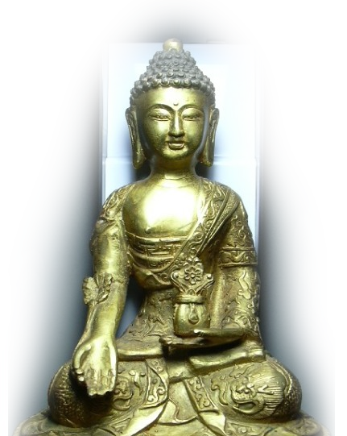
There are not multiple ways …
A Catholic way
A New Ager way
A Baptist way
A Moslem way
A Buddhist way
Notes:
Google = for reuse = http://2.bp.blogspot.com/_-PhgD2TLyHs/S39QjQrbkQI/AAAAAAAABfI/YsiBvebwgwc/s1600-h/Medicine+Buddha.JPG

Slide 26
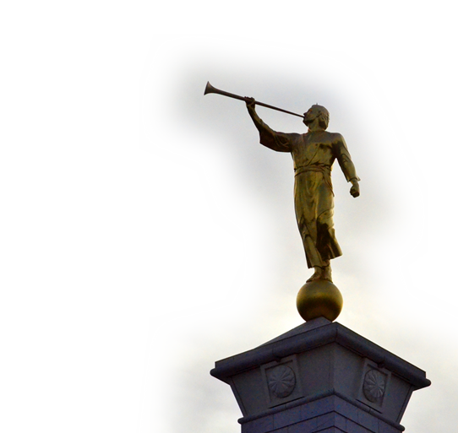
There are not multiple ways …
A Catholic way
A New Ager way
A Baptist way
A Moslem way
A Buddhist way
A Mormon way
Notes:
Mormon Angel = free = http://www.flickr.com/photos/41260125@N05/5552731965/sizes/o/in/photostream/

Slide 27
There are not multiple ways …
A Catholic way
A New Ager way
A Baptist way
A Moslem way
A Buddhist way
A Mormon way
NO! There is only one way.

Slide 28
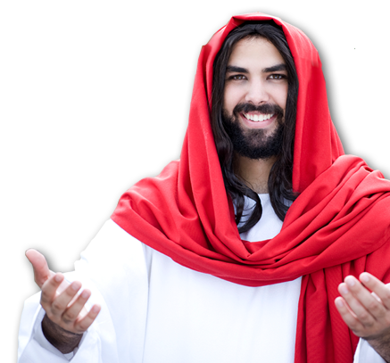
The Truth:
"I am the way and the truth and the life. No one comes to the Father except through me.
(John 14:6)
Notes:
Jesus = Licensed and NOT Free for reuse from = iStock_000007254772Small

Slide 29
The Truth:
¹² “Salvation is found in no one else, for there is no other name under heaven given to men by which we must be saved." (Act 4:12)

Slide 30
The Truth:
Salvation means that “He has made no distinction between us and them, for he purified their hearts by faith. (Act 15:9 )

Slide 31
ERROR #3:

Slide 32
ERROR #3:
Being Saved is just a bunch of difficult rules and regulations (do’s and don’ts).
For example …

Slide 33
ERROR #3:
Circumcision
Ten Commandments
No Drinking
No Smoking
No Gambling
No Movies
No Dancing
No Dress
No Long Hair

Slide 34
The Truth:
Salvation is uncomplicated. “We should not make it difficult for the Gentiles who are turning to God.” (Act 15:19)

Slide 35
ERROR #4:

Slide 36
ERROR #4:
Salvation then does not make any difference.
For example …

Slide 37
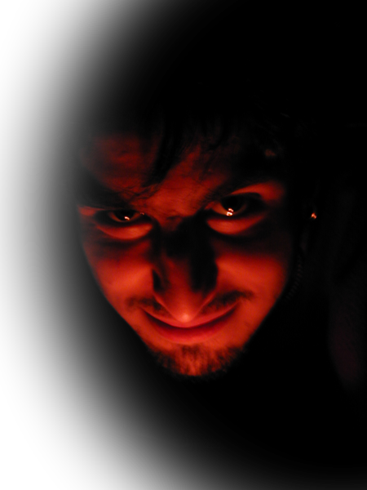
ERROR #4:
People who say they are Christians and live like the devil
Q - Shall we go on sinning so that grace may increase? Rom 6:1
Notes:
Devil = Free from http://www.sxc.hu/browse.phtml?f=download&id=229100

Slide 38
ERROR #4:
A- ² By no means! We died to sin; how can we live in it any longer? Rom 6:1-2

Slide 39
The Truth:
Salvation does change your life.
“new creation” 1 Cor 15:17
“we are His workmanship” Eph 2:10
So it is in Acts 15:19-34

Slide 40
The Truth:
¹⁹ "It is my judgment, therefore, that we should not make it difficult for the Gentiles who are turning to God. ²⁰ Instead we should write to them, telling them to abstain from food polluted by idols, from sexual immorality, from the meat of strangled animals and from blood. Act 15:19-20
1

Slide 41
The Truth:
¹⁹ "It is my judgment, therefore, that we should not make it difficult for the Gentiles who are turning to God. ²⁰ Instead we should write to them, telling them to abstain from food polluted by idols, from sexual immorality, from the meat of strangled animals and from blood. Act 15:19-20
2

Slide 42
The Truth:
¹⁹ "It is my judgment, therefore, that we should not make it difficult for the Gentiles who are turning to God. ²⁰ Instead we should write to them, telling them to abstain from food polluted by idols, from sexual immorality, from the meat of strangled animals and from blood. Act 15:19-20
3

Slide 43
The Truth:
¹⁹ "It is my judgment, therefore, that we should not make it difficult for the Gentiles who are turning to God. ²⁰ Instead we should write to them, telling them to abstain from food polluted by idols, from sexual immorality, from the meat of strangled animals and from blood. Act 15:19-20
4

Slide 44
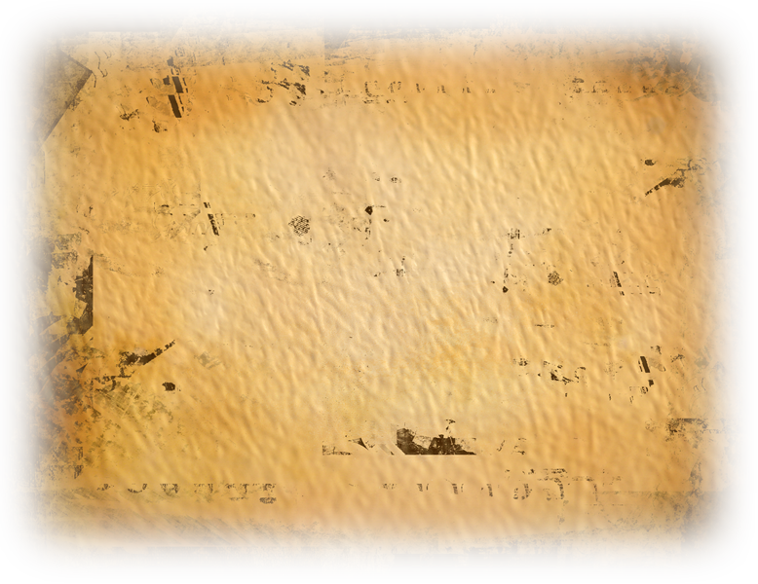
The Truth:
You will do well to avoid these things. Farewell. (Act 15:29)
Notes:
Papyrus = FREE = dreamstimefree_1485969

Slide 45
The Point:
True believers try to abstain from offending God, others, or oneself-- because they are saved. (Eph 2: 8-10)

Slide 46
ERROR #5:

Slide 47
ERROR #5:
If Salvation were true, then all Christians would agree.

Slide 48
The Truth:
As great as Grace and Salvation are … Christians still disagree.
Acts 15:36-41

Slide 49
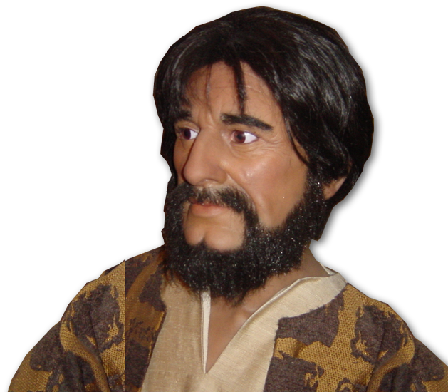
Paul vs Barnabas
³⁶ Some time later Paul said to Barnabas,
"Let us go back and visit the brothers in all the towns ...“

Slide 50
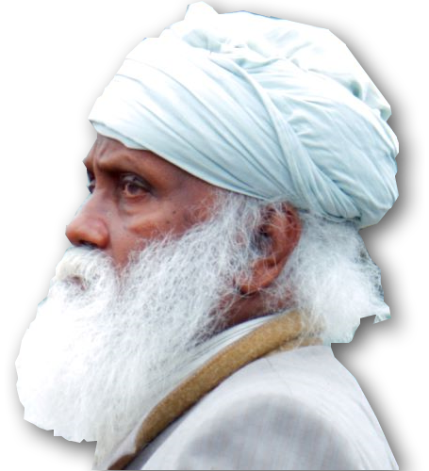
Paul vs Barnabas
³⁷ Barnabas wanted to take John, also called Mark, with them,
³⁸ but Paul did not think it wise to take him, because he had deserted them

Slide 51
Paul vs Barnabas
³⁹ They had such a sharp disagreement that they parted company

Slide 52
So What’s the Point?
You need Jesus alone to be saved.
You cannot add anything to what he has done.
Salvation is so simple, many people miss it.
Salvation will change your life, not regulate it.
Of course people will still disagree with you, but that will not change that …

Slide 53
So What’s the Point?
it is through the grace of our Lord Jesus that we are saved. (Act 15:11)

Slide 54
Perhaps today you should be “SAVED”
LET’S PRAY

