Slide 1
ACTS 13:1-14:27
www.BiblePoint.com
2011 © Single Initiative LLC
Notes:
Copyright © 2000-2011. All rights reserved. Bible Point is a registered trademark of Single Initiative, LLC. All other trademarks acknowledged.
Bible Point contains graphics from Bible Point artists. These illustrations belong to Bible Point and the respective artists. You may use the designs and illustrations for graphical illustration of lessons free and without special permission, provided they are not used in any way that maligns the Christian faith. Furthermore, republication or production of any illustration by any other graphic service whether it be in book, in a machine-readable form, or in any other design resource is strictly prohibited. Furthermore, they cannot be duplicated or resold as any other form of publishing, clip art, or graphic resource.
So What does it mean? (A simple translations of the legal jargon)
So, if you don’t own the presentation(s), graphic(s), and text(s) how can you legally use them? The purchase of the license allows you to use all the images in the product. However, the actual ownership and copyright of the presentation(s), graphic(s), and text(s) remain the property of Bible Point and its licensors. If you had plans on using this product in your “for sale” work—think again!
License Agreement
Article 1: License Grant
All the graphics and text in Bible Point presentations (excluding quotes from the Bible and stated sources) are the intellectual and real property of Bible Point and its licensors, and is protected by law, including United States copyright laws and international treaties. Bible Point grants to you a license:
1. To use the presentation in a single church, single school, or single office of a Christian organization.
2. To make a single archival back-up copy of the program.
3. To modify the presentation(s) and merge with other presentations in a single church, school, or Christian organization.
4. To transfer to another party if that party agrees to accept the terms and conditions of this agreement, and you do not retain any copies of the presentation, whether printed, machine readable, modified, or merged form.
Article 2: Terms
This license is effective until terminated. You may terminate the license at any time by destroying the presentation(s), graphic(s), or text(s) together with all copies, modifications and merged portions in any form. Bible Point may terminate your license if you fail to comply with this Agreement. You agree, upon such termination, for any reason, to destroy the presentation(s), graphics, and text(s) with all copies, modifications, and merged portions in any form.
Article 3: Disclaimers
1. Bible Point presentations, graphics, and texts are licensed to you As Is. You, the consumer, bear the entire risk relating to the quality and performance of the presentation(s), graphic(s), or text(s). In no event will Bible Point be liable for damages resulting from any defect.
2. Thirty-day limited warrantee on disks. Bible Point warrants the disks to be free of defects in material and workmanship under normal use for 30 days after purchase. During the 30-day period you may return a defective presentation, graphic, or text with proof of purchase and it will be replaced without charge, unless the presentation is damaged by misuse.
Article 4: General
1. You may not sub-license, assign, or transfer the license of the presentation(s), graphic(s), or text(s) except as provided by this Agreement.
2. This Agreement will be governed by the laws of the State of Michigan.
So What does it mean? (A simple translations of the legal jargon)
May I let someone borrow or copy my licensed Bible Point presentation (even after I modified it)? As long as it is within your local church, or single school, or the immediate office of a Christian organization you may. Otherwise, please refer the person interested in borrowing to: http://www.biblepoint.com or E-mail: dh@biblepoint.com with any related questions.
---------------------------------------------------------------------------------------------------------------------------
Scripture taken from the HOLY BIBLE, NEW INTERNATIONAL VERSION®. NIV®. Copyright©1973, 1978, 1984 by International Bible Society. Used by permission of Zondervan. All rights reserved.

Slide 2
You Are About to Leave YOUR COMFORT ZONE!
ACTS 13-14
Notes:
Prison bars free from http://www.sxc.hu/photo/1226063

Slide 3
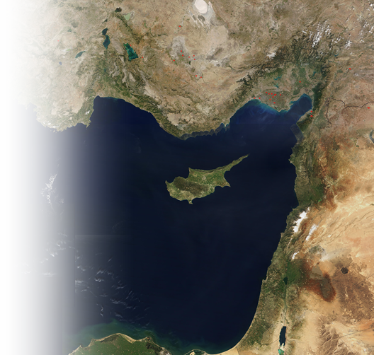
The Situation
¹ In the church at Antioch there were prophets and teachers: Barnabas, Simeon called Niger, Lucius of Cyrene, Manaen (who had been brought up with Herod the tetrarch) and Saul.

Slide 4
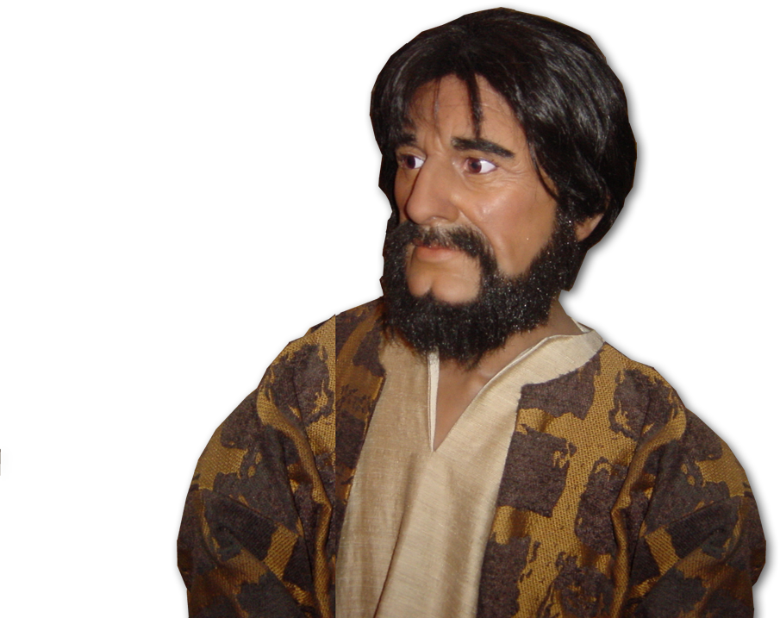
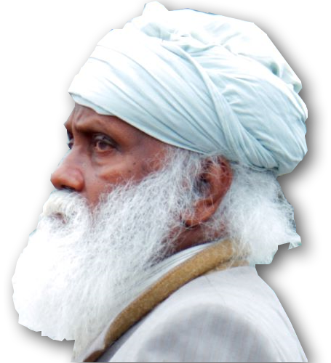
1– The Call 13:2
² While they were worshiping the Lord and fasting, the Holy Spirit said,
"Set apart for me Barnabas and Saul for the work to which I have called them."
Notes:
Paul = FREE =BiblePoint photo
Barnabas =

Slide 5
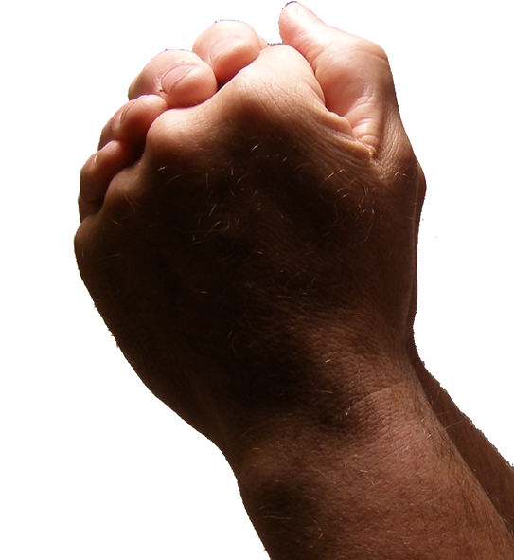
2– The Commission 13:3-6
³ So after they had fasted and prayed, they placed their hands on them and sent them off. ….
Notes:
Praying hands = FREE from = http://www.sxc.hu/browse.phtml?f=download&id=405036

Slide 6
3– The Commencement 13:3-6
⁴ The two of them, sent on their way by the Holy Spirit, went down to Seleucia and sailed from there to Cyprus.

Slide 7
3– The Commencement 13:3-6
⁵ When they arrived at Salamis, they proclaimed the word of God in the Jewish synagogues. John was with them as their helper.
Notes:
Book = FREE from = dreamstimefree_823501

Slide 8
4– The Perversion 13:6-12
⁶ They traveled through the whole island until they came to Paphos. There they met a Jewish sorcerer and false prophet named Bar-Jesus, …

Slide 9
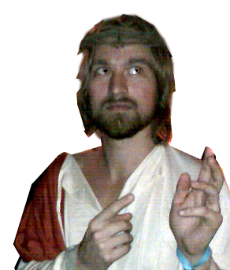
4– The Perversion 13:6-12
⁶ They traveled through the whole island until they came to Paphos. There they met a Jewish sorcerer and false prophet named Bar-Jesus, …
Notes:
Bar-Jesus free http://commons.wikimedia.org/wiki/File:Halloween_2009_New_Orleans_Jesus.jpg

Slide 10
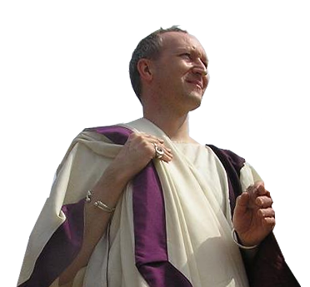
4– The Perversion 13:6-12
[the] attendant of the proconsul, Sergius Paulus…[who] wanted to hear the word of God. ⁸ But … the sorcerer opposed them and tried to turn the proconsul from the faith.
Notes:
Proconsul – FREE fro reuse from http://upload.wikimedia.org/wikipedia/commons/6/60/Pax_romana04.jpg

Slide 11
4– The Perversion 13:6-12
[the] attendant of the proconsul, Sergius Paulus…[who] wanted to hear the word of God. ⁸ But … the sorcerer opposed them and tried to turn the proconsul from the faith.
Notes:
Proconsul – need permission from : http://www.prestonopera.org.uk/norma/normafri.htm

Slide 12
4– The Perversion 13:6-12
⁹ Then Saul, who was also called Paul, … said,
¹⁰ "You are a child of the devil and an enemy of everything that is right! You are full of all kinds of deceit and trickery. Will you never stop perverting the right ways of the Lord?

Slide 13
4– The Perversion 13:6-12
⁹ Then Saul, who was also called Paul, … said,
¹¹ Now the hand of the Lord is against you. You are going to be blind, and for a time you will be unable to see the light of the sun."
Immediately … darkness …

Slide 14
4– The Perversion 13:6-12
¹² When the proconsul saw what had happened, he believed, for he was amazed at the teaching about the Lord.

Slide 15
5– The Desertion 13:13
¹³ From Paphos, Paul and his companions sailed to Perga in Pamphylia, where John left them to return to Jerusalem.

Slide 16
5– The Desertion 13:13
¹⁴ From Perga they went on to Pisidian Antioch. On the Sabbath they entered the synagogue ...

Slide 17
6– The Message 13:14-42
Paul’s first recorded message …
1—Preparation for the Good News 16-25
²⁶ "Brothers, children of Abraham, and you God-fearing Gentiles, it is to us that this message of salvation has been sent.
Patriarchs
Samuel
J E S
U
S
Exodus
Judges
Saul
Wilderness
David

Slide 18
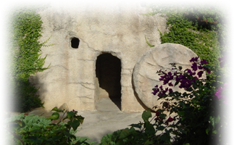
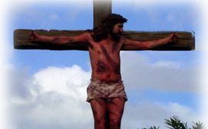
6– The Message 13:14-43
1—Preparation for the Good News 16-25
2—Declaration of the Good News 26-37
they asked Pilate to have him executed...
³⁰ But God raised him from the dead, … ³²
"We tell you the good news .…
Notes:
Crucifixion and Empty Tomb = free = Bible Point photos.

Slide 19
6– The Message 13:14-42
1—Preparation for the Good News 16-25
2—Declaration of the Good News 26-37
3—Application of the Good News 38-42
through Jesus the forgiveness of sins is proclaimed to you. ³⁹ Through him everyone who believes is justified from everything you could not be justified from by the law of Moses.
Notes:
Open handcuffs = FREE from = http://www.dreamstime.com/open-handcuffs-free-stock-photo-imagefree2935405

Slide 20
6– The Message 13:14-42
1—Preparation for the Good News 16-25
2—Declaration of the Good News 26-37
3—Application of the Good News 38-42
through Jesus the forgiveness of sins is proclaimed to you. ³⁹ Through him everyone who believes is justified from everything you could not be justified from by the law of Moses.
Notes:
Gavel free from: http://commons.wikimedia.org/wiki/File:Gavel.png

Slide 21
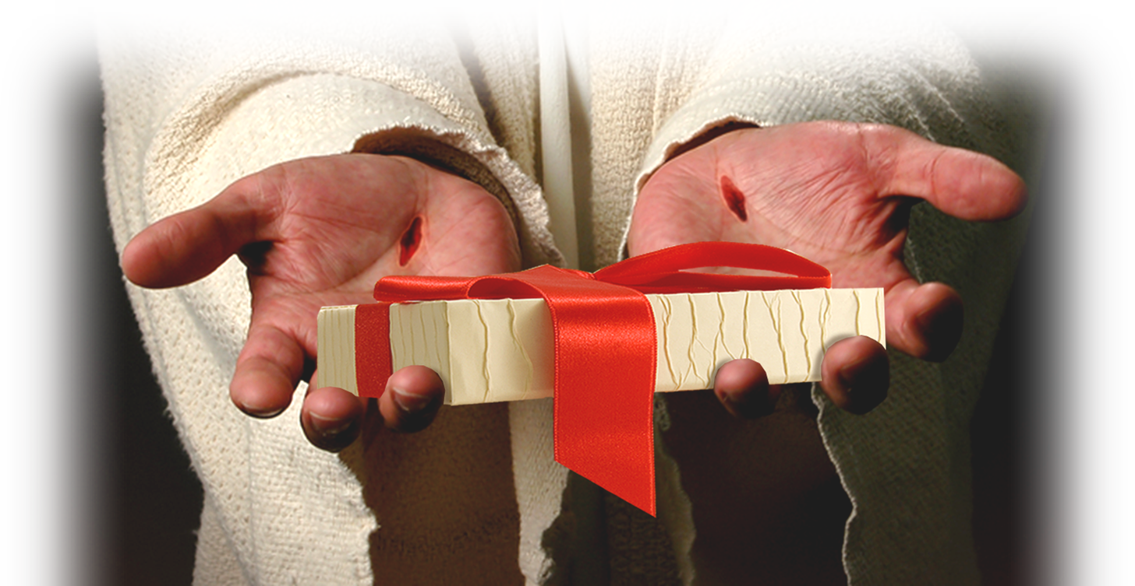
6– The Message 13:14-42
⁴³ When the congregation was dismissed, … Paul and Barnabas … urged them to continue in the grace of God.
Notes:
Hands of Jesus = Not for Reuse; Licensed from = dreamstime_1384310
Package =Not For Reuse; Licensed from = dreamstime_7395452

Slide 22
7—The Challenge 13:44-52
⁴⁴ On the next Sabbath almost the whole city gathered to hear the word of the Lord. ⁴⁵ When the Jews saw the crowds, they were filled with jealousy and talked abusively against what Paul was saying
Notes:
Book = FREE from = dreamstimefree_823501

Slide 23
8—The Defense 13:43-52
⁴⁶ Then Paul … answered … boldly: "We had to speak the word of God to you first. Since you reject it and do not consider yourselves worthy of eternal life, we now turn to the Gentiles."

Slide 24
8—The Defense 13:43-52
⁴⁹ The word of the Lord spread through the whole region.
⁵⁰ But the Jews ... stirred up persecution against Paul and Barnabas, and expelled them from their region.

Slide 25
8—The Defense 13:43-52
⁵¹ So they shook the dust from their feet in protest against them and went to Iconium.

Slide 26
9– The Division 14:1-7
¹ [they] went as usual into the Jewish synagogue ... a great number of Jews and Gentiles believed.
² But the Jews who refused to believe stirred up the Gentiles and poisoned their minds against the brothers.
⁴ The people of the city were divided; some sided with the Jews, others with the apostles.
⁵ There was a plot afoot among the Gentiles and Jews, together with their leaders, to mistreat them and stone them.
⁶ But they found out about it and fled to the Lycaonian cities of Lystra and Derbe and to the surrounding country, (Act 14:2-6 NIV)
³ So Paul and Barnabas spent consider- able time there, speaking boldly

Slide 27
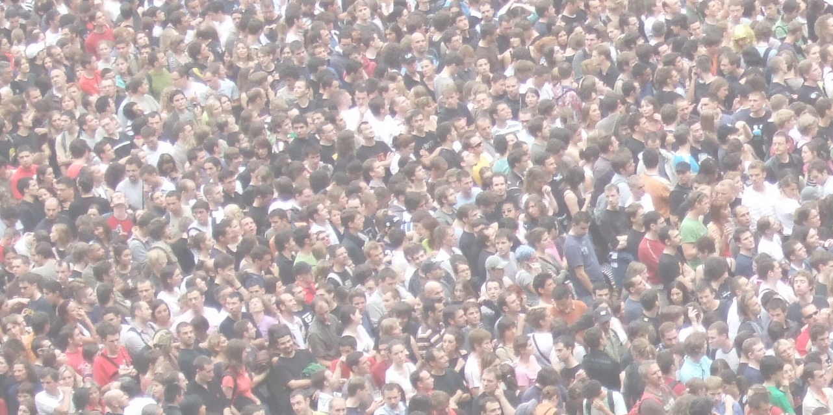
9– The Division 14:1-7
⁴ The people of the city were divided;
⁵ There was a plot ... to mistreat them and stone them.
Notes:
Crowd = FREE to use with credit to http://www.flickr.com/photos/jamescridland/613445810/sizes/o/in/photostream/

Slide 28
9– The Division 14:1-7
⁶ But they found out about it and fled to the Lycaonian cities of Lystra and Derbe

Slide 29
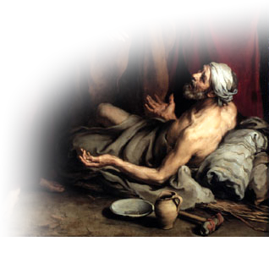
10– The Delusion 14:8-21a
⁸ In Lystra there sat a man crippled … and had never walked. ⁹ He listened to Paul as he was speaking.
Paul looked directly at him, saw that he had faith to be healed
"Stand up on your feet!" At that, the man jumped up and began to walk.
¹¹ When the crowd saw what Paul had done, they shouted in the Lycaonian language, "The gods have come down to us in human form!"
(Act 14:8-11 NIV)
Notes:
Paralytic man free from: http://upload.wikimedia.org/wikipedia/commons/0/0f/Curacin_del_paraltico_Murillo_1670.jpg

Slide 30
10– The Delusion 14:8-21a
Paul looked directly at him, saw that he had faith to be healed ¹⁰ and called out,
"Stand up on your feet!"
“
…the man jumped up and began to walk.
"Stand up on your feet!"

Slide 31
10– The Delusion 14:8-21a
¹¹ When the crowd saw what Paul had done, they shouted in the Lycaonian language,
"The gods have come down to us in human form!"

Slide 32
10– The Delusion 14:8-21a
¹² Barnabas they called Zeus, and Paul they called Hermes

Slide 33
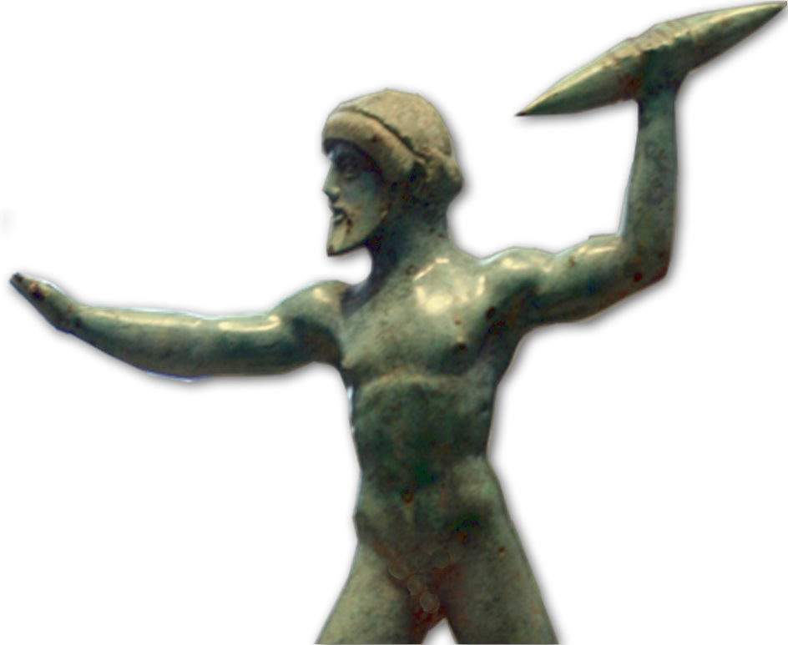
10– The Delusion 14:8-21a
¹³ The priest of Zeus,
Notes:
Zeus free from: http://upload.wikimedia.org/wikipedia/commons/d/dd/Blitzschleudender_Zeus.JPG

Slide 34
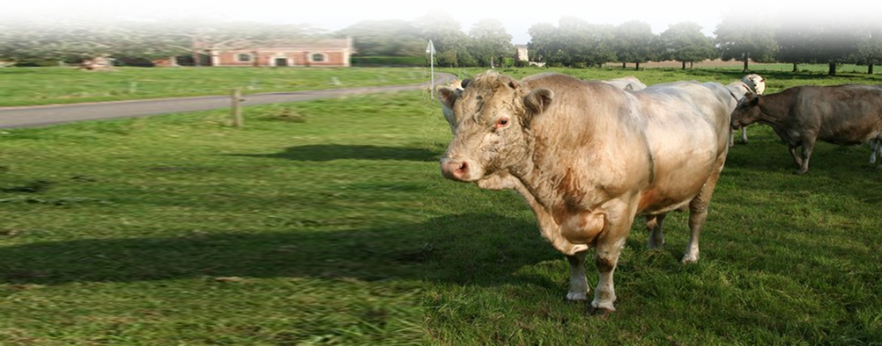
10– The Delusion 14:8-21a
¹³ The priest of Zeus, ... brought bulls ... because he and the crowd wanted to offer sacrifices to them.
Notes:
Zeus free from: http://upload.wikimedia.org/wikipedia/commons/d/dd/Blitzschleudender_Zeus.JPGhttp://upload.wikimedia.org/wikipedia/commons/e/ef/Bull%27s_eye_-_geograph.org.uk_-_242591.jpg
BULL free from:

Slide 35
10– The Delusion 14:8-21a
¹⁵ "Men, why are you doing this? We too are only men, human like you. We are bringing you good news, telling you to turn from these worthless things to the living God, ....

Slide 36
10– The Delusion 14:8-21a
¹⁸ Even with these words, they had difficulty keeping the crowd from sacrificing to them. ¹⁹ … They stoned Paul and dragged him outside the city, thinking he was dead.

Slide 37
10– The Delusion 14:8-21a
²⁰ But after the disciples had gathered around him, he got up and went back into the city. The next day he and Barnabas left for Derbe.

Slide 38
11– The Double-Back 14:21b-28
²¹ They preached the good news in that city and won a large number of disciples. Then they returned to Lystra, Iconium and Antioch,

Slide 39
11– The Double-Back 14:21b-28
1
²² strengthening the disciples and encouraging them to remain true to the faith. "We must go through many hard-ships to enter the kingdom of God," they said.
2

Slide 40
11– The Double-Back 14:21b-28
²³ Paul and Barnabas appointed elders for them in each church and, with prayer and fasting, committed them to the Lord, in whom they had put their trust.
3

Slide 41
11– The Double-Back 14:21b-28
²⁴ After going through Pisidia, they came into Pamphylia,
²⁵ and when they had preached the word in Perga, they went down to Attalia.

Slide 42
11– The Double-Back 14:21b-28
²⁶ From Attalia they sailed back to Antioch, where they had been committed to the grace of God for the work they had now completed.

Slide 43
11– The Double-Back 14:21b-28
²⁷ On arriving there, they gathered the church together and reported all that God had done through them and how he had opened the door of faith to the Gentiles.

Slide 44
11– The Double-Back 14:21b-28
²⁷ On arriving there, they gathered the church together and reported all that God had done through them and how he had opened the door of faith to the Gentiles.

Slide 45
What’s the Point?
You were called to serve.
Serving the Lord will take you out of your comfort zone!
Biblical serving means sharing the “Good News.”
Serving may become hostile to your well being.
Therefore, …

Slide 46
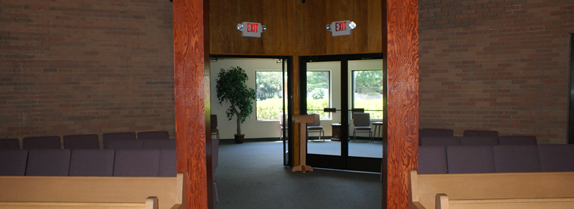
You Are About to Enter the Mission Field
Notes:
Exit Doors = FREE = Biblepoint photo.

Slide 47
You Are About to Leave YOUR COMFORT ZONE!
ACTS 13-14
Notes:
Prison bars free from http://www.sxc.hu/photo/1226063

Slide 48
Let’s Pray!

