Slide 1
ACTS 12:1-25
www.BiblePoint.com
2011 © Single Initiative LLC
Notes:
Copyright © 2000-2011. All rights reserved. Bible Point is a registered trademark of Single Initiative, LLC. All other trademarks acknowledged.
Bible Point contains graphics from Bible Point artists. These illustrations belong to Bible Point and the respective artists. You may use the designs and illustrations for graphical illustration of lessons free and without special permission, provided they are not used in any way that maligns the Christian faith. Furthermore, republication or production of any illustration by any other graphic service whether it be in book, in a machine-readable form, or in any other design resource is strictly prohibited. Furthermore, they cannot be duplicated or resold as any other form of publishing, clip art, or graphic resource.
So What does it mean? (A simple translations of the legal jargon)
So, if you don’t own the presentation(s), graphic(s), and text(s) how can you legally use them? The purchase of the license allows you to use all the images in the product. However, the actual ownership and copyright of the presentation(s), graphic(s), and text(s) remain the property of Bible Point and its licensors. If you had plans on using this product in your “for sale” work—think again!
License Agreement
Article 1: License Grant
All the graphics and text in Bible Point presentations (excluding quotes from the Bible and stated sources) are the intellectual and real property of Bible Point and its licensors, and is protected by law, including United States copyright laws and international treaties. Bible Point grants to you a license:
1. To use the presentation in a single church, single school, or single office of a Christian organization.
2. To make a single archival back-up copy of the program.
3. To modify the presentation(s) and merge with other presentations in a single church, school, or Christian organization.
4. To transfer to another party if that party agrees to accept the terms and conditions of this agreement, and you do not retain any copies of the presentation, whether printed, machine readable, modified, or merged form.
Article 2: Terms
This license is effective until terminated. You may terminate the license at any time by destroying the presentation(s), graphic(s), or text(s) together with all copies, modifications and merged portions in any form. Bible Point may terminate your license if you fail to comply with this Agreement. You agree, upon such termination, for any reason, to destroy the presentation(s), graphics, and text(s) with all copies, modifications, and merged portions in any form.
Article 3: Disclaimers
1. Bible Point presentations, graphics, and texts are licensed to you As Is. You, the consumer, bear the entire risk relating to the quality and performance of the presentation(s), graphic(s), or text(s). In no event will Bible Point be liable for damages resulting from any defect.
2. Thirty-day limited warrantee on disks. Bible Point warrants the disks to be free of defects in material and workmanship under normal use for 30 days after purchase. During the 30-day period you may return a defective presentation, graphic, or text with proof of purchase and it will be replaced without charge, unless the presentation is damaged by misuse.
Article 4: General
1. You may not sub-license, assign, or transfer the license of the presentation(s), graphic(s), or text(s) except as provided by this Agreement.
2. This Agreement will be governed by the laws of the State of Michigan.
So What does it mean? (A simple translations of the legal jargon)
May I let someone borrow or copy my licensed Bible Point presentation (even after I modified it)? As long as it is within your local church, or single school, or the immediate office of a Christian organization you may. Otherwise, please refer the person interested in borrowing to: http://www.biblepoint.com or E-mail: dh@biblepoint.com with any related questions.
---------------------------------------------------------------------------------------------------------------------------
Scripture taken from the HOLY BIBLE, NEW INTERNATIONAL VERSION®. NIV®. Copyright©1973, 1978, 1984 by International Bible Society. Used by permission of Zondervan. All rights reserved.

Slide 2

ACTS 12
Notes:
Prison bars = FREE FOR REUSE = from http://www.sxc.hu/photo/1226063

Slide 3
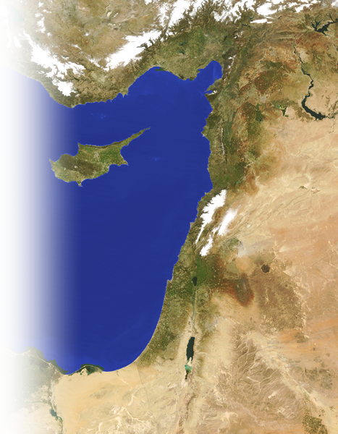
The Timing of the Great Escape
¹ It was about this time
What Time?
The “Time” when
Antioch Church was
Prospering!
(11:24-30)

Slide 4
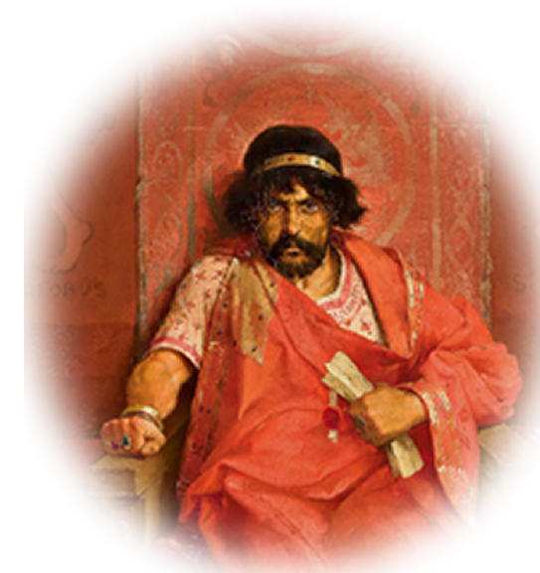
The Timing of the Great Escape
¹ It was about this time that King Herod arrested some who belonged to the church, intending to persecute them.
² He had James, the brother of John,
put to death with the sword.
Notes:
Herod = free from = http://commons.wikimedia.org/wiki/File:Lybaert_7.jpg

Slide 5
The Politics of the Great Escape
³ When he saw that this pleased the Jews, he proceeded to seize Peter also. This happened during the Feast of Unleavened Bread.

Slide 6
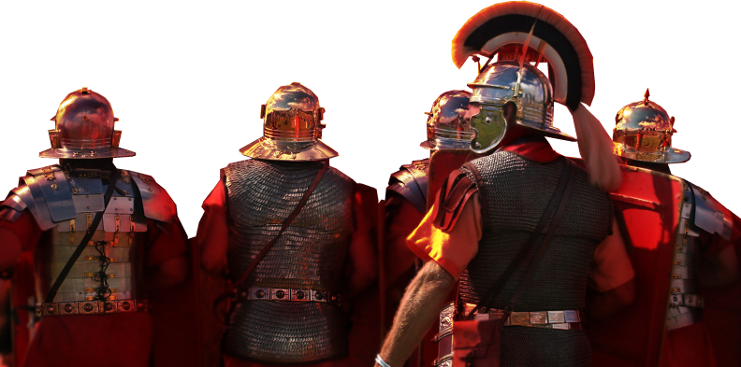
The Politics of the Great Escape
⁴ After arresting him, he put him in prison, handing him over to be guarded by four squads of four soldiers
each.
Herod intended to bring him out for public trial after the Passover.
16 Romans
Notes:
Romans licensed from i-stock photo image = 3820420 –Not to be reused.

Slide 7
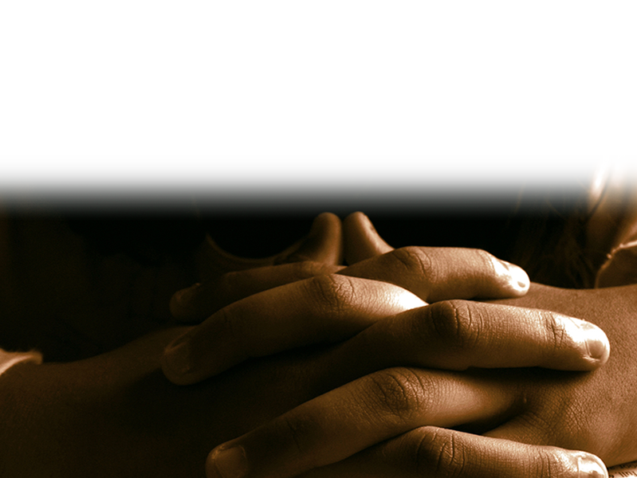
The Source of the Great Escape
⁵ So Peter was kept in prison, but
the church was earnestly praying to God for him.
Notes:
Praying hands = http://www.sxc.hu/browse.phtml?f=download&id=946931
Earnestly = strictly in an extended way Frieberg Analytical
I don’t know exactly what they said, “Free, Peter” or “Remove Herod?” Whatever it was intense “ in an extended way.”

Slide 8
The Great Escape
⁶ The night before Herod was to bring him to trial, Peter was sleeping between two soldiers, bound with two chains, and sentries stood guard at the entrance.

Slide 9
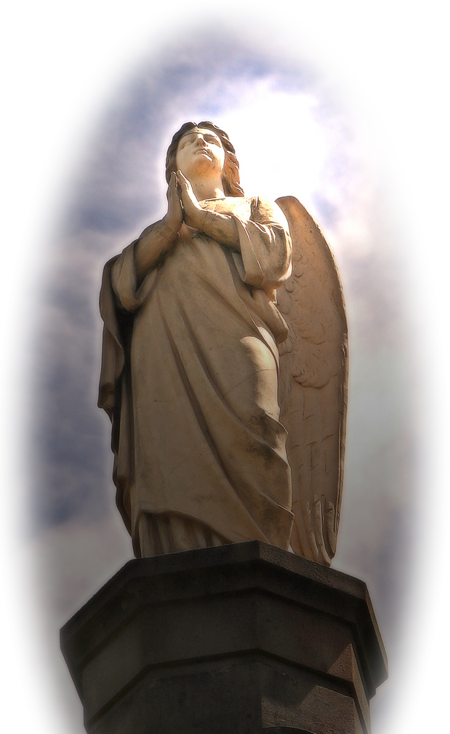
The Great Escape
⁷ Suddenly an angel of the Lord appeared and a light shone in the cell.
He struck Peter on the side
and woke him up.
"Quick, get up!"
he said, and the chains
fell off Peter's wrists.
Notes:
Angel free from: http://upload.wikimedia.org/wikipedia/commons/0/0a/Angel_statue.jpg

Slide 10
The Great Escape
⁸ Then the angel said to him,
"Put on your clothes
and sandals."
And Peter did so.
"Wrap your cloak
around you and
follow me,"
the angel told him.
Notes:
Angel free from: http://upload.wikimedia.org/wikipedia/commons/0/0a/Angel_statue.jpg

Slide 11
The Great Escape
⁹ Peter followed him out of the prison, but he had no idea that what
the angel was doing was
really happening; he
thought he was seeing
a vision.
Notes:
Angel free from: http://upload.wikimedia.org/wikipedia/commons/0/0a/Angel_statue.jpg

Slide 12
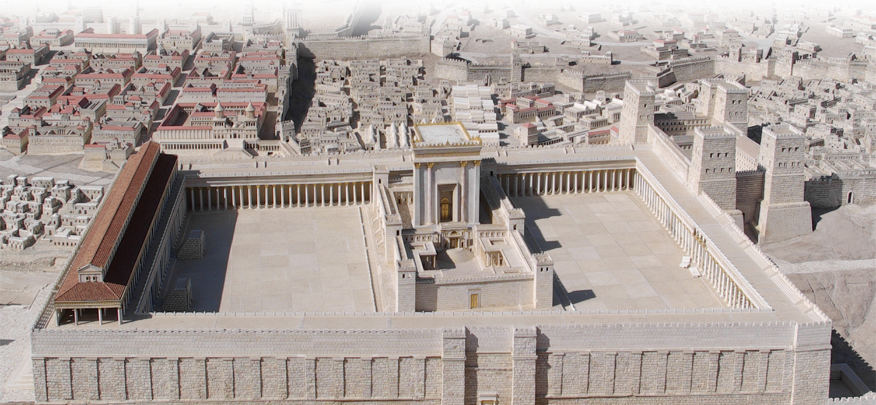
The Great Escape
¹⁰ They passed the first and second guards and came to the iron gate leading to the city. It opened for them by itself, and they went through it.
Notes:
Temple = See previous lessons.

Slide 13
The Great Escape
When they had walked the length of one street, suddenly the angel left him.

Slide 14
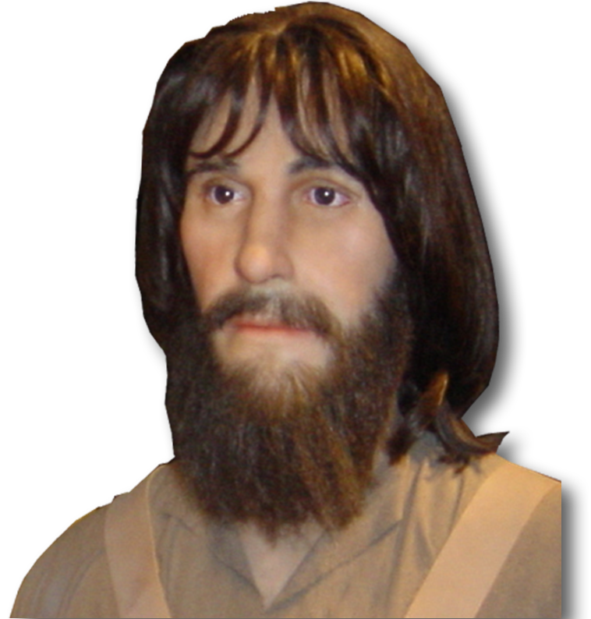
The Great Escape
¹¹ Then Peter came to himself and said,
"Now I know without
a doubt that the Lord
sent his angel and
rescued me from
Herod's clutches and
from everything the
Jewish people were
anticipating."

Slide 15

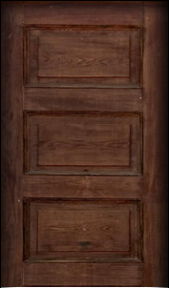
The Great Escape
¹² When this had dawned on him, he went to the house of Mary the mother of John, also called Mark, where many people had gathered and were praying.
Notes:
House = FREE for reuse from http://www.sxc.hu/browse.phtml?f=download&id=1316780
Door = FREE for reuse from http://www.sxc.hu/browse.phtml?f=download&id=1344803

Slide 16
The Great Surprise to …
¹³ Peter knocked at the outer entrance, and a servant girl named Rhoda came to answer the door.

Slide 17
The Great Surprise
¹⁴ When she recognized Peter's voice, she was so overjoyed she ran back without opening it and exclaimed,
"Peter is at the door!”

Slide 18
The Great Surprise
they told her. When she kept insisting that it was so,
they said,
"It must be
his angel."
¹⁵ "You're out of your
mind,"

Slide 19
The Great Surprise
¹⁶ But Peter kept on knocking, and when they opened the door and saw him, they were astonished.
Weren’t they a
little like us?
Notes:
I’m as human as they are.
Last year we were studying James 5 “anointing with oil” etc.

Slide 20
The Great Surprise
¹⁷ Peter motioned with his hand for them to be quiet and described how the Lord had brought him out of prison.
"Tell James and the
brothers about this,"
he said, and then
he left for another place.

Slide 21
The Great Surprise
¹⁸ In the morning, there was no small commotion among the soldiers as to what had become of Peter.

Slide 22
The Great Surprise
¹⁹ After Herod had a thorough search made for him and did not find him, he cross-examined the guards and ordered that they be executed.

Slide 23
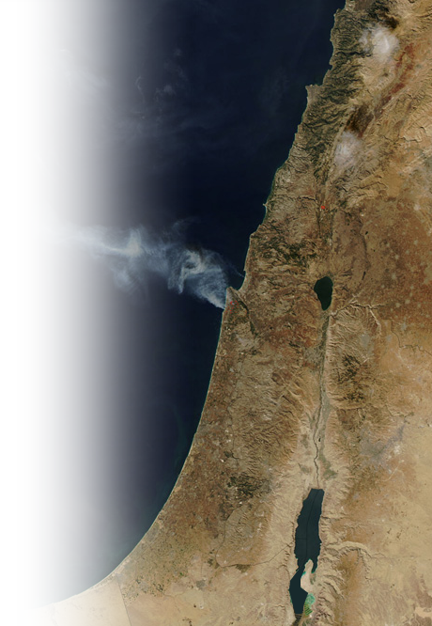
The Great Surprise
Then Herod went from Judea to
Caesarea and stayed there a while.

Slide 24
The Great Surprise
²⁰ He had been quarreling with the people of Tyre and Sidon; they
now joined together and sought
an audience with him. Having
secured the support of Blastus,
a trusted personal servant of t
he king, they asked for peace,
because they depended on
the king's country for their
food supply.

Slide 25
The Great Surprise
²¹ On the appointed day Herod, wearing his royal robes, sat on his throne and delivered a public address to the people.
²² They shouted,
"This is the voice of a
god, not of a man."

Slide 26
The Great Surprise
²³ Immediately, because Herod did not give praise to God, an angel of the Lord struck him down, and he was eaten by worms and died.
Idiom for an unpleasant death similar to our
“bite the dust” or
“kick the bucket.”

Slide 27
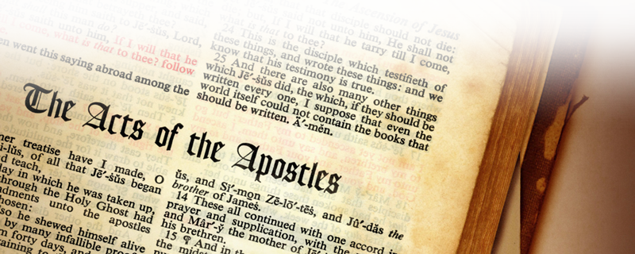
The Great Surprise
²⁴ But the word of God continued to increase and spread.
Notes:
Book of Acts = FREE for reuse from = http://www.sxc.hu/browse.phtml?f=download&id=1336835

Slide 28
The Great MISSION
²⁵ When Barnabas and Saul had finished their mission, they returned from Jerusalem, taking with them John, also called Mark.

Slide 29
Think about this …
1– While some Christians experience blessings of the faith, others are persecuted for the same faith. We can never judge a Christian by his or her circumstances—only by the heart.
2—When the people of God pray, God always hears.
3—Even godly people are surprised when God brings about a “Great Escape” in answer to prayer.

Slide 30
Today, we will pray …
1– As the closing songs are sung we invite you to come for prayer.
2—Tell us succinctly what your request is and …
3—We will anoint with oil and pray for you and your request.
4—We will expect God to surprise us too!

Slide 31
Let’s Pray & Sing

