Slide 1
ACTS 11:1-30
www.BiblePoint.com
2011 © Single Initiative LLC
Notes:
Copyright © 2000-2011. All rights reserved. Bible Point is a registered trademark of Single Initiative, LLC. All other trademarks acknowledged.
Bible Point contains graphics from Bible Point artists. These illustrations belong to Bible Point and the respective artists. You may use the designs and illustrations for graphical illustration of lessons free and without special permission, provided they are not used in any way that maligns the Christian faith. Furthermore, republication or production of any illustration by any other graphic service whether it be in book, in a machine-readable form, or in any other design resource is strictly prohibited. Furthermore, they cannot be duplicated or resold as any other form of publishing, clip art, or graphic resource.
So What does it mean? (A simple translations of the legal jargon)
So, if you don’t own the presentation(s), graphic(s), and text(s) how can you legally use them? The purchase of the license allows you to use all the images in the product. However, the actual ownership and copyright of the presentation(s), graphic(s), and text(s) remain the property of Bible Point and its licensors. If you had plans on using this product in your “for sale” work—think again!
License Agreement
Article 1: License Grant
All the graphics and text in Bible Point presentations (excluding quotes from the Bible and stated sources) are the intellectual and real property of Bible Point and its licensors, and is protected by law, including United States copyright laws and international treaties. Bible Point grants to you a license:
1. To use the presentation in a single church, single school, or single office of a Christian organization.
2. To make a single archival back-up copy of the program.
3. To modify the presentation(s) and merge with other presentations in a single church, school, or Christian organization.
4. To transfer to another party if that party agrees to accept the terms and conditions of this agreement, and you do not retain any copies of the presentation, whether printed, machine readable, modified, or merged form.
Article 2: Terms
This license is effective until terminated. You may terminate the license at any time by destroying the presentation(s), graphic(s), or text(s) together with all copies, modifications and merged portions in any form. Bible Point may terminate your license if you fail to comply with this Agreement. You agree, upon such termination, for any reason, to destroy the presentation(s), graphics, and text(s) with all copies, modifications, and merged portions in any form.
Article 3: Disclaimers
1. Bible Point presentations, graphics, and texts are licensed to you As Is. You, the consumer, bear the entire risk relating to the quality and performance of the presentation(s), graphic(s), or text(s). In no event will Bible Point be liable for damages resulting from any defect.
2. Thirty-day limited warrantee on disks. Bible Point warrants the disks to be free of defects in material and workmanship under normal use for 30 days after purchase. During the 30-day period you may return a defective presentation, graphic, or text with proof of purchase and it will be replaced without charge, unless the presentation is damaged by misuse.
Article 4: General
1. You may not sub-license, assign, or transfer the license of the presentation(s), graphic(s), or text(s) except as provided by this Agreement.
2. This Agreement will be governed by the laws of the State of Michigan.
So What does it mean? (A simple translations of the legal jargon)
May I let someone borrow or copy my licensed Bible Point presentation (even after I modified it)? As long as it is within your local church, or single school, or the immediate office of a Christian organization you may. Otherwise, please refer the person interested in borrowing to: http://www.biblepoint.com or E-mail: dh@biblepoint.com with any related questions.
---------------------------------------------------------------------------------------------------------------------------
Scripture taken from the HOLY BIBLE, NEW INTERNATIONAL VERSION®. NIV®. Copyright©1973, 1978, 1984 by International Bible Society. Used by permission of Zondervan. All rights reserved.

Slide 2
Independence Day
2011
Notes:
Flag background = free = http://www.sxc.hu/browse.phtml?f=download&id=1193557

Slide 3
Like Independence Day Some things are worth …

Slide 4
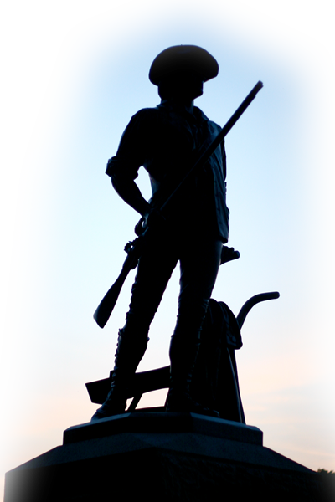
1—DEFENDING (11:1-18)
“…that all men are created equal, that they are endowed by their Creator with certain unalienable Rights, that among these are Life, Liberty and the pursuit of Happiness.”
Notes:
Minuteman = Free = http://www.flickr.com/photos/calliope/1231343382/sizes/o/in/photostream/

Slide 5
1—DEFENDING (11:1-18)
¹ The apostles and the brothers throughout Judea heard that the Gentiles also had received the word of God. ² So when Peter went up to Jerusalem, the circumcised believers criticized him ³ and said,
"You went into the house of uncircumcised men and ate with them.”

Slide 6
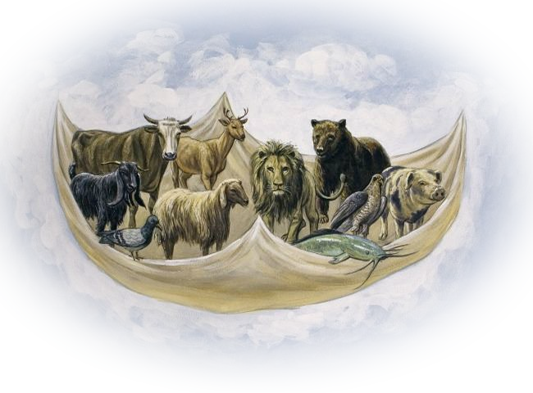
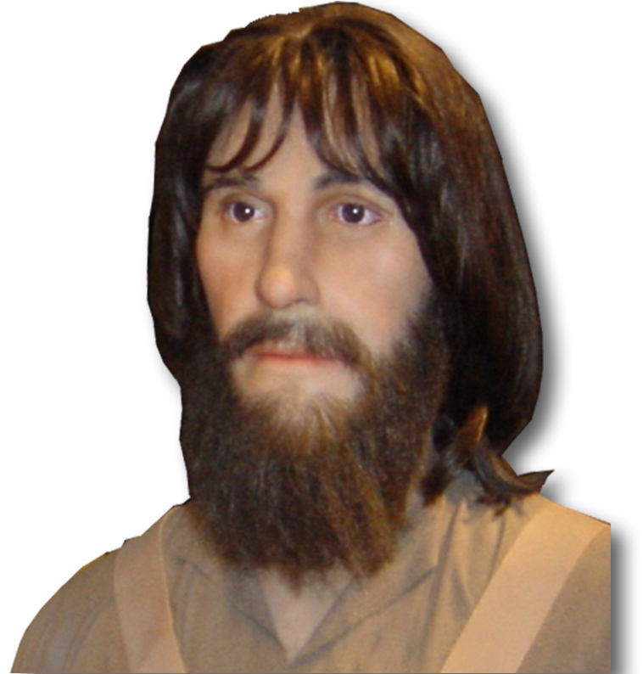
1—DEFENDING (11:1-18)
⁴ Peter began and explained everything to them precisely as it had happened…
"Get up, Peter. Kill and eat.”
Notes:
Animals = FREE = see previous lesson

Slide 7
1—DEFENDING (11:1-18)
"Surely not, Lord. Nothing impure or unclean has ever entered my mouth."
⁴ Peter began and explained everything to them precisely as it had happened…

Slide 8
1—DEFENDING (11:1-18)
⁴ Peter began and explained everything to them precisely as it had happened…
"Do not call anything impure that God has made clean.“

Slide 9
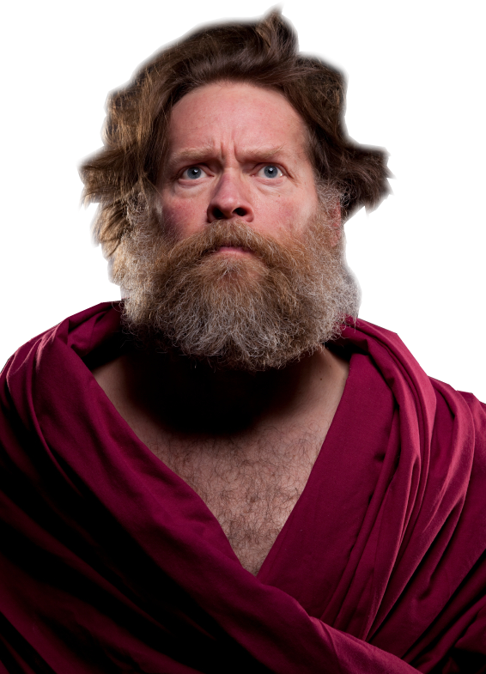
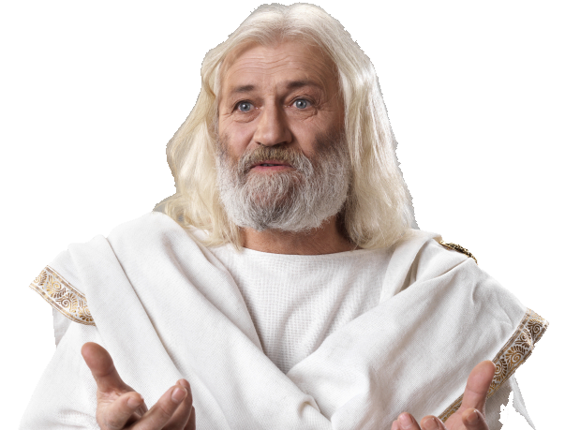
1—DEFENDING (11:1-18)
Right then three men … from Caesarea stopped at the house where I was staying.
Notes:
Romans Soldier = Licensed and NOT FOR REUSE from http://www.istockphoto.com/stock-photo-14398831-roman-army.php?st=852d6d1
Middle man = Licensed and NOT FOR REUSE from http://www.istockphoto.com/stock-photo-15682354-spiritual-man.php?st=5037f19
Man in White = Licensed and NOT FOR REUSE from http://www.istockphoto.com/stock-photo-16998244-old-wise-man-dressed-in-toga.php?st=5037f19

Slide 10
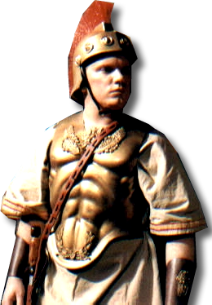
1—DEFENDING (11:1-18)
¹² … six brothers also went with me, and we entered the man's house.

Slide 11
1—DEFENDING (11:1-18)
¹³ [Cornelius] … told us how he had seen an angel appear in his house and say,
'Send to Joppa for Simon who is called Peter. ¹⁴ He will bring you a message through which you and all your household will be saved.’

Slide 12
1—DEFENDING (11:1-18)
¹⁵ "As I began to speak, the Holy Spirit came on them as he had come on us at the beginning.
ACTS 2
Notes:
Dove = Licensed = Not for reuse = from iStock_000009179621XSmall

Slide 13
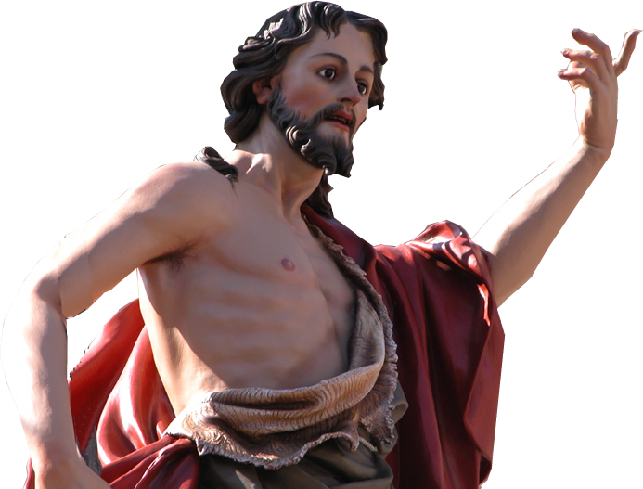
1—DEFENDING (11:1-18)
ACTS 1:5
¹⁶ Then I remembered what the Lord had said: 'John baptized with water, but you will be baptized with the Holy Spirit.'
Notes:
John Baptist = FREE for reuse from http://upload.wikimedia.org/wikipedia/commons/e/e6/StJohnXewkija.jpg

Slide 14
1—DEFENDING (11:1-18)
¹⁷ So if God gave them the same gift as he gave us, who believed in the Lord Jesus Christ, who was I to think that I could oppose God?”
FORGIVEN SINS
HOLY SPIRIT
BELIEVE
WATER
BAPTISM
Notes:
Images = SEE previous lesson

Slide 15
1—DEFENDING (11:1-18)
¹⁸ When they heard this, they had no further objections and praised God, saying,
"So then, God has granted even the Gentiles repentance unto life.”

Slide 16
Like Independence Day Some things are worth …

Slide 17
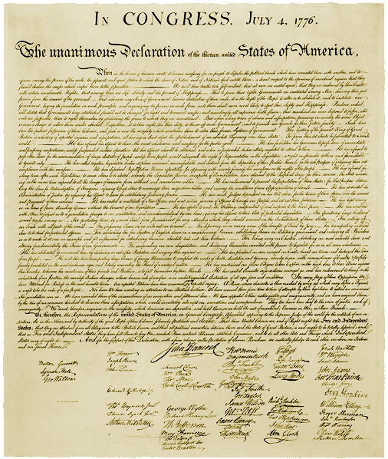
2—DECLARING (11:19-21)
Notes:
Declaration of independence = FREE for reuse from http://upload.wikimedia.org/wikipedia/commons/0/07/Us_declaration_independence.jpg

Slide 18
2—DECLARING (11:19-21)
¹⁹ Now those who had been scattered by the persecution in connection with Stephen traveled as far as Phoenicia, Cyprus and Antioch, telling the message only to Jews.

Slide 19
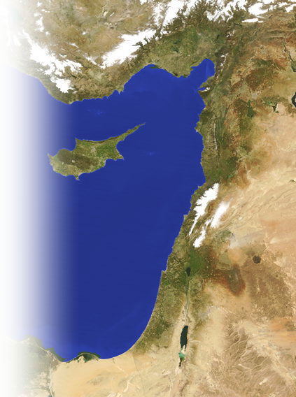
2—DECLARING (11:19-21)
¹⁹ Now those who had been scattered by the persecution in connection with Stephen traveled as far as Phoenicia, Cyprus and Antioch, telling the message only to Jews.

Slide 20
2—DECLARING (11:19-21)
¹⁹ Now those who had been scattered by the persecution in connection with Stephen traveled as far as Phoenicia, Cyprus and Antioch, telling the message only to Jews.

Slide 21
2—DECLARING (11:19-21)
¹⁹ Now those who had been scattered by the persecution in connection with Stephen traveled as far as Phoenicia, Cyprus and Antioch, telling the message only to Jews.

Slide 22
2—DECLARING (11:19-21)
¹⁹ Now those who had been scattered by the persecution in connection with Stephen traveled as far as Phoenicia, Cyprus and Antioch, telling the message only to Jews.

Slide 23
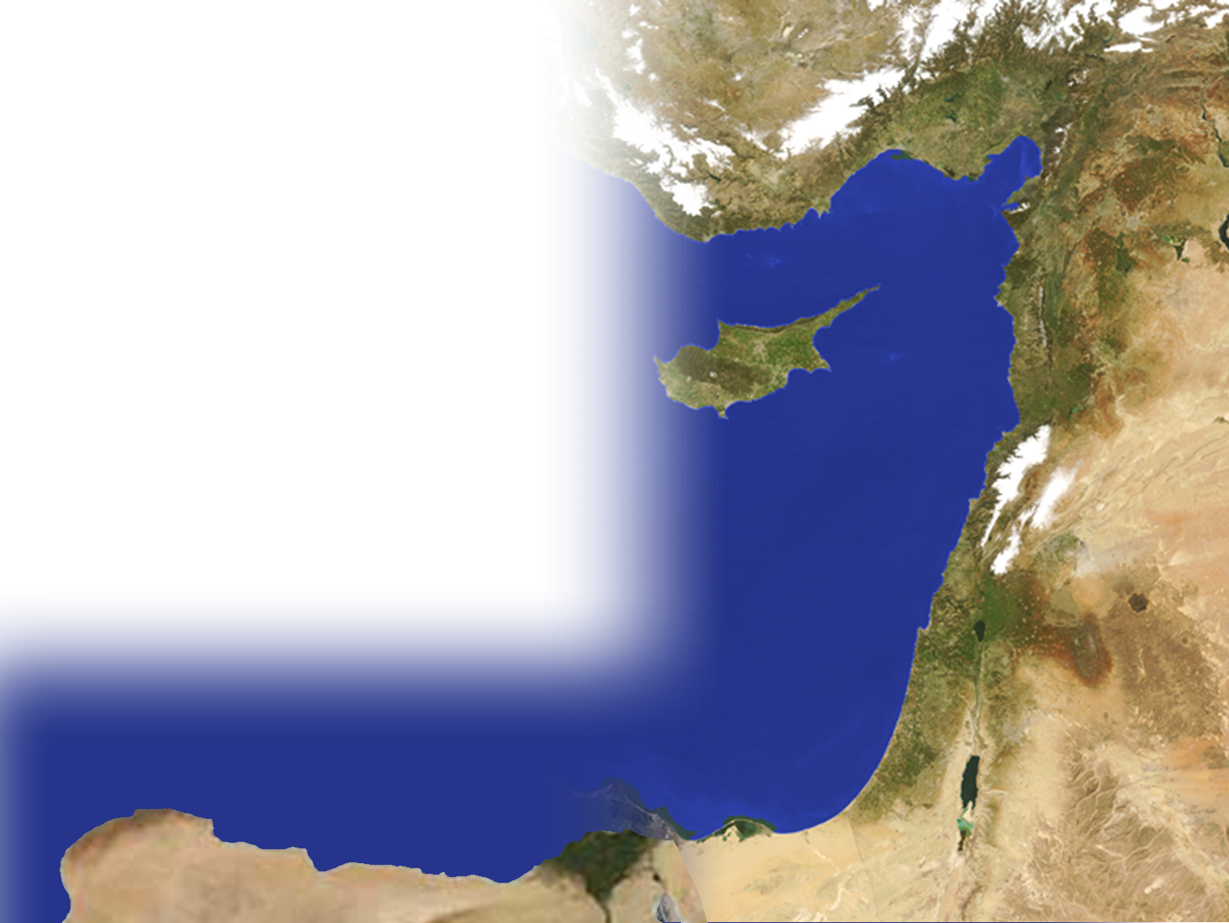
2—DECLARING (11:19-21)
²⁰ Some of them, however, men from Cyprus and Cyrene, went to Antioch and began to speak to Greeks also, telling them the good news about the Lord Jesus.

Slide 24
2—DECLARING (11:19-21)
²⁰ Some of them, however, men from Cyprus and Cyrene, went to Antioch and began to speak to Greeks also, telling them the good news about the Lord Jesus.

Slide 25
2—DECLARING (11:19-21)
²⁰ Some of them, however, men from Cyprus and Cyrene, went to Antioch and began to speak to Greeks also, telling them the good news about the Lord Jesus.

Slide 26
2—DECLARING (11:19-21)
²⁰ Some of them, however, men from Cyprus and Cyrene, went to Antioch and began to speak to Greeks also, telling them the good news about the Lord Jesus.

Slide 27
2—DECLARING (11:19-21)
²¹ The Lord's hand was with them, and a great number of people believed and turned to the Lord.

Slide 28
Like Independence Day Some things are worth …

Slide 29
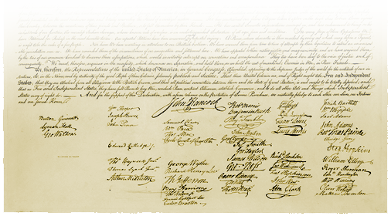
3—DEFINING (11:22-30)
The disciples were called Christians first at Antioch. (Act 11:26)
Notes:
Declaration of independence = FREE for reuse from http://upload.wikimedia.org/wikipedia/commons/0/07/Us_declaration_independence.jpg
Called “We the people” but signed by Patriots like John Hancock.
Is there enough evidence in your life to support an accusation that you are a Christian?

Slide 30
3—DEFINING (11:22-30)
²² News of this reached the ears of the church at Jerusalem, and they sent Barnabas to Antioch.

Slide 31
3—DEFINING (11:22-30)
²³ When he arrived and saw the evidence of the grace of God, he was glad and encouraged them all to remain true to the Lord with all their hearts.
²⁴ He was a good man, full of the Holy Spirit and faith, and a great number of people were brought to the Lord.

Slide 32
3—DEFINING (11:22-30)
²⁵ Then Barnabas went to Tarsus to look for Saul,
²⁶ and when he found him, he brought him to Antioch. So for a whole year Barnabas and Saul met with the church and taught great numbers of people.

Slide 33
3—DEFINING (11:22-30)
The disciples were called Christians first at Antioch.

Slide 34
3—DEFINING (11:22-30)
²⁷ During this time some prophets came down from Jerusalem to Antioch. ²⁸ One of them, named Agabus, stood up and through the Spirit predicted that a severe famine would spread over the entire Roman world.

Slide 35
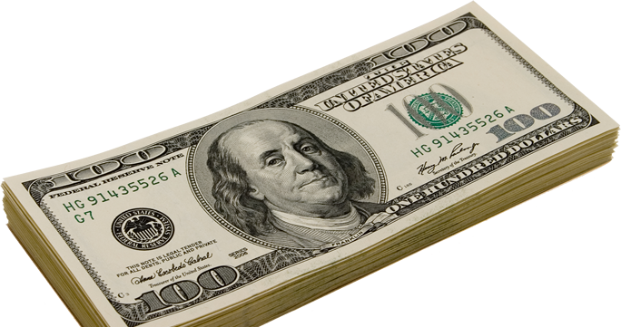
3—DEFINING (11:22-30)
²⁹ The disciples, each according to his ability, decided to provide help for the brothers living in Judea. ³⁰ This they did, sending their gift to the elders by Barnabas and Saul.
Notes:
100 Dollar bills = FREE for reuse from Dreamstime photo #dreamstimefree_7866547

Slide 36
Let’s Sum Up
Like independence day …
Some things are worth …
Defending
Declaring
Defining

Slide 37
Let’s Pray

Slide 38
Independence Day
2011
Notes:
Flag background = free = http://www.sxc.hu/browse.phtml?f=download&id=1193557

