Slide 1
ACTS 10:1-48
www.BiblePoint.com
2011 © Single Initiative LLC
Notes:
Copyright © 2000-2011. All rights reserved. Bible Point is a registered trademark of Single Initiative, LLC. All other trademarks acknowledged.
Bible Point contains graphics from Bible Point artists. These illustrations belong to Bible Point and the respective artists. You may use the designs and illustrations for graphical illustration of lessons free and without special permission, provided they are not used in any way that maligns the Christian faith. Furthermore, republication or production of any illustration by any other graphic service whether it be in book, in a machine-readable form, or in any other design resource is strictly prohibited. Furthermore, they cannot be duplicated or resold as any other form of publishing, clip art, or graphic resource.
So What does it mean? (A simple translations of the legal jargon)
So, if you don’t own the presentation(s), graphic(s), and text(s) how can you legally use them? The purchase of the license allows you to use all the images in the product. However, the actual ownership and copyright of the presentation(s), graphic(s), and text(s) remain the property of Bible Point and its licensors. If you had plans on using this product in your “for sale” work—think again!
License Agreement
Article 1: License Grant
All the graphics and text in Bible Point presentations (excluding quotes from the Bible and stated sources) are the intellectual and real property of Bible Point and its licensors, and is protected by law, including United States copyright laws and international treaties. Bible Point grants to you a license:
1. To use the presentation in a single church, single school, or single office of a Christian organization.
2. To make a single archival back-up copy of the program.
3. To modify the presentation(s) and merge with other presentations in a single church, school, or Christian organization.
4. To transfer to another party if that party agrees to accept the terms and conditions of this agreement, and you do not retain any copies of the presentation, whether printed, machine readable, modified, or merged form.
Article 2: Terms
This license is effective until terminated. You may terminate the license at any time by destroying the presentation(s), graphic(s), or text(s) together with all copies, modifications and merged portions in any form. Bible Point may terminate your license if you fail to comply with this Agreement. You agree, upon such termination, for any reason, to destroy the presentation(s), graphics, and text(s) with all copies, modifications, and merged portions in any form.
Article 3: Disclaimers
1. Bible Point presentations, graphics, and texts are licensed to you As Is. You, the consumer, bear the entire risk relating to the quality and performance of the presentation(s), graphic(s), or text(s). In no event will Bible Point be liable for damages resulting from any defect.
2. Thirty-day limited warrantee on disks. Bible Point warrants the disks to be free of defects in material and workmanship under normal use for 30 days after purchase. During the 30-day period you may return a defective presentation, graphic, or text with proof of purchase and it will be replaced without charge, unless the presentation is damaged by misuse.
Article 4: General
1. You may not sub-license, assign, or transfer the license of the presentation(s), graphic(s), or text(s) except as provided by this Agreement.
2. This Agreement will be governed by the laws of the State of Michigan.
So What does it mean? (A simple translations of the legal jargon)
May I let someone borrow or copy my licensed Bible Point presentation (even after I modified it)? As long as it is within your local church, or single school, or the immediate office of a Christian organization you may. Otherwise, please refer the person interested in borrowing to: http://www.biblepoint.com or E-mail: dh@biblepoint.com with any related questions.
---------------------------------------------------------------------------------------------------------------------------
Scripture taken from the HOLY BIBLE, NEW INTERNATIONAL VERSION®. NIV®. Copyright©1973, 1978, 1984 by International Bible Society. Used by permission of Zondervan. All rights reserved.

Slide 2
Vs. "Surely not, Lord!" (Act 10:14 NIV)

Slide 3
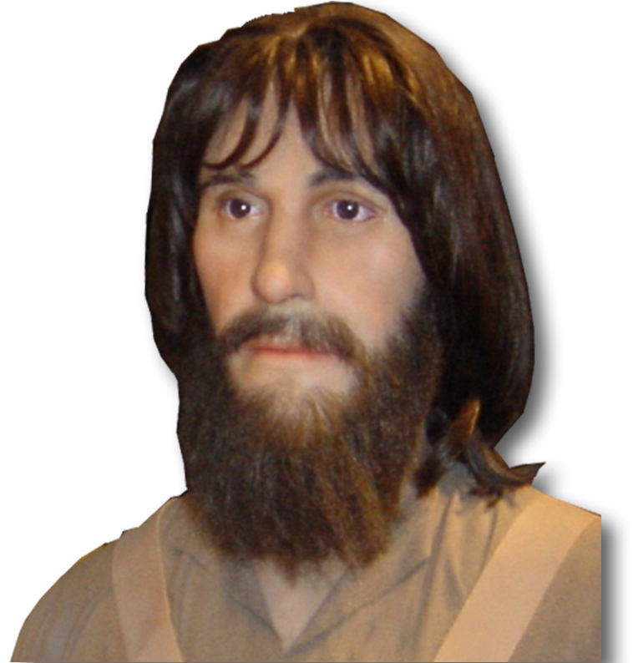
The Greatest Contradiction:
"Surely not, Lord!" Peter replied. (Act 10:14)
Notes:
Peter = FREE = BiblePoint photo

Slide 4
Let’s set the stage …

Slide 5
Peter should have known better:
Paralytic Man Obeyed Jesus 9:32-35
Notes:
Wheelchair = free = http://www.flickr.com/photos/doulkeridis/4754688708/sizes/m/in/photostream/

Slide 6
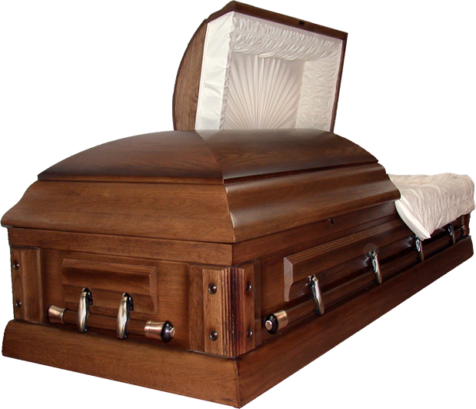
Peter should have known better:
2) Dead Lady Obeyed Jesus 9:40-43
Notes:
Casket =FREE for reuse from 4’ http://www.sxc.hu/browse.phtml?f=download&id=165815

Slide 7
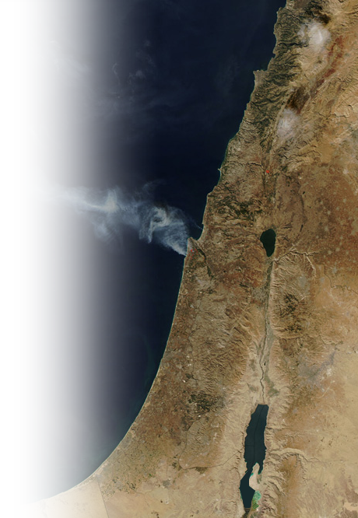
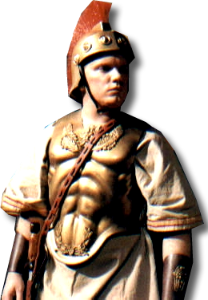
Peter should have known better:
3) Italian Roman Centurion Obeyed 10:1-8
Notes:
Roman = FREE = Bible Point
Angel = free from = http://www.sxc.hu/browse.phtml?f=download&id=586382
Peter = Bible Point photo = free

Slide 8
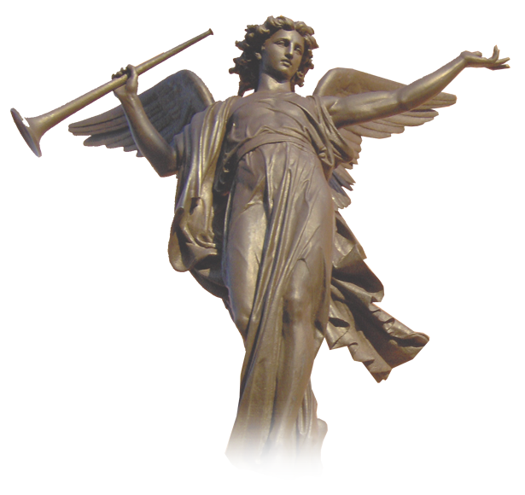
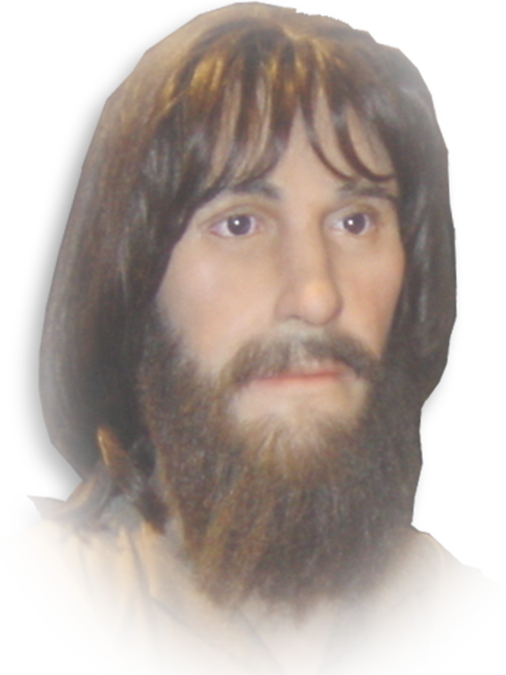
Peter should have known better:
⁵ Now send men to Joppa to bring back a man named Simon who is called Peter.
3) Italian Roman Centurion Obeyed 10:1-8
“…called two servants … and sent them to Joppa.”
Notes:
Roman = FREE = Bible Point
Angel = free from = http://www.sxc.hu/browse.phtml?f=download&id=586382
Peter = Bible Point photo = free

Slide 9
[Meanwhile …]
⁹ About noon the following day … Peter went up on the roof to pray. ¹⁰ He became hungry and wanted something to eat, and while the meal was being prepared, he fell into a trance.

Slide 10
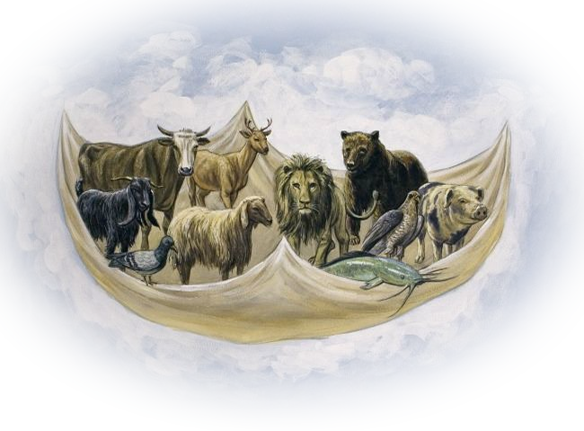
Peter’s test … (10:9-22)
¹¹ He saw heaven opened and something like a large sheet being let down to earth by its four corners.
¹² It contained all kinds of four-footed animals, as well as reptiles of the earth and birds of the air.
Notes:
Sheet with animals = Free = http://biblelessonsite.org/slideshow93.html

Slide 11
Peter’s test … (10:9-22)
¹³ Then a voice told him,
"Get up, Peter. Kill and eat.”
Notes:
Sheet with animals = Free = http://biblelessonsite.org/slideshow93.html

Slide 12
The Greatest Contradiction:
"Surely not, Lord!" Peter replied.

Slide 13
The Defensive Shield:
"I have never eaten anything impure or unclean."

Slide 14
The Lesson:
"Do not call anything impure that God has made clean."
¹⁶ This happened three times, and immediately the sheet was taken back to heaven.

Slide 15
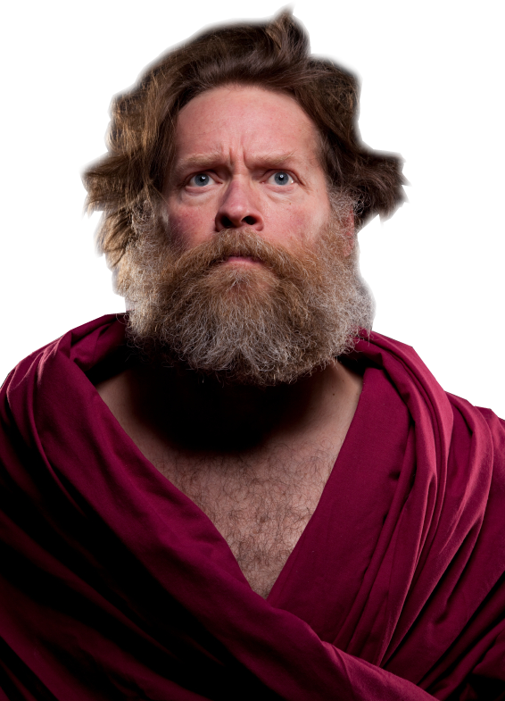
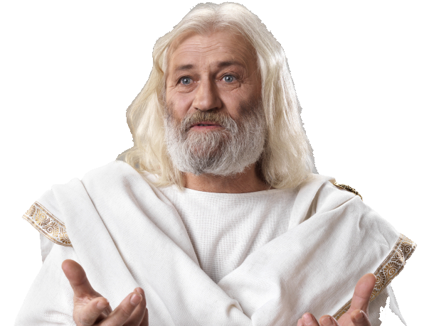
Peter’s Response:
¹⁷ While Peter was wondering about the meaning of the vision, the men sent by Cornelius … stopped at the gate….
Notes:
Romans Soldier = Licensed and NOT FOR REUSE from http://www.istockphoto.com/stock-photo-14398831-roman-army.php?st=852d6d1
Middle man = Licensed and NOT FOR REUSE from http://www.istockphoto.com/stock-photo-15682354-spiritual-man.php?st=5037f19
Man in White = Licensed and NOT FOR REUSE from http://www.istockphoto.com/stock-photo-16998244-old-wise-man-dressed-in-toga.php?st=5037f19

Slide 16
Peter’s Response:
¹⁷ While Peter was wondering about the meaning of the vision, the men sent by Cornelius … stopped at the gate….
Coincidence or Divine Providence?

Slide 17
Peter’s Response:
¹⁷ While Peter was wondering about the meaning of the vision, the men sent by Cornelius … stopped at the gate….
²³ …The next day Peter started out with them, …..

Slide 18
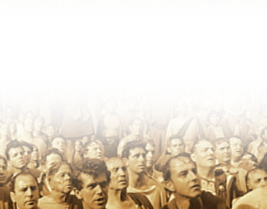
A Lesson Learned Well!
²⁷ … Peter went inside and found a large gathering of people.
Notes:
Crowd = Need to replace = http://www.americanrhetoric.com/MovieSpeeches/moviespeechjuliuscaesarbrutus.html

Slide 19
A Lesson Learned Well!
²⁸ He said to them:
"You are well aware that it is against our law for a Jew to associate with a Gentile or visit him. But God has shown me that I should not call any man impure or unclean."

Slide 20
A Powerful Message
³⁴ Then Peter began to speak:
"I now realize how true it is that God does not
show favoritism ³⁵ but accepts men from every nation who fear him and do what is right.
³⁶ You know the message God sent to the people of Israel, telling the good news of peace through Jesus Christ, who is Lord of all.
³⁷ You know what has happened throughout Judea, beginning in Galilee after the baptism that John preached--
³⁸ how God anointed Jesus of Nazareth with the Holy Spirit and power, and how he went around doing good and healing all who were under the power of the devil, because God was with him.
³⁹ "We are witnesses of everything he did in the country of the Jews and in Jerusalem. They killed him by hanging him on a tree,
⁴⁰ but God raised him from the dead on the third day and caused him to be seen.
⁴¹ He was not seen by all the people, but by witnesses whom God had already chosen--by us who ate and drank with him after he rose from the dead.
⁴² He commanded us to preach to the people and to testify that he is the one whom God appointed as judge of the living and the dead.
⁴³ All the prophets testify about him that everyone who believes in him receives forgiveness of sins through his name."
(Act 10:34-43 NIV)

Slide 21
A Powerful Message
³⁴ Then Peter began to speak:
³⁶ You know the message God sent to the people of Israel, telling the good news of peace through Jesus Christ, who is Lord of all.

Slide 22
A Powerful Message
³⁴ Then Peter began to speak:
³⁷ You know what has happened … ³⁸ how God anointed Jesus …, and how he went around doing good and healing … because God was with him.

Slide 23
A Powerful Message
³⁴ Then Peter began to speak:
³⁹ "We are witnesses …. They killed him by hang- ing him on a tree, ⁴⁰ but God raised him from the dead on the third day and caused him to be seen.

Slide 24
A Powerful Message
³⁴ Then Peter began to speak:
… ⁴² He commanded us to preach to the people and to testify that he is the one whom God appointed as judge of the living and the dead.

Slide 25
A Powerful Message
³⁴ Then Peter began to speak:
⁴³ All the prophets testify about him that everyone who believes in him receives forgiveness of sins through his name.”

Slide 26
The Results Were Powerful
⁴⁴ While Peter was still speaking these words, the Holy Spirit came on all who heard the message.
⁴⁵ The circumcised believers who had come with Peter were astonished that the gift of the Holy Spirit had been poured out even on the Gentiles.
Notes:
Dove = Licensed = Not for reuse = from iStock_000009179621XSmall

Slide 27
The Results Were Powerful
⁴⁶ For they heard them speaking in tongues and praising God. Then Peter said,
⁴⁷ "Can anyone keep these people from being baptized with water? They have received the Holy Spirit just as we have."

Slide 28
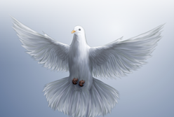
The Results Were Powerful
⁴⁸ So he ordered that they be baptized in the name of Jesus Christ. Then they asked Peter to stay with them for a few days.
FORGIVEN SINS
HOLY SPIRIT
BELIEVE
WATER
BAPTISM
Notes:
Heart= PowerPoint image
Dove = free from = http://www.flickr.com/photos/knowhim/336337024/
Cuffs = free from = http://www.flickr.com/photos/fyrfli/2679885374/sizes/o/in/photostream/
Water = Licensed and NOT for reuse = iStock_000006973332XSmall

Slide 29
Let’s Sum Up
There is no sin so great that the blood of Jesus Christ cannot remove it!
There is no person so bad that the blood of Jesus Christ cannot redeem him or her!
What (or Who) God has cleansed we must not call “unclean.”
When it comes to reaching people for the Lord, we can never say, “Surely not, Lord.”

Slide 30
Whatever God calls us to do we must say…

Slide 31
Let’s Pray

