Slide 1
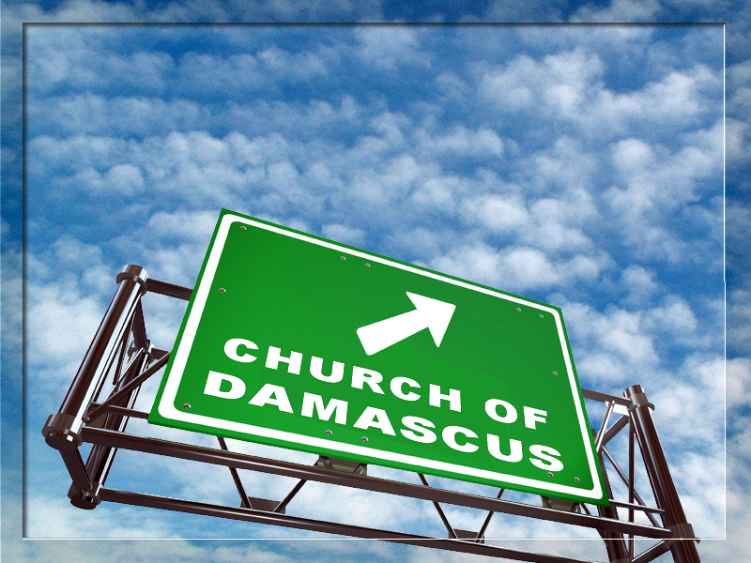
Something Unusual Happened on the Way to Church Today!
Notes:
Sign = see previous lesson notes.

Slide 2
Saul met Jesus on the way …

Slide 3
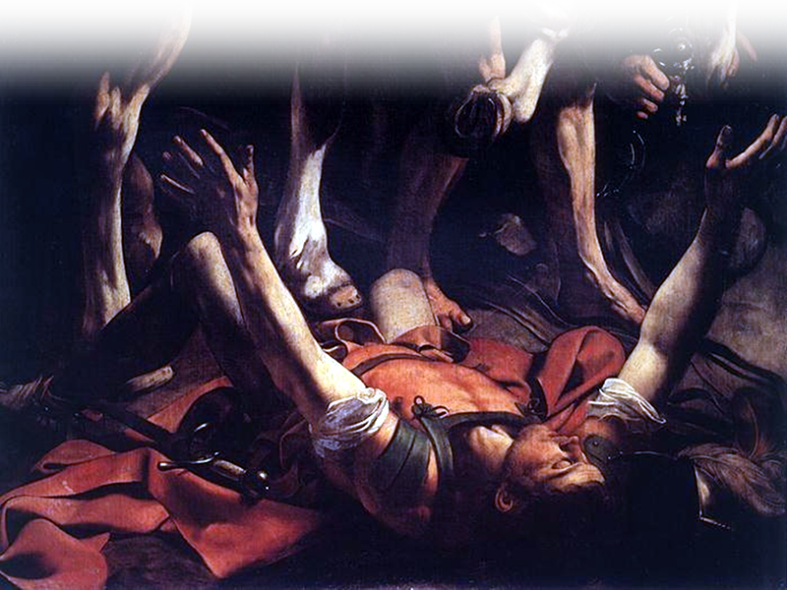
Saul met Jesus on the way …
Notes:
Paul = see previous lesson notes.

Slide 4
Something Unusual Happened Leaving Church Today!

Slide 5
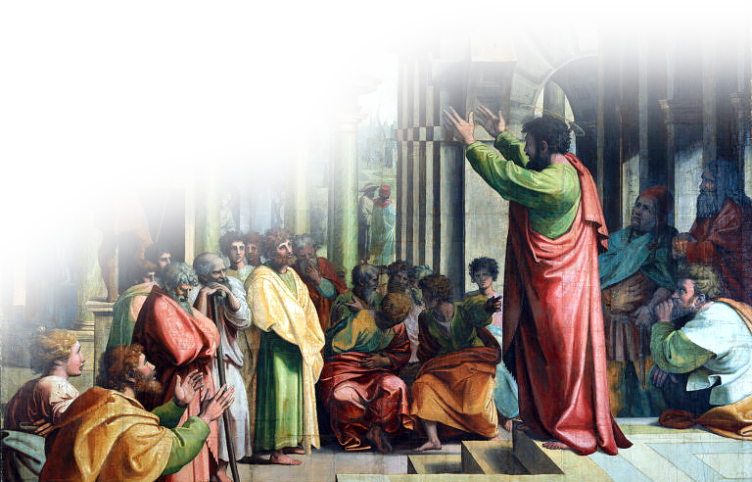
He couldn’t contain it!
²⁰ At once he began to preach in the synagogues that Jesus is the Son of God.
Notes:
Preaching – free - http://commons.wikimedia.org/wiki/File:V%26A_-_Raphael,_St_Paul_Preaching_in_Athens_%281515%29.jpg

Slide 6
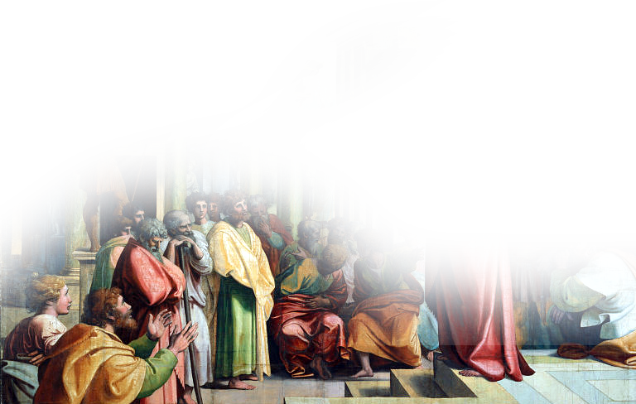
His audience was astonished by it!
"Isn't he the man who raised havoc in Jerusalem among those who call on this name? And hasn't he come here to take them as prisoners to the chief priests?”
²¹ All those who heard him were astonished and asked,

Slide 7
He became more convinced of it!
²² Yet Saul grew more and more powerful and baffled the Jews living in Damascus by proving that Jesus is the Christ.

Slide 8
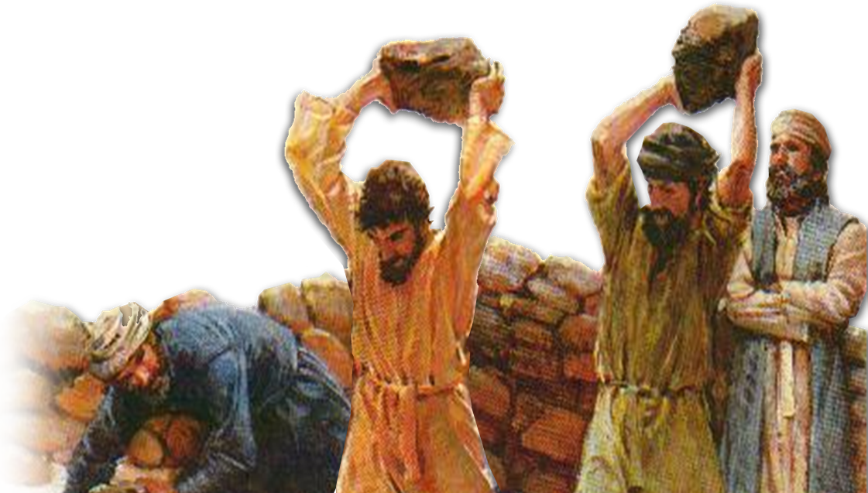
He put his life on the line for it!
²³ After many days had gone by, the Jews conspired to kill him, ²⁴ but Saul learned of their plan. Day and night they kept close watch on the city gates in order to kill him.
Notes:
Stoning = free =http://upload.wikimedia.org/wikipedia/commons/7/78/Tireux_de_roches.jpg

Slide 9
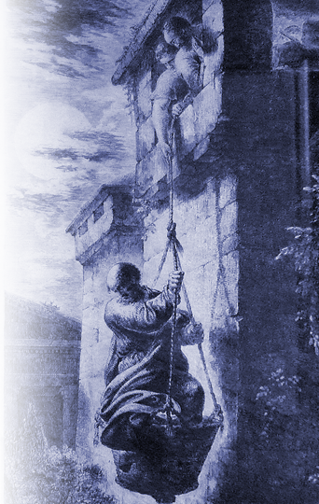
He evaded them!
²⁵ But his followers took him by night and lowered him in a basket through an opening in the wall.
Notes:
Paul let down in basket – free -- http://upload.wikimedia.org/wikipedia/commons/6/68/Rode_2.jpg

Slide 10
I’m amazed how the Damascus Christians accepted his change!

Slide 11
Not Everyone is so Accepting of Change!

Slide 12
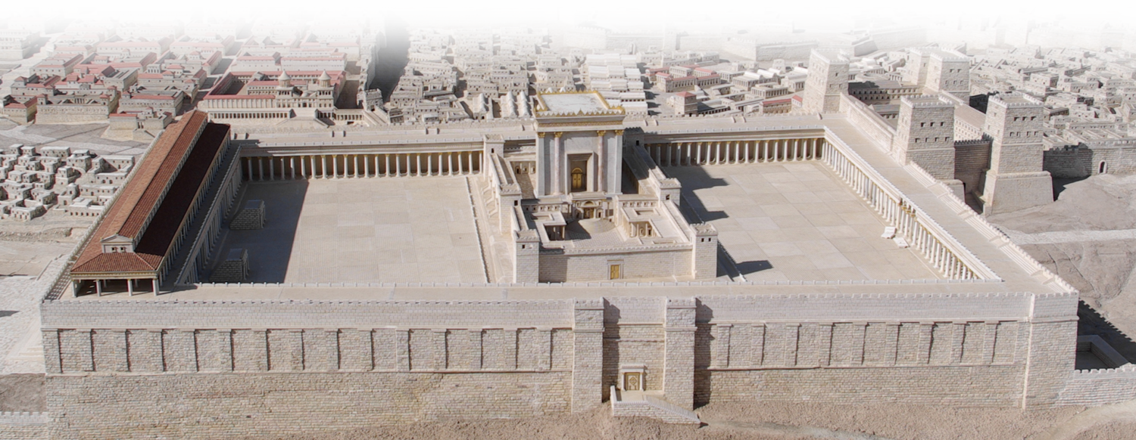
He Tried to Join the Jerusalem Church
²⁶ When he came to Jerusalem, he tried to join the disciples, but they were all afraid of him, not believing that he really was a disciple.
Notes:
Jerusalem model = FREE for reuse with credit from http://www.flickr.com/photos/emeryjl/508067090/sizes/o/in/photostream/

Slide 13
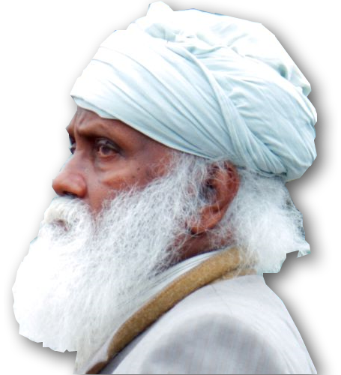
But ONE man encouraged Him!
²⁷ But Barnabas took him and brought him to the apostles.
^{4:36} Joseph, a Levite from Cyprus, whom the apostles called Barnabas (which means Son of Encouragement),
Notes:
Barnabas = free = http://www.flickr.com/photos/peterv/3537989486/sizes/o/in/photostream/

Slide 14
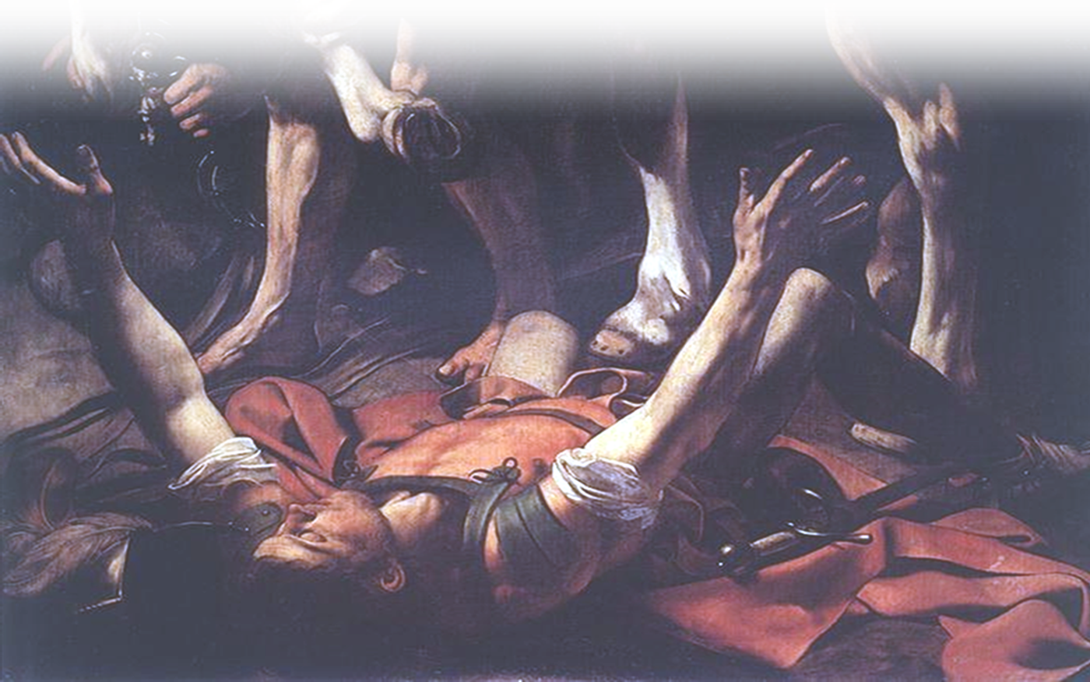
But ONE man encouraged Him!
²⁷ But Barnabas took him and brought him to the apostles. He told them how Saul on his journey had seen the Lord and that the Lord had spoken to him, and how in Damascus he had preached fearlessly in the name of Jesus.

Slide 15
ONE Man Made the Difference
²⁸ So Saul stayed with them and moved about freely in Jerusalem, speaking boldly in the name of the Lord.

Slide 16
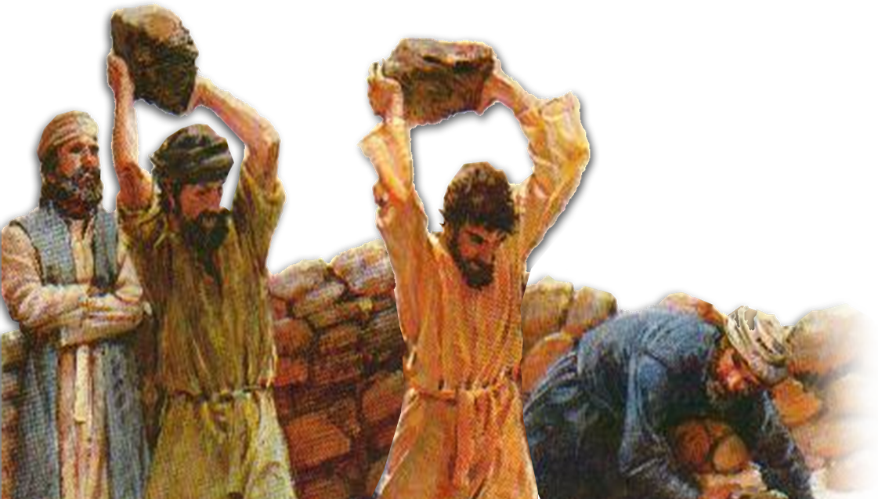
Result: A New Defender of the Faith
²⁹ He talked and debated with the Grecian Jews, but they tried to kill him.
Notes:
Stoning = free =http://upload.wikimedia.org/wikipedia/commons/7/78/Tireux_de_roches.jpg

Slide 17
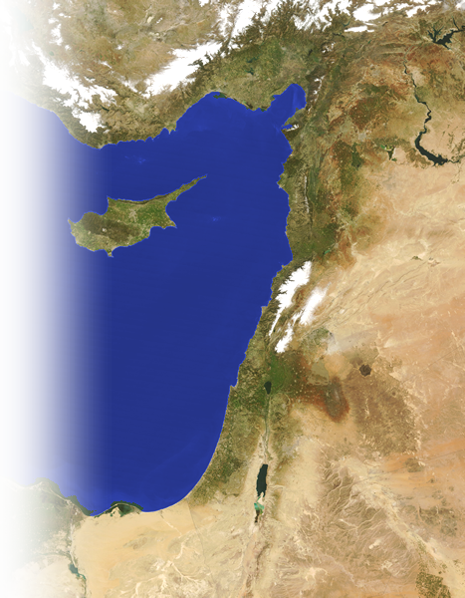
³⁰ When the brothers learned of this, they took him down to Caesarea and sent him off to Tarsus.
Notes:
Map = NASA photo public domain

Slide 18
Result: A Time of Peace Ensued
³¹ Then the church throughout Judea, Galilee and Samaria enjoyed a time of peace.

Slide 19
Result: The Church was Blessed
³¹ … It was strengthened; and encouraged by the Holy Spirit, it grew in numbers, living in the fear of the Lord.

Slide 20
Summary:
The Lord is looking for Barnabas here.
So
Peace, strength, growth, and fear of the Lord might increase!

Slide 21
Let Something Unusual Happen as YOU Leave Church Today!

Slide 22
Let’s Pray

