Slide 1
ACTS 9:1-19
www.BiblePoint.com
2011 © Single Initiative LLC
Notes:
Copyright © 2000-2011. All rights reserved. Bible Point is a registered trademark of Single Initiative, LLC. All other trademarks acknowledged.
Bible Point contains graphics from Bible Point artists. These illustrations belong to Bible Point and the respective artists. You may use the designs and illustrations for graphical illustration of lessons free and without special permission, provided they are not used in any way that maligns the Christian faith. Furthermore, republication or production of any illustration by any other graphic service whether it be in book, in a machine-readable form, or in any other design resource is strictly prohibited. Furthermore, they cannot be duplicated or resold as any other form of publishing, clip art, or graphic resource.
So What does it mean? (A simple translations of the legal jargon)
So, if you don’t own the presentation(s), graphic(s), and text(s) how can you legally use them? The purchase of the license allows you to use all the images in the product. However, the actual ownership and copyright of the presentation(s), graphic(s), and text(s) remain the property of Bible Point and its licensors. If you had plans on using this product in your “for sale” work—think again!
License Agreement
Article 1: License Grant
All the graphics and text in Bible Point presentations (excluding quotes from the Bible and stated sources) are the intellectual and real property of Bible Point and its licensors, and is protected by law, including United States copyright laws and international treaties. Bible Point grants to you a license:
1. To use the presentation in a single church, single school, or single office of a Christian organization.
2. To make a single archival back-up copy of the program.
3. To modify the presentation(s) and merge with other presentations in a single church, school, or Christian organization.
4. To transfer to another party if that party agrees to accept the terms and conditions of this agreement, and you do not retain any copies of the presentation, whether printed, machine readable, modified, or merged form.
Article 2: Terms
This license is effective until terminated. You may terminate the license at any time by destroying the presentation(s), graphic(s), or text(s) together with all copies, modifications and merged portions in any form. Bible Point may terminate your license if you fail to comply with this Agreement. You agree, upon such termination, for any reason, to destroy the presentation(s), graphics, and text(s) with all copies, modifications, and merged portions in any form.
Article 3: Disclaimers
1. Bible Point presentations, graphics, and texts are licensed to you As Is. You, the consumer, bear the entire risk relating to the quality and performance of the presentation(s), graphic(s), or text(s). In no event will Bible Point be liable for damages resulting from any defect.
2. Thirty-day limited warrantee on disks. Bible Point warrants the disks to be free of defects in material and workmanship under normal use for 30 days after purchase. During the 30-day period you may return a defective presentation, graphic, or text with proof of purchase and it will be replaced without charge, unless the presentation is damaged by misuse.
Article 4: General
1. You may not sub-license, assign, or transfer the license of the presentation(s), graphic(s), or text(s) except as provided by this Agreement.
2. This Agreement will be governed by the laws of the State of Michigan.
So What does it mean? (A simple translations of the legal jargon)
May I let someone borrow or copy my licensed Bible Point presentation (even after I modified it)? As long as it is within your local church, or single school, or the immediate office of a Christian organization you may. Otherwise, please refer the person interested in borrowing to: http://www.biblepoint.com or E-mail: dh@biblepoint.com with any related questions.
---------------------------------------------------------------------------------------------------------------------------
Scripture taken from the HOLY BIBLE, NEW INTERNATIONAL VERSION®. NIV®. Copyright©1973, 1978, 1984 by International Bible Society. Used by permission of Zondervan. All rights reserved.

Slide 2

Something Unusual Happen on the Way to Church
Notes:
Sign = licensed = not for reuse

Slide 3
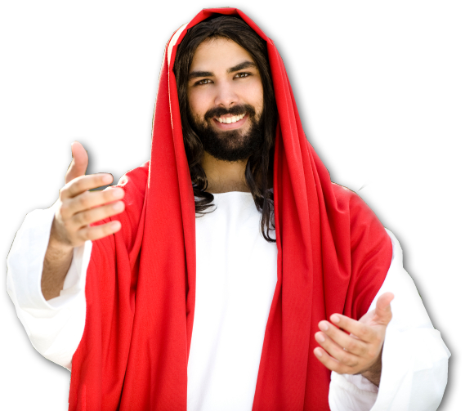
What was so unusual?
He met Jesus!
What’s so unusual about that?
Notes:
Jesus = licensed = not for reuse.

Slide 4
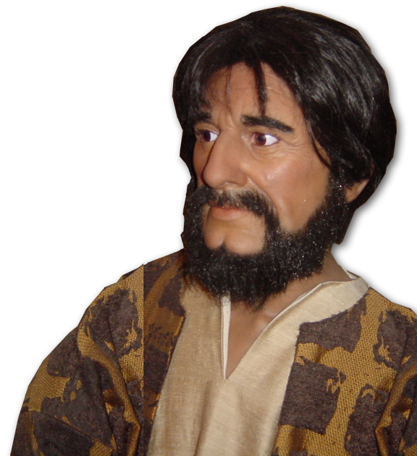
He wasn’t expecting to …
¹ Meanwhile, Saul was still breathing out murderous threats against the Lord's disciples.
Notes:
Paul = Bible Point photo = For reuse.

Slide 5
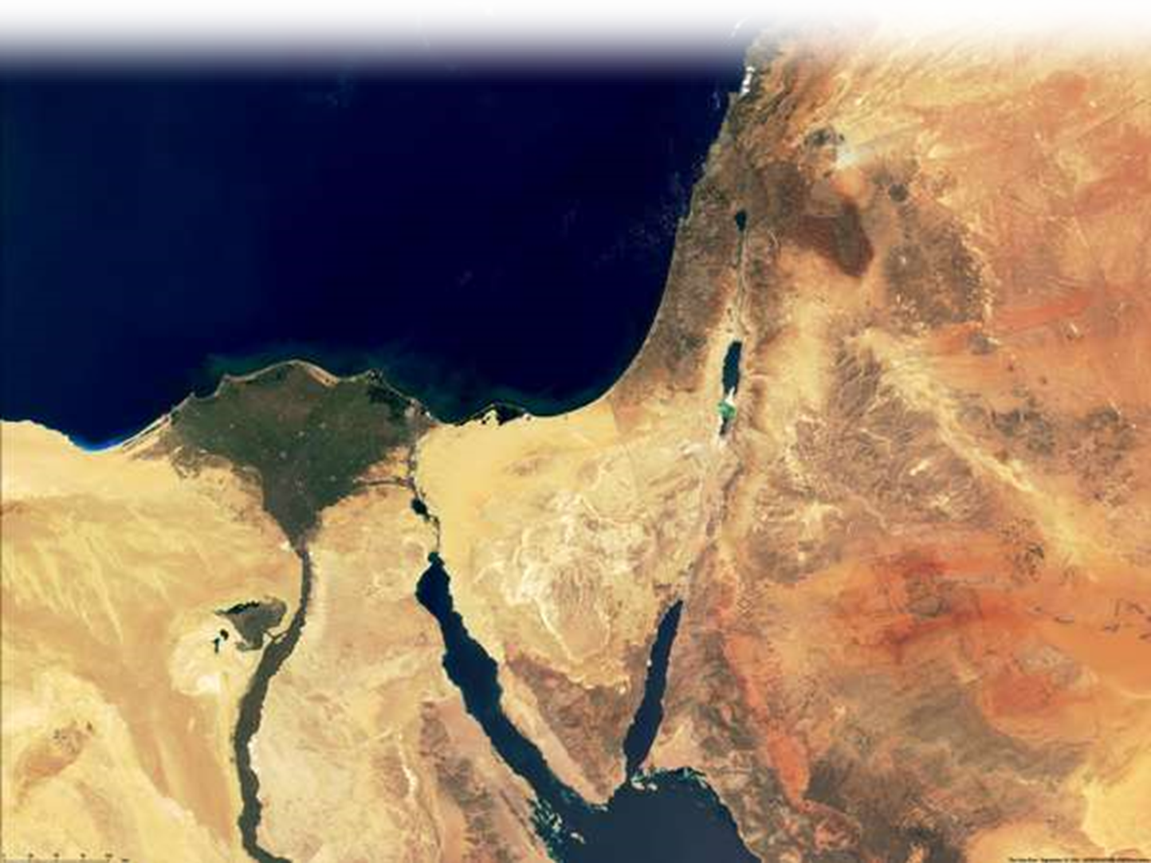
He was on a mission …
He went to the high priest ² and asked him for letters to the synagogues in Damascus,
Notes:
Map = free for reuse = From NASA

Slide 6
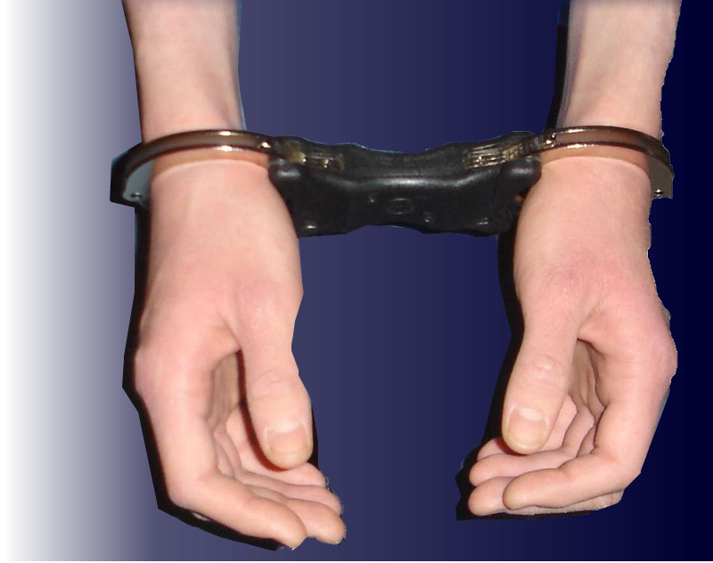
He was on a mission …
so that if he found any there who belonged to the Way, whether men or women, he might take them as prisoners to Jerusalem.
Notes:
Handcuffs = free = http://upload.wikimedia.org/wikipedia/commons/2/29/Speedcuffs_Front_P2P.jpg

Slide 7
What’s Your Mission … Why are you HERE?
1 – I have to …
2 – It’s my duty …
3 – It’s my habit …
4 – It’s my social network …
5 – It makes ME feel good …
6 – I want to hear from GOD!

Slide 8

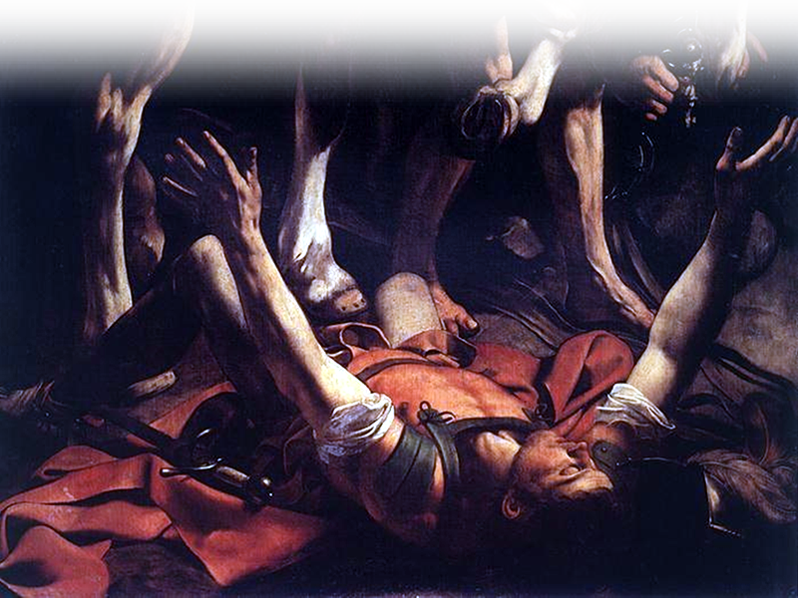
Mission Interrupted
suddenly a light from heaven flashed around him. ⁴ He fell to .
the ground …
Notes:
Paul = by Michelangelo Caravaggio = free = http://commons.wikimedia.org/wiki/File:Michelangelo_Caravaggio_036.jpg

Slide 9

Mission Interrupted
"Saul, Saul,
why do you
persecute me?”
and heard a
voice say to
him,
⁴ He fell to the ground and heard a voice say to him, "Saul, Saul, why do you persecute me?"
⁵ "Who are you, Lord?" Saul asked. "I am Jesus, whom you are persecuting," he replied.
(Act 9:3-5 NIV)

Slide 10
Mission Interrupted
"I am Jesus, whom you are persecuting,”
he replied.
⁵ "Who are you,
Lord?"
Saul
asked.
⁴ He fell to the ground and heard a voice say to him, "Saul, Saul, why do you persecute me?"
⁵ "Who are you, Lord?" Saul asked. "I am Jesus, whom you are persecuting," he replied.
(Act 9:3-5 NIV)

Slide 11
Mission Interrupted
⁶ "Now get up and go into the city, and you will be told what you must do.”

Slide 12
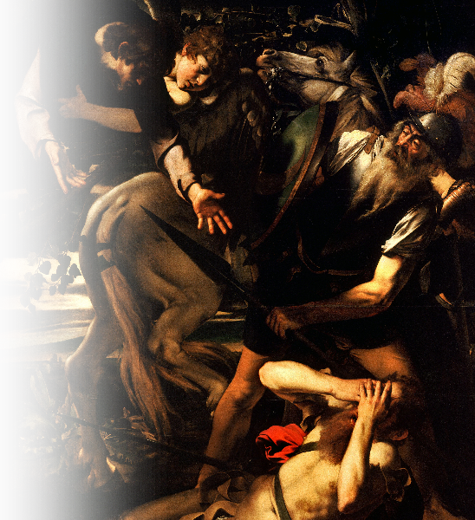
⁷ The men traveling with Saul stood there speechless; they heard the sound but did not see anyone. ⁸ Saul got up from the ground, but when he opened his eyes he could see nothing. So they led him by the hand into Damascus.
Notes:
Paul’s Conversion = by Caravaggio = free = http://upload.wikimedia.org/wikipedia/commons/b/bb/The_Conversion_of_Saint_Paul-Caravaggio_%28c._1600-1%29.jpg

Slide 13
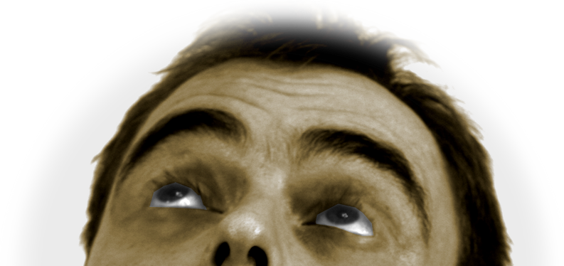
He wasn’t expecting this!
⁹ For three days he was blind, and did not eat or drink anything.
Notes:
Eyes = free = http://www.dreamstime.com/casual-man-s-face-with-expression-free-stock-photo-imagefree2039857

Slide 14
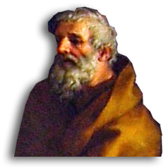
Another unusual thing happened?
He met a Jesus Follower!
¹⁰ In Damascus there was a disciple named Ananias.
What’s so unusual about that?
Notes:
Ananias = free = http://commons.wikimedia.org/wiki/File:Saint_Paul_Ananias_Sight_Restored.jpg

Slide 15
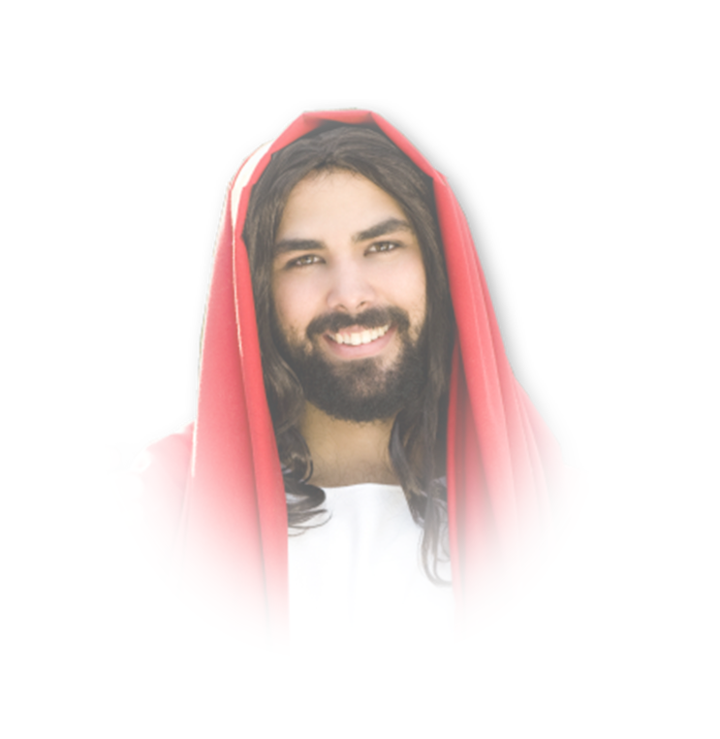
Ananias’ Vision
The Lord called to him in a vision,
"Ananias!"
"Yes, Lord,"
he answered.
Notes:
Jesus = licensed = not for reuse.

Slide 16
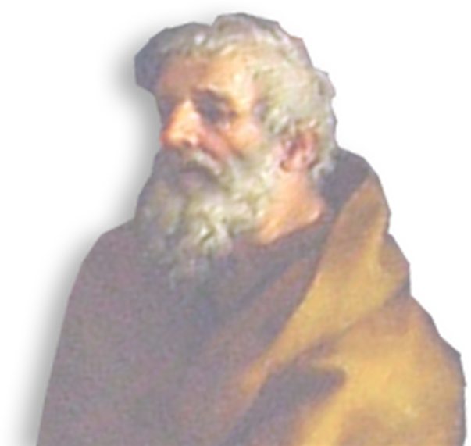
Ananias’ Vision
¹¹ The Lord told him,
"Go to the house of Judas on Straight Street and ask for a man from Tarsus named Saul, for he is praying.

Slide 17
Ananias’ Vision
¹¹ The Lord told him,
“¹² In a vision he has seen
a man named Ananias
come and place his hands
on him to restore his
sight.“

Slide 18
Ananias’ Vision
¹³ "Lord,“ Ananias answered,
"I have heard many
reports about this man
and all the harm he has
done to your saints in Jerusalem.

Slide 19
Ananias’ Vision
¹⁴ And he has come here with authority from the chief priests to arrest all who call on your name.“

Slide 20
Ananias’ Vision
¹⁵ But the Lord said to Ananias,
"Go! This man is my chosen instrument to carry my name before the Gentiles and their kings and before the people of Israel. ¹⁶ I will show him how much he must suffer for my name.”

Slide 21
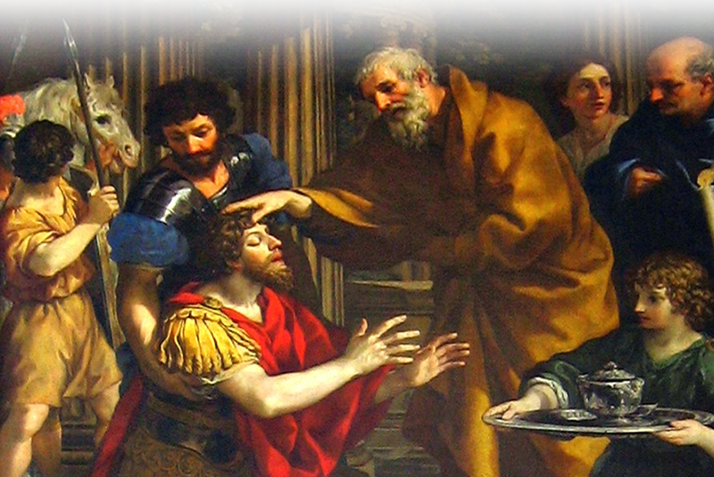
¹⁷ Then Ananias went to the house and entered it. Placing his hands on Saul,

Slide 22

he said,
"Brother Saul, the
Lord--Jesus, who
appeared to you
on the road as
you were
coming
here—

Slide 23

he said,
has sent me so that
you may see again
and be filled
with the Holy
Spirit.“

Slide 24
¹⁸ Immediately, something like scales fell from Saul's eyes, and he could see again.

Slide 25



¹⁸ Immediately, something like scales fell from Saul's eyes, and he could see again.
He got up and was baptized,
SIGHT
LORD
BAPTIZED
SPIRIT
Notes:
Eye = free = http://www.sxc.hu/browse.phtml?f=download&id=1164515
Dove = free = http://www.sxc.hu/browse.phtml?f=download&id=1195513
Water = Licensed = iStock_000006973332XSmall

Slide 26
¹⁹ and after taking some food, he regained his strength. Saul spent several days with the disciples in Damascus.

Slide 27
Something Unusual Happen on the Way to Church
He met Jesus
He met a Jesus Follower
Then he became one
Notes:
Sign = licensed = not for reuse

Slide 28
Let’s Pray

