Slide 1
ACTS 8:26-40
www.BiblePoint.com
2011 © Single Initiative LLC
Notes:
Copyright © 2000-2011. All rights reserved. Bible Point is a registered trademark of Single Initiative, LLC. All other trademarks acknowledged.
Bible Point contains graphics from Bible Point artists. These illustrations belong to Bible Point and the respective artists. You may use the designs and illustrations for graphical illustration of lessons free and without special permission, provided they are not used in any way that maligns the Christian faith. Furthermore, republication or production of any illustration by any other graphic service whether it be in book, in a machine-readable form, or in any other design resource is strictly prohibited. Furthermore, they cannot be duplicated or resold as any other form of publishing, clip art, or graphic resource.
So What does it mean? (A simple translations of the legal jargon)
So, if you don’t own the presentation(s), graphic(s), and text(s) how can you legally use them? The purchase of the license allows you to use all the images in the product. However, the actual ownership and copyright of the presentation(s), graphic(s), and text(s) remain the property of Bible Point and its licensors. If you had plans on using this product in your “for sale” work—think again!
License Agreement
Article 1: License Grant
All the graphics and text in Bible Point presentations (excluding quotes from the Bible and stated sources) are the intellectual and real property of Bible Point and its licensors, and is protected by law, including United States copyright laws and international treaties. Bible Point grants to you a license:
1. To use the presentation in a single church, single school, or single office of a Christian organization.
2. To make a single archival back-up copy of the program.
3. To modify the presentation(s) and merge with other presentations in a single church, school, or Christian organization.
4. To transfer to another party if that party agrees to accept the terms and conditions of this agreement, and you do not retain any copies of the presentation, whether printed, machine readable, modified, or merged form.
Article 2: Terms
This license is effective until terminated. You may terminate the license at any time by destroying the presentation(s), graphic(s), or text(s) together with all copies, modifications and merged portions in any form. Bible Point may terminate your license if you fail to comply with this Agreement. You agree, upon such termination, for any reason, to destroy the presentation(s), graphics, and text(s) with all copies, modifications, and merged portions in any form.
Article 3: Disclaimers
1. Bible Point presentations, graphics, and texts are licensed to you As Is. You, the consumer, bear the entire risk relating to the quality and performance of the presentation(s), graphic(s), or text(s). In no event will Bible Point be liable for damages resulting from any defect.
2. Thirty-day limited warrantee on disks. Bible Point warrants the disks to be free of defects in material and workmanship under normal use for 30 days after purchase. During the 30-day period you may return a defective presentation, graphic, or text with proof of purchase and it will be replaced without charge, unless the presentation is damaged by misuse.
Article 4: General
1. You may not sub-license, assign, or transfer the license of the presentation(s), graphic(s), or text(s) except as provided by this Agreement.
2. This Agreement will be governed by the laws of the State of Michigan.
So What does it mean? (A simple translations of the legal jargon)
May I let someone borrow or copy my licensed Bible Point presentation (even after I modified it)? As long as it is within your local church, or single school, or the immediate office of a Christian organization you may. Otherwise, please refer the person interested in borrowing to: http://www.biblepoint.com or E-mail: dh@biblepoint.com with any related questions.
---------------------------------------------------------------------------------------------------------------------------
Scripture taken from the HOLY BIBLE, NEW INTERNATIONAL VERSION®. NIV®. Copyright©1973, 1978, 1984 by International Bible Society. Used by permission of Zondervan. All rights reserved.

Slide 2

Getting Out of Your Box
Acts 8
Notes:
Man in Box licensed from Dreamstime 4108673 Not for reuse.

Slide 3
What is the “Box?”
It’s the little world you live in.
It’s your “comfort zone.”

Slide 4
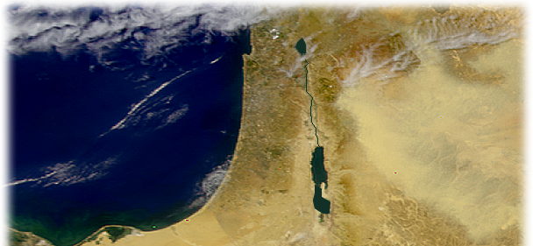

In Acts 8 it was
Remaining in Jerusalem
vs. Acts 1:8

Slide 5
Sometimes
We Need a Nudge to Get Us to Move …
Sometimes He nudges with …
Persecutors
Preachers
Pretenders
Today we will see …

Slide 6
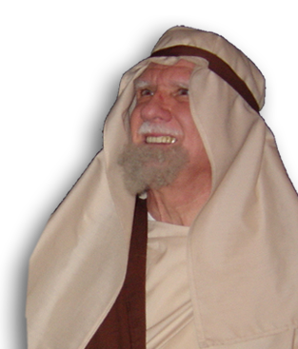
An Angel
²⁶ Now an angel of the Lord said to Philip,
"Go south to
the road—the desert
road--that goes down
from Jerusalem
to Gaza.“
Notes:
Philip = free = Bible Point photo

Slide 7
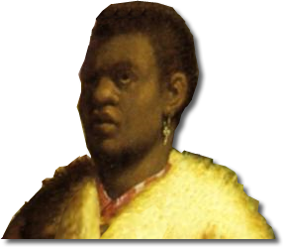
A SEEKER
²⁷ So he started out, and on his way he met an Ethiopian,
eunuch
an important official
in charge of all the treasury of Candace, queen of the Ethiopians.
This man had gone to Jerusalem to worship,
Notes:
Ethiopian Eunuch = free from: http://upload.wikimedia.org/wikipedia/commons/7/76/Rembrandt_169.jpg

Slide 8
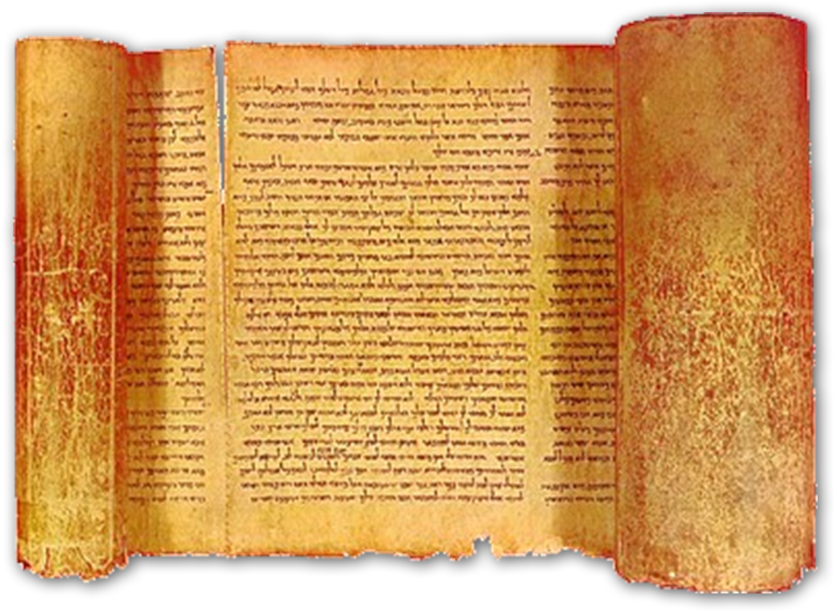
A SEEKER
²⁸ and on his way home was sitting in his chariot reading the book of Isaiah the prophet.
Notes:
Isaiah scroll = http://www.historyofinformation.com/images/isaiah_scroll.jpg

Slide 9
A Servant
²⁹ The Spirit told Philip,
"Go to that chariot
and stay near it.“
Notes:
A Deacon is a “Servant”

Slide 10
A sensitive question
³⁰ Then Philip ran up to the chariot and heard the man reading Isaiah the prophet.
"Do you understand
what you are reading?"
Philip asked.

Slide 11
A SEEKERS
³¹ "How can I,”
he said,
"unless someone explains it to me?"
A “SEEKER” is a person who is trying to figure it out!

Slide 12
A SEEKER
So he invited Philip to come up and sit with him. ³² The eunuch was reading this passage of Scripture:
"He was led like a sheep to the slaughter, and as a lamb before the shearer is silent, so he did not open his mouth. ³³ In his humiliation he was deprived of justice. Who can speak of his descendants? For his life was taken from the earth.“
Isa 53: 7-8

Slide 13
A SEEKER’s Question
³⁴ The eunuch asked Philip,
"Tell me, please, who is the prophet talking about, himself or someone else?"

Slide 14
What Do You Say?
³⁵ Then Philip began with that very passage of Scripture and told him the good news about Jesus.
What might he have said?

Slide 15

Perhaps …
REJECTION of Jesus 53:1-3
Unbelievable
Unattractive
Unacceptable
Notes:
Jesus = FREE for reuse from http://upload.wikimedia.org/wikipedia/en/6/61/Thepassionposterface-1-.jpg

Slide 16
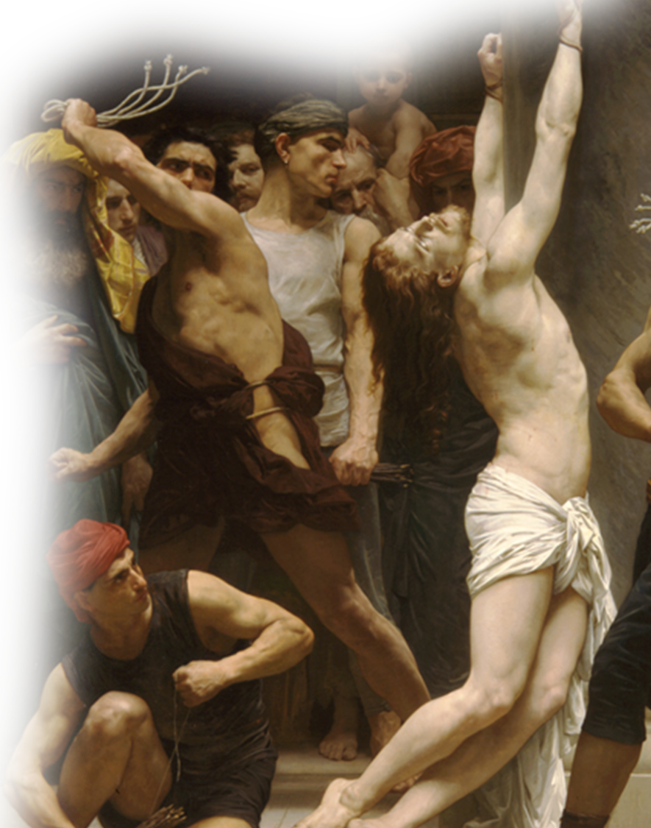
Perhaps …
SUBSTITUTION of Jesus 53:4-6
Smitten for us
Wounded for us
Sin Bearer for us
Notes:
Passion picture FREE for reuse from = http://upload.wikimedia.org/wikipedia/en/6/61/Thepassionposterface-1-.jpg

Slide 17
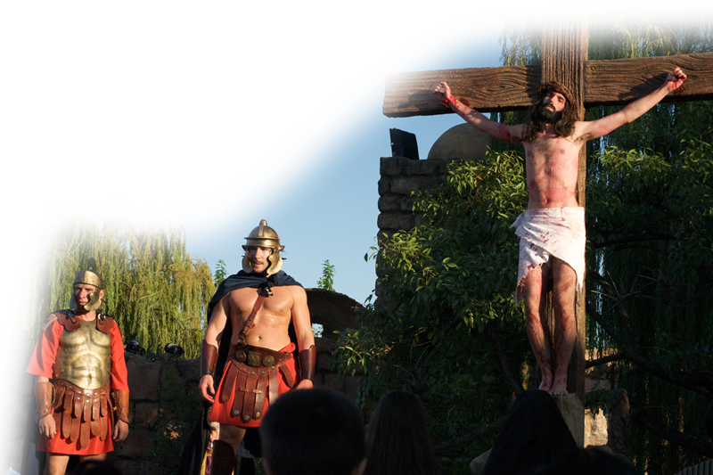
Perhaps …
PASSION of Jesus 53:7-9
Jesus Silently Condemned
Jesus Violently Killed
Jesus Buried in the grave
Notes:
Crucifixion = FREE with credit from http://www.flickr.com/photos/blmurch/3434523441/sizes/o/in/photostream/

Slide 18

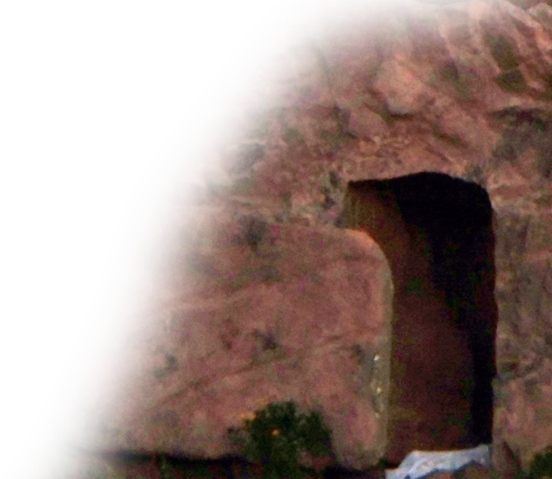
Perhaps …
PURPOSE of Jesus 53:10-12
Jesus an offering for sin
Jesus raised from the dead
Jesus rewarded with life
Notes:
Empty tomb = FREE =BiblePoint photo.

Slide 19


The SEEKER
³⁶ As they traveled along the road, they came to some water and the eunuch said,
"Look, here is water. Why
shouldn't I be baptized?"
Notes:
Water = FREE for reuse from dreamstimefree_1411398

Slide 20
The SEEKER
³⁶ As they traveled along the road, they came to some water and the eunuch said,
"Look, water! What forbids me to be immersed?“ DLH
Notes:
What a strange question – unless you were forbidden from entering the temple because you were a euunch (see Deut 23:1).
He wants to know if, as a believer, is he forbidden from full access to public display?
Today, in our culture the opposite seems to be true. People believe but refuse to be biblically baptized after they believe.

Slide 21
The SEEKER
³⁷
³⁸ And he gave orders …

Slide 22
The SEEKER
³⁷ Philip said,
“If you believe with all of your heart, you may.”
³⁸ And he gave orders …

Slide 23
The SEEKER
³⁷ … And he answered and said,
"I believe that Jesus Christ is the Son of God.”
³⁸ And he gave orders…
Notes:
What a strange question – unless you were forbidden from entering the temple because you were a euunch (see Deut 23:1).
He wants to know if, as a believer, is he forbidden from full access to public display?
Today, in our culture the opposite seems to be true. People believe but refuse to be biblically baptized after they believe.

Slide 24
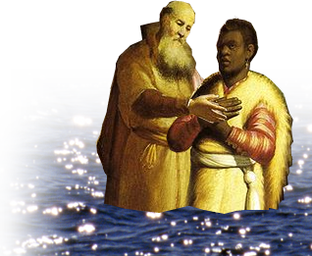
The believer
³⁸ And he gave orders to stop the chariot. Then both Philip and the eunuch went down into the water
and Philip baptized him.
³⁹ When they came up out of the water, the Spirit of the Lord suddenly took Philip away, and the eunuch did not see him again, but went on his way rejoicing.
⁴⁰ Philip, however, appeared at Azotus and traveled about, preaching the gospel in all the towns until he reached Caesarea. (Act 8:26-40 NIV)

Slide 25
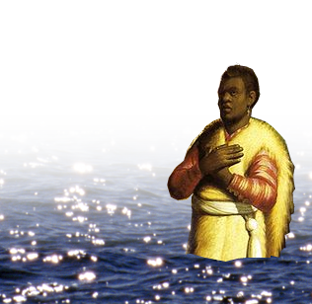
The believer
³⁹ When they came up out of the water, the Spirit of the Lord suddenly took Philip away, and the eunuch did not see him again, but went on his way rejoicing.

Slide 26
The mission
⁴⁰ Philip, however, appeared at Azotus and traveled about, preaching the gospel in all the towns until he reached Caesarea.

Slide 27
Let’s Sum up…
God gives us nudges to get out of our Boxes!
He can use just about anything …
In this case He used …
A SEEKER– “So what are you looking for?
A SERVANT – “So who are you serving anyway?”

Slide 28
Let’s Pray!

