Slide 1
ACTS 8:1-25
www.BiblePoint.com
2011 © Single Initiative LLC
Notes:
Copyright © 2000-2011. All rights reserved. Bible Point is a registered trademark of Single Initiative, LLC. All other trademarks acknowledged.
Bible Point contains graphics from Bible Point artists. These illustrations belong to Bible Point and the respective artists. You may use the designs and illustrations for graphical illustration of lessons free and without special permission, provided they are not used in any way that maligns the Christian faith. Furthermore, republication or production of any illustration by any other graphic service whether it be in book, in a machine-readable form, or in any other design resource is strictly prohibited. Furthermore, they cannot be duplicated or resold as any other form of publishing, clip art, or graphic resource.
So What does it mean? (A simple translations of the legal jargon)
So, if you don’t own the presentation(s), graphic(s), and text(s) how can you legally use them? The purchase of the license allows you to use all the images in the product. However, the actual ownership and copyright of the presentation(s), graphic(s), and text(s) remain the property of Bible Point and its licensors. If you had plans on using this product in your “for sale” work—think again!
License Agreement
Article 1: License Grant
All the graphics and text in Bible Point presentations (excluding quotes from the Bible and stated sources) are the intellectual and real property of Bible Point and its licensors, and is protected by law, including United States copyright laws and international treaties. Bible Point grants to you a license:
1. To use the presentation in a single church, single school, or single office of a Christian organization.
2. To make a single archival back-up copy of the program.
3. To modify the presentation(s) and merge with other presentations in a single church, school, or Christian organization.
4. To transfer to another party if that party agrees to accept the terms and conditions of this agreement, and you do not retain any copies of the presentation, whether printed, machine readable, modified, or merged form.
Article 2: Terms
This license is effective until terminated. You may terminate the license at any time by destroying the presentation(s), graphic(s), or text(s) together with all copies, modifications and merged portions in any form. Bible Point may terminate your license if you fail to comply with this Agreement. You agree, upon such termination, for any reason, to destroy the presentation(s), graphics, and text(s) with all copies, modifications, and merged portions in any form.
Article 3: Disclaimers
1. Bible Point presentations, graphics, and texts are licensed to you As Is. You, the consumer, bear the entire risk relating to the quality and performance of the presentation(s), graphic(s), or text(s). In no event will Bible Point be liable for damages resulting from any defect.
2. Thirty-day limited warrantee on disks. Bible Point warrants the disks to be free of defects in material and workmanship under normal use for 30 days after purchase. During the 30-day period you may return a defective presentation, graphic, or text with proof of purchase and it will be replaced without charge, unless the presentation is damaged by misuse.
Article 4: General
1. You may not sub-license, assign, or transfer the license of the presentation(s), graphic(s), or text(s) except as provided by this Agreement.
2. This Agreement will be governed by the laws of the State of Michigan.
So What does it mean? (A simple translations of the legal jargon)
May I let someone borrow or copy my licensed Bible Point presentation (even after I modified it)? As long as it is within your local church, or single school, or the immediate office of a Christian organization you may. Otherwise, please refer the person interested in borrowing to: http://www.biblepoint.com or E-mail: dh@biblepoint.com with any related questions.
---------------------------------------------------------------------------------------------------------------------------
Scripture taken from the HOLY BIBLE, NEW INTERNATIONAL VERSION®. NIV®. Copyright©1973, 1978, 1984 by International Bible Society. Used by permission of Zondervan. All rights reserved.

Slide 2

Getting Out of Your Box
Acts 8
Notes:
Man in Box licensed from Dreamstime 4108673 Not for reuse.

Slide 3
What is the “Box?”
It’s the little world you live in.
It’s your “comfort zone.”

Slide 4
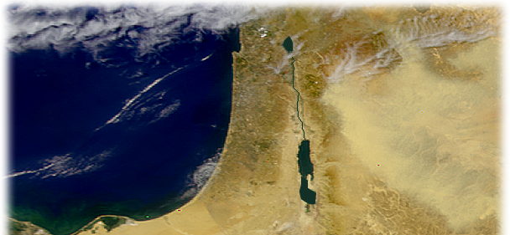

In Acts 8 it was
Remaining in Jerusalem
vs. Acts 1:8

Slide 5
Sometimes
We Need a Nudge to Get Us to Move …
Sometimes He nudges with …

Slide 6
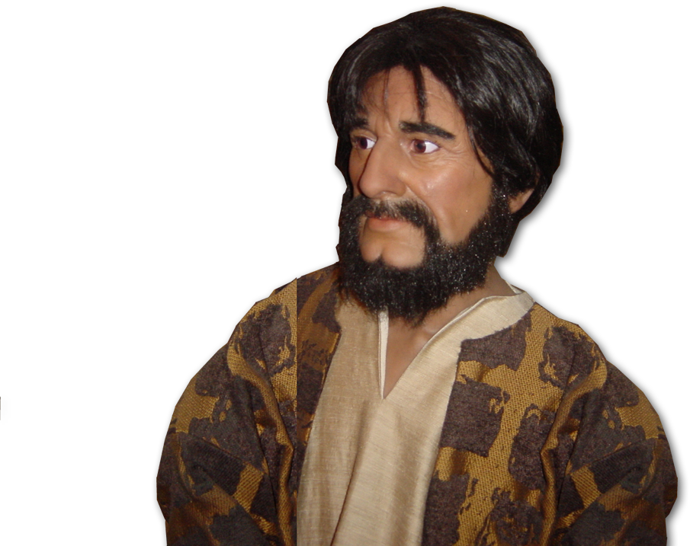
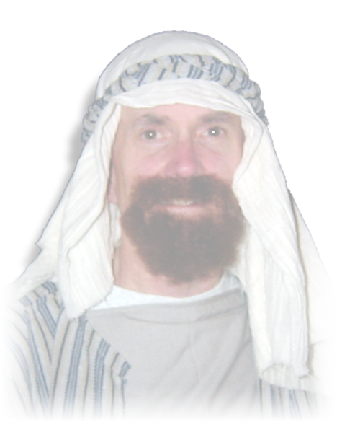
A Persecutor
¹ And Saul was there, giving approval to his death.
² Godly men buried Stephen
and mourned deeply for him.
Notes:
Steven and Paul are Bible Point photos. Free to use.

Slide 7
A Persecutor
¹ And Saul was there, giving approval to his death. On that day a great persecution broke out against the church
at Jerusalem, and all except
the apostles were scattered
throughout Judea and
Samaria.
² Godly men buried Stephen
and mourned deeply for him.
Notes:
Paul = Bible Point photos. Free to use.

Slide 8
A Persecutor
³ But Saul began to destroy the church. Going from house to house,
he dragged off men and
women and put them in prison.
Let’s complete the picture of Saul …
Notes:
Paul = Bible Point photos. Free to use.

Slide 9
A Persecutor
“unto the death” 22:4
“from one synagogue to another” 26:11
“to have them punished” 26:11
“force them to blaspheme” 26:11
“In my obsession against them,
I even went to foreign cities
to persecute them. Act 26:11
Notes:
Paul = Bible Point photos. Free to use.

Slide 10
A Persecutor
The Point:
⁴ Those who had been scattered
preached the word wherever they went.
Notes:
NASA map = public domain.

Slide 11

A PREACHER
The Point:
⁴ Those who had been scattered
preached the word wherever they went.
Notes:
Bible is a licensed photo. You may not reuse.

Slide 12
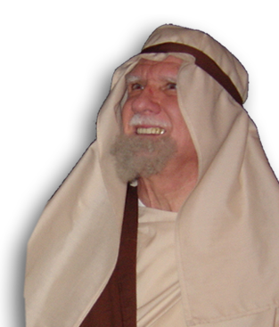
A Preacher
⁵ Philip went down to a city in Samaria and proclaimed the Christ there.
They chose Stephen, a man full of faith and of the Holy Spirit; also Philip, Procorus, Nicanor, Timon, Parmenas, and Nicolas from Antioch, a convert to Judaism. (6:5)
Notes:
Philip = Bible Point photo. Free to use.

Slide 13
A Preacher
⁵ Philip went down to a city in Samaria and proclaimed the Christ there.
)
Notes:
Map is a NASA photo = public domain.

Slide 14
A Preacher
1
2
⁶ When the crowds heard Philip and saw the miraculous signs he did, they all paid close attention to what he said.
⁷ With shrieks, evil spirits came
out of many, and many
paralytics and cripples
were healed.
⁸ So there was great joy in that city.
⁶ When the crowds heard Philip and saw the miraculous signs he did, they all paid close attention to what he said.
⁷ With shrieks, evil spirits came out of many, and many paralytics and cripples were healed.
⁸ So there was great joy in that city.
⁹ Now for some time a man named Simon had practiced sorcery in the city and amazed all the people of Samaria. He boasted that he was someone great,
¹⁰ and all the people, both high and low, gave him their attention and exclaimed, "This man is the divine power known as the Great Power."
¹¹ They followed him because he had amazed them for a long time with his magic.
¹² But when they believed Philip as he preached the good news of the kingdom of God and the name of Jesus Christ, they were baptized, both men and women.
¹³ Simon himself believed and was baptized. And he followed Philip everywhere, astonished by the great signs and miracles he saw.
(Act 8:5-13 NIV)
3
4
Notes:
Philip = Bible Point photo. Free to use.

Slide 15
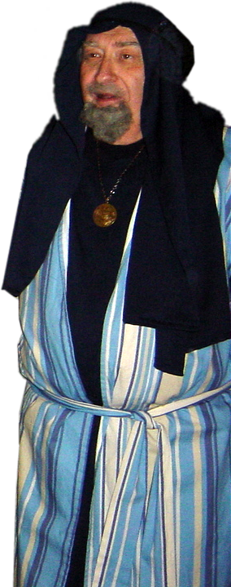
A Pretender
⁹ Now for some time a man named Simon
had practiced sorcery in the city and
amazed all the people of Samaria.
He boasted that he was someone
great, ¹⁰ and all the people, both
high and low, gave him their
attention and exclaimed, "This
man is the divine power
known as the Great Power."
Notes:
Simon = Bible Point photo free to use.

Slide 16
A pretender
¹¹ They followed him because he had amazed them for a long time with his
magic.
Notes:
Simon = Bible Point photo free to use.

Slide 17
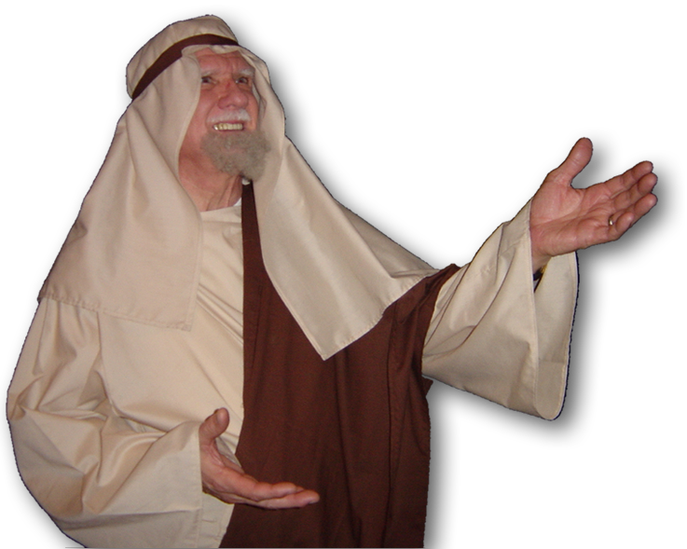
A pretender
2
¹² But when they believed Philip as he preached the good news of the kingdom
of God and the name of Jesus
Christ, they were baptized, both
men and women.
1
3
Notes:
Philip = Bible Point photo. Free to use.

Slide 18
A pretender
¹³ Simon himself believed and was baptized.
And he followed Philip
everywhere, astonished by
the great signs and miracles
he saw.
Notes:
Simon = Bible Point photo free to use.

Slide 19
A pretender
¹⁴ When the apostles in Jerusalem heard that Samaria had accepted the word of God, they sent Peter and John to them.
Notes:
This verse speaks to the accountability of it’s missionaries to the local church

Slide 20
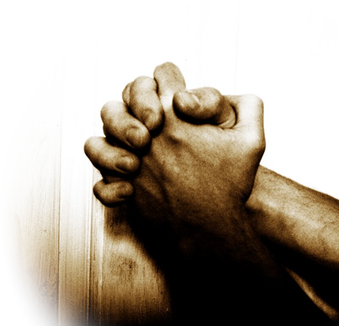
A pretender
¹⁵ When they arrived, they prayed for them that they might receive the Holy Spirit,
Notes:
Praying hands = FREE = sxc photo.

Slide 21


A pretender
¹⁶ because the Holy Spirit had not yet come upon any of them; they had simply been baptized into the name of the Lord Jesus.
Notes:
Water = Licensed = Not for reuse. From iStock_000006973332XSmall
Cloud = FREE = modified from dreamstimefree_257779

Slide 22
A pretender
¹⁷ Then Peter and John placed their hands on them, and they received the Holy Spirit.
Why the Delay?
We receive Him at point of faith.
(1 Cor 12:13)

Slide 23
A pretender
¹⁸ When Simon saw that the Spirit was given at the laying on of the apostles' hands, he offered them money ¹⁹ and said,
"Give me also this ability
so that everyone on whom
I lay my hands may receive
the Holy Spirit.”

Slide 24
A pretender
²⁰ Peter answered:
"May your money perish with you, because you thought you could buy the gift of God with money!

Slide 25
A pretender
²⁰ Peter answered:
²¹ You have no part or share in this ministry, because your heart is not right before God.

Slide 26
A pretender
²⁰ Peter answered:
²² Repent of this wickedness and pray to the Lord. Perhaps he will forgive you for having such a thought in your heart.

Slide 27
A pretender
²⁰ Peter answered:
²³ For I see that you are full of bitterness and captive to sin."
Simon’s Faith was not sincere …
Timothy’s Faith was sincere (Tim 1:5)
Notes:
AT Robertson “full of bitterness” = “in the gall of bitterness” = “a yellowish green, bile or gall”
Point is Peter is shrewd enough to see Simon’s offer as poison and a chain.
He was a charlatan – peddler of magic and spiritism– and never changed.

Slide 28
A pretender
²⁴ Then Simon answered,
"Pray to the Lord for me so
that nothing you have said
may happen to me.“
Notes:
Simon does not pray and repent – he tries to ward off the curse by having Peter intervene.
Peter’s assessment was accurate.

Slide 29
Let’s Sum up…
God gives us nudges to get out of our Boxes!
He can use just about anything …
A Persecutor – “Where are your difficulties leading you?”
A Preacher – “How does the preached message impact your life?”
Even a Pretender – “Is your faith genuine or are you in a ‘pretending’ box?”

Slide 30
Next Time …
a SEEKER gets out of His Box

Slide 31
Let’s Pray!

