Slide 1
ACTS 7:1-60
www.BiblePoint.com
2011 © Single Initiative LLC
Notes:
Copyright © 2000-2011. All rights reserved. Bible Point is a registered trademark of Single Initiative, LLC. All other trademarks acknowledged.
Bible Point contains graphics from Bible Point artists. These illustrations belong to Bible Point and the respective artists. You may use the designs and illustrations for graphical illustration of lessons free and without special permission, provided they are not used in any way that maligns the Christian faith. Furthermore, republication or production of any illustration by any other graphic service whether it be in book, in a machine-readable form, or in any other design resource is strictly prohibited. Furthermore, they cannot be duplicated or resold as any other form of publishing, clip art, or graphic resource.
So What does it mean? (A simple translations of the legal jargon)
So, if you don’t own the presentation(s), graphic(s), and text(s) how can you legally use them? The purchase of the license allows you to use all the images in the product. However, the actual ownership and copyright of the presentation(s), graphic(s), and text(s) remain the property of Bible Point and its licensors. If you had plans on using this product in your “for sale” work—think again!
License Agreement
Article 1: License Grant
All the graphics and text in Bible Point presentations (excluding quotes from the Bible and stated sources) are the intellectual and real property of Bible Point and its licensors, and is protected by law, including United States copyright laws and international treaties. Bible Point grants to you a license:
1. To use the presentation in a single church, single school, or single office of a Christian organization.
2. To make a single archival back-up copy of the program.
3. To modify the presentation(s) and merge with other presentations in a single church, school, or Christian organization.
4. To transfer to another party if that party agrees to accept the terms and conditions of this agreement, and you do not retain any copies of the presentation, whether printed, machine readable, modified, or merged form.
Article 2: Terms
This license is effective until terminated. You may terminate the license at any time by destroying the presentation(s), graphic(s), or text(s) together with all copies, modifications and merged portions in any form. Bible Point may terminate your license if you fail to comply with this Agreement. You agree, upon such termination, for any reason, to destroy the presentation(s), graphics, and text(s) with all copies, modifications, and merged portions in any form.
Article 3: Disclaimers
1. Bible Point presentations, graphics, and texts are licensed to you As Is. You, the consumer, bear the entire risk relating to the quality and performance of the presentation(s), graphic(s), or text(s). In no event will Bible Point be liable for damages resulting from any defect.
2. Thirty-day limited warrantee on disks. Bible Point warrants the disks to be free of defects in material and workmanship under normal use for 30 days after purchase. During the 30-day period you may return a defective presentation, graphic, or text with proof of purchase and it will be replaced without charge, unless the presentation is damaged by misuse.
Article 4: General
1. You may not sub-license, assign, or transfer the license of the presentation(s), graphic(s), or text(s) except as provided by this Agreement.
2. This Agreement will be governed by the laws of the State of Michigan.
So What does it mean? (A simple translations of the legal jargon)
May I let someone borrow or copy my licensed Bible Point presentation (even after I modified it)? As long as it is within your local church, or single school, or the immediate office of a Christian organization you may. Otherwise, please refer the person interested in borrowing to: http://www.biblepoint.com or E-mail: dh@biblepoint.com with any related questions.
---------------------------------------------------------------------------------------------------------------------------
Scripture taken from the HOLY BIBLE, NEW INTERNATIONAL VERSION®. NIV®. Copyright©1973, 1978, 1984 by International Bible Society. Used by permission of Zondervan. All rights reserved.

Slide 2
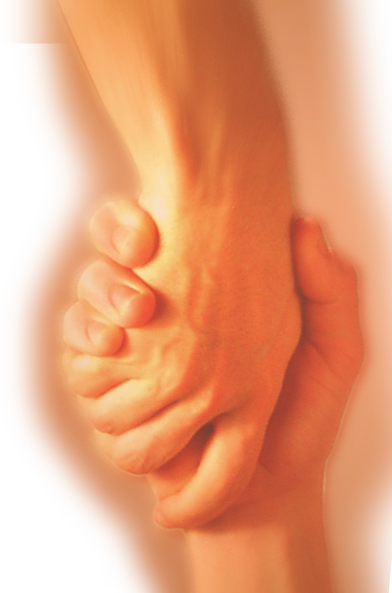
A Study in the
Book of ACTS
D
I
F
F
E
R
E
N
C
E
making a
Notes:
Difference

Slide 3
The Ultimate PRICE that Makes a Difference
The real question is …

Slide 4
What are you willing to stake your life on?
Science?
Technology?
America?
Your job or career?
Your possessions?
Your friends?
Your family?
Your Bible?

Slide 5

Stephen staked his life on
The Bible
Notes:
Open Book = FREE = See previous lesson

Slide 6
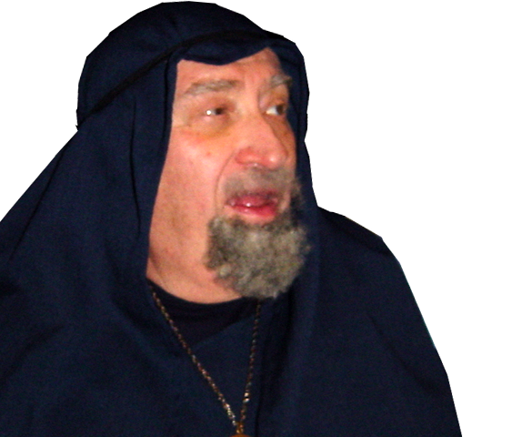
He was accused of two blasphemes:
"This fellow never stops speaking against this holy place and against the law.
1
Notes:
Man = FREE = BiblePoint photo

Slide 7
He was accused of two blasphemes:
"This fellow never stops speaking against this holy place and against the law.
2
Such accusations could lead to death!

Slide 8
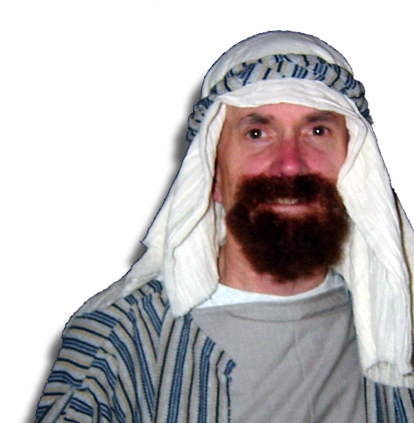
He staked his faith/life on
The BIBLE
Its HISTORICITY
Its PERSONALITIES
Its APPLICABILITY
Notes:
Stephen = FREE = BiblePoint photo

Slide 9
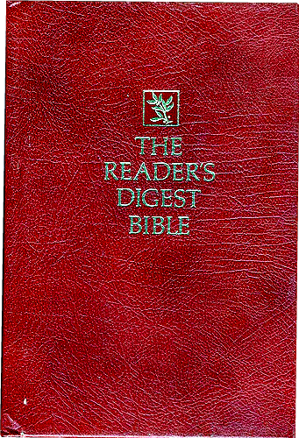
Staked on the BIBLE
He Digested the Bible
to answer the charges against him.

Slide 10
Staked on HISTORY
Inerrant Historical Narrative

Slide 11
Staked on PERSONALITIES
Abraham (and Patriarchs)
Joseph
Moses (and Aaron)
David
Solomon
BIBLCAL
HISTORICAL
PERSONALITIES
APPLICABLE

Slide 12
Let’s digest Stephen’s digest
He begins answering the second accusation first …
"This fellow never stops speaking against this holy place and against the law. ¹⁴
2

Slide 13
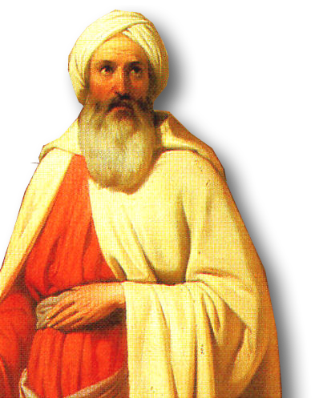
Begins with Abraham
“The God of glory appeared to our father Abraham while he was still in Mesopotamia, before he lived in Haran.”
Notes:
Abraham picture free from http://commons.wikimedia.org/wiki/File:Moln%C3%A1r_%C3%81brah%C3%A1m_kik%C3%B6lt%C3%B6z%C3%A9se_1850.jpg

Slide 14
Begins with Abraham
³ 'Leave your country and your people,' God said, 'and go to the land I will show you.‘
⁴ "So he left ….
He OBEYED
because
he believed

Slide 15
Begins with Abraham
⁵ … no inheritance here, not even a foot of ground …
⁷ But God promised him that he and his descendants after him would possess the land …
⁸ father of Isaac …
father of Jacob …
father of 12 patriarchs
He OBEYED
because
he believed
the promise
and God
blessed him.

Slide 16
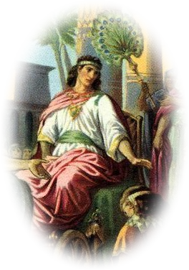
Highlights Joseph
⁹ "Because the patriarchs were jealous of Joseph, they sold him as a slave into Egypt. But God was with him…
Notes:
Coat of Many Colors was NOT labeled from http://newsyoucanbelieve.com/bible/wp-content/uploads/2010/01/Joseph-Coat-of-Many-colors.jpg

Slide 17
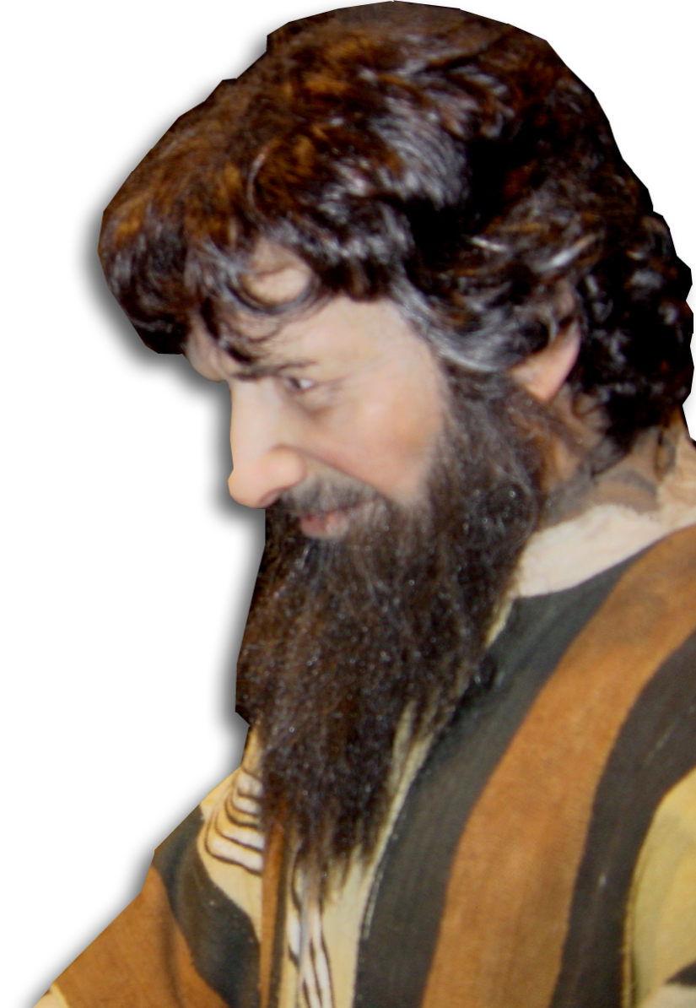
Highlights Joseph
⁹ "Because the patriarchs were jealous of Joseph, they sold him as a slave into Egypt. But God was with him…
¹⁷ Then the high priest and
all his associates…were filled with jealousy. Act 5:17
Notes:
Joseph = FREE for reuse from BiblePoin photos.

Slide 18
Highlights Joseph
⁹ "Because the patriarchs were jealous of Joseph, they sold him as a slave into Egypt.

Slide 19
Highlights Joseph
⁹ "Because the patriarchs were jealous of Joseph, they sold him as a slave into Egypt. But God was with him…
¹⁰ … made him ruler over Egypt
You’ve sold out
your Savior too!

Slide 20
Highlights Joseph
¹⁸ Then another king, who knew nothing about Joseph, became ruler of Egypt. ¹⁹ He dealt treacherously with our people …

Slide 21
Now MOSES
²⁰ "At that time Moses was born, …

Slide 22
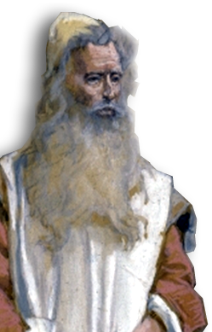
Now MOSES
²³ "When Moses was forty years old, he
decided to visit his fellow Israelites.
²⁴ He saw one of them being
mistreated by an Egyptian, so he
went to his defense and avenged
him by killing the Egyptian

Slide 23
Now MOSES
²⁵ Moses thought that his
own people would realize that God was using him to rescue them, but they did not.
Notes:
Moses public domain http://upload.wikimedia.org/wikipedia/commons/4/44/Tissot_Moses.jpg

Slide 24
Now MOSES
²⁵ Moses thought that his
own people would realize that God was using him to rescue them, but they did not.
SAVE
Notes:
Moses public domain http://upload.wikimedia.org/wikipedia/commons/4/44/Tissot_Moses.jpg

Slide 25
They MISSED IT!
²⁶ The next day … He tried to reconcile … [his] brothers…. ²⁷ "But … [one] said,
'Who made you ruler and judge over us? ²⁸ Do you want to kill me as you
killed the Egyptian …?’
Moses fled
Notes:
Moses public domain http://upload.wikimedia.org/wikipedia/commons/4/44/Tissot_Moses.jpg

Slide 26
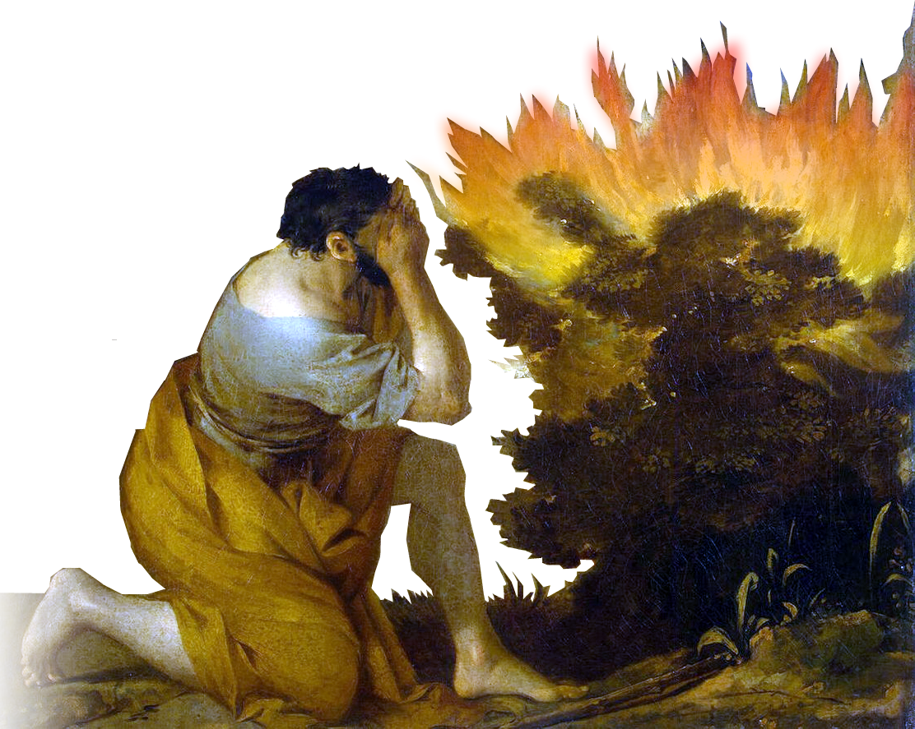
Moses Again!
³⁰ "After forty years had passed, an angel appeared to Moses in the flames of a burning bush …
Notes:
Moses public domain http://upload.wikimedia.org/wikipedia/commons/4/44/Tissot_Moses.jpg
BURNING BUSH free from http://upload.wikimedia.org/wikipedia/commons/4/49/Bourdon%2C_S%C3%A9bastien_-_Burning_bush.jpg

Slide 27
The Point
³⁵ "This is the same Moses whom they had rejected with the words, 'Who made you
ruler and judge?' He was sent to be
their ruler and deliverer
by God himself,
through the angel
who appeared to
him in the bush.
Notes:
Moses public domain http://upload.wikimedia.org/wikipedia/commons/4/44/Tissot_Moses.jpg
BURNING BUSH free from http://upload.wikimedia.org/wikipedia/commons/4/49/Bourdon%2C_S%C3%A9bastien_-_Burning_bush.jpg

Slide 28
The Point
³⁵ "This is the same Moses whom they had rejected with the words, 'Who made you
ruler and judge?' He was sent to be
their ruler and deliverer
by God himself,
through the angel
who appeared to
him in the bush.
Notes:
Moses public domain http://upload.wikimedia.org/wikipedia/commons/4/44/Tissot_Moses.jpg
BURNING BUSH free from http://upload.wikimedia.org/wikipedia/commons/4/49/Bourdon%2C_S%C3%A9bastien_-_Burning_bush.jpg

Slide 29
Stephen’s Point
³⁵ "This is the same Moses whom they had rejected with the words, 'Who made you
ruler and judge?' He was sent to be
their ruler and deliverer
by God himself,
through the angel
who appeared to
him in the bush.
Redeemer
Notes:
Moses public domain http://upload.wikimedia.org/wikipedia/commons/4/44/Tissot_Moses.jpg
BURNING BUSH free from http://upload.wikimedia.org/wikipedia/commons/4/49/Bourdon%2C_S%C3%A9bastien_-_Burning_bush.jpg

Slide 30
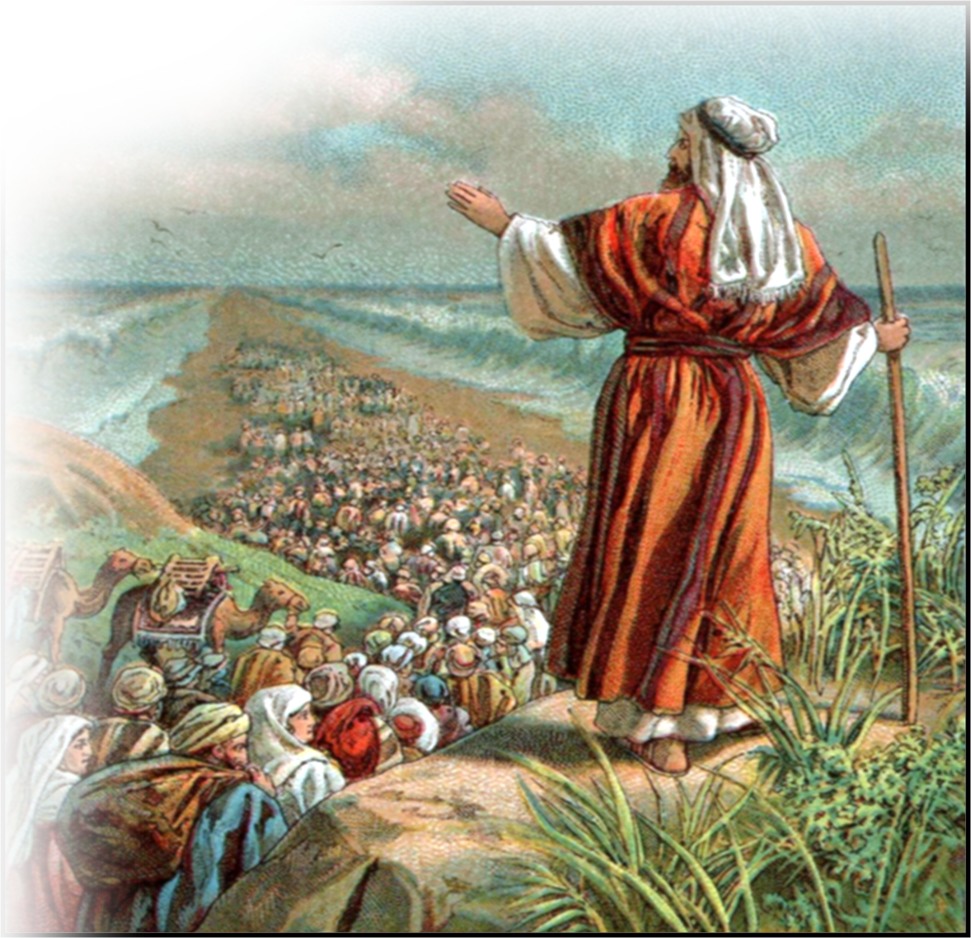
Furthermore
³⁶ He led them out of Egypt and did wonders and miraculous signs
in Egypt, at the Red Sea and
for forty years in
the desert.
Notes:
Moses public domain http://upload.wikimedia.org/wikipedia/commons/4/44/Tissot_Moses.jpg
BURNING BUSH free from http://upload.wikimedia.org/wikipedia/commons/4/49/Bourdon%2C_S%C3%A9bastien_-_Burning_bush.jpg

Slide 31
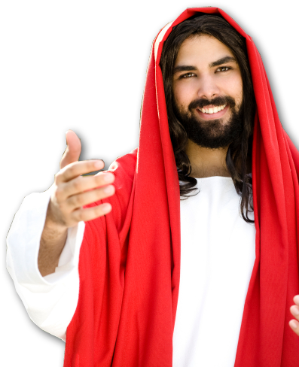
The Point:
³⁷ "This is that Moses who told the Israelites,
'God will send you a prophet like me from your own people.'
Notes:
Moses public domain http://upload.wikimedia.org/wikipedia/commons/4/44/Tissot_Moses.jpg
BURNING BUSH free from http://upload.wikimedia.org/wikipedia/commons/4/49/Bourdon%2C_S%C3%A9bastien_-_Burning_bush.jpg

Slide 32
The Point:
³⁷ "This is that Moses who told the Israelites,
'God will send you a prophet like me from your own people.'
³⁹ "But our fathers refused
to obey him. Instead, they rejected him and in their hearts turned back to Egypt.
Notes:
Moses public domain http://upload.wikimedia.org/wikipedia/commons/4/44/Tissot_Moses.jpg
BURNING BUSH free from http://upload.wikimedia.org/wikipedia/commons/4/49/Bourdon%2C_S%C3%A9bastien_-_Burning_bush.jpg

Slide 33
The Point:
³⁷ "This is that Moses who told the Israelites,
'God will send you a prophet like me from your own people.'
³⁹ "But our fathers refused
to obey him. Instead, they rejected him and in their hearts turned back to Egypt.
Notes:
Moses public domain http://upload.wikimedia.org/wikipedia/commons/4/44/Tissot_Moses.jpg
BURNING BUSH free from http://upload.wikimedia.org/wikipedia/commons/4/49/Bourdon%2C_S%C3%A9bastien_-_Burning_bush.jpg

Slide 34
The Point:
³⁷ "This is that Moses who told the Israelites,
'God will send you a prophet like me from your own people.'
³⁹ "But our fathers refused
to obey him. Instead, they rejected him and in their hearts turned back to Egypt.
Notes:
Moses public domain http://upload.wikimedia.org/wikipedia/commons/4/44/Tissot_Moses.jpg
BURNING BUSH free from http://upload.wikimedia.org/wikipedia/commons/4/49/Bourdon%2C_S%C3%A9bastien_-_Burning_bush.jpg

Slide 35
The Point:
³⁷ "This is that Moses who told the Israelites,
'God will send you a prophet like me from your own people.'
³⁹ "But our fathers refused
to obey him. Instead, they rejected him and in their hearts turned back to Egypt.
Notes:
Moses public domain http://upload.wikimedia.org/wikipedia/commons/4/44/Tissot_Moses.jpg
BURNING BUSH free from http://upload.wikimedia.org/wikipedia/commons/4/49/Bourdon%2C_S%C3%A9bastien_-_Burning_bush.jpg

Slide 36
Re: The First Accusation
"This fellow never stops speaking against this holy place and against the law.
1

Slide 37
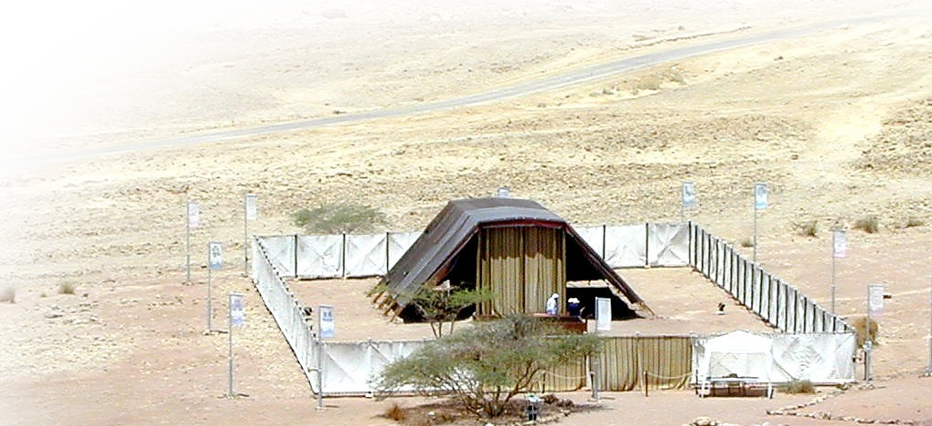
The Tabernacle:
⁴⁴ "Our forefathers had the tabernacle of the Testimony with them in the desert. It had been made as God directed Moses,
Notes:
Tabernacle free from http://www.bibleplaces.com/images/Tabernaclefromabove,tbn052201.jpg

Slide 38
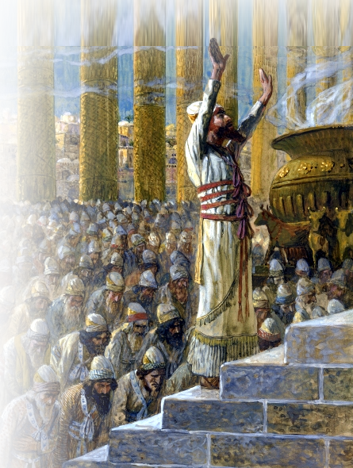
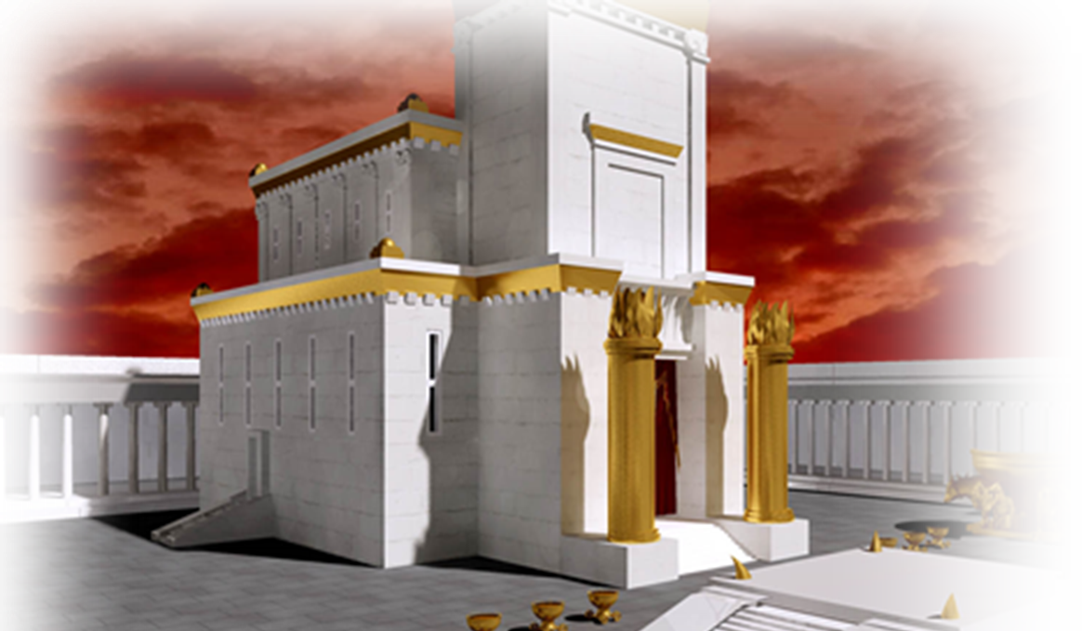
The Temple:
⁴⁷ But it was Solomon who built the house for him.
Notes:
Temple free from http://commons.wikimedia.org/wiki/File:Tissot_Solomon_Dedicates_the_Temple_at_Jerusalem.jpg

Slide 39
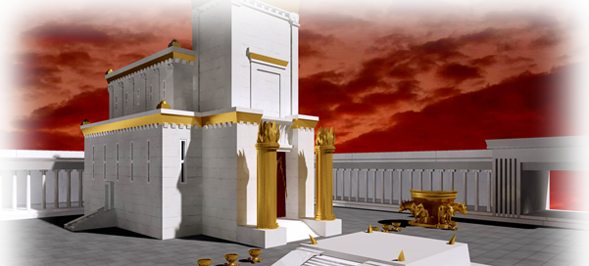
The Temple:
"However, the Most High does not live in houses made by men. As the prophet says:
⁴⁹ " 'Heaven is my throne, and the earth is my footstool.
It’s not the building that matters!

Slide 40
The Application:
⁵¹ "You stiff-necked people, with uncircumcised hearts and ears! You are just like your fathers: You always resist the Holy Spirit!

Slide 41
The Application:
⁵² Was there ever a prophet your fathers did not persecute? They even killed those who predicted the coming of the Righteous One.

Slide 42
The Application:
And now you have betrayed and murdered him-- ⁵³ you who have received the law that was put into effect through angels but have not obeyed it.”

Slide 43
The Application:
And now you have betrayed and murdered him-- ⁵³ you who have received the law that was put into effect through angels but have not obeyed it.”
Notes:
Stephen = Free = see previous lesson

Slide 44
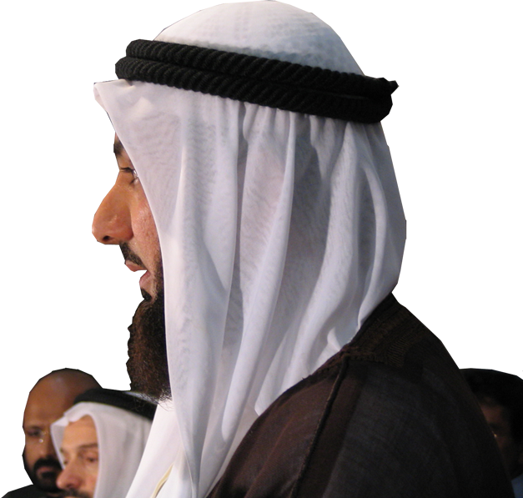
The Results:
They were “furious” 7:54
They “gnashed” at him 7:54
They “dragged him out” 7:58
They stoned him. 7:59
Notes:
Others = Free = see previous lesson

Slide 45
The Results:
⁵⁵ But Stephen, full of the Holy Spirit, looked up to heaven and saw the glory of God, and Jesus standing at the right hand of God.
⁵⁶ "Look, … I see heaven
open and the Son of Man
standing at the right
hand of God."

Slide 46
The Results:
Stephen prayed,
"Lord Jesus, receive my spirit."
⁶⁰ Then he fell …and
cried out,
"Lord, do not hold this sin
against them."
… he fell asleep.

Slide 47
Let’s Sum Up:
His life made a difference because:
He STAKED his life on the Word of God!
What do you stake your life on?

Slide 48
Let’s Sum Up:
He was UNLIKE those who:
Sold out the Lord
Refused to obey the Lord
Rejected the Lord
Turned back from the Lord
He was LIKE Abraham who:
Obeyed because he believed.
Who are you LIKE? Who do you believe?

Slide 49
Let’s Sum Up:
He died for it—because he lived it!
What are you willing to die for?
What are you living for?
In the end He saw “the Glory of God”
What will you see?

Slide 50
Let’s PRAY

