Slide 1
ACTS 6:1-15
www.BiblePoint.com
2011 © Single Initiative LLC
Notes:
Copyright © 2000-2011. All rights reserved. Bible Point is a registered trademark of Single Initiative, LLC. All other trademarks acknowledged.
Bible Point contains graphics from Bible Point artists. These illustrations belong to Bible Point and the respective artists. You may use the designs and illustrations for graphical illustration of lessons free and without special permission, provided they are not used in any way that maligns the Christian faith. Furthermore, republication or production of any illustration by any other graphic service whether it be in book, in a machine-readable form, or in any other design resource is strictly prohibited. Furthermore, they cannot be duplicated or resold as any other form of publishing, clip art, or graphic resource.
So What does it mean? (A simple translations of the legal jargon)
So, if you don’t own the presentation(s), graphic(s), and text(s) how can you legally use them? The purchase of the license allows you to use all the images in the product. However, the actual ownership and copyright of the presentation(s), graphic(s), and text(s) remain the property of Bible Point and its licensors. If you had plans on using this product in your “for sale” work—think again!
License Agreement
Article 1: License Grant
All the graphics and text in Bible Point presentations (excluding quotes from the Bible and stated sources) are the intellectual and real property of Bible Point and its licensors, and is protected by law, including United States copyright laws and international treaties. Bible Point grants to you a license:
1. To use the presentation in a single church, single school, or single office of a Christian organization.
2. To make a single archival back-up copy of the program.
3. To modify the presentation(s) and merge with other presentations in a single church, school, or Christian organization.
4. To transfer to another party if that party agrees to accept the terms and conditions of this agreement, and you do not retain any copies of the presentation, whether printed, machine readable, modified, or merged form.
Article 2: Terms
This license is effective until terminated. You may terminate the license at any time by destroying the presentation(s), graphic(s), or text(s) together with all copies, modifications and merged portions in any form. Bible Point may terminate your license if you fail to comply with this Agreement. You agree, upon such termination, for any reason, to destroy the presentation(s), graphics, and text(s) with all copies, modifications, and merged portions in any form.
Article 3: Disclaimers
1. Bible Point presentations, graphics, and texts are licensed to you As Is. You, the consumer, bear the entire risk relating to the quality and performance of the presentation(s), graphic(s), or text(s). In no event will Bible Point be liable for damages resulting from any defect.
2. Thirty-day limited warrantee on disks. Bible Point warrants the disks to be free of defects in material and workmanship under normal use for 30 days after purchase. During the 30-day period you may return a defective presentation, graphic, or text with proof of purchase and it will be replaced without charge, unless the presentation is damaged by misuse.
Article 4: General
1. You may not sub-license, assign, or transfer the license of the presentation(s), graphic(s), or text(s) except as provided by this Agreement.
2. This Agreement will be governed by the laws of the State of Michigan.
So What does it mean? (A simple translations of the legal jargon)
May I let someone borrow or copy my licensed Bible Point presentation (even after I modified it)? As long as it is within your local church, or single school, or the immediate office of a Christian organization you may. Otherwise, please refer the person interested in borrowing to: http://www.biblepoint.com or E-mail: dh@biblepoint.com with any related questions.
---------------------------------------------------------------------------------------------------------------------------
Scripture taken from the HOLY BIBLE, NEW INTERNATIONAL VERSION®. NIV®. Copyright©1973, 1978, 1984 by International Bible Society. Used by permission of Zondervan. All rights reserved.

Slide 2

A Study in the
Book of ACTS
D
I
F
F
E
R
E
N
C
E
making a
Notes:
Difference

Slide 3
The PROBLEMS that Makes a Difference
INTERNAL = Inside the Church
EXTERNAL = Outside the Church

Slide 4
Internal Problems:

Slide 5
SOURCE OF THE PROBLEM
¹ In those days when the number of disciples was increasing, the Grecian Jews among them complained against the Hebraic Jews because their widows were being overlooked in the daily distribution of food.
2,000
7,000
5,000
More
CHANGE!

Slide 6
NATURE OF THE PROBLEM
¹ In those days when the number of disciples was increasing, the Grecian Jews among them complained against the Hebraic Jews because their widows were being overlooked in the daily distribution of food.
“wasn’t like this until they came along …”

Slide 7
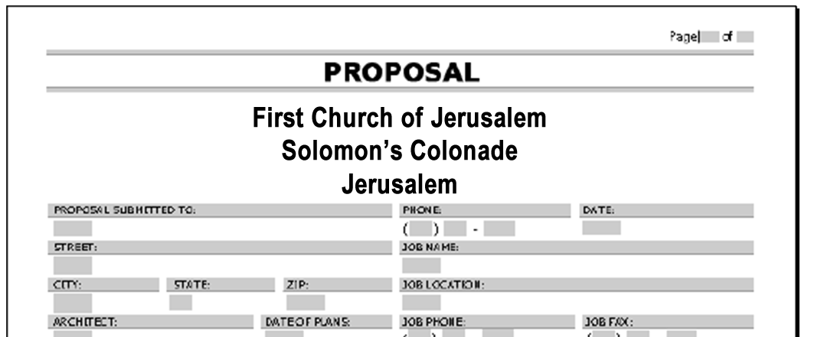
SOLUTION TO THE PROBLEM
² So the Twelve gathered all the disciples together and said, [verses 2-4]
⁵ This proposal

Slide 8

How NOT to solve a problem
"It would not be right for us to neglect the ministry of the word of God in order to wait on tables.

Slide 9
How NOT to solve a problem
"It would not be right for us to neglect the ministry of the word of God in order to wait on tables.

Slide 10
How NOT to solve a problem
διακονεῖν
to deacon
"It would not be right for us to neglect the ministry of the word of God in order to wait on tables.

Slide 11
HOW TO solve the problem

Slide 12
1. SELECT the right people
o x ³ Brothers, choose seven men from among you who are known to be
full of the Spirit and wisdom. We will turn this responsibility over to them

Slide 13
2. Select the RIGHT people
o x ³ Brothers, choose seven men from among you who are known to be
full of the Spirit and wisdom. We will turn this responsibility over to them
For a church of at least 7,000 people

Slide 14
3. Select REPUTABLE people
o x ³ Brothers, choose seven men from among you who are known to be
full of the Spirit and wisdom. We will turn this responsibility over to them

Slide 15
4. ASSIGN the right people
o x ³ Brothers, choose seven men from among you who are known to be
full of the Spirit and wisdom. We will turn this responsibility over to them
WHY?

Slide 16
5. FREE UP the right people
o x ⁴ and [WE] will give our attention to prayer and the ministry of the word."

Slide 17
RESULTS of the Problem

Slide 18
RESULTS of the Problem
⁵ This proposal pleased the whole group. They chose Stephen, a man full of faith
and of the Holy Spirit; also Philip, Procorus, Nicanor, Timon, Parmenas, and Nicolas from Antioch, a convert to Judaism.

Slide 19
RESULTS of the Problem
⁵ This proposal pleased the whole group. They chose Stephen, a man full of faith
and of the Holy Spirit; also Philip, Procorus, Nicanor, Timon, Parmenas, and Nicolas from Antioch, a convert to Judaism.
o x

Slide 20
RESULTS of the Problem
⁵ This proposal pleased the whole group. They chose Stephen, a man full of faith
and of the Holy Spirit; also Philip, Procorus, Nicanor, Timon, Parmenas, and Nicolas from Antioch, a convert to Judaism.
o x

Slide 21
RESULTS of the Problem
⁵ This proposal pleased the whole group. They chose Stephen, a man full of faith
and of the Holy Spirit; also Philip, Procorus, Nicanor, Timon, Parmenas, and Nicolas from Antioch, a convert to Judaism.
1
2
3
4
5
6
7
o x

Slide 22
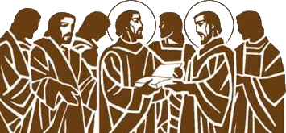
RESULTS of the Problem
⁶ They presented these men to the apostles, who prayed and laid their hands on them.
First Deacons
Notes:
Replace this deacon image from http://3.bp.blogspot.com/_9dgygL2C9zg/TDk-sSEOOpI/AAAAAAAAAAU/ZIcavCmOZSU/s1600/7deacons1.jpg

Slide 23
RESULTS of the Problem
⁶ They presented these men to the apostles, who prayed and laid their hands on them.

Slide 24
RESULTS of the Problem
⁶ They presented these men to the apostles, who prayed and laid their hands on them.
Now organized

Slide 25

RESULTS of the Problem
⁷ So the word of God spread. The number of disciples in Jerusalem increased rapidly, and a large number of priests became obedient to the faith.
Notes:
Open book = FREE = dreamstimefree_823501

Slide 26
RESULTS of the Problem
⁷ So the word of God spread. The number of disciples in Jerusalem increased rapidly, and a large number of priests became obedient to the faith.
Increased
More
7,000
5,000
2,000

Slide 27
External Problems:

Slide 28
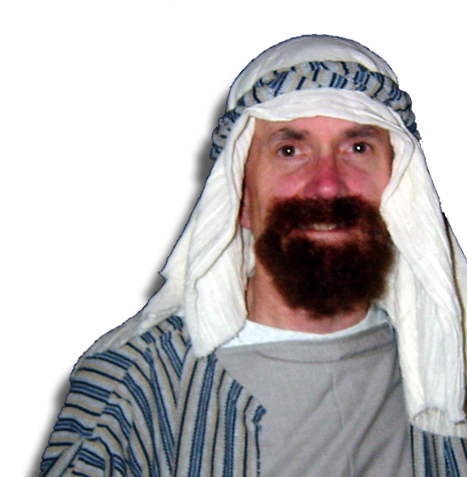
Focus of External Problems:
⁸ Now Stephen, a man full of God's grace and power, did great wonders and miraculous signs among the
people.
³ … full of the Spirit and wisdom
⁵ … a man full of faith
and of the Holy Spirit
Notes:
Stephen = FREE = BiblePoint photo

Slide 29
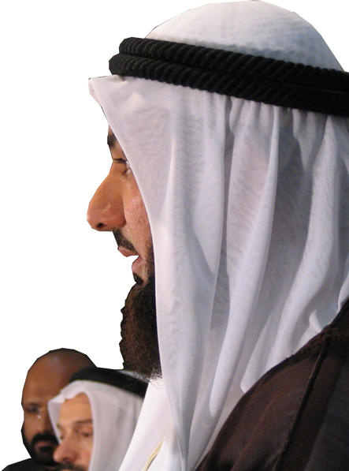
ID of External Problems:
⁹ Opposition arose, however, from members of the Synagogue of the Freedmen (as it was called)—
Jews of Cyrene and Alexandria
as well as the provinces of
Cilicia and Asia. These men
began to argue with Stephen,
Notes:
Middle Eastern clothed man free from = http://commons.wikimedia.org/wiki/File:Agal_%28accessory%29.jpg

Slide 30
Countering External Problems:
¹⁰ but they could not stand up against his wisdom or the Spirit by whom
he spoke.

Slide 31
Evil of the External Problems:
¹¹ Then they secretly persuaded
some men to say,
"We have heard Stephen
speak words of blasphemy
against Moses and against
God.“

Slide 32
Evil of the External Problems:
¹² So they stirred up the people and
the elders and the teachers of
the law. They seized Stephen
and brought him before the
Sanhedrin.
¹³ They produced false witnesses,
who testified,

Slide 33
Evil of the External Problems:
¹² So they stirred up the people and
the elders and the teachers of
the law. They seized Stephen
and brought him before the
Sanhedrin.
¹³ They produced false witnesses,
who testified,

Slide 34
Evil of the External Problems:
¹² So they stirred up the people and
the elders and the teachers of
the law. They seized Stephen
and brought him before the
Sanhedrin.
¹³ They produced false witnesses,
who testified,

Slide 35
Evil of the External Problems:
¹² So they stirred up the people and
the elders and the teachers of
the law. They seized Stephen
and brought him before the
Sanhedrin.
¹³ They produced false witnesses,
who testified,

Slide 36
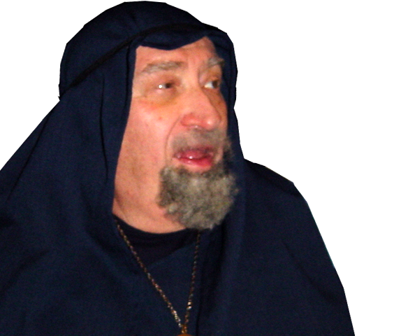
Evil of the External Problems:
"This fellow never stops speaking against this holy place and against the law. ¹⁴ For we have heard him say that this Jesus of Nazareth will destroy this place and change the customs Moses handed down to us.”
Notes:
Man = FREE = BiblePoint photo.

Slide 37
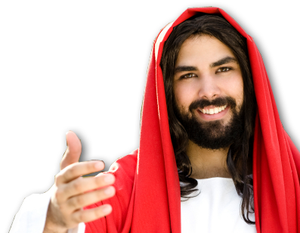
Evil of the External Problems:
"This fellow never stops speaking against this holy place and against the law. ¹⁴ For we have heard him say that this Jesus of Nazareth will destroy this place and change the customs Moses handed down to us.”
"Destroy this temple, and I will raise it again in three days."
(John 2:19)
Notes:
Jesus = Licensed NOT for Reuse = see previous lessons.

Slide 38
Evil of the External Problems:
"This fellow never stops speaking against this holy place and against the law. ¹⁴ For we have heard him say that this Jesus of Nazareth will destroy this place and change the customs Moses handed down to us.”
¹⁷ "Do not think that I have come to abolish the Law or the Prophets; I have not come to abolish them but to fulfill them.” (Mat 5:17)

Slide 39

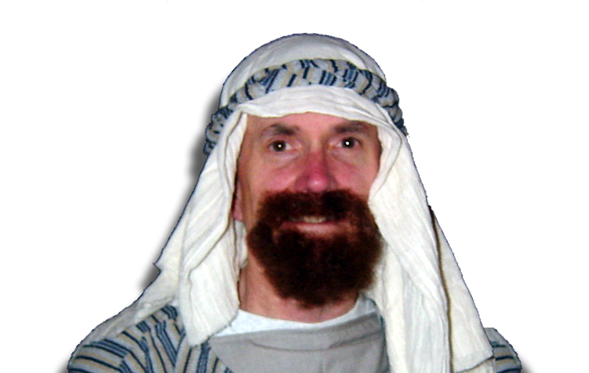
Victory Over External Problems:
¹⁵ All who were sitting in the Sanhedrin looked intently at Stephen, and they saw that his face was like the face of an angel.
Notes:
Stephen = FREE = BiblePoint photo.

Slide 40
Final Thoughts:
As Christians we face two sets of problems:
Internal = within the Church
External = outside the Church
Spiritual Victory comes from the “Fullness:”
Full of the Spirit 6:3
Full of Wisdom 6:3
Full of Faith 6:5
Full of God’s Grace 6:8
Full of Power 6:8
He Truly Made
A Difference
Notes:
He truly made a difference—next time we will see how—
He impacts one life—that changed the course of Western Civilization.
That one life is Saul, who later became Paul the Apostle.

Slide 41
Let’s PRAY

