Slide 1
ACTS 5:12-42
www.BiblePoint.com
2011 © Single Initiative LLC
Notes:
Copyright © 2000-2011. All rights reserved. Bible Point is a registered trademark of Single Initiative, LLC. All other trademarks acknowledged.
Bible Point contains graphics from Bible Point artists. These illustrations belong to Bible Point and the respective artists. You may use the designs and illustrations for graphical illustration of lessons free and without special permission, provided they are not used in any way that maligns the Christian faith. Furthermore, republication or production of any illustration by any other graphic service whether it be in book, in a machine-readable form, or in any other design resource is strictly prohibited. Furthermore, they cannot be duplicated or resold as any other form of publishing, clip art, or graphic resource.
So What does it mean? (A simple translations of the legal jargon)
So, if you don’t own the presentation(s), graphic(s), and text(s) how can you legally use them? The purchase of the license allows you to use all the images in the product. However, the actual ownership and copyright of the presentation(s), graphic(s), and text(s) remain the property of Bible Point and its licensors. If you had plans on using this product in your “for sale” work—think again!
License Agreement
Article 1: License Grant
All the graphics and text in Bible Point presentations (excluding quotes from the Bible and stated sources) are the intellectual and real property of Bible Point and its licensors, and is protected by law, including United States copyright laws and international treaties. Bible Point grants to you a license:
1. To use the presentation in a single church, single school, or single office of a Christian organization.
2. To make a single archival back-up copy of the program.
3. To modify the presentation(s) and merge with other presentations in a single church, school, or Christian organization.
4. To transfer to another party if that party agrees to accept the terms and conditions of this agreement, and you do not retain any copies of the presentation, whether printed, machine readable, modified, or merged form.
Article 2: Terms
This license is effective until terminated. You may terminate the license at any time by destroying the presentation(s), graphic(s), or text(s) together with all copies, modifications and merged portions in any form. Bible Point may terminate your license if you fail to comply with this Agreement. You agree, upon such termination, for any reason, to destroy the presentation(s), graphics, and text(s) with all copies, modifications, and merged portions in any form.
Article 3: Disclaimers
1. Bible Point presentations, graphics, and texts are licensed to you As Is. You, the consumer, bear the entire risk relating to the quality and performance of the presentation(s), graphic(s), or text(s). In no event will Bible Point be liable for damages resulting from any defect.
2. Thirty-day limited warrantee on disks. Bible Point warrants the disks to be free of defects in material and workmanship under normal use for 30 days after purchase. During the 30-day period you may return a defective presentation, graphic, or text with proof of purchase and it will be replaced without charge, unless the presentation is damaged by misuse.
Article 4: General
1. You may not sub-license, assign, or transfer the license of the presentation(s), graphic(s), or text(s) except as provided by this Agreement.
2. This Agreement will be governed by the laws of the State of Michigan.
So What does it mean? (A simple translations of the legal jargon)
May I let someone borrow or copy my licensed Bible Point presentation (even after I modified it)? As long as it is within your local church, or single school, or the immediate office of a Christian organization you may. Otherwise, please refer the person interested in borrowing to: http://www.biblepoint.com or E-mail: dh@biblepoint.com with any related questions.
---------------------------------------------------------------------------------------------------------------------------
Scripture taken from the HOLY BIBLE, NEW INTERNATIONAL VERSION®. NIV®. Copyright©1973, 1978, 1984 by International Bible Society. Used by permission of Zondervan. All rights reserved.

Slide 2
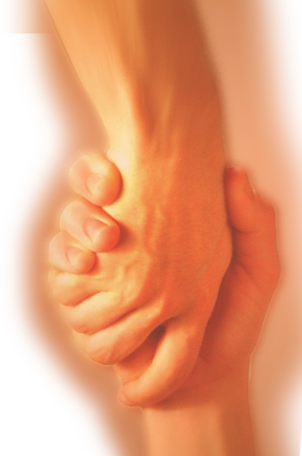
A Study in the
Book of ACTS
D
I
F
F
E
R
E
N
C
E
making a
Notes:
Difference

Slide 3
We left off with the idea...
¹¹ Great fear seized the whole church and all who heard about these events.
Fear led to OBEDIENCE

Slide 4
OBEDIENCE is
The PRACTICE that Makes a Difference

Slide 5
A Few Beginning Thoughts
1st -- But Samuel replied: "Does the LORD delight in burnt offerings and sacrifices as much as in obeying the voice of the LORD? To obey is better than sacrifice, and to heed is better than the fat of rams.
(1 Samuel 15:22)

Slide 6
A Few Beginning Thoughts
2nd-- Therefore go and make disciples of all nations, (Mat 28:19)
3rd -- I tell you the truth, anyone who has faith in me will do what I have been doing. He will do even greater things than these, because I am going to the Father. (John 14:12)

Slide 7
A Formula to make a
D
I
F
F
E
R
E
N
C
E
Obedience
+ Making Disciples
= Do great things!

Slide 8
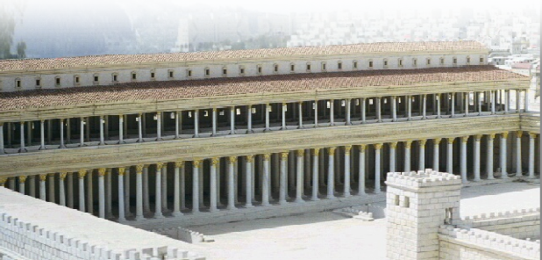
The FACT that Obedience
Makes a Difference
¹² The apostles performed many miraculous signs and wonders among the people. And all the believers used to meet together in Solomon's Colonnade.
Notes:
Temple court = FREE = see previous chapters

Slide 9
The FACT that Obedience
Makes a Difference
¹² The apostles performed many miraculous signs and wonders among the people. And all the believers used to meet together in Solomon's Colonnade.

Slide 10
The RESULTS of Obedience
Makes a Difference

Slide 11
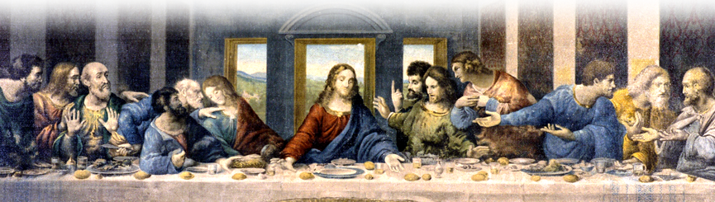
1—POSITIVE Results …
¹³ No one else dared join them, even though they were highly regarded by the people.
Notes:
Lord’s Supper = Lord’s Supper = Free = from http://upload.wikimedia.org/wikipedia/commons/4/44/La_C%C3%A8ne.JPG

Slide 12
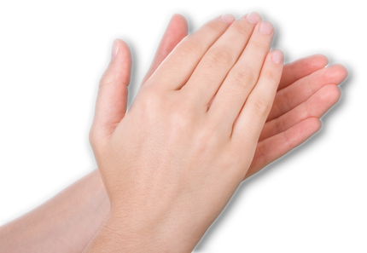
1—POSITIVE Results …
¹³ No one else dared join them, even though they were highly regarded by the people.
Notes:
Hand clapping = Licensed and NOT for reuse = dreamstime_8497532

Slide 13
1—POSITIVE Results …
¹⁴ Nevertheless, more and more men and women believed in the Lord and were added to their number.
2,000 -- Acts 2:42
? Added Daily -- Acts 2:47
5,000 men -- Acts 4:4
? More and More Acts 5:14
7,000 + (perhaps 20,000)

Slide 14

1—POSITIVE Results …
¹⁵ As a result, people brought the sick into the streets and laid them on beds and mats so that at least Peter's shadow might fall on some of them as he passed by. ¹⁶ Crowds gathered also from the towns around Jerusalem, bringing their sick and those tormented by evil spirits, and all of them were healed.
Notes:
Medical Symbol Credit Oliver Burston, Wellcome Images

Slide 15
2—NEGATIVE Results …

Slide 16
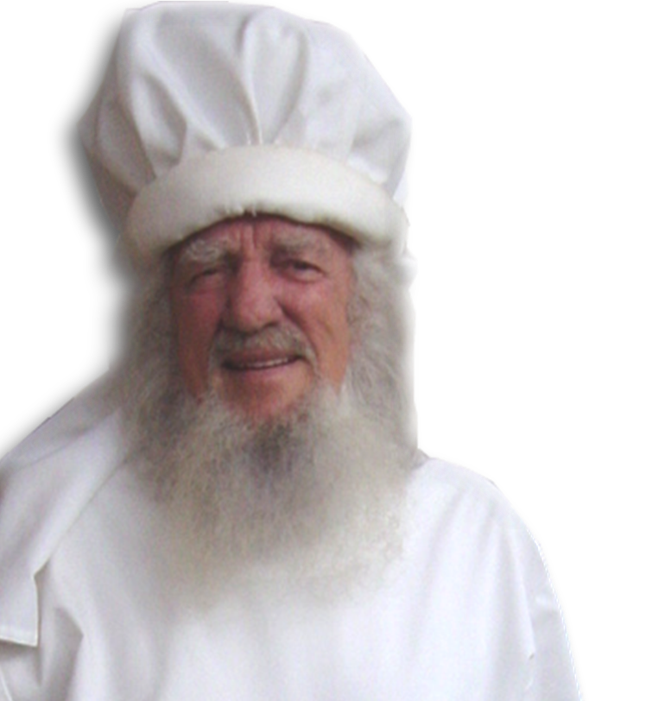
2—NEGATIVE Results …
¹⁷ Then the high priest and all his associates, who were members of the party of the Sadducees, were filled with jealousy.
Notes:
High Priest = FREE = BiblePoint photo

Slide 17
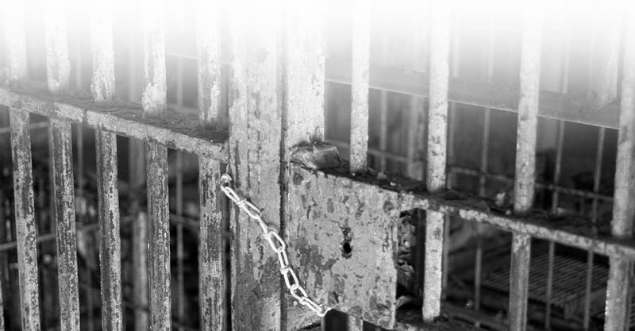
2—NEGATIVE Results …
¹⁸ They arrested the apostles and put them in the public jail
Notes:
Jail cell = FREE = sxc-1226063_47301727

Slide 18
RECOMMISIONED TO OBEY

Slide 19

WHEN Re-Commissioned
¹⁹ But during the night an angel of the Lord opened the doors of the jail and brought them out.
Notes:
Moon =

Slide 20
HOW Re-Commissioned
¹⁹ But during the night an angel of the Lord opened the doors of the jail and brought them out.

Slide 21
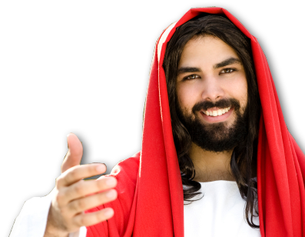
WHAT is Re-Commissioned
²⁰ "Go, stand in the temple courts," he said, "and tell the people the full message of this new life.”
“Go and make disciples of all nations” (Mat 28:19)
“and you will be my witnesses” (Act 1:8)

Slide 22
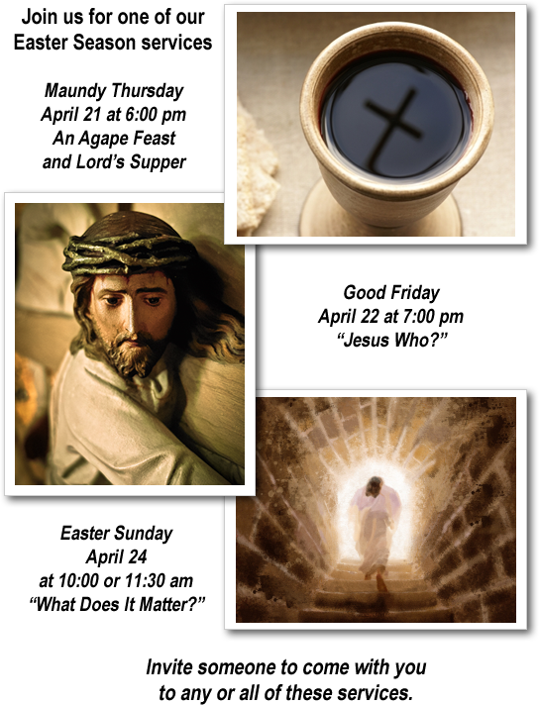

WHAT is Re-Commissioned
We’re Celebrating
²⁰ "Go, stand in the temple courts," he said, "and tell the people the full message of this new life.”

Slide 23
OBEDIENCE makes a
D
I
F
F
E
R
E
N
C
E
²¹ At daybreak they entered the temple courts, as they had been told, and began to teach the people.

Slide 24
OBEDIENCE makes a
D
I
F
F
E
R
E
N
C
E
When the high priest … sent to the jail for the apostles. ²² But on arriving at the jail, the officers did not find them there. So they went back and reported,
Notes:
High Priest = FREE = Bible Point photo.

Slide 25
OBEDIENCE makes a
D
I
F
F
E
R
E
N
C
E
²³ "We found the jail securely locked, with the guards standing at the doors; but when we opened them, we found no one inside.“

Slide 26
OBEDIENCE makes a
D
I
F
F
E
R
E
N
C
E
²⁴ On hearing this report, the captain of the temple guard and the chief priests were puzzled, wondering what would come of this.
?
?
?
?

Slide 27
OBEDIENCE makes a
D
I
F
F
E
R
E
N
C
E
²⁵ Then someone came and said,
"Look! The men you
put in jail are standing
in the temple courts
teaching the people.”

Slide 28
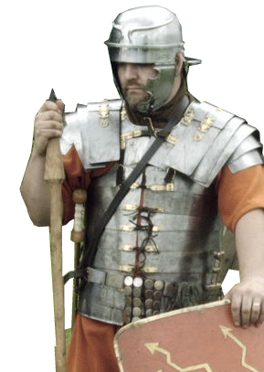
OBEDIENCE makes a
D
I
F
F
E
R
E
N
C
E
²⁶ At that, the captain went with his officers and brought the apostles. They did not use force, because they feared that the people
would stone them
Notes:
Soldier Labeled for reuse: http://www.flickr.com/photos/e_phots/106534450/sizes/o/in/photostream/

Slide 29
The Challenge to Obedience
²⁷ Having brought the apostles, they made them appear
before the Sanhedrin to be questioned by the high priest.
Notes:
Priest = FREE = Bible Point photo.

Slide 30
The Challenge to Obedience
²⁸ "We gave you strict orders not to teach in this name," he said. "Yet you have filled Jerusalem with your teaching and are determined to make us guilty of this man's blood."

Slide 31
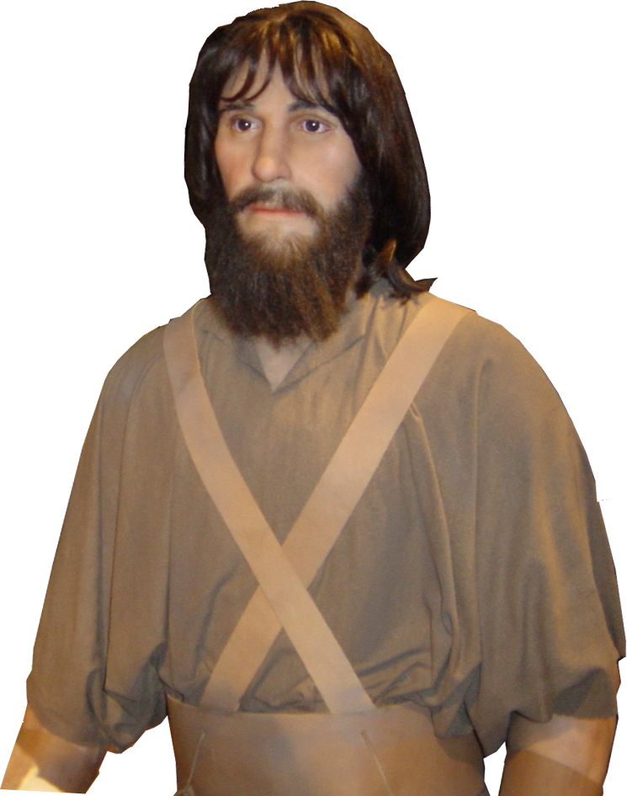
The DEFENSE of Obedience
²⁹ Peter and the other apostles replied:
"We must obey God rather
than men! ³⁰ The God of
our fathers raised Jesus
from the dead--whom you
had killed by hanging him
on a tree.
Notes:
Peter = Bible Point Photo.

Slide 32
The DEFENSE of Obedience
³¹ God exalted him to his own right hand as Prince and Savior that he might give repentance and forgiveness of sins to Israel.

Slide 33
The DEFENSE of Obedience
³² We are witnesses of these things, and so is the Holy Spirit, whom God has given to those who obey him.”

Slide 34
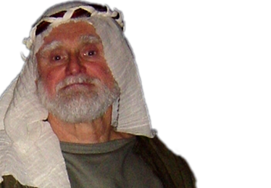
The Compromise of Obedience
³³ When they heard this, they … wanted to put them to death. ³⁴ But a Pharisee named Gamaliel, … ³⁵ … addressed them:
"Men of Israel, …. ³⁶ Some time ago Theudas appeared, claiming to be somebody, and …. He was killed, all his followers were dispersed, and it all came to nothing.
Notes:
Gamaliel = FREE = Bible Point photo.

Slide 35
The Compromise of Obedience
³⁷ After him, Judas the Galilean appeared …. He too was killed, and all his followers were scattered. ³⁸ Therefore, in the present case I advise you:

Slide 36
The Compromise of Obedience
Leave these men alone! Let them go! For if their purpose or activity is of human origin, it will fail. ³⁹ But if it is from God, you will not be able to stop these men; you will only find yourselves fighting against God.”

Slide 37
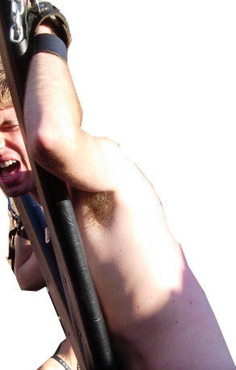
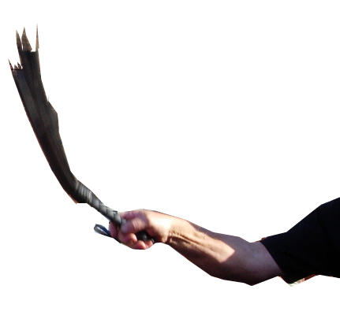
CONCLUSION to Obedience that makes a …
D
I
F
F
E
R
E
N
C
E
⁴⁰ His speech persuaded them. They called the apostles in and had them
flogged.
Notes:
Flogging labeled for reuse: http://www.flickr.com/photos/crimsonic/253881891/sizes/l/in/photostream/

Slide 38
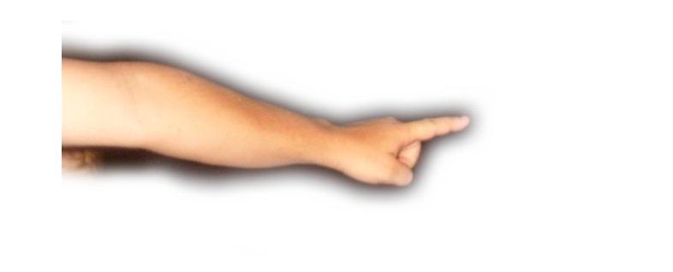
CONCLUSION to Obedience that makes a …
D
I
F
F
E
R
E
N
C
E
Then they ordered them not to speak in the name of Jesus, and let them go.
Notes:
Finger pointing labeled for reuse: http://www.flickr.com/photos/gecco/3874640802/sizes/o/in/photostream/

Slide 39
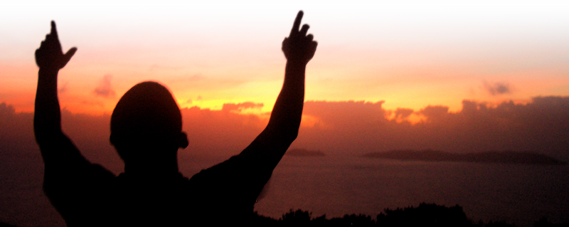
CONCLUSION to Obedience that makes a …
D
I
F
F
E
R
E
N
C
E
⁴¹ The apostles left the Sanhedrin, rejoicing because they had been counted worthy of suffering disgrace for the Name.
Notes:
Praising is a free photo from: http://www.sxc.hu/browse.phtml?f=download&id=700879

Slide 40
CONCLUSION to Obedience that makes a …
D
I
F
F
E
R
E
N
C
E
⁴² Day after day, in the temple courts and from house to house, they never stopped teaching and proclaiming the good news that Jesus is the Christ.

Slide 41
Let’s Sum It Up
Some of you want to have a life that makes a difference … here’s how:
1—Begin with OBEDIENCE
2—Start MAKING DISCIPLES
3—Expect to do GREAT THINGS

Slide 42
Let’s PRAY

