Slide 1
ACTS 5:1-11
www.BiblePoint.com
2011 © Single Initiative LLC
Notes:
Copyright © 2000-2011. All rights reserved. Bible Point is a registered trademark of Single Initiative, LLC. All other trademarks acknowledged.
Bible Point contains graphics from Bible Point artists. These illustrations belong to Bible Point and the respective artists. You may use the designs and illustrations for graphical illustration of lessons free and without special permission, provided they are not used in any way that maligns the Christian faith. Furthermore, republication or production of any illustration by any other graphic service whether it be in book, in a machine-readable form, or in any other design resource is strictly prohibited. Furthermore, they cannot be duplicated or resold as any other form of publishing, clip art, or graphic resource.
So What does it mean? (A simple translations of the legal jargon)
So, if you don’t own the presentation(s), graphic(s), and text(s) how can you legally use them? The purchase of the license allows you to use all the images in the product. However, the actual ownership and copyright of the presentation(s), graphic(s), and text(s) remain the property of Bible Point and its licensors. If you had plans on using this product in your “for sale” work—think again!
License Agreement
Article 1: License Grant
All the graphics and text in Bible Point presentations (excluding quotes from the Bible and stated sources) are the intellectual and real property of Bible Point and its licensors, and is protected by law, including United States copyright laws and international treaties. Bible Point grants to you a license:
1. To use the presentation in a single church, single school, or single office of a Christian organization.
2. To make a single archival back-up copy of the program.
3. To modify the presentation(s) and merge with other presentations in a single church, school, or Christian organization.
4. To transfer to another party if that party agrees to accept the terms and conditions of this agreement, and you do not retain any copies of the presentation, whether printed, machine readable, modified, or merged form.
Article 2: Terms
This license is effective until terminated. You may terminate the license at any time by destroying the presentation(s), graphic(s), or text(s) together with all copies, modifications and merged portions in any form. Bible Point may terminate your license if you fail to comply with this Agreement. You agree, upon such termination, for any reason, to destroy the presentation(s), graphics, and text(s) with all copies, modifications, and merged portions in any form.
Article 3: Disclaimers
1. Bible Point presentations, graphics, and texts are licensed to you As Is. You, the consumer, bear the entire risk relating to the quality and performance of the presentation(s), graphic(s), or text(s). In no event will Bible Point be liable for damages resulting from any defect.
2. Thirty-day limited warrantee on disks. Bible Point warrants the disks to be free of defects in material and workmanship under normal use for 30 days after purchase. During the 30-day period you may return a defective presentation, graphic, or text with proof of purchase and it will be replaced without charge, unless the presentation is damaged by misuse.
Article 4: General
1. You may not sub-license, assign, or transfer the license of the presentation(s), graphic(s), or text(s) except as provided by this Agreement.
2. This Agreement will be governed by the laws of the State of Michigan.
So What does it mean? (A simple translations of the legal jargon)
May I let someone borrow or copy my licensed Bible Point presentation (even after I modified it)? As long as it is within your local church, or single school, or the immediate office of a Christian organization you may. Otherwise, please refer the person interested in borrowing to: http://www.biblepoint.com or E-mail: dh@biblepoint.com with any related questions.
---------------------------------------------------------------------------------------------------------------------------
Scripture taken from the HOLY BIBLE, NEW INTERNATIONAL VERSION®. NIV®. Copyright©1973, 1978, 1984 by International Bible Society. Used by permission of Zondervan. All rights reserved.

Slide 2

A Study in the
Book of ACTS
D
I
F
F
E
R
E
N
C
E
making a
Notes:
Difference

Slide 3
The PHOBEA (fear) that Makes a Difference

Slide 4
Different kinds of FEAR:
Aquaphobia- Fear of water.
Bibliophobia - Fear of books.
Claustrophobia - Fear of confined spaces.
Dentophobia - Fear of dentists.
Gamophobia - Fear of marriage.
Mysophobia - Fear of germs.
Necrophobia - Fear of death.
Pyrophobia - Fear of fire.
Technophobia - Fear of technology.

Slide 5
Regarding EXCESSIVE fear:
2 Timothy 1:7 For God hath not given us the spirit of fear; but of power, and of love, and of a sound mind. (KJV)

Slide 6
The point of our passage:
⁵…great fear seized all who heard what had happened.
φοβοs
phobos

Slide 7
The point of our passage:
¹¹ Great fear seized the whole church and all who heard about these events.
φοβοs
phobos
This is a GOOD phobia!

Slide 8
The point of our passage:
¹¹ Great fear seized the whole church and all who heard about these events.
“of the Lord”
“…is pure, enduring forever.” Psa 19:9
“…is the beginning of wisdom” Psa 111:10
“…is the beginning of knowledge” Pro 1:7
“…is to hate evil” Pro 8:13
“…is a fountain of life” Pro 14:27
“…is the key to treasure” Isa 33:6

Slide 9
The point of our passage:
¹¹ Great fear seized the whole church and all who heard about these events.

Slide 10
The point of our passage:
¹¹ Great fear seized the whole church and all who heard about these events.

Slide 11
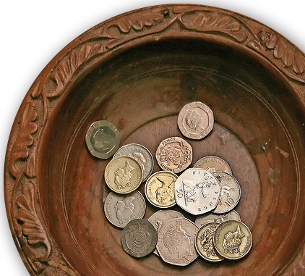
The point of our passage:
¹¹ Great fear seized the whole church and all who heard about these events.
On the surface = church offering.
Notes:
Collection plate labeled as a photo for reuse: http://www.flickr.com/photos/lwr/166988094/

Slide 12
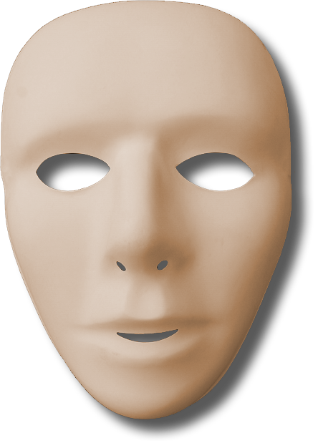
The point of our passage:
¹¹ Great fear seized the whole church and all who heard about these events.
On the surface = church offering.
Beneath the surface =
personal hypocrisy.
Notes:
Collection plate labeled as a photo for REUSE: http://www.flickr.com/photos/lwr/166988094/
Mask = FREE for reuse from http://www.sxc.hu/browse.phtml?f=download&id=1155518

Slide 13
The Event Behind the Phobia
4:36-37 …Barnabas (which means Son of Encouragement), ³⁷ sold a field he owned and brought the money and put it at the apostles' feet.

Slide 14
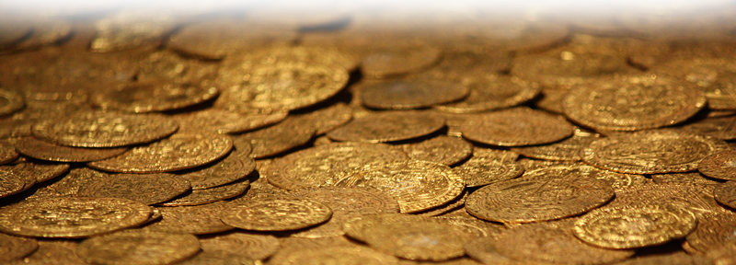
The Event Behind the Phobia
4:36-37 …Barnabas (which means Son of Encouragement), ³⁷ sold a field he owned and brought the money and put it at the apostles' feet.
He had a “Fear of the Lord” that was…
Pure (Psalm 19:9)
a Treasure … of salvation and wisdom
and knowledge (Isa 33:6)
Notes:
Gold Coins = FREE for reuse from http://upload.wikimedia.org/wikipedia/commons/c/cf/Hoard_of_ancient_gold_coins.jpg

Slide 15
The Lack of this Phobia
¹ Now a man named Ananias, together with his wife Sapphira, also sold a piece of property. ² With his wife's full knowledge he kept back part of the money for himself, but brought the rest and put it at the apostles' feet.

Slide 16
The Lack of this Phobia
¹ Now a man named Ananias, together with his wife Sapphira, also sold a piece of property. ² With his wife's full knowledge he kept back part of the money for himself, but brought the rest and put it at the apostles' feet.

Slide 17
Cause of Lacking this Phobia

Slide 18
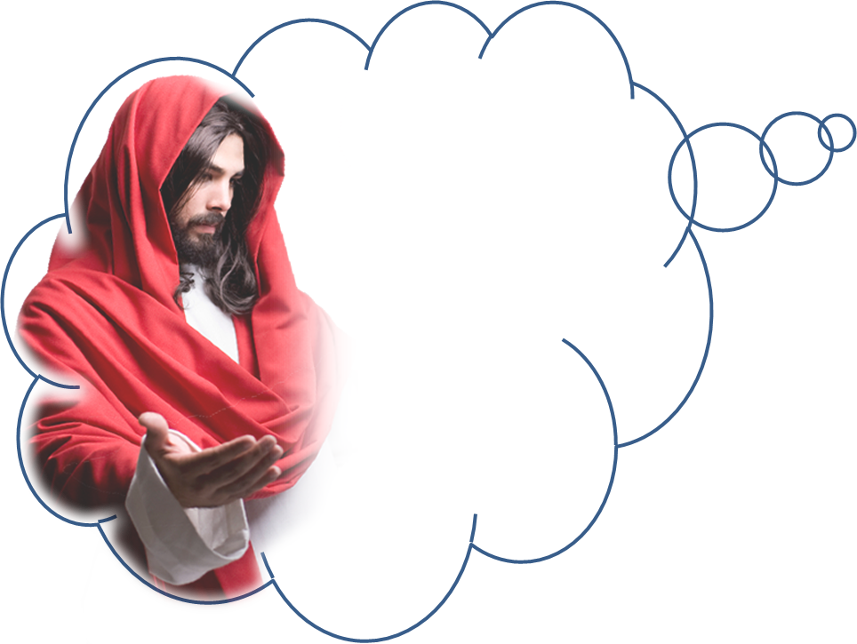
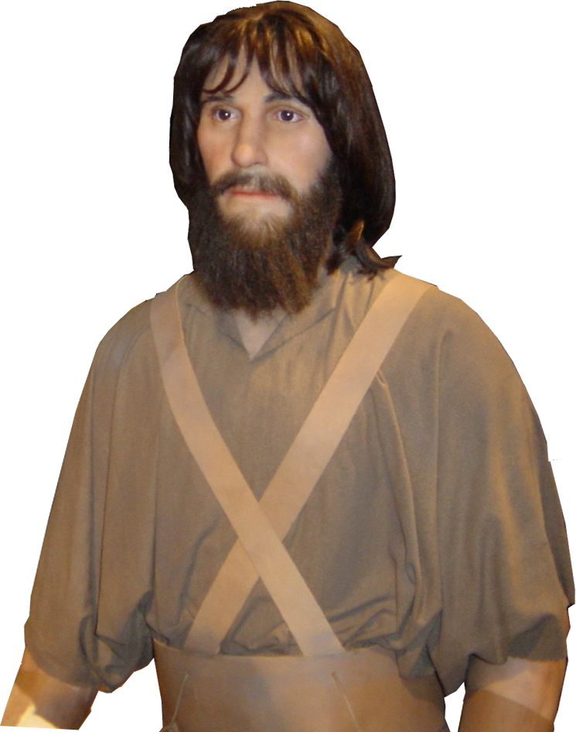
Cause of Lacking this Phobia
³ Then Peter said,
"Ananias, how is it that Satan has so filled your heart that you have lied to the Holy Spirit and have kept for yourself some of the money you received for the land?
"Get behind me, Satan!" he said. "You do not have in mind the things of God, but the things
of men.”

Slide 19
Cause of Lacking this Phobia
³ Then Peter said,
"Ananias, how is it that Satan has so filled your heart that you have lied to the Holy Spirit and have kept for yourself some of the money you received for the land?
"Simon, Simon, Satan has asked
to sift you as wheat. But I
have prayed for
you, Simon, that
your faith
may not
fail.

Slide 20


Cause of Lacking this Phobia
³ Then Peter said,
"Ananias, how is it that Satan has so filled your heart that you have lied to the Holy Spirit and have kept for yourself some of the money you received for the land?

Slide 21
Heart of Lacking this Phobia
³ Then Peter said,
"Ananias, how is it that Satan has so filled your heart that you have lied to the Holy Spirit and have kept for yourself some of the money you received for the land?

Slide 22
On the Surface
⁴ Didn't it belong to you before it was sold? And after it was sold, wasn't the money at your disposal? What made you think of doing such a thing? You have not lied to men but to God."

Slide 23
On the Surface
⁴ Didn't it belong to you before it was sold? And after it was sold, wasn't the money at your disposal? What made you think of doing such a thing? You have not lied to men but to God."

Slide 24
Below the Surface
⁴ Didn't it belong to you before it was sold? And after it was sold, wasn't the money at your disposal? What made you think of doing such a thing? You have not lied to men but to God."

Slide 25
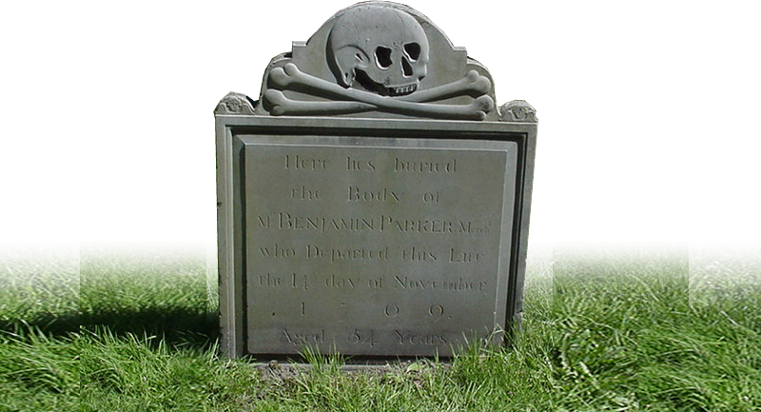
Intrusion of Divine Judgment
⁵ When Ananias heard this, he fell down and died.
And great fear seized all who heard what had happened.
Notes:
Tombstone = FREE = Biblepoint photo

Slide 26
Intrusion of Divine Judgment
⁶ Then the young men came forward, wrapped up his body, and carried him out and buried him.

Slide 27
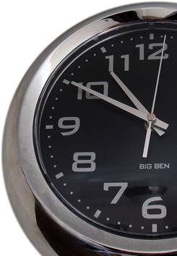
Fast Forward …
⁷ About three hours later his wife came in, not knowing what had happened.
Notes:
Clock labeled for reuse: http://capl.washjeff.edu/browseresults.php?langID=2&photoID=3715&size=l

Slide 28
Déjà vu ...

Slide 29
Déjà vu ...
⁸ Peter asked her,
"Tell me, is this the price you and Ananias got for the land?"
"Yes," she said,
"that is the price.”

Slide 30
Déjà vu ...
⁹ Peter said to her,
"How could you agree to test the Spirit of the Lord? Look! The feet of the men who buried your husband are at the door, and they will carry you out also.”
⁷ Jesus answered him, "It is also written:
'Do not put
the Lord your God to the test.'"

Slide 31
Déjà vu ...
⁹ Peter said to her,
"How could you agree to test the Spirit of the Lord? Look! The feet of the men who buried your husband are at the door, and they will carry you out also.”

Slide 32
Déjà vu ...
¹⁰ At that moment she fell down at his feet and died. Then the young men came in and, finding her dead, carried her out and buried her beside her husband.
Intrusion of Divine Judgment
Notes:
Tombstones = FREE = BiblePoint photos

Slide 33
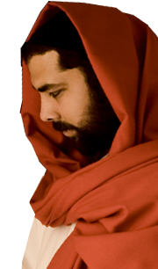
A Neglected NT Concept
⁴ "I tell you, my friends, do not be afraid of those who kill the body and after that can do no more. ⁵ But I will show you whom you should fear: Fear him who, after the killing of the body, has power to throw you into hell. Yes, I tell you, fear him. (Luke 12:4-5)
Notes:
Jesus knocking at door = Licensed NOT for reuse = iStock_000003455310Small

Slide 34
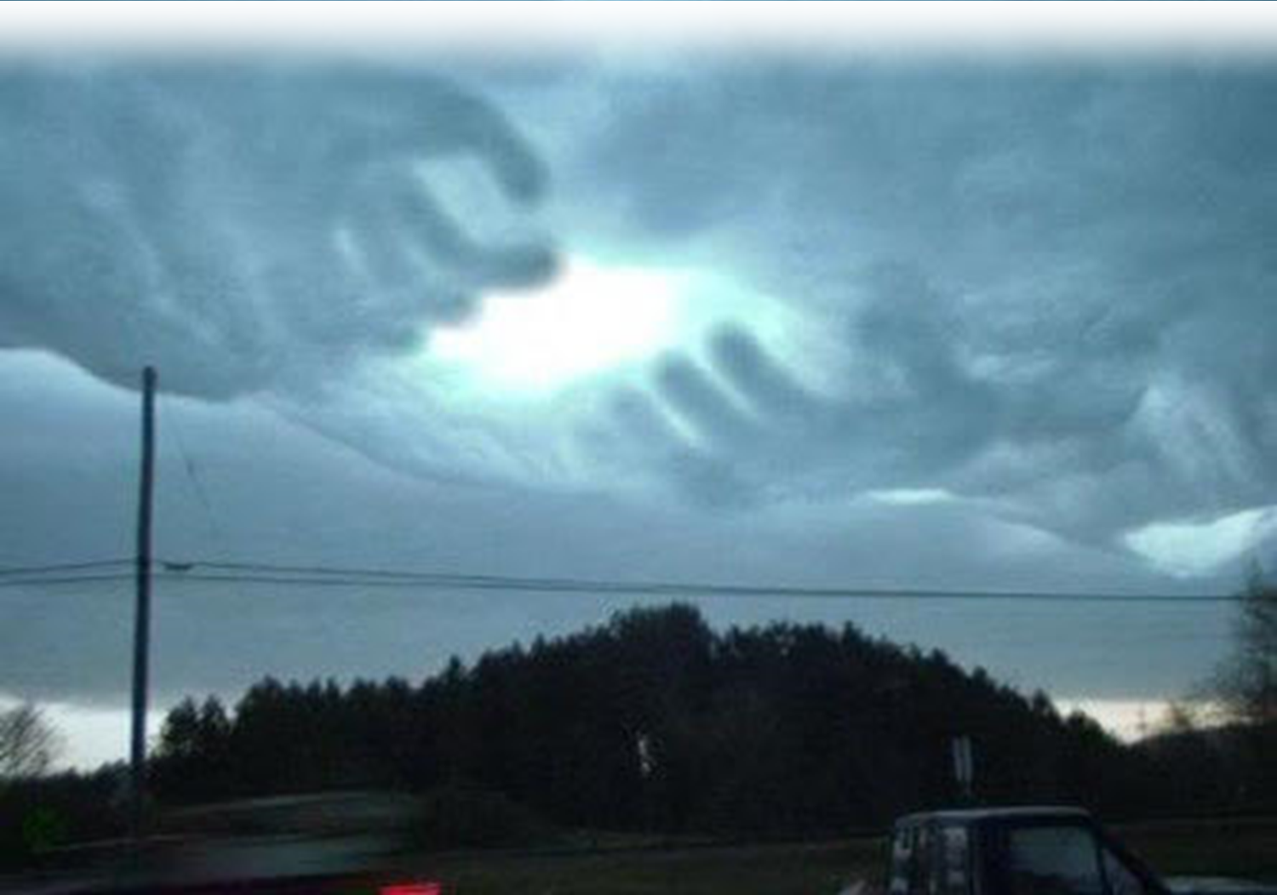
Neglected NT Concept
It is a fearful thing to fall into the hands of the living God. (Hebrews 10:31 KJV)

Slide 35
The point of our passage:
¹¹ Great fear seized the whole church and all who heard about these events.
φοβοs
phobos
This is a GOOD phobia!

Slide 36
The point of our passage:
¹¹ Great fear seized the whole church and all who heard about these events.
“of the Lord”
“…is to hate evil” Pro 8:13

Slide 37
Take Inventory
Is my life making a difference?
Am I totally honest with God?
Am I trying to deceive God?
Who am I trying to fool?
Am I wearing a mask?
Isn’t it time to “Fear the Lord” again?

Slide 38
Let’s Pray!

