Slide 1
ACTS 4:23-37
www.BiblePoint.com
2011 © Single Initiative LLC
Notes:
Copyright © 2000-2011. All rights reserved. Bible Point is a registered trademark of Single Initiative, LLC. All other trademarks acknowledged.
Bible Point contains graphics from Bible Point artists. These illustrations belong to Bible Point and the respective artists. You may use the designs and illustrations for graphical illustration of lessons free and without special permission, provided they are not used in any way that maligns the Christian faith. Furthermore, republication or production of any illustration by any other graphic service whether it be in book, in a machine-readable form, or in any other design resource is strictly prohibited. Furthermore, they cannot be duplicated or resold as any other form of publishing, clip art, or graphic resource.
So What does it mean? (A simple translations of the legal jargon)
So, if you don’t own the presentation(s), graphic(s), and text(s) how can you legally use them? The purchase of the license allows you to use all the images in the product. However, the actual ownership and copyright of the presentation(s), graphic(s), and text(s) remain the property of Bible Point and its licensors. If you had plans on using this product in your “for sale” work—think again!
License Agreement
Article 1: License Grant
All the graphics and text in Bible Point presentations (excluding quotes from the Bible and stated sources) are the intellectual and real property of Bible Point and its licensors, and is protected by law, including United States copyright laws and international treaties. Bible Point grants to you a license:
1. To use the presentation in a single church, single school, or single office of a Christian organization.
2. To make a single archival back-up copy of the program.
3. To modify the presentation(s) and merge with other presentations in a single church, school, or Christian organization.
4. To transfer to another party if that party agrees to accept the terms and conditions of this agreement, and you do not retain any copies of the presentation, whether printed, machine readable, modified, or merged form.
Article 2: Terms
This license is effective until terminated. You may terminate the license at any time by destroying the presentation(s), graphic(s), or text(s) together with all copies, modifications and merged portions in any form. Bible Point may terminate your license if you fail to comply with this Agreement. You agree, upon such termination, for any reason, to destroy the presentation(s), graphics, and text(s) with all copies, modifications, and merged portions in any form.
Article 3: Disclaimers
1. Bible Point presentations, graphics, and texts are licensed to you As Is. You, the consumer, bear the entire risk relating to the quality and performance of the presentation(s), graphic(s), or text(s). In no event will Bible Point be liable for damages resulting from any defect.
2. Thirty-day limited warrantee on disks. Bible Point warrants the disks to be free of defects in material and workmanship under normal use for 30 days after purchase. During the 30-day period you may return a defective presentation, graphic, or text with proof of purchase and it will be replaced without charge, unless the presentation is damaged by misuse.
Article 4: General
1. You may not sub-license, assign, or transfer the license of the presentation(s), graphic(s), or text(s) except as provided by this Agreement.
2. This Agreement will be governed by the laws of the State of Michigan.
So What does it mean? (A simple translations of the legal jargon)
May I let someone borrow or copy my licensed Bible Point presentation (even after I modified it)? As long as it is within your local church, or single school, or the immediate office of a Christian organization you may. Otherwise, please refer the person interested in borrowing to: http://www.biblepoint.com or E-mail: dh@biblepoint.com with any related questions.
---------------------------------------------------------------------------------------------------------------------------
Scripture taken from the HOLY BIBLE, NEW INTERNATIONAL VERSION®. NIV®. Copyright©1973, 1978, 1984 by International Bible Society. Used by permission of Zondervan. All rights reserved.

Slide 2

A Study in the
Book of ACTS
D
I
F
F
E
R
E
N
C
E
making a
Notes:
Difference

Slide 3
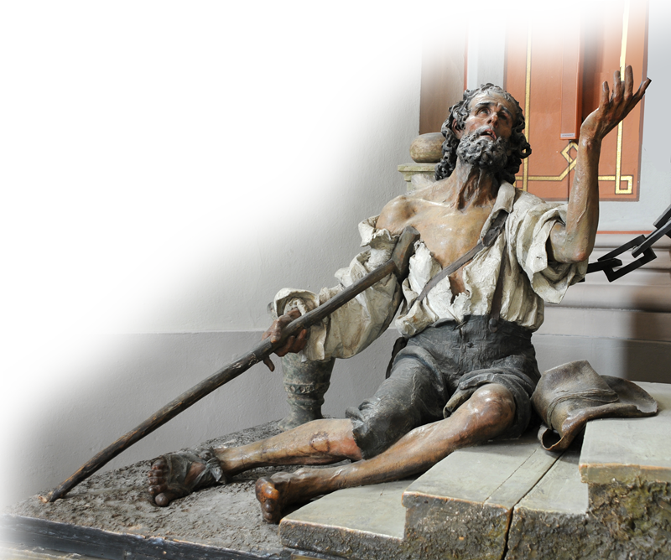
We left off …
The PROCLAMATION
that makes a Difference:
The name of JESUS

Slide 4
The PETITION that Makes a Difference
IS…

Slide 5
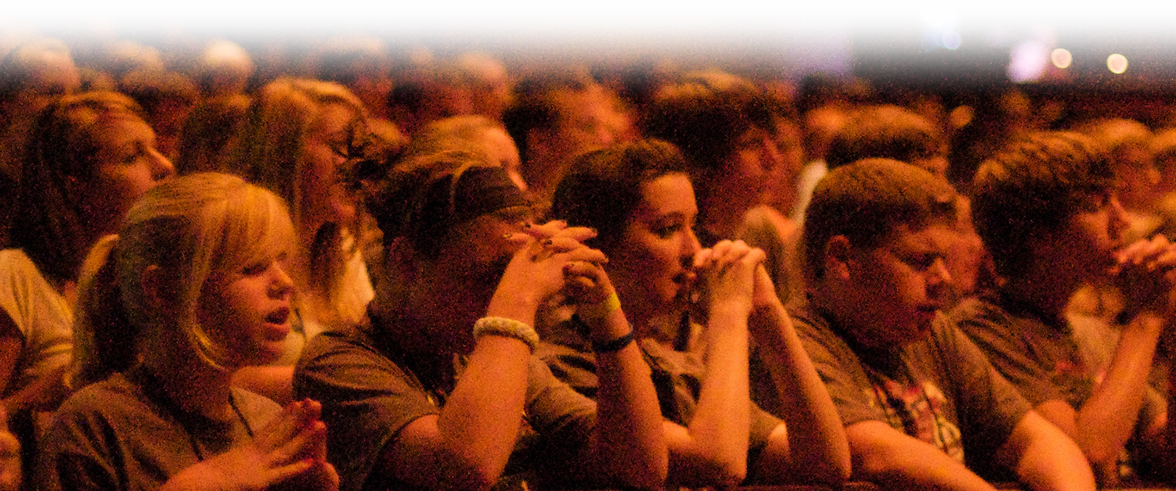
1- A CORPORATE Petition
ordinary men 4:13
²³ On their release, Peter and John went back to their own people and reported all that the chief priests and elders had said to them. ²⁴ When they heard this, they raised their voices together in prayer….
Notes:
praying group = FREE = http://www.flickr.com/photos/stlyouth/3735428097/sizes/o/in/photostream/

Slide 6
1- A CORPORATE Petition
²³ On their release, Peter and John went back to their own people and reported all that the chief priests and elders had said to them. ²⁴ When they heard this, they raised their voices together in prayer….
Notes:
Free photo praying group: http://www.flickr.com/photos/stlyouth/3735428097/sizes/o/in/photostream/

Slide 7

2- An EXALTING Petition
²³ On their release, Peter and John went back to their own people and reported all that the chief priests and elders had said to them. ²⁴ When they heard this, they raised their voices together in prayer to God.
Notes:
Free photo praying group: http://www.flickr.com/photos/stlyouth/3735428097/sizes/o/in/photostream/

Slide 8
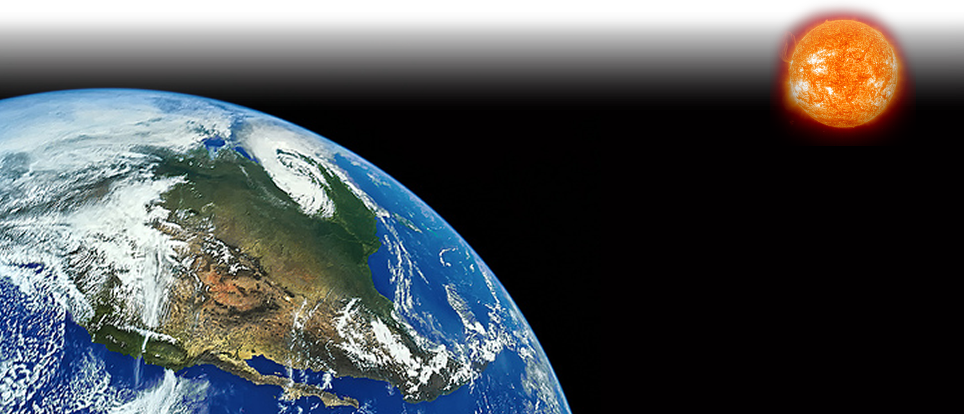
Lord of CREATION: 24
"Sovereign Lord," they said, "you made the heaven and the earth and the sea, and everything in them.
Notes:
Earth Labeled for reuse: http://www.flickr.com/photos/ironrodart/4132833849/

Slide 9

Lord of REVELATION 25-26
²⁵ You spoke by the Holy Spirit through the mouth of your servant, our father David:
" 'Why do the nations rage and the peoples plot in vain? ²⁶ The kings of
the earth take their stand and the
rulers gather together against the
Lord and against his Anointed One. '
Notes:
Scrolls = see previous presentations

Slide 10

Lord of PROVIDENCE 27-28
²⁷ Indeed Herod and Pontius Pilate met together with the Gentiles and the people
of Israel in this city to conspire against your holy servant Jesus, whom you anointed. ²⁸ They did what your power and will had decided beforehand should happen.
Notes:
World in hands labeled for reuse: http://www.flickr.com/photos/yeix/4209870009/sizes/o/in/photostream/

Slide 11

3- A TIMELY Petition
²⁹ Now, Lord, consider their threats and enable your servants to speak your word with great boldness.
Notes:
Clock = FREE for reuse from http://www.sxc.hu/browse.phtml?f=download&id=852177

Slide 12
Timely CONSIDERATION
²⁹ Now, Lord, consider their threats and enable your servants to speak your word with great boldness.

Slide 13
Timely ENABLEMENT
²⁹ Now, Lord, consider their threats and enable your servants to speak your word with great boldness.

Slide 14
Timely HEALING HAND
²⁹ Now, Lord, consider their threats and enable your servants to speak your word with great boldness.
³⁰ Stretch out your hand to heal
and perform miraculous
signs and wonders through
the name of your holy
servant Jesus."

Slide 15
Timely MIRACULOUS HAND
²⁹ Now, Lord, consider their threats and enable your servants to speak your word with great boldness.
³⁰ Stretch out your hand to heal
and perform miraculous
signs and wonders through
the name of your holy
servant Jesus."

Slide 16
4- A CHRIST-MEDIATED Petition
J
e
s
u
s
²⁹ Now, Lord, consider their threats and enable your servants to speak your word with great boldness.
³⁰ Stretch out your hand to heal
and perform miraculous
signs and wonders through
the name of your holy
servant Jesus."

Slide 17
5- A POWERFUL Petition
³¹ After they prayed

Slide 18
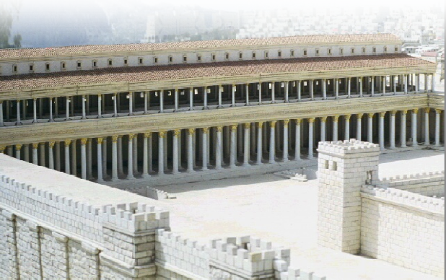
PHYSICALLY Powerful
³¹ After they prayed, the place where they were meeting was shaken.
Notes:
Temple = FREE for reuse = see previous presentations

Slide 19


SPIRITUALLY Powerful
³¹ After they prayed, the place where they were meeting was shaken. And they were all filled with the Holy Spirit
Notes:
Motel sign = FREE for reuse from = http://www.sxc.hu/photo/470657

Slide 20
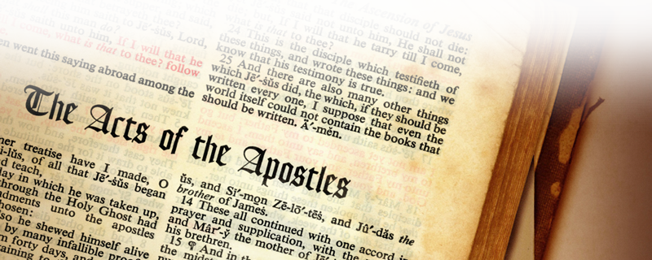
BIBLICALLY Powerful
³¹ After they prayed, the place where they were meeting was shaken. And they were all filled with the Holy Spirit and spoke the word of God boldly.
Notes:
Bible free from : sxc.com

Slide 21
6- A UNITING Petition
³² All the believers were one in heart and mind. No one claimed that any of his possessions was his own, but they shared everything they had.
1

Slide 22

One in HEART
³² All the believers were one in heart and mind. No one claimed that any of his possessions was his own, but they shared everything they had.
1
Notes:
Heart free from .sxc.com

Slide 23

One in MIND
³² All the believers were one in heart and mind. No one claimed that any of his possessions was his own, but they shared everything they had.
1
Notes:
Brain free photo from http://www.sxc.hu/browse.phtml?f=download&id=1254880

Slide 24

One in GENEROSITY
³² All the believers were one in heart and mind. No one claimed that any of his possessions was his own, but they shared everything they had.
1
Notes:
Dollar sign free from http://www.sxc.hu/browse.phtml?f=download&id=1229466

Slide 25
7- An EMPOWERING Petition
³³ With great power the apostles continued to testify to the resurrection of the Lord Jesus, and much grace was upon them all.
³⁴ There were no needy persons among them. For from time to time those who owned lands or houses sold them, brought the money from the sales
³⁵ and put it at the apostles' feet, and it was distributed to anyone as he had need.

Slide 26
Empowered to TESTIFY
³³ With great power the apostles continued to testify to the resurrection of the Lord Jesus, and much grace was upon them all.
³⁴ There were no needy persons among them. For from time to time those who owned lands or houses sold them, brought the money from the sales
³⁵ and put it at the apostles' feet, and it was distributed to anyone as he had need.

Slide 27
Empowered to GIVE
³³ With great power the apostles continued to testify to the resurrection of the Lord Jesus, and much grace was upon them all.
³⁴ There were no needy persons among them. For from time to time those who owned lands or houses sold them, brought the money from the sales
³⁵ and put it at the apostles' feet, and it was distributed to anyone as he had need.

Slide 28
Empowered to GIVE
³⁶ Joseph, a Levite from Cyprus, whom the apostles called Barnabas (which means Son of Encouragement),
³⁷ sold a field he owned and brought the money and put it at the apostles' feet

Slide 29
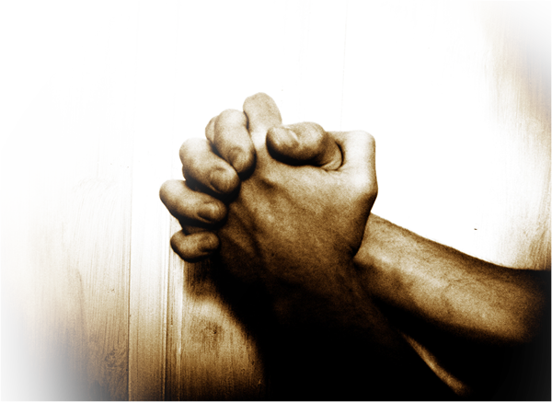
The PRAYER that Makes a Difference is:
Corporate
Exalting
Timely
Christ-Mediated
Powerful
Uniting
Empowering
Notes:
Praying hands = FREE = See previous presentations.

Slide 30
Let’s Pray.

