Slide 1
ACTS 4:1-22
www.BiblePoint.com
2011 © Single Initiative LLC
Notes:
Copyright © 2000-2011. All rights reserved. Bible Point is a registered trademark of Single Initiative, LLC. All other trademarks acknowledged.
Bible Point contains graphics from Bible Point artists. These illustrations belong to Bible Point and the respective artists. You may use the designs and illustrations for graphical illustration of lessons free and without special permission, provided they are not used in any way that maligns the Christian faith. Furthermore, republication or production of any illustration by any other graphic service whether it be in book, in a machine-readable form, or in any other design resource is strictly prohibited. Furthermore, they cannot be duplicated or resold as any other form of publishing, clip art, or graphic resource.
So What does it mean? (A simple translations of the legal jargon)
So, if you don’t own the presentation(s), graphic(s), and text(s) how can you legally use them? The purchase of the license allows you to use all the images in the product. However, the actual ownership and copyright of the presentation(s), graphic(s), and text(s) remain the property of Bible Point and its licensors. If you had plans on using this product in your “for sale” work—think again!
License Agreement
Article 1: License Grant
All the graphics and text in Bible Point presentations (excluding quotes from the Bible and stated sources) are the intellectual and real property of Bible Point and its licensors, and is protected by law, including United States copyright laws and international treaties. Bible Point grants to you a license:
1. To use the presentation in a single church, single school, or single office of a Christian organization.
2. To make a single archival back-up copy of the program.
3. To modify the presentation(s) and merge with other presentations in a single church, school, or Christian organization.
4. To transfer to another party if that party agrees to accept the terms and conditions of this agreement, and you do not retain any copies of the presentation, whether printed, machine readable, modified, or merged form.
Article 2: Terms
This license is effective until terminated. You may terminate the license at any time by destroying the presentation(s), graphic(s), or text(s) together with all copies, modifications and merged portions in any form. Bible Point may terminate your license if you fail to comply with this Agreement. You agree, upon such termination, for any reason, to destroy the presentation(s), graphics, and text(s) with all copies, modifications, and merged portions in any form.
Article 3: Disclaimers
1. Bible Point presentations, graphics, and texts are licensed to you As Is. You, the consumer, bear the entire risk relating to the quality and performance of the presentation(s), graphic(s), or text(s). In no event will Bible Point be liable for damages resulting from any defect.
2. Thirty-day limited warrantee on disks. Bible Point warrants the disks to be free of defects in material and workmanship under normal use for 30 days after purchase. During the 30-day period you may return a defective presentation, graphic, or text with proof of purchase and it will be replaced without charge, unless the presentation is damaged by misuse.
Article 4: General
1. You may not sub-license, assign, or transfer the license of the presentation(s), graphic(s), or text(s) except as provided by this Agreement.
2. This Agreement will be governed by the laws of the State of Michigan.
So What does it mean? (A simple translations of the legal jargon)
May I let someone borrow or copy my licensed Bible Point presentation (even after I modified it)? As long as it is within your local church, or single school, or the immediate office of a Christian organization you may. Otherwise, please refer the person interested in borrowing to: http://www.biblepoint.com or E-mail: dh@biblepoint.com with any related questions.
---------------------------------------------------------------------------------------------------------------------------
Scripture taken from the HOLY BIBLE, NEW INTERNATIONAL VERSION®. NIV®. Copyright©1973, 1978, 1984 by International Bible Society. Used by permission of Zondervan. All rights reserved.

Slide 2
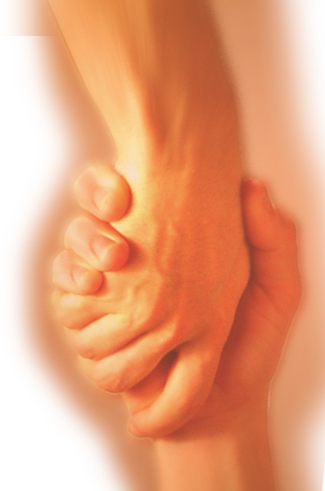
A Study in the
Book of ACTS
D
I
F
F
E
R
E
N
C
E
making a
Notes:
Difference

Slide 3
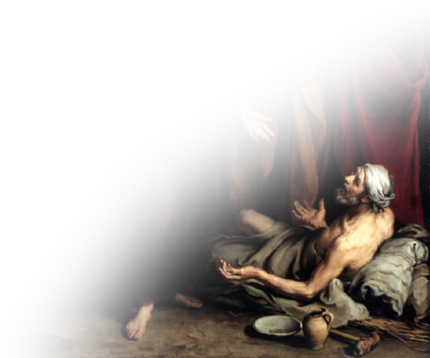
Last time we noted
The PERSON’S NAME
that makes a Difference:
JESUS
Notes:
Beggar = FREE for reuse from = http://upload.wikimedia.org/wikipedia/commons/0/0f/Curacin_del_paraltico_Murillo_1670.jpg

Slide 4
The PROCLAMATION that Makes a Difference
Proclaiming the
Name of Jesus

Slide 5
The PROCLAMATION that Makes a Difference
IS…

Slide 6
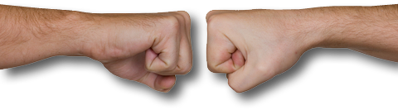
1-CONTROVERSIAL
¹ The priests and the captain of the temple guard and the Sadducees came up to Peter and John while they were speaking to the people.
Notes:
Two fists – Licensed NOT for reuse from = Dreamstime: dreamstime_3628060

Slide 7
1-CONTROVERSIAL
² They were greatly disturbed because the apostles were teaching the people and proclaiming in Jesus the resurrection of the dead.

Slide 8
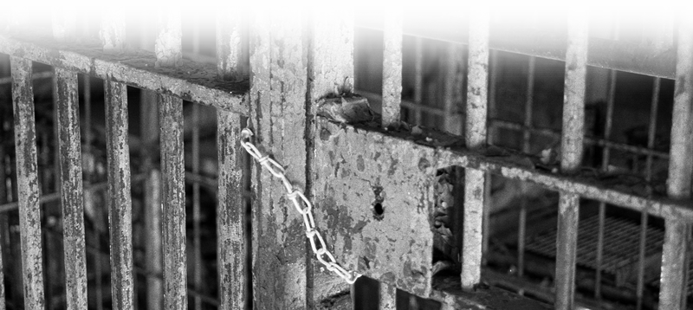
2-COSTLY
³ They seized Peter and John, and because it was evening, they put them in jail until the next day.
Notes:
Jail Cell door = free = http://www.sxc.hu/browse.phtml?f=download&id=1226063

Slide 9

3-REWARDING
⁴ But many who heard the message believed, and the number of men grew to about five thousand.
Notes:
Crowd = Licensed NOT for reuse = iStock photos: 13823183

Slide 10

4-TRYING
⁵ The next day the rulers, elders and teachers of the law met in Jerusalem.
⁶ Annas the high priest was there, and so were Caiaphas, John, Alexander and the other men of the high priest's family.
Notes:
Gavel = FREE = ww.sxc.com image:952313_79933908

Slide 11
4-TRYING
⁷ They had Peter and John brought before them and began to question them:
"By what power or what name did you do this?”

Slide 12
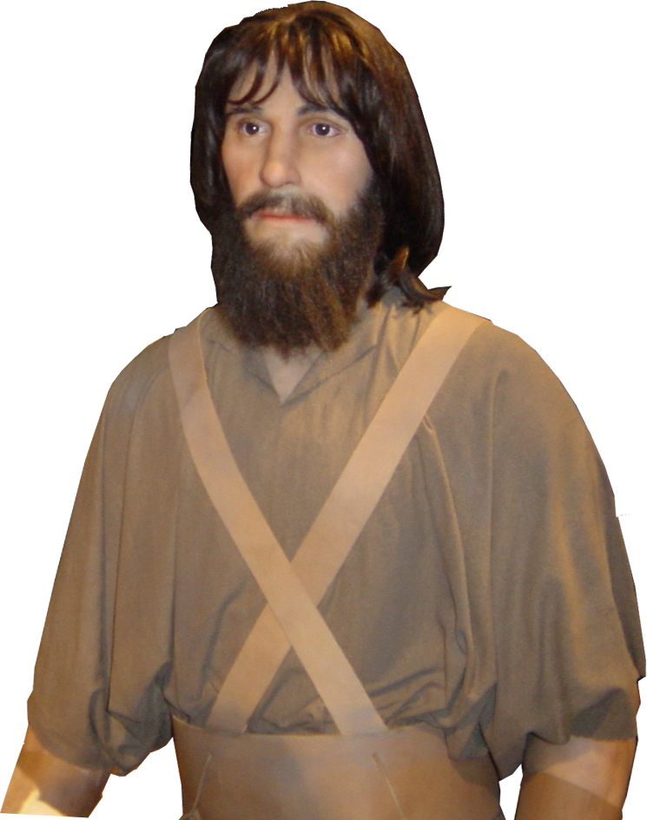
5-SIMPLE
⁸ Then Peter, filled with the Holy Spirit,
said to them:
"Rulers and elders of the
people! ⁹ If we are being
called to account today for
an act of kindness shown
to a cripple and are asked
how he was healed, …

Slide 13
5-SIMPLE
¹⁰ then know this, you and all the people of Israel: It is by the name of Jesus Christ of Nazareth, whom you crucified but whom God raised from the dead, that this man stands before you healed.

Slide 14
5-SIMPLE
¹¹ He is " 'the stone you builders rejected, which has become the capstone. ‘

Slide 15
6-NARROW
¹² Salvation is found in no one else, for there is no other name under heaven given to men by which we must be saved."

Slide 16
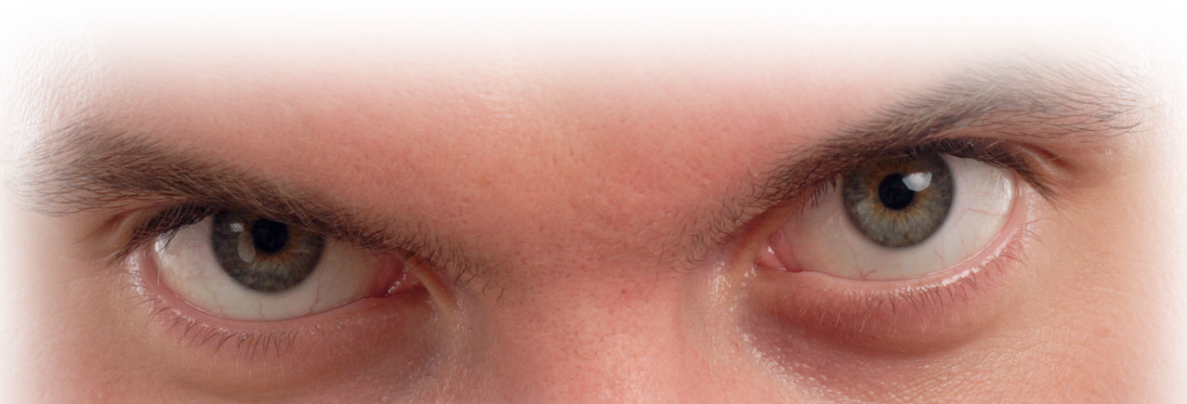
7-COURAGEOUS
VISIBLE COURAGE
¹³ When they saw the courage of Peter and John …
Notes:
Man’s eyes = Licensed NOT for reuse = dreamstimefree_1072801

Slide 17
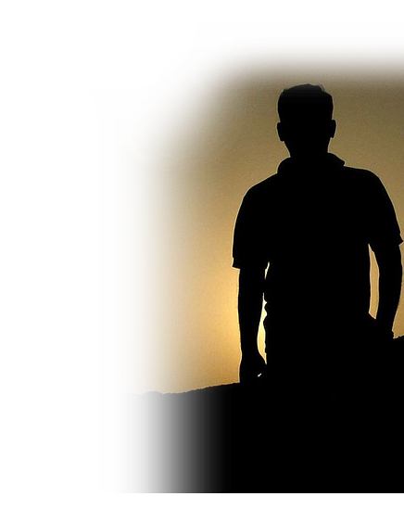
7-COURAGEOUS
ASTONISHING COURAGE
¹³ When they saw the courage of Peter and John and realized that they were unschooled, ordinary men, they were astonished and they took note that these men had been with Jesus.
Notes:
Silhouette man = free from: http://www.flickr.com/photos/marypaulose/295058238/sizes/z/in/photostream/

Slide 18

7-COURAGEOUS
NOTEWORTHY COURAGE
¹³ When they saw the courage of Peter and John and realized that they were unschooled, ordinary men, they were astonished and they took note that these men had been with Jesus.
Notes:
Hand with pencil = FREE FOR REUSE from http://www.sxc.hu/photo/1000794

Slide 19
7-COURAGEOUS
IRREFUTABLE COURGE
¹⁴ But since they could see the man who had been healed standing there with them, there was nothing they could say.

Slide 20
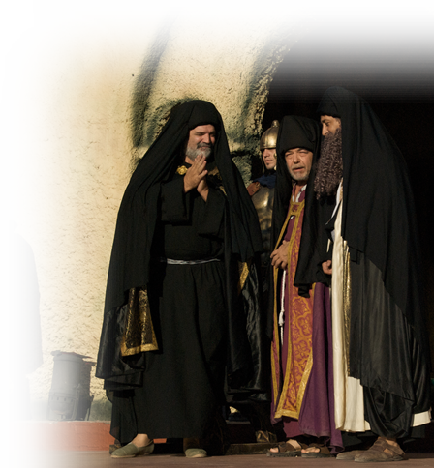
7-COURAGEOUS
IRREFUTABLE COURGE
¹⁵ So they ordered them to withdraw from the Sanhedrin and then conferred together.
Notes:
Sanhedrin = Free = http://www.flickr.com/photos/blmurch/3435178400/sizes/o/in/photostream/

Slide 21
7-COURAGEOUS
IRREFUTABLE COURGE
¹⁶ "What are we going to do with these men?" they asked. "Everybody living in Jerusalem knows they have done an outstanding miracle, and we cannot deny it.

Slide 22

7-COURAGEOUS
UNSTOPPABLE COURAGE
¹⁷ But to stop this thing from spreading any further among the people, we must warn these men to speak no longer to anyone in this name."
Notes:
Stop sign = FREE FOR REUSE from http://www.sxc.hu/browse.phtml?f=download&id=1201945

Slide 23

7-COURAGEOUS
UNSTOPPABLE COURAGE
¹⁸ Then they called them in again and commanded them not to speak or teach at all in the name of Jesus.

Slide 24
8-OBEDIENT TO GOD!
¹⁹ But Peter and John replied,
"Judge for yourselves
whether it is right in
God's sight to obey
you rather than God.
Notes:
Stop sign free from : http://commons.wikimedia.org/wiki/File:Stop_sign_us.jpg

Slide 25
8-OBEDIENT TO GOD!
²⁰ For we cannot help speaking about what we have seen and heard."

Slide 26
CONCLUSION:
²¹ After further threats they let them go. They could not decide how to punish them, because all the people were praising God for what had happened.
²² For the man who was miraculously healed was over forty years old.

Slide 27
Let’s sum up:
Ordinary people make the most powerful proclamations when speaking “in the Name of Jesus.”
It can be …
It must be …
Controversial
Costly
Rewarding
Trying
Simple
Narrow
Courageous
Obedient

Slide 28
Let’s Pray.

