Slide 1
ACTS 3:1-26
www.BiblePoint.com
2011 © Single Initiative LLC
Notes:
Copyright © 2000-2011. All rights reserved. Bible Point is a registered trademark of Single Initiative, LLC. All other trademarks acknowledged.
Bible Point contains graphics from Bible Point artists. These illustrations belong to Bible Point and the respective artists. You may use the designs and illustrations for graphical illustration of lessons free and without special permission, provided they are not used in any way that maligns the Christian faith. Furthermore, republication or production of any illustration by any other graphic service whether it be in book, in a machine-readable form, or in any other design resource is strictly prohibited. Furthermore, they cannot be duplicated or resold as any other form of publishing, clip art, or graphic resource.
So What does it mean? (A simple translations of the legal jargon)
So, if you don’t own the presentation(s), graphic(s), and text(s) how can you legally use them? The purchase of the license allows you to use all the images in the product. However, the actual ownership and copyright of the presentation(s), graphic(s), and text(s) remain the property of Bible Point and its licensors. If you had plans on using this product in your “for sale” work—think again!
License Agreement
Article 1: License Grant
All the graphics and text in Bible Point presentations (excluding quotes from the Bible and stated sources) are the intellectual and real property of Bible Point and its licensors, and is protected by law, including United States copyright laws and international treaties. Bible Point grants to you a license:
1. To use the presentation in a single church, single school, or single office of a Christian organization.
2. To make a single archival back-up copy of the program.
3. To modify the presentation(s) and merge with other presentations in a single church, school, or Christian organization.
4. To transfer to another party if that party agrees to accept the terms and conditions of this agreement, and you do not retain any copies of the presentation, whether printed, machine readable, modified, or merged form.
Article 2: Terms
This license is effective until terminated. You may terminate the license at any time by destroying the presentation(s), graphic(s), or text(s) together with all copies, modifications and merged portions in any form. Bible Point may terminate your license if you fail to comply with this Agreement. You agree, upon such termination, for any reason, to destroy the presentation(s), graphics, and text(s) with all copies, modifications, and merged portions in any form.
Article 3: Disclaimers
1. Bible Point presentations, graphics, and texts are licensed to you As Is. You, the consumer, bear the entire risk relating to the quality and performance of the presentation(s), graphic(s), or text(s). In no event will Bible Point be liable for damages resulting from any defect.
2. Thirty-day limited warrantee on disks. Bible Point warrants the disks to be free of defects in material and workmanship under normal use for 30 days after purchase. During the 30-day period you may return a defective presentation, graphic, or text with proof of purchase and it will be replaced without charge, unless the presentation is damaged by misuse.
Article 4: General
1. You may not sub-license, assign, or transfer the license of the presentation(s), graphic(s), or text(s) except as provided by this Agreement.
2. This Agreement will be governed by the laws of the State of Michigan.
So What does it mean? (A simple translations of the legal jargon)
May I let someone borrow or copy my licensed Bible Point presentation (even after I modified it)? As long as it is within your local church, or single school, or the immediate office of a Christian organization you may. Otherwise, please refer the person interested in borrowing to: http://www.biblepoint.com or E-mail: dh@biblepoint.com with any related questions.
---------------------------------------------------------------------------------------------------------------------------
Scripture taken from the HOLY BIBLE, NEW INTERNATIONAL VERSION®. NIV®. Copyright©1973, 1978, 1984 by International Bible Society. Used by permission of Zondervan. All rights reserved.

Slide 2
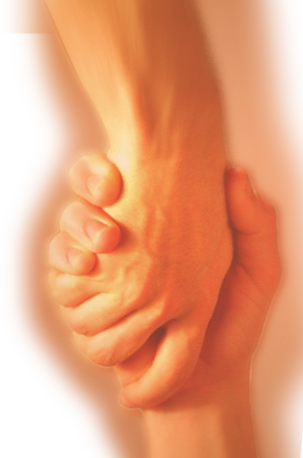
A Study in the
Book of ACTS
D
I
F
F
E
R
E
N
C
E
making a
Notes:
Difference

Slide 3
The PERSON Who
Makes a Difference
has a
“POWERFUL NAME”

Slide 4
“JESUS”
In the name of Jesus Christ of Nazareth (3:6)
His [i.e.God’s] servant (3:13)
The Holy and Righteous One (3:14)
The author of life (3:15)
In the name of Jesus (3:16)
It is Jesus' name (3:16)
The Christ (3:20)
A prophet like Moses (Act 3:22)
His Name has …

Slide 5
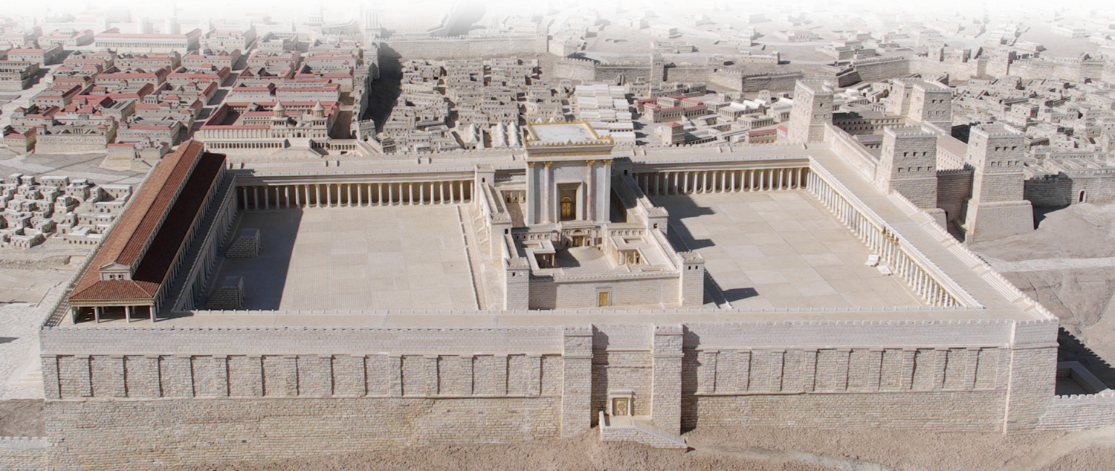
HEALING Power
¹ One day Peter and John were going up to the temple at the time of prayer--at three in the afternoon.
Notes:
http://upload.wikimedia.org/wikipedia/commons/8/84/Jerusalem_Modell_BW_2.JPG

Slide 6
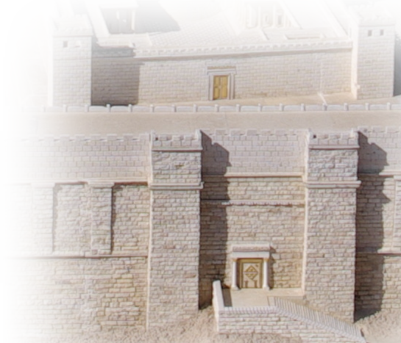
HEALING Power
² Now a man crippled from birth was being carried to the temple gate called Beautiful, where he was put every day to beg from those going into the temple courts.
Notes:
http://upload.wikimedia.org/wikipedia/commons/8/84/Jerusalem_Modell_BW_2.JPG

Slide 7
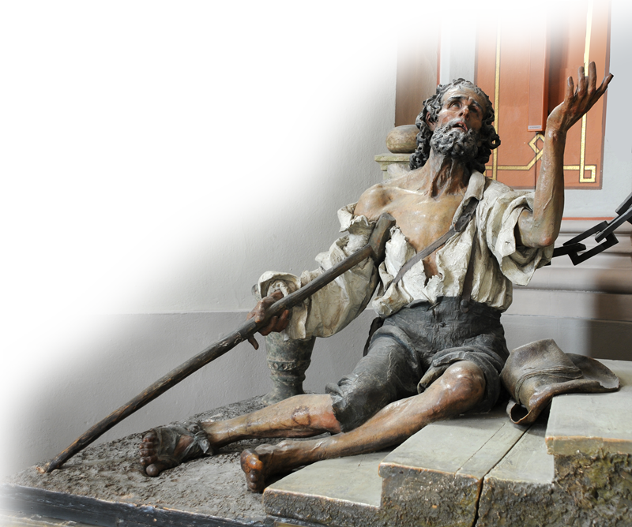
HEALING Power
³ When he saw Peter and John about to enter, he asked them for money.
⁴ Peter looked straight at him,
as did John. Then Peter said,
"Look at us!“
⁵ So the man gave them
his attention,
expecting to get
something
from them.
Notes:
Beggar stautue – free from: http://commons.wikimedia.org/wiki/File:Beggar_Saint_Elisabeth_Group.jpg

Slide 8
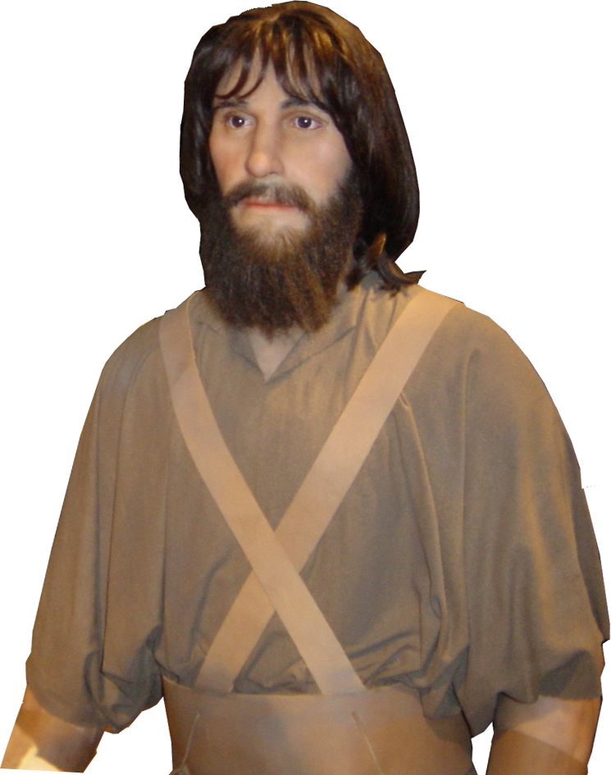
HEALING Power
⁶ Then Peter said,
"Silver or gold I do not have, but what I have I give you. In the name of Jesus Christ of Nazareth, walk."
Notes:
Peter is a BiblePoint photo

Slide 9
HEALING Power
⁷ Taking him by the right hand, he helped him up, and instantly the man's feet and ankles became strong.
⁸ He jumped to his feet and began to walk. Then he went with them into the temple courts, walking and jumping, and praising God.

Slide 10
HEALING Power
⁹ When all the people saw him walking and praising God,
¹⁰ they recognized him as the same man who used to sit begging at the temple gate called Beautiful, and they were filled with wonder and amazement at what had happened to him.

Slide 11
Pictures our Salvation
The Lame Man
Us
Born lame Physically
A poor beggar
Outside Temple
Healed by GRACE
Able to Stand
Praised God
Born lame Spiritually
Spiritually bankrupt
Outside God’s Family
Healed by GRACE
Changed life
Praising God
Once he could stand, there was no question where he stood!

Slide 12
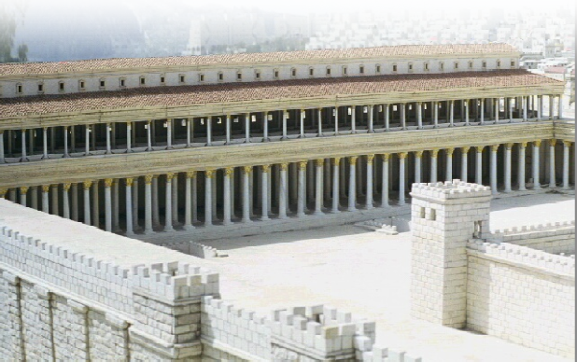
SURPRISING Power
¹¹ While the beggar held on to Peter and John, all the people were astonished and came running to them in the place called Solomon's Colonnade.

Slide 13

SURPRISING Power
¹² When Peter saw this, he said to them:
"Men of Israel, why does this surprise you? Why do you stare at us as if by our own power or godliness we had made this man walk?

Slide 14
CONVICTING Power
¹³ The God of Abraham, Isaac and Jacob, the God of our fathers, has glorified his servant Jesus.…

Slide 15
CONVICTING Power
You handed him over to be killed, and you disowned him before Pilate, though he had decided to let him go.
¹⁴ You disowned the Holy and Righteous One and asked that a murderer be released to you.

Slide 16
CONVICTING Power
¹⁵ You killed the author of life, but God raised him from the dead. We are witnesses of this.

Slide 17
CONVICTING Power
¹⁶ By faith in the name of Jesus, this man whom you see and know was made strong. It is Jesus' name and the faith that comes through him that has given this complete healing to him, as you can all see.
Notes:
I think it is safe to say, that had the lame man said earlier, “I don’t want your faith in Jesus, I want your money.” that he would have remained lame.
It is “by faith in the name of Jesus”— by “name of” it means, Who Jesus is and What Jesus does/did.
It is faith in that name and the faith that has Jesus as its object that gives “complete healing.” (Not partial!)
// this to Mark 2 – which is easier to say, Your sins are forgiven or take up your mat and walk?
Obviously this healing was as spiritual as it was physical—but because the audience can see the physical, the healing verified the spiritual as well.

Slide 18
CONVICTING Power
¹⁷ "Now, brothers, I know that you acted in ignorance, as did your leaders. ¹⁸ But this is how God fulfilled what he had foretold through all the prophets, saying that his Christ would suffer.

Slide 19
LIFE-CHANGING Power
¹⁹ Repent, then, and turn to God,

Slide 20
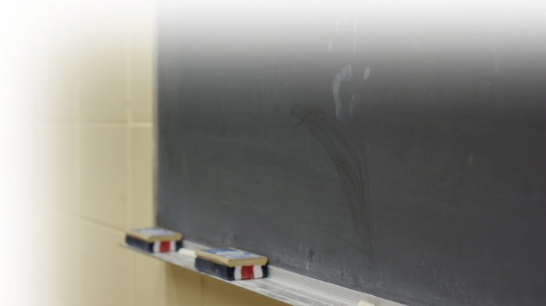

FORGIVING Power
¹⁹ Repent, then, and turn to God, so that your sins may be wiped out,
Notes:
Chalkboard = FREE = http://www.flickr.com/photos/jaymiek/2519350535/sizes/o/in/photostream/

Slide 21

FORGIVING Power
¹⁹ Repent, then, and turn to God, so that your sins may be wiped out,

Slide 22
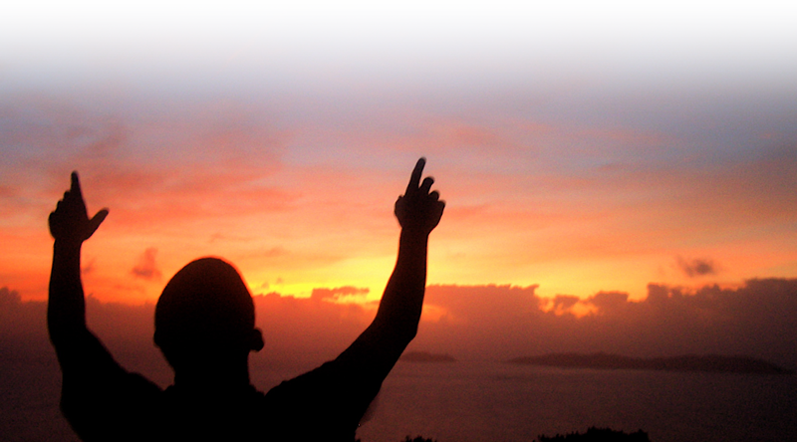
REFRESHING Power
¹⁹ Repent, then, and turn to God, so that your sins may be wiped out, that times of refreshing may come from the Lord,
Notes:
Man Praising God with Sunset = FREE = http://www.sxc.hu/browse.phtml?f=download&id=700879

Slide 23
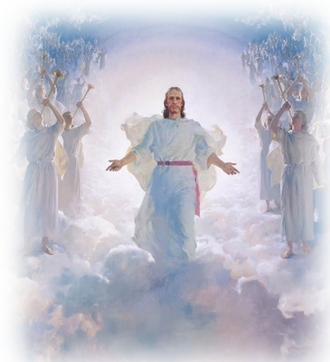
PRESENCE Power
¹⁹ Repent, then, and turn to God, so that your sins may be wiped out, that times of refreshing may come from the Lord,
²⁰ and that he may
send the Christ,
who has been
appointed for you—
even Jesus.
Notes:
Jesus Second Coming = FREE = http://www.mormonwiki.com/File:Second-Coming-Jesus-Christ-Mormon.jpg

Slide 24
RESTORING Power
²¹ He must remain in heaven until the time comes for God to restore everything, as he promised long ago through his holy prophets.

Slide 25

FULFILLING Power
²² For Moses said,
'The Lord your God will raise up for you a prophet like me from among your own people; you must listen to everything he tells you. ²³ Anyone who does not listen to him will be completely cut off from among his people.’
Notes:
Scrolls = FREE = see previous lesson

Slide 26
FULFILLING Power
²⁴ "Indeed, all the prophets from Samuel on, as many as have spoken, have foretold these days. ²⁵ And you are heirs of the prophets and of the covenant God made with your fathers.

Slide 27
BLESSING Power
He said to Abraham,
'Through your offspring all
peoples on earth will be blessed.‘
[See Gen 22:18]
²⁶ When God raised up his servant, he sent him first to you to bless you by turning each of you from your wicked ways.”

Slide 28
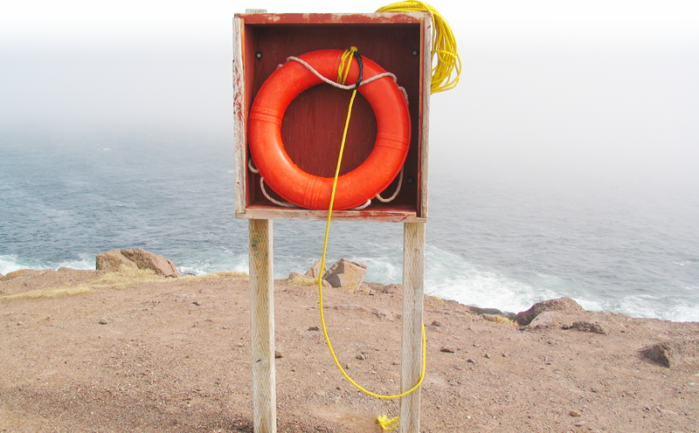
Next Time: SAVING Power
Notes:
Life line =FREE = http://www.dreamstime.com/life-saver-free-stock-image-imagefree427030

Slide 29

His Powerful NAME will…
Heal You
Surprise You
Convict You
Change You
Forgive You
Be With You
Fulfill You
Bless You
We must …
Acknowledge our need & ask
Have faith in
His Name
Repent …
Notes:
Key = http://www.sxc.hu/browse.phtml?f=download&id=258532

Slide 30
Let’s Pray.

