Slide 1
ACTS 2:42-47
www.BiblePoint.com
2011 © Single Initiative LLC
Notes:
Copyright © 2000-2011. All rights reserved. Bible Point is a registered trademark of Single Initiative, LLC. All other trademarks acknowledged.
Bible Point contains graphics from Bible Point artists. These illustrations belong to Bible Point and the respective artists. You may use the designs and illustrations for graphical illustration of lessons free and without special permission, provided they are not used in any way that maligns the Christian faith. Furthermore, republication or production of any illustration by any other graphic service whether it be in book, in a machine-readable form, or in any other design resource is strictly prohibited. Furthermore, they cannot be duplicated or resold as any other form of publishing, clip art, or graphic resource.
So What does it mean? (A simple translations of the legal jargon)
So, if you don’t own the presentation(s), graphic(s), and text(s) how can you legally use them? The purchase of the license allows you to use all the images in the product. However, the actual ownership and copyright of the presentation(s), graphic(s), and text(s) remain the property of Bible Point and its licensors. If you had plans on using this product in your “for sale” work—think again!
License Agreement
Article 1: License Grant
All the graphics and text in Bible Point presentations (excluding quotes from the Bible and stated sources) are the intellectual and real property of Bible Point and its licensors, and is protected by law, including United States copyright laws and international treaties. Bible Point grants to you a license:
1. To use the presentation in a single church, single school, or single office of a Christian organization.
2. To make a single archival back-up copy of the program.
3. To modify the presentation(s) and merge with other presentations in a single church, school, or Christian organization.
4. To transfer to another party if that party agrees to accept the terms and conditions of this agreement, and you do not retain any copies of the presentation, whether printed, machine readable, modified, or merged form.
Article 2: Terms
This license is effective until terminated. You may terminate the license at any time by destroying the presentation(s), graphic(s), or text(s) together with all copies, modifications and merged portions in any form. Bible Point may terminate your license if you fail to comply with this Agreement. You agree, upon such termination, for any reason, to destroy the presentation(s), graphics, and text(s) with all copies, modifications, and merged portions in any form.
Article 3: Disclaimers
1. Bible Point presentations, graphics, and texts are licensed to you As Is. You, the consumer, bear the entire risk relating to the quality and performance of the presentation(s), graphic(s), or text(s). In no event will Bible Point be liable for damages resulting from any defect.
2. Thirty-day limited warrantee on disks. Bible Point warrants the disks to be free of defects in material and workmanship under normal use for 30 days after purchase. During the 30-day period you may return a defective presentation, graphic, or text with proof of purchase and it will be replaced without charge, unless the presentation is damaged by misuse.
Article 4: General
1. You may not sub-license, assign, or transfer the license of the presentation(s), graphic(s), or text(s) except as provided by this Agreement.
2. This Agreement will be governed by the laws of the State of Michigan.
So What does it mean? (A simple translations of the legal jargon)
May I let someone borrow or copy my licensed Bible Point presentation (even after I modified it)? As long as it is within your local church, or single school, or the immediate office of a Christian organization you may. Otherwise, please refer the person interested in borrowing to: http://www.biblepoint.com or E-mail: dh@biblepoint.com with any related questions.
---------------------------------------------------------------------------------------------------------------------------
Scripture taken from the HOLY BIBLE, NEW INTERNATIONAL VERSION®. NIV®. Copyright©1973, 1978, 1984 by International Bible Society. Used by permission of Zondervan. All rights reserved.

Slide 2

A Study in the
Book of ACTS
D
I
F
F
E
R
E
N
C
E
making a
Notes:
Difference

Slide 3
The PASSION that
Makes a Difference

Slide 4

Let’s pick up …
⁴¹ Those who accepted his message were baptized, and about three thousand were added to their number that day.
SCRIPTURES
WORD OF
GOD
CHRIST
BELIEVED
Notes:
Scrolls = Licensed not for reuse = dreamstime_4691385

Slide 5

Let’s pick up …
⁴¹ Those who accepted his message were baptized, and about three thousand were added to their number that day.
SCRIPTURES
WORD OF
GOD
CHRIST
BELIEVED
BAPTIZED
Notes:
Water = Licensed NOT for reuse = iStock_000006973332XSmall

Slide 6
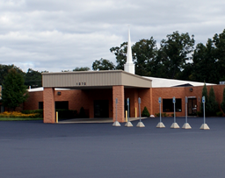
Let’s pick up …
⁴¹ Those who accepted his message were baptized, and about three thousand were added to their number that day.
SCRIPTURES
WORD OF
GOD
CHRIST
BELIEVED
BAPTIZED
MEMBERS
Notes:
Church = FREE for reuse = BiblePoint photo

Slide 7
The Church that
“Makes a Difference” has a PASSION

Slide 8
A Passion for TEACHING
⁴² They devoted themselves to the apostles' teaching

Slide 9




A Passion for TEACHING
⁴² They devoted themselves to the apostles' teaching
Tuesday Senior Bible Study
11 am (in the Lounge)
Notes:
Replace the teaching opportunities on the screen with those in your own church.

Slide 10
A Passion for TEACHING
⁴² They devoted themselves to the apostles' teaching
Notes:
Replace these images with teaching opportunities for your class.

Slide 11
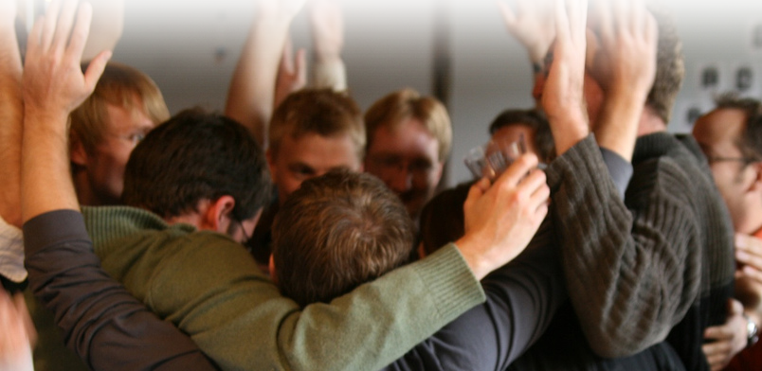
A Passion for FELLOWSHIP
⁴² They devoted themselves to the apostles' teaching and to the fellowship,
A Relationship characterized by sharing in common.
--Friberg Analytical Lexicon
“Sharing the experience together.”
--Pastor Dennis
Notes:
Group = FREE = http://www.flickr.com/photos/sharynmorrow/1923984297/sizes/l/in/photostream/

Slide 12
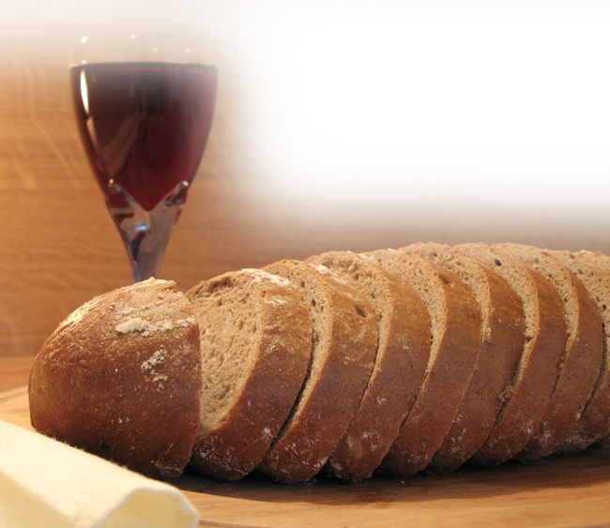
A Passion for COMMUNION
⁴² They devoted themselves to the apostles' teaching and to the fellowship, to the breaking of bread
Notes:
Bread and Wine = FREE = http://www.sxc.hu/browse.phtml?f=download&id=1072441

Slide 13

A Passion for PRAYER
⁴² They devoted themselves to the apostles' teaching and to the fellowship, to the breaking of bread and to prayer[s].
Notes:
Praying Hands = Licensed = iStock photo: iStock_000001262149Small

Slide 14

A Passion for the AMAZING
⁴³ Everyone was filled with awe,
and many wonders and
miraculous signs were done
by the apostles.
Notes:
Praise = FREE for reuse from http://www.sxc.hu/browse.phtml?f=download&id=945302

Slide 15

A Passion to be TOGETHER
⁴⁴ All the believers were together and had everything in common.
Notes:
Group photo = Licensed Not for reuse = iStock photo: http://www.istockphoto.com/stock-photo-8908803-sardana.php

Slide 16

A Passion for PEOPLE
⁴⁵ Selling their possessions and goods, they gave to anyone as he had need.

Slide 17
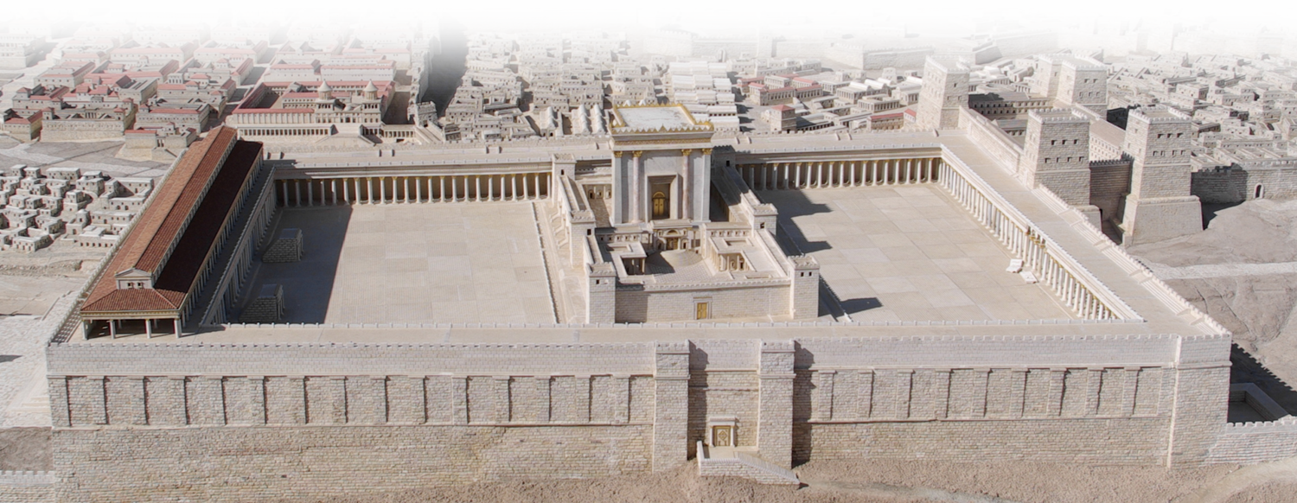
A Passion for MEETING
⁴⁶ Every day they continued to meet together in the temple courts. They broke bread in their homes and ate together with glad and sincere hearts,
Notes:
Jerusalem = FREE for reuse with credit to = http://www.flickr.com/photos/emeryjl/508067090/

Slide 18
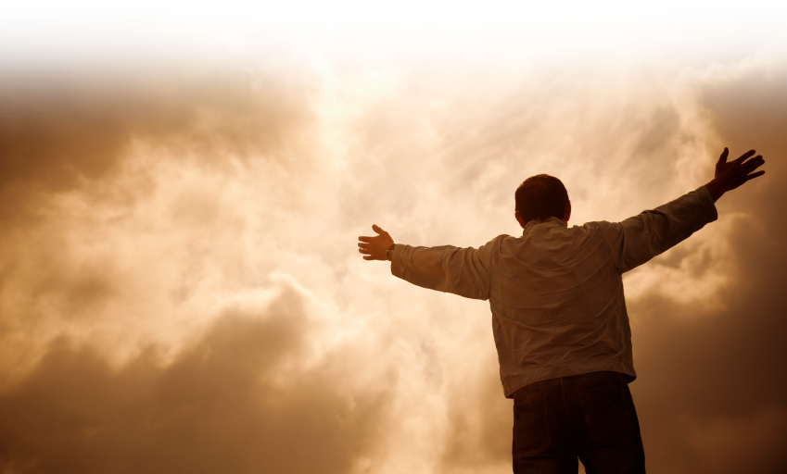
A Passion for WORSHIP
⁴⁷ praising God and enjoying the favor of all the people. And the Lord added to their number daily those who were being saved.
Notes:
Praise Photo = Licensed and Not for Reuse = iStock_000010757626Small

Slide 19
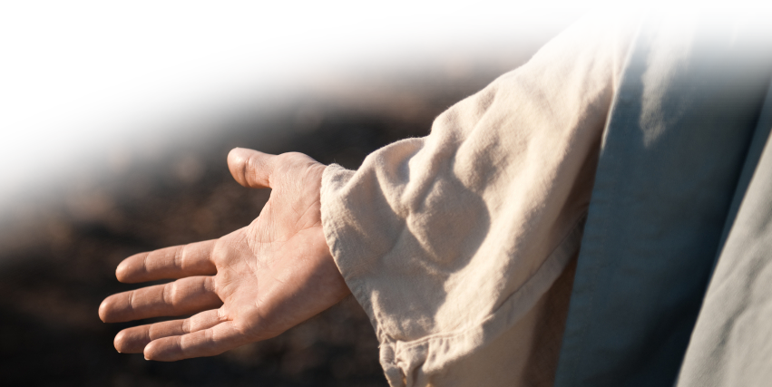
A Passion for GROWTH
⁴⁷ praising God and enjoying the favor of all the people. And the Lord added to their number daily those who were being saved.
Notes:
Right hand =Licensed and NOT for Reuse from = iStock_000011291066Small

Slide 20
When we get PASSIONATE
About:
Bible TEACHING
FELLOWSHIP
COMMUNION
PRAYER
God’s WONDERS
Being TOGETHER
PEOPLE
MEETING
WORSHIP
CHURCH GROWTH
Then WE will make a DIFFERENCE, too.

Slide 21
Let’s Pray.

