Slide 1
ACTS 2:14-41
www.BiblePoint.com
2011 © Single Initiative LLC
Notes:
Copyright © 2000-2011. All rights reserved. Bible Point is a registered trademark of Single Initiative, LLC. All other trademarks acknowledged.
Bible Point contains graphics from Bible Point artists. These illustrations belong to Bible Point and the respective artists. You may use the designs and illustrations for graphical illustration of lessons free and without special permission, provided they are not used in any way that maligns the Christian faith. Furthermore, republication or production of any illustration by any other graphic service whether it be in book, in a machine-readable form, or in any other design resource is strictly prohibited. Furthermore, they cannot be duplicated or resold as any other form of publishing, clip art, or graphic resource.
So What does it mean? (A simple translations of the legal jargon)
So, if you don’t own the presentation(s), graphic(s), and text(s) how can you legally use them? The purchase of the license allows you to use all the images in the product. However, the actual ownership and copyright of the presentation(s), graphic(s), and text(s) remain the property of Bible Point and its licensors. If you had plans on using this product in your “for sale” work—think again!
License Agreement
Article 1: License Grant
All the graphics and text in Bible Point presentations (excluding quotes from the Bible and stated sources) are the intellectual and real property of Bible Point and its licensors, and is protected by law, including United States copyright laws and international treaties. Bible Point grants to you a license:
1. To use the presentation in a single church, single school, or single office of a Christian organization.
2. To make a single archival back-up copy of the program.
3. To modify the presentation(s) and merge with other presentations in a single church, school, or Christian organization.
4. To transfer to another party if that party agrees to accept the terms and conditions of this agreement, and you do not retain any copies of the presentation, whether printed, machine readable, modified, or merged form.
Article 2: Terms
This license is effective until terminated. You may terminate the license at any time by destroying the presentation(s), graphic(s), or text(s) together with all copies, modifications and merged portions in any form. Bible Point may terminate your license if you fail to comply with this Agreement. You agree, upon such termination, for any reason, to destroy the presentation(s), graphics, and text(s) with all copies, modifications, and merged portions in any form.
Article 3: Disclaimers
1. Bible Point presentations, graphics, and texts are licensed to you As Is. You, the consumer, bear the entire risk relating to the quality and performance of the presentation(s), graphic(s), or text(s). In no event will Bible Point be liable for damages resulting from any defect.
2. Thirty-day limited warrantee on disks. Bible Point warrants the disks to be free of defects in material and workmanship under normal use for 30 days after purchase. During the 30-day period you may return a defective presentation, graphic, or text with proof of purchase and it will be replaced without charge, unless the presentation is damaged by misuse.
Article 4: General
1. You may not sub-license, assign, or transfer the license of the presentation(s), graphic(s), or text(s) except as provided by this Agreement.
2. This Agreement will be governed by the laws of the State of Michigan.
So What does it mean? (A simple translations of the legal jargon)
May I let someone borrow or copy my licensed Bible Point presentation (even after I modified it)? As long as it is within your local church, or single school, or the immediate office of a Christian organization you may. Otherwise, please refer the person interested in borrowing to: http://www.biblepoint.com or E-mail: dh@biblepoint.com with any related questions.
---------------------------------------------------------------------------------------------------------------------------
Scripture taken from the HOLY BIBLE, NEW INTERNATIONAL VERSION®. NIV®. Copyright©1973, 1978, 1984 by International Bible Society. Used by permission of Zondervan. All rights reserved.

Slide 2

A Study in the
Book of ACTS
D
I
F
F
E
R
E
N
C
E
making a
Notes:
Difference

Slide 3
The PREACHING that
Makes a Difference

Slide 4
It’s RELEVANT
¹⁴ “… let me explain this to you; listen carefully to what I say.”

Slide 5
It’s RELEVANT
¹⁴ “… let me explain this to you; listen carefully to what I say.”
they asked
one another,
"What does
this mean?”
Some…made fun of them and said,
"They have had
too much wine. “

Slide 6
It’s RELEVANT
¹⁴ “… let me explain this to you; listen carefully to what I say.”
¹⁵ These men are not drunk, as you suppose. It's only nine in the morning!
they asked
one another,
"What does
this mean?”
Some…made fun of them and said,
"They have had
too much wine. “

Slide 7
It’s BIBLICAL
¹⁶ No, this is what was spoken by the prophet Joel….

Slide 8

¹⁴ "Fellow Jews and all of you who live in Jerusalem, let me explain this to you; listen carefully to what I say.
¹⁵ These men are not drunk, as you suppose. It's only nine in the morning!
¹⁶ No, this is what was spoken by the prophet Joel:
¹⁷ " 'In the last days, God says, I will pour out my Spirit on all people. Your sons and daughters will prophesy, your young men will see visions, your old men will dream dreams.
¹⁸ Even on my servants, both men and women, I will pour out my Spirit in those days, and they will prophesy.
¹⁹ I will show wonders in the heaven above and signs on the earth below, blood and fire and billows of smoke.
²⁰ The sun will be turned to darkness and the moon to blood before the coming of the great and glorious day of the Lord.
²¹ And everyone who calls on the name of the Lord will be saved.'
²² "Men of Israel, listen to this: Jesus of Nazareth was a man accredited by God to you by miracles, wonders and signs, which God did among you through him, as you yourselves know.
²³ This man was handed over to you by God's set purpose and foreknowledge; and you, with the help of wicked men, put him to death by nailing him to the cross.
²⁴ But God raised him from the dead, freeing him from the agony of death, because it was impossible for death to keep its hold on him.
²⁵ David said about him: " 'I saw the Lord always before me. Because he is at my right hand, I will not be shaken.
²⁶ Therefore my heart is glad and my tongue rejoices; my body also will live in hope,
²⁷ because you will not abandon me to the grave, nor will you let your Holy One see decay.
²⁸ You have made known to me the paths of life; you will fill me with joy in your presence.'
²⁹ "Brothers, I can tell you confidently that the patriarch David died and was buried, and his tomb is here to this day.
³⁰ But he was a prophet and knew that God had promised him on oath that he would place one of his descendants on his throne.
³¹ Seeing what was ahead, he spoke of the resurrection of the Christ, that he was not abandoned to the grave, nor did his body see decay.
³² God has raised this Jesus to life, and we are all witnesses of the fact.
³³ Exalted to the right hand of God, he has received from the Father the promised Holy Spirit and has poured out what you now see and hear.
³⁴ For David did not ascend to heaven, and yet he said, " 'The Lord said to my Lord: "Sit at my right hand
³⁵ until I make your enemies a footstool for your feet." '
³⁶ "Therefore let all Israel be assured of this: God has made this Jesus, whom you crucified, both Lord and Christ.“
½ Quotations
12 of 22 verses

Slide 9

It’s BIBLICAL
¹⁷ " 'In the last days, God says, I will pour out my Spirit on all people. Your sons and daughters will prophesy, your young men will see visions, your old men will dream dreams. ¹⁸ Even on my servants, both men and women, I will pour out my Spirit in those days, and they will prophesy.

Slide 10
It’s BIBLICAL
¹⁷ " 'In the last days, God says, I will pour out my Spirit on all people. Your sons and daughters will prophesy, your young men will see visions, your old men will dream dreams. ¹⁸ Even on my servants, both men and women, I will pour out my Spirit in those days, and they will prophesy.
Book Ends to answer to “What is this?”

Slide 11
It’s BIBLICAL
¹⁹ I will show wonders in the heaven above and signs on the earth below, blood and fire and billows of smoke.
²⁰ The sun will be turned to darkness and the moon to blood before the coming of the great and glorious day of the Lord.
²¹ And everyone who calls on the name of the Lord will be saved.'

Slide 12
It’s BIBLICAL
¹⁹ I will show wonders in the heaven above and signs on the earth below, blood and fire and billows of smoke.
²⁰ The sun will be turned to darkness and the moon to blood before the coming of the great and glorious day of the Lord.
²¹ And everyone who calls on the name of the Lord will be saved.'

Slide 13
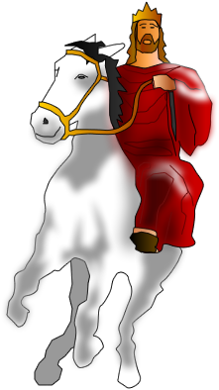
It’s BIBLICAL
Tribulation
¹⁹ I will show wonders in the heaven above and signs on the earth below, blood and fire and billows of smoke.
²⁰ The sun will be turned to darkness and the moon to blood before the coming of the great and glorious day of the Lord.
²¹ And everyone who calls on the name of the Lord will be saved.'
Notes:
Jesus on White Horse = FREE = BiblePoint drawing

Slide 14
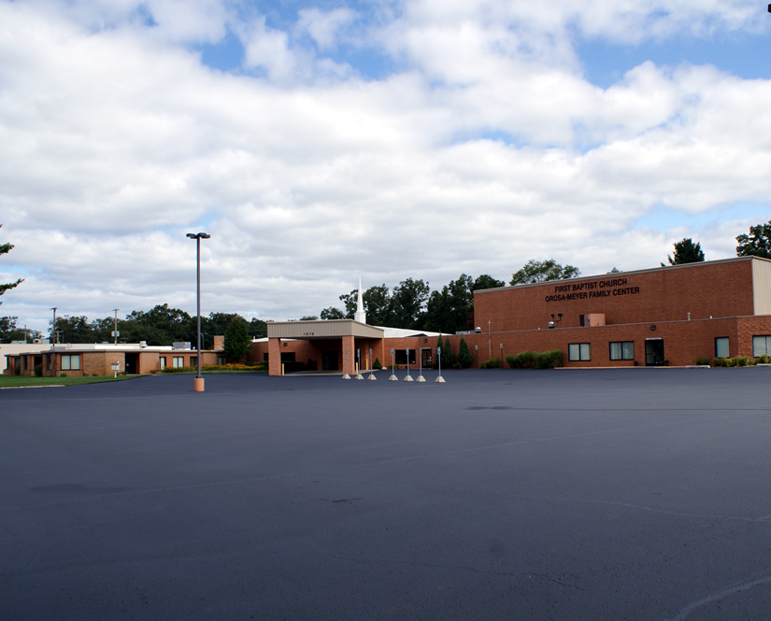
It’s BIBLICAL
Tribulation
¹⁹ I will show wonders in the heaven above and signs on the earth below, blood and fire and billows of smoke.
²⁰ The sun will be turned to darkness and the moon to blood before the coming of the great and glorious day of the Lord.
²¹ And everyone who calls on the name of the Lord will be saved.'
“The last days”
Notes:
Church building = FREE = BiblePoint photo

Slide 15
It’s BIBLICAL
Church - Tribulation
Tribulation
¹⁹ I will show wonders in the heaven above and signs on the earth below, blood and fire and billows of smoke.
²⁰ The sun will be turned to darkness and the moon to blood before the coming of the great and glorious day of the Lord.
²¹ And everyone who calls on the name of the Lord will be saved.'
“The last days”

Slide 16
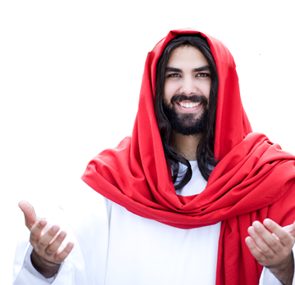
It’s CHRIST-CENTERED
²² "Men of Israel, listen to this: Jesus of Nazareth was a man accredited by God to you by miracles, wonders
and signs, which God did
among you through him,
as you yourselves know.
…that you may believe that Jesus is the Christ, the Son of God, (John 20:31)
Notes:
Jesus = Licensed—do not reuse = iStock_000007254772

Slide 17
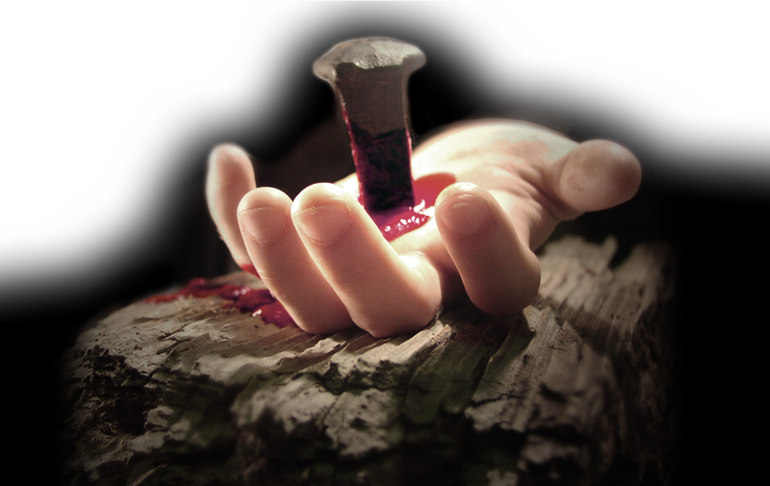
It’s CHRIST-CENTERED
²³ This man was handed over to you by God's set purpose and foreknowledge; and you, with the help of wicked men, put him to death by nailing him to the cross.
Notes:
Free Image of hand with nail = http://www.imagebase.davidniblack.com/main.php?g2_itemId=1889&g2_imageViewsIndex=1

Slide 18
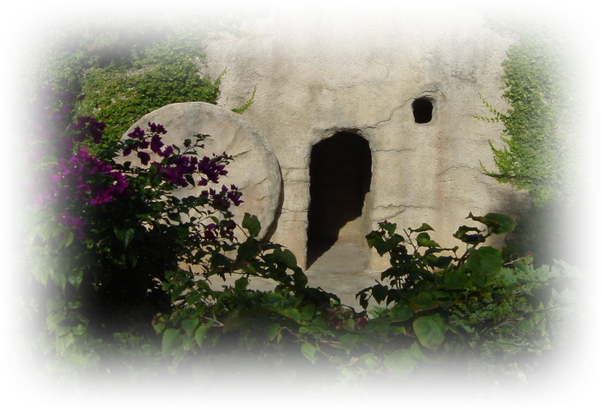
It’s CHRIST-CENTERED
²⁴ But God raised him from the dead, freeing him from the agony of death, because it was impossible for death to keep its hold on him.
Notes:
Empty tomb = FREE = BiblePoint.

Slide 19
It’s BIBLICAL
²⁵ David said about him: " 'I saw the Lord always before me. Because he is at my right hand, I will not be shaken. ²⁶ Therefore my heart is glad and my tongue rejoices; my body also will live in hope, ²⁷ because you will not abandon me to the grave, nor will you let your Holy One see decay. ²⁸ You have made known to me the paths of life; you will fill me with joy in your presence.'

Slide 20
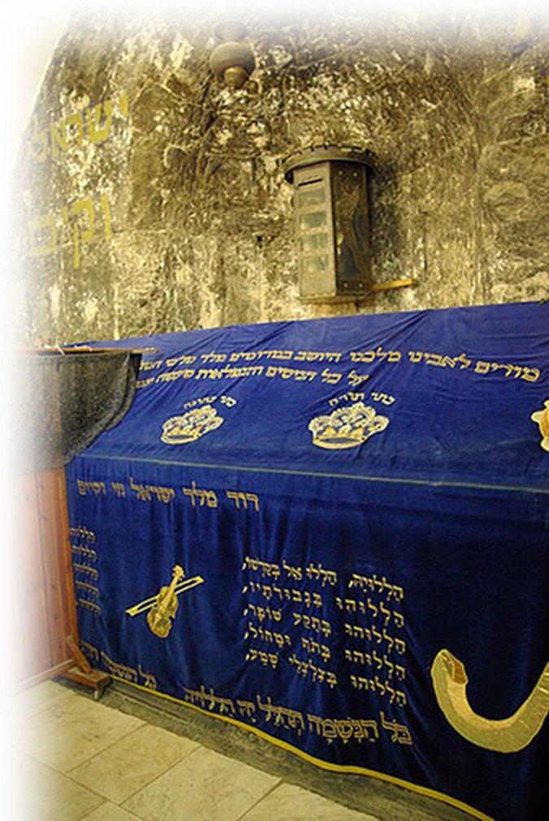
It’s CHRIST-CENTERED
²⁹ "Brothers, I can tell you confidently that the patriarch David died and was buried, and his tomb is here to this day.
Notes:
King David’s Tomb in Jerusalem = FREE for reuse from = http://upload.wikimedia.org/wikipedia/commons/7/77/Jerusalem_Tomb_of_David_BW_1.JPG

Slide 21
It’s CHRIST-CENTERED
³⁰ But he was a prophet and knew that God had promised him on oath that he would place one of his descendants on
his throne.

Slide 22
It’s CHRIST-CENTERED
³¹ Seeing what was ahead, he spoke of the resurrection of the Christ, that he was not abandoned to the grave, nor did his body see decay.

Slide 23
It’s CHRIST-CENTERED
³² God has raised this Jesus to life, and we are all witnesses of the fact.

Slide 24
It’s CHRIST-CENTERED
³³ Exalted to the right hand of God,

Slide 25
It’s RELEVANT
³³ Exalted to the right hand of God, he has received from the Father the promised Holy Spirit and has poured out what you now see and hear.

Slide 26



It’s BIBLICAL
³⁴ For David did not ascend to heaven, and yet he said, " 'The Lord said to my Lord: "Sit at my right hand
³⁵ until I make your enemies a footstool for your feet." '
Notes:
Jesus on GWT = FREE = BiblePoint drawing.

Slide 27
It’s CONVICTING

Slide 28
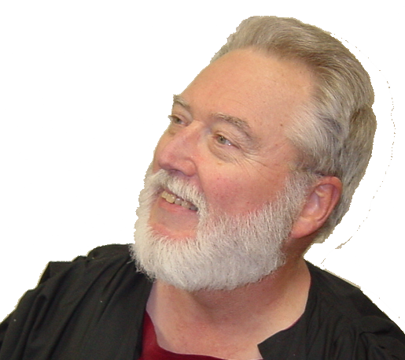
It’s CONVICTING
³⁶ "Therefore let all Israel be assured of this: God has made this Jesus, whom you crucified, both Lord and Christ."
Notes:
Peter = FREE = BiblePoint photo.

Slide 29
It’s CONVICTING
³⁷ When the people heard this, they were cut to the heart and said to Peter and the other apostles,
"Brothers, what
shall we do?”

Slide 30
It’s LIFE-CHANGING

Slide 31
It’s LIFE-CHANGING
³⁸ Peter replied, "Repent and be baptized, every one of you, in
the name of Jesus Christ for
the forgiveness of your sins.
And you will receive the gift
of the Holy Spirit. ³⁹ The promise is for you and your children and for all who are far off--for all whom the Lord our God will call.”

Slide 32
It’s LIFE-CHANGING
³⁸ Peter replied, "Repent and be baptized, every one of you, in
the name of Jesus Christ for
the forgiveness of your sins.
And you will receive the gift
of the Holy Spirit. ³⁹ The promise is for you and your children and for all who are far off--for all whom the Lord our God will call.”

Slide 33

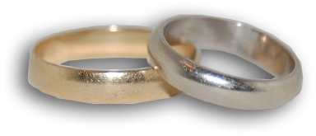
It’s LIFE-CHANGING
³⁸ Peter replied, "Repent and be baptized, every one of you, in
the name of Jesus Christ for
the forgiveness of your sins.
And you will receive the gift
of the Holy Spirit. ³⁹ The promise is for you and your children and for all who are far off--for all whom the Lord our God will call.”

Slide 34
It’s LIFE-CHANGING
³⁸ Peter replied, "Repent and be baptized, every one of you, in
the name of Jesus Christ for
the forgiveness of your sins.
And you will receive the gift
of the Holy Spirit. ³⁹ The promise is for you and your children and for all who are far off--for all whom the Lord our God will call.”
Lit. = “into.”
“Because of” &
“On account of.”
See: Mat 3:11

Slide 35
It’s LIFE-CHANGING
⁴⁰ With many other words he warned them; and he pleaded with them,
"Save yourselves
from this corrupt
generation."

Slide 36

It’s LIFE-CHANGING
⁴¹ Those who accepted his message were baptized, and about three thousand were added to their number that day.
SCRIPTURES
WORD OF
GOD
CHRIST
BELIEVED

Slide 37

It’s LIFE-CHANGING
⁴¹ Those who accepted his message were baptized, and about three thousand were added to their number that day.
SCRIPTURES
WORD OF
GOD
CHRIST
BELIEVED
BAPTIZED

Slide 38
It’s LIFE-CHANGING
⁴¹ Those who accepted his message were baptized, and about three thousand were added to their number that day.
SCRIPTURES
WORD OF
GOD
CHRIST
BELIEVED
BAPTIZED
MEMBERS

Slide 39
Preaching that makes a
D
I
F
F
E
R
E
N
C
E
Relevant
Biblical
Christ-Centered
Convicting
Life-Changing

Slide 40
Let’s Pray.

