Slide 1
ACTS 2:1-13
www.BiblePoint.com
2011 © Single Initiative LLC
Notes:
Copyright © 2000-2011. All rights reserved. Bible Point is a registered trademark of Single Initiative, LLC. All other trademarks acknowledged.
Bible Point contains graphics from Bible Point artists. These illustrations belong to Bible Point and the respective artists. You may use the designs and illustrations for graphical illustration of lessons free and without special permission, provided they are not used in any way that maligns the Christian faith. Furthermore, republication or production of any illustration by any other graphic service whether it be in book, in a machine-readable form, or in any other design resource is strictly prohibited. Furthermore, they cannot be duplicated or resold as any other form of publishing, clip art, or graphic resource.
So What does it mean? (A simple translations of the legal jargon)
So, if you don’t own the presentation(s), graphic(s), and text(s) how can you legally use them? The purchase of the license allows you to use all the images in the product. However, the actual ownership and copyright of the presentation(s), graphic(s), and text(s) remain the property of Bible Point and its licensors. If you had plans on using this product in your “for sale” work—think again!
License Agreement
Article 1: License Grant
All the graphics and text in Bible Point presentations (excluding quotes from the Bible and stated sources) are the intellectual and real property of Bible Point and its licensors, and is protected by law, including United States copyright laws and international treaties. Bible Point grants to you a license:
1. To use the presentation in a single church, single school, or single office of a Christian organization.
2. To make a single archival back-up copy of the program.
3. To modify the presentation(s) and merge with other presentations in a single church, school, or Christian organization.
4. To transfer to another party if that party agrees to accept the terms and conditions of this agreement, and you do not retain any copies of the presentation, whether printed, machine readable, modified, or merged form.
Article 2: Terms
This license is effective until terminated. You may terminate the license at any time by destroying the presentation(s), graphic(s), or text(s) together with all copies, modifications and merged portions in any form. Bible Point may terminate your license if you fail to comply with this Agreement. You agree, upon such termination, for any reason, to destroy the presentation(s), graphics, and text(s) with all copies, modifications, and merged portions in any form.
Article 3: Disclaimers
1. Bible Point presentations, graphics, and texts are licensed to you As Is. You, the consumer, bear the entire risk relating to the quality and performance of the presentation(s), graphic(s), or text(s). In no event will Bible Point be liable for damages resulting from any defect.
2. Thirty-day limited warrantee on disks. Bible Point warrants the disks to be free of defects in material and workmanship under normal use for 30 days after purchase. During the 30-day period you may return a defective presentation, graphic, or text with proof of purchase and it will be replaced without charge, unless the presentation is damaged by misuse.
Article 4: General
1. You may not sub-license, assign, or transfer the license of the presentation(s), graphic(s), or text(s) except as provided by this Agreement.
2. This Agreement will be governed by the laws of the State of Michigan.
So What does it mean? (A simple translations of the legal jargon)
May I let someone borrow or copy my licensed Bible Point presentation (even after I modified it)? As long as it is within your local church, or single school, or the immediate office of a Christian organization you may. Otherwise, please refer the person interested in borrowing to: http://www.biblepoint.com or E-mail: dh@biblepoint.com with any related questions.
---------------------------------------------------------------------------------------------------------------------------
Scripture taken from the HOLY BIBLE, NEW INTERNATIONAL VERSION®. NIV®. Copyright©1973, 1978, 1984 by International Bible Society. Used by permission of Zondervan. All rights reserved.

Slide 2

A Study in the
Book of ACTS
D
I
F
F
E
R
E
N
C
E
making a
Notes:
Difference

Slide 3
The POWER that
Makes a Difference
is the Holy Spirit!

Slide 4
The Power of Spirit Baptism
1:4 "Do not leave Jerusalem, but wait for the gift my Father promised, which you have heard me speak about.

Slide 5


The Power of Spirit Baptism
1:4 "Do not leave Jerusalem, but wait for the gift my Father promised, which you have heard me speak about.
⁵ For John baptized
with water,
but in a few days you will be baptized with
the Holy Spirit.”

Slide 6
The Power of Spirit Baptism
1:8 But you will receive
power when the
Holy Spirit comes
on you; and you
will be my witnesses
in Jerusalem, and in
all Judea and Samaria, and to the ends of the earth.”

Slide 7
The Power of Spirit Baptism
1:8 But you will receive
power when the
Holy Spirit comes
on you; and you
will be my witnesses
in Jerusalem, and in
all Judea and Samaria, and to the ends of the earth.”

Slide 8
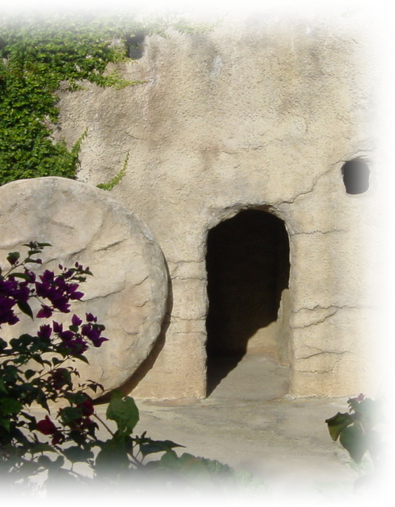
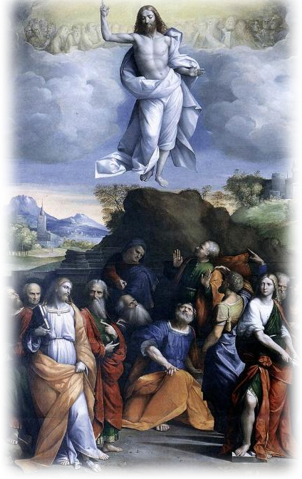
The Power of Spirit Baptism
^{2:1} When the day of Pentecost came, they were all together in one place.
F
E
A
S
T
O
F
1st
F
R
U
I
T
S
F
E
A
S
T
O
F
W
E
E
K
S
40
days
10
days
“Pentecost” means 50 days

Slide 9
The Power of Spirit Baptism
^{2:1} When the day of Pentecost came, they were all together in one place.
² Suddenly a sound like the blowing of a violent wind came from heaven and filled the whole house where they were sitting.

Slide 10

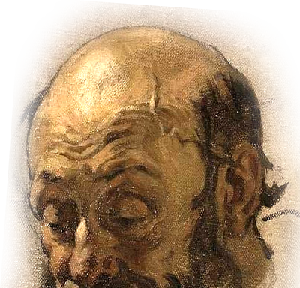
The Power of Spirit Baptism
³ They saw what seemed to be tongues of fire that separated and came to rest on each
of them.
Notes:
Tongue of fire picture labeled for reuse at google and found at: http://www.adrian.vanbreda.org/art/Pentecost%202008d.jpg
Head of man free from: http://upload.wikimedia.org/wikipedia/commons/9/92/Pantazis_Pericles_Old_man%27s_head.jpg

Slide 11
The Power of Spirit Baptism
Where does it say this is the “Baptism” of the Spirit?
Notes:
Pentecost picture found at: http://www.google.com/imgres?imgurl=http://jeremypryor.files.wordpress.com/2008/12/pentecost1.jpg&imgrefurl=http://jeremypryor.wordpress.com/2008/12/08/bring-back-the-prayer-meeting/pentecost1/&usg=__c4-_eydFSDSfZklvAmXLwMrUemI=&h=480&w=637&sz=95&hl=en&start=43&sig2=frR8afJbJ_EXfPJK8xN-5Q&zoom=1&tbnid=soez7qQSVPzwhM:&tbnh=147&tbnw=195&ei=eldRTcPcOsOAlAfUtKiWCg&prev=/images%3Fq%3Dpentecost%26um%3D1%26hl%3Den%26client%3Dfirefox-a%26rls%3Dorg.mozilla:en-US:official%26biw%3D1176%26bih%3D610%26tbs%3Disch:10%2C1294&um=1&itbs=1&iact=hc&vpx=349&vpy=119&dur=685&hovh=147&hovw=195&tx=109&ty=150&oei=b1dRTY7TBoGdlgfhyISbCQ&esq=3&page=3&ndsp=20&ved=1t:429,r:15,s:43&biw=1176&bih=610

Slide 12
The Power of Spirit Baptism
Where does it say this is the “Baptism” of the Spirit?
Act 11:15-16 "As I began to speak, the Holy Spirit came on them as he had come on us at the beginning. ¹⁶ Then I remembered what the Lord had said: 'John baptized with water, but you will be baptized with the Holy Spirit.'
Notes:
Pentecost picture found at: http://www.google.com/imgres?imgurl=http://jeremypryor.files.wordpress.com/2008/12/pentecost1.jpg&imgrefurl=http://jeremypryor.wordpress.com/2008/12/08/bring-back-the-prayer-meeting/pentecost1/&usg=__c4-_eydFSDSfZklvAmXLwMrUemI=&h=480&w=637&sz=95&hl=en&start=43&sig2=frR8afJbJ_EXfPJK8xN-5Q&zoom=1&tbnid=soez7qQSVPzwhM:&tbnh=147&tbnw=195&ei=eldRTcPcOsOAlAfUtKiWCg&prev=/images%3Fq%3Dpentecost%26um%3D1%26hl%3Den%26client%3Dfirefox-a%26rls%3Dorg.mozilla:en-US:official%26biw%3D1176%26bih%3D610%26tbs%3Disch:10%2C1294&um=1&itbs=1&iact=hc&vpx=349&vpy=119&dur=685&hovh=147&hovw=195&tx=109&ty=150&oei=b1dRTY7TBoGdlgfhyISbCQ&esq=3&page=3&ndsp=20&ved=1t:429,r:15,s:43&biw=1176&bih=610

Slide 13
The Power of Spirit Baptism
So what is this baptism of the Spirit?
It is the work of the Holy Spirit immersing the believer into the
“body of Christ” which is the church!
Notes:
Pentecost picture found at: http://www.google.com/imgres?imgurl=http://jeremypryor.files.wordpress.com/2008/12/pentecost1.jpg&imgrefurl=http://jeremypryor.wordpress.com/2008/12/08/bring-back-the-prayer-meeting/pentecost1/&usg=__c4-_eydFSDSfZklvAmXLwMrUemI=&h=480&w=637&sz=95&hl=en&start=43&sig2=frR8afJbJ_EXfPJK8xN-5Q&zoom=1&tbnid=soez7qQSVPzwhM:&tbnh=147&tbnw=195&ei=eldRTcPcOsOAlAfUtKiWCg&prev=/images%3Fq%3Dpentecost%26um%3D1%26hl%3Den%26client%3Dfirefox-a%26rls%3Dorg.mozilla:en-US:official%26biw%3D1176%26bih%3D610%26tbs%3Disch:10%2C1294&um=1&itbs=1&iact=hc&vpx=349&vpy=119&dur=685&hovh=147&hovw=195&tx=109&ty=150&oei=b1dRTY7TBoGdlgfhyISbCQ&esq=3&page=3&ndsp=20&ved=1t:429,r:15,s:43&biw=1176&bih=610

Slide 14
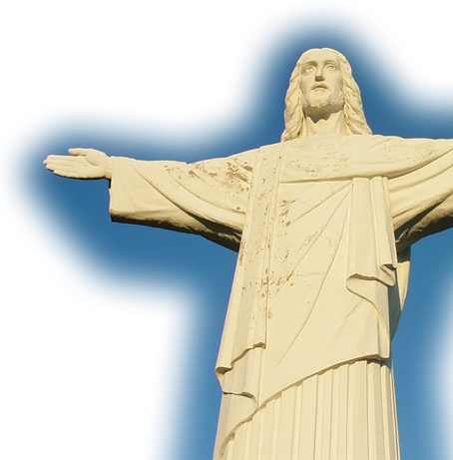

The Power of Spirit Baptism
So what is this baptism of the Spirit?
²² … God … appointed
him [Christ] to be head
over everything
for the church, ²³
which is his body,….
(Eph 1:22-23)

Slide 15
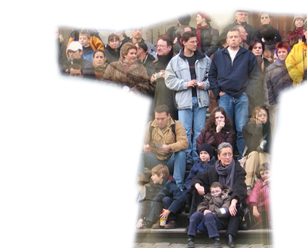
The Power of Spirit Baptism
And if anyone
does not have the
Spirit of Christ, he does not belong to Christ.
(Rom 8:9)
So what is this baptism of the Spirit?
¹² The body is a unit, though it is made up of many parts; and though all its parts are
many, they form one
body. So it is with
Christ. ¹³ For we
were all baptized by one
Spirit into one body-- 1Co 12:12-14
Notes:
Jesus statue : http://commons.wikimedia.org/wiki/File:Christ_Statue_over_La_Cumbre_-_Argentina.jpg
People: http://www.edwebproject.org/wsis03/geneva.html

Slide 16
The Power of Spirit Filling
⁴ All of them were filled with the Holy Spirit

Slide 17

The Power of Spirit Filling
⁴ All of them were filled with the Holy Spirit
¹⁸ Do not get drunk on wine,
which leads to debauchery.
Instead, be filled with the
Spirit. (Eph 5:18)
Notes:
Bottle of wine free from: http://www.sxc.hu/browse.phtml?f=download&id=1140342

Slide 18


The Power of Spirit Filling
⁴ All of them were filled with the Holy Spirit
Notes:
Vacancy sign is a free photo: http://www.sxc.hu/photo/470657

Slide 19
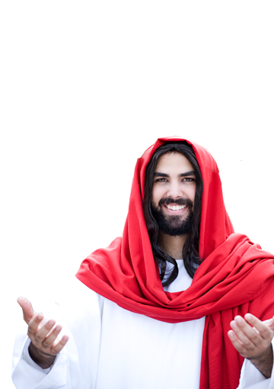
The Power of Spirit Speaking
⁴ All of them were filled with the Holy Spirit and began to speak in other tongues as the Spirit enabled them.
you will receive power when the Holy Spirit comes on you; and you
will be my witnesses

Slide 20
The Power of Spirit Speaking
²⁶ "When the Counselor comes, whom I will send
to you from the Father,
the Spirit of truth who
goes out from the Father, he will testify about me.
²⁷ And you also must testify, for you have been with me from the beginning. (John15:26-27)
⁴ All of them were filled with the Holy Spirit and began to speak in other tongues as the Spirit enabled them.

Slide 21
The Power of Spirit Speaking
²⁶ "When the Counselor comes, whom I will send
to you from the Father,
the Spirit of truth who
goes out from the Father, he will testify about me.
²⁷ And you also must testify, for you have been with me from the beginning. (John15:26-27)
⁴ All of them were filled with the Holy Spirit and began to speak in other tongues as the Spirit enabled them.

Slide 22
The Power of Spirit Speaking
⁴ All of them were filled with the Holy Spirit and began to speak in other tongues as the Spirit enabled them.
γλωσσαις - Literally the organ “tongue.” When used of speech, “language.”

Slide 23
The Power of Spirit Speaking
⁴ All of them were filled with the Holy Spirit and began to speak in other tongues as the Spirit enabled them.
“other”
– Literally, “other of
a different kind.”
γλωσσαις - Literally the organ “tongue.” When used of speech, “language.”

Slide 24
The Power of Spirit Speaking
The Audience--
⁵ Now there were staying in Jerusalem God-fearing Jews from every nation under heaven.

Slide 25
The Power of Spirit Speaking
The Audience--
⁶ When they heard this sound, a crowd came together in bewilderment, because each one heard them speaking in his own language.

Slide 26

The Power of Spirit Speaking
The Audience—
⁷ Utterly amazed, they asked:
"Are not all these men who are speaking Galileans?
⁸ Then how is it that each of us hears them in his own native language?

Slide 27
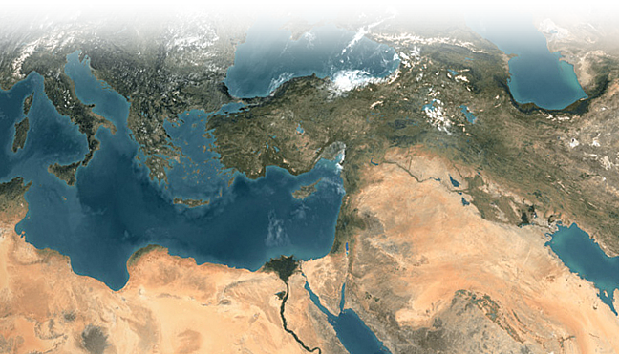
The Power of Spirit Speaking
The Audience—
,
Rome
Pontus
Asia
Cappadocia
Parthians
Phrygia
Pamphylia
Medes
Elam
Crete
Mesopotamia
Cyrene
Judea
Libya
Egypt
Arabia
Notes:
Map from http://www.zonu.com/fullsize-en/2009-11-17-11125/Middle-East-seen-from-space.html

Slide 28
The Power of Spirit Speaking
The Audience—
… we hear them declaring the wonders of God in our own tongues!”
²² Tongues, then, are a sign, not for believers but for unbelievers; (1Co 14:22)

Slide 29
The Power of Spirit Speaking
The Audience—
… we hear them declaring the wonders of God in our own tongues!"
¹² Amazed and perplexed, they asked one another, "What does this mean?"
SEEKERS

Slide 30
The Power of Spirit Speaking
The Audience—
… we hear them declaring the wonders of God in our own tongues!"
¹² Amazed and perplexed, they asked one another, "What does this mean?"
¹³ Some, however, made fun of them and said, "They have had too much wine. "
MOCKERS

Slide 31

That brings us to YOU!
Do you want POWER to Make a Difference?
Then:
1) Accept Christ to be baptized by the Spirit
into the body of Christ –the church!
2) Give the Spirit the keys to every room in
your life—”Be filled with the Spirit.”
3) Speak! Tell others what you know!

Slide 32
Let’s Pray.

